Slide 1

" In Depth Brand Intelligence of An Indian Pharma Industry
(Sun Pharma – Pharma Division)”
At
Cognitrex Consultants Pvt Ltd., Sector – 57, Gurugram, Haryana
By
Aashish Garg (PG/2021/003)
Under the Guidance of
Dr. Punit Yadav
International Institute of Health Management and Research, New Delhi

Slide 2
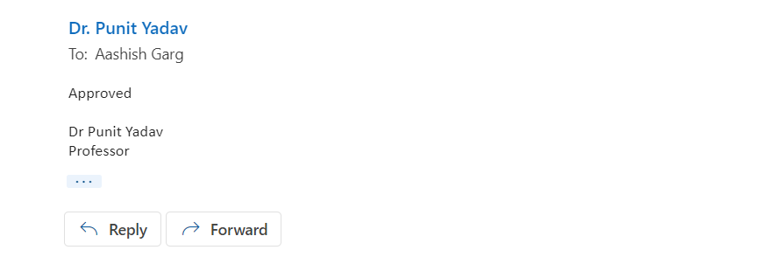
MENTOR APPROVAL

Slide 3
INTRODUCTION
Established in 2015, Cognitrex Consultants is a market research, competitive intelligence, and consulting company with substantial presence in healthcare domain which includes pharmaceuticals, medical devices, medical equipment, consumables etc. Company studies markets in more than 30 countries to help healthcare and pharmaceutical clients to access the market dynamics, analyze competitive activity and develop business strategies.

Slide 4
NEED FOR THE STUDY (RATIONALE)
It is to be hypothesized that determining the market position of brands of Sun pharma (Pharma Division) will help the competitor company to analyze what its market position is as compared to Sun Pharma and what all tactics can be adopted to improve their market share by understanding the business strategies of Sun Pharma.

Slide 5
OBJECTIVE OF STUDY
Primary Objective :-
To Study the Competitive & Strategic Assessment of Sun Pharma - Pharma Division.
Secondary Objective :-
To find out the perception of ex – employees of sales team about the sales (2021-2022)
To identify resource; team structure – Sales and Marketing
To identify the clinician focus; specialties targeted
To determine strategy on segmentation, positioning and targeting brand
To find out the Tactics of Promotion
To carry out the SWOT Analysis

Slide 6
METHODOLOGY
We will carry out in depth primary interviews with various sources of knowledge as mentioned below to develop the key information required.
Target companies: We will target various functions including sales, marketing, medical affairs and will carry out multiple interviews to develop the information required.
Distributors and other channel partners such as retailers of the target companies
Others including communication agencies, conference organizers, etc

Slide 7
Through in-depth secondary research, we would target the following to derive information to meet the objective of the study such as webinars, speakers, Conferences, Speaker programs, International Speaker programs, Workshops, Seminars, Symposiums etc.
Company website
Annual report of the company
Press releases of the company
Social Media handles of the company: Facebook, Instagram, LinkedIn, Twitter etc.
Website of medical bodies and doctors
Social Media handles of the medical bodies: Facebook, Instagram, LinkedIn, Twitter etc.
Social Media handles of the doctors : Facebook, Instagram, LinkedIn, Twitter etc.
Third party website, social media handles who manages target company digital media if any
Google Play store to identify if any mobile apps are there for doctors
Company centric doctors website if any

Slide 8
Study Design - Study is Retrospective in nature.
Selection Criteria – Include all the Sales Force People, Distributors, Channel partners who are promoting the brands of Pharma division of Sun Pharma.
Sampling Technique – Convenience Sampling with sample size of 12.
Stakeholders for | Number of interviews/respondents-a to be targeted per brand
Personnel from different functions of the target company – sales Team, [3 respondents from each region; East, West, North & South] | 12

Slide 9
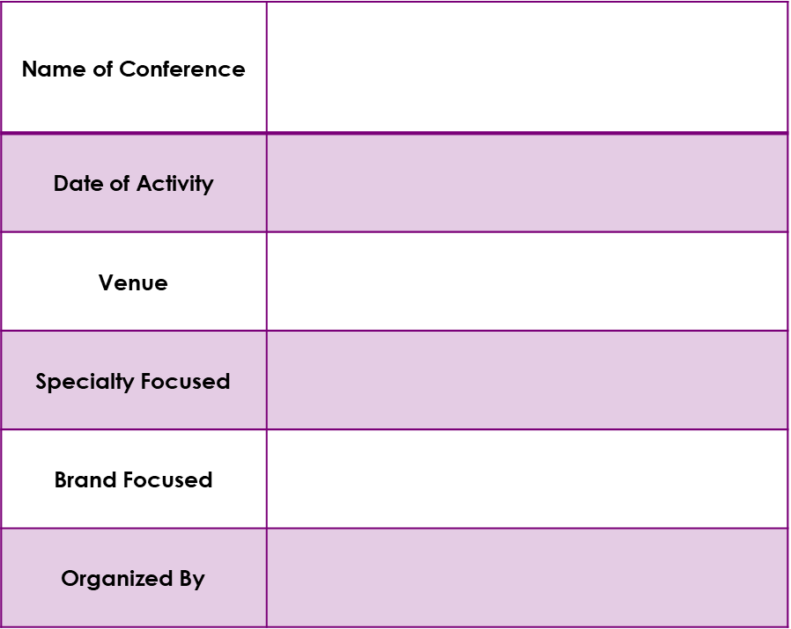
Technique of Collection – In-Depth Interview
Method and Tool to be used – 1. Primary Data – In-depth interviews were conducted to collect the data.
2. Secondary Data – Checklist were used to collect information about conferences, CMEs and other promotional activities.
Checklist for Conferences.

Slide 10
RESULTS

Slide 11
Sales Assessment
Southern India contributes to 32% of the total sales
EAST: Bihar, West Bengal, Jharkhand, Orissa and Assam
WEST : Maharashtra, Madhya Pradesh, Gujarat and Goa
NORTH : Uttar Pradesh, Rajasthan, Punjab, Haryana, New Delhi, Chandigarh and J&K
SOUTH: Andhra Pradesh, Karnataka, Kerala and Tamil Nadu

Slide 12
Sales Assessment (Cont’d)
Trade contributes to 60% of the total Business

Slide 13
Sales Assessment (cont’d)
Nursing Homes has been the highest contributor for Pharma brands contributing 40% of the overall sales, among the private sector, they are followed by Stand alone Hospitals.
ESIC and Defense are the highest contributors with 21% and 22% each among the government sector.
Others includes state governments, medical colleges, Public Sector Units etc

Slide 14
Sales Assessment (cont’d)
Consulting Physicians and GPs contributes 40% of the total sales of division followed by Gastroenterologists.

Slide 15
Sales Structure of Division
The Sales force structure of division is placed below:
  National Sales Managers: 1
  Zonal Sales Manager: 7
  Regional Sales Manager: 24
  Field Sales Manager/Area manager: 85
  Sales Officers/Territory Sales Executive/Territory Sales manager: 385
Vice President (1)
National Sales Manager (1)
Zonal Sales Managers (7)
Region | Numbers | Sales in Crs., 2018 | YPM
North | 92 | 161.5 | 14.63
South | 102 | 198.7 | 16.24
West | 79 | 74.5 | 7.86
East | 112 | 186.3 | 13.86
Total | 385 | 621 | 13.44
Regional Sales Managers (24)
1st Line Managers (85)
Sales Officers (385)

Slide 16
Doctor Coverage and Brand Positioning
Each of the sales executive covers a doctor list of 160 doctors based on the territory coverage
Category | No. of visits/month | Definition
Super Core | 3 | Having business potential of more than Rs 2.5 Lakhs in a month for overall product range of division.
Core | 2 | Having business potential in between 1.5-2.5 Lakhs in a month for overall product range of division.
VIP | 1 | Having business potential of less than Rs 1.5 Lakhs in a month for overall product range of division.
Daily call average
Doctors | 12
Specialists | Category (no. of clinicians)
 | Super Core | Core | VIP | Total
Consulting Physician & GPs | 5 | 30 | 35 | 70
Gastroenterologists | 10 | - | - | 10
Surgeons | 5 | 10 | 5 | 20
Orthopedicians | - | 10 | 10 | 20
Neurologists | - | 10 | - | 10
Pulmonologists/Chest Phys | - | 10 | 5 | 15
Others (Cardio, Diabeto, Nephro) | - | 10 | 5 | 15
Total | 20 | 80 | 60 | 160

Slide 17
Doctor Coverage and Brand Positioning (Cont’d)
Specialists | Order of priority during promotion/detailing
 | Priority 1 | Priority 2 | Priority 3 | Priority 4 | Priority 5 | Priority 6
Consulting Physician & GPs | Pantocid DSR | Pantocid | Pruease | Rifagut | Etoshine | Lumia
Gastroenterologists | Pantocid DSR | Pantocid | Rifagut | Pruease | Lactihep | Sonata
Surgeons | Lactihep Plus | Pantocid | Pantocid DSR | Rifagut | Pruease | Sonata
Orthopaedic | Etoshine | Etoshine MR | Pantocid DSR | Pantocid | Lumia
Neurologists | Pantocid DSR | Pantocid | Pruease | Etoshine | Etoshine MR | Lumia
Pulmonologists/Chest Phys | Pantocid DSR | Pantocid | Lumia
Others (Cardio, Diabeto, Nephro) | Pantocid DSR | Pantocid | Rifagut | Pruease | Lumia

Slide 18
Distribution Network and Margin Play
Sun pharma provides a margin of 8-11% to the distributors
No additional margin is being provided even on additional purchase to the distributor
Sun pharma provides a margin of 40% on the MRP to the retailers.
There is a scheme in which additional margin of 10% (apart from their regular margin) is being given to the hospitals based on their purchase volume. Only 5 counters are being approved per HQ to limit the discounted business of territory looking into the business given by the Hospital.
1
DOMESTIC MANUFACTURING
CENTRAL WAREHOUSES/DISTRIBUTION CENTERS
2
3
CFAS (25)
  1-2% of the total invoice + official expenses
  Margin:
  8-11%-a
DISTRIBUTORS/STOCKISTS (2,100)
4
Daily call average of chemist
Pharmacies | 5-6
5
PHARMACY/HOSPITAL/
INSTITUTIONS/
NURSING HOMES
  Margin:
  40%-a
Does not include promotional offers, schemes and bonuses.

Slide 19
Academic and Promotional Inputs
Following inputs are provided to the clinicians for the promotion of its key brands
Inputs | Quarterly
 | Units | Name | Specialties Targeted
Journal Reprints | 20 | Journal of American College of Gastroenterology | Gastroenterologists and CPs
 | 20 | Journal of American Orthopaedic Society for Sports Medicine | Orthopedicians
 | 20 | Journal of American College of Surgeons | Gen. Surgeons
Case Studies | 20 | Endorsed by KOLs | Gastroenterologists and CPs
Product Monograph | 50 | Nusam | Gastroenterologists and CPs
HEP to DATE | 10 | Hep to Date | Gastroenterologists
Book | 2 | AO Principles of Fracture Management | Orthopedicians
Inputs | Monthly |  | Quarterly |  | Half Yearly
 | Brand | Units | Brand | Units | Brand | Units
LBL | - | - | Pantocid Pantocid DSR Lactihep Plus Rifagut Pruease | 60 60 30 50 50 | - | -
Brand Reminders | - | - | All brands | 150 | - | -

Slide 20

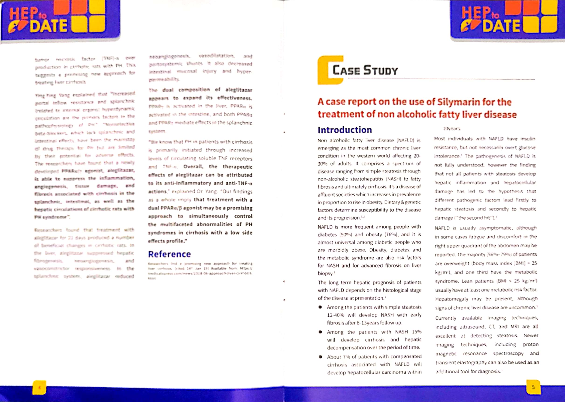
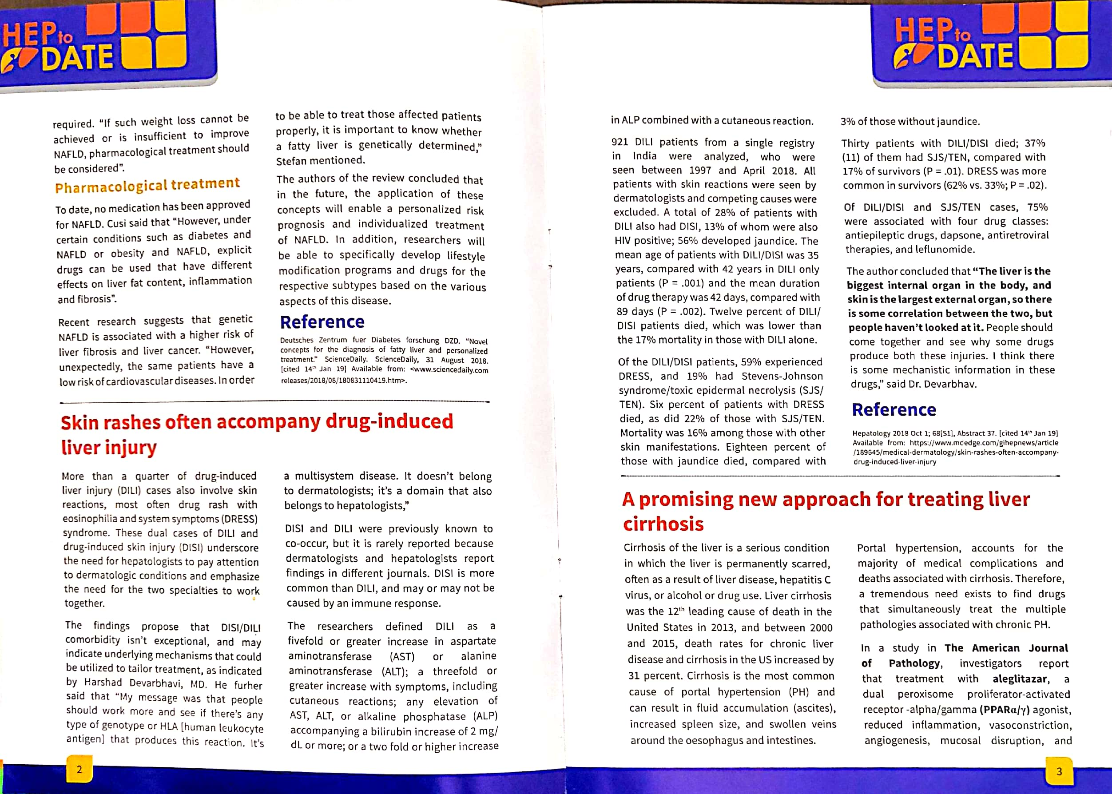
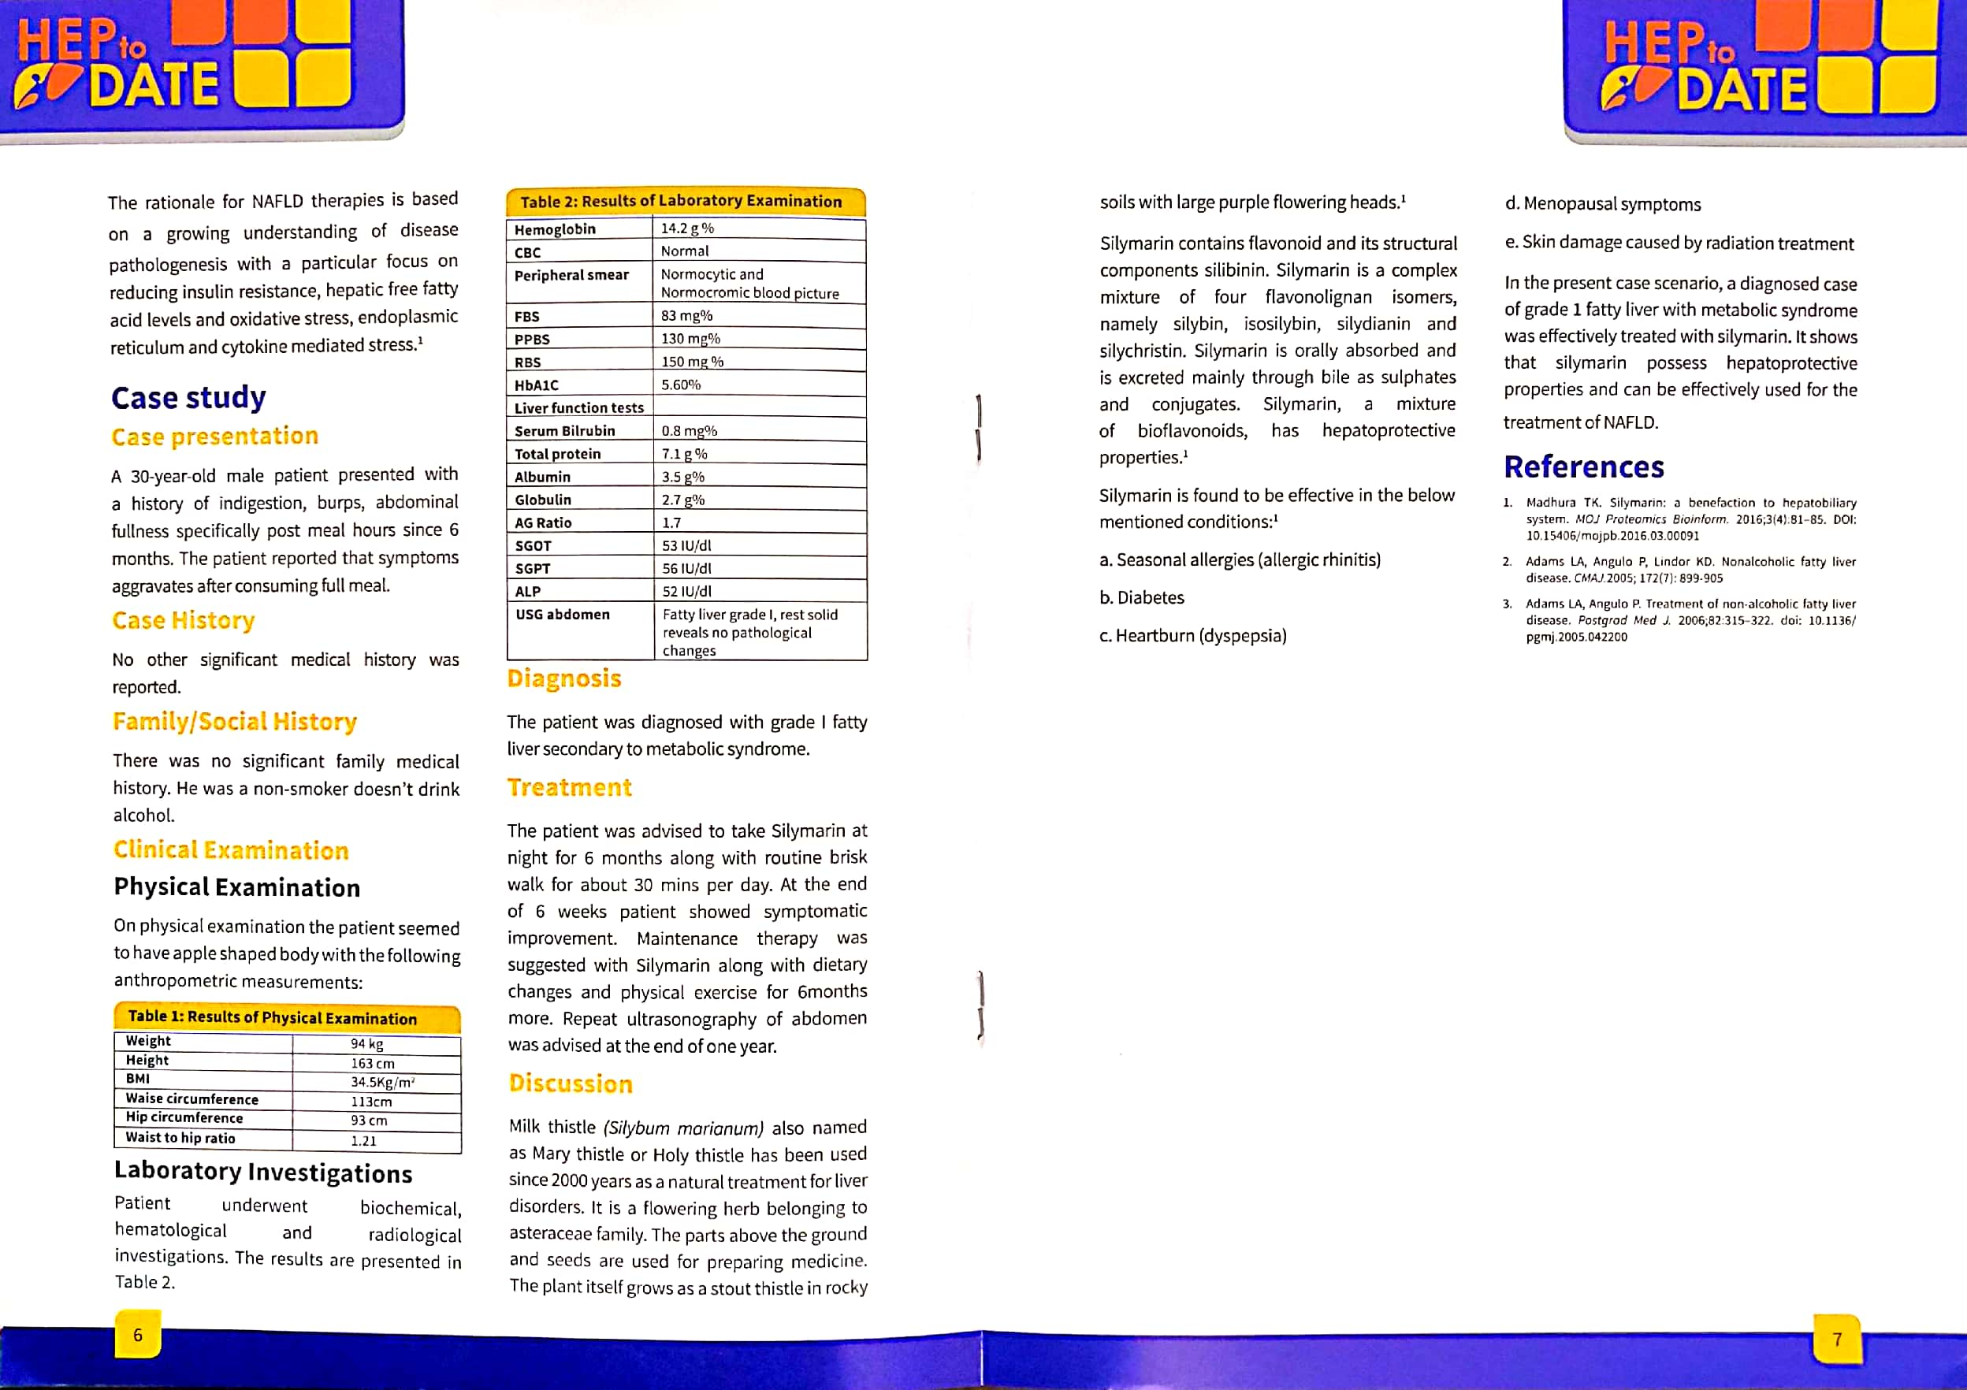
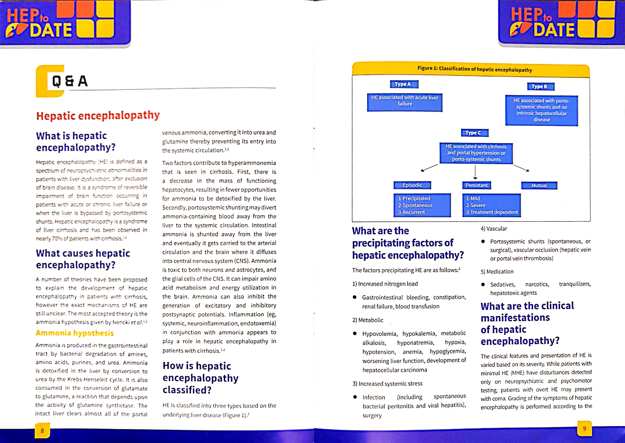
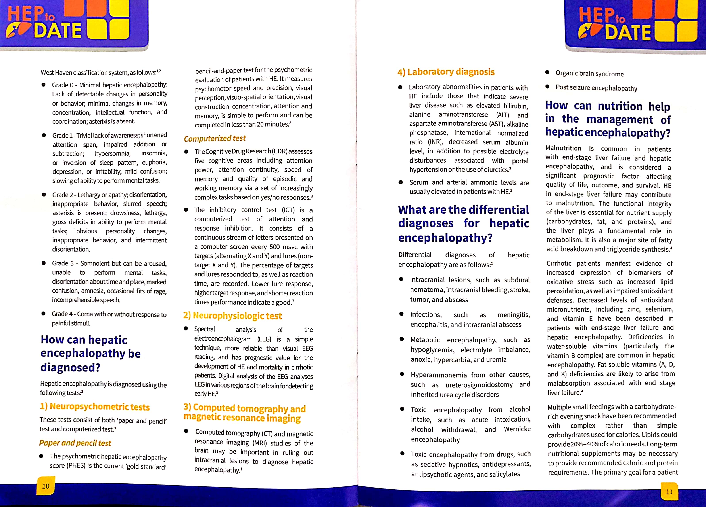
Academic and Promotional Inputs (Cont’d)

Slide 21
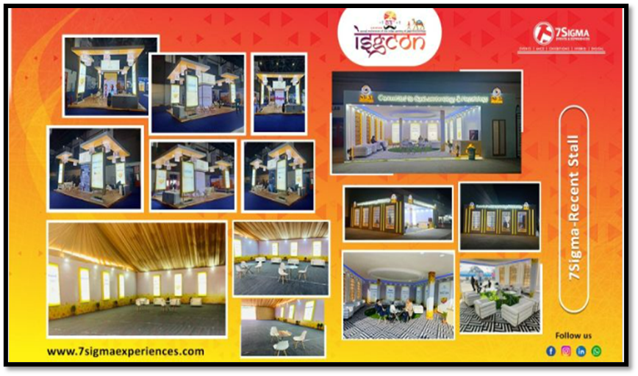
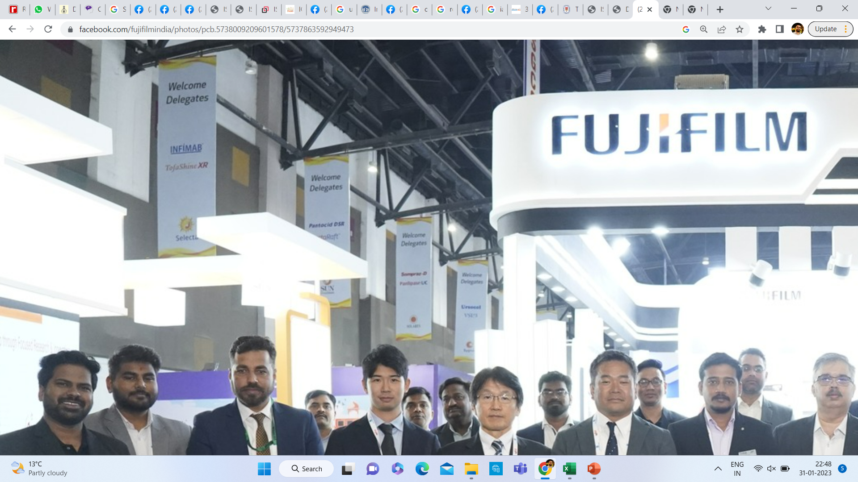
Participation in Conferences
ISGCON 2023 was held at Jaipur, Rajasthan and further details of the conference is mentioned in the table below:
Name of Conference | Annual conference of the Indian Society of Gastroenterology (ISGCON)
Date of Activity | 5th – 8th January, 2023
Venue | Jaipur, Rajasthan
Specialty Focused | Gastroenterologist, GPs, CPs
Brand Focused | Division Focused
Organized By | Indian Society of Gastroenterology

Slide 22
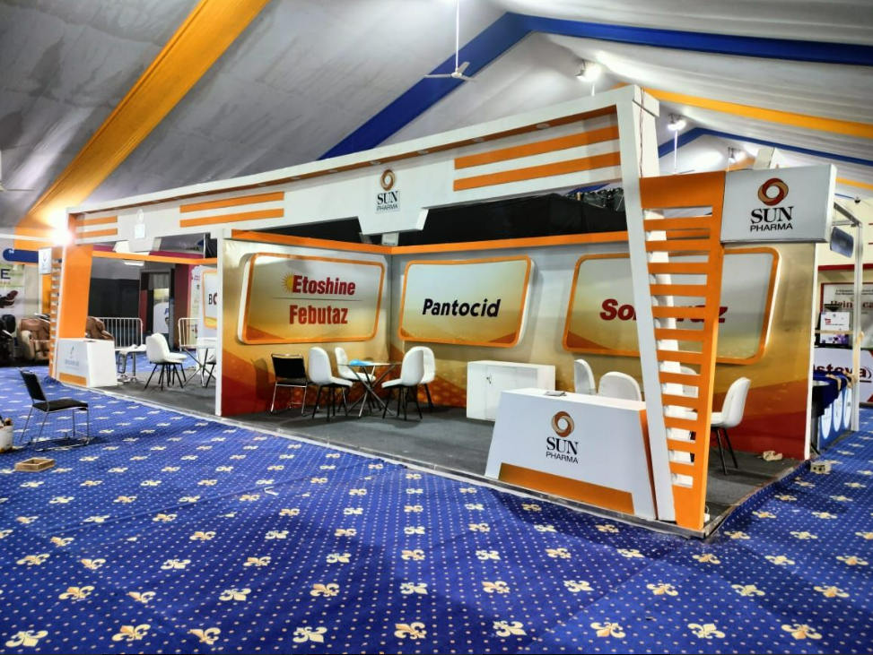
Participation in Conferences (Cont’d)
IOACON 2022 was held at Guru Nanak Dev University, Amritsar and further details of the conference is mentioned in the table below:
Name of Conference | Annual Conference of The Indian Orthopaedic Association (IOACON 2022)
Date of Activity | 28TH Nov – 3rd Dec, 2022
Venue | Guru Nanak Dev University, Amritsar
Specialty Focused | Gastroenterologist, GPs, CPs
Brand Focused | Division Focused
Organized By | The Indian Orthopaedic Association

Slide 23
Camps and Campaigns
Name of Campaign | Brand/s targeted | Frequency | Approx. No. of doctors targeted | Type of doctors targeted | Responsibility | Objective of the campaign
4 for Sure | Sompraz Group |  | 50 | Gastroenterologists, CP’s | Sales Officer | The objective of this campaign is to make the clinicians aware about Sompraz being responsible for achieving intragastric pH > 4 for sure. This campaign is carried out by distributing LBLs to the clinicians and discuss about pH upon every visit.
Uric Acid Camps | Febutaz | 2/Month | 2 | CP’s | Sales Officer | Every month 50 strips/ SO for uric acid detection are sent to Front line managers. Each SO is required to carry out 2 Uric acid camps in a month. 25 patients in each camp are presented by immediate uric acid report and what to do and Not to do paper chits are provided in conditions, if their reports are found out to be higher than normal parameters. Doctors are requested to prescribe the brand Febutaz for those patients.
OPD Camps | Sompraz | 4/Month | 4 | Gastroenterologists/CPs | Sales Officer | In this activity, SO visits the clinician in morning just before starting OPD and present him with Juice bottle and reminder for his key brands and demands for 5 rxns atleast and sits outside/inside OPD for 2-3 hours and thank the doctor for their support.
M
M
Monthly
Q
Quarterly
H
Half yearly
A
Annually
O
Occasionally

Slide 24
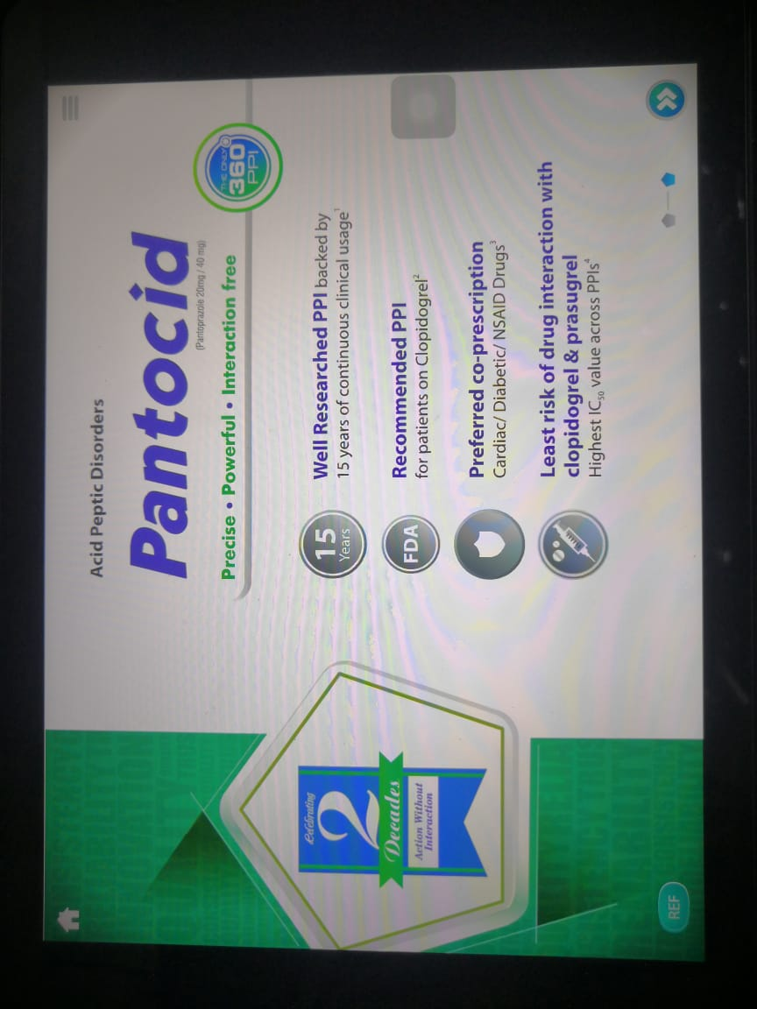
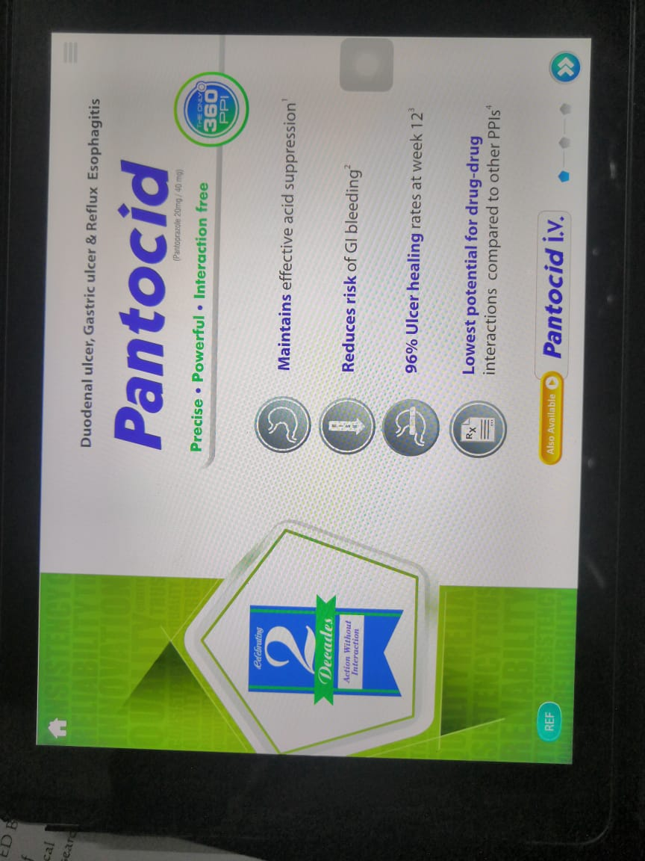
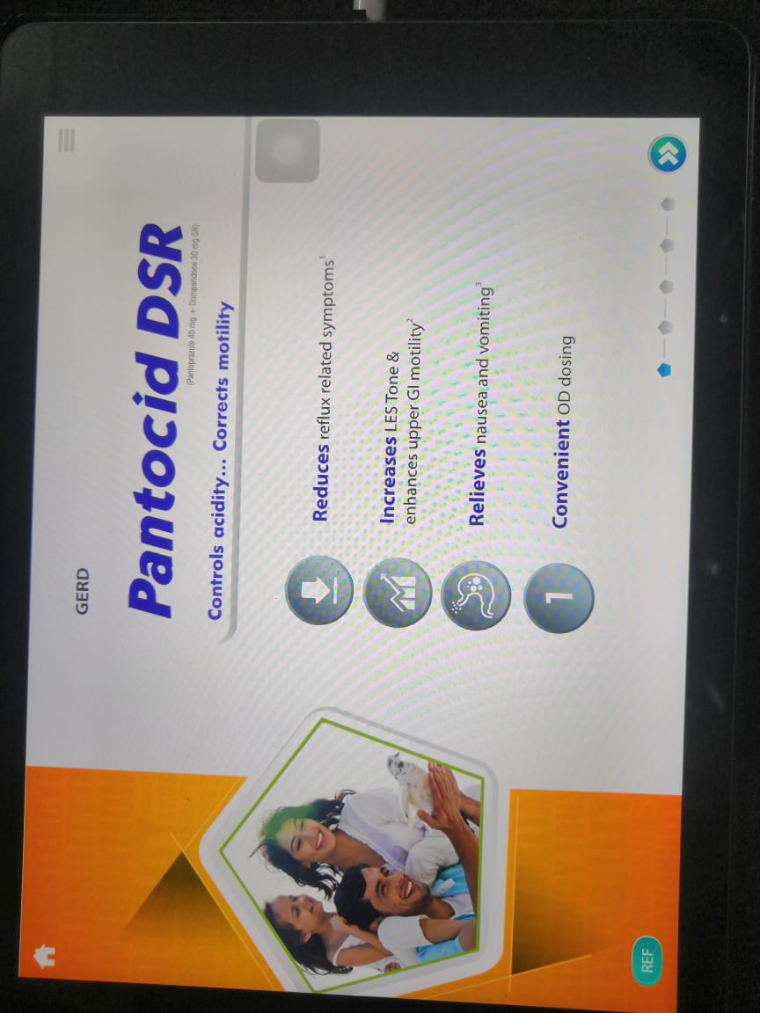
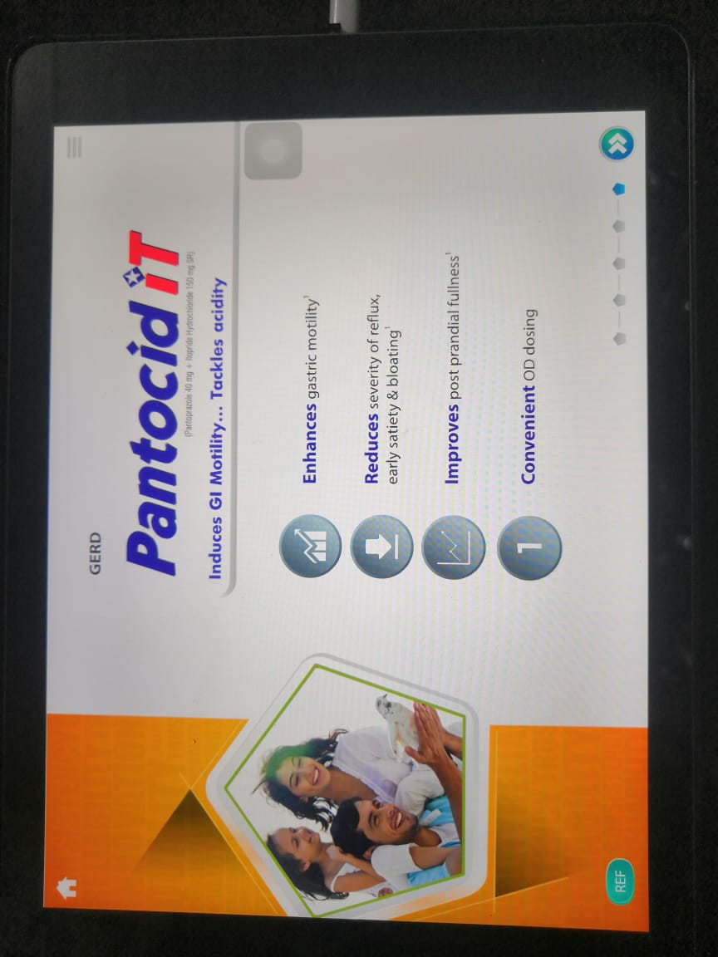
LBLs

Slide 25
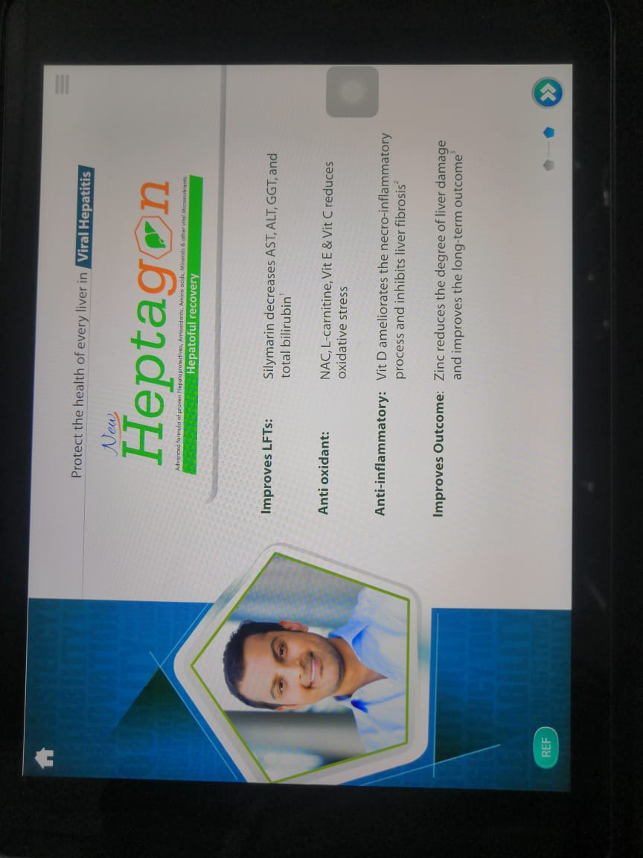
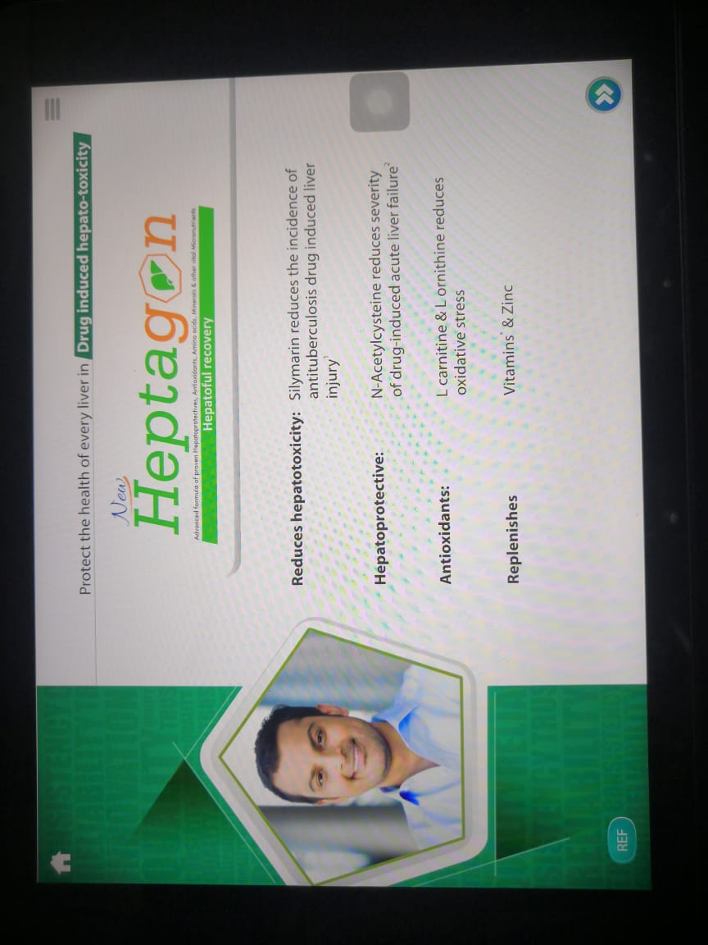
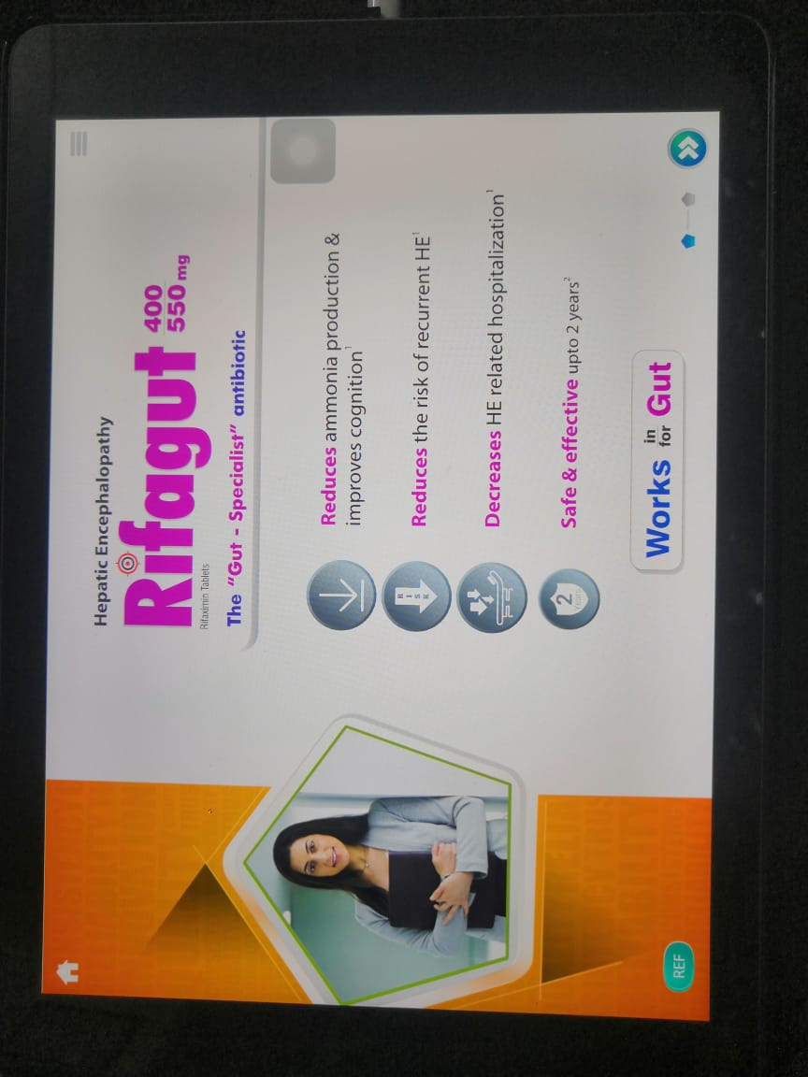
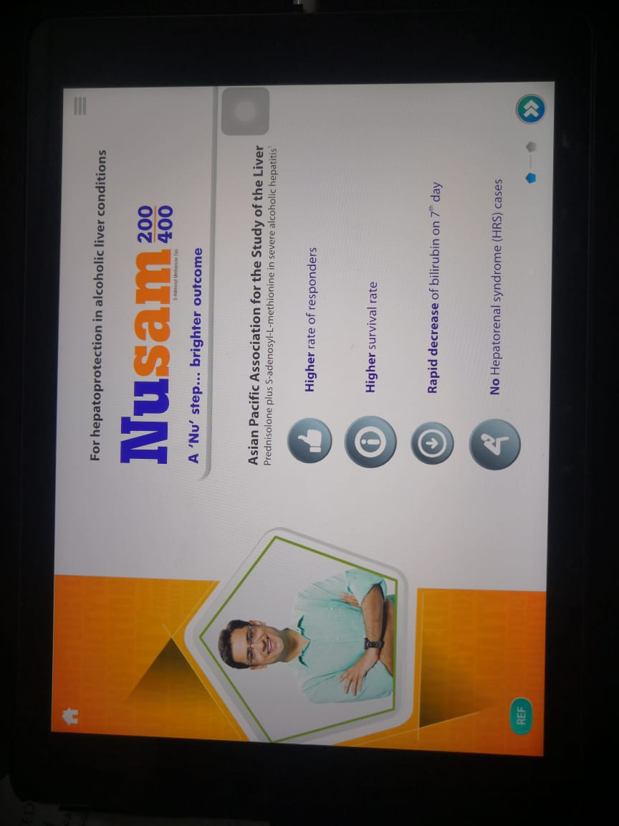
LBLs (Cont’d)

Slide 26
SWOT Analysis
STRENGTHS
WEAKNESSES
    Sun Pharma – Pharma Division has strong footprint in the gastro segment.
    Diverse product portfolio with a range of gastro drugs.
Stiff Competition from Competitors Brands.
Differentiate Brand from other Branded generics & innovator’s molecule.
OPPORTUNITIES
THREATS
Intense competition from other large and well-established players in the industry
Rapidly changing therapy landscape and evolving customer preferences.
Increasing regulations and compliance requirements in the industry
Establish the Brand in Teir-1 & Teir-2 areas that are untapped by Innovator & would become drivers of growth.
Sun Pharma has an existing prescriber base of Pantocid which can be utilized for increasing the sale of other brands in the division.

Slide 27
DISCUSSION
Sales of the division: Rs 621 Crs.
Marketing and Promotion Spent for the division: Rs.58 Crs.
Name of the division: Pharma
Sales
Promo
Division
Sales Team (394)
National Sales Manager (1)
Zonal Sales Manager (7)
Regional Sales Manager (24)
First Line Manager (85)
Sales Officer (385)
Marketing Team:
Marketing Head (1)
Product Managers (4)
Distribution network:
CFAs: 25
Distributors/stockists : 2,100
Sales Structure
Marketing Team
Distribution
Address: Sun House, CTS No. 201 B/1, Western Express Highway, Goregaon (E), Mumbai 400063
Ph.: +91-22-43244324, Website: http://www.sunpharma.com

Slide 28
REFERENCES
1. Pharmaceutical Branding Strategies and Communication
International Journal of Pure and Applied Mathematics, Volume 118 No. 18 2018, 1209-1220
2. Pharmaceutical Marketing: A Literature Review
April 2022International Journal of Engineering and Management Research 12(2):56-63
3. https://sunpharma.com/
4. https://www.linkedin.com/company/sun-pharma/
5. https://www.facebook.com/SunPharmaLive

Slide 29
LIMITATIONS
Data points were collected from the ex-employes of the sales team.
Sample size was low as specified by the norms of the organization for collection of the data points.

Slide 30
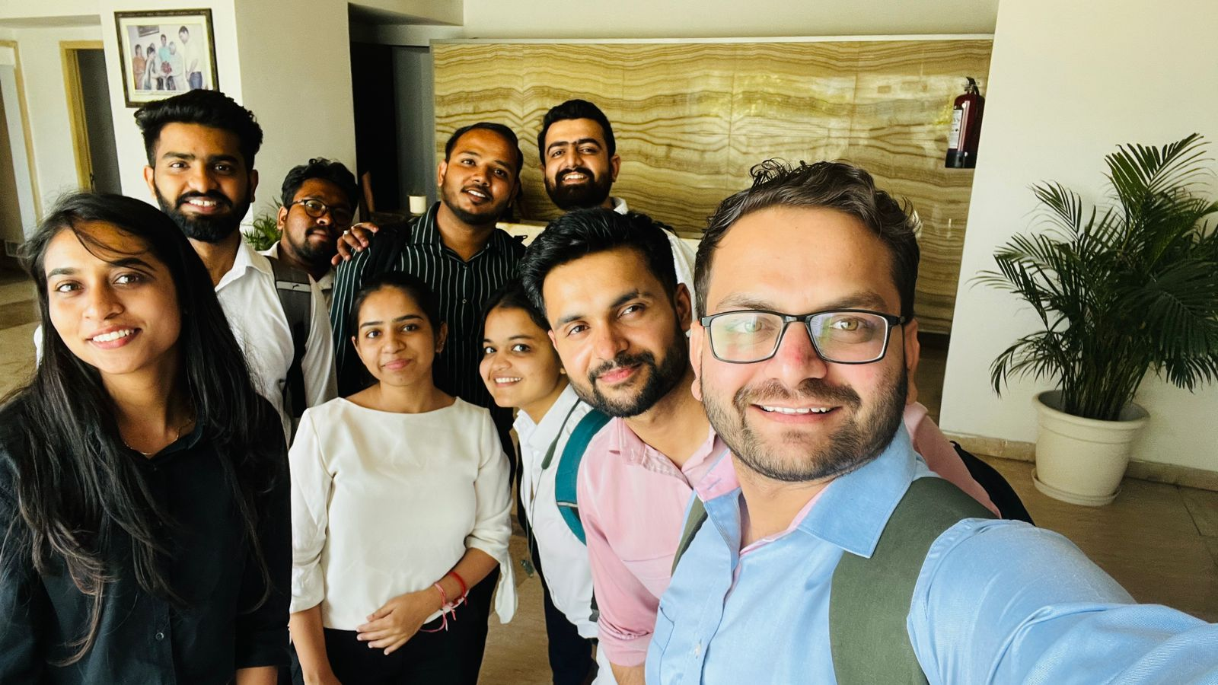
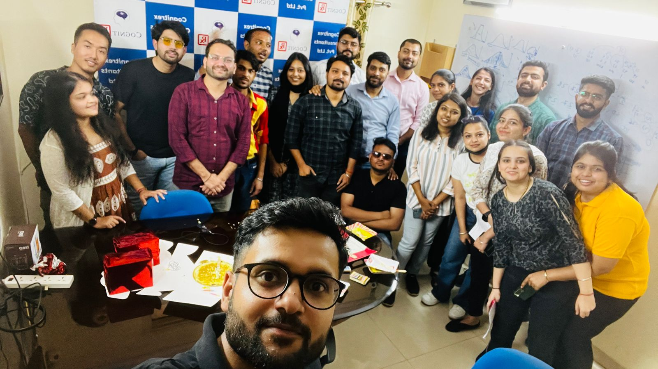
PICTORIAL JOURNEY

Slide 31
THANK YOU

