Slide 1

Revenue Generation from Call Centre
Shiv Nishad (PG/23/109)
Asst. Prof - Dr. Rupsa Banerjee
IIHMR Delhi

Slide 2
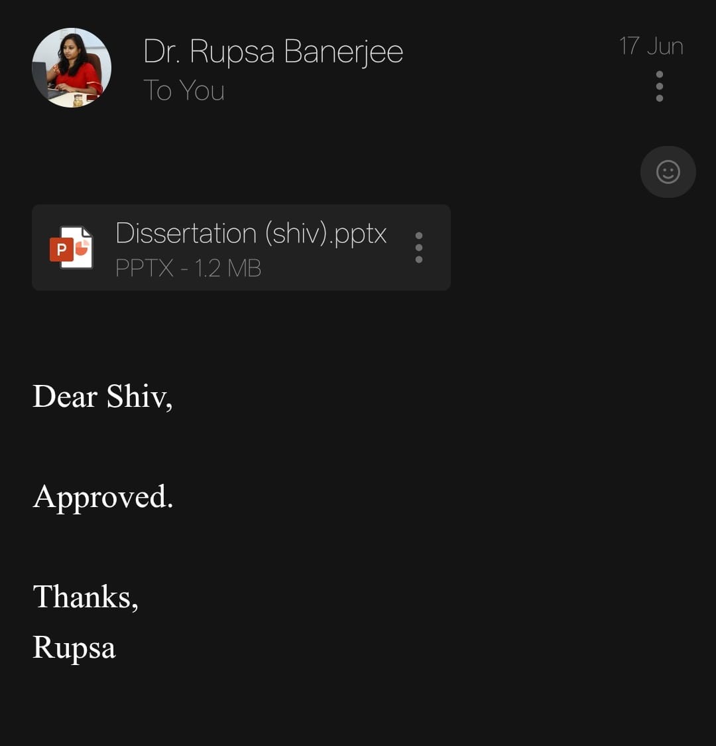
Mentor Approval

Slide 3
INTRODUCTION
Call centers Centralized call centers are becoming an important strategic element of hospitals, particularly multispecialty and tertiary care hospitals in the form of increasing the gap between patients and healthcare services. A hospital call Centre is a specialized hospital department that entertains a huge variety of patient calls like appointment booking, doctor consultations, health check-up related calls, admission related information, complaints and attend to them.
These center are contacted by the trained call executives, who handle both inbound and outbound calls with real time coordination of the departments including OPD scheduling, diagnostics, billing and homecare services.
As the healthcare industry becomes more competitive, patients have started expecting clear, fast, and concerned responses and communications. Thus, hospital call Centre performance has a direct impact on patient satisfaction, hospital reputation, and clinical outcome in a few situations.
To assess the lead generation methods and patient conversion techniques and their effectiveness.
To examines both patient experience quality and revenue generation results due to effective communication methods.

Slide 4
OBJECTIVE OF STUDY
To assess the lead generation methods and patient conversion techniques and their effectiveness.
To examines both patient experience quality and revenue generation results due to effective communication methods.
To investigates the capabilities of call center regarding doctor OPD scheduling management and hospital operational enhancement.

Slide 5
METHODOLOGY
Study Design: Primary Data Analysis from records like call log and hospital records.
Study area: Manipal Hospital, Gurugram, Haryana
Study sample: Caller patient records and call centre operational data- especially those who called to inquire about doctor appointment, services or had to follow-up needs.
Sampling technique: All available records from JAN 2025 to March 2025.
Data Collection Tool: Abstraction form to collect data from Hospital Management Information System (HMIS) and Call Centre Reports related to patient calls, OPD scheduling, and conversion logs.
Method of data collection: Secondary data retrieved from internal call logs, patient interaction records, appointment schedules, and revenue reports.
Data Analysis: Descriptive and comparative analysis using Microsoft Excel (e.g., pivot tables, bar charts, trend lines) Examination of gathered call centre records together with patient interaction logs aims to uncover lead generation patterns along with appointment scheduling approaches and patient conversion activities. We will use Microsoft Excel to create visual presentations from complex data that showcase how efficiently the call center supports patient care at the hospital.

Slide 6
METHODOLOGY
Flowchart
INBOUND CALL
GREET THE CALLER AND IDENTIFY THE QUERY .
CLASSIFY THE TYPES OF QUERY .
APPOITMENT BOOKING
SCHEDULING DOCTOR APPT.
DIAGNOSTIC/TEST.
SHARE PRICING AND TIMING .
GENERAL ENQUIRY.
SHARE ESTIMATED/REPORTS/SLOTS/HOME COLLECTION/DOCUMENT/OTHERS.
ESCALATE TO CONCERN TEAMS.
FOLLOW-UP IF NEEDED.
CALL CLOSURE .

Slide 7
RESULTS
Most of the problems are solved at the same time .
Many patients get their answer in just on call ,no need to visit the hospital or call multiples times( those who just come for the appointment booking ,knowing the schedule of doctor and for the reports etc)
Reduce the queue time .
We make sure the caller get connected to right department quickly.
We help patients for treatment ,many calls result in booked appointments, lab test visits or admissions.
By these things it helps the directly the hospital serve more people and improve revenue.
Making lead data like which need appointment like MRI ,CT SCAN AND USG etc we just booked appointment and make a Excel sheet of that person and feed it into data and after check that that patients who called ,patients does the diagnose from hospital or not .

Slide 8
RESULTS
The frequent questions and general problems we get to hear around can make the hospital know what should be fixed - such as delays in reports or problems in billing.
Number of call analyzed per month average is approx. = 24000 calls
Per day average = 800 calls
These calls are distributed into:

Slide 9
RESULTS
Numbers of calls in each month from February to May are likely .
This data approximately taken as per previous months

Slide 10
RESULTS
OPD SCHEDULING AND OPERATIONAL ENHANCEMENT
The call centre books appointment by checking availability on hospital HMIS.
Executive manage quick rescheduling and booking appt and avoid the no show calls .
By managing appointment through call instead of walk-in ,it makes smoother schedule of doctor and leading less crowding and better consultation .
More than 450-500 footfall of hospital is per day .
75% Patients are avail services from hospital.
Remaining 25% patients done diagnostic from outside.

Slide 11
DISCUSSION
To ensure that every time your patients contacts the hospital ,s/he is how the resolution is of high quality.
In this service, the patients receive precision and authentic information through the inquiry handling specialists.
It is very important in facilitating hassle free communication between the patients and the hospital departments. Fortunately, judging by the condition and observation, the call center is more than a place where calls are accepted it is actually the initial encounter point of patients and their families.
Sometime during calling patients indicates that patients are more willing to talk to a person can answer them fast and correctly as opposed to walking to hospital itself so, patients can come at given follow-up time.
We help patients for sample collection from her home.
To help reduce queue by providing the information to the patients.
This paper demonstrates that a call centre in a hospital is not only a particular location of communication between two or more parties but also a potent source of increasing patient engagement and revenue. With the help of call logs research, appointment storage research, and follow-up research, the vital conclusion that the significant contribution of the call centre to lead generation was made, as well as to patient conversion.

Slide 12
DISCUSSION
To decreases the amount of workload within the in-hospital departments as it responds to routine enquiries over the phone. This saves the physical counters (such as billing, OPD, reception) to work more efficiently. What is more, the calls are usually followed by confirmed appointments or booking of tests, which indicates its effect on income.
CHALLENGES
Too many calls at the same time.
Departments no answering when calls are transferring ,if the patients need information.
Wrong information causses big issues.

Slide 13
CONCLUSION
It help in developing patient retention strategies by identifying high-value patients, hospitals can tailor their communication, follow-up care, and support to enhance patient satisfaction and loyalty, thus increasing the likelihood of long-term relationship and higher, so that make the make more revenue.
We are not an answering point only , it is the voice of the hospital. It is an important source of guidance, support, and assistance to the patients and their families daily. This can be as simple as making an appointment or resolving a billing-related question, or it can be responding to an ICU inquiry, but whatever the patient needs, the call Centre will ensure that the appropriate assistance is availed and at the correct time.
It will relieve the burden on the front desk, lead to enhanced patient satisfaction, and can even make the hospital more revenue, by assisting in conversions.
Ultimately, a call center that is handled well enhances the reputation of the hospital and creates confidence in the patient. Indeed.

Slide 14
REFERENCES (ONLY VANCOUVER STYLE)
1. Shah P, Mathew R, Kaur H, Patel T, Shah H, Shaikh F, et al. A study on hospital call centers: evaluating their role and effectiveness in patient experience and operational management. J Family Med Prim Care. 2024;13(5):847–53.
2. SquadStack. Health call centers: why they’re essential for patient engagement [Internet]. SquadStack Blog. 2023 [cited 2025 Jun 15].
3. Amtelco. The role of hospital call centers [Internet]. Resources. [cited 2025 Jun 15].
: 4. Global Healthcare Resource. Call center services [Internet]. [cited 2025 Jun 15]. Available from:

Slide 15
INVOLVEMENT IN COMMUNITY OUTREACH PROGRAMME (COP) ACTIVITIES
Total no. of visits done by the Student: 6
Day-wise activities done by the student:
Mapped households, local health facilities, and landmark.
Identified basic health concerns through informal conversation.
Collected data on common diseases .

Slide 16
KEY LEARNING FROM COP ACTIVITIES
Made to be able to solve different problems of the patient through call orchestration.
Learned how to deliver reliable and quality information to the patients.
Got the full picture of the working process of OPD and handled queues among patient.
Arrangements made with departments such as ICU, radiology, billing and so on to assist patients.
Better communication experience due to difficult queries and complaints.
Assisted the discharge procedure and aided patients in the arrangement of appointments for follow-up.
Also did regular IPD rounds to monitor patient satisfaction and comfort.
Acquired the ability to multitask, empathies, and collaborate with others in the work of the hospitals.

Slide 17
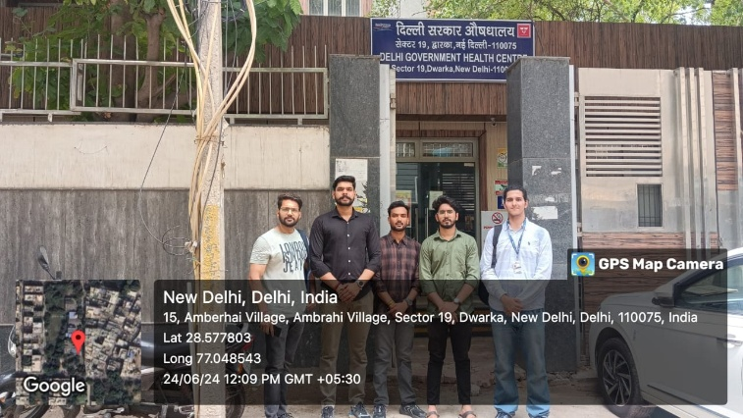
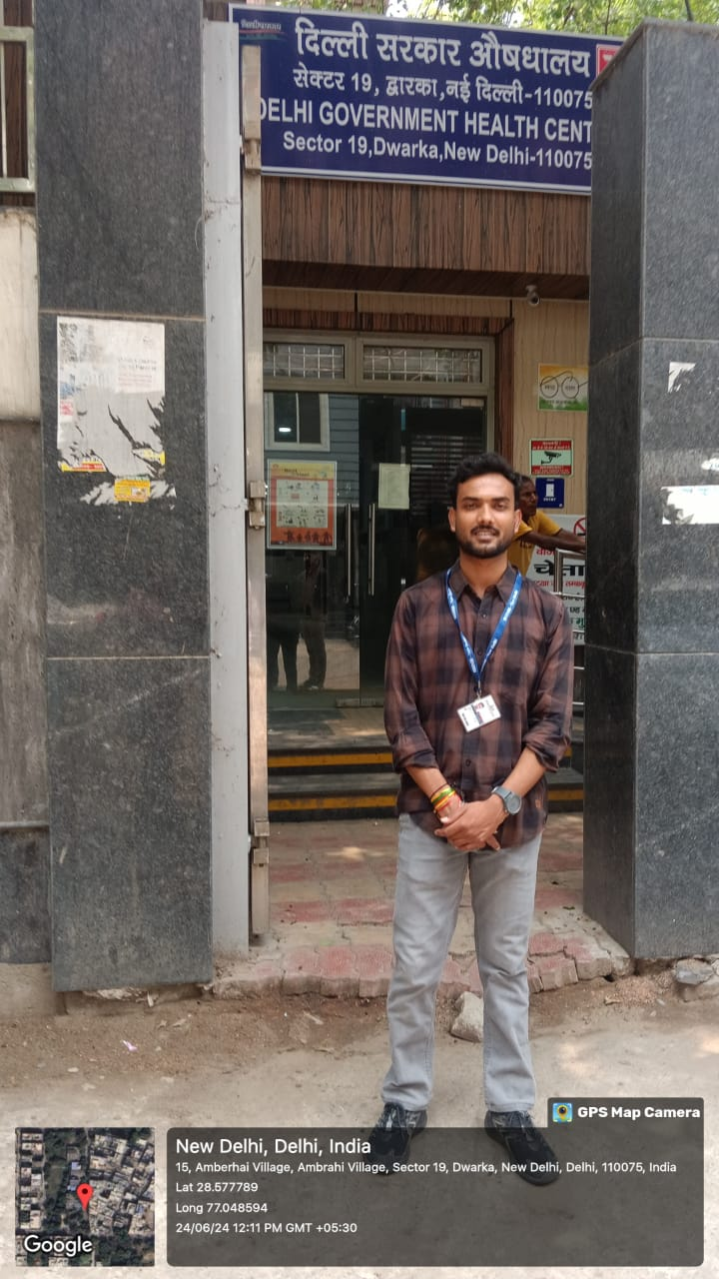
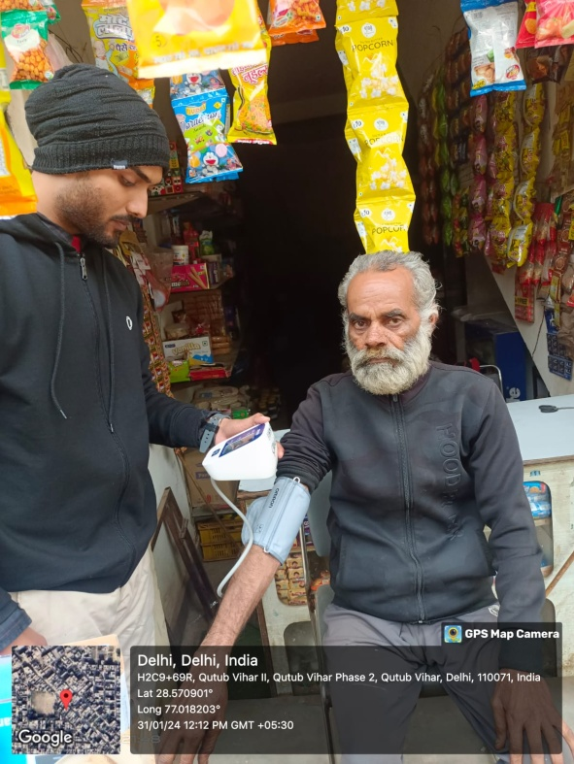
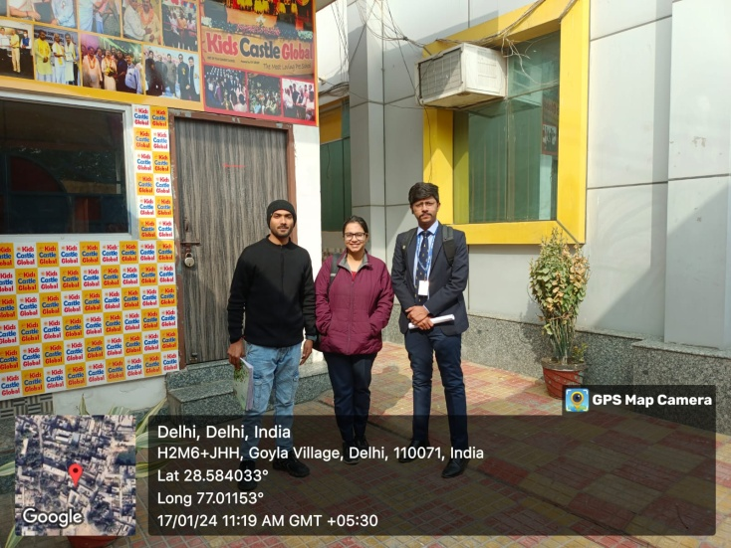
COP FIELD ACTIVITIES PHOTOGRAPHS

Slide 18
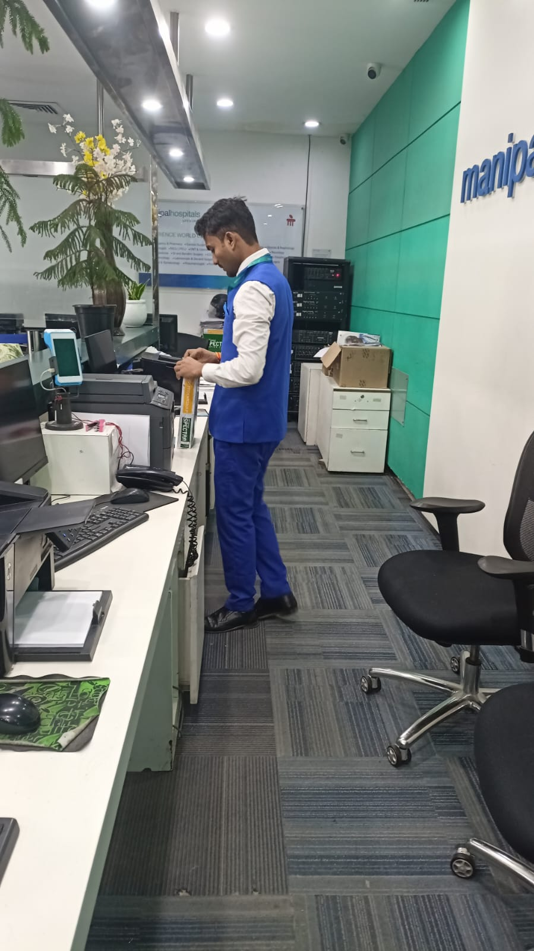
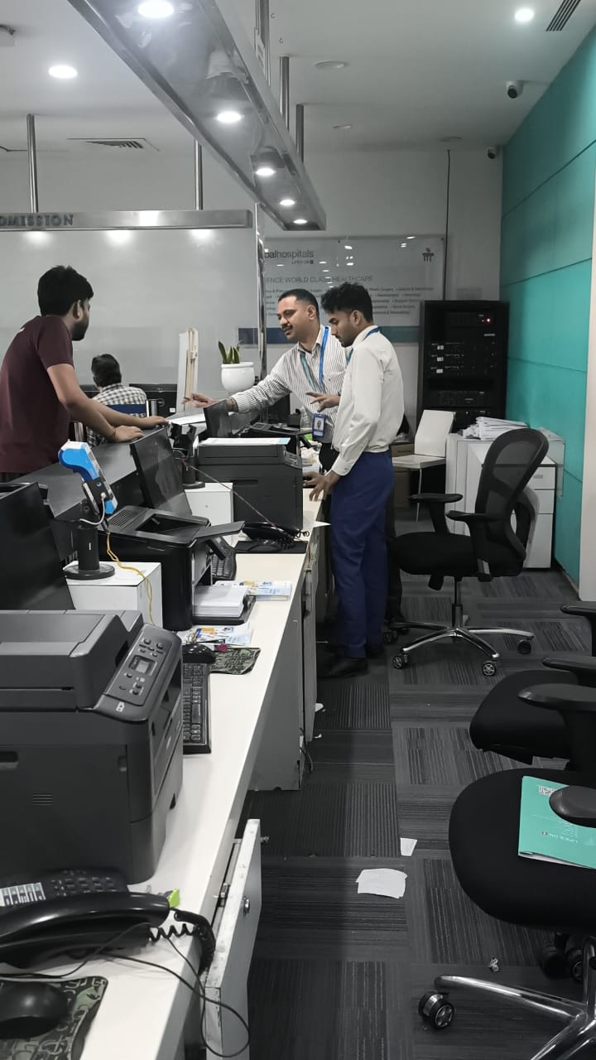
PICTORIAL JOURNEY

Slide 19
Thank You
Any Questions

