Slide 1


Reliability of Generative AI
(GPT vs Gemini) Using AIIMS Triage Protocol
Organization: Jivi.AI
Name: Neha Rana (PG/22/0058)
Faculty name: Dr. Sumant Swain
IIHMR Delhi

Slide 2
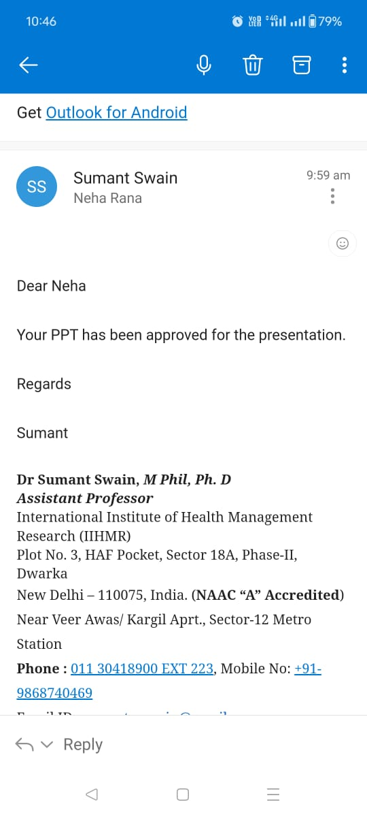
MENTOR APPROVAL

Slide 3
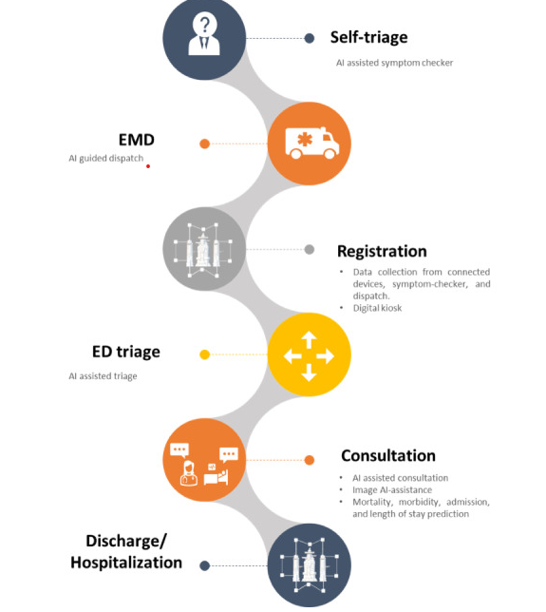
INTRODUCTION
Emergency departments (EDs) are essential for providing urgent healthcare, operating continuously to handle a growing number of visits globally.
Efficient management is critical, and the triage room plays a pivotal role in prioritizing patient care based on urgency. Systems like the Emergency Severity Index (ESI), Canadian Triage and Acuity Scale (CTAS),AIIMS Triaging protocol( ATP) and others help reduce mortality and morbidity by ensuring critically ill patients receive immediate attention.
Effective triage is linked to better patient outcomes and optimized resource use. However, in low and middle-income countries (LMICs), EDs often rely on informal screening by untrained staff, leading to challenges due to varying disease severity and limited resources.
Key challenges in triaging include clinical competence, emotional stability, and management issues like staff shortages and inadequate space.

Slide 4
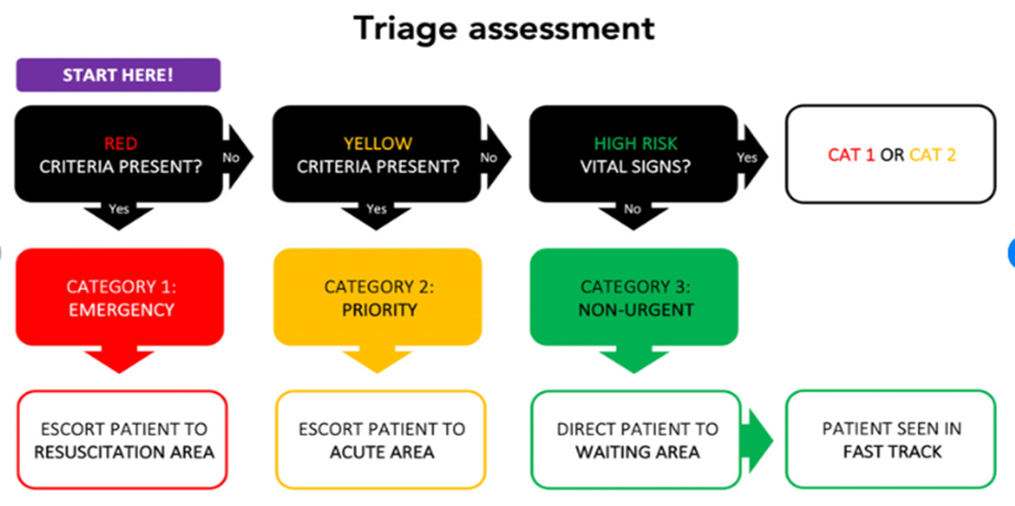
INTRODUCTION
Artificial intelligence (AI) offers promising solutions to these challenges. Machine learning and deep learning can enhance triage accuracy, predict patient influx, optimize resources, and automate administrative tasks.
AI can also personalize patient care by providing tailored treatment recommendations and identifying high-risk patients for proactive interventions. By automating routine tasks, AI helps reduce physician burnout, allowing medical staff to focus on complex patient care, ultimately improving ED efficiency and patient outcomes.

Slide 5

objectives
Primary objective:
To identify the generative AI model that best emulates human decision-making for patient triage on General medicine cases.
Secondary objective:
Evaluate the agreement between the human rater and each AI tool in triaging patients based on provided datasets containing patient demographics, vitals, and chief complaints.
Implement Cohen's Kappa coefficient to quantify the level of agreement.
To find the most appropriate Generative Ai based on the analysis

Slide 6
METHODOLOGY
Study type: Comparative study using secondary data
Sample size: 200 cases including patient age, gender, chief complaint, vital signs, and other relevant clinical information.
. Triaging Protocol:
Protocol Used: AIIMS triaging protocol.
Rating Categories: Each rater will assign a triage category to each scenario based on the protocol.
Study participants:
Human Rater: An experienced healthcare professionals who are well known of AIIMS triage protocol ( GVK EMRI )
Generative AI Tools:
ChatGPT-3.5: Developed by OpenAI.
GPT-4: An advanced version of ChatGPT with improved capabilities.
Gemini: A state-of-the-art generative AI tool.
Data analysis: COHEN KAPPA (Inter-rater reliability)

Slide 7
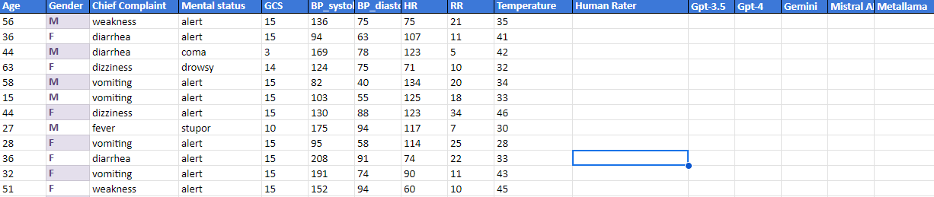
DATA SET
Scenario Distribution: 200 simulated scenarios are prepared and distributed to the human rater and each AI tool.
Triaging: Each rater (human and AI tools) independently assigns a triage category to each scenario.
Data Collection: Triage decisions from each rater are collected and documented

Slide 8
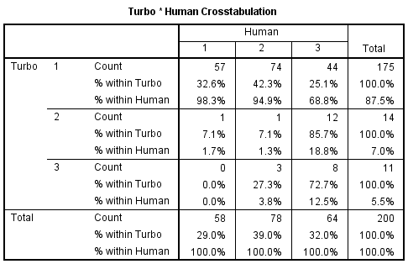
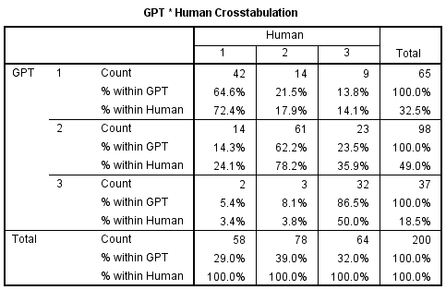
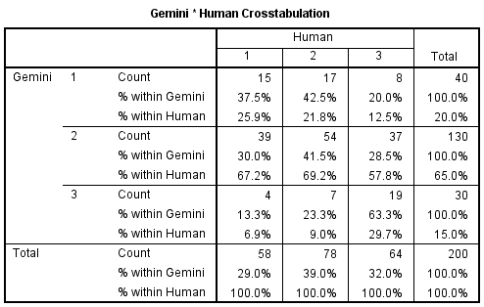
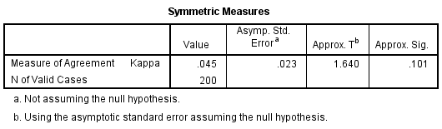
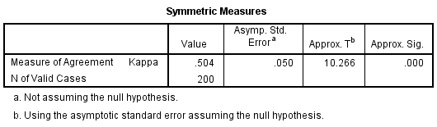
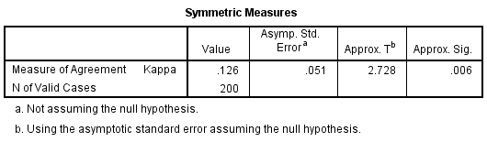
RESULTS

Slide 9


RESULTS

Slide 10
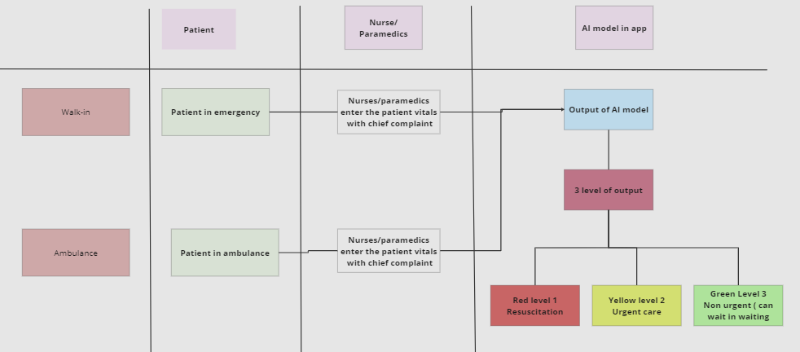
Process

Slide 11
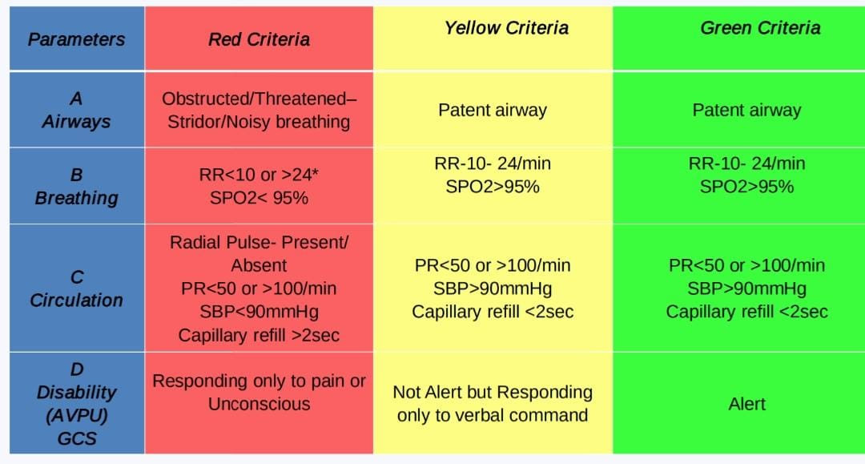
AIIMS Triage Protocol

Slide 12
Investigate the potential benefits of AI
Predictive Analytics: Machine learning algorithms can forecast patient influx patterns, optimize resource allocation, and enhance triage accuracy, ensuring timely care.
Medical Imaging: Deep learning models can analyze medical images with high precision, facilitating rapid diagnosis for conditions needing immediate attention.
Administrative Efficiency: AI can streamline tasks such as documentation and billing, reducing administrative burdens on medical staff.
Personalized Care: By analyzing patient data, AI can offer tailored treatment recommendations and identify high-risk patients for proactive interventions.
Reducing Burnout: Automating routine tasks allows healthcare professionals to focus on complex patient care, improving job satisfaction and reducing burnout.

Slide 13
discussion
Challenges in ED
The challenges in emergency department triage encompass clinical competence, psychological capacity, and management issues. Clinically, nurses may lack essential knowledge and skills, impacting patient prioritization and care quality. Psychological challenges like emotional stability are critical due to the high-stress environment of triage.
Management-related problems such as staffing shortages and inadequate infrastructure further strain triage operations, contributing to errors and inefficiencies. Addressing these challenges requires improved training, clear guidelines, and supportive policies to enhance both clinical competence and operational effectiveness in emergency triage settings.
Performance: ChatGPT-3.5 nearly matches human triage accuracy.
Fine tune to the LLM can make it more reliable and provide accuracy
Limitations:
Training data bias.
General-purpose design limits in specialized tasks.
Integration challenges with existing systems, privacy issues, regulatory hurdles, and acceptance.

Slide 14

DISSCUSSION
Future Steps:
Develop emergency-specific AI models.
Integrate AI with hospital systems.
Conduct clinical trials for validation.
Ensure regulatory compliance and staff training.
Enhance patient communication about AI use.
Refine AI through continuous feedback.
Scale AI for diverse healthcare settings.
Foster collaboration among AI developers, healthcare professionals, and public health experts.

Slide 15
Conclusion
The investigation into the effectiveness of generative AI in emergency triage demonstrates promising potential to enhance decision-making and resource allocation within emergency departments. Despite varying degrees of agreement with human raters across different AI models, tools like ChatGPT-3.5 have shown substantial compatibility in triage assessments, nearing human-level accuracy.
This suggests a viable path forward where AI can support emergency medical professionals by providing a consistent, objective, and scalable approach to patient assessment. Future advancements should focus on refining AI technologies to address specific medical contexts, ensuring their integration is both clinically relevant and technically sound. As AI becomes increasingly integrated into healthcare settings, ongoing evaluations, user training, and regulatory compliance will be essential to fully harness its capabilities, improving both patient outcomes and system efficiency

Slide 16

REFRENCES
Jae Hyuk Kim, Sun Kyung Kim, Choi J, Lee Y. Reliability of ChatGPT for performing triage task in the emergency department using the Korean Triage and Acuity Scale. DIGITAL HEALTH. 2024 Jan 1;10.
Paslı S, Şahin AS, Beşer MF, Topçuoğlu H, Yadigaroğlu M, İmamoğlu M. Assessing the precision of artificial intelligence in emergency department triage decisions: Insights from a study with ChatGPT. The American Journal of Emergency Medicine [Internet]. 2024 Apr 1;78:170–5.
Gan RK, Ogbodo JC, Wee YZ, Gan AZ, González PA. Performance of Google bard and ChatGPT in mass casualty incidents triage. The American Journal of Emergency Medicine [Internet]. 2024 Jan 1 [cited 2024 Jan 13];75:72–8.
Bijani M, Khaleghi AA. Challenges and Barriers Affecting the Quality of Triage in Emergency Departments: A Qualitative Study. Galen Medical Journal [Internet]. 2019 Oct 12;8. Available from: https://www.ncbi.nlm.nih.gov/pmc/articles/PMC8344134/
Saban M, Dubovi I. A comparative vignette study: Evaluating the potential role of a generative AI model in enhancing clinical decision‐making in nursing. Journal of Advanced Nursing. 2024 Feb 17;
Chenais G, Lagarde E, Gil-Jardiné C. Artificial Intelligence in Emergency Medicine: a Viewpoint of Current Applications, Foreseeable Opportunities and Challenges (Preprint). Journal of Medical Internet Research. 2022 Jun 2;25.
Jacob J. ChatGPT: Friend or Foe? – Utility in Trauma Triage. Indian Journal of Critical Care Medicine. 2023 Jul 31;27(8):561–4.

Slide 17

THANK YOU
ANY QUESTIONS

Slide 18


Slide 19


