Slide 1



Determinants of Loss to Follow Up during treatment among Tuberculosis patients in various states of India.
Presented by: Kanishka Garjola
Roll no.: PG/23/046
Mentor: Dr. Punit Yadav

Slide 2
BACKGROUND & RATIONALE
India has highest TB burden globally 2 million cases annually
Non-compliance to TB treatment leads to:
TB is the second leading cause of death after HIV
Incomplete therapy
Increased transmission
Emergence of drug-resistant TB
Higher mortality

Slide 3
BACKGROUND & RATIONALE
Study aims to understand determinants of treatment default.
Focuses on drug-sensitive TB (DSTB) patients (both pulmonary & extra-pulmonary).
Uses data from Ni-Kshay, the Government of India’s TB tracking system.
Employs logistic regression analysis to identify key risk factors.

Slide 4
Research Question
What socio-demographic factors are significantly associated with treatment non-compliance among diagnosed pulmonary and extra-pulmonary tuberculosis (TB) for Drug Sensitive Tuberculosis (DSTB) patients in various states of India.

Slide 5
Objectives of Study
Primary Objective
To identify and analyze the socio-demographic factors contributing to treatment non-compliance among diagnosed pulmonary and extra-pulmonary tuberculosis (TB) for Disease Sensitive Tuberculosis (DSTB) patients in various states of India.
Specific Objective
1. To study the association of socio-economic status on TB treatment adherence among patients.
2. To evaluate the influence of occupation, tobacco (smoking), alcohol consumption, and marital status on the likelihood of treatment default.
3. To provide recommendations to program division aimed at reducing treatment non-compliance.

Slide 6
Methodology
Study design overview
Study Design: Retrospective cohort study
Data Source: Secondary data from Ni-Kshay portal (2022–2023 cohort)
Coverage: 6 Indian regions (North, South, East, West, Central, Northeast)
States Selected: Goa, Manipur, Karnataka, Bihar, Punjab, Chhattisgarh

Slide 7
Methodology
Sample size & variables
Sample Size: Goa – 1,949 Manipur – 1,657 Karnataka, Bihar, Punjab and Chhattisgarh– 1,999
Dependent Variable: Loss to follow-up (LTFU): Stopped treatment for ≥2 months without consent
Independent Variables: Age (adult >18 yrs), Gender, Place of residence (state/outside), Type of TB (pulmonary/extra-pulmonary),Alcohol use, Tobacco smoking, Socio-economic status (BPL/APL

Slide 8
Data Analysis
The data is presented in frequency and percentage based on a LTFU status. Univariate logistic analysis is performed to determine the relationship between the independent and dependent variables. P-value <0.05 was considered statistically significant. The independent variable, which had a p-value lower than 0.25, was included in the multivariable analysis. The final model was analyzed using logistic regression. All analyzes was performed by SPSS 22.

Slide 9
Results
Sample Overview
Total Participants: 11602 patients across 8 states
Demographics
Gender: Males predominated (up to 66.5%) in most states
Geographic Patterns of LTFU
Highest LTFU: Bihar (40.9%), Chhattisgarh (30.9%), Punjab (28.9%)
Treatment Completed: ~69% to 96% depending on state
LTFU Rates: Ranged from 3.7% (Goa) to 40.9% (Bihar)
Age: Majority between 18–50 years
TB Type: Pulmonary TB most common (~75–83% of cases)
Lowest LTFU: Goa (3.7%), Manipur (5.7%)
Demographics
Alcohol & Tobacco Use:
Alcohol use: 24–57%
Tobacco use: 27–45%

Slide 10
Results
Zone-wise Findings
North Zone – Punjab
LTFU Rate: 28.9%
Tobacco Use: OR = 2.02 → Doubles the risk of LTFU
Alcohol Use: OR = 0.48 → Alcohol users more likely to default
Socio-economic Status (APL protective): OR = 0.013 → BPL at very high risk
Geographic Disparity (UP residence): OR = 162.0 → Indicates massive risk outside core state
Non-significant: Age, sex, TB site
South Zone – Karnataka LTFU Rate: 27%
Tobacco Use: OR = 0.263 → Users significantly more likely to default
Alcohol Use: OR = 0.149 → Strongly predictive of LTFU
Socio-economic Status (BPL): OR = 2.24 → Doubles LTFU odds
Pulmonary TB: OR = 2.15 → Higher default risk than extra-pulmonary
Age (18–30 protective): OR = 1.63
East Zone – Bihar,
LTFU Rate: 40.9% (Highest in study) Tobacco Use: OR = 1.93 → Nearly doubles LTFU odds, Socio-economic Status (BPL): OR = 1.79, Residence (e.g., UP): OR = 162.6 → Severe regional risk, Non-significant: Age, gender, alcohol use, TB site

Slide 11
Results
Zone-wise Findings
West Zone – Goa
LTFU Rate: 3.7% (Lowest in study)
Top Risk Factors:
Pulmonary TB: OR = 0.428 → Risk higher than extra-pulmonary
Female Gender: OR = 2.82 → Women more likely to default
Geographic (residing outside Goa): OR = 0.026 (Goa residents least likely to default)
Non-significant: SES, alcohol, tobacco, age
Central Zone – Chhattisgarh
LTFU Rate: 30.9%
Top Risk Factors:
Alcohol Use: OR = 0.34 → Alcohol users ~3x more likely to be LTFU
Pulmonary TB: OR = 0.347 → More prone to default
SES (APL protective): OR = 1.71 for APL
Age (18–30 protective): OR = 2.37
Gender (Male): OR = 1.4
Non-significant: Tobacco, residence
Northeast Zone – Manipur
LTFU Rate: 5.7%
Top Risk Factors:
Socio-economic Status (BPL): OR = 2026.8 → Extreme risk
Residence (vs. Maharashtra): OR = 1377.5 → Very high risk based on geography
Pulmonary TB: OR = 0.247
Alcohol Use: OR = 0.383 → Increased LTFU
Age (18–30 protective): OR = 5.10
Non-significant: Gender, tobacco

Slide 12
Limitations of the Study
Based on secondary data from Ni-Kshay – may contain errors or missing values.
Important variables not available:
Mental health status
Quality of counseling
Stigma, family support, awareness, transport access
Socio-cultural factors underrepresented
Predictor variables assumed static, though they may change during treatment
No data on co-morbidities like HIV, diabetes, or psychological stress
Potential bias due to unmeasured confounders

Slide 13
Discussion & Conclusion
Socio-Economic Status (SES) was the most consistent predictor of LTFU. Patients from Below Poverty Line (BPL) backgrounds had significantly higher odds of defaulting on treatment across nearly all states.
Alcohol consumption was strongly associated with treatment non-adherence, especially in Karnataka, Manipur, and Chhattisgarh, indicating the need for behavioral interventions during TB care.
Pulmonary TB patients had higher LTFU rates compared to those with extra-pulmonary TB in most states, possibly due to stigma, more severe symptoms, and longer treatment duration.

Slide 14
Discussion & Conclusion
Younger age groups (18–30 years) were more likely to complete treatment, while older adults had higher default rates, suggesting the need for age-specific adherence support.
Tobacco use showed variable association across states but was a significant risk factor in Punjab, Bihar, and Karnataka, highlighting the importance of integrated tobacco cessation counseling.
Geographic disparities influenced LTFU rates, with states like Bihar and regions such as UP and Manipur showing higher risk due to factors like migration, access barriers, and weaker programmatic follow-up

Slide 15
References
World Health Organization. (2023). Global Tuberculosis Report 2023. Geneva: WHO. Retrieved from https://www.who.int/tb/publications/global_report/en/
Central TB Division, Ministry of Health and Family Welfare. (2023). India TB Report 2023. Government of India. Retrieved from https://tbcindia.gov.in
Ni-Kshay Portal. Ministry of Health and Family Welfare, Government of India. Retrieved from https://www.nikshay.in
Munro, S. A., Lewin, S. A., Smith, H. J., Engel, M. E., Fretheim, A., & Volmink, J. (2007). Patient adherence to tuberculosis treatment: a systematic review of qualitative research. PLoS Medicine, 4(7), e238. https://doi.org/10.1371/journal.pmed.0040238
Rodrigues, M. M. S., et al. (2020). Machine learning algorithms using national registry data to predict loss to follow-up during tuberculosis treatment. PLOS ONE, 15(9), e0238974. https://doi.org/10.1371/journal.pone.0238974
Xie, Y., Hu, J., & Zhang, L. (2021). Survival Analysis of Risk Factors for Mortality in a Cohort of Patients with Tuberculosis. BMC Public Health, 21, 566. https://doi.org/10.1186/s12889-021-10645-y

Slide 16
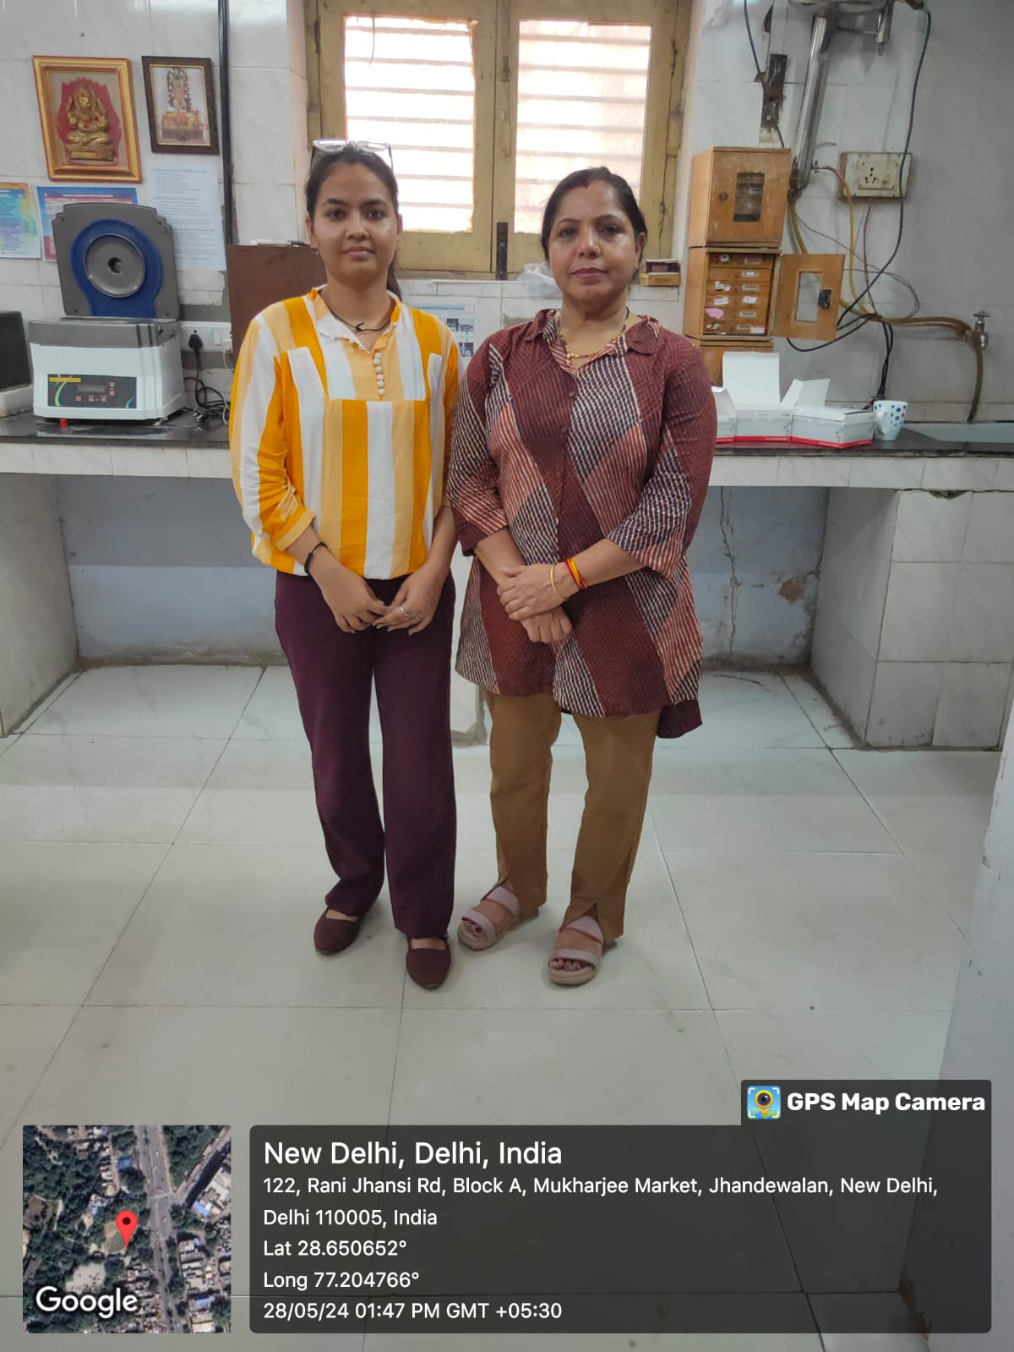
Involvement in Community Outreach Program (COP) Activities
Experience in TB Unit – Community Outreach
Assisted in active case finding and contact tracing, helping identify TB suspects and ensuring they were referred for testing and treatment.
Participated in community awareness sessions, educating vulnerable populations about TB symptoms, prevention, and the importance of treatment adherence.
Supported field visits with health workers (ASHAs/ANMs) to monitor patient follow-up, improve treatment compliance, and address barriers like stigma and misinformation.

Slide 17
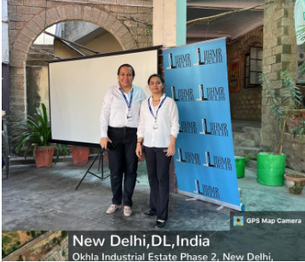
Involvement in Community Outreach Program (COP) Activities
Total no of visits:-Visited Goyala Dairy around 6-7 times.
No of activities done:-
Surveyed the members asking them about their ABHA card and are they aware about its benefits, how they get Daily needs in their household, measured their height, weight and BP, & Ask for any chronic disease they are suffering from and also their family social history including them.
Where they go in first place whenever anyone from their family suffer from any Health related issue (mostly free treatment).
How they Receive water in their household? Suppiled by government vehicles, and the location they live in has no proper drainage system.

Slide 18
Thank You
Any Questions

