Slide 1


Community-Based Management of health impact due to Heat Stress:
Exploring Adaptation Strategies in peri-urban areas in Delhi, India
BY
RITIKA
PG/22/094
UNDER THE GUIDANCE OF
Dr. SUMANT SWAIN
Notes:
As climate change fuels more frequent, intense, and longer heat waves, record-breaking, brutally hot weather is already a major health threat for vulnerable communities in India and other parts of the world.1 Heat stress refers to physiological ailments and symptoms caused by exposure to high temperatures and often humidity. Heat stress already affects 68 million people worldwide as of 2021.2 New analysis finds that if global temperatures increase by 2°C (3.6°F) over pre-industrial levels, a billion people will endure extreme heat stress.3 This finding underscores the importance of limiting global warming relative to preindustrial temperatures to less than 2°C, and preferably to 1.5°C as outlined in the Paris Agreement; 1.0°C of warming has already occurred.4 The India Meteorological Department (IMD) in its annual Seasonal Outlook for 2022 forecast a higher probability of heat waves occurring over west-central and some parts of northwest India.5 Heat Action Plans (HAPs) are essential to protect communities and save lives from extreme heat. Over 90 percent of India's total area is in the "extremely cautious" or "danger zone" of being hit by heatwaves, which are becoming more frequent due to climate change, according to the study conducted by Ramit Debnath and colleagues at the University of Cambridge, Delhi is particularly vulnerable to severe heatwave impacts and millions of workers experiencing heat-related stress, effective strategies are urgently needed. This study highlights the impacts of heat waves in India's capital, Delhi with adoption and explores the need for community-based solutions.

Slide 2
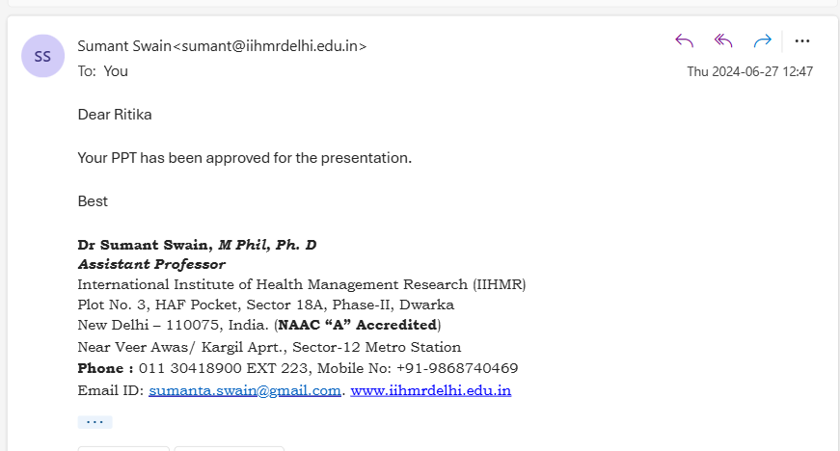
Mentors’ Approval

Slide 3
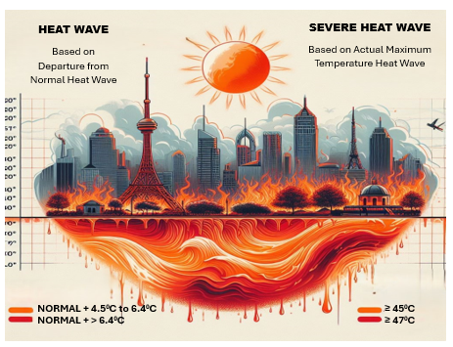
What are Heat Waves ?
Notes:
Heat waves are periods of abnormally high temperatures which pose a significant threat to public health in India. These events are becoming increasingly frequent and severe due to climate change, cause a range of health problems, from dehydration to heatstroke.
The Indian Meteorological Department (IMD) has given the following criteria for Heat Wave:
Heat Wave need not be considered till maximum temperature of a station reaches at least 40°C for Plains and at least 30°C for Hilly region.
When normal maximum temperature of a station is less than or equal to 40°C, Heat Wave Departure from normal is 5°C to 6°C Severe Heat Wave Departure from normal is 7°C or more.
When normal maximum temperature of a station is more than 40°C Heat Wave Departure from normal is 4°C to 5°C Severe Heat Wave Departure from normal is 6°C or more.
When actual maximum temperature remains 45°C or more irrespective of normal maximum temperature, heat waves should be declared.

Slide 4
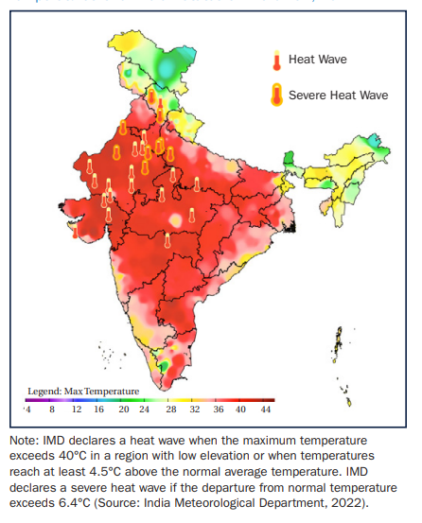
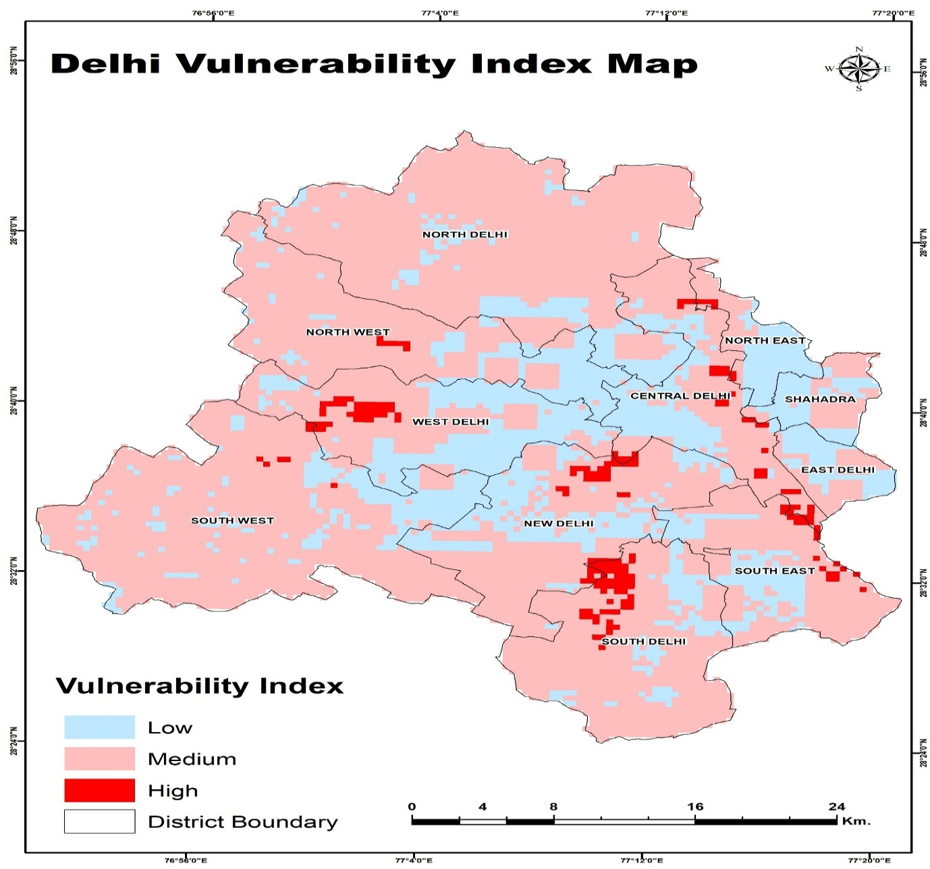
Notes:
This vulnerability index is a Heat wave hazard and vulnerability map of NCT prepared using remote sensing and GIS techniques, this map highlights that South-Delhi has highest concentration of vulnerability pockets. Some other pockets were also found in New Delhi and West Delhi districts. Some scattered pockets were also located in North-West Delhi and Eastern Delhi while no venerability pockets were found in North Delhi district. More than 70% area of NCT was located in the vulnerability index which implies that the population density and built-up concentration are above the limit and hence increases the risk of heat wave in NCT. The low vulnerability area is scattered in pockets of each district, but maximum concentration was observed in Central Delhi, which has comparatively lower population density and following some environmental conditions of green belts.

Slide 5

Background
Heatwaves in Delhi
Escalating Threat: Heatwaves pose a significant threat to public health in India, particularly in Delhi, due to climate change.
Vulnerability: Delhi's high population density and urban heat island effect make it particularly vulnerable to the impacts of heatwaves.
Health Problems: Heatwaves cause a range of health problems, from dehydration to heatstroke, affecting millions of workers.
Studies indicate that over 75% (around 380 million people) of India's workforce experiences heat stress, putting a strain on their health and productivity
Notes:
This research focuses on the community-based management of health impacts due to heat stress in peri-urban areas of Delhi. The study aims to explore adaptation strategies employed by peri-urban communities to manage heat stress-related health outcomes during hot weather conditions caused by climate change. The importance of studying heat stress in urban settings lies in the vulnerability of peri- urban populations to heat waves, particularly in densely populated areas like Delhi. The urban heat island effect exacerbates the already scorching temperatures, impacting the health and productivity of a large portion of Delhi's residents.

Slide 6

STUDY OBJECTIVE
General Objective
To identify and analyze the adoption strategies employed by peri-urban communities in Delhi to manage heat stress-related health outcomes during hot weather conditions due to climate change.
Notes:
The research objectives include identifying key health outcomes due to heat stress, investigating coping strategies and mechanisms used by peri-urban communities to adapt and manage these health outcomes, and developing a comprehensive framework for community-based management of heat stress. The study also aims to provide recommendations and insights for policymakers, public health officials, and community leaders in Delhi to develop evidence-based strategies for sustainable heat stress management at the community level to minimize adverse health impacts.

Slide 7

Secondary Objectives
To identify key health outcomes due to heat stress at the community level.
To investigate the coping strategy /mechanisms through which peri-urban communities in Delhi adapt and manage key health outcomes related to heat stress.
To document the community-based interventions in enhancing community resilience to heat stress in urban settings, with a focus on the outcomes and challenges faced by people.
To provide recommendations and insights for policymakers, public health officials, and community leaders in Delhi to develop evidence-based strategies for sustainable heat stress management at the community level to minimize adverse health impacts.
Study Outcomes

Slide 8
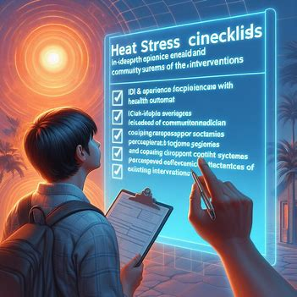
Methodology
Study Design: This population-based cross-sectional study and was followed by a mixed-method approach.
Study Area: Goyla Dairy, Delhi.
Study Population: Head of the households for a quantitative survey and ASHA, ANM, MAS members, local self-government members, and healthcare providers for IDI and FGD.
Sample Size: 200 households and six frontline health workers and provides for IDI and 3 FGD among Mahila Arogya Samiti (MAS) members.
Study Period: March to June 2024
Samling Technique: Convenient sampling technique was used to cover the sample size.

Slide 9
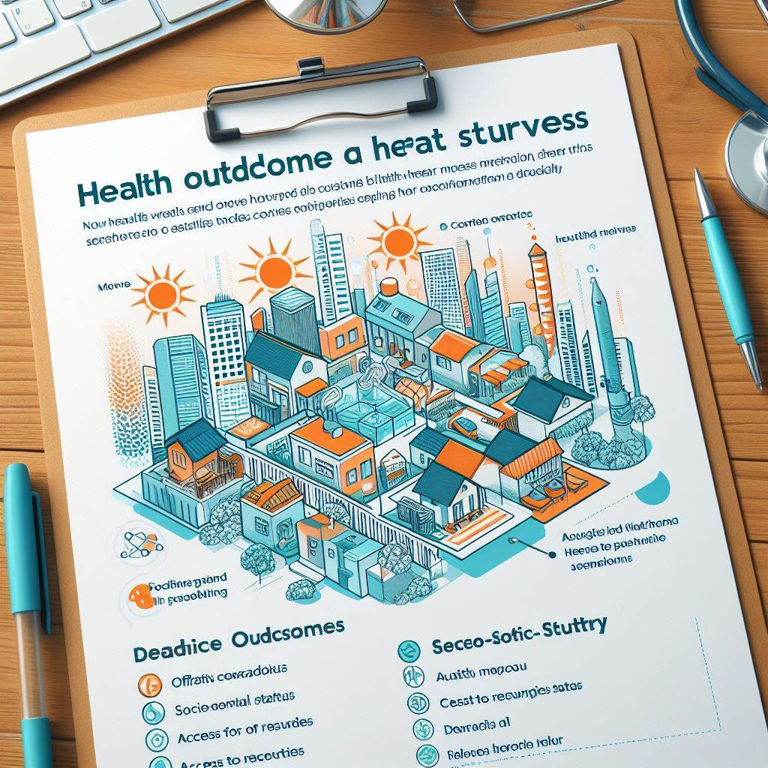
Study Tools:
Quantitative Survey
  A household survey was conducted to collect data on health outcomes related to heat stress and existing coping mechanisms, socio-economic status, access to resources, and demographics.
Qualitative Interviews
  IDI and FGD checklists was developed for this study to explore in-depth experiences with heat stress related health outcome, coping strategies, community support systems, and perceived effectiveness of existing interventions.

Slide 10
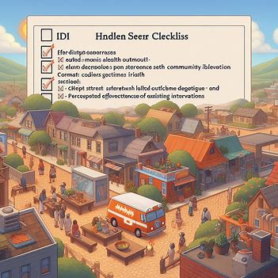
Ethical Consideration:
All the participants were explained the objectives of the study when they were being surveyed through a questionnaire. Throughout the course of study, the core principles of research ethics such as respect for respondents, beneficence and justice were considered and applied as required. Informed consent was taken from each participant, after explaining the background and other details of the study. The respondent were assured of anonymity, confidentiality of the information they share with me as well as the rights to voluntary participate and withdraw from the study at any point of time without any consequences.

Slide 11

Data Analysis: The data was analysed using Statistical software statistical package for the social sciences (SPSS).
Data Integration: Quantitative and qualitative findings were triangulated to provide a richer and more nuanced understanding of the research questions.
Dissemination: Findings were disseminated through research reports and presentations

Slide 12
Results
Demographic composition of pilot neighborhoods.
S.No. | Background characteristics | Number | Percentage
Households
1. | Number of House-holds covered | 206
2. | Median income | 25000
3. | Total Population covered | 679
SEX
1. | No. of males | 368 | 54.19 %
2. | No. of females | 311 | 45.80%
RESIDENCE
1. | Kutcha | 8 | 3.88%
2. | Pucca | 198 | 96.11%

Slide 13
Results
S.No. | Background characteristics | Number | Percentage
AGE
1. | 0-4 | 44 | 6.48%
2. | 5- 10 | 87 | 12.81%
3. | 11-20 | 96 | 14.13%
4. | 21-35 | 117 | 17.23%
5. | 36-65 | 300 | 44.18%
6. | 65 Above | 35 | 5.15%
Education Level
1. | Illiterate | 5 | 2.4%
2. | Primary | 89 | 43.2%
3. | Secondary | 69 | 33.5%
4. | And above | 43 | 20.9%

Slide 14
Results
SYMPTOMS | CASES REPORTED PERCENTAGE
Sweating | 98.27
Shivering | 15.22
Increase and decrease in appetite | 77.16
Tiredness | 77.91
Dehydration | 72.24
Electrolyte imbalance | 13.58
Fatigue | 90.15
Nausea | 45.97
Vomiting | 43.13
Drop in blood pressure | 85.97
Fever | 17.01
Irritability | 92.54
Confusion | 76.42
Dizziness | 75.22
Anxiety | 92.09
Headaches | 8.21
Heat cramps | 3.13
Intense thirst | 96.12
Dry mouth | 90.90
Rapid heartbeat | 30.15
Worsening of allergies and asthma | 10.90
The data shows that heat stress is a major concern in the community. Sweating, intense thirst, irritability, anxiety, and dry mouth are the most prevalent symptoms, affecting over 90% of the cases, while Shivering, electrolyte imbalance, and worsening allergies/asthma are less frequent but still noteworthy symptoms, affecting more than 10% of the cases.
Notes:
The data suggests that heat stress is a significant concern in the community.It is important to take steps to prevent heat stress, such as staying hydrated, avoiding strenuous activity in hot weather, and wearing loose-fitting clothing. If one experiences any of the symptoms of heat stress, seeking medical attention is necessary as neglecting these symptoms can be fatal.

Slide 15
Results
ADOPTION STRATEGIES EMPLOYED AT INDIVIDUAL LEVEL
Remedies using herbs, plants and coolant paste
Food Choices
Drinking water from earthen pots
Clothing pattern and coverings to protect from heat
Cooling appliances
Housing structure

Slide 16
Results
ADOPTION STRATEGIES EMPLOYED AT INDIVIDUAL LEVEL
Narrative 1: Mango Tango
It's scorching hot outside, and the heat seems unbearable. But wait, grandma has a secret weapon! She whips up a paste by blending raw mangoes, tangy tamarind, and vibrant palash flowers. This magical concoction is then applied to the body or even consumed as a drink. The raw mangoes provide a cooling sensation, while the tamarind adds a touch of sweetness. The palash flowers, with their unique properties, are believed to further combat the heat's harsh effects.
Narrative 2: Nature's Bath
As the sun beats down mercilessly, a wave of heat engulfs the village. Seeking solace, people turn to nature's wisdom. Large pots are filled with water, and palash flowers are added to create a fragrant, therapeutic bath. The crimson flowers are believed to possess cooling properties, perfect for bringing down body temperature. Additionally, neem leaves, known for their medicinal benefits, are boiled in separate pots. The resulting neem water is then used for bathing, providing a refreshing and feversoothing effect.
Narrative 3: Clay Savior
The heatwave seems relentless, sapping all energy. But there's a simple solution passed down through generations. Multani mitti, a naturally occurring clay, is mixed with water to form a cool, soothing paste. This paste is then applied generously to the body. The multani mitti, with its absorbent properties, is believed to draw out heat, leaving a cool and refreshed feeling. This age-old remedy offers a welcome respite from the scorching sun

Slide 17
Results
ADOPTION STRATEGIES EMPLOYED AT COMMUNITY LEVEL
Narrative 1: A Village United
The relentless sun beats down on Delhi, but its residents refuse to be defeated. Strong social networks come to the fore as people seek refuge in the shade of community gardens and parks. Water jars strategically placed throughout the village offer cool refreshment, while the distribution of coolant drinks keeps everyone hydrated. This spirit of togetherness extends to wildlife, with water containers placed at various points to quench the thirst of animals.
Narrative 2: A Coalition for Coolth
NGOs like Action India have joined forces to provide much-needed relief. Dispensaries offer ORS solutions and vital medicines, while medical camps ensure everyone has access to basic healthcare. Recognizing the long-term solution, RWA has embarked on a tree-planting program to create shade and lower overall temperatures. NGOs have even constructed resting rooms, offering a haven from the scorching sun and a platform for door-to-door awareness.
Narrative 3: A Lifeline in the Heat
With soaring temperatures comes the risk of dehydration and heatstroke. Anganwadis, government-run childcare centers, have become a vital lifeline for children. Trained workers provide ORS solutions and create awareness among families about staying safe in the heat. For those working in the unorganized or agricultural sectors, the scorching sun poses a significant health risk. The government has stepped in, providing shelter homes with fans and coolers as a temporary escape from the harsh conditions. Additionally, water tankers cool down the roads while ensuring residents in water-scarce areas have access to clean drinking water.

Slide 18
Results
APPLIANCES IN HOUSEHOLD | Count of House
TV / टीवी/ cooler | 19
A.C. / ए.सी., refrigerator/ रेफ्रिजरेटर, TV / टीवी/ cooler | 13
A.C. / ए.सी., refrigerator/ रेफ्रिजरेटर, TV / टीवी/ cooler, scooter / स्कूटर | 6
A.C. / ए.सी., refrigerator/ रेफ्रिजरेटर, TV / टीवी/ cooler, scooter / स्कूटर, car/ कार | 4
A.C. / ए.सी., refrigerator/ रेफ्रिजरेटर, TV / टीवी/ cooler, VCR / वीसीआर, scooter / स्कूटर | 1
A.C. / ए.सी., refrigerator/ रेफ्रिजरेटर, TV / टीवी/ cooler, washing machine/ वॉशिंग मशीन | 5
A.C. / ए.सी., refrigerator/ रेफ्रिजरेटर, TV / टीवी/ cooler, washing machine/ वॉशिंग मशीन, scooter / स्कूटर | 9
A.C. / ए.सी., refrigerator/ रेफ्रिजरेटर, TV / टीवी/ cooler, washing machine/ वॉशिंग मशीन, scooter / स्कूटर, car/ कार | 11
refrigerator/ रेफ्रिजरेटर TV / टीवी/ cooler | 2
refrigerator/ रेफ्रिजरेटर TV / टीवी/ cooler | 17
refrigerator/ रेफ्रिजरेटर, scooter / स्कूटर | 3
refrigerator/ रेफ्रिजरेटर, TV / टीवी/ cooler | 28
refrigerator/ रेफ्रिजरेटर, TV / टीवी/ cooler, scooter / स्कूटर | 17
refrigerator/ रेफ्रिजरेटर, TV / टीवी/ cooler, washing machine/ वॉशिंग मशीन | 20
refrigerator/ रेफ्रिजरेटर, TV / टीवी/ cooler, washing machine/ वॉशिंग मशीन, scooter / स्कूटर | 36
refrigerator/ रेफ्रिजरेटर, TV / टीवी/ cooler, washing machine/ वॉशिंग मशीन, scooter / स्कूटर, car/ कार | 1
refrigerator/ रेफ्रिजरेटर, VCR / वीसीआर, washing machine/ वॉशिंग मशीन, scooter / स्कूटर | 1
refrigerator/ रेफ्रिजरेटर, washing machine/ वॉशिंग मशीन | 4
refrigerator/ रेफ्रिजरेटर, washing machine/ वॉशिंग मशीन, scooter / स्कूटर | 6
TV / टीवी, scooter / स्कूटर | 3
Grand Total | 206
The data and observations clearly show that irrespective of the house type or income the household possess a cooling device as a measure

Slide 19
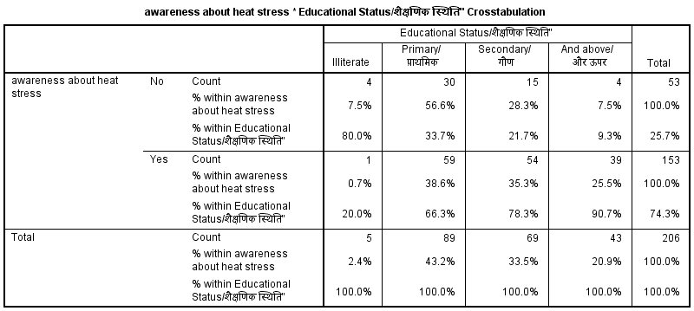
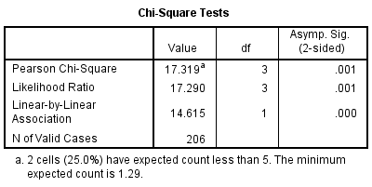
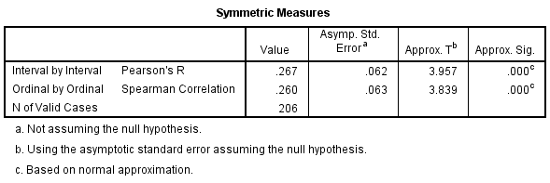
Results
The study analysis suggests a statistically significant association between educational status and awareness of heat stress. People with higher levels of education are more likely to be aware of heat stress compared to those with lower education levels.
Notes:
All three tests (Pearson Chi-Square, Likelihood Ratio, and Linear-by-Linear Association) have a p-value of 0.000, indicating a very strong association
Both coefficients are Positive (around 0.27) indicating a positive correlation. This means as educational status increases (higher education levels), awareness of heat stress also tends to increase.

Slide 20
Association of various risk factors to heat stress
Risk factors | Experienced Heat stress |  | Not Experienced Heat stress
AGE | N (679) | % | N (679) | %
0-4 | 15 | 34.09% | 29 | 65.91%
5-10 | 24 | 27.59% | 63 | 72.41%
11-20 | 28 | 29.17% | 68 | 70.83%
21-35 | 42 | 35.90% | 75 | 64.10%
36-65 | 74 | 24.67% | 226 | 75.33%
65 Above | 27 | 77.14% | 8 | 22.86%
GENDER
Male | 171 | 46.47% | 197 | 53.53%
Female | 39 | 12.54% | 269 | 86.50%
ALCOHOL
YES | 24 | 80.00% | 6 | 20.00%
NO | 186 | 28.66% | 463 | 71.34%
TOBACCO
YES | 57 | 77.03% | 17 | 22.97%
NO | 153 | 25.29% | 452 | 74.71%
BMI
Underweight | 45 | 21.03% | 169 | 78.97%
Normal | 143 | 32.50% | 297 | 67.50%
Overweight | 15 | 88.24% | 2 | 11.76%
Obese | 7 | 87.50% | 1 | 12.50%
Physical Activity
Sternous | 172 | 45.74% | 204 | 54.26%
Sedentary | 38 | 12.54% | 265 | 87.46%
Pre - existing conditions
Heart diseases | 13 | 25.00% | 1 | 1.92%
Hypertension | 18 | 34.62% | 0 | 0.00%
Diabetes | 10 | 19.23% | 2 | 3.85%
Respiratory disorders | 8 | 15.38% | 0 | 0.00%
Results
The study analysis suggests a statistically significant association between the following factors.
Signifying that overweight and obese males above 65 years consuming alcohol or tobacco having pre-existing conditions and performing sternous activities are more prone to heat stress.

Slide 21
Discussion
The findings of this study reveal the various strategies adopted by peri-urban communities in Delhi to manage heat stress-related health outcomes during hot weather conditions are well in place and effective.
The study identified a range of individual-level interventions, including remedies using herbs, plants, and coolant paste, food choices, drinking water from earthen pots, and clothing patterns and coverings to protect from heat. Community-level interventions included gathering under shade, visiting parks, placing water jars, distributing fruits and water, tree plantation, conserving wildlife, and utilizing services provided by NGOs and the government.
The study also highlighted the challenges faced by these communities, such as lack of access to proper physical infrastructure, financial resources, proper health conditions, and even natural resources. Additionally, the study found a statistically significant association between educational status and awareness of heat stress. People with higher levels of education were more likely to be aware of heat stress compared to those with lower education levels.
These findings suggest that there is a need for multi-pronged approach to address heat stress in peri-urban communities. This approach should include educating communities about heat stress and its health outcomes, as well as providing them with the resources they need to cope with extreme heat. Additionally, policymakers and public health officials should work to improve access to cooling centers, green spaces, and safe drinking water in these communities.

Slide 22

Limitations
This study has some limitations.
First, the study was conducted in a single city in India. The findings may not be generalizable to other peri-urban communities in India or other parts of the world.
Second, the study relied on self-reported data, which may be subject to recall bias.
Third, the study did not collect data on the long-term health effects of heat stress.
Future research directions
Future research should investigate the long-term health effects of heat stress in peri-urban communities.
Additionally, research is needed to develop and evaluate interventions to reduce heat stress in these communities.
Finally, research is also needed to identify the best ways to educate communities about heat stress and its health outcomes.

Slide 23
Recommendations
To enhance community resilience to heat stress in Delhi, several interventions could be considered:
Cool Roofing Solutions: A project in Delhi is exploring the use of heat-reflective paint on roofs to lower indoor temperatures. This passive cooling method could make households less vulnerable to extreme heat and improve their resilience against climate change risks.
Conversion of Community Centres into Cooling Stations: Another recommendation is to convert community centres and baraat ghars into cooling stations with supply of water and cooling options like fans and air coolers. This could provide relief for outdoor workers who are at major risk of heat stress.
Heat Action Plan: Implementing a Heat Action Plan that includes strategies such as establishing an early warning system, inter-agency coordination, capacity building/training programs, and public awareness and community outreach.
Addressing Vulnerable Groups: Special attention should be given to vulnerable groups such as outdoor workers, who are at a higher risk of heat stress. Measures could include adjusting work hours to avoid peak heat times.
Public Awareness and Community Outreach: Building public awareness about the risks of heat stress and ways to mitigate it is crucial. This could involve education campaigns and community outreach programs.

Slide 24
Suggestions for managing heat stress in urban settings:
Urban Planning: Careful city layout design is essential to address urban climate challenges. This includes considering the orientation and spacing of buildings to maximize shade and airflow.
Green Spaces: Incorporating more vegetation in urban areas can help reduce the urban heat island effect. This could include creating green roofs, vertical gardens, and city parks.
Building Materials: Optimizing building materials and colors can also help reduce heat absorption. For example, using light-colored concrete and white roofs can reflect more sunlight and keep buildings cooler.
Human-Nature Interactions: Promoting human-nature interactions is crucial for sustainable city climate management. This could involve creating more accessible green spaces and encouraging outdoor activities.
Shared Visibility of Climate Risk: Creating shared visibility of climate risk is important for effective heat stress management. This could involve using data and technology to map heat susceptibility and enhance heat resilience.
Community-Based Solutions: Implementing community-based solutions can help address heat stress at the neighborhood level. This could involve local-level adaptation strategies that reduce heat-related risk.

Slide 25

Conclusion
In conclusion, effectively addressing heat stress in peri-urban communities requires a multi-faceted approach.
Empowering communities through education and resource provision is crucial.
Policymakers and public health officials should focus on improving access to cooling centers, green spaces, and safe drinking water.
Collaborative efforts between communities, NGOs, and the government are essential to build resilience against the escalating threats posed by climate change and extreme heat.

Slide 26
References
India Today [Internet]. 2023 [cited 2024 Apr 20]. 90% of India in heatwave “danger zones”, extreme weather threatening country’s progress: Study. Available from: https://www.indiatoday.in/india/story/90-pc-india-heatwave-danger-zones-extreme-weather-threatening-country-progress-study-2362189-2023-04-20
Standard B. 90% of India, entire Delhi in “danger zone” of heat wave impacts: Study [Internet]. 2023 [cited 2024 Apr 20]. Available from: https://www.business-standard.com/india-news/90-of-india-entire-delhi-in-danger-zone-of-heatwave-impacts-study-123041901236_1.html
PricewaterhouseCoopers. PwC. [cited 2024 Apr 20]. A case study on the extreme heat action plan for India. Available from: https://www.pwc.com/gx/en/industries/healthcare/casestudies/heat-health-action-plan-in-India.html
Singh N, Mhawish A, Ghosh S, Banerjee T, Mall RK. Attributing mortality from temperature extremes: A time series analysis in Varanasi, India. Science of The Total Environment. 2019 May 15;665:453–64.
Guardaro M, Messerschmidt M, Hondula DM, Grimm NB, Redman CL. Building community heat action plans story by story: A three neighborhood case study. Cities. 2020 Dec 1;107:102886.
Perkins-Kirkpatrick SE, Gibson PB. Changes in regional heatwave characteristics as a function of increasing global temperature. Sci Rep. 2017 Sep 25;7:12256.
India Today [Internet]. 2022 [cited 2024 Apr 20]. Devastating heatwaves in India: Here’s all you need to know. Available from: https://www.indiatoday.in/diu/story/devastating-heatwaves-in-india-all-you-need-to-know-1962392-2022-06-14

Slide 27
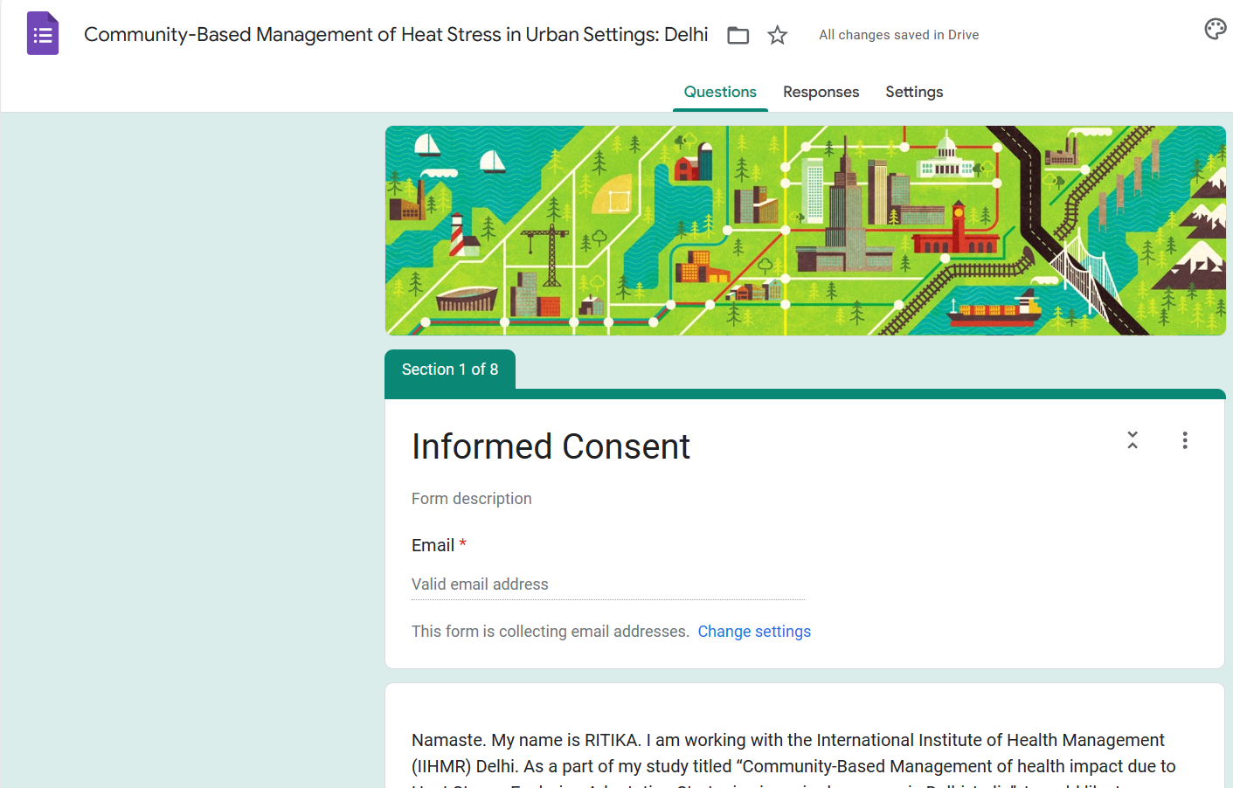
Annexures
https://docs.google.com/forms/d/e/1FAIpQLSekZCKq6Fzof_-8BApuddCIZhGdjDnhYVQVjeuvLE5Hzp5M6w/viewform?usp=sf_link

Slide 28


