Slide 1


Study on International Patient Division - International Patient Services at KIMS Hospitals, Secunderabad
Name : DR. Niharika Mahajan (PG/23/072)
Mentor: Dr. Altaf Yousuf Mir
IIHMR Delhi

Slide 2
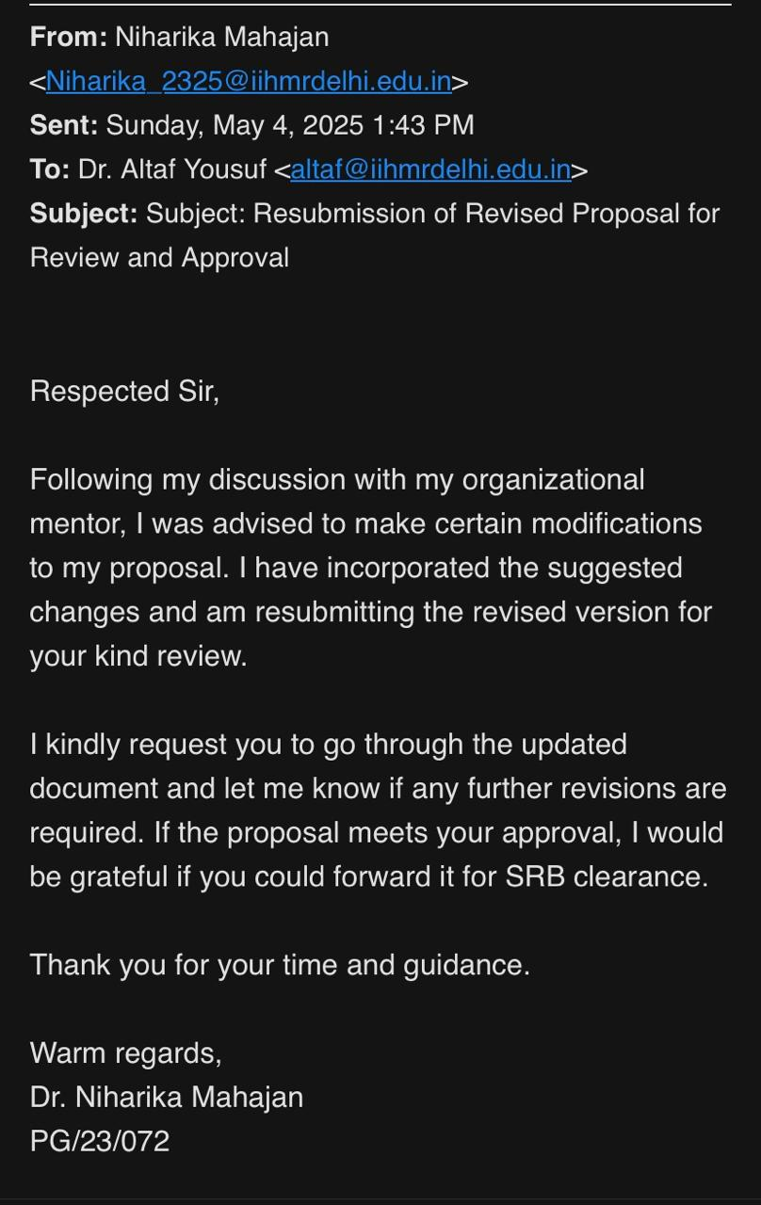
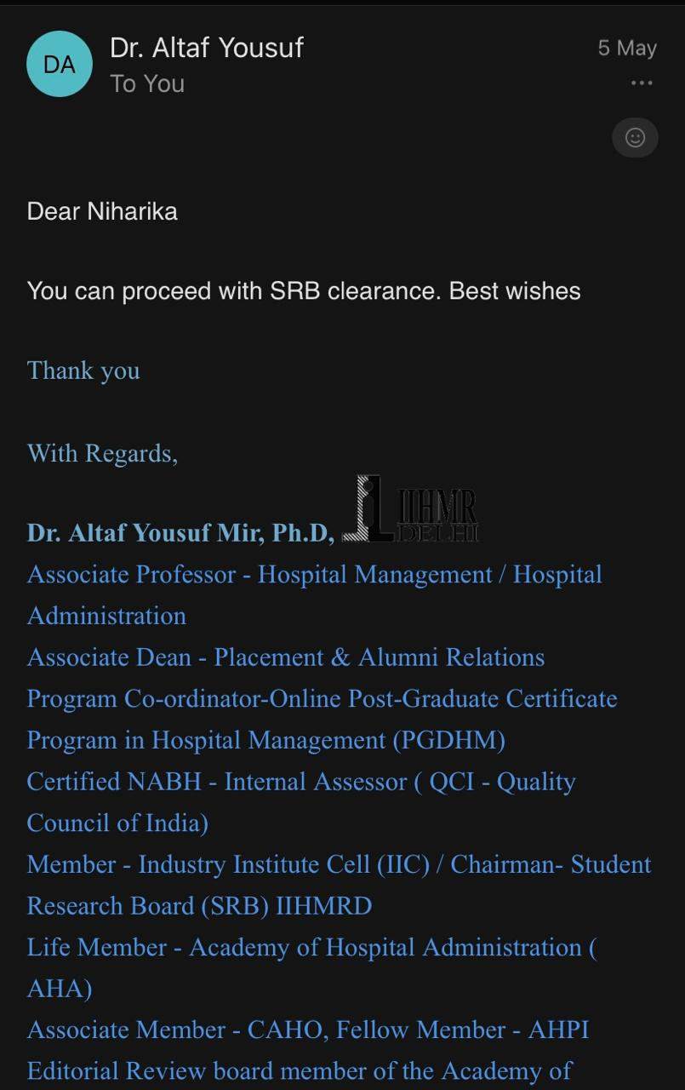
SRB Approval

Slide 3
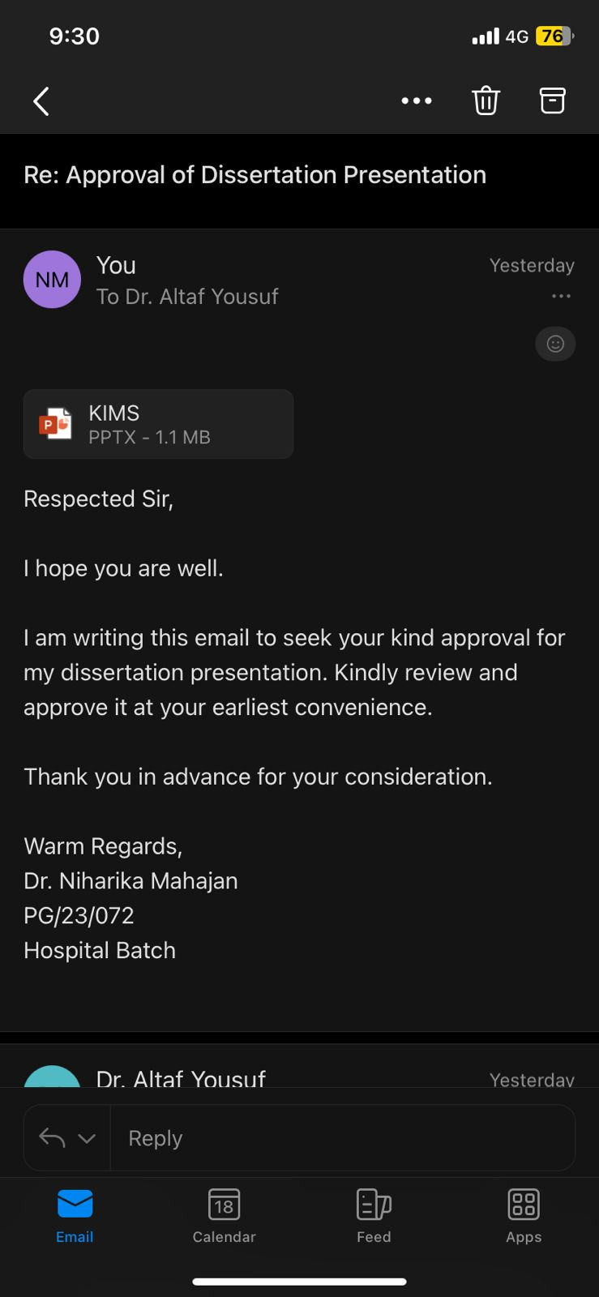
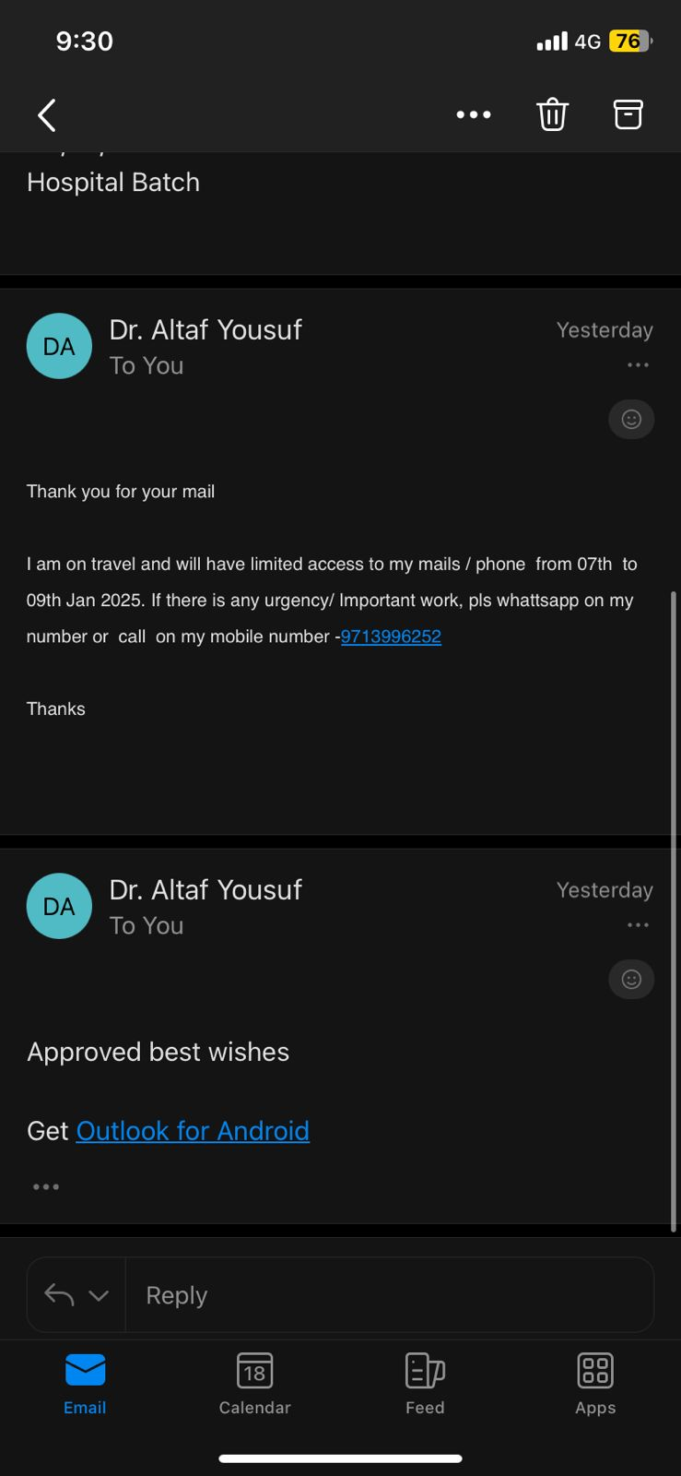
Mentor Approval

Slide 4
Introduction
Rising Importance of International Patient Services
With the global surge in medical tourism, hospitals in India are becoming key destinations for international patients.
To meet the complex needs of these patients, many institutions have created dedicated International Patient Divisions (IPDs).
IPDs handle every aspect of the patient journey — from medical coordination and travel logistics to financial guidance and post-treatment support.
However, this model also presents challenges: cultural sensitivity, language barriers, and coordination complexities.
This study focuses on KIMS Hospitals, Secunderabad, exploring how their International Patient Services (IPS) function to provide seamless, patient centered care.

Slide 5
Literature Review
Rise of medical tourismpoints covered: cagr >12% – deloitte, 2023india's strengths: affordability, skilled staff, techrise of international services in hospitals(1).
Role of international patient divisions (ipds)points covered: functions: coordination, pre-arrival consults, visas, interpreters, follow-upsvalue-based care concept(2).
International patient journeypoints covered: journey stages: contact → travel → treatment → follow-upbarriers: language, trust, cultural unfamiliarityimportance of cultural sensitivity(3).
Communication & trust buildingpoints covered: 24/7 helplines, multilingual staff, empathypersonalized communication = better outcomes(4).
Operational challenges in ipdspoints covered: departmental coordination, logistics, accreditationimportance of streamlined processes and training(5).
Competitive advantage of indian hospitalspoints covered: apollo, fortis, kims as case examplesintegrated services: translators, case managers, hospitalityholistic care models(6).
Economic impact of medical tourismmedical tourism contributes significantly to host countries' gdp and healthcare sector investment.according to bookman & bookman (2007), countries like india benefit not only from direct medical services but also from ancillary sectors like hospitality and travel.fetscherin & stephano (2016) suggest that medical tourism helps create employment in health and allied sectors(7).

Slide 6
Literature Review
Accreditation and quality: assuranceinternational accreditations (jci, nabh) serve as a quality signal to medical tourists.hanefeld et al. (2015) note that accreditation impacts patient trust and influences their choice of healthcare providers abroad.hospitals are aligning clinical outcomes with international standards to maintain competitive standing(8).
Technology and virtual health integration: telemedicine, virtual consultations, and online medical records have transformed how hospitals serve international patients pre- and post-treatment.connell (2013) noted that digital platforms bridge geographical gaps and enhance follow-up care.ai-enabled chatbots and crm systems are now assisting ipds in managing inquiries and patient navigation(9).
Patient satisfaction and service quality: parasuraman et al. (1988) proposed the servqual model, which is widely used to assess service quality in hospital settings, especially for international patients.dimensions like tangibles, reliability, responsiveness, assurance, and empathy are crucial in shaping perceptions.a study by heung, kucukusta & song (2010) found that service quality significantly influenced satisfaction and likelihood of return visits among medical tourists(10).
Ethical and legal considerations concerns around informed consent, continuity of care, and malpractice liability are often raised in international patient scenarios.turner (2007) emphasizes the need for international guidelines to protect medical tourists, especially from vulnerable populations.patients may face challenges when complications arise after returning home, leading to gaps in care continuity(10).
Patient-centric innovations in ipd design: hospitals are designing “medical concierge” services, personalized treatment packages, and cultural cuisine to enhance comfort.crooks et al. (2017) highlight how patient experience strategies—beyond clinical excellence—are now key competitive differentiators.these innovations contribute to both short-term satisfaction and long-term institutional reputation(11).

Slide 7
Objectives
Primary Objective:
To assess the satisfaction levels of international patients at kims hospitals, secunderabad, and evaluate the quality of services provided by the international patient division (ipd).
Secondary Objectives:
To identify key service strengths such as staff professionalism, communication, and support systems that positively influence patient satisfaction.
To examine common challenges faced by international patients and their impact on patient experience.
To provide recommendations for improving international patient services through better communication, cultural sensitivity, and coordinated care models.

Slide 8
Methodology
📘 Study Design
Descriptive approach
Focused on evaluating International Patient Division (IPD) services at KIMS Hospitals, Secunderabad
🧮 Sample Size
72 international patients
Calculated using Cochran’s formula for finite population
🧾 Data Collection Tools
Semi-structured questionnaire
Likert scales, Multiple choice, and Open-Ended Responses
📊 Data Collection Methods
Digital and In-Person form submissions

Slide 9
Methodology
👥 Target Group
International patients using IPD services
🔍 Data Analysis
Quantitative: descriptive statistics (e.g., satisfaction levels)
✅ Ethical Considerations
Informed consent obtained
Full confidentiality maintained

Slide 10
Result
Overall Satisfaction
Observations and Insights:
71% of respondents rated their experience as “Excellent", indicating a very high level of satisfaction with the services provided by kims ipd.
22% rated their experience as “Good", showing that nearly all patients were pleased with the overall service.
6% marked it as “Average", suggesting minor gaps in expectation vs. experience.
93% of patients rated their experience as “Excellent" or “Good", showcasing strong service delivery and patient satisfaction.

Slide 11
Result
Key Strengths Identified
Professionalism is a clear strength – 49 of patients rated staff professionalism as a key positive, indicating strong trust in hospital personnel.
Timely communication builds satisfaction – 47 of patients acknowledged quick responses, highlighting operational efficiency in patient interactions.
Well-defined processes improve experience – 40 praised the smooth process flow, suggesting streamlined hospital pathways from admission to discharge.
Perceived medical care quality needs emphasis – Only 35 rated medical care as a key strength, implying expectations may not have fully aligned with clinical outcomes or communication.
Cultural sensitivity is a notable gap – With just 22 recognizing it as a strength, there's a clear need for better language support, dietary options, and personalized services for international patients.

Slide 12
Result
Communication Smoothness
Insights & Observations: Communication Smoothness
Excellent Communication Experience – A significant majority (46 respondents) stated communication was always smooth, highlighting strong coordination across hospital touchpoints.
Moderate Inconsistency Exists – A combined 24 respondents chose "sometimes" (12) and "often" (12), suggesting some inconsistency in communication quality.
Minimal Dissatisfaction – Only 1 respondent each marked "never" and "rarely", indicating that complete breakdowns in communication are extremely rare.
Overall Trend is highly positive – With over 75% of responses in the “always” category, the data reflects a generally seamless communication flow between hospital staff and international patients.
Opportunity for improvement – While performance is strong, focusing on converting the “sometimes” and “often” group into “always” can help the hospital reach near-universal communication excellence.

Slide 13
Result
Procedure Clarity
Insights & Observations: Procedure Clarity
Strong procedural communication – A majority of respondents (44 individuals) felt that procedures were explained very clearly, indicating excellent staff guidance throughout the patient journey.
High clarity overall – With 26 patients stating that procedures were mostly clear, over 90% of respondents had a positive understanding of hospital processes.
Minimal ambiguity – Only 1 respondent each felt the procedure was "somewhat clear" or "not explained", suggesting that unclear communication is extremely rare.
Staff training appears effective – The data reflects the hospital’s success in training its team to consistently explain treatment protocols and steps to international patients.
Scope to achieve 100% clarity – While performance is excellent, targeted efforts to identify and support borderline cases can help move from “mostly clear” to “very clear” for all patients.

Slide 14
Result
Support Services
Insights & Observations: Support Services
Accommodation arrangement is the top-rated support – With 59 patients acknowledging this service, it reflects the hospital's strong efforts in providing comfort for international patients and their families.
Airport pickup is highly appreciated – Scoring 56, this shows how crucial seamless airport-to-hospital transition is in patient satisfaction and hospitality.
Language interpretation ranks third – With 51 acknowledgments, this highlights the importance of overcoming language barriers in medical communication.
Visa assistance remains a key strength – With 50 mentions, the hospital’s ability to help with medical visas is a significant contributor to ease of access and patient inflow.
Cultural support is slightly behind – Although still strong at 48, this relatively lower count suggests potential for improvement in customized care, food options, or religious/cultural accommodations.

Slide 15
Result
Challenges Faced
Insights & Observations: Challenges Faced
Majority reported no challenges – A strong 34 respondents (the highest) indicated they faced no issues, reflecting the hospital’s efficiency in managing international patient services.
Cultural barriers are the top concern – Mentioned directly or in combination in 19 cases, cultural differences remain the most significant challenge, underscoring the need for better cultural sensitivity training and services.
Communication gaps are notable – Reported by 12 respondents (9 standalone + 3 with cultural barriers), this points to occasional breakdowns in information flow between staff and patients.
Billing-Related Concerns Exist – A total of 9 responses (7 direct + 2 with cultural barriers) indicate some dissatisfaction or confusion related to billing, highlighting an area for administrative improvement.
Minimal Travel and Appointment delays – Only 1–2 cases each mention visa/travel issues or appointment delays, suggesting these are well-managed processes in the current system.

Slide 16
Result
Language Barrier
Insights & Observations: Language Barrier
Majority found language support fully adequate – A significant 42 respondents felt the hospital provided completely effective language assistance, indicating a robust interpretation or multilingual staff system.
Moderate room for improvement – 14 participants rated the support as “Mostly Adequate", suggesting occasional gaps in understanding or translation that could be enhanced.
Small fraction faced inadequacy – A few respondents (2 marked inadequate, 6 marked somewhat adequate) experienced communication difficulty, highlighting the need for expanded translator access or culturally aligned communication styles.
“Not Applicable” suggests variation in need – 7 patients likely did not require language assistance, possibly due to shared language or accompanied support, which reflects diversity in language dependency.
Overall Trend is Strongly Positive – With a combined 56 out of 72 respondents rating language support as fully or mostly adequate, the hospital demonstrates effective cross-linguistic communication, though fine-tuning for edge cases could bring it to excellence

Slide 17
Discussion
Key Interpretations:
An overwhelming 93% of international patients rated their experience as either “Excellent” (71%) or “Good” (22%), indicating a strong positive perception of services offered by KIMS Hospitals’ international patient division.
The high percentage of “Excellent” ratings suggests outstanding performance in areas such as medical care quality, process coordination, and staff professionalism.
A smaller segment, 6% rating the service as “average”, signals minor expectations gaps—possibly related to support services, communication clarity, or waiting times.
The near-absence of poor ratings reflects effective operational practices and patient-centric service delivery.

Slide 18
Discussion
Alignment with literature:
These findings support global studies in medical tourism, which emphasize the importance of cultural sensitivity (10), coordinated care(8), and responsive communication(12) in enhancing patient satisfaction.

Slide 19
Conclusion
Conclusion:
The research concludes that the international patient services at KIMS hospitals, secunderabad are well-structured and highly effective.
With over 9 out of 10 patients expressing high satisfaction, the ipd demonstrates excellence in managing international patient experiences.
Minor neutral feedback points to areas where further refinement can add value.

Slide 20
Recommendations
Focus on continuous quality monitoring
→ regularly analyse patient satisfaction trends to identify and respond to subtle service gaps.
Enhance communication touchpoints
→ provide multilingual orientation guides and digital handholding for patients pre-arrival and during treatment.
Streamline waiting and coordination protocols
→ explore automated alerts and centralized coordination dashboards to minimize perceived delays.
Deepen staff training in cultural competence
→ regular refresher sessions on cross-cultural engagement can further improve patient comfort and trust.

Slide 21
Tools
For data collection -
For analysis – ms excel
KIMS hospitals. International patient services. Available from: https://kimshospitals.Com/international-patients
https://ee.kobotoolbox.org/x/XVS7JhRr

Slide 22
References
Gupta S, Sharma R. Enhancing international patient experience in Indian hospitals: The role of communication and support services. Int J Health Care Qual Assur. 2021;34(6):541–555. doi:10.1108/IJHCQA-10-2020-0220.
Porter ME, Teisberg EO. Redefining health care: Creating value-based competition on results. Boston: Harvard Business Press; 2006.
World Health Organization. Global competency standards for health workers: Cultural sensitivity in cross-border health care [Internet]. Geneva: WHO; 2022 [cited 2025 Jun 18]. Available from: https://www.who.int/publications/i/item/9789240037742.
Heung VCS, Kucukusta D, Song H. A conceptual model of medical tourism: Implications for future research. J Travel Tour Mark. 2010;27(3):236–251. doi:10.1080/10548401003744677.
Hanefeld J, Horsfall D, Lunt N, Smith R. Medical tourism: A cost or benefit to the NHS? PLoS One. 2015;10(10):e0136377. doi:10.1371/journal.pone.0136377.
Fetscherin M, Stephano RM. The medical tourism index: Scale development and validation. Tourism Management. 2016;52:539–556. doi:10.1016/j.tourman.2015.07.017.
Connell J. Contemporary medical tourism: Conceptualisation, culture and commodification. Tourism Management. 2013;34:1–13. doi:10.1016/j.tourman.2012.05.009.
Johnston R, Crooks VA, Snyder J, Kingsbury P. What is known about the effects of medical tourism in destination and departure countries? Int J Equity Health. 2010;9:24.
Parasuraman A, Zeithaml VA, Berry LL. SERVQUAL: A multiple-item scale for measuring consumer perceptions of service quality. J Retail. 1988;64(1):12–40.
Connell J. Contemporary medical tourism: Conceptualisation, culture and commodification. Tourism Manag. 2013;34:1–13. doi:10.1016/j.tourman.2012.05.009.

Slide 23
References
10. Hanefeld J, Lunt N, Smith R, Horsfall D. Medical tourism: A cost or benefit to the NHS? PLoS One. 2013;8(10):e70406.
11. Heung VCS, Kucukusta D, Song H. A conceptual model of medical tourism: Implications for future research. J Travel Tour Mark. 2010;27(3):236–251. doi:10.1080/10548401003744677.
12. Connell J. Contemporary medical tourism: Conceptualisation, culture and commodification. Tour Manag. 2013;34:1–13.
13. Turner L. ‘First world health care at third world prices’: Globalization, bioethics and medical tourism. BioSocieties. 2007;2(3):303–325. doi:10.1017/S1745855207005765
14. Crooks VA, Kingsbury P, Snyder J, Johnston R. What is known about the patient’s experience of medical tourism? A scoping review. BMC Health Serv Res. 2017;17:788. doi:10.1186/s12913-017-2737-1.
15. Lunt N, Smith RD, Exworthy M, Green ST, Horsfall D, Mannion R. Medical tourism: Treatments, markets and health system implications. OECD; 2011.
16. Deloitte. 2023 Global Healthcare Outlook – Medical Tourism Trends. Deloitte Insights.

Slide 24
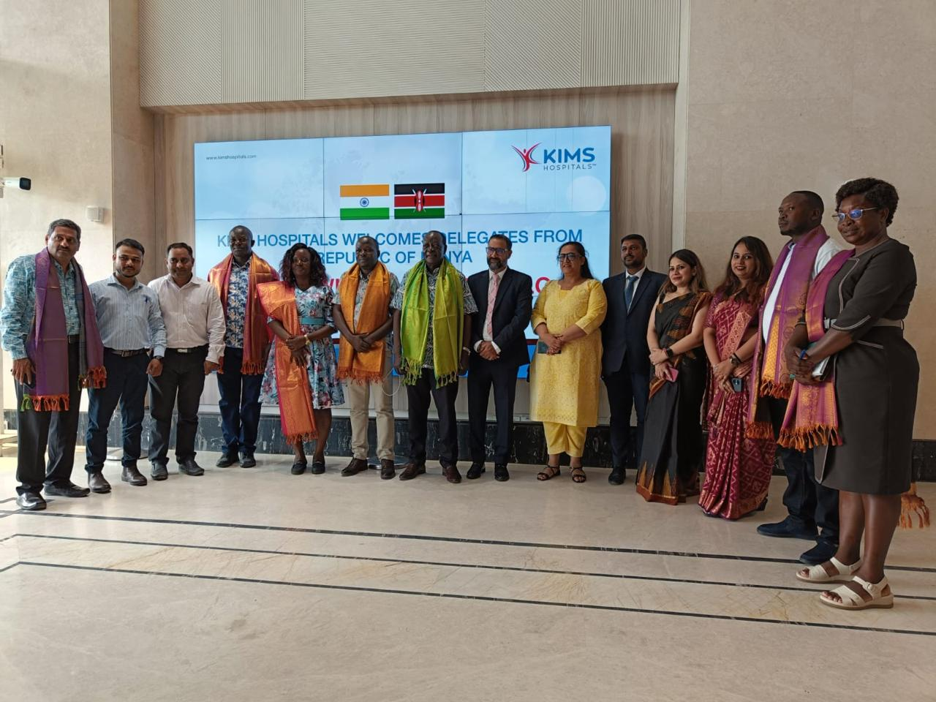

Slide 25
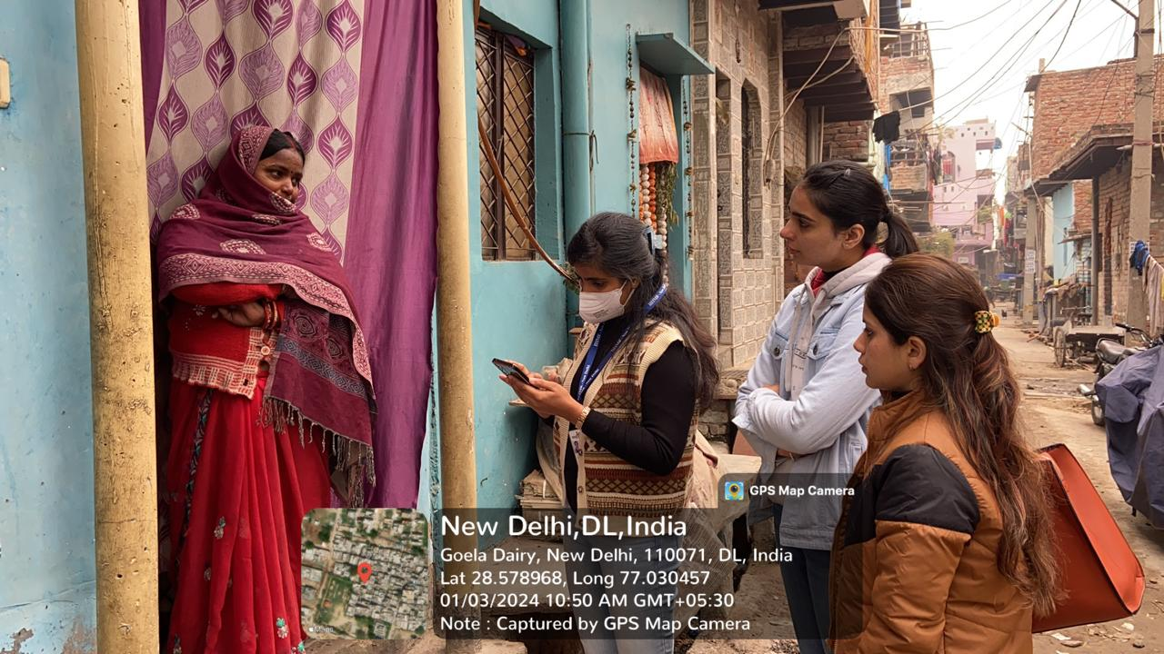
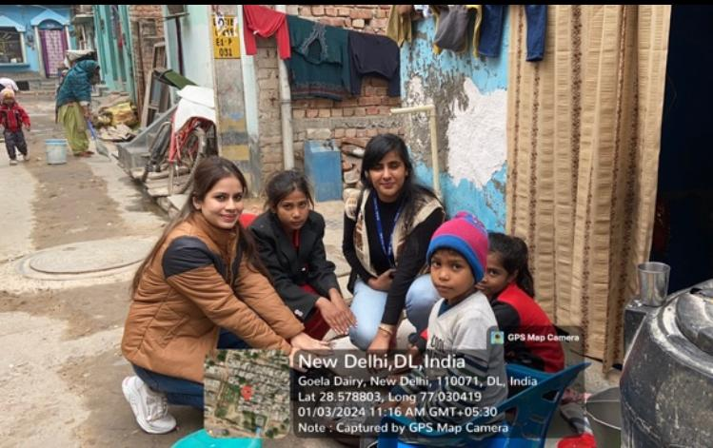
Involvement in Community Outreach Programme (COP) Activities.
Location: Goyla dairy
Activities done:
Data collection
Interaction with community health workers.
Key learnings:
Understanding field level challenges.
Community layout

Slide 26
Thank You
Any Questions

