Slide 1


Awareness of Hospital Staff on Biomedical Waste (BMW) Management
DISSERTATION PRESENTATION BY
JUNAIT MALHOTRA
Mentor - Dr. NIDHI YADAV
PGDM (Hospital and Health Management)
2023-2025
International Institute of Health Management Research, New Delhi

Slide 2

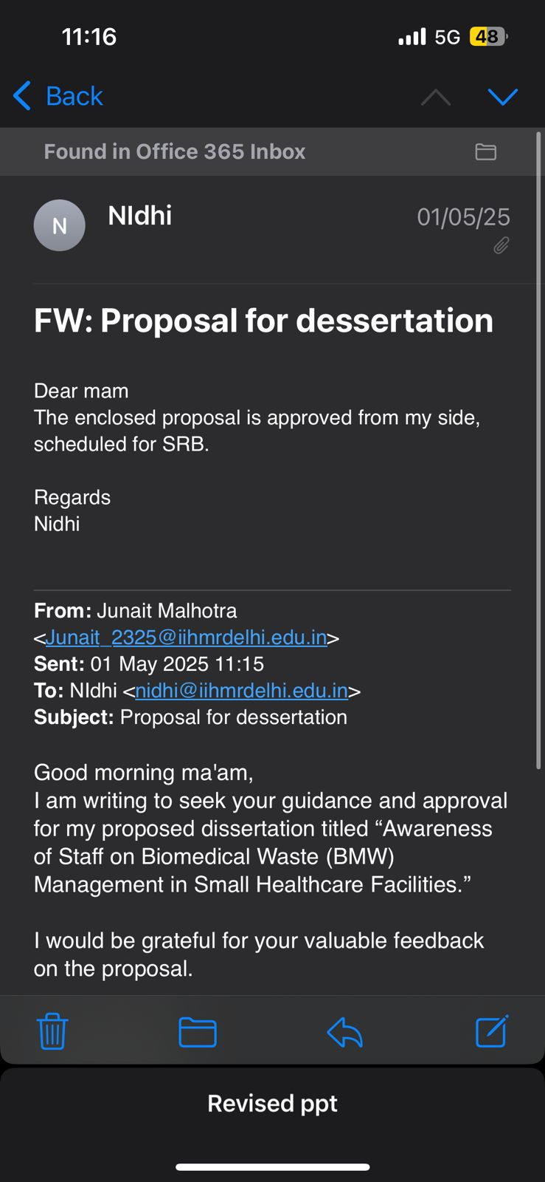
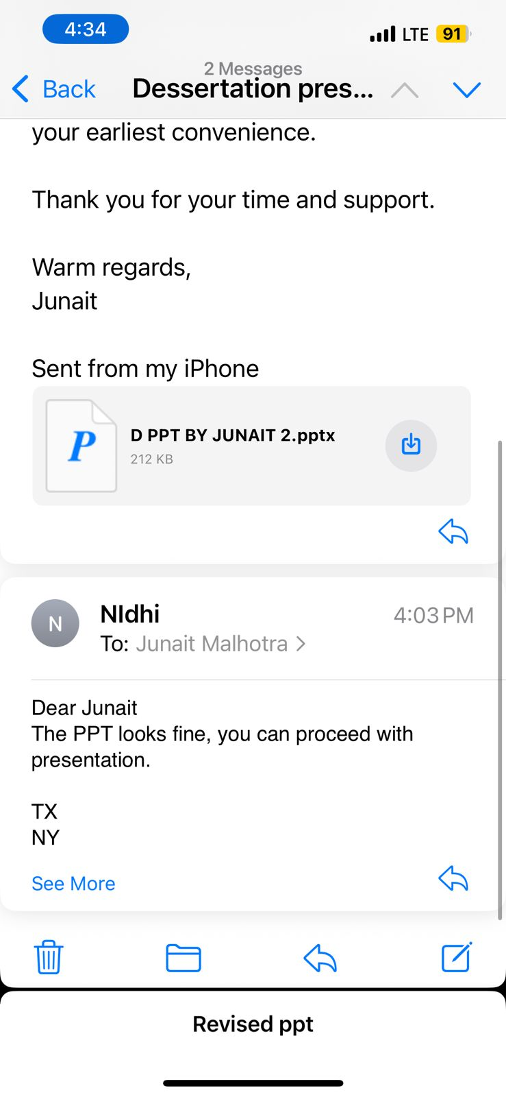
Mentor Approval
SRB Approval
Final Approval

Slide 3
Introduction
Biomedical Waste (BMW) management is a critical component of healthcare operations, essential for ensuring environmental safety and infection control. Effective BMW handling minimizes health risks to healthcare workers, patients, and the broader community. However, small healthcare facilities often face unique challenges due to limited resources, training, and regulatory oversight.
This study aims to assess the current level of awareness regarding BMW management among healthcare staff in small healthcare facilities. It also seeks to identify knowledge gaps and common misconceptions in BMW handling practices. Based on the findings, the study provides recommendations to strengthen awareness and enhance training initiatives to ensure compliance with established protocols and promote safe waste disposal practices.

Slide 4
Objectives of Your Study
To assess the current level of awareness on Biomedical Waste (BMW) management among healthcare staff in small healthcare facilities.
To identify knowledge gaps and common misconceptions in BMW handling practices.
To provide recommendations for awareness-building and training based on the findings.

Slide 5
Methodology (1/3)
Study Design:
Cross-sectional study conducted to assess awareness of Biomedical Waste (BMW) management.
Study Population Includes:
Doctors, Nurses, Lab Technicians
Radiographers, Dental Assistants
Housekeeping
Sampling Technique:
Convenience sampling from selected small healthcare facilities located in Delhi, specifically those tied up with Quantzo Consultancy.

Slide 6
Data Collection Tool:
Methodology (2/3)
A validated, structured multiple-choice questionnaire designed to assess:
Knowledge of BMW categories
Segregation and disposal protocols
Legal and regulatory compliance
Safety practices
Data Collection Method:
Self-administered questionnaires distributed:
In-person to on-site staff
Online, wherever applicable, for remote participants

Slide 7
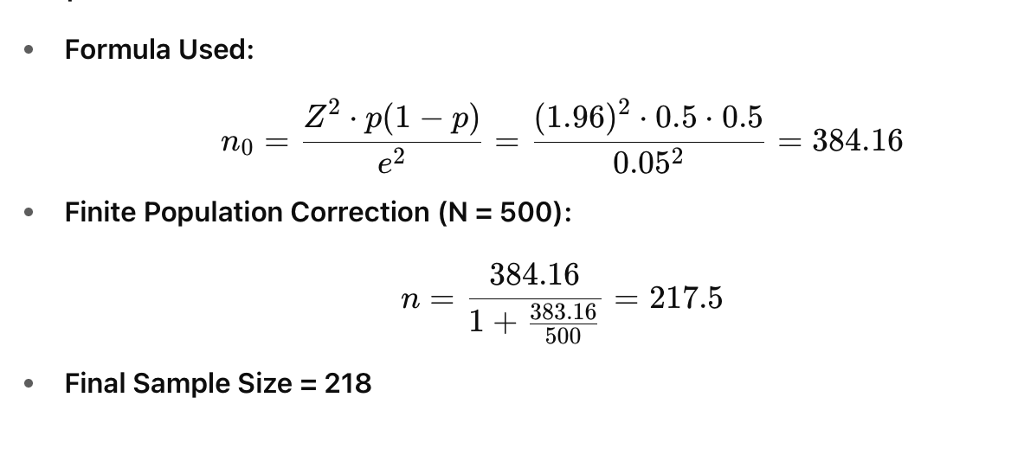
Sample Size Calculation
Methodology (3/3)
Sample Size Calculation:

Slide 8
Demographic variables
ROLE | Population | PERCENTAGE
NURSE | 67 | 30.7
Dental asstent | 34 | 15.6
Doctor | 55 | 25.2
PERA MEDICAL STAFF | 8 | 3.7
Housekeeping | 44 | 20.2
Medical Admin | 10 | 4.6
designation
AGE | Count | Percentage
18-25 | 130 | 59.6
26-30 | 48 | 22
31-35 | 28 | 12.8
36-40 | 8 | 3.7
41-45 | 4 | 1.8
Age
Gender
MALE | 119
FEMAIL | 99

Slide 9
QUESTIONNAIRE(1/5)
BMW Questionnaire
GENERAL BMW KNOWLEDGE
What is Biomedical Waste (BMW)?
A) General office waste
B) Waste generated from diagnostic and treatment procedures in healthcare settings
C) Kitchen waste from hospitals
D) Non-hazardous plastic waste
What Personal Protective Equipment (PPE) should be worn while handling biomedical waste?
A) Gloves only
B) Gloves and apron only
C) Gloves, gown, mask, and eye protection
D) Only mask

Slide 10
QUESTIONNAIRE(2/5)
2. WASTE SEGREGATION AND DISPOSAL
Which color-coded bin is used for disposing of infectious waste, like dressings and cotton swabs?
A) Yellow
B) Red
C) Blue
D) Black
Sharps such as needles and scalpels should be disposed of in:
A) Blue bag
B) Cardboard box
C) Puncture-proof container
D) Plastic bottle
The red bag is used for disposing of:
A) Expired medicines
B) Human anatomical waste
C) Contaminated plastic waste (IV sets, tubing)
D) Soiled linen

Slide 11
QUESTIONNAIRE(3/5)
BMW Questionnaire
2. WASTE SEGREGATION AND DISPOSAL
Cytotoxic drugs and radioactive materials should be disposed of in:
A) Red bin
B) Black bin
C) Yellow bin with special labelling D) Green bin
The correct way to handle a needle after use is:
A) Recap the needle and throw it in a dustbin
B) Break the needle and throw it in a cardboard box
C) Do not recap, dispose in sharps container immediately
D) Wrap it in gauze and discard in black bag

Slide 12
QUESTIONNAIRE(4/5)
BMW Questionnaire
3. REGULATORY COMPLIANCE
BMW should be treated and disposed of within how many hours of generation (as per guidelines)?
A) 24 hours
B) 48 hours
C) 12 hours
D) 72 hours
Which authority enforces biomedical waste management rules in hospitals?
A) Hospital administration
B) Central Pollution Control Board (CPCB)
C) Local Municipal Corporation
D) Health Ministry and State Pollution Control Boards

Slide 13
QUESTIONNAIRE(5/5)
BMW Questionnaire
4. SAFETY PROTOCOL
The primary risk associated with poor biomedical waste management includes:
A) Budget overrun
B) Environmental pollution and transmission of diseases
C) Staff absenteeism
D) Poor hospital reputation

Slide 14
Results (1/2)
Mean and Median Interpretation:
The mean score of 7.66 and median of 8 indicate that most participants demonstrated a moderate to high level of awareness regarding Biomedical Waste (BMW) management
2. Standard Deviation Insight:
A standard deviation of 1.71 shows a moderate spread of scores around the mean
This indicates that while most participants were close to the average performance, a few deviated either significantly higher or lower.
3. Overall Interpretation:
The result indicates a generally good awareness level among healthcare workers in small facilities.
However, the variation in scores emphasizes the need for standardizing training and ensuring consistent knowledge across all roles, especially among housekeeping and support staff
 | A
N | 218
Missing | 0
Mean | 7.66
Median | 8
Standard deviation | 1.71
Minimum | 3
Maximum | 10

Slide 15
Results (2/2)
Findings
Strengths:
High awareness in General BMW Knowledge and Safety Protocols (89% each).
Good knowledge in Waste Segregation and Disposal (85.2%).
Weaknesses:
Low awareness in Regulatory Compliance (38%) indicating lack of clarity about rules, documentation, and authority roles (e.g., CPCB, SPCBs).
Questionnaire Analysis:
Most participants correctly answered basic questions about types of waste and PPE.
Misunderstandings were noted in areas like authority responsibility and disposal timelines.

Slide 16
Discussion (1/1)
This study shows moderate to high awareness of BMW management among staff in small healthcare facilities (mean: 7.66/10, median: 8),. However, lower scores among housekeeping staff highlight the need for targeted training (Singh et al., 2018).
High awareness in General BMW Knowledge and Safety Protocols (both 89%) reflects global trends. A WHO review (2019) links such strengths to regular drills, and segregation awareness (85.2%) aligns with global success using color-coded systems (Pande et al., 2020). These suggest that visual aids and protocols enhance compliance, as also supported by CDC guidelines.
However, Regulatory Compliance awareness remains low (38%), Confusion about CPCB/SPCB roles mirrors findings by Pandit et al. (2019), indicating that legal awareness needs more context-based training.

Slide 17
Recommendations
Focus on Regulatory Training:
  Conduct dedicated sessions on BMW 2016 Rules, the roles and responsibilities of DPCB, legal obligations, and documentation processes.
  Emphasize penalties for non-compliance and the importance of adhering to legal standards.
Regular Refresher Programs:
  Implement quarterly training sessions for all staff covering BMW categories, segregation methods, disposal timelines, and any updated protocols.
  Use visual aids, color-coded posters, videos, and real-life scenarios to make the training more interactive and impactful.
Monthly Training for Third-Party/Outsourced Staff:
  Ensure monthly orientation and training sessions for all housekeeping staff, waste handlers, and other third-party personnel involved in BMW handling.
  Include practical demonstrations and basic assessments to verify understanding.

Slide 18
Conclusion
Healthcare staff in small healthcare facilities show moderate to high awareness of BMW management.
Major gap found in regulatory compliance:
Only 38% had adequate understanding of BMW Rules 2016, DPCB roles, and legal documentation.
Quantitative analysis (mean score 7.7/10) shows:
Most staff are knowledgeable.
Some staff scored low (minimum score 3), indicating a need for retraining.

Slide 19
References
Singh A, Sharma RK, Sharma M. Awareness and management of biomedical waste in small healthcare facilities: A study of staff perceptions. J Environ Health Sci. 2018;10(2):45–50.
World Health Organization. Health-care waste: Key facts [Internet]. Geneva: WHO; 2019 [cited 2025 Jun 25]. Available from: https://www.who.int/news-room/fact-sheets/detail/health-care-waste
Pande T, Patel A, Sharma S. Impact of color-coded segregation on biomedical waste management: A cross-sectional study in urban India. Int J Community Med Public Health. 2020;7(4):1505–9.
Centers for Disease Control and Prevention. Guidelines for environmental infection control in health-care facilities[Internet]. Atlanta: CDC; 2020 [cited 2025 Jun 25]. Available from: https://www.cdc.gov/infectioncontrol/guidelines/environmental/index.html
Pandit N, Desai R, Shah S. Gaps in understanding regulatory frameworks for biomedical waste disposal among healthcare workers. Natl J Community Med. 2019;10(1):25–9.

Slide 20
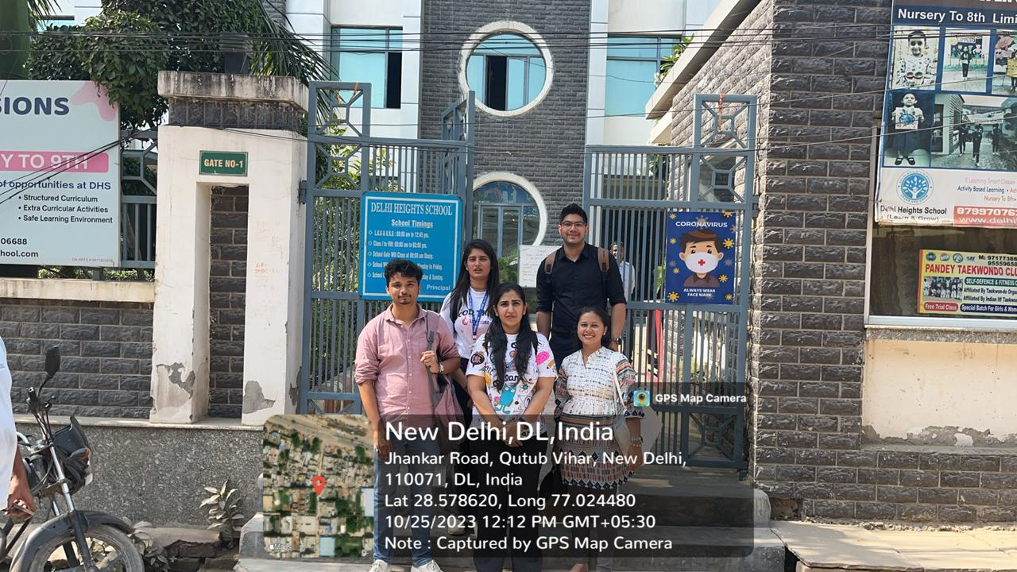
INVOLVEMENT IN COMMUNITY OUTREACH PROGRAMME (COP) ACTIVITIES
Total no. of visits done by the student: 8 (Goyala Dairy)
Activities done by student:
Mapping and listing of the area
Interaction with community FLWHs
Data collection

Slide 21
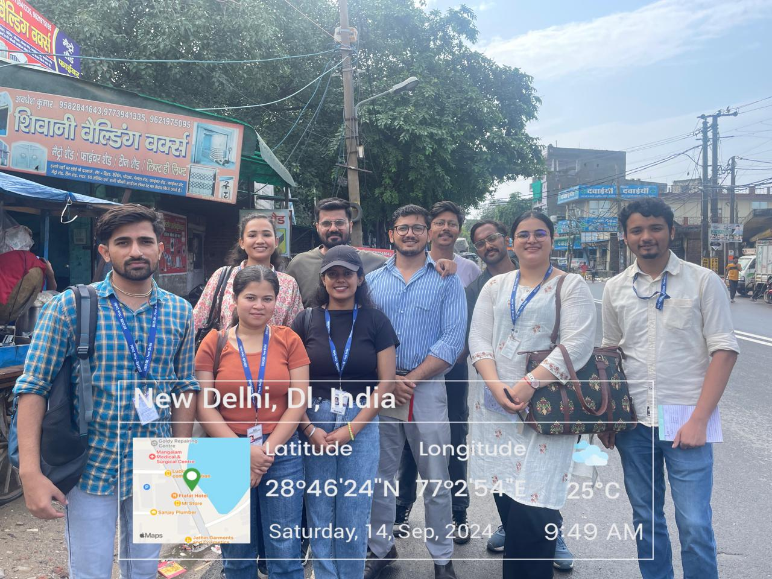
KEY LEARNINGS FROM COP ACTIVITIES
Understood community layout
Patience and Persistence are Required
Building Trust is Essential
Communication Must Be Two-Way and Culturally Sensitive
Measuring Impact and Seeking Feedback is Vital

Slide 22
Thank You

