Slide 1
Internship Report
&
Dissertation Study
Presentation By:
Vineetha S Pai
PG/13/075

Slide 2
Implementation of Clinical Nutrition Module
&
Study on Satisfaction rate among end users Post Implementation
Presentation By:
Vineetha S Pai
PG/13/075

Slide 3

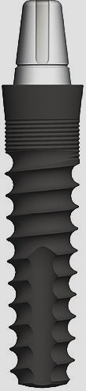

Agenda
Organization Profile
Internship Report
  Project Overview
  Activity & Time Allocation
  Project Plan
  Lessons Learned
Dissertation Report
  Need of the Study
  Objective
  Literature Review
  Methodology
  Results
  Discussion Points
  Conclusion
  Recommendations
Internship Report & Dissertation Study

Slide 4

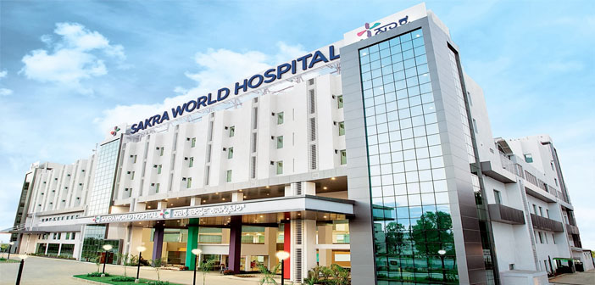
Organization Profile - Sakra World Hospital
350 bedded hospital, situated in Bangalore
Joint Venture: Kirloskar, ToyotaTsusho and Secom Hospitals
Mission
  Providing High Quality care through cutting edge technology and highly skilled man power. Caring beyond the treatment include complete after-care. Being responsible for the patient’s well being and continuous enhancement of his quality of life
Vision
  We commit to medical care that enhances the quality of human life
Internship Report & Dissertation Study

Slide 5
Organization Profile – Contd…
Four Pillars of Hospital
  Skills
  Technology
  Ethics
  Family Atmosphere
Core Values
  Safety
  Team Practice
  Trust
  Integrity
  Honesty
  Empathy
  Respect
  Excellence
  Ethics
Internship Report & Dissertation Study

Slide 6
Internship Report
Internship Report & Dissertation Study

Slide 7
Project Overview
Internship Period: 19th February 2015 to 19th May 2015
Project: Implementation of Clinical Nutrition Module
Expected Outcome: To Successfully Implement the clinical nutrition, F&B and Support services module
End-users: Nurses, Nutritionists, F&B Staff
Clinical Nutrition Module include
  Diet Chart for Nurses
  Diet & Nutrition For nutritionists
  Food & Beverages for F&B staffs
Internship Report & Dissertation Study

Slide 8
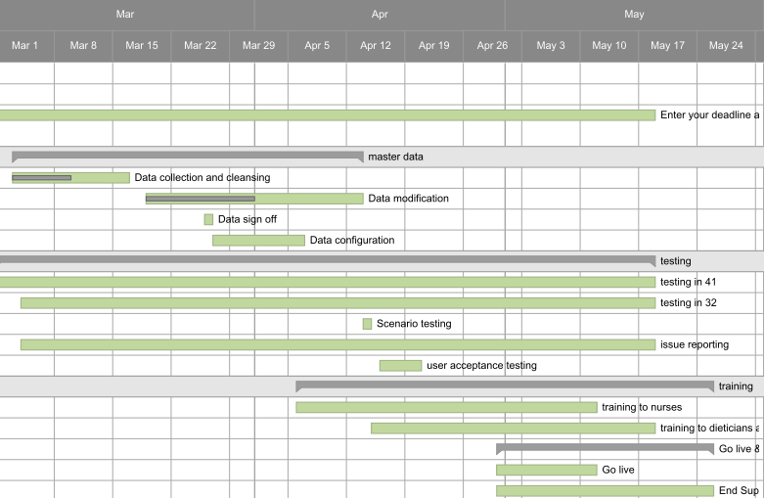
Activity & Time Allocation
Internship Report & Dissertation Study

Slide 9
Project Plan
Initial Phase
  Held meeting with the Head of the Department IT, Senior Manager IT, Deputy Manager IT and Head of the Department Clinical nutrition.
Planning Phase
  Data were collected and resources, training, go live and risk management were planned and communicated with all stake holders
Execution Phase
  Master data were configured, training to the super users and end users were conducted. Application was tested and issues were logged and resolved. End user support was provided during Go live
Closing Phase
  Survey was conducted among end users
Internship Report & Dissertation Study

Slide 10
Lessons Learned
Configuration the Master Data for implementing the module
Planning and executing the implementation of HIS. (Details regarding the project planning and execution mentioned below)
Testing and testing process of the software to ensure quality
Learned Work flow of Nutrition Department and prepared training plan, materials. Training and evaluating end users (User Guide is mentioned below)
Post Go Live support, Issue handling and maintenance
Internship Report & Dissertation Study

Slide 11
Dissertation Report
Study on Satisfaction rate among end users Post Implementation
Internship Report & Dissertation Study

Slide 12

Need of the Study
Purpose
  End user satisfaction is significant for successful implementation of any information system. This study will help us to understand the satisfaction rate among the end users after the implementation of Clinical Nutrition Module.
Research Questions
  Are nurses satisfied in diet referral?
  Are nutritionists satisfied in preparing diet Plan for Patients?
  Are F&B staffs satisfied in module?
  Are there fewer complaints in Food dispatch?
  Is there time saving for dieticians post implementation?
Internship Report & Dissertation Study

Slide 13
Objective
General Objective
  To study the satisfaction rate of staff members after implementing Clinical Nutrition Module.
Specific Objectives
  To study the satisfaction rate among nurses post implementation
  To study the satisfaction rate among nutritionists post implementation
  To study the satisfaction rate among F&B staffs post implementation
Internship Report & Dissertation Study

Slide 14
Literature Review
Assessment Of End User Satisfaction Of Hospital Information System, Dr Rajesh Kumar Sinha, et al
Diet Pal: A web based dietary menu generating and management system, Noah SA et al
A Survey on the Users’ Satisfaction with the Hospital Information Systems (HISs) based on DeLone and McLean’s Model in the Medical-Teaching Hospitals in Isfahan City, Sakineh saghaeiannejad-Isfahani et al.
Is the ICU staff satisfied with the computerized physician order entry? A cross-sectional survey study, Renata Rego Lins Fumis at all
Measurement of CPOE end user satisfaction among ICU physicians and nurses, P.L.T Hoonakker et al
Internship Report & Dissertation Study

Slide 15
Methodology
Study Area:
  Study was performed in a 350 bedded hospital of Wards, Clinical Nutrition and Food & beverages Department in the hospital
Research Approach:
  Quantitative
Study Design:
  Descriptive Cross Sectional Study
Study Population
  55 staff members including nurses, nutritionist, F&B staff
Sampling Method
  Convenient Sampling
Expected Outcome:
  Satisfaction rate among staff members after implementing the Clinical nutrition and F&B Module
Internship Report & Dissertation Study

Slide 16
Methodology – Contd...
Time Frame:
  20th February 2015 to 19th May 2015
Data Collection Method:
  Structured Questionnaire
  5 Point Likert Scale
Data Sources:
  Primary Data Source: Structured Questionnaire
Data Analysis:
  Done with Statistical Package for Social Science (SPSS)
Limitations of the Study:
  Small sample size- 55 staffs were taken as sample size
  No review of Literature is available for comparing the research study
Internship Report & Dissertation Study

Slide 17
Results – Respondents Profile
 |  | Nurses (N=40) | Nutritionists (N=5) | F&B Staff (N=10)
Gender | Male | 15 | 0 | 8
 | Female | 25 | 5 | 2
Age Group | 21-30 | 31 | 3 | 2
 | 31-40 | 9 | 2 | 4
 | 41-50 | 0 | 0 | 4
Qualification | Diploma | 16 | 0 | 0
 | Graduation | 18 | 0 | 6
 | Post Graduation | 6 | 5 | 4
Clinical Experience | > 1 Year | 10 | 1 | 0
 | 1- 3 Years | 9 | 2 | 2
 | 3- 7 Year | 12 | 2 | 3
 | < 7 Years | 9 | 0 | 5
Internship Report & Dissertation Study

Slide 18
Results – Nurses
 | Strongly Agree | Agree | Neutral | Disagree | Strongly Disagree | Mean
Module is user friendly | 8 (20%) | 26(65%) | 6 (15%) | 0 (0%) | 0 (0%) | 4.05
Decrease in incidence related to wrong food dispatch to patients | 10(25%) | 20 (50%) | 7 (17.5%) | 3(7.5%) | 0 (0%) | 3.92
Module make easier to track the diet changes throughout the patient stay | 11(27.5%) | 23(57.5%) | 5 (12.5%) | 1 (2.5%) | 0 (0%) | 4.1
Post Implementation manual process | 10(25%) | 17(42.5%) | 5 (12.5%) | 7 | 1 (2.5%) | 3.7
Post implementation increases productivity | 11(27.5%) | 17(42.5%) | 10(25%) | 2 (5%) | 0 (0%) | 3.92
Diet plan of a patient can be viewed from the HIS | 16(40%) | 24(60%) | 0 (0%) | 0 (0%) | 0 (0%) | 4.4
Over all satisfaction with the module | 11(27.5%) | 23(57.5%) | 6(15%) | 0 (0%) | 0 (0%) | 4.12
Easy Communication with dietician and F&B | 17(42.5%) | 20 (50%) | 3(7.5%) | 0(0%) | 0(0%) | 4.35
Require Enhancement/Modification | 7 (17.5%) | 18(45%) | 11(27.5%) | 4(10%) | 0(0%) | 3.7
Internship Report & Dissertation Study

Slide 19
Results - Nutritionists
 | Strongly Agree | Agree | Neutral | Disagree | Strongly Disagree | Mean
Module is User friendly | 0(0%) | 1(20%) | 1 (20%) | 1(20%) | 2(40%) | 2.2
Reduction in manual process | 0 (0%) | 1 (20%) | 1 (20%) | 3 (60%) | 0(0%) | 2.6
Reduction in total time taken to plan the diet | 0(0%) | 1(20%) | 1 (20%) | 1 (20%) | 2(40%) | 2.2
Easy communication with F&B | 0(0%) | 2 (20%) | 2(20%) | 0(0%) | 1 (20%) | 3
Able to track full diet plan and diet changes of patients | 1 (20%) | 2(20%) | 1 (20%) | 0(0%) | 1 (20%) | 3.4
Diet plan can be made easily | 0(0%) | 2(20%) | 1 (20%) | 1 (20%) | 1 (20%) | 2.8
Post implementation increases productivity | 1 (20%) | 0(0%) | 1 (20%) | 3 (60%) | 0(0%) | 2.8
Satisfied with using Clinical nutrition module | 1 (20%) | 2(20%) | 1 (20%) | 1 (20%) | 0(0%) | 2.6
Require Enhancement/Modification | 4(80%) | 1 (20%) | 0(0%) | 0(0%) | 0(0%) | 4.8
Internship Report & Dissertation Study

Slide 20
Results – F&B Staff
 | Strongly Agree | Agree | Neutral | Disagree | Strongly Disagree | Mean
Module is User friendly | 3 (30%) | 4(40%) | 3 (30%) | 0 (0%) | 0 (0%) | 4
Decrease in incidence related to wrong food dispatch to patients | 0(0%) | 2 (20%) | 8(80%) | 0(0%) | 0(0%) | 3.2
Module make easier to track the diet through out the patient stay | 1 (10%) | 8(80%) | 1 (10%) | 0(0%) | 0(0%) | 4
Post Implementation reduces paperwork /manual process | 0(0%) | 8(80%) | 2 (20%) | 0(0%) | 0(0%) | 3.8
Post implementation makes diet dispatch easier | 3 (30%) | 5(50%) | 2(20%) | 0(0%) | 0(0%) | 4.1
Satisfied with F&B Module | 2(20%) | 8(80%) | 0(0%) | 0(0%) | 0(0%) | 4.2
Easier to view Diet reports in the Module | 8(80%) | 2(20%) | 0(0%) | 0(0%) | 0(0%) | 4.8
Require enhancements/modifications | 0(0%) | 2(20%) | 8(80%) | 0(0%) | 0(0%) | 2.7
Internship Report & Dissertation Study

Slide 21
Discussion Points - Nurses
Module is User friendly: Mean = 4.05, Agree
Decrease in incidence related to wrong food dispatch to patients: mean = 3.92, Agree
Module make easier to track the diet changes throughout the patient stay, mean = 4.1, Agree
Post Implementation reduces manual process: Mean = 3.7, Agree
Post implementation increases productivity: Mean = 3.92, Agree
Diet plan of a patient can be viewed from the HIS, Mean = 4.4, Agree
Over all satisfaction with the module: Mean = 4.12, Agree
Easy Communication with dietician and F&B : Mean =4.35, Neutral
Require Enhancement/Modification in Module: mean = 3.7, Agree
Internship Report & Dissertation Study

Slide 22
Discussion Points - Nutritionists
Module is User friendly : Mean = 2.2, Disagree
Reduction in manual process: Mean = 2.6, Neutral
Reduction in total time taken to plan the diet : Mean=2.2, Neutral
Easy communication with F&B: Mean=3, Neutral
Able to track full diet plan and diet changes of patients: Mean =3.4, Neutral
Diet plan can be made easily: Mean = 2.8, Neutral
Post implementation increases productivity, Mean = 2.8, Neutral
I am satisfied with using Clinical nutrition module, Mean = 2.6, Neutral
Require Enhancement/Modification in Module, Mean = 4.8, Strongly Agree
Internship Report & Dissertation Study

Slide 23
Discussion Points – F&B Staff
Module is User friendly: Mean = 4, Agree
Decrease in incidence related to wrong food dispatch to patients: Mean = 4, Agree
Module make easier to track the diet through out the patient stay: Mean =4, Agree
Post Implementation reduces manual process: Mean = 3.8, Agree
Post implementation makes diet dispatch easier: Mean = 4.1, Agree
I am satisfied with F&B Module: Mean = 4.2, Agree
Easier to view Diet reports in the Module: Mean = 4.8, Strongly agree
Require enhancements/modifications: Mean = 2.7, Neutral
Internship Report & Dissertation Study

Slide 24
Conclusion
Nurses are satisfied with diet referral
F&B Staffs are Satisfied
Nutritionists responses are Neutral
Nutritionists are not satisfied in preparing Diet plan
According to nutritionists, Process is time consuming
Less complaints in food Dispatch
Internship Report & Dissertation Study

Slide 25
Recommendations
Smart Choice option when adding an item for a particular Meal type
Discharge patient name should be shown in another colour
Vegetarian and Non Vegetarian need some colour code
Require more diet category like neutropenic, low fat low salt, combinations like diabetic & Renal etc. required.
Tick Box should be included in the screen Diet IP counselling work list
Bar Coded Diet Sticker
Internship Report & Dissertation Study

Slide 26
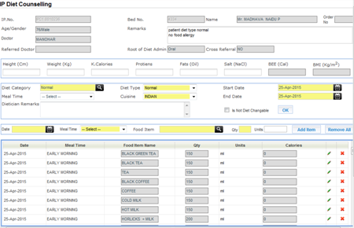
Root Cause Analysis -
Nutritionist Dissatisfaction
  Configured Menu is not used
  Adding items consumes more time
  Delete items
Internship Report & Dissertation Study

Slide 27


Immediate Loaded 1-Piece Implants: Prospective Study

Slide 28

Immediate Loaded 1-Piece Implants: Prospective Study

