Slide 1

INSURANCE PATIENTS DISCHARGE ANALYSIS
Sitaram Bhartia Institute Of Science And Research
Report By : Dr Ridhima Kataria
Mentor- Dr. Sumant Swain
Assistant professor
IIHMR Delhi

Slide 2
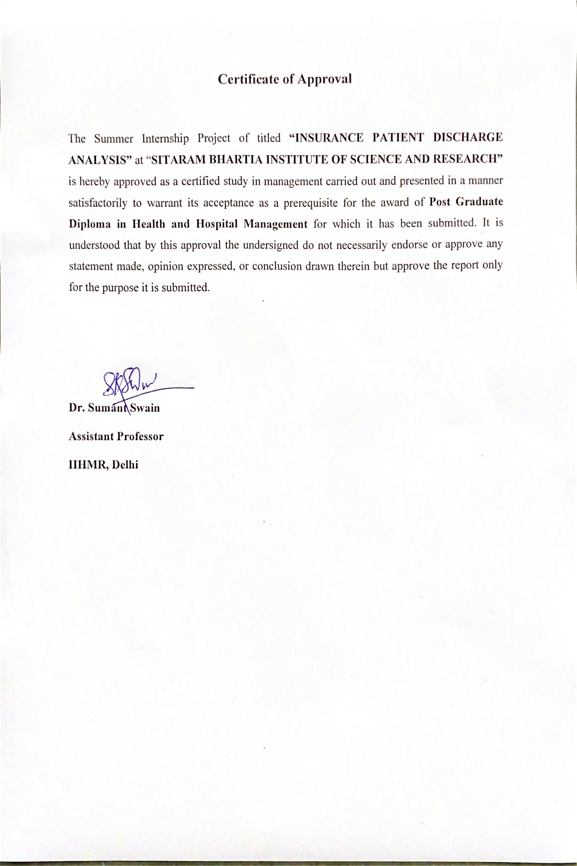
Screenshot of Approval

Slide 3
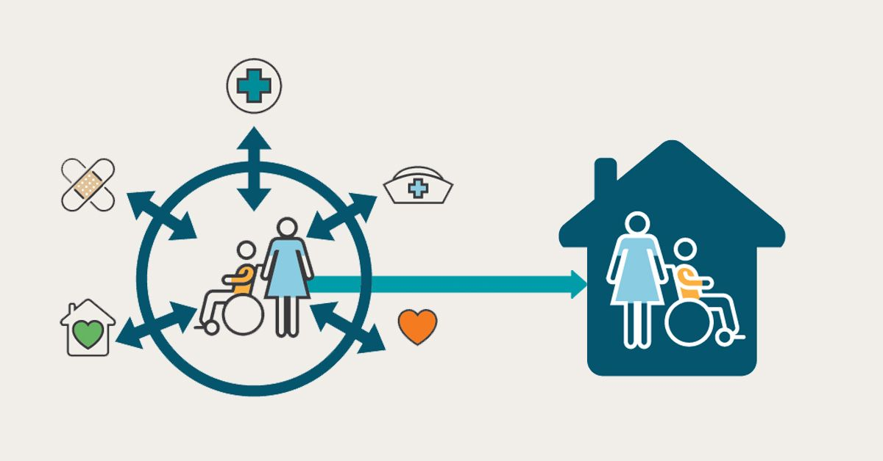
Introduction
Patient satisfaction is a common and important indicator for measuring the quality of healthcare in a health setting.
Patient satisfaction affects clinical outcome, patient retention and the over all image of the hospital.
One of the factor that affects patient satisfaction is timely discharge of in patient from the hospital care.
Hospital discharge process may seem relatively simple and straightforward, but it involves various layer of services provided by multiple health and social care workers , who need to co-ordinate their specialist activities to make the process possible.

Slide 4

Discharge time taken by hospitals is an important indicator to access the efficiency and quality of hospital.
Maintaining an acceptable level of discharge time is very important, which is usually judged by turn around time (TAT).
It is observed that TAT for patients who are insured is more than uninsured patients, there are various others reasons for it which will be discussed in this research report.

Slide 5
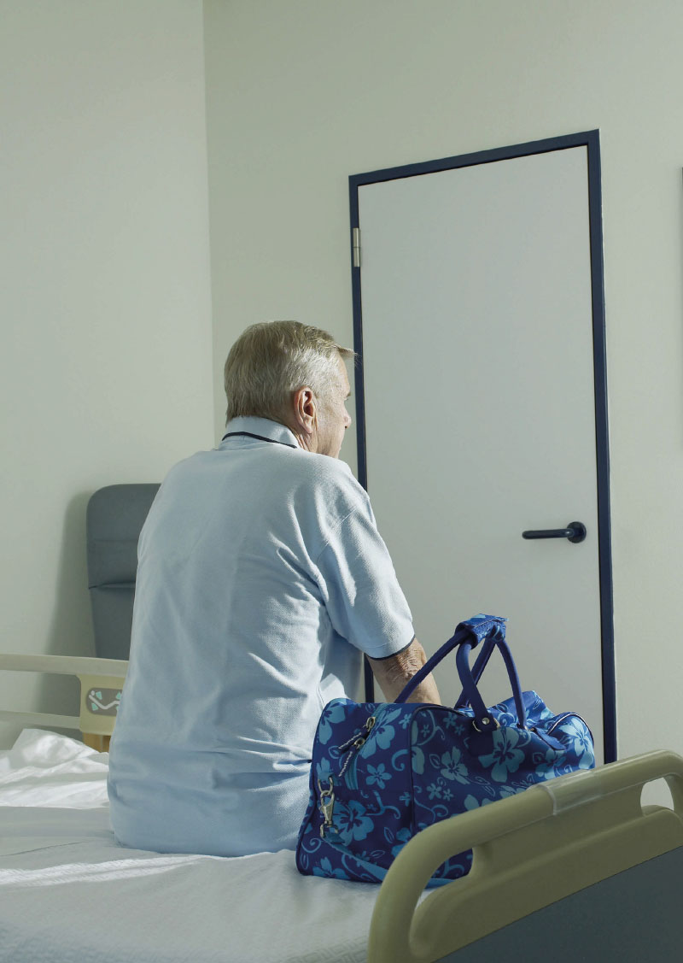
Objective
OBJECTIVE OF STUDY
The main aim of the study is to study the following aspects in Sitaram Bhartia Institute of Science and Research.
Study the work flow of discharge process of TPA patient.
Find out reason for the delay in the discharge of TPA process.
To recommend measures to reduce discharge time in TPA patients.

Slide 6
Methodology
Study design and setting: This study was conducted on TPA discharge for the month of March and April 2022 at Sitaram Bhartia Institute of Science and Research.
STUDY DURATION : 2 MONTHS
Mode of data collection: “PRIMARY” Mode of collection of data. Data was tracked and maintained using excel sheet.
Sample size: A sample size of 240 insured patient were taken to carry out the study
A track sheet was then prepared to record the data of TAT(turn around time) during various steps of discharge process. The whole discharge process was sub divided according to the TAT for the respective step
TAT 1 | Nursing and Pharmacy
TAT 2 | Billing
TAT 3 | TPA processing
TAT 4 | Patient

Slide 7
STEPS IN TPA DISCHARGE AT SITARAM BHARTIA

Slide 8
Results
Total time taken and number for TPA discharges in a specific period of time
TOTAL TIME TAKEN FOR DISCHARGE | MARCH | APRIL
LESS THAN 2 HR | 14 | 12
2-5 HR | 99 | 51
5-7 HR | 24 | 20
MORE THAN 7 HR | 13 | 7
PERCENTAGE
Fig 3 : The above bar graph shows that in March and April , 9% and 13% of patient discharges were done in less than 2 hours, 66% and 57% was done in 2-5 hours, 16% and 23% was done in 5-7 hours , 9% and 7% was done in more than 7 hours respectively.

Slide 9
Number of non compliance in each Department TAT after analysis
Turn Around Time (TAT) | MARCH’22 | APRIL’22
TAT 1 (Nursing and Pharmacy) | 38 | 15
TAT 2 (Billing) | 10 | 9
TAT 3 (TPA processing) | 47 | 40
TAT 4 (Patient) | 54 | 25
Fig : The above bar graph shows that non compliance for March and April for Nursing and Pharmacy was 25% and 17%, in Billing was 6% and 17%, in TPA processing was 31% and 44% and from patient side was 36% and 28% respectively.

Slide 10
Results
Percentage of delay from the side of each Department in March and April

Slide 11
Discussion
REASONS FOR DELAY IN TPA DISCHARGE
Less number of planned discharges in hospital. Only 40% of all discharges in March to April were planned.
2. Delay due to Nursing and pharmacy :
Changes in discharge summary by primary doctor.
Post dressing and medicine after the discharge is been made
Delay in multi-speciality cases where there is involvement of primary and secondary doctor
Delay in discharge summary finalising due to doctor unavailability
After medicine indent delay due to pharmacy

Slide 12
3. Reasons for delay caused due to billing
Change in medicine, medicine indent in discharge summary
3-4 discharges at same time caused delay in billing process
Delay in receiving OT chargesheet
Man power shortage after 6 pm.
Delay due to discharge summary
4. Maximum delay in discharge is due to TPA processing.
This factor is considered as an external factor and an uncontrollable factor, as it is the time taken by external TPA to give approval of the submitted bill and the discharge summary.
Most of the time, the delay is also due to the communication gap between the in-house TPA department and External TPA .
External TPA sends “QUERY” which has to be answered by internal TPA.
5. Delay in discharge was due to patients side.
take time to vacate the room
Time taken to do final settlement.

Slide 13

Limitations of Study
In this study, only time is considered as a measure of efficiency.
Other factors such as
nursing, training in discharge
planning and management
role of pharmacists in discharge
management and communication
within the discharge process are not considered due to the limitation of time.

Slide 14
Suggestions/Recommendation
Almost 40% of patients discharge time takes about more than 5hrs which is not according to the standard set by the hospital.
Discharge planning - at the time of admission or at least 24 hrs before discharge
One point of contact during discharge for all departments- discharge manager should be appointed.
Good coordination between primary and secondary doctors in multi speciality cases
Interim Bill must be adequately updated time to time in the HIS.
Integrating new Health Information System to fasten and ease the discharge.
Increase in the billing man power specially post 6 pm to reduce the work load.
Training modules to be available to train new/junior doctors to fill in the pre authorisation form, query replies.
During room orientation explaining and counselling the patient and attendants about the importance of vacating the room on time and request them to do so during discharge.
Patient and attendant should be informed well in advance the estimated date and time of discharge to avoid any further delays
A clearance charts and hospital planning checklist must be regularly monitored to keep a track of all delays and control these immediately

Slide 15
Conclusion
Discharge of patients is one of the important area that needs improvement in hospital.
In order to reduce the delay in discharge ,the hospital needs proper cooperation and coordination of other department staffs.
One of the cause of delay in the discharge process of insured patients is the time taken to prepare discharge summaries.
The second cause is considered as external but up to some extent, it is controllable if pre authorisation form and query replies are done in correct way.
The study also indicated that increasing the number of planned discharges can help reduce the total TAT for discharge and can make the process smooth and well planned.
A clearance charts and hospital planning checklist must be regularly monitored to keep a track of all delays and control these immediately

Slide 16
References (Only Vancouver Style)
1. | Researchgate.net. [cited 2022 Jun 28]. Available from: https://www.researchgate.net/publication/332142504_INSURED_PATIENTS'_DISCHARGE_DELAYS_CAUSES_AND_SOLUTIONS
2. | Arthi MS, Divya S. A study on causes of delay in discharge process in one of the prominent hospitals in Tamilnadu [Internet]. Ijcrt.org. [cited 2022 Jun 28]. Available from: https://www.ijcrt.org/papers/IJCRT2004012.pdf
3. | Sarkar DN, Professor and Dean - Academics, NSHM College of Management and Technology, Durgapur., Nath MT, Junior Executive - Operations, The Mission Hospital, Durgapur. Analysis of patient waiting time for hospital admission and discharge process. Int J Adv Res (Indore) [Internet]. 2016;4(8):1097–108. Available from: http://www.journalijar.com/uploads/321_IJAR-11829.pdf
4. | Researchgate.net. [cited 2022 Jun 28]. Available from: https://www.researchgate.net/publication/273340797_Role_of_discharge_planning_and_other_determinants_in_total_discharge_time_at_a_large_tertiary_care_hospital

Slide 17
A STUDY ON INSURANCE PATIENT DISCHARGE DELAY : CAUSES AND SOLUTION
INTRODUCTION
MEHTHOLOGY
DATA ANALYSIS
CONCLUSION
Patient satisfaction is an important indicator for measuring the quality of healthcare. One factor that affects patient satisfaction is timely discharge of in patient.
Time taken by the hospital from the moment doctor announces discharge to the time patient leaves the hospital is analyzed by calculating Turn Around Time (TAT)
The standard TAT for discharge of Insurance patient is usually 5-6 hours but it is observed that a marked delay.
The reasons for delay was found through this study and suggestion were recommended to improve which can potentially bring down the TAT close to its benchmark.
Study design and setting: This study was conducted on TPA discharge for the month of March and April 2022 at Sitaram Bhartia Institute of Science and Research.
Mode of data collection: “PRIMARY” Mode of collection of data. Data was tracked and maintained using excel sheet.
Sample size: A sample size of 240 insured patient were taken to carry out the study.
DISCHARGE WORKFLOW AT HOSPITAL
The cause of delay in the discharge process of insured patients is the time taken for discharge summaries to reach the in-house TPA department, and the time taken by external insurance companies to give the approval after submitting the final bills and discharge summaries.
The second cause is considered as external ie time taken by external TPA for giving approval and delays due to queries raised by TPA,
The study indicated that increasing in the number of planned discharges can help reduce the total TAT for discharge and can make the process smooth.
Planned and Unplanned discharge
Non Compliance in each TAT
RECOMMENDATION
Discharge planning to be done on the day of admission or least 24 hours before discharge.
One point of contact during discharge for all departments - a Discharge Manager to be appointed to take care of the entire discharge procedure.
Interim Bill must be adequately updated time to time
During room orientation explaining and counselling the patient and attendants about the importance of vacating the room on time and request them to do so during discharge.
Training module to train new/junior doctors to fill pre authorisation forms and query replies.
Vital information can be revealed to prepare a external TPA “Check List”
Integrating new Health Information System in hospital
Increase in the billing man power specially post 6 pm to reduce the work load.
TAT 1:Nursing, Pharmacy ; TAT 2:Billing TAT3:TPA processing TAT 4: Patient
OBJECTIVE
Study the work flow of discharge process of TPA patient.
Find out reason for the delay in the discharge of TPA process.
To recommend measures to reduce discharge time in TPA patients.
Delay Stakeholders in March and April
REFRENCE
Kasturi Shukla , Shweta Mehta, Jatesh Nair, Sunil Rao article on discharge time a crucial quality indicator, is dependent on several other factors like clearance time and patient related issues.
Ms.S.Arthi and S.Divya published an article on The major area that needs to be streamlined in hospital is discharge process of patients which is directly related to patients satisfaction.
Dr. Niloy Sarkar , and Ms. Tatini Nath article on The main objective of the study is to identify the gaps, highlight those areas where delay can be eliminated and recommend accordingly, so that the hospital admission and discharge process can be managed smoothly.

Slide 18
Thank You
Any Questions

Slide 19
Internship Experiences
Learning during Internship
Overall self comments on Internship
Understanding basic operations, non clinical department and working of hospital
Working of OPD and IPD
Workflow of discharge in TPA and cash patient.
Learnt the Role of different departments in discharge.
Doing gap analysis for quality improvement.
Learnt how to do Patient counselling
Under the leadership of my mentor in the hospital I observed and learnt the basic leadership skills to run the department, hospital and for patient satisfaction
The duration of my internship in Sitaram Bhartia help me learn , improve and enhance my knowledge on health and hospital care also patient handling.
This experience helped me build a solid foundation for my future as a healthcare manager.

Slide 20
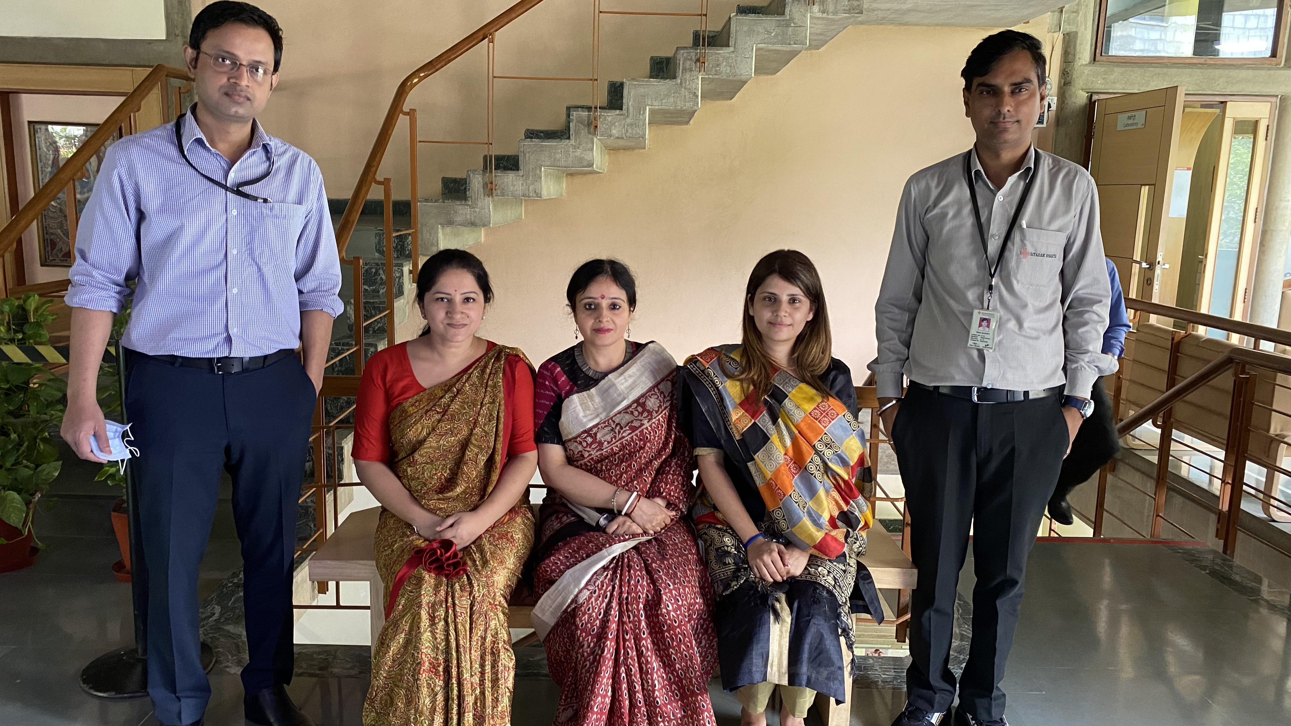

Pictorial Journey
PATIENT SERVICES CORE TEAM

Slide 21
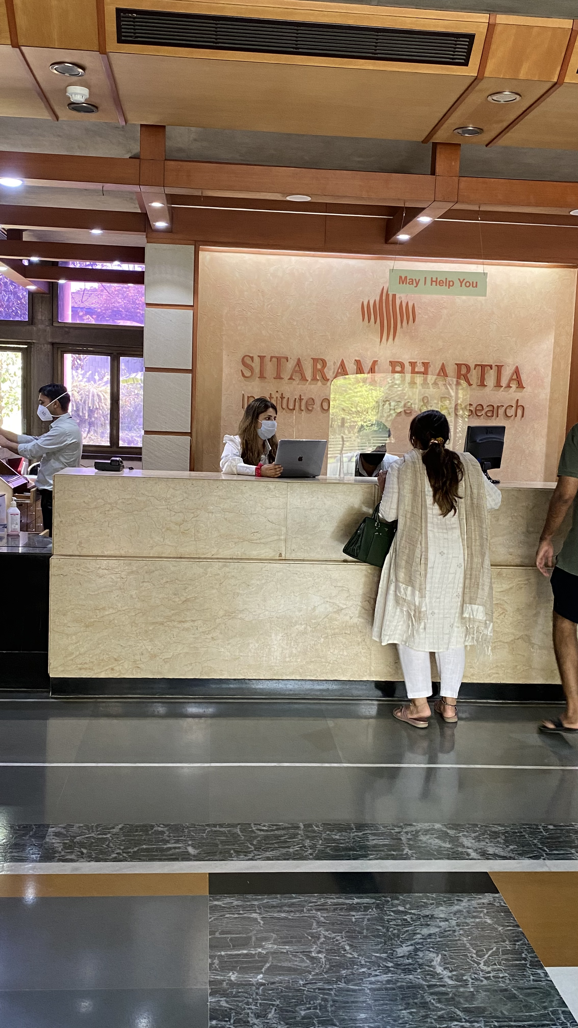
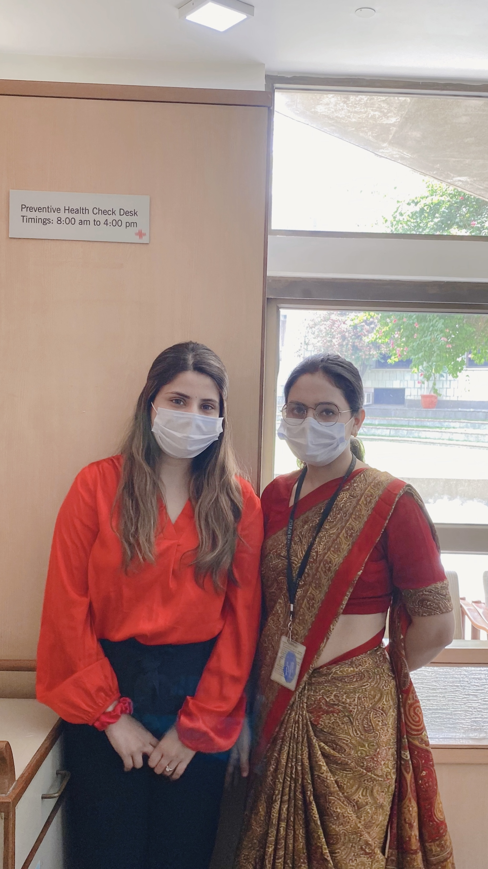
Pictorial Journey
Understanding the working of IPD,OPD and PHC department in hospital

