Slide 1


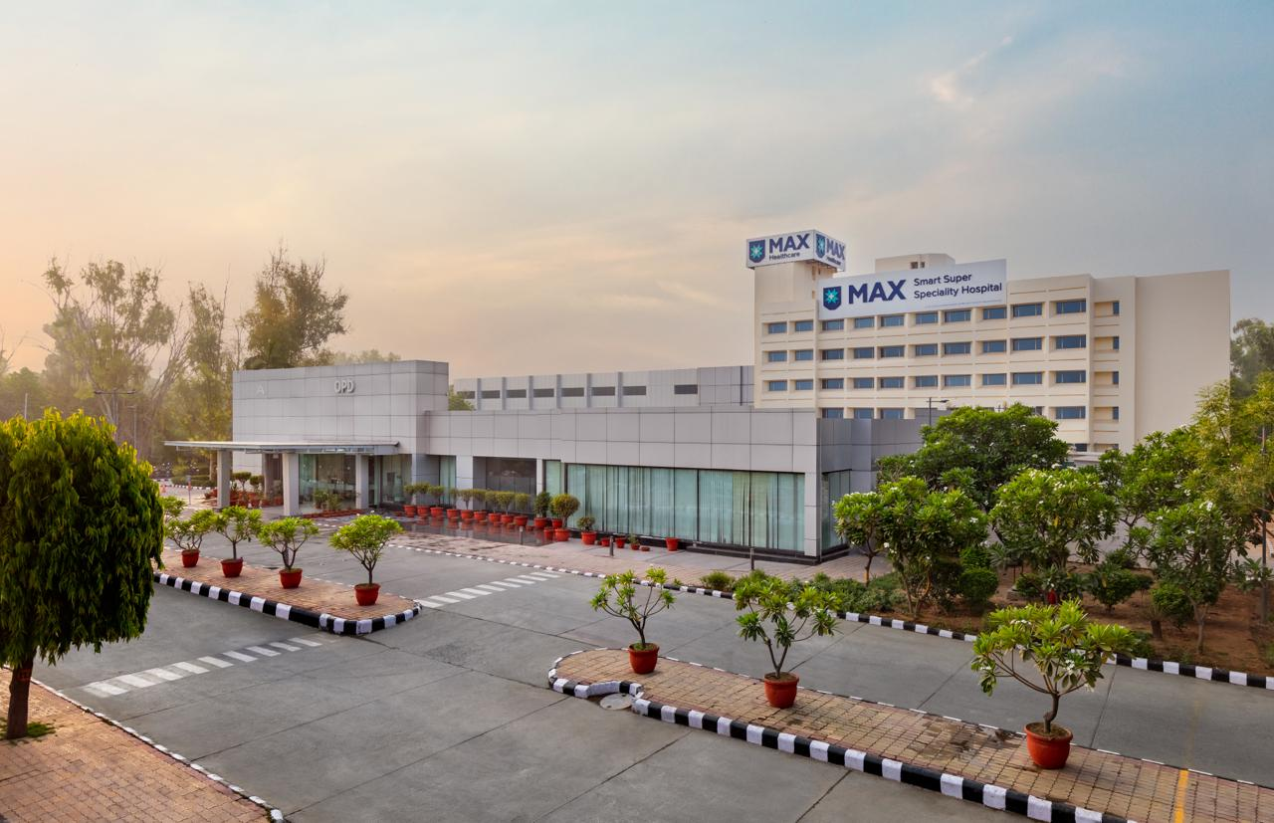
To study the influence of quality of patient care in emergency department on hospital admission rates and patient satisfaction to improve overall outcomes
MAX Smart Super Speciality Hospital, SAKET
(NEW DELHI)
Dr Kashish Mahajan
Faculty Mentor- Dr Pankaj Talreja(Associate Professor IIHMR DELHI)
Project Mentor- Dr Kamal Palta(Principal Consultant & Head of Emergency Department)

Slide 2
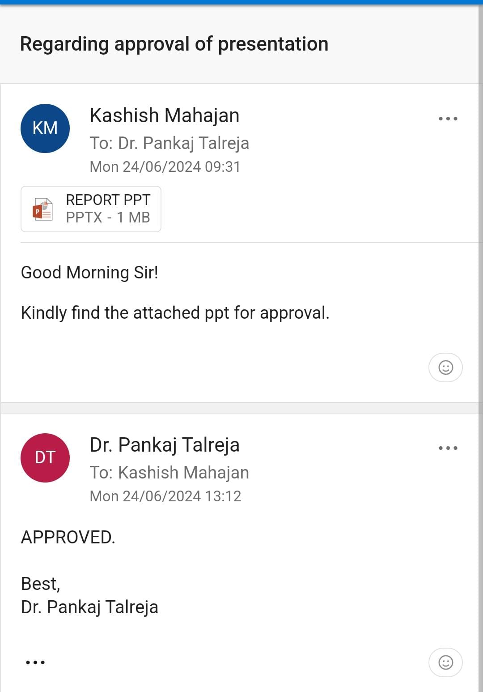
SCREENSHOT OF APPROVAL

Slide 3
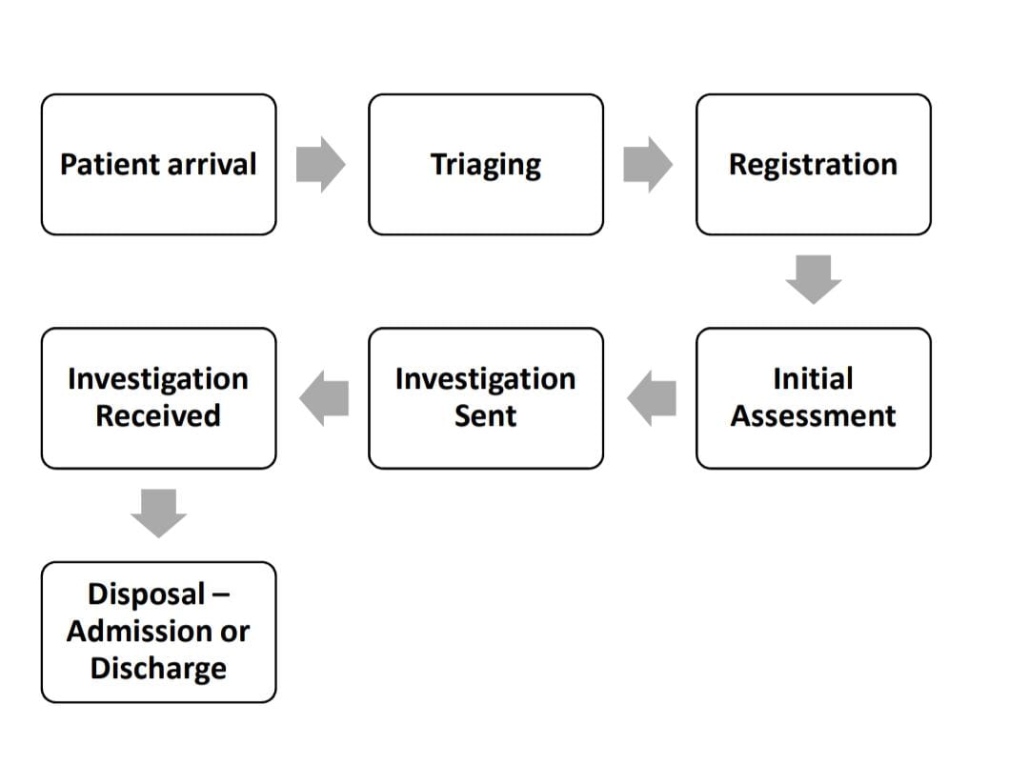
INTRODUCTION
Critical Healthcare Access
The seamless integration of hospital operations ensures that its Emergency Department operates efficiently to provide high-quality, 24/7 acute care
Operational Demands
Operational challenges include managing high patient volumes and diverse medical conditions, necessitating effective triage and resource allocation.
Specialized Areas
The ED features distinct zones:
Triage Station: Beds categorized by urgency levels following
  established triage protocols
  Critical Care Unit: Dedicated beds for critically ill patients
  requiring intensive monitoring and treatment.
  Resuscitation Room: Equipped for immediate medical interventions.
ED PROCESS FLOW

Slide 4
The relationship between two crucial facets of ED function:
ER TO IP CONVERSION RATES: This refers to the percentage of ER patients that are admitted to the Inpatient Department (IPD)
PATIENT SATISFACTION: A gauge of how well a patient feels they were treated in the emergency department.
Examining the relationship between these characteristics and any moderators, especially in times of higher patient traffic, can yield important information for enhancing ED performance.

Slide 5

OBJECTIVES
PRIMARY OBJECTIVE :
Explore potential interventions to improve the quality of care in the emergency department.
SECONDARY OBJECTIVES :
Identify specific aspects of quality care that most significantly impact ER to IP conversion rates and patient satisfaction score
To identify potential strategies for improving quality of care by entailing concentration on bottlenecks
RATIONALE OF THE STUDY :
This study essentially attempts to support increased patient satisfaction, higher-quality care, and an improved emergency department system.

Slide 6
METHODOLOGY
RESEARCH STUDY DESIGN- Prospective observational study
RESEARCH APPROACH- Direct observation / Telephonic surveys
STUDY POPULATION – Patients admitted and discharged from ER
SAMPLE SIZE – record of 1069 patients of April’24 and 1138 patients of May’24 who got admitted and
discharged from ER & feedback remarks of 252 pts of Apr’24 and 387 pts of May’24
SAMPLING METHOD – Convenience sampling
PERIOD OF STUDY - (MAY 1ST – 31ST MAY 2024)
STUDY SETTING – Emergency Department of Max Smart Super Specialty Hospital, a 250-bed facility.

Slide 7
SOURCE OF DATA COLLECTION-
PRIMARY DATA – Direct Observation and Telephonic surveys ( confidentiality ensured)
SECONDARY DATA - (HIS), CPRS and the ER registration
DATA COLLECTION TOOLS-
(Microsoft excel for collecting, data management and statistical analysis)
INCLUSION CRITERIA – All patients who got admitted and discharged through ER
EXCLUSION CRITERIA – Patients who went LAMA
ETHICAL CONSIDERATION – Confidentiality & privacy: All data collected will be kept confidential, used only for study, kept safe, and accessible to authorized personnel only.
Beneficence and non-maleficence: the aim of the study is to promote health without putting participants in danger.

Slide 8
DATA ANALYSIS
USING STATISTICAL STUDY TOOL:
ON COMPARING PATIENTS’ AVERAGE LENGTH OF STAY IN APRIL-MAY:
ER to IP conversion rates
ALOS in ER
Pt satisfaction experience (PSAT)
CATEGORIES OF PTS | Apr'24 |  | May'24
Less than 2 hours | 291 | 65% | 319 | 57%
More than 2 hours | 121 | 27% | 189 | 34%
More than 6 hours | 36 | 8% | 55 | 10%
Total Patients in ER | 1069 | 100% | 1138 | 100%
MS EXCEL – TO MANAGE AND ANALYZE DATA REGARDING
ON COMPARING ER’s MONTHLY CENSUS
ON COMPARING PATIENT’S SATISFACTION EXPERIENCE LEVEL
ER DEPARTMENT PATIENTS STATUS | Apr'24 | May'24
Exclusion Criteria (Referral, Brought Dead) | 21 | 23
LAMA (Leave against medical advice) | 48 | 68
Converted to IPD | 552 | 484
Normal Discharge | 448 | 563
Total Patients in ER | 1069 | 1138
Patient Response | Apr'24 |  | May'24
Not Responded | 33 | 13% | 66 | 17%
Satisfied | 199 | 79% | 275 | 71%
Unsatisfied | 20 | 8% | 46 | 12%
Total Sample Size | 252 | 100% | 387 | 100%
PSAT Score | Apr’24 (79%) | May'24 (71%)

Slide 9
RESULTS AND INTERPRETATIONS

Slide 10
The ALOS for these patients 4 hours.
the ALOS of patients is broken down by duration (less than two hours, between two and six hours, and more than six hours).
DATA INTERPRETATIONS:-
It is observed that there were more patients seen with longer ALOS in May, than in April. This suggests that in May, a greater percentage of patients waited longer in the emergency department

Slide 11
DATA INTERPRETATIONS:-
This data analysis signifies the overall satisfaction experience level of patients at ER.
There is a significant decrease in the level of satisfaction May’24 (71% pts being reported satisfied) as compared to April’24 (79%satisfied pts)
The major reasons for decrease in pt. satisfaction are being depicted:-
Reasons for Unsatisfied Patients | Apr'24 |  | May'24
Non Availability of Beds | 10 | 50% | 25 | 54%
Financial Issues | 4 | 20% | 5 | 11%
Improper Treatment | 1 | 5% | 2 | 4%
Waiting Time | 3 | 15% | 11 | 24%
Lack of Coordination between Staff & Doctors | 2 | 10% | 3 | 7%

Slide 12
DISCUSSION
EXTENDED ALOS AND PATIENT FOOTFALL
REDUCED CONVERSION RATES FROM ER TO IP
DECLINE IN PATIENT SATISFACTION LEVEL
May had 115 more patients than April (563 vs. 448), potentially contributing to ED crowding and longer ALOS leading to discontentment.
Conversion rate from ED to IPD dropped by 6% (52% in April to 46% in May), indicating challenges in admitting patients due to bed shortages or other factors
Patient satisfaction scores decreased from 79% in April to 71% in May, possibly influenced by longer waits and poorer perceived care quality
INCREASE IN LAMA CASES:
In May, patients visiting ER took LAMA“left against medical advice ”, thus indicating dissatisfaction or concerns about care quality.

Slide 13
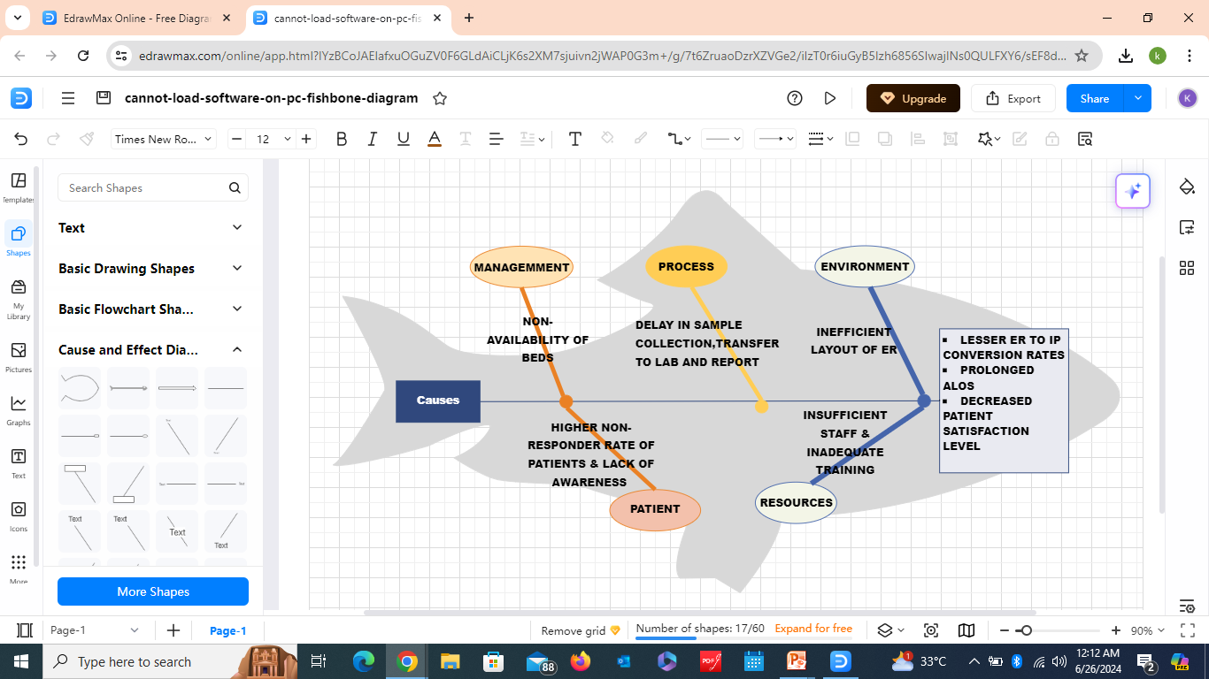
BOTTLENECKS OF STUDY
Many patients from OPD were coming to ED just for small processes.
Delay in sample collection, transfer to lab and report collection
Space constraints in ED layout
To assess these factors and to get significant recommendations, an Ishikawa fishbone diagram is being used in my study. The main effect is represented by the diagram's head, and possible causal categories found during brainstorming or research sessions are represented by the "fish bones." A deeper understanding of the bottlenecks in the observed month of study (May’24) and their underlying root causes is made possible by our analysis.
Ishikawa fishbone diagram
SOURCE
https://www.ahrq.gov/sites/default/files/wysiwyg/ncepcr/resources/job-aid-5-whys.pdf

Slide 14
RECOMMENDATIONS
EFFECTIVE RESOURCE & BED MANAGEMENT
Use adaptable tactics to maximize staffing
REVIEW SPACE OPTIMIZATION
Review ED layout to enhance flow and productivity.
This will help reducing ALOS
Boost departmental bed coordination
TO IMPROVE CONVERSION RATES AND BOOSTING PATIENT EXPERIENCE
Put into practice effective discharge planning to decrease ALOS
Simplify the diagnosis procedure

Slide 15
CONCLUSION
Effective management of ED crowding is crucial due to its pivotal role and diverse patient triage needs.
Reducing ALOS and raising patient satisfaction requires addressing issues like bed shortages, delayed investigations, and poor staff communication.
Optimizing ED operations requires significant investments in workforce management, including appropriate staffing levels and training.
By reducing inefficiencies in data transfer and streamlining procedures, the implementation of electronic medical record systems and digitalization can improve overall efficiency.
Sustaining improvement in ED effectiveness and patient care outcomes requires constant strategy adaption and monitoring.

Slide 16
REFERENCES
(Reham Mostafa¹ and Khaled El-Atawi, 2024 Jan). doi: 10.7759/cureus.52879 PMID: 38406097 - Strategies to Measure and Improve Emergency Department Performance: A Review
(Tobias-Perdahl, December 2015)Patient and organizational characteristics predict a long length of stay in the emergency department – a Swedish cohort study-European Journal of Emergency Medicine 24(4):1
(Ghassan Abass, 2021); 10(4): 1718–1725. Published online 2021 Apr 29. doi: 10.4103/jfmpc.jfmpc_8_20PMCID: PMC8144764,PMID: 34123918Patient satisfaction with the emergency department services at an academic teaching hospital
(Edwin D Boudreaux , 2004 Jan);26(1):13-26.doi: 10.1016/j.jemermed.2003.04.003 Patient satisfaction in the Emergency Department: a review of the literature and implications for practice

Slide 17




To study the influence of quality of patient care in emergency department on hospital admission rates and patient satisfaction to improve overall outcomes
By: Dr Kashish Mahajan (PG/23/047)
College Mentor- Dr Pankaj Talreja (IIHMR DELHI)
Project Mentor – Dr Kamal Palta (PRINCIPAL CONSULTANT & HEAD OF EMERGENCY DEPARTMENT)
BACKGROUND OF STUDY
METHODOLOGY
RECOMMENDATIONS
Impact of ED patient care quality on hospital admissions and satisfaction.
Examining the relationship between these characteristics, especially in times of higher patient traffic, can yield important information for enhancing ED performance.
SOURCE OF DATA COLLECTION-
PRIMARY DATA - Telephonic surveys ( confidentiality ensured)
SECONDARY DATA - (HIS), CPRS and the ER registration
DATA COLLECTION TOOLS-
(Microsoft excel for collecting and statistical analysis)
Effective Resource Management:
Use adaptable tactics to maximize staffing.
Boost departmental bed coordination.
To improve inpatient transfers:
Put into practice effective discharge planning.
Boost the Experience of Patients:
Simplify the diagnosis procedure.
REVIEW OF LITERATURE
FINDINGS
Strategies to Measure and Improve Emergency Department Performance: A Review Monitoring Editor:Alexander Muacevic and John R Adler Reham Mostafa¹ and Khaled El-Atawi²
(Edwin D Boudreaux ,2004 Jan);26(1):13-26.doi: 10.1016/j.jemermed.2003.04.003 Patient satisfaction in the Emergency Department: a review of the literature and implications for practice
Decreased ED to IP conversion rate, possibly due to bed shortages, impacted patient admissions.
Higher LAMA cases and declining Patient Satisfaction Score (PSAT) highlighted issues with patient experience and service quality
KEY LEARNINGS
OBJECTIVEE
Enhancing ED effectiveness and patient satisfaction requires efficient patient flow and resource allocation management.
To improve overall ED results, tactics must be continuously monitored and adjusted.
Explore potential interventions to improve the quality of care in the Emergency Department.
Identify specific aspects of quality care that most significantly impact ER to IP conversion rates and patient satisfaction score
To identify potential strategies for improving quality of care by entailing concentration on bottlenecks

Slide 18

Any Questions

Slide 19
INTERNSHIP EXPERIENCE
What did I learn !?
Overall self comments on Internship
Operational insights
Data driven decision- making
Interdepartmental communication
Professional presentation
Time management
Professionalism
Self - management skills
Problem solving skills
CPRS/HIS learning
During my internship, I gained practical insights in the hospital industry through:
Assessing OPD and ER operations and making suggestions for improvements.
Coordinating to resolve operational issues with the administrative and medical departments.
Monitoring and enhancing patient experience through effective resolution of questions and grievances.

Slide 20
SUGGESTIONS GIVEN TO ORGANIZATION
Strategies need to be implemented to ensure the continuity of quality of patient care (4 C’S)
Communication
Coordination
Collaboration
Continual reassessment
Data-driven decision making: using the data collected to track performance
Resource distribution: Examining staffing numbers, equipment accessibility, and space allotment

Slide 21


PICTORIAL JOURNEY

Slide 22
HEALTH AND WELLNESS CENTRE
HUMAN RESOURCES
(TOTAL = 20)
Doctors – 6
Nursing officer – 1
Pharmacy officers – 3
Clerical personnel – 1
Data entry operator – 1
Multitasking employees – 2
Housekeeping personnel – 3
Security guards – 3
PATIENT FOOTFALL
300 – 500 daily
DIAGNOSTICS
No diagnostics available
OTHER FACILITIES
Although the building is operational , routine upkeep would be beneficial
A satisfactory level of cleanliness and sanitation is maintained

Slide 23
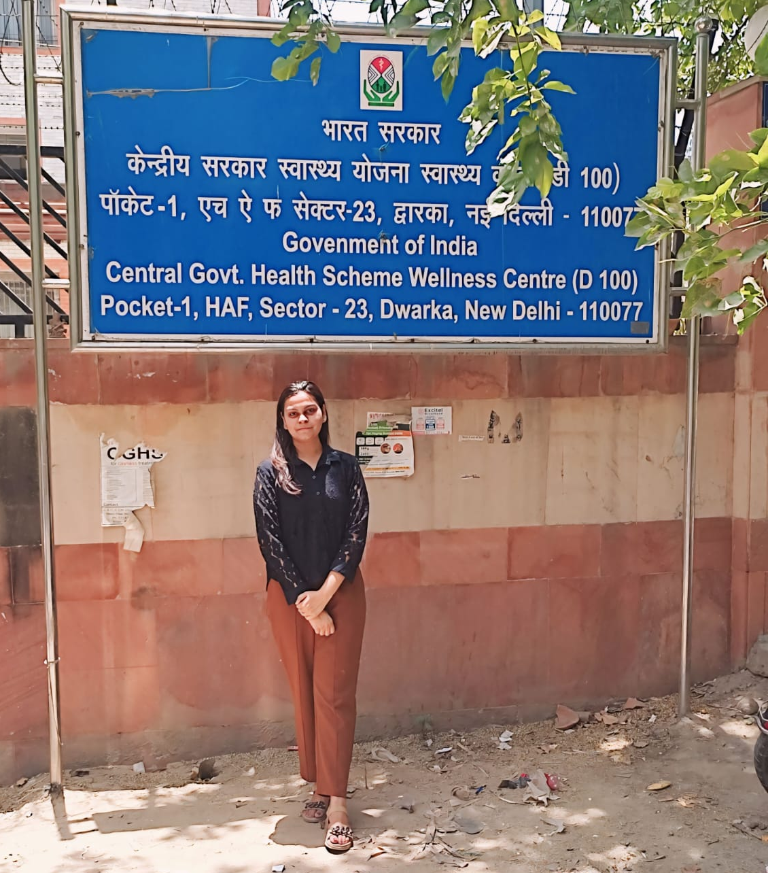
SUGGESTIONS FOR IMPROVEMENT
SUGGESTION BOXES FOR PATIENTS
Availability of suggestion boxes for patients to provide feedback.
This would access the overall quality care.
FACILITIES FOR DIAGNOSTICS
The Centre lacks vital diagnostic services including a pathology lab even with the requisite infrastructure. By delivering prompt and precise diagnoses, putting these into practice will improve the quality of healthcare.

