Slide 1

TO EVALUATE THE ROLE OF KAYAKALP
IN NQAS IMPLEMENTATION
National Health Systems Resource Centre (NHSRC),
New Delhi
Presented By: Mentored By:
Dr Gaurav Pandey Dr. Rohini Ruhil
PG/20/018- IIHMR, Delhi Associate Professor
20th June 2018

Slide 2
Screenshot of Approval
Dr. Rohini Ruhil​
(Associate Professor)​
IIHMR, New Delhi​

Slide 3

Introduction
What is Quality of Care?
Different Cadre of People
Different Perception
Ultimate Goal
Desired Health Outcomes

Slide 4

Key initiatives taken by the Government of India:
2015
2007
Indian Public Health Standards
2008–2012
State initiative like NABH, ISO 9001:2008, Family Friendly Hospital Initiative (FFHI)
2013
National Quality Framework (National Quality Assurance Standards)
Kayakalp

Slide 5
Objective of the Study
General Objective:
To evaluate the role of Kayakalp in NQAS implementation in India
Specific Objectives:
To assess the role of infection control practices under Kayakalp achievement in NQAS certified public health care facilities.
To assess the role of Kayakalp implementation of NQAS in the public health facilities.

Slide 6
Methodology
Study Area: The study covered PHCs & UPHCs of 36 states /UTs of India which were awarded under Kayakalp scheme and were further certified under the NQAS Program of Government of India during FY 2020-2021.
Study Population: 167
Sample Size: 62 (NQAS Certified & Kayakalp Awardee)
Statistical Analysis: Microsoft excel 2010
Study Design: Descriptive study
Study Subjects: From the secondary data provided by NHSRC, 62 PHCs & Urban PHCs which are (NQAS Certified & Kayakalp Awardee)
Study Instruments: Kayakalp & NQAS Tool.
Time Period: 2020-2021(financial year)
Sampling Technique: Purposive Sampling technique
Ethical Issues: Requisite approval undertaken from NHSRC for the study from secondary data provided by them.

Slide 7
Methodology
Inclusion Criteria:
62 PHCs & UPHCs were included.
All the nationally certified PHCs & UPHCs under National Quality Standards
Program & Kayakalp program.
PHCs & UPHCs scoring more than 70 percent marks
Data taken from NHSRC
Facilities got Kayakalp award prior to the NQAS Certification.
Exclusion Criteria
All conditional certified PHCs & UPHCs were excluded from the study.

Slide 8
Results: PHCs
Infection Control Practices
Coefficient (r): | 0.41473429
N: | 48
T statistic: | 3.09125533
DF: | 46
p value: | 0.0034
Hand Hygiene Practices
Coefficient (r): | 0.5252682
N: | 48
T statistic: | 4.1866128
DF: | 46
p value: | 0.00013
Personal Protection
Coefficient (r): | 0.238824111
N: | 48
T statistic: | 1.668052629
DF: | 46
p value: | 0.10
Decontamination, Disinfection & Sterilization
Coefficient (r): | 0.2014
N: | 48
T statistic: | 1.39
DF: | 46
p value: | 0.17

Slide 9
Results: PHCs
Environmental Control
Coefficient (r): | 0.246375048
N: | 48
T statistic: | 1.724144376
DF: | 46
p value: | 0.09
Segregation, collection, treatment &disposal of biomedical & hazardous waste
Coefficient (r): | 0.275851325
N: | 48
T statistic: | 1.946435804
DF: | 46
p value: | 0.06

Slide 10
Results: U-PHCs
Hand Hygiene Practices
Coefficient (r): | 0.478051035
N: | 14
T statistic: | 1.885411497
DF: | 12
p value: | 0.083811116
Personal Protection Practices
Coefficient (r): | 0.459770907
N: | 14
T statistic: | 1.793497491
DF: | 12
p value: | 0.098112688
Decontamination, Disinfection & Sterilization
Coefficient (r): | 0.509551879
N: | 14
T statistic: | 2.051438357
DF: | 12
p value: | 0.062712251
Segregation, collection, treatment &disposal of biomedical & hazardous waste
Coefficient (r): | 0.484777961
N: | 14
T statistic: | 1.920018963
DF: | 12
p value: | 0.078937966

Slide 11
Discussion
The present study is a review study based on the data provided by NHSRC New Delhi. Quality framework within NQAS and Kayakalp incorporate and divides quality in 3 segments structure, process & outcome according to the well accepted Donabedian model . In order to compare NQAS with Kayakalp the checkpoint is most important tool for it & it was found that all Kayakalp checkpoint are taken from the NQAS itself. When we did the comparative analysis b/w two programs on the basis of specific standards /criteria i.e., in NQAS we take standards (F1, F2, F3, F4, F5, F6) of Infection control area of concern on other hand we take standards/criteria(C1to C6, C8 and C9, D1to D5, D8,D9,D10) of 2 thematic areas ( Infection Control & Waste Management ) and divides these standards/criteria into some indicators i.e, Infection Control Practices ( r=0.41 &p value = 0.0034), Hand Hygiene Practices (r=0.53 & p value = 0.0001) ,Personal Protection ( r=0.24 &p value = 0.10) ,Decontamination , Disinfection & Sterilization( r=0.20 &p value = 0.17) ,Environmental Control( r=0.25 &p value = 0.09), Segregation, collection, treatment &disposal of biomedical & hazardous waste( r=0.28 &p value = 0.06) ,in order to drive deeper we finds that all indicators shows the positive correlation but not significant in nature except in infection control and hand hygiene practices which shows the significance in PHCs analysis , Our results suggest that Kayakalp having some component similar as NQAS .

Slide 12
Limitations
    Data collection was difficult as assessment checklist have to be collected from respective states of the facility.
    Confidentiality and Privacy issue within the organization regarding declaration of certification of the facility under NQAS.
    Only certified PHCs & U-PHCs were included because of time constraint.
    Sample size less due to covid less no. of facilities certified during this period.
    Less study done on Kayakalp that’s why less literature review done on Kayakalp.

Slide 13
Conclusion
This study was carried out to provide a perspective to the Role of Kayakalp in NQAS Implementation (NQAS), both the programs were launched by National Health Mission in order to services related to0quality providing to the0community. Findings having significant nature come out from the study.
All the indicators show the positive correlation and no significance except Infection control practices, hand hygiene in PHCs (showing the significance).
Another0interesting finding is that facility national assessment is a lengthy process 0All of these 0procedures will take time to complete. Once the facility has completed the necessary preparations for NQAS0certification.
NQAS is a process-oriented program, can be improved by applying basic tools of quality.
Kayakalp is the foundation stone for NQAS but definitely not a pillar.
Good, better, best. Never let it rest. ‘Till your good is better and better is best.
Miles to go, needs further research in this area.

Slide 14
References
Agrawal, A., Srivastava, J. N., & Priyadarshi, M. (2019). Impact of Implementation of "Kayakalp" Initiative on Quality Certification of District Hospitals to National Quality Assurance Standards. Indian journal of community medicine : official publication of Indian Association of Preventive & Social Medicine, 44(3), 228–232. https://doi.org/10.4103/ijcm.IJCM_346_18
Ninama R, Thakor N, Vala M, Dund J, Kadra A. Quality assessment of facilities available at Primaryfacilities available at Primary Health Care Centers in Rajkot district. A cross sectional study. Int J Med Sci Public Health. 2014; 3(12): 1449-52.
India records 5.2 million medical injuries a year. The Times of India [Internet]. 2013 September 21 [cited 2018 April 27].
Department of Health and Family Welfare. Assessor’s Guidebook for Quality Assurance in District Hospitals 2013. India: Ministry of Health and Family Welfare; 2018.
Department of Health and Family Welfare. Award to Public Health Facilities KAYAKALP 2015. India: Ministry of Health and Family Welfare; 2018.

Slide 15
Any Question ?
Thank you

Slide 16
Suggestions to the Organization where the Study was Conducted
More field visits for better understanding of the programs
Technical advancement required
Use of IT enabled software in order to reduce paperwork, financial expenditures and repetition of work
More weight-age may be given to the facilities those already Kayakalp awardee during the NQAS Certification.
Facility those are wining Kayakalp awards in consecutive year must get NQAS certification within in specific period of time.
GUNAK ,IT-based checklist for NQAS assessment has been already in place but some strengthening.

Slide 17
Dissertation Experiences
What did you learn (skill/ topic)?
Overall self-comments on Dissertation
Learn about the different program ( working )
Capacity Building
Checklist building formation
Communication different states
Toolkit formation
Working with other developing partners
Great learning Experience
Evolution of programs
Interconnection of programs

Slide 18
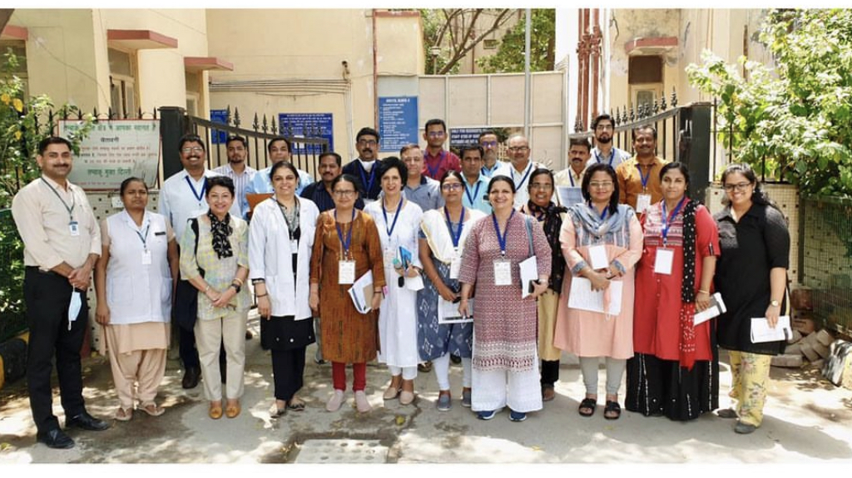
Field Visit

Slide 19
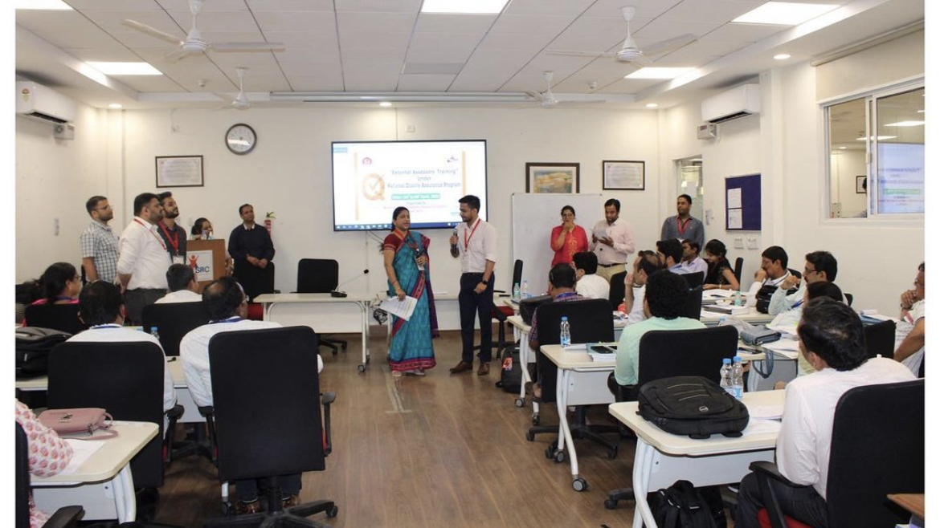
External Assessors Training

