Slide 1

Digital Health Maturity Assessment Of High-, Middle- And Low-income Countries Using Global Digital Health Monitor Indicators
IIHMR, Delhi
Dr Prachi Tyagi
Mentor: Dr Archana Thakur
Under The Guidance Of: Dr Nishikant Bele
IIHMR Delhi

Slide 2

Mentor Approval

Slide 3

Introduction (1/2)
Digital health refers to the use of information and communication technologies to improve healthcare and promote wellness.
Digital health interventions can help reduce fragmentation and inefficiencies in patient care and drive earlier and better public health actions.
Digital health can help make health systems more efficient and sustainable, enabling them to deliver good quality, affordable and equitable care.

Slide 4
INTRODUCTION
A Digital Health Maturity Assessment (DHMA) evaluates an organization’s or country’s progress in leveraging digital technologies to improve healthcare delivery and outcomes.
It helps identify strengths, weaknesses, and areas for improvement in digital health capabilities, guiding strategic planning and investment.
Various tools for DHMA :
Digital Health Assessment Toolkit | World Bank Group, 2021
Global Digital Health Index (GDHI) and Maturity Model
Information Systems for Health (IS4H) Toolkit, and IS4H Maturity Assessment
HIS Interoperability Maturity Toolkit
Digital Health Investment Review Tool (by USAID)

Slide 5
INTRODUCTION
The Global Digital Health Monitor (GDHM) is an interactive resource that supports countries prioritizing and monitoring their digital health ecosystem, built on the WHO/ITU eHealth Strategy Toolkit’s seven foundational pillars:
leadership and governance,
strategy and investment,
legislation, policy and compliance,
services and applications,
infrastructure,
standards and interoperability, and
workforce.
A digital health maturity assessment across different income levels is essential for global health system strengthening. It will help to shed some light on the problems faced by the marginalized countries in achieving their health goals by leveraging digital health systems. It will highlight the areas which need improvement and targeted interventions so that optimum resource allocation can be done.

Slide 6
Objectives of The Study
To assess the existing state of digital health infrastructure and maturity in selected high-, middle- and low-income countries using GDHM indicators.
To identify successful strategies and policies from high maturity countries that can be adopted by low maturity countries to enhance their digital health systems.
To examine gaps or challenges faced by low maturity countries in attaining optimum level of digital maturity.

Slide 7
Strategy and Investment
Leadership and Governance
Legislation Policy & Compliance
Services & Applications
Standards and Interoperability
Infrastructure
Standards and Interoperability
Workforce

Slide 8
Methodology
RESEARCH DESIGN:
The digital health maturity levels of the selected countries was analyzed by conducting a secondary analysis using data from official government and ministry websites, WHO digital health resources (Global Repository on Digital Health resources), Global Health Observatory and other published reports.
GDHM employs a structured methodology to assess and score countries' digital health maturity across 7 key enabling environments which are sub divided into 23 indicators, each of which is scored on a 5-point scale ranging from 1 meaning non existent to 5 meaning fully developed.
Scoring scale across 23 key indicators
1: Non-existent
2: First initial steps taken
3: Existing but not in working order
4: Existing in working order but not implemented at organizational level, or scaled at developmental level
5: Fully developed, implemented, and is scalable

Slide 9
Methodology
Each nation was assigned a Digital Health Maturity Score, which ranges from Level 1 (least mature) to Level 5 (most mature), based on the aggregate of these scores.
Selection of countries:
Stratified random sampling approach was used to select 3 countries from each section. Countries with insufficient data were excluded. The World Bank classification of countries on basis of Gross National Income (GNI) per capita is used.
Following this sampling approach, the countries selected were as follows:
Digital Health Maturity Score
1: Very beginning stage
2: Early stage, with foundational elements in development
3: Moderate level of progress
4: Advanced stage with most enablers in place
5: Highest maturity level
High Income Countries | Middle Income Countries | Low Income Countries
1.Portugal | 1.Ghana | 1.Mali
2.Finland | 2.Malaysia | 2.Ethiopia
3.Ireland | 3.Morocco | 3.Liberia

Slide 10
Results
The scoring of all the 9 countries are summarized in the following tables:

Slide 11
SCORING OF PORTUGAL : 5
Category | Indicator | Score | Total
Workforce | Indicator 11 -Digital health integrated in health and related professional pre-service training (prior to deployment) | 3 | 4
 | Indicator 12 -Digital health integrated in health and related professional in-service training (after to deployment) | 4
 | Indicator 13 -Training of digital health workforce | 4
 | Indicator 14 -Maturity of public sector digital health professional careers | 3
Standards & Interoperability | Indicator 15 -National digital health architecture and/or health information exchange | 5 | 5
 | Indicator 16 -Health information standards | 5
Infrastructure | Indicator 17 -Network readiness | 4 | 5
 | Indicator 18 -Planning and support for ongoing digital health infrastructure maintenance | 5
Services & Applications | Indicator 19 -Nationally scaled digital health systems | 5 | 5
 | Indicator 20 -Digital identity management of service providers, administrators, and facilities for digital health, including location data for GIS mapping | 4
 | Indicator 21 -Digital identity management of individuals for health | 5
 | Indicator 21a -Digital identity management of individuals for health | 5
 | Indicator 22 -Secure Patient Feedback Systems | 4
 | Indicator 23 -Population health management contribution of digital health | 4
Category | Indicator | Score | Total
Leadership & Governance | Indicator 1 -Digital health prioritized at the national level through dedicated bodies / mechanisms for governance | 5 | 5
 | Indicator 2 -Digital Health prioritized at the national level through planning | 5
 | Indicator 2a -Health is prioritized in national digital transformation and data governance policies | 5
 | Indicator 3 -Readiness for emerging technologies adoption and governance | 5
 | Indicator 4 -Diversity, Equity, and human rights analysis, planning and monitoring included in national digital health strategies and plans | 5
 | Indicator 4a -Gender considerations accounted for in digital health strategies and digital health governance | 3
Strategy & Investment | Indicator 5 -National eHealth/ Digital Health Strategy or Framework | 5 | 5
 | Indicator 5a -National digital strategy alignment with Universal Health Coverage (UHC) Core Components | 5
 | Indicator 6 -Public funding for digital health | 4
 | Indicator 6a -Private sector participation and investments in digital health | 4
Legislation, Policy, & Compliance | Indicator 7 -Legal Framework for Data Protection (Security/ Cybersecurity) | 5 | 4
 | Indicator 8 -Laws or Regulations for privacy, consent, confidentiality and access to health information (Privacy) | 5
 | Indicator 9 -Protocol for regulating or certifying devices and/or health services- including provisions for AI and algorithms (at higher stages of maturity) | 4
 | Indicator 9a -Protocol for regulating and certifying AI within health services | 1
 | Indicator 10 -Cross-border data security and sharing | 5

Slide 12
SCORING OF FINLAND : 5
Category | Indicator | Score | Total
Workforce | Indicator 11 -Digital health integrated in health and related professional pre-service training (prior to deployment) | 3 | 4
 | Indicator 12 -Digital health integrated in health and related professional in-service training (after to deployment) | 4
 | Indicator 13 -Training of digital health workforce | 4
 | Indicator 14 -Maturity of public sector digital health professional careers | 4
Standards & Interoperability | Indicator 15 -National digital health architecture and/or health information exchange | 5 | 5
 | Indicator 16 -Health information standards | 5
Infrastructure | Indicator 17 -Network readiness | 5 | 5
 | Indicator 18 -Planning and support for ongoing digital health infrastructure maintenance | 4
Services & Applications | Indicator 19 -Nationally scaled digital health systems | 5 | 5
 | Indicator 20 -Digital identity management of service providers, administrators, and facilities for digital health, including location data for GIS mapping | 5
 | Indicator 21 -Digital identity management of individuals for health | 5
 | Indicator 21a -Digital identity management of individuals for health | 5
 | Indicator 22 -Secure Patient Feedback Systems | 5
 | Indicator 23 -Population health management contribution of digital health | 5
Category | Indicator | Score | Total
Leadership & Governance | Indicator 1 -Digital health prioritized at the national level through dedicated bodies / mechanisms for governance | 4 | 5
 | Indicator 2 -Digital Health prioritized at the national level through planning | 5
 | Indicator 2a -Health is prioritized in national digital transformation and data governance policies | 5
 | Indicator 3 -Readiness for emerging technologies adoption and governance | 5
 | Indicator 4 -Diversity, Equity, and human rights analysis, planning and monitoring included in national digital health strategies and plans | 4
 | Indicator 4a -Gender considerations accounted for in digital health strategies and digital health governance | 4
Strategy & Investment | Indicator 5 -National eHealth/ Digital Health Strategy or Framework | 5 | 5
 | Indicator 5a -National digital strategy alignment with Universal Health Coverage (UHC) Core Components | 5
 | Indicator 6 -Public funding for digital health | 4
 | Indicator 6a -Private sector participation and investments in digital health | 4
Legislation, Policy, & Compliance | Indicator 7 -Legal Framework for Data Protection (Security/ Cybersecurity) | 5 | 4
 | Indicator 8 -Laws or Regulations for privacy, consent, confidentiality and access to health information (Privacy) | 5
 | Indicator 9 -Protocol for regulating or certifying devices and/or health services- including provisions for AI and algorithms (at higher stages of maturity) | 5
 | Indicator 9a -Protocol for regulating and certifying AI within health services | 4
 | Indicator 10 -Cross-border data security and sharing | 4

Slide 13
SCORING OF ETHIOPIA : 4
Category | Indicator | Score | Total
Workforce | Indicator 11 -Digital health integrated in health and related professional pre-service training (prior to deployment) | 5 | 5
 | Indicator 12 -Digital health integrated in health and related professional in-service training (after to deployment) | 4
 | Indicator 13 -Training of digital health workforce | 5
 | Indicator 14 -Maturity of public sector digital health professional careers | 4
Standards & Interoperability | Indicator 15 -National digital health architecture and/or health information exchange | 3 | 3
 | Indicator 16 -Health information standards | 3
Infrastructure | Indicator 17 -Network readiness | 3 | 4
 | Indicator 18 -Planning and support for ongoing digital health infrastructure maintenance | 4
Services & Applications | Indicator 19 -Nationally scaled digital health systems | 4 | 3
 | Indicator 20 -Digital identity management of service providers, administrators, and facilities for digital health, including location data for GIS mapping | 2
 | Indicator 21 -Digital identity management of individuals for health | 1
 | Indicator 21a -Digital identity management of individuals for health | 1
 | Indicator 22 -Secure Patient Feedback Systems | 3
 | Indicator 23 -Population health management contribution of digital health | 4
Category | Indicator | Score | Total
Leadership & Governance | Indicator 1 -Digital health prioritized at the national level through dedicated bodies / mechanisms for governance | 5 | 4
 | Indicator 2 -Digital Health prioritized at the national level through planning | 5
 | Indicator 2a -Health is prioritized in national digital transformation and data governance policies | 3
 | Indicator 3 -Readiness for emerging technologies adoption and governance | 2
 | Indicator 4 -Diversity, Equity, and human rights analysis, planning and monitoring included in national digital health strategies and plans | 4
 | Indicator 4a -Gender considerations accounted for in digital health strategies and digital health governance | 3
Strategy & Investment | Indicator 5 -National eHealth/ Digital Health Strategy or Framework | 5 | 4
 | Indicator 5a -National digital strategy alignment with Universal Health Coverage (UHC) Core Components | 4
 | Indicator 6 -Public funding for digital health | 3
 | Indicator 6a -Private sector participation and investments in digital health | 2
Legislation, Policy, & Compliance | Indicator 7 -Legal Framework for Data Protection (Security/ Cybersecurity) | 3 | 3
 | Indicator 8 -Laws or Regulations for privacy, consent, confidentiality and access to health information (Privacy) | 3
 | Indicator 9 -Protocol for regulating or certifying devices and/or health services- including provisions for AI and algorithms (at higher stages of maturity) | 3
 | Indicator 9a -Protocol for regulating and certifying AI within health services | 2
 | Indicator 10 -Cross-border data security and sharing | 2

Slide 14
SCORING OF GHANA : 3
Category | Indicator | Score | Total
Workforce | Indicator 11 -Digital health integrated in health and related professional pre-service training (prior to deployment) | 3 | 3
 | Indicator 12 -Digital health integrated in health and related professional in-service training (after to deployment) | 3
 | Indicator 13 -Training of digital health workforce | 4
 | Indicator 14 -Maturity of public sector digital health professional careers | 2
Standards & Interoperability | Indicator 15 -National digital health architecture and/or health information exchange | 2 | 3
 | Indicator 16 -Health information standards | 3
Infrastructure | Indicator 17 -Network readiness | 3 | 4
 | Indicator 18 -Planning and support for ongoing digital health infrastructure maintenance | 4
Services & Applications | Indicator 19 -Nationally scaled digital health systems | 3 | 2
 | Indicator 20 -Digital identity management of service providers, administrators, and facilities for digital health, including location data for GIS mapping | 2
 | Indicator 21 -Digital identity management of individuals for health | 1
 | Indicator 21a -Digital identity management of individuals for health | 1
 | Indicator 22 -Secure Patient Feedback Systems | 3
 | Indicator 23 -Population health management contribution of digital health | 4
Category | Indicator | Score | Total
Leadership & Governance | Indicator 1 -Digital health prioritized at the national level through dedicated bodies / mechanisms for governance | 4 | 4
 | Indicator 2 -Digital Health prioritized at the national level through planning | 4
 | Indicator 2a -Health is prioritized in national digital transformation and data governance policies | 3
 | Indicator 3 -Readiness for emerging technologies adoption and governance | 3
 | Indicator 4 -Diversity, Equity, and human rights analysis, planning and monitoring included in national digital health strategies and plans | 4
 | Indicator 4a -Gender considerations accounted for in digital health strategies and digital health governance | 3
Strategy & Investment | Indicator 5 -National eHealth/ Digital Health Strategy or Framework | 5 | 4
 | Indicator 5a -National digital strategy alignment with Universal Health Coverage (UHC) Core Components | 4
 | Indicator 6 -Public funding for digital health | 3
 | Indicator 6a -Private sector participation and investments in digital health | 2
Legislation, Policy, & Compliance | Indicator 7 -Legal Framework for Data Protection (Security/ Cybersecurity) | 4 | 3
 | Indicator 8 -Laws or Regulations for privacy, consent, confidentiality and access to health information (Privacy) | 4
 | Indicator 9 -Protocol for regulating or certifying devices and/or health services- including provisions for AI and algorithms (at higher stages of maturity) | 3
 | Indicator 9a -Protocol for regulating and certifying AI within health services | 2
 | Indicator 10 -Cross-border data security and sharing | 2

Slide 15
SCORING OF MOROCCO : 3
Category | Indicator | Score | Total
Workforce | Indicator 11 -Digital health integrated in health and related professional pre-service training (prior to deployment) | 3 | 3
 | Indicator 12 -Digital health integrated in health and related professional in-service training (after to deployment) | 3
 | Indicator 13 -Training of digital health workforce | 3
 | Indicator 14 -Maturity of public sector digital health professional careers | 3
Standards & Interoperability | Indicator 15 -National digital health architecture and/or health information exchange | 2 | 3
 | Indicator 16 -Health information standards | 3
Infrastructure | Indicator 17 -Network readiness | 4 | 3
 | Indicator 18 -Planning and support for ongoing digital health infrastructure maintenance | 3
Services & Applications | Indicator 19 -Nationally scaled digital health systems | 3 | 2
 | Indicator 20 -Digital identity management of service providers, administrators, and facilities for digital health, including location data for GIS mapping | 3
 | Indicator 21 -Digital identity management of individuals for health | 2
 | Indicator 21a -Digital identity management of individuals for health | 2
 | Indicator 22 -Secure Patient Feedback Systems | 1
 | Indicator 23 -Population health management contribution of digital health | 1
Category | Indicator | Score | Total
Leadership & Governance | Indicator 1 -Digital health prioritized at the national level through dedicated bodies / mechanisms for governance | 3 | 3
 | Indicator 2 -Digital Health prioritized at the national level through planning | 4
 | Indicator 2a -Health is prioritized in national digital transformation and data governance policies | 4
 | Indicator 3 -Readiness for emerging technologies adoption and governance | 3
 | Indicator 4 -Diversity, Equity, and human rights analysis, planning and monitoring included in national digital health strategies and plans | 3
 | Indicator 4a -Gender considerations accounted for in digital health strategies and digital health governance | 3
Strategy & Investment | Indicator 5 -National eHealth/ Digital Health Strategy or Framework | 3 | 3
 | Indicator 5a -National digital strategy alignment with Universal Health Coverage (UHC) Core Components | 4
 | Indicator 6 -Public funding for digital health | 3
 | Indicator 6a -Private sector participation and investments in digital health | 3
Legislation, Policy, & Compliance | Indicator 7 -Legal Framework for Data Protection (Security/ Cybersecurity) | 3 | 3
 | Indicator 8 -Laws or Regulations for privacy, consent, confidentiality and access to health information (Privacy) | 3
 | Indicator 9 -Protocol for regulating or certifying devices and/or health services- including provisions for AI and algorithms (at higher stages of maturity) | 3
 | Indicator 9a -Protocol for regulating and certifying AI within health services | 3
 | Indicator 10 -Cross-border data security and sharing | 3

Slide 16
SCORING OF LIBERIA : 2
Category | Indicator | Score | Total
Workforce | Indicator 11 -Digital health integrated in health and related professional pre-service training (prior to deployment) | 2 | 2
 | Indicator 12 -Digital health integrated in health and related professional in-service training (after to deployment) | 2
 | Indicator 13 -Training of digital health workforce | 3
 | Indicator 14 -Maturity of public sector digital health professional careers | 2
Standards & Interoperability | Indicator 15 -National digital health architecture and/or health information exchange | 2 | 2
 | Indicator 16 -Health information standards | 2
Infrastructure | Indicator 17 -Network readiness | 2 | 3
 | Indicator 18 -Planning and support for ongoing digital health infrastructure maintenance | 3
Services & Applications | Indicator 19 -Nationally scaled digital health systems | 3 | 2
 | Indicator 20 -Digital identity management of service providers, administrators, and facilities for digital health, including location data for GIS mapping | 2
 | Indicator 21 -Digital identity management of individuals for health | 1
 | Indicator 21a -Digital identity management of individuals for health | 1
 | Indicator 22 -Secure Patient Feedback Systems | 2
 | Indicator 23 -Population health management contribution of digital health | 3
Category | Indicator | Score | Total
Leadership & Governance | Indicator 1 -Digital health prioritized at the national level through dedicated bodies / mechanisms for governance | 3 | 2
 | Indicator 2 -Digital Health prioritized at the national level through planning | 3
 | Indicator 2a -Health is prioritized in national digital transformation and data governance policies | 2
 | Indicator 3 -Readiness for emerging technologies adoption and governance | 2
 | Indicator 4 -Diversity, Equity, and human rights analysis, planning and monitoring included in national digital health strategies and plans | 2
 | Indicator 4a -Gender considerations accounted for in digital health strategies and digital health governance | 2
Strategy & Investment | Indicator 5 -National eHealth/ Digital Health Strategy or Framework | 2 | 2
 | Indicator 5a -National digital strategy alignment with Universal Health Coverage (UHC) Core Components | 2
 | Indicator 6 -Public funding for digital health | 1
 | Indicator 6a -Private sector participation and investments in digital health | 2
Legislation, Policy, & Compliance | Indicator 7 -Legal Framework for Data Protection (Security/ Cybersecurity) | 2 | 2
 | Indicator 8 -Laws or Regulations for privacy, consent, confidentiality and access to health information (Privacy) | 2
 | Indicator 9 -Protocol for regulating or certifying devices and/or health services- including provisions for AI and algorithms (at higher stages of maturity) | 2
 | Indicator 9a -Protocol for regulating and certifying AI within health services | 1
 | Indicator 10 -Cross-border data security and sharing | 2

Slide 17
SCORING OF MALI : 3
Category | Indicator | Score | Total
Workforce | Indicator 11 -Digital health integrated in health and related professional pre-service training (prior to deployment) | 2 | 3
 | Indicator 12 -Digital health integrated in health and related professional in-service training (after to deployment) | 3
 | Indicator 13 -Training of digital health workforce | 4
 | Indicator 14 -Maturity of public sector digital health professional careers | 2
Standards & Interoperability | Indicator 15 -National digital health architecture and/or health information exchange | 3 | 3
 | Indicator 16 -Health information standards | 3
Infrastructure | Indicator 17 -Network readiness | 3 | 3
 | Indicator 18 -Planning and support for ongoing digital health infrastructure maintenance | 3
Services & Applications | Indicator 19 -Nationally scaled digital health systems | 3 | 2
 | Indicator 20 -Digital identity management of service providers, administrators, and facilities for digital health, including location data for GIS mapping | 2
 | Indicator 21 -Digital identity management of individuals for health | 1
 | Indicator 21a -Digital identity management of individuals for health | 1
 | Indicator 22 -Secure Patient Feedback Systems | 3
 | Indicator 23 -Population health management contribution of digital health | 4
Category | Indicator | Score | Total
Leadership & Governance | Indicator 1 -Digital health prioritized at the national level through dedicated bodies / mechanisms for governance | 4 | 3
 | Indicator 2 -Digital Health prioritized at the national level through planning | 4
 | Indicator 2a -Health is prioritized in national digital transformation and data governance policies | 3
 | Indicator 3 -Readiness for emerging technologies adoption and governance | 2
 | Indicator 4 -Diversity, Equity, and human rights analysis, planning and monitoring included in national digital health strategies and plans | 4
 | Indicator 4a -Gender considerations accounted for in digital health strategies and digital health governance | 3
Strategy & Investment | Indicator 5 -National eHealth/ Digital Health Strategy or Framework | 5 | 4
 | Indicator 5a -National digital strategy alignment with Universal Health Coverage (UHC) Core Components | 4
 | Indicator 6 -Public funding for digital health | 3
 | Indicator 6a -Private sector participation and investments in digital health | 2
Legislation, Policy, & Compliance | Indicator 7 -Legal Framework for Data Protection (Security/ Cybersecurity) | 3 | 3
 | Indicator 8 -Laws or Regulations for privacy, consent, confidentiality and access to health information (Privacy) | 3
 | Indicator 9 -Protocol for regulating or certifying devices and/or health services- including provisions for AI and algorithms (at higher stages of maturity) | 3
 | Indicator 9a -Protocol for regulating and certifying AI within health services | 2
 | Indicator 10 -Cross-border data security and sharing | 2

Slide 18
SCORING OF MALAYSIA : 4
Category | Indicator | Score | Total
Workforce | Indicator 11 -Digital health integrated in health and related professional pre-service training (prior to deployment) | 3 | 3
 | Indicator 12 -Digital health integrated in health and related professional in-service training (after to deployment) | 3
 | Indicator 13 -Training of digital health workforce | 4
 | Indicator 14 -Maturity of public sector digital health professional careers | 2
Standards & Interoperability | Indicator 15 -National digital health architecture and/or health information exchange | 3 | 3
 | Indicator 16 -Health information standards | 3
Infrastructure | Indicator 17 -Network readiness | 4 | 4
 | Indicator 18 -Planning and support for ongoing digital health infrastructure maintenance | 4
Services & Applications | Indicator 19 -Nationally scaled digital health systems | 3 | 3
 | Indicator 20 -Digital identity management of service providers, administrators, and facilities for digital health, including location data for GIS mapping | 4
 | Indicator 21 -Digital identity management of individuals for health | 3
 | Indicator 21a -Digital identity management of individuals for health | 3
 | Indicator 22 -Secure Patient Feedback Systems | 3
 | Indicator 23 -Population health management contribution of digital health | 4
Category | Indicator | Score | Total
Leadership & Governance | Indicator 1 -Digital health prioritized at the national level through dedicated bodies / mechanisms for governance | 4 | 4
 | Indicator 2 -Digital Health prioritized at the national level through planning | 5
 | Indicator 2a -Health is prioritized in national digital transformation and data governance policies | 3
 | Indicator 3 -Readiness for emerging technologies adoption and governance | 4
 | Indicator 4 -Diversity, Equity, and human rights analysis, planning and monitoring included in national digital health strategies and plans | 3
 | Indicator 4a -Gender considerations accounted for in digital health strategies and digital health governance | 2
Strategy & Investment | Indicator 5 -National eHealth/ Digital Health Strategy or Framework | 5 | 4
 | Indicator 5a -National digital strategy alignment with Universal Health Coverage (UHC) Core Components | 3
 | Indicator 6 -Public funding for digital health | 3
 | Indicator 6a -Private sector participation and investments in digital health | 3
Legislation, Policy, & Compliance | Indicator 7 -Legal Framework for Data Protection (Security/ Cybersecurity) | 5 | 4
 | Indicator 8 -Laws or Regulations for privacy, consent, confidentiality and access to health information (Privacy) | 4
 | Indicator 9 -Protocol for regulating or certifying devices and/or health services- including provisions for AI and algorithms (at higher stages of maturity) | 4
 | Indicator 9a -Protocol for regulating and certifying AI within health services | 2
 | Indicator 10 -Cross-border data security and sharing | 4

Slide 19
SCORING OF IRELAND : 3
Category | Indicator | Score | Total
Workforce | Indicator 11 -Digital health integrated in health and related professional pre-service training (prior to deployment) | 3 | 3
 | Indicator 12 -Digital health integrated in health and related professional in-service training (after to deployment) | 4
 | Indicator 13 -Training of digital health workforce | 4
 | Indicator 14 -Maturity of public sector digital health professional careers | 2
Standards & Interoperability | Indicator 15 -National digital health architecture and/or health information exchange | 2 | 3
 | Indicator 16 -Health information standards | 3
Infrastructure | Indicator 17 -Network readiness | 4 | 4
 | Indicator 18 -Planning and support for ongoing digital health infrastructure maintenance | 3
Services & Applications | Indicator 19 -Nationally scaled digital health systems | 2 | 2
 | Indicator 20 -Digital identity management of service providers, administrators, and facilities for digital health, including location data for GIS mapping | 2
 | Indicator 21 -Digital identity management of individuals for health | 2
 | Indicator 21a -Digital identity management of individuals for health | 2
 | Indicator 22 -Secure Patient Feedback Systems | 2
 | Indicator 23 -Population health management contribution of digital health | 3
Category | Indicator | Score | Total
Leadership & Governance | Indicator 1 -Digital health prioritized at the national level through dedicated bodies / mechanisms for governance | 3 | 3
 | Indicator 2 -Digital Health prioritized at the national level through planning | 3
 | Indicator 2a -Health is prioritized in national digital transformation and data governance policies | 3
 | Indicator 3 -Readiness for emerging technologies adoption and governance | 3
 | Indicator 4 -Diversity, Equity, and human rights analysis, planning and monitoring included in national digital health strategies and plans | 3
 | Indicator 4a -Gender considerations accounted for in digital health strategies and digital health governance | 3
Strategy & Investment | Indicator 5 -National eHealth/ Digital Health Strategy or Framework | 3 | 3
 | Indicator 5a -National digital strategy alignment with Universal Health Coverage (UHC) Core Components | 3
 | Indicator 6 -Public funding for digital health | 4
 | Indicator 6a -Private sector participation and investments in digital health | 3
Legislation, Policy, & Compliance | Indicator 7 -Legal Framework for Data Protection (Security/ Cybersecurity) | 3 | 3
 | Indicator 8 -Laws or Regulations for privacy, consent, confidentiality and access to health information (Privacy) | 3
 | Indicator 9 -Protocol for regulating or certifying devices and/or health services- including provisions for AI and algorithms (at higher stages of maturity) | 3
 | Indicator 9a -Protocol for regulating and certifying AI within health services | 2
 | Indicator 10 -Cross-border data security and sharing | 3

Slide 20
SCORING OF INDIA : 4
Category | Indicator | Score | Total
Workforce | Indicator 11 -Digital health integrated in health and related professional pre-service training (prior to deployment) | 4 | 3
 | Indicator 12 -Digital health integrated in health and related professional in-service training (after to deployment) | 4
 | Indicator 13 -Training of digital health workforce | 3
 | Indicator 14 -Maturity of public sector digital health professional careers | 3
Standards & Interoperability | Indicator 15 -National digital health architecture and/or health information exchange | 5 | 5
 | Indicator 16 -Health information standards | 5
Infrastructure | Indicator 17 -Network readiness | 4 | 4
 | Indicator 18 -Planning and support for ongoing digital health infrastructure maintenance | 4
Services & Applications | Indicator 19 -Nationally scaled digital health systems | 4 | 4
 | Indicator 20 -Digital identity management of service providers, administrators, and facilities for digital health, including location data for GIS mapping | 3
 | Indicator 21 -Digital identity management of individuals for health | 3
 | Indicator 21a -Digital identity management of individuals for health | 3
 | Indicator 22 -Secure Patient Feedback Systems | 4
 | Indicator 23 -Population health management contribution of digital health | 4
Category | Indicator | Score | Total
Leadership & Governance | Indicator 1 -Digital health prioritized at the national level through dedicated bodies / mechanisms for governance | 4 | 4
 | Indicator 2 -Digital Health prioritized at the national level through planning | 5
 | Indicator 2a -Health is prioritized in national digital transformation and data governance policies | 5
 | Indicator 3 -Readiness for emerging technologies adoption and governance | 4
 | Indicator 4 -Diversity, Equity, and human rights analysis, planning and monitoring included in national digital health strategies and plans | 4
 | Indicator 4a -Gender considerations accounted for in digital health strategies and digital health governance | 3
Strategy & Investment | Indicator 5 -National eHealth/ Digital Health Strategy or Framework | 5 | 5
 | Indicator 5a -National digital strategy alignment with Universal Health Coverage (UHC) Core Components | 5
 | Indicator 6 -Public funding for digital health | 4
 | Indicator 6a -Private sector participation and investments in digital health | 4
Legislation, Policy, & Compliance | Indicator 7 -Legal Framework for Data Protection (Security/ Cybersecurity) | 4 | 4
 | Indicator 8 -Laws or Regulations for privacy, consent, confidentiality and access to health information (Privacy) | 5
 | Indicator 9 -Protocol for regulating or certifying devices and/or health services- including provisions for AI and algorithms (at higher stages of maturity) | 3
 | Indicator 9a -Protocol for regulating and certifying AI within health services | 4
 | Indicator 10 -Cross-border data security and sharing | 2

Slide 21
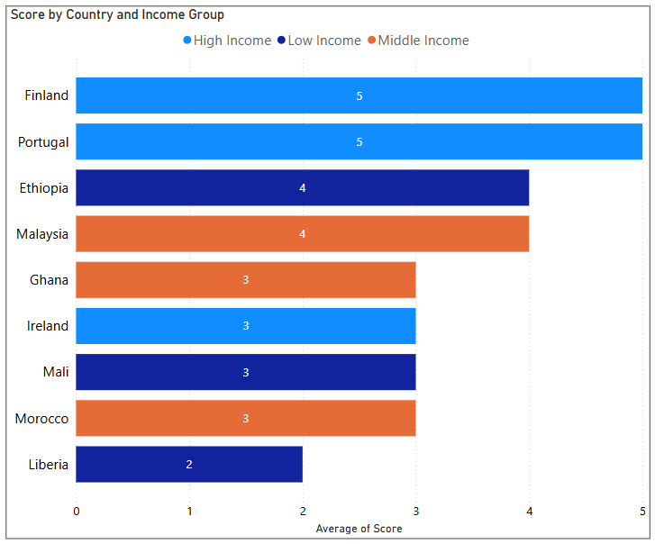
Results

Slide 22
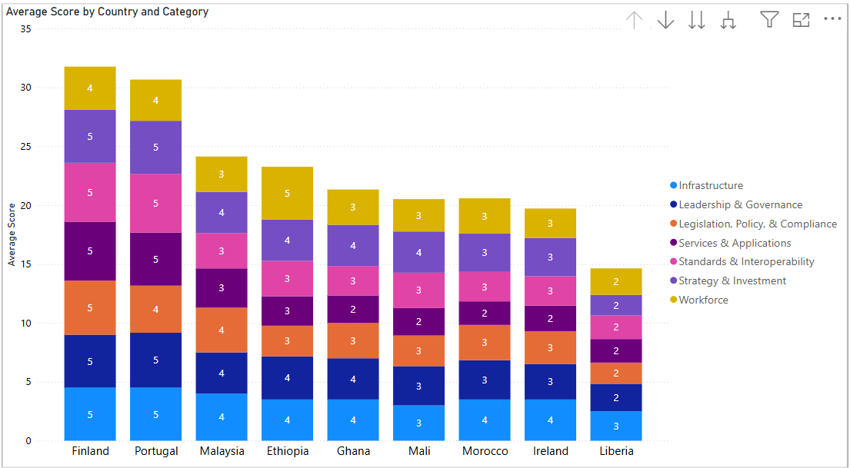
Results

Slide 23
Discussion
High-income countries have implemented proven frameworks that are scalable and adaptable for lower-income contexts. For instance:
Finland’s Kanta platform enables seamless health data sharing and consent-driven access, it has integrated ePrescription systems, national health information exchange (HIE), and AI-powered patient-facing tools (e.g., Omaolo), which could be modeled by countries with fragmented infrastructures.
Portugal’s comprehensive ePrescription lifecycle and national standards provide a replicable template for countries aiming to digitize clinical workflows.
Middle-income countries such as Malaysia, Morocco and Ghana are transitioning towards higher maturity, with digital health strategies in place, growing digital literacy, and foundational infrastructure.
Ghana’s Government is commited to digital transformation (Ghana Digital Health Strategy), but faces challenges like limited broadband access to rural areas and trained workforce shortages.
Morocco: Morocco has developed a National eHealth Strategy (2020–2025)
Low-income countries ( Mali, Liberia) demonstrate functional systems (e.g., DHIS2), yet face structural limitations including fragmented governance, weak legal ecosystems, limited private investment, and infrastructure challenges.

Slide 24
Discussion
Despite its high-income status, Ireland shows limited digital health maturity, due to fragmented and legacy IT systems, many of which are not interoperable. There are partial frameworks for data protection and governance, but workforce capacity, and AI readiness are still underdeveloped.
Strategy / Policy | Proven In
Centralized architecture with HIE (e.g., Kanta) | Finland
AI-enabled patient engagement (e.g., Omaolo) | Finland
ePrescription lifecycle with legal integration | Portugal
GDPR-style privacy & data control laws | Finland, Portugal
Public–private innovation partnerships | Portugal
Political prioritization, early adoption of digital health | Ethiopia

Slide 25
Discussion
Countries | GDHM Scores(2023) | Current Scores(2025)
Finland | 5 | 5
Portugal | 5 | 5
Ireland | 2 | 3
Ghana | 3 | 3
Malaysia | 4 | 4
Morocco | 2 | 3
Mali | 3 | 3
Ethiopia | 4 | 4
Liberia | 2 | 2

Slide 26
Conclusion
This study demonstrates the importance of structured digital health maturity assessments in understanding the evolving digital landscape across varying national contexts. To bridge the maturity gap, low-income countries must prioritize:
Enacting and enforcing digital health legislation
Strengthening digital health workforce pipelines
Investing in scalable and interoperable infrastructure
Promoting patient-facing digital tools
Promoting Public Private Partnerships
Ultimately, digital health equity is achievable through informed policy design, sustained investment, and international knowledge sharing. These findings serve as a guide for targeted interventions and support the global agenda of strengthening health systems through digital transformation.

Slide 27
References
Kanta Services. My Kanta Pages. Finnish Institute for Health and Welfare. [Internet]. [cited 2025 Jun 14]. Available from: https://www.kanta.fi/en/web/guest/my-kanta-pages
Federal Ministry of Health, Ethiopia. Digital Health Blueprint 2021–2025. [Internet]. 2021 [cited 2025 Jun 14]. Available from: https://extranet.who.int/countryplanningcycles/sites/default/files/public_file_rep/ETH_Ethiopia_Digital-Health-Blueprint_2021.pdf
Ministry of Health, Ethiopia. Official Website. [Internet]. [cited 2025 Jun 14]. Available from: https://www.moh.gov.et/index.php/en
Ministry of Health, Ghana. Policy and Strategy on Digital Health 2023–2027. [Internet]. 2023 [cited 2025 Jun 14]. Available from: https://extranet.who.int/countryplanningcycles/sites/default/files/public_file_rep/GHA_Ghana_Policy-and-Strategy-on-Digital-Health_2023-2027.Pdf
Ministry of Health, Ghana. UHC Roadmap 2020–2030. [Internet]. 2020 [cited 2025 Jun 14]. Available from: https://www.moh.gov.gh/wp-content/uploads/2021/08/UHC-Roadmap-2020-2030.pdf
Health Service Executive, Ireland. Digital for Care 2024–2030. [Internet]. [cited 2025 Jun 14]. Available from: https://www.ehealthireland.ie/Strategic-Programmes/Digital-for-Care-2024-2030.pdf
Medic. Transforming Global Health: Medic’s Pledge to a Community-Owned Digital Future. [Internet]. [cited 2025 Jun 14]. Available from: https://medic.org/stories/transforming-global-health-medics-pledge-to-a-community-owned-digital-future/
OpenGov Asia. Malaysia Leverages AI to Improve Healthcare. [Internet]. 2025 Feb 7 [cited 2025 Jun 14]. Available from: https://opengovasia.com/2025/02/07/malaysia-leverages-ai-to-improve-healthcare/
World Bank. Malaysia: Health Systems Reform Project (P168812). [Internet]. [cited 2025 Jun 14]. Available from: https://projects.worldbank.org/en/projects-operations/project-detail/P168812
DataGuidance. Mali - Data Protection Overview. [Internet]. [cited 2025 Jun 14]. Available from: https://www.dataguidance.com/jurisdictions/mali
Government of Morocco. Public Policies in Health and Social Protection. [Internet]. [cited 2025 Jun 14]. Available from: https://www.maroc.ma/en/strategies-and-public-policies/public-policies-health-and-social-protection
Digital Health Portugal. National Digital Health Strategy. [Internet]. [cited 2025 Jun 14]. Available from: https://www.digitalhealthportugal.eu/

Slide 28


Community Outreach Program

Slide 29
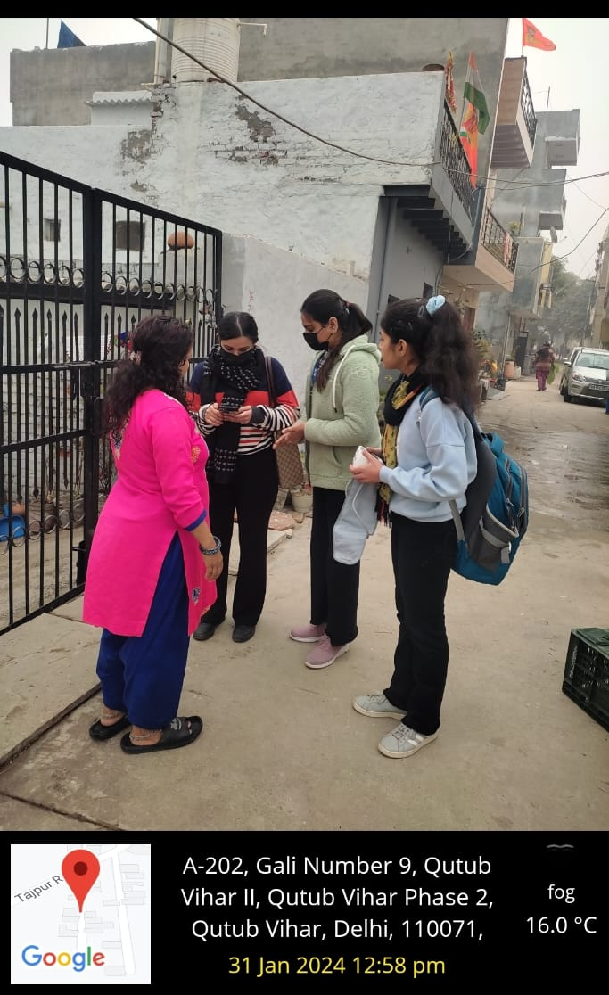
Goyla Dairy Visit

Slide 30
Thank You
Any Questions

