Slide 1

Patient-Centered Decision-Making in Third Molar Management
IIHMR,DELHI
Presented by: Dr. Arpita Lohani
Faculty Mentor : Dr. Preetha
IIHMR Delhi

Slide 2
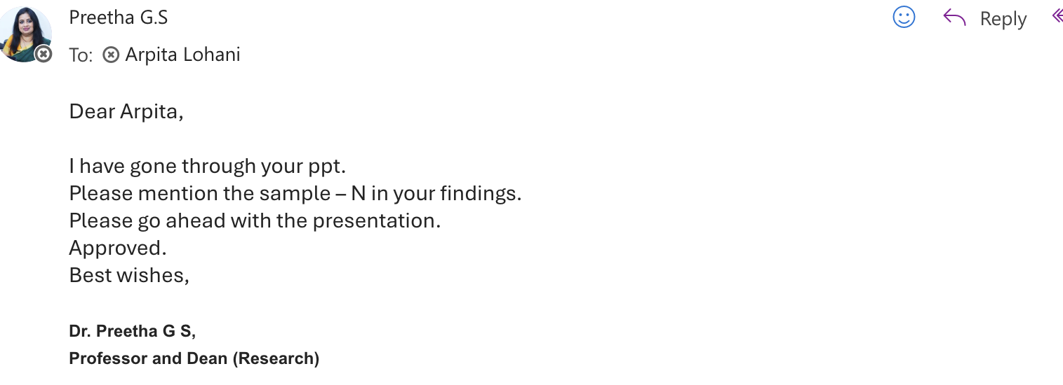
Mentor Approval

Slide 3
Introduction
Patients often struggle with deciding whether to remove third molars as a preventative measure.
Key factors influencing this decision include:
Concerns about pain, recovery, and long-term consequences
Recommendations from dental professionals
Trust and financial considerations
Understanding these can improve shared decision-making and patient-centered care in dentistry.

Slide 4
Literature Review
Shared Decision-Making (SDM) in Dentistry: SDM is increasingly recognized as a vital component in dental care, promoting patient autonomy and informed consent. However, its implementation varies across practices, with some dentists focusing more on information provision than collaborative discussions.
Patient Preferences vs. Perceived Roles: Studies indicate a discrepancy between patients' desired involvement in decision-making and their actual experiences. Many patients prefer a more active role than they perceive they are given during dental consultations. ​
Third Molar Extraction Decisions: Decision-making regarding third molar extractions is influenced by various factors, including the dentist's experience and the patient's understanding of potential risks and benefits. Younger dentists may recommend extractions more frequently, highlighting the need for standardized guidelines. ​

Slide 5
Objectives of Your Study
Primary Objective:
To explore factors influencing patient decision-making regarding third molar extraction.
Secondary Objectives:
To analyze the impact of dentist recommendations on patient choices.
To promote patient-centered care by supporting shared decision-making frameworks.

Slide 6
Methodology
Study Design:
cross-sectional study
Mixed-methods (quantitative + qualitative)
Cross-sectional surveys and interviews
Sampling:
Purposive sampling of patients and dental professionals
Participants:
Patients: 150–200 for surveys
Dental Professionals: 5 for interviews
Case Studies: 5 detailed patient consultations
Study Population
Patients aged 18–40 advised to consider third molar extraction.
Dental professionals (general dentists and oral surgeons) involved in their care.

Slide 7
Methodology
Data Collection:
Online patient surveys (Likert scale, multiple choice)
Semi-structured interviews with dentists and oral surgeons
Review of patient consultation cases
Data Analysis:
Quantitative: Statistical analysis of survey data with SPSS.
Qualitative: Thematic analysis of interviews and case narratives
Ethical Considerations:
Informed consent, anonymity, and confidentiality ensured

Slide 8
Annexures
Patient Survey Tool
Interview Guide for Dental Professionals
Interview Guide for case study
Informed Consent Format

Slide 9
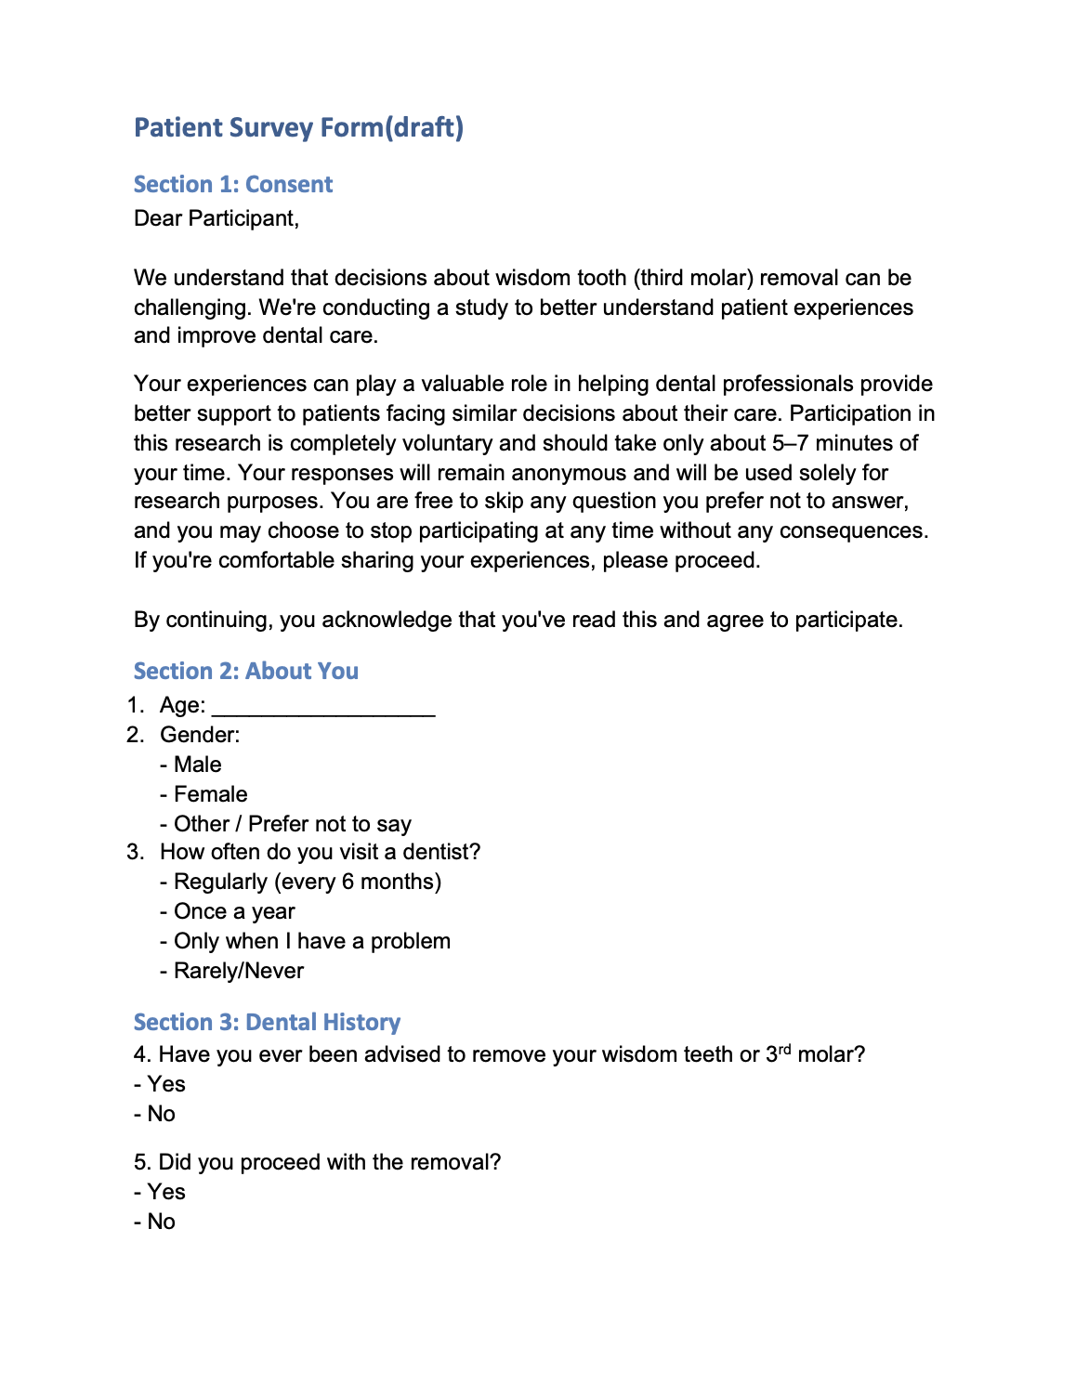
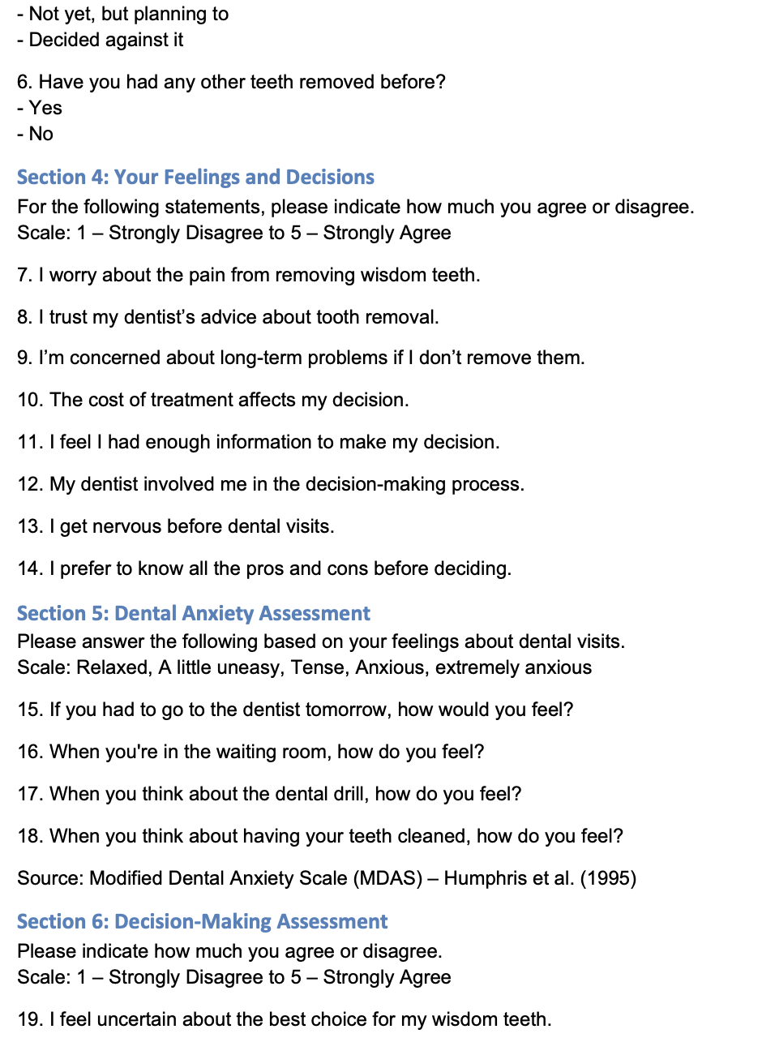

Slide 10
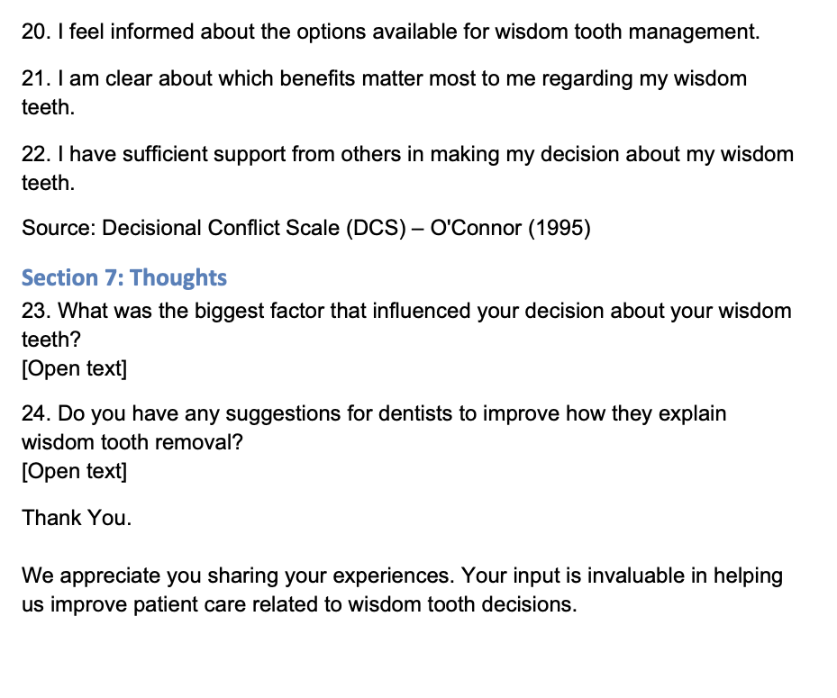

Slide 11
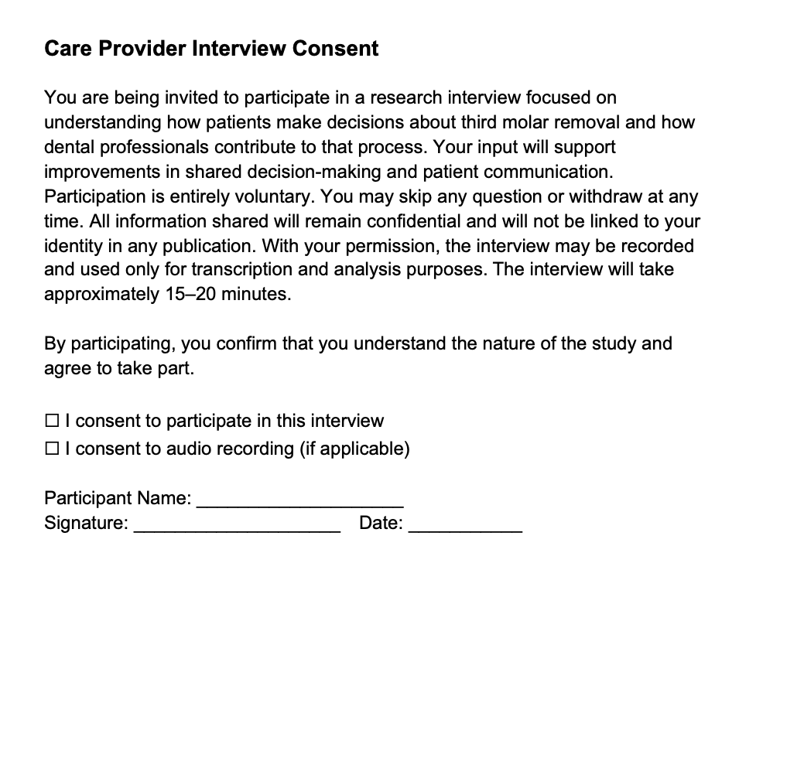
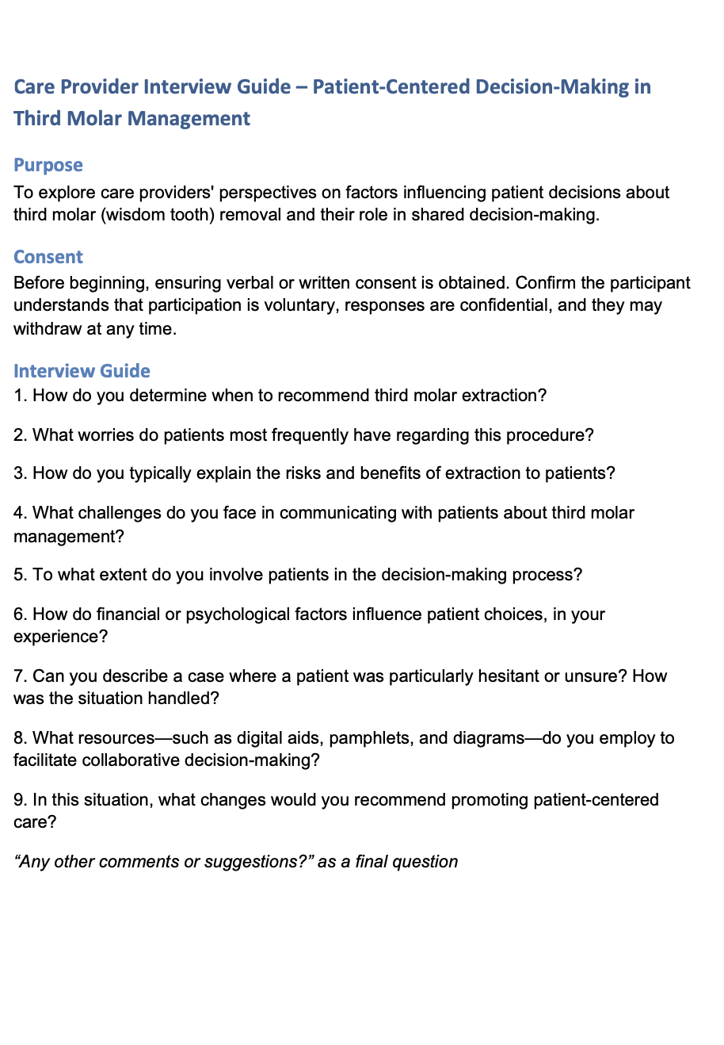

Slide 12
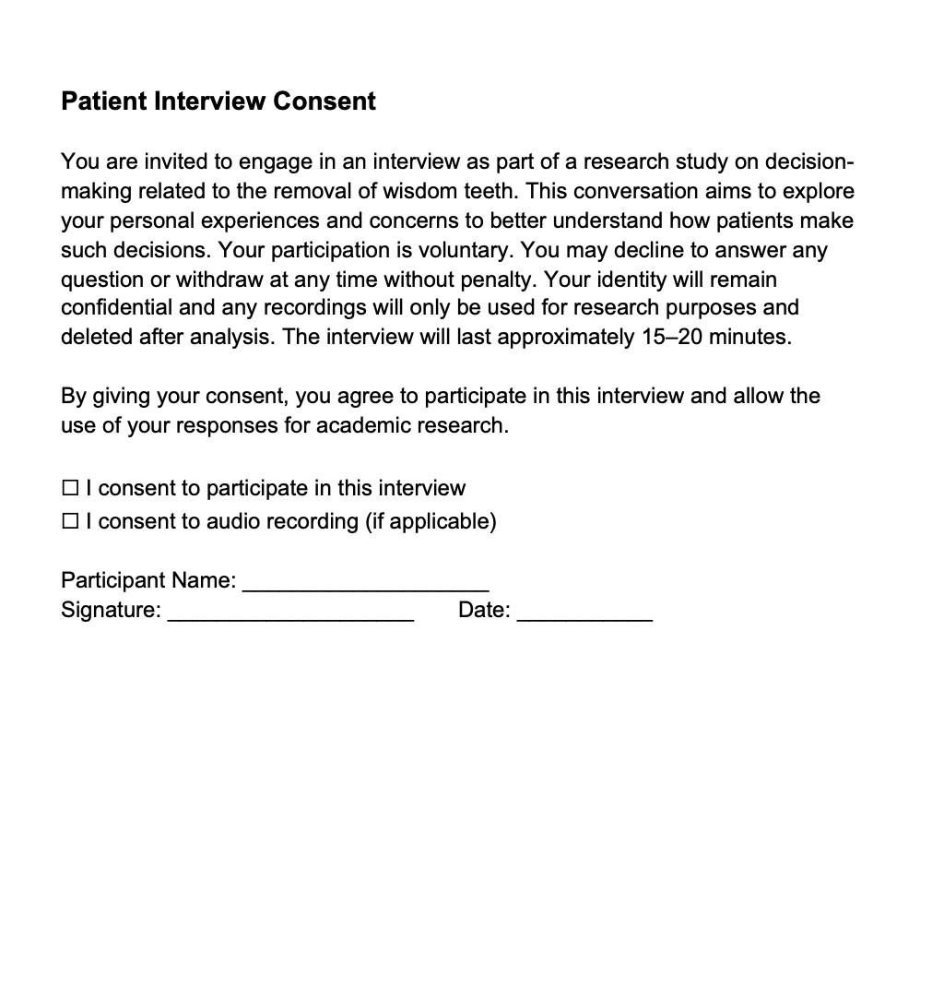
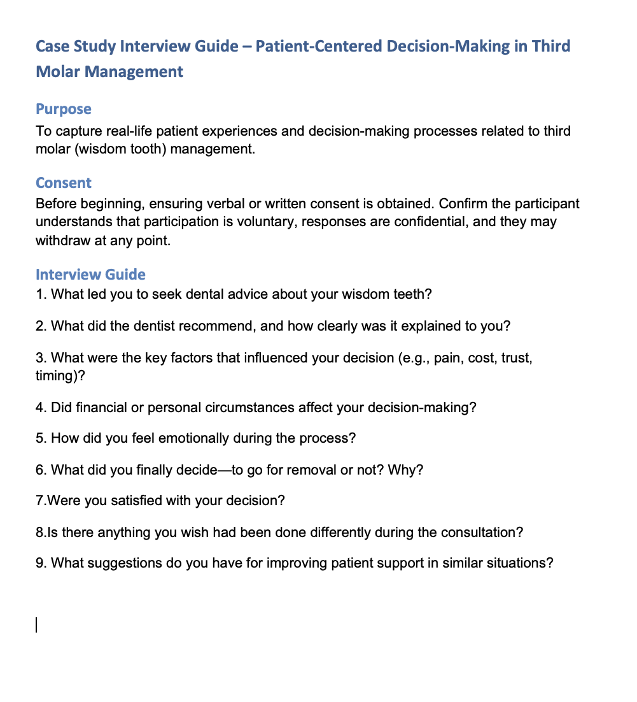

Slide 13
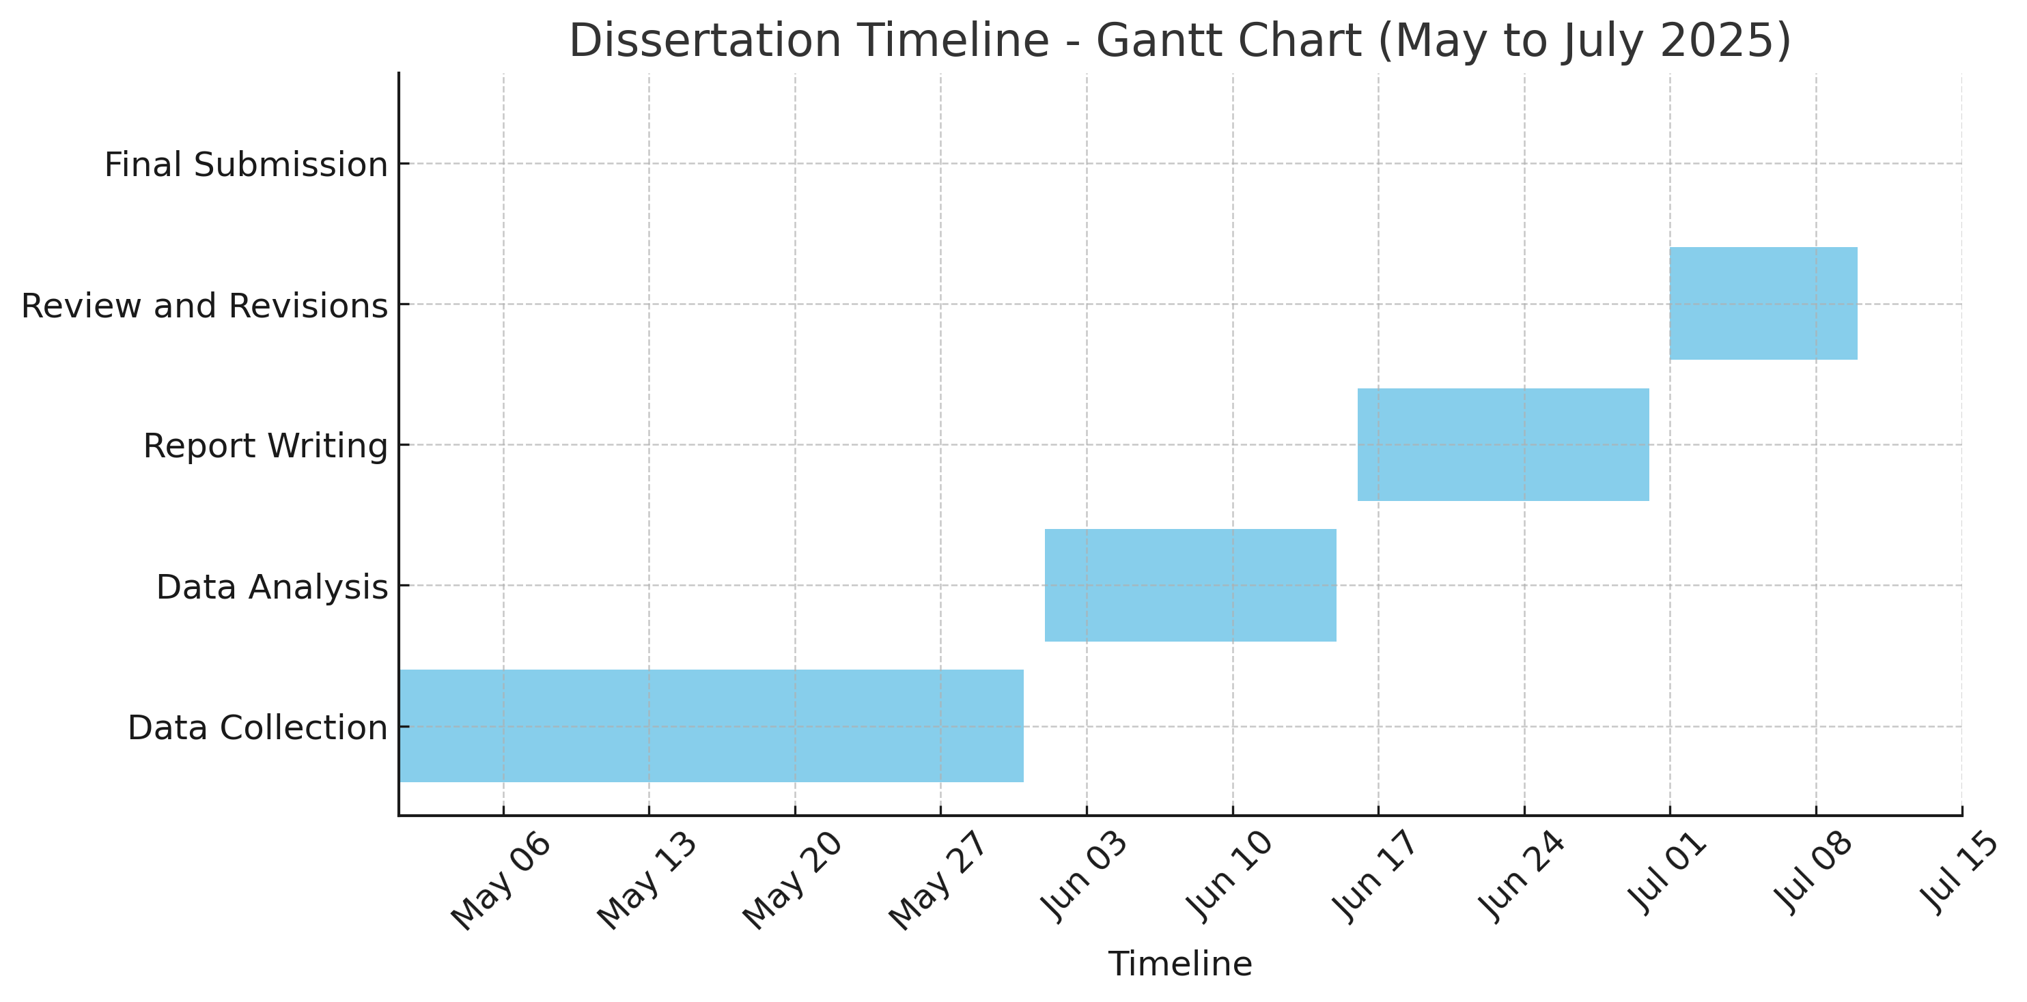
Timeline(Estimated)

Slide 14
Expected Outcomes
Clear understanding of patient attitudes toward third molar extraction.
Identification of key decision-making factors.
Practical recommendations to strengthen SDM in dental settings.

Slide 15
Results (Quantitative Survey)
• Patients moderately worry about pain (Mean = 3.43).
• Trust in dentist advice is positive but varied (Mean = 3.45).
• Long-term consequences are a concern (Mean = 3.57).
• Cost moderately affects decisions (Mean = 3.25).
• Some decision uncertainty exists (Mean = 3.26).
Sample Size (n Values)
Total survey respondents (patients): n = 153
Total interviews conducted with dental care providers: n = 5
Patient case studies reviewed: n = 5

Slide 16
Decision Factors and Preferences
Top influencing factors reported by patients:
- Pain and dentist advice (70 mentions each)
- Cost (64), Family opinion (59), Fear of surgery (49)
• Patients strongly prefer knowing all pros and cons (Mean = 4.29).
• Moderate dental anxiety observed (Mean = 3.32).

Slide 17
Qualitative Insights (Thematic Analysis)
Key themes from dentist and patient interviews:
• Fear of pain, myths (e.g., vision loss), and cost impact decisions.
• Patients trust visual explanations like X-rays, videos.
• Family involvement and regional language resources help.
• Clear post-op guidance is often lacking.
• Dentists suggest more awareness campaigns to improve decisions.

Slide 18
Thematic Analysis Table
Fear of Pain and Recovery | Patients delayed treatment due to fear of pain and post-surgery effects; pain was the most cited concern.
Common Misconceptions | Many patients feared that extraction could affect eyesight; this required myth-busting by dentists.
Communication and Trust | Visual aids, simplified language, and personalized explanations increased patient trust.
Financial and Psychological Barriers | Cost of treatment and emotional anxiety led to postponement or avoidance of surgery.
Shared Decision-Making and Family Role | Decisions were often influenced by family; dentists encouraged family participation and flexible payment options.
Desire for Better Support and Awareness | Patients sought more post-op care guidance and resources in regional languages; dentists recommended awareness campaigns.

Slide 19
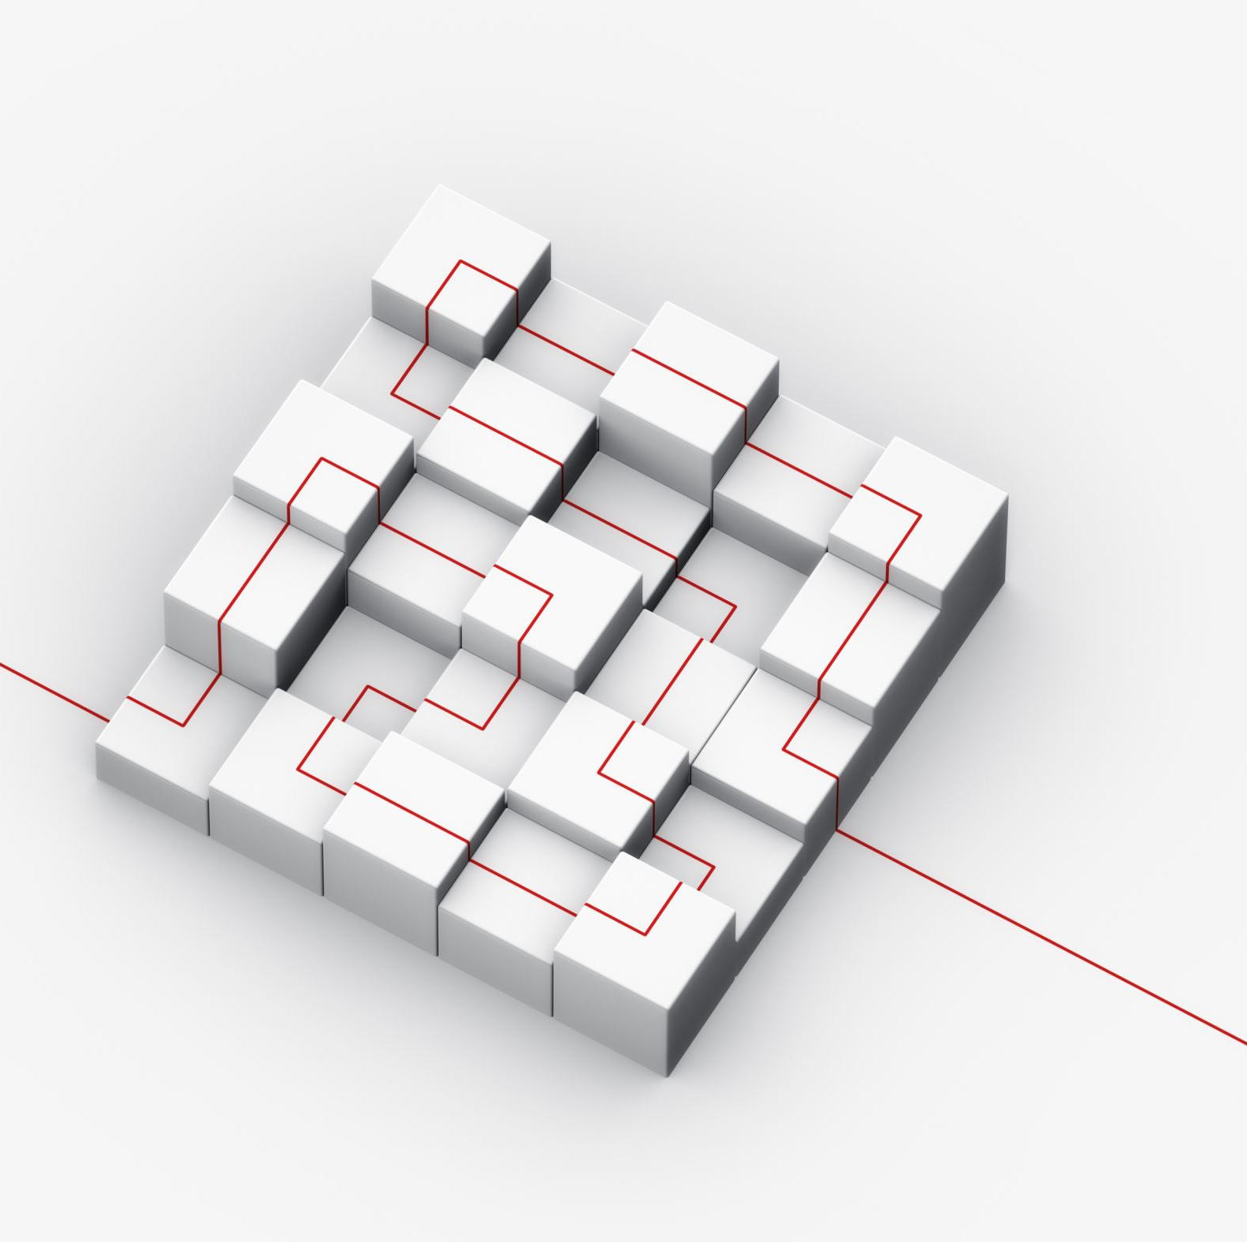
Limitations
• Purposive sampling may reduce generalizability.
• Self-reported responses are subject to bias.
• Limited geographical and linguistic diversity among respondents.
• The design does not track changes in patient perception over time.

Slide 20
Conclusions
Decisions about wisdom tooth removal are shaped by pain, cost, trust, and anxiety.
Visual tools and local language help build trust and understanding.
Financial concerns and myths (e.g., vision loss) delay timely treatment.
Family involvement is common and culturally significant in India.
Patients want clearer guidance and more participation in decisions.

Slide 21
Recommendations
Use visual and language-friendly tools to explain procedures.
1
Involve patients and families in shared decision-making.
2
Offer flexible payment or government options to reduce cost barriers.
3
Run awareness campaigns to correct common myths.
4
Provide simple aftercare guides in regional languages.
5
Study long-term changes in patient decisions and behavior.
6

Slide 22
Management Implications
• Improve patient satisfaction through tailored communication.
• Standardize decision-making using visual tools and checklists.
• Reduce no-shows by addressing cost and fear upfront.
• Allocate resources effectively based on patient needs.
• Train staff in empathy and patient-centered care.
• Design preventive services and outreach based on cultural insights.

Slide 23
References
Camargo IB, Melo AR, Fernandes AV, Cunningham LL Jr, Laureano Filho JR, Van Sickels JE. Decision making in third molar surgery: a survey of Brazilian oral and maxillofacial surgeons. Int Dent J. 2015 Aug;65(4):169-77. doi: 10.1111/idj.12165. Epub 2015 Apr 16. PMID: 25879578; PMCID: PMC9376505.
Benecke M, Kasper J, Heesen C, Schäffler N, Reissmann DR. Patient autonomy in dentistry: demonstrating the role for shared decision making. BMC Med Inform Decis Mak. 2020 Dec 2;20(1):318. doi: 10.1186/s12911-020-01317-5. PMID: 33267847; PMCID: PMC7709219.
Asa'ad F. Shared decision-making (SDM) in dentistry: A concise narrative review. J Eval Clin Pract. 2019 Dec;25(6):1088-1093. doi: 10.1111/jep.13129. Epub 2019 Mar 28. PMID: 30920092.

Slide 24
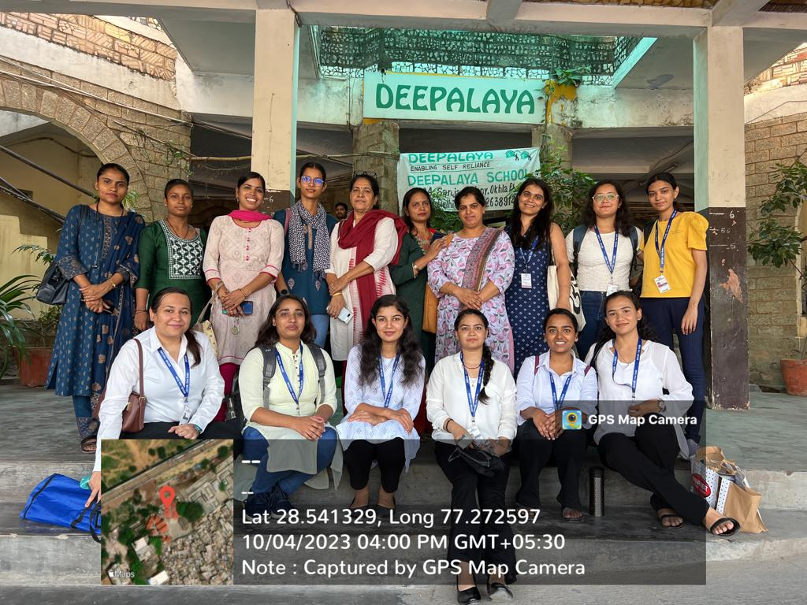
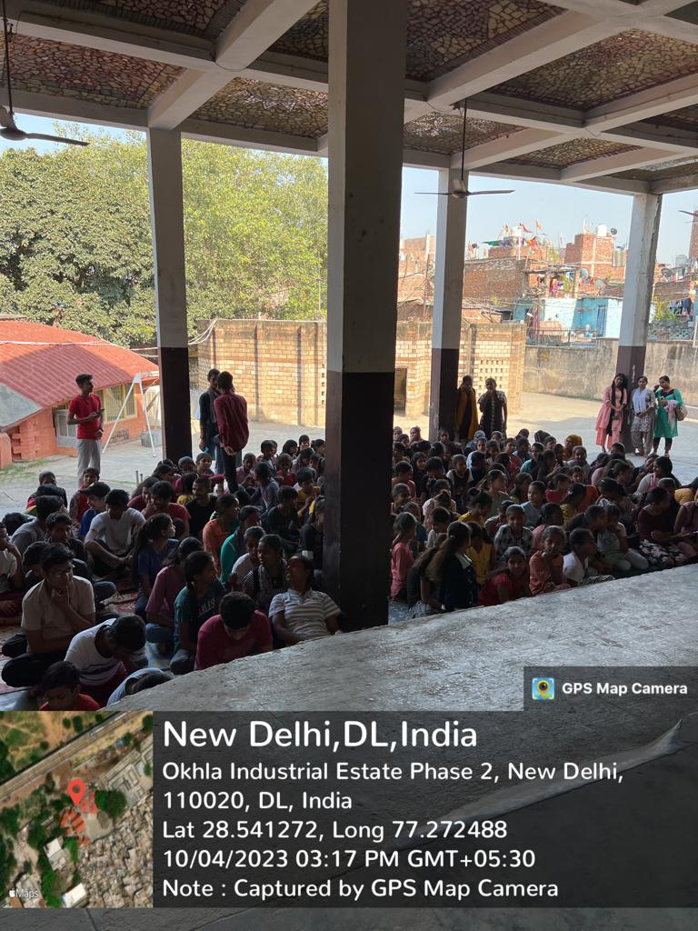
COP FIELD ACTIVITIES PHOTOGRAPHS

Slide 25
Thank You
Any Questions

