Slide 1

Dissertation Proposal
By:
Dt. Priya Bansal
PG/23/083 (2023-25)
International Institute of Health Management Research

Slide 2
Project name: “Prevalence of iron deficiency Anaemia among the population of Delhi NCR and promotion of healthy growth and development through early detection, awareness, referral, and treatment through IFA tablets and food intervention” by
Doctors For You
In association with
Metropolis Foundation submitted to
IIIHMR Delhi

Slide 3
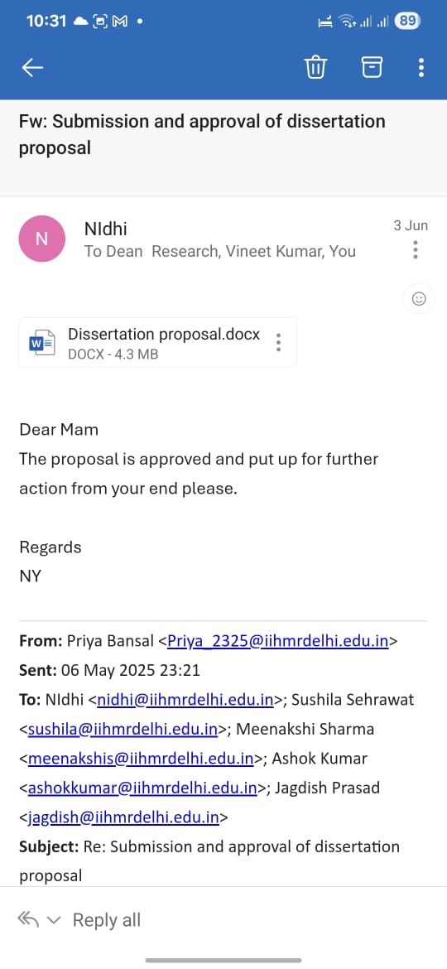
Mentor Approval

Slide 4
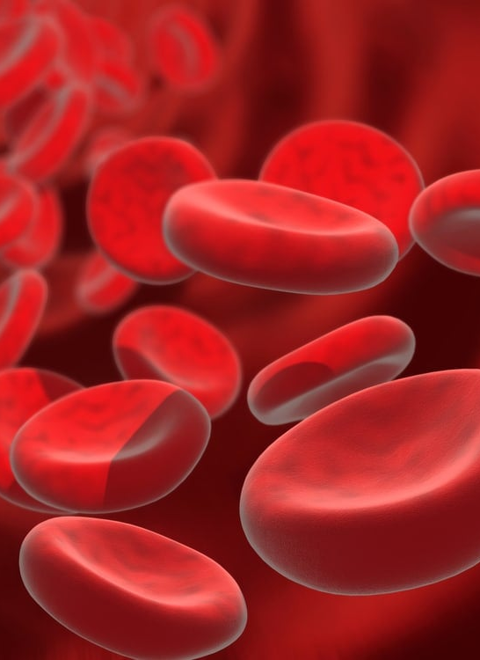
Introduction
Anaemia due to iron deficiency affects around 30% of the global population and 37% of school children. In India, anaemia is highly prevalent, especially among children and women, with rates ranging from 27% to 90% across studies. According to NFHS-5 (2019–21), 67.1% of children (6–59 months) and 57% of women (15–49 years) are anaemic, showing an increase from previous years. Iron deficiency contributes to poor pregnancy outcomes and 20% of maternal deaths. Anaemia in children leads to delayed development and reduced cognitive abilities. Environmental and socioeconomic factors significantly influence its prevalence.
This Photo by Unknown Author is licensed under CC BY-SA-NC

Slide 5
General Objectives
To identify and address anaemia among the population of Delhi NCR, promoting healthy growth and development through early detection, awareness, referral, and treatment with IFA tablets and Food intervention.

Slide 6
Specific Objectives
To reduce the prevalence of anaemia among the population of Delhi NCR.
To check the effectiveness of food intervention for improving haemoglobin levels.
Enhance the awareness among children, adolescents, adults and the elderly about anaemia and healthy foods to treat it.

Slide 7
Methodology
Study design- Pre-post intervention study
Study period- 3 Months.
Study setting- Delhi NCR
Study population- Indian population aged 5 years and above.
Inclusion criteria:
Respondent should be at least 5 years old or above.
Residents of Delhi.
  -

Slide 8
Methodology
3. Both males and females are included.
4. For nutrition kits/food intervention: Only anaemic (mild, moderate, and severe) males with age between 5-9 years and only anaemic (mild, moderate and severe) females with age between 5-20 years.
Exclusion criteria:
Children who will be 4 + years, even 1 day less to 5 years
People did not consent to participate in the survey.

Slide 9
Sampling technique- Convenience sampling.
Sample size estimation- The sample size is 1000 study participants.
Study variables:
Independent Variables:
Iron Folic Acid tablets (IFA tab): It will be the count of the population who received the IFA tablets.
Nutrition Kit: It will count the population who received the food intervention.
Demographic factors: Age, gender, and location.

Slide 10

To be continued:
Dependent Variables:
Anaemia screening: It will state the prevalence of anaemia in the population of Delhi NCR.
Effectiveness of Food Intervention
Awareness and Behavioural Change through Improvement in dietary habits, and Adherence to supplementation or dietary recommendations
This Photo by Unknown Author is licensed under CC BY

Slide 11
Results
The number of people made aware of anaemia is 18,394.
The number of screenings done is 16,866.
The number of anemics is 6,659.
5,325 people referred to PHC/Meena Devi Jindal Hospital for further treatment or advanced diagnosis.
The number of people given the Iron-Folic Acid tablet/No. of people received treatment is 3,782.
The number of Nutrition kits distributed to anemics is 1,428.
36 schools participated in the study.
The number of anemics followed up is 4,782.
1,004 repeat tests had been done.
642 anaemics got treated or reversed their anaemia with the help of food intervention and IFA tablets.

Slide 12
Results
The beneficiaries were categorized by age, including 4,651 children aged 5-9 years, 6,240 adolescents aged 10-19 years and 5,975 adults aged 20 and above.

Slide 13
Discussion
The project successfully conducted 16,866 screenings, identifying 6.659 individuals as anaemic. However, anaemia referrals were significantly lower, with only 6460 referred out of the 6,730 anaemic cases. Follow-up tests were also a challenge, with no re-testing initially, but improvements were observed in later months. Children’s screening numbers stood at 4,652 due to difficulties in school permissions. A total of 1,428 nutrition kits were distributed to anaemic individuals to support dietary improvements. Haemoglobin improvement was recorded in 642 beneficiaries only, due to challenges in tracking and follow-ups. The total number of schools covered was 36, primarily due to access restrictions. The number of anaemic cases identified was 6,659, while only 3,782 beneficiaries received IFA tablets, indicating a significant gap. Initially, medicines were not distributed at the campsite; instead, anaemic individuals were given referral slips to collect their medication from the MDJ Hospital. However, due to the distance between the communities and the hospital, the turnout for the collection was low. Recognising this challenge, the distribution process was revised, and from November onwards, IFA tablets were provided directly at the campsite to ensure better accessibility and adherence

Slide 14
Limitations
Despite efforts, the target for anaemia screenings among children aged 5-9 years was not achieved, and the improvement in haemoglobin levels also fell short of expectations. While, the number of beneficiaries with improved haemoglobin status increased with time, overall progress remained low. The primary reason for this shortfall was the lack of government permission to conduct screenings in schools, which led to re-testing in community settings instead. Unlike schools, where attendance is strict, a community-based re-testing faced challenges such as lower turnout, irregular participation, and difficulties in mobilisation.
Government Permissions: The lack of authorisation to conduct screenings in schools significantly affected outreach and participation.
Repeat Testing Challenges: Conducting follow-up tests in community settings proved to be a major hurdle. Unlike schools, where students are easily accessible, community-based setups make it difficult to trace and re-engage the same beneficiaries for repeat haemoglobin testing, leading to gaps in continuity and monitoring.
Moving forward, engaging with government authorities to secure school permissions and exploring alternative screening locations such as community centres or anganwadis were critical to improving outreach and ensuring the program's continued success.

Slide 15
References
RJD Moy, Editorial. New approaches to the detection and prevention of iron-deficiency /anaemia, Journal of Tropical Pediatrics, Volume 45, Issue 6, December 1999, Pages 320–321, https://doi.org/10.1093/tropej/45.6.320
ANAEMIA MUKT BHARAT. (n.d.). https://pib.gov.in/PressReleasePage.aspx?PRID=1795421
K. Ghosh, G.S. Desai Prevalence and detecting spatial clustering of anaemia among children 6–59 months in the districts of India Clinical Epidemiology and Global Health, 12 (June) (2021), Article 100845, 10.1016/j.cegh.2021.100845
Ministry of Health and Family Welfare, Gupta, A., Kumar, R., Salhotra, V. S., Mohan, A., Rahi, S., Kapil, U., Sachdev, H., Kotecha, P., Mittal, S., Ramachandran, P., Singh, A., Saxena, V., Ray, R., Azad, G. N., Pradhan, P. K., & Gupta, A. (2013). Guidelines for control of iron Deficiency Anaemia. https://www.nhm.gov.in/images/pdf/programmes/child-health/guidelines/Control-of-Iron-Deficiency-Anaemia.pdf

Slide 16
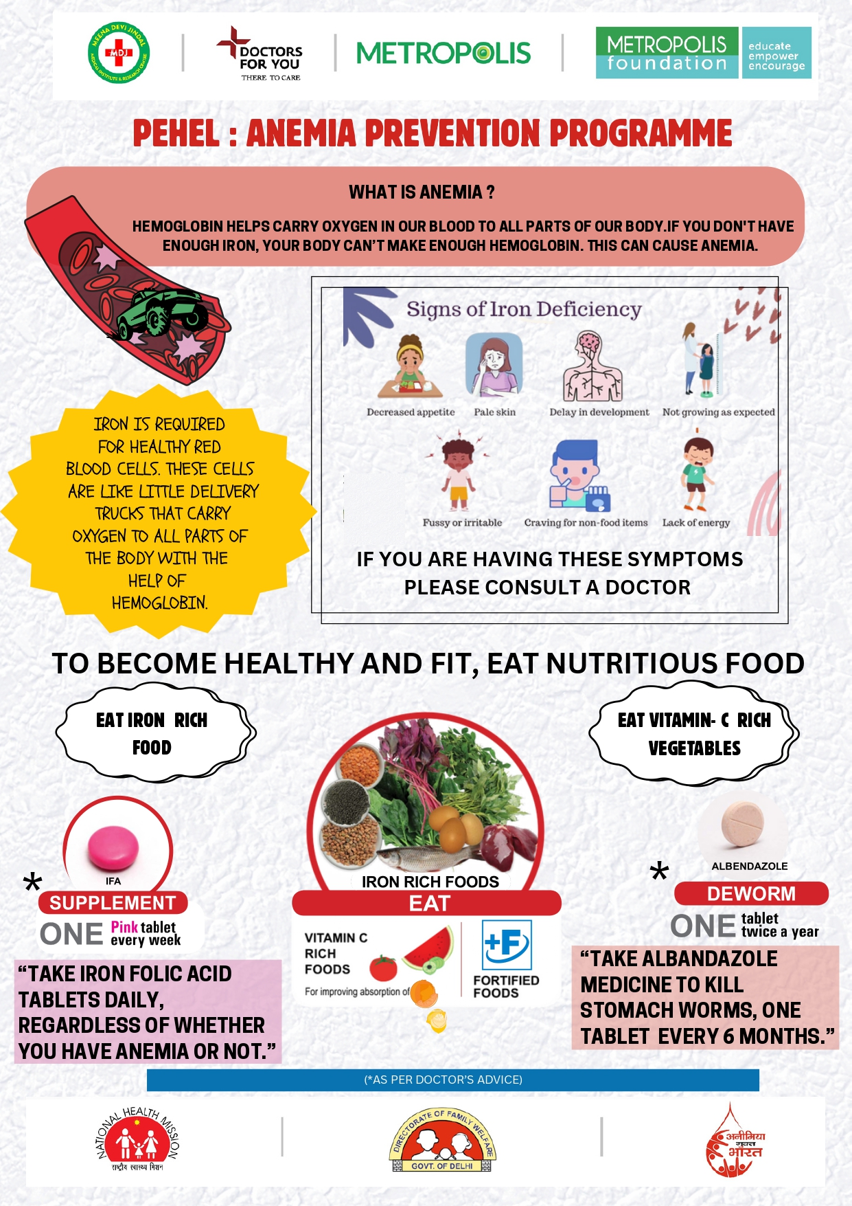

Slide 17
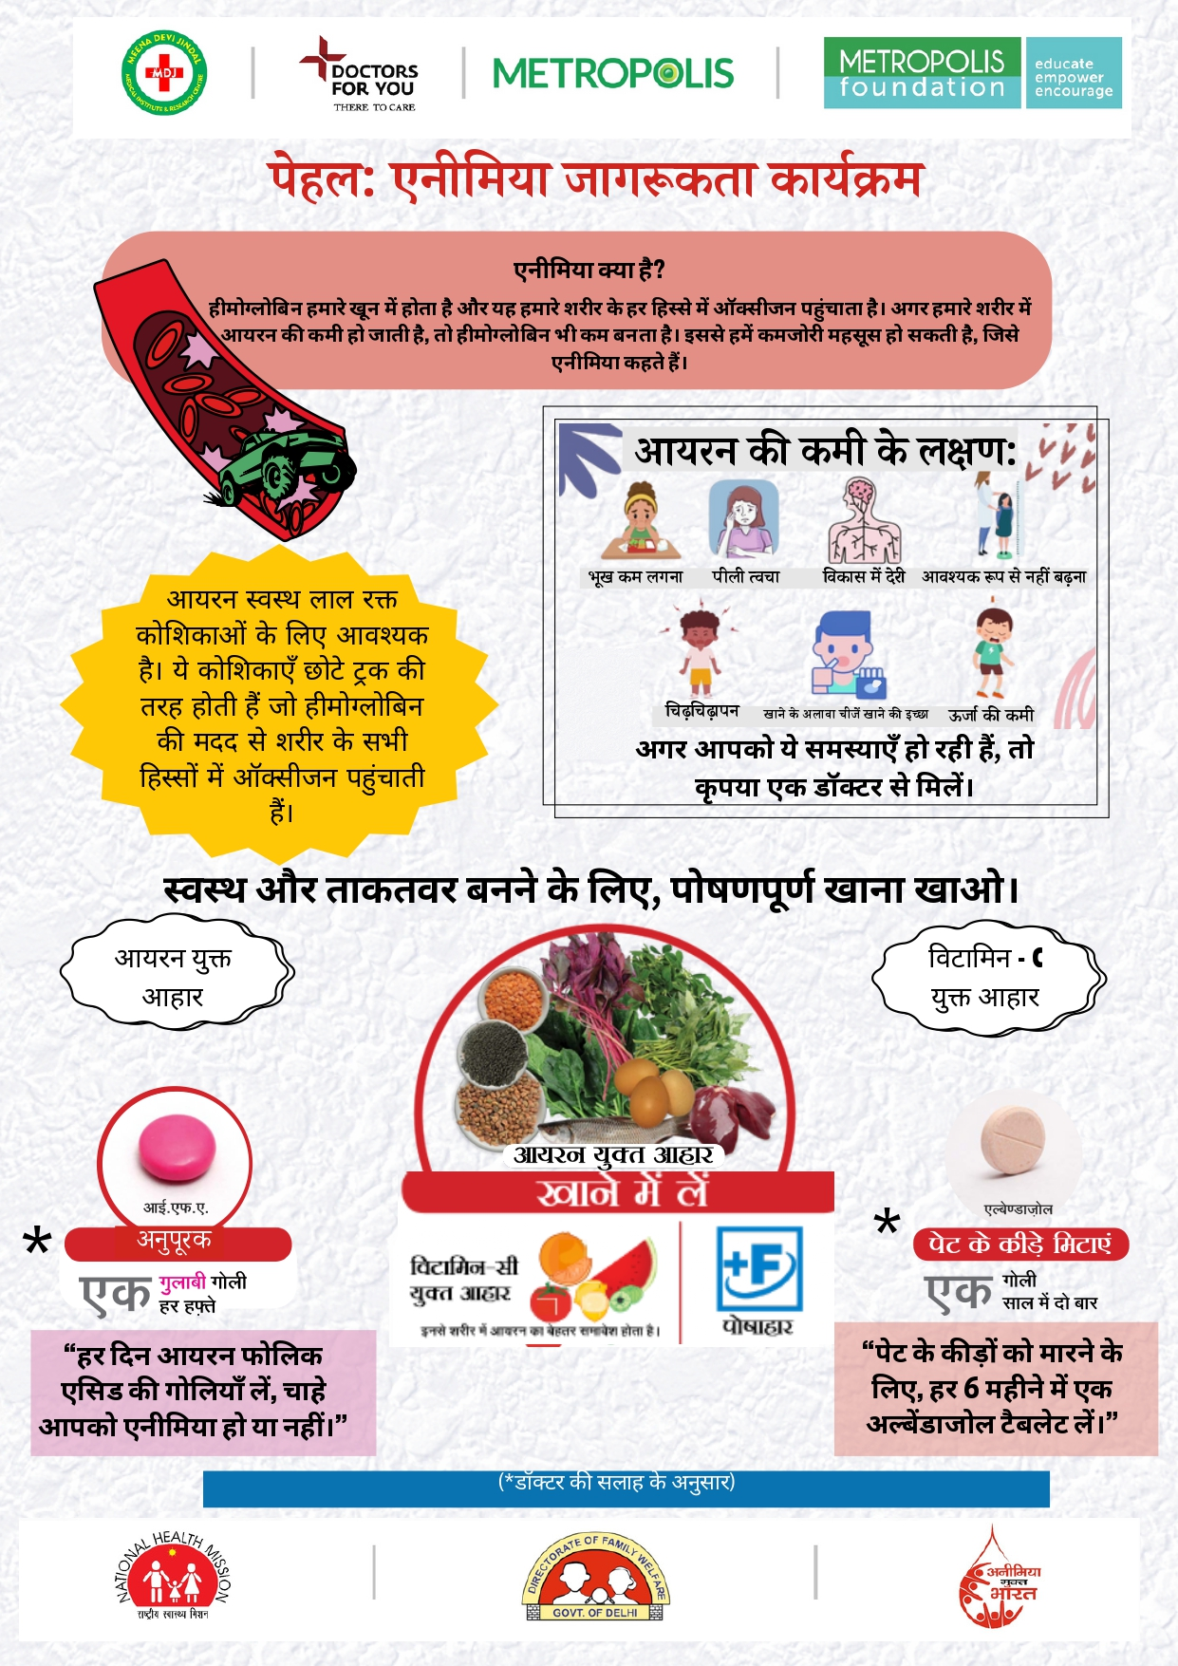

Slide 18







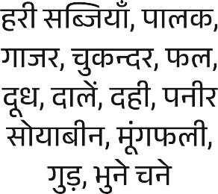






Slide 19


Slide 20
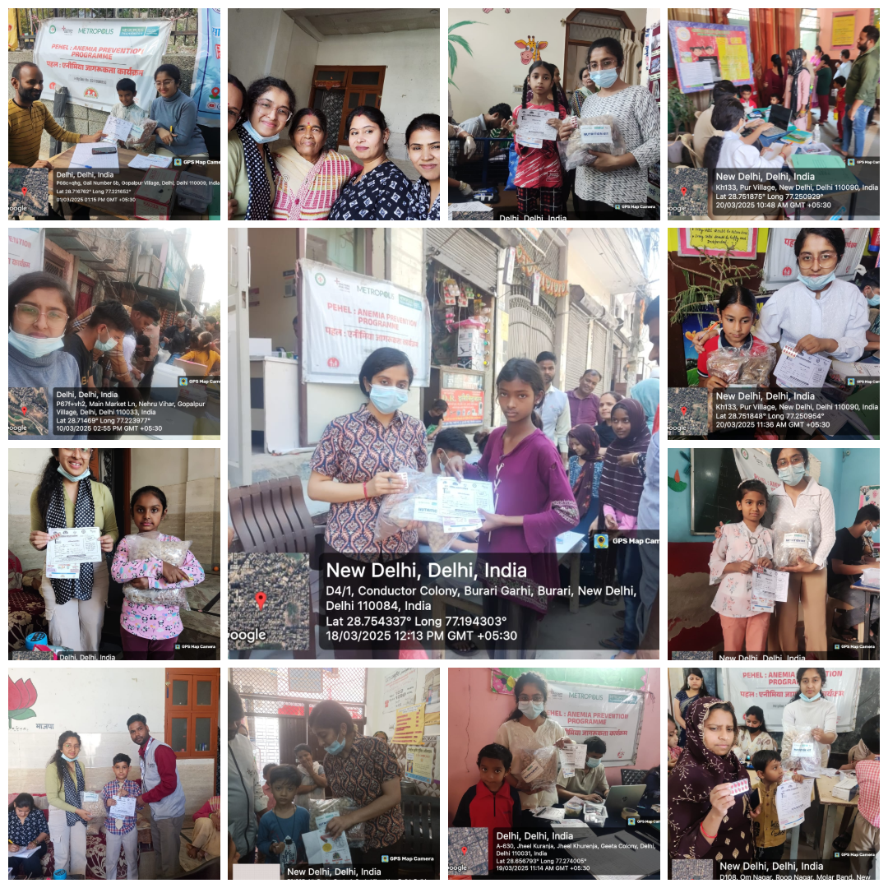

Slide 21
THANK YOU

