Slide 1

Enhancing Collaboration Between Insurance Companies and Healthcare Providers for Efficient Patient Management
DISSERTATION PRESENTATION BY
PRANICA CHOUDHARY
PGDM (Hospital and Health Management)
2023-2025
International Institute of Health Management Research, New Delhi

Slide 2
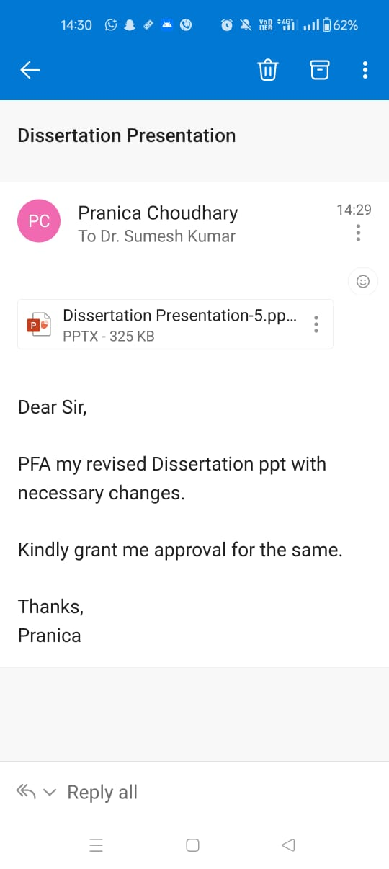
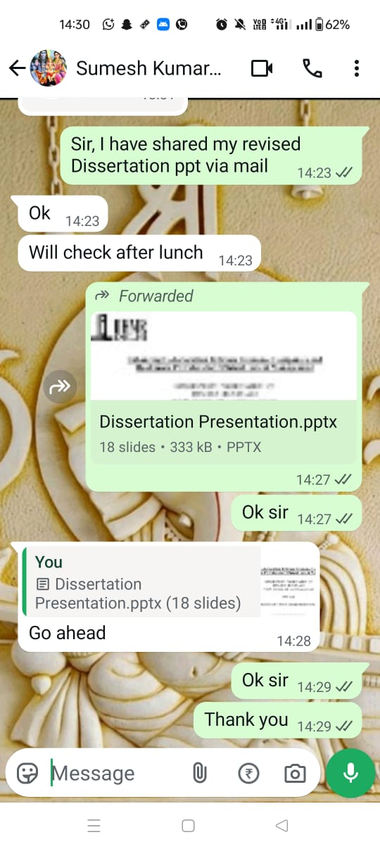
Mentor Approval

Slide 3
Introduction
Eexpedise Health, based in Gurgaon, operates at the intersection of healthcare and insurance, offering specialized support services that resemble the functioning of a medical tourism facilitator. The company bridges the gap between insurance companies, hospitals, and insured individuals to streamline the hospitalization and claims process, ensuring a smooth and efficient patient journey.
Our operations are divided into two core departments: Query and Claim.
1.The Claim Department plays a crucial role from the very beginning of the patient journey. It handles patients before hospital admission, assisting with documentation, eligibility checks, and coordinating with insurance providers to ensure a hassle-free admission process.
2.The Query Department, where I am currently involved, manages all hospital-side coordination from admission to discharge. This includes handling real-time queries, facilitating approvals, resolving discrepancies, and ensuring proper documentation throughout the patient's hospital stay.

Slide 4
Literature Review
Effective collaboration between healthcare providers and insurance companies is essential for ensuring timely and seamless patient care. Research highlights that communication gaps, delays in insurance approvals, and documentation errors significantly contribute to patient dissatisfaction and operational inefficiencies. Patient-centered care, which emphasizes aligning healthcare processes with patients’ needs—including transparency in billing and insurance communication—has been shown to improve outcomes and satisfaction. Delays in insurance processing and unclear documentation not only compromise patient safety but also hinder service efficiency, as reflected in findings where over 60% of patients experienced admission or discharge delays due to such issues. Building integrated communication systems between facilitators, hospitals, and insurers can help minimize stress, enhance clarity, and significantly improve the overall patient experience.

Slide 5

Objectives of Your Study
To interact with member (Insured Individual) and understand the challenges they face during the admission and discharge process.
To suggest a practical and simple framework to improve communication between Insured Individual, Healthcare providers and facilitators.

Slide 6

Methodology
Approach:
Qualitative research through direct telephonic interaction.
Data Collection:
Phone calls with 85 insured patients over 25 days(Total number of participants: A total of 95 participants were approached for the study through telephonic communication. Each individual was un contacted personally to explain the purpose of the research and to seek their willingness to participate. Out of the 95 individuals contacted, 85 provided a positive response and agreed to participate in the study).
Use of a question checklist to guide each conversation.
Duration per call: 5–10 minutes.
Patients selected from recent hospital (both in-network and out-of-network hospitals)

Slide 7
Methodology
Focus Areas:
Admission and discharge experience
Communication with hospital and facilitator
Issues with documents or approvals
Overall satisfaction and suggestions
Data Analysis:
Group responses into themes (e.g., delays, communication gaps, approval issues).
Using Bar graphs and Pie charts.

Slide 8
Questions asked to the member over phone call
I am calling from Eexpedise Health. We are collecting feedback to improve our hospital and insurance coordination services. The call will take around 5–10 minutes. Your responses will remain confidential and will be used only to improve our services. May I have your permission to ask a few questions regarding your recent hospital experience?“
QUESTIONS-Each question becomes a field:
Short answers for name, hospital, admission date
Paragraph/long answer for experience questions
Multiple choice (Yes/No) for clarity/delay-based questions
Linear scale (1–5) for satisfaction

Slide 9
Questions asked to the member over phone call
First of all, I took basic information of the patient like Patient Name ,Hospital Name, Date of Admission, Date of Call .
Q1: Member’s Admission Experience
Q2: Delay in Admission? (Yes/No)
Q3: Reason for Delay
Q4: Was Documentation Clear? (Yes/No)
Q5: Communication from Team
Q6: Could You Contact the Team Easily?
Q7: Support Satisfaction (1–5)
Q8: Insurance Approval Issues? (Yes/No)
Q9: Had to Resubmit Documents? (Yes/No)
Q10: Informed About Approval Status? (Yes/No)
Q11: Discharge Experience
Q12: Delay in Discharge? (Yes/No)
Q13: Reason for Discharge Delay
Q14: Billing & Insurance Clarity (Yes/No)
Q15: Biggest Challenge Faced
Q16: Satisfaction Rating (1–5)
Q17: Suggestions for Improvement |

Slide 10
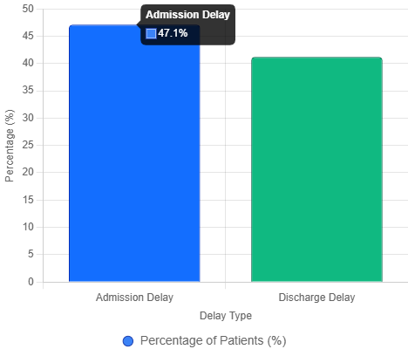
Results
Chart 1: Admission and Discharge Delays (Bar Chart)
This chart shows the percentage of member’s who experienced delays during admission and discharge .From the data, 47.1% (40/85) reported admission delays, and 41.2% (35/85) reported discharge delays.

Slide 11

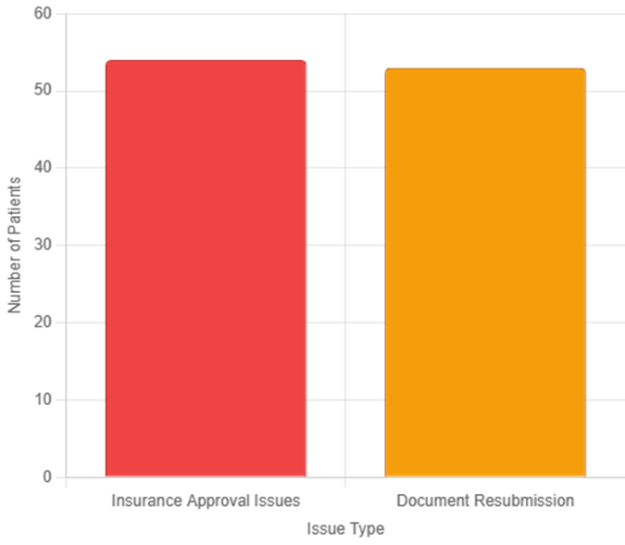
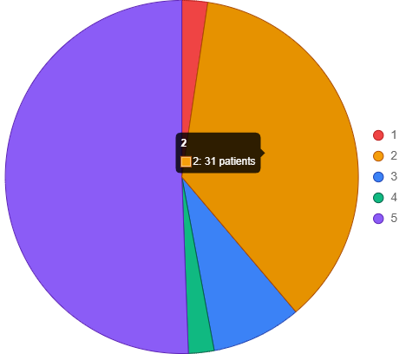
Results
Chart 3: Insurance and Documentation Issues (Bar Chart)
This chart shows the number of patients reporting insurance approval issues, 54/85 "Yes") and document resubmission, 53/85 "Yes").
Chart 2: Overall Satisfaction Ratings (Pie Chart)
This chart displays the distribution of overall satisfaction ratings. From the data: 1 (2 patients), 2 (31 patients), 3 (7 patients), 4 (2 patients), 5 (43 patients).

Slide 12

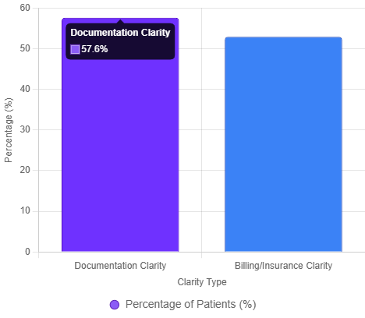
Results
Chart 4: No Clarity in Documentation and Billing (Bar Chart)
This chart compares the percentage of patients who found documentation not clear, 49/85 "Yes", 57.6%) and billing/insurance not clear, 45/85 "Yes", 52.9%).
Overall, the following results clearly provide a clear visual representation of patient experience challenges, with insurance and communication issues at the forefront. By addressing these pain points, hospitals can reduce delays, enhance clarity, and improve overall satisfaction, leading to better patient outcomes and operational efficiency. These findings are critical for my research, highlighting actionable areas for healthcare providers to enhance service delivery.

Slide 13
Suggestions
To suggest a practical and simple framework to improve communication between Insured Individual, Healthcare providers and facilitators.
Action | Responsible Party | Tools/Methods | Expected Outcome
Send pre-admission guide with document checklist | Healthcare Provider | Email, portal, brochure | Clearer documentation and fewer resubmissions
Assign single case coordinator | Facilitator | CRM, dedicated contact | Better coordination and easier contact with the patient
Automate status updates via SMS/portal | Healthcare Provider and Facilitator | SMS, portal notifications | More informed patients and fewer follow-ups

Slide 14

Suggestions
Action | Responsible Party | Tools/Methods | Expected Outcome
Pre-check insurance 3–5 days before admission | Facilitator | E-mail | Reduced insurance delays and faster admissions
Provide clear billing summary at discharge | Healthcare Provider and Facilitator | Email and portal | Improved billing clarity and faster discharges
Collect post-discharge feedback | Facilitator | Direct contact through phone call and survey tools | Continuous improvement and fewer issues

Slide 15
Conclusion and Discussion
Many patients experienced delays during admission and discharge due to insurance approval and documentation issues.
Communication gaps between hospitals, facilitators, and patients increased stress during hospitalization.
Despite these issues, some patients had positive experiences, showing that smooth coordination improves satisfaction.
The findings highlight the need for clearer communication, faster approvals, and stronger support systems during the hospital journey.

Slide 16
Conclusion and Discussion
The study conducted at Eexpedise Health, involving telephonic interviews with 85 insured patients, revealed critical challenges in the hospitalization process, particularly in communication, insurance processing, and documentation.
The key findings indicate that 47.1% of patients experienced admission delays and 41.2% faced discharge delays, primarily due to insurance verification issues (affecting 63.5% of patients) and documentation resubmissions (62.4%). Additionally, 42.4% reported unclear documentation, and 47.1% found billing/insurance processes unclear, contributing to low satisfaction ratings (36.5% rated 2/5).
Despite these challenges, 50.6% of patients gave a 5/5 satisfaction rating, highlighting that seamless coordination leads to positive experiences.

Slide 17

References
Expedise Technologies Pvt. Ltd. Healthcare Services – eExpedise. [Internet]. Gurugram (IN): eExpedise Technologies; [cited 2025 Jun 18]. Available from: https://www.eexpedise.com/services/
Luxford K, Safran DG, Delbanco T. Promoting patient-centered care: a qualitative study of facilitators and barriers in healthcare organizations. Health Expect. 2011;14(3):239-50. doi:10.1111/j.1369-7625.2010.00632.xhttps://pubmed.ncbi.nlm.nih.gov/?term=health+insurance+AND+healthcare+quality
Rathert C, Wyrwich MD, Boren SA. Patient-centered care and outcomes: a systematic review of the literature. Med Care Res Rev. 2013;70(4):351-79. doi:10.1177/1077558712465774.
World Health Organization. Patient safety: making health care safer. Geneva: WHO; 2017 [cited 2025 Jun 18]. Available from: https://www.who.int/publications/i/item/patient-safety-making-health-care-safer
AmbitionBox. eExpedise Group Reviews and Ratings by Employees. [Internet]. Gurugram (IN): AmbitionBox; [cited 2025 Jun 18]. Available from: https://www.ambitionbox.com/reviews/eexpedise-group-reviews

Slide 18
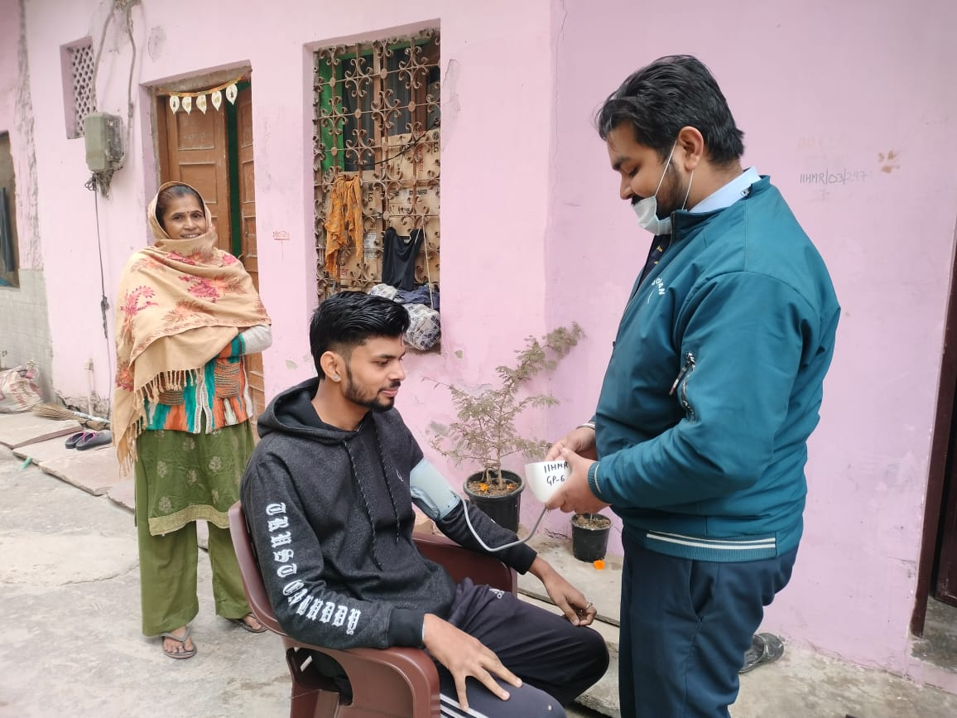
Community Outreach Programme
Total no of visits:-Visited Goyala Dairy around 4-5 times.
No of activities done:-
Surveyed the members about: ABHA (Ayushman Bharat Health Account) card and Basic household amenities.
Measured: Height, Weight and Blood Pressure (BP).
Collected information on: Any existing diseases, nearest hospital they visit for treatment and Total cost incurred for treatment.
Accessed: Accessibility to clean drinking water, Sanitation and cleanliness in their locality and Whether any health check-ups are conducted by the government.

Slide 19
Thank You

