Slide 1
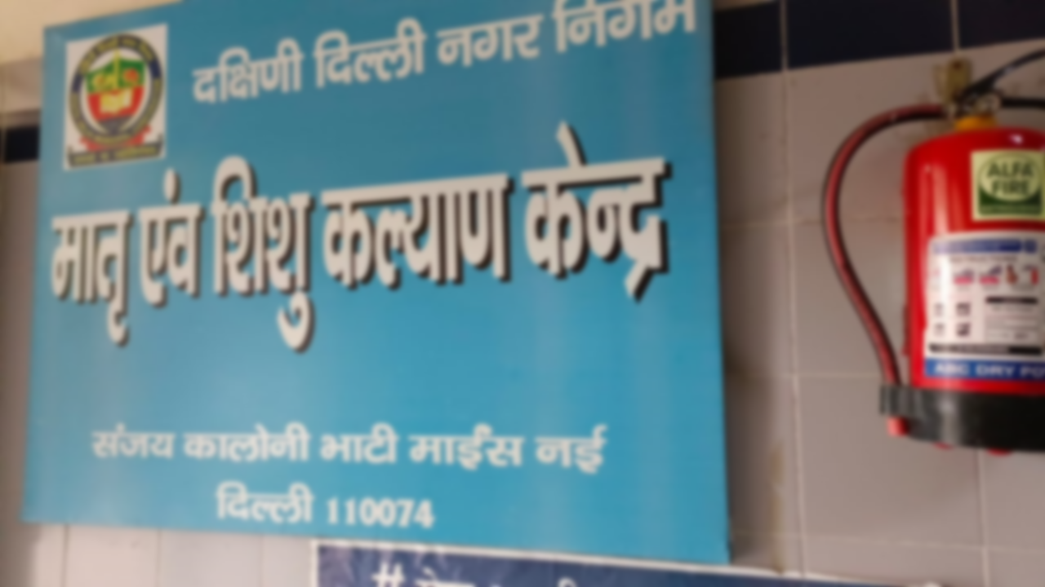

An Exploratory Study Of Determinants Of Traditional Home Birth In Bhatti Mines, Chhatarpur Area In New Delhi
Organization - Population Services International (PSI)
(Project Samagra)
Under the Mentorship of Dr. Rohini Ruhil (IIHMR)
By - Dr. Abhaya Gupta (004)
PGDM Batch 2021-23

Slide 2

Screenshot of Approval
You are not allowed to add slides to this presentation

Slide 3
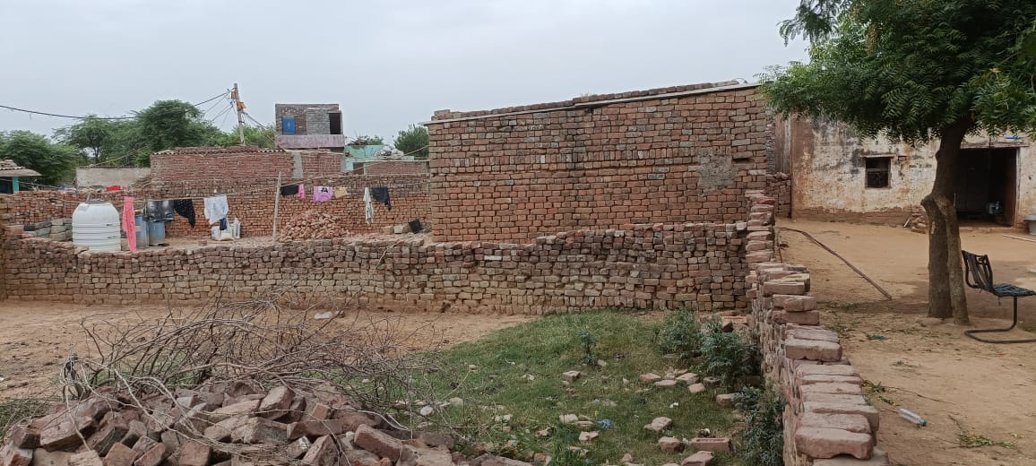
Introduction
Home delivery without skilled care at birth has a significant impact on maternal deaths.
Almost 295,000 mothers died from various pregnancy and childbirth-related problems in 2017, amounting to 810 maternal deaths every day.
Increasing institutional births is a key global strategy to reduce maternal and new-born mortality.
The WHO (2010) statistics shows that only half of expectant mothers in India complete four antenatal care (ANC) visits

Slide 4
Introduction
NRHM of India launched the Janani Suraksha Yojana (JSY) programme in 2005 with the goal of reducing maternal and neonatal mortality by promoting institutional births.
Researcher across India have argued the existing disparity in terms of utilization and accessibility to maternal healthcare services among the socially marginalized group
Studies related to home birth have argued that factors influence the choice of place of delivery
The main aim of this study was to understand the factors influencing the place of delivery, and why women prefer home deliveries in urban slums areas
You are not allowed to add slides to this presentation

Slide 5
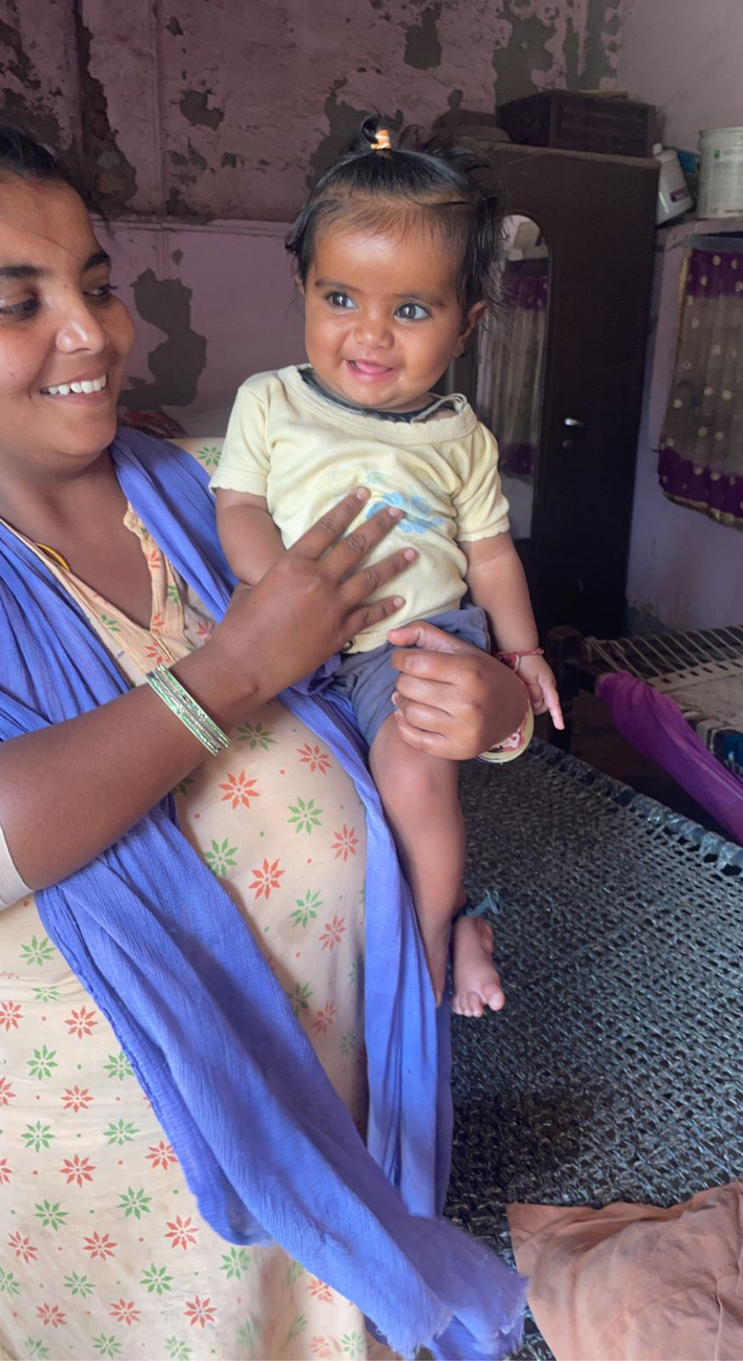
Objectives of Study
To determine the existing status of home childbirth and institutional deliveries looking at women of age 15-49 years who have delivered in the preceding 3 years in the Bhatti Mines area New Delhi.
To assess the determinants of home births compared to institutional delivery in women of age group 15-49 years who have delivered in the preceding 3 years.
You are not allowed to add slides to this presentation

Slide 6
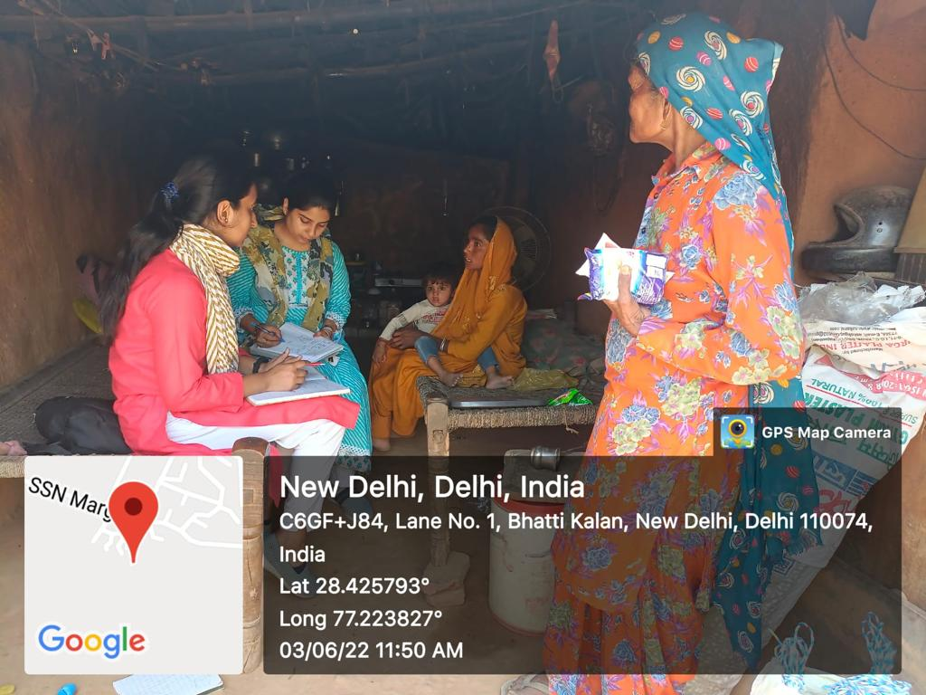
Methodology
STUDY DESIGN
Cross Sectional Survey using mixed methods
STUDY SETTING
This study was conducted in south west zone of Delhi in Bhatti mines, which is home to nearly 22,000 people spread among 4,000 households.
SAMPLING
Mapping of Households – A list of households were delivery has happened in past 3 years was prepared by the help of ASHA register.
SAMPLE SIZE
Assuming a sample size of 75 among 300 deliveries each year, we took sample one in four deliveries each year. i.e. 225
SAMPLING METHOD
Out of the household list that we have prepared from the ASHA list of deliveries, our sample of every 4th household in the list. In case of non-availability of members of household the next house on the list will be selected.
You are not allowed to add slides to this presentation

Slide 7


Methodology
DATA COLLECTION TOOL
The data collection tools consisted of structured interview having close ended questions using Google Forms. The 2021 Global Multidimensional Poverty Index (MPI) of UNDP was used to measure deprivation.
DATA ANALYSIS PLAN
The data was recorded in the excel sheet. The data was then analysed using IBM SPSS Version 22 for Windows (IBM Corporate, Armonk, New York, USA). Using Open-Epi software, Chi-square test was performed to test associations between certain factors such as deprivation, cost of delivery and high-risk pregnancy with prevalence of home births or institutional births. A value of p<0.05 was considered as statistically significant.
You are not allowed to add slides to this presentation

Slide 8
Results
Socio-demographic characteristics
N=226
Figure 1
Variables | Study population N=226
Age
<20 yrs. | 2
20-30 yrs | 187
>30 yrs | 37
Education
Illiterate | 80
Upto High school | 121
High school and Above | 25
Parity
1 | 64
2 | 78
3 | 48
>3 | 36
Deprivation Index
Yes | 168
No | 58
Figure 2

Slide 9
On Comparison with Place of Delivery
Figure 3
Figure 4 P value < 0.05 Correlation = 0.398
Figure 5 P value <0.05 Correlation = 1
Figure 6 P value <0.05 Correlation = 0.762

Slide 10
On Comparison with Place of Delivery
Figure 7 P value <0.05 Correlation = 0.78
Figure 8
Figure 9

Slide 11
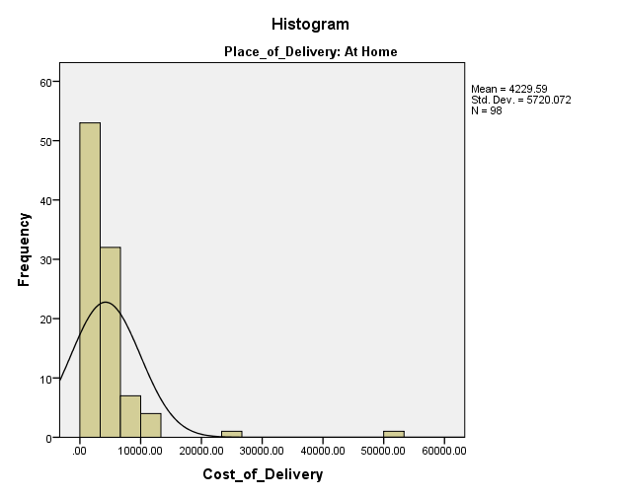
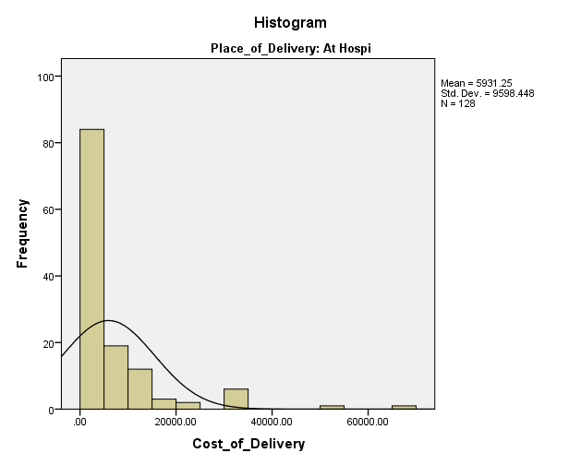
On Comparison with Place of Delivery
Figure 10 Cost of Delivery at Homebirths
Figure 11 Cost of Delivery at Institutional Delivery
Figure 12

Slide 12
Figure 13
Figure 14
Figure 15

Slide 13
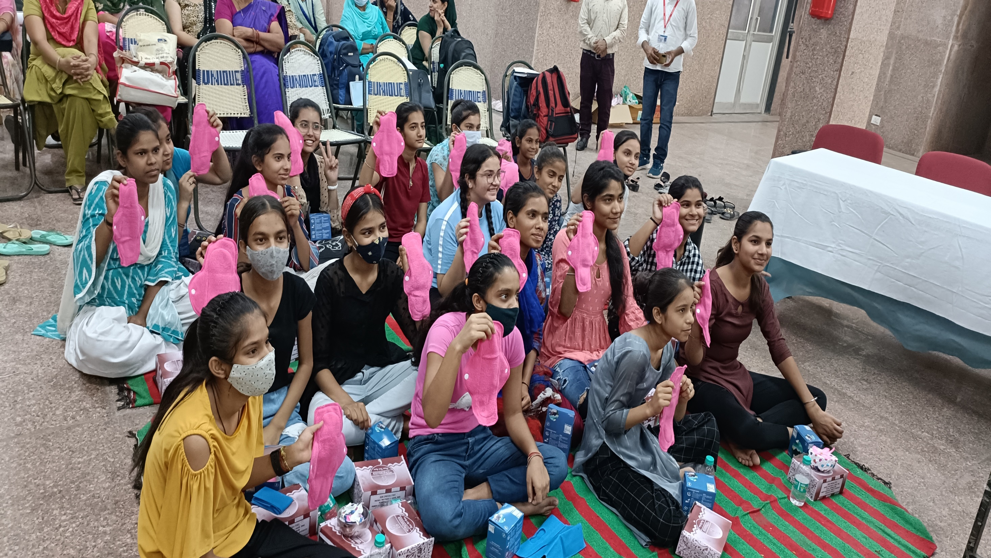
Discussion (1/2)
Our study with a sample size of 226, out of which 98 home birth and 128 institutional deliveries were identified. Though it was found that 128 (56.6%) institutional deliveries took place, it was less than the average institutional rate of India (88.6%).
Lack of education and awareness among women
A strong correlation exists between depreciation in amenities and availing the health care facilities
High parity among women gives rise to many risk factors like anemia, malnutrition and post-natal complications.
You are not allowed to add slides to this presentation

Slide 14
Discussion (2/2)
Institutional Delivery at Government health facilities' are cost effective
Lack of awareness of JSY Scheme and Beneficiaries not receiving incentives
Women facing gender based violence and lack of family support which contributes to the hindrance of health-seeking behaviour.

Slide 15
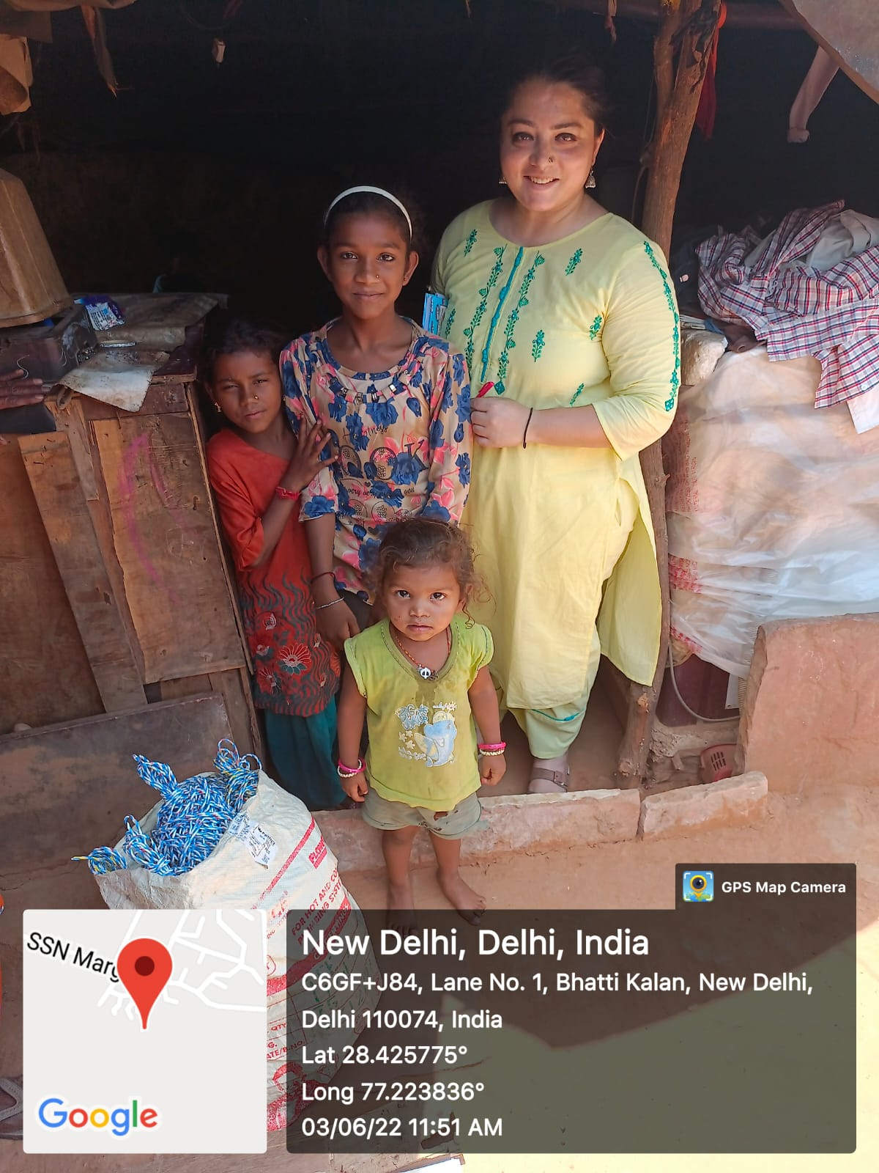
Conclusion
Despite proximity and support of health services to urban poor community, access is restricted. This happens on the account of there being crowded, ineffective outreach activities, weak referral system, social exclusion, lack of information and their unfamiliarity with the modern environment.
Maternal and Child Care Centre is present at Bhati mines, but facilities for conducting childbirth are not present. Therefore, community have to travel 18-25km at government facilities to deliver children.
You are not allowed to add slides to this presentation

Slide 16
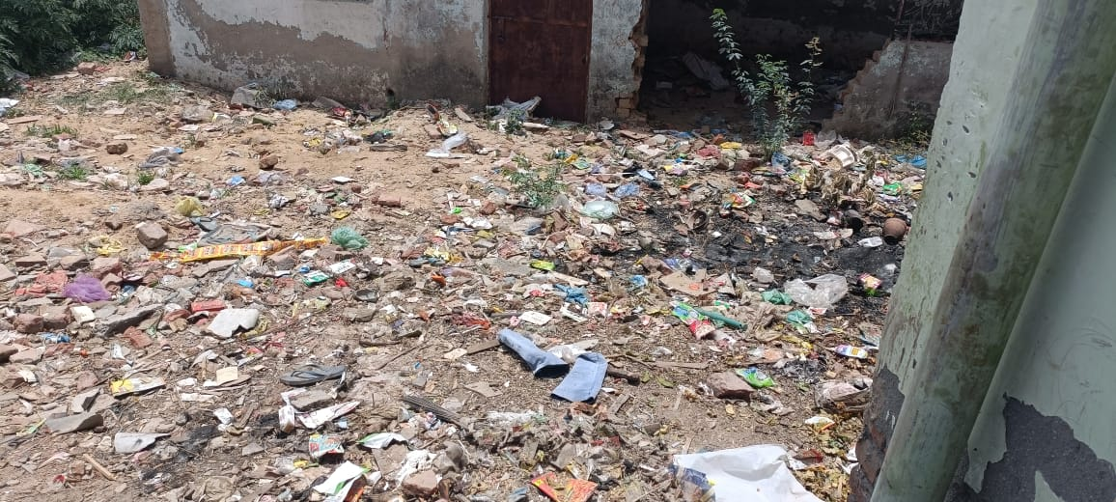
Limitations of Study
Since there are a majority of daily wage workers in the area, during our time of study most of them were not at home to give the answers.
Concurrent health facility assessment was not performed which would have helped to understand additional supply side factors.
You are not allowed to add slides to this presentation

Slide 17
References (Only Vancouver Style)
Ou CY, Yasmin M, Ussatayeva G, Lee MS, Dalal K. Maternal Delivery at Home: Issues in India. Advances in Therapy. 2021 Jan;38(1):386-98.
Ronsmans C, Graham WJ, Lancet Maternal Survival Series steering group. Maternal mortality: who, when, where, and why. The lancet. 2006 Sep 30;368(9542):1189-200.
Montgomery AL, Ram U, Kumar R, Jha P, Million Death Study Collaborators. Maternal mortality in India: causes and healthcare service use based on a nationally representative survey. PloS one. 2014 Jan 15;9(1):e83331
Koblinsky M, Matthews Z, Hussein J, Mavalankar D, Mridha MK, Anwar I, Achadi E, Adjei S, Padmanabhan P, van Lerberghe W, Lancet Maternal Survival Series steering group. Going to scale with professional skilled care. The Lancet. 2006 Oct 14;368(9544):1377-86.
Campbell OM, Graham WJ, Lancet Maternal Survival Series steering group. Strategies for reducing maternal mortality: getting on with what works. The lancet. 2006 Oct 7;368(9543):1284-99.
You are not allowed to add slides to this presentation

Slide 18
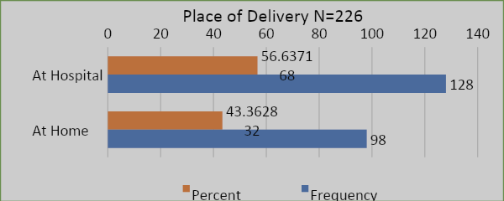
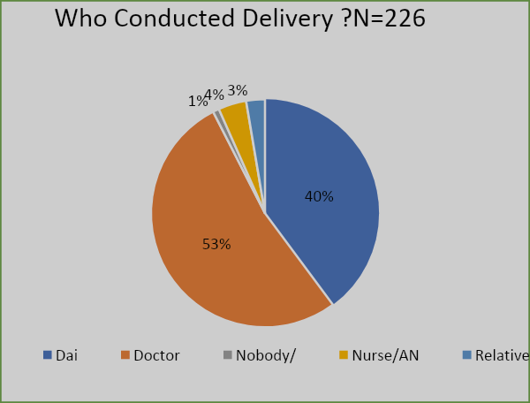
An Exploratory Study Of Determinants Of Traditional Home Birth In Bhatti Mines,
Chhatarpur Area In New Delhi
Dr. Abhaya Gupta
Organization - Population Services International (PSI) (Project Samagra)
Topic for internship project was An Exploratory Study of the Determinants of Traditional home birth in Bhatti Mines, Chhatarpur Area of New Delhi Home delivery without skilled care at birth has a significant impact on maternal deaths. Almost 295,000 mothers died from various pregnancy and childbirth-related problems in 2017, amounting to 810 maternal deaths every day. The WHO (2010) statistics shows that only half of expectant mothers in India complete four antenatal care (ANC) visits The main aim of this study was to understand the factors influencing the place of delivery, and why women prefer home deliveries in urban slums areas To looking at women of age 15-49 years who have delivered in the preceding 3 years in the Bhatti Mines area New Delhi. To assess the determinants of home births compared to institutional delivery in women of age group 15-49 years who have delivered in the preceding 3 years.etermine the existing status of home childbirth and institutional deliveries | STUDY DESIGN – Cross Sectional Survey using mixed methods STUDY SETTING – This study was conducted in south west zone of Delhi in Bhatti mines, which is home to nearly 22,000 people spread among 4,000 households. ASHAs and ANM workers help were taken to identify deliveries in the area over the preceding 3 years, in Bhatti mines. SAMPLING - Mapping of Households – A list of households were delivery has happened in past 3 years was prepared by the help of ASHA register. Sample Size – Assuming crude birth rate of 14.4/1000 in Delhi a population of 22,000 had approx. 300 deliveries in a year. Using Statical sample size calculator of Epi Info for simple random sampling in a population survey of a population of 300 persons with expected frequency of 50% and a 10% acceptable margin of error and design effect of 1 we must have a sample of 73 for confidence level of 95%. Assuming a sample size of 75 among 300 deliveries each year, we took sample one in four deliveries each year. i.e. 225 Sampling Method:- Out of the household list that we have prepared from the ASHA list of deliveries, our sample of every 4th household in the list. In case of non-availability of members of household the next house on the list will be selected. |  | ‘Home births are frequent among the urban poor’. As compared to the national average of institutional deliveries, which is 88.6 % according to NFHS 5, the percentage of hospital deliveries in Bhatti mines is very less, 56.6 %. This study highlights the urgent need for improvements in the hospital facilities and need for family support as the key modifiable factors affecting over two-thirds of this population. These findings should inform the design of strategies to promote institutional births. Ou CY, Yasmin M, Ussatayeva G, Lee MS, Dalal K. Maternal Delivery at Home: Issues in India. Advances in Therapy. 2021 Jan;38(1):386-98. Ronsmans C, Graham WJ, Lancet Maternal Survival Series steering group. Maternal mortality: who, when, where, and why. The lancet. 2006 Sep 30;368(9542):1189-200. Montgomery AL, Ram U, Kumar R, Jha P, Million Death Study Collaborators. Maternal mortality in India: causes and healthcare service use based on a nationally representative survey. PloS one. 2014 Jan 15;9(1):e83331 Koblinsky M, Matthews Z, Hussein J, Mavalankar D, Mridha MK, Anwar I, Achadi E, Adjei S, Padmanabhan P, van Lerberghe W, Lancet Maternal Survival Series steering group. Going to scale with professional skilled care. The Lancet. 2006 Oct 14;368(9544):1377-86.
INTRODUCTION
MATERIAL & METHOD
RESULT
CONCLUSION
GRAPH 1
AIMS & OBJECTIVES
BIBILOGRAPHY
GRAPH2
Graph1 depict the place of delivery weather it was in the home or institutional deliveries.
Graph 2 depict who conducted the deliveries

Slide 19
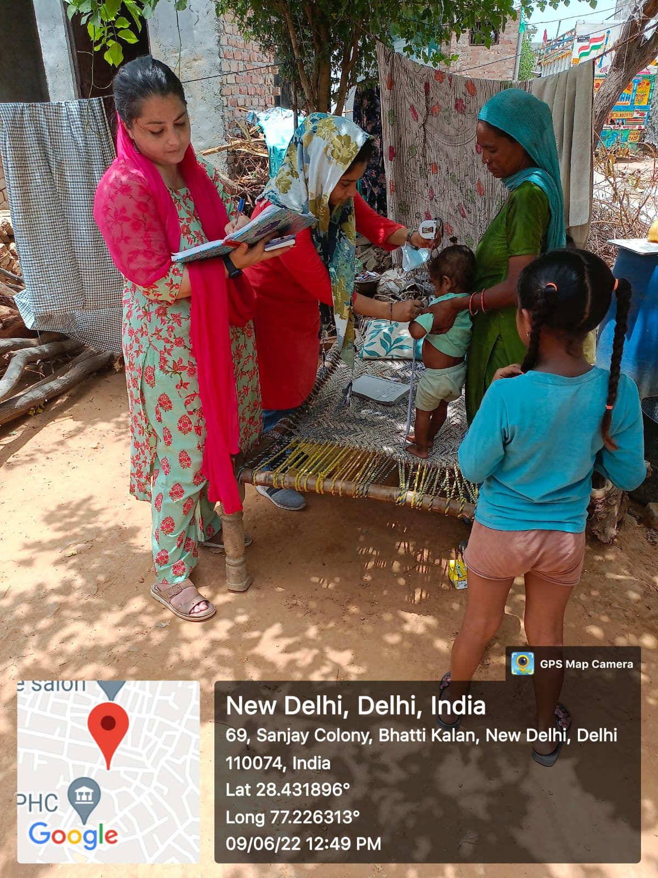
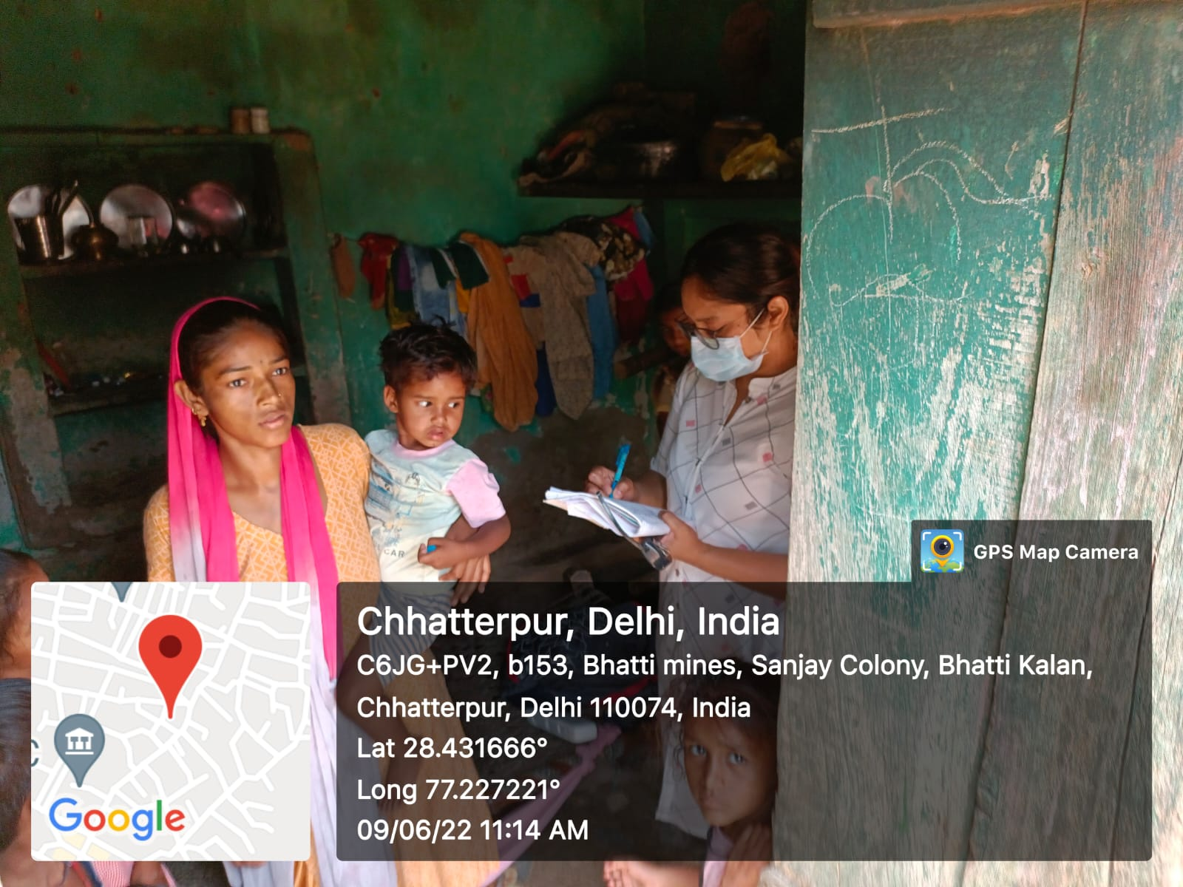
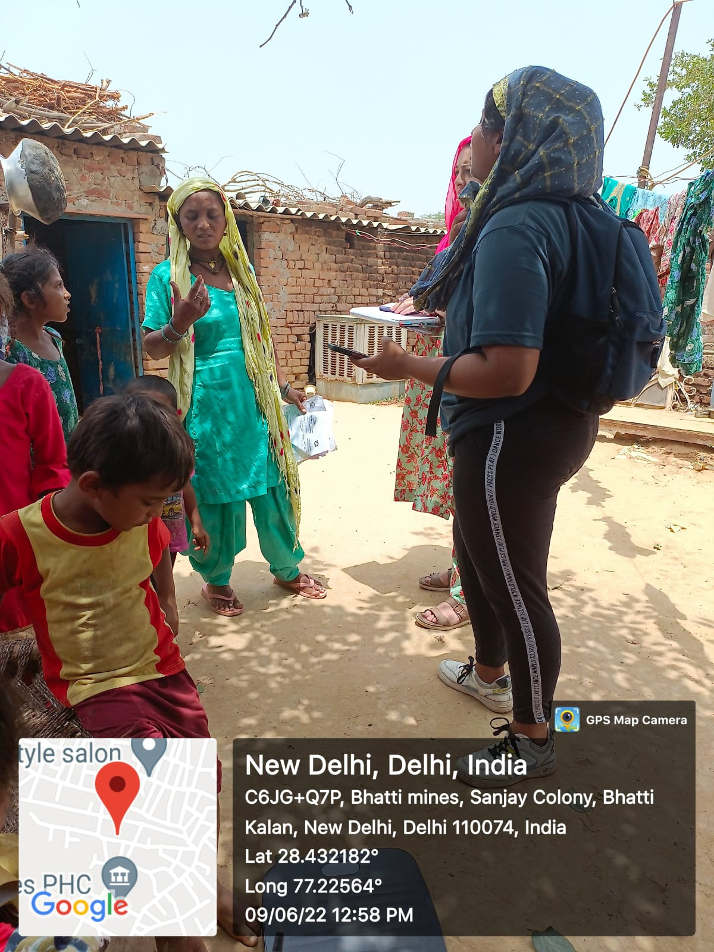
Thank You
Any Questions
You are not allowed to add slides to this presentation

Slide 20
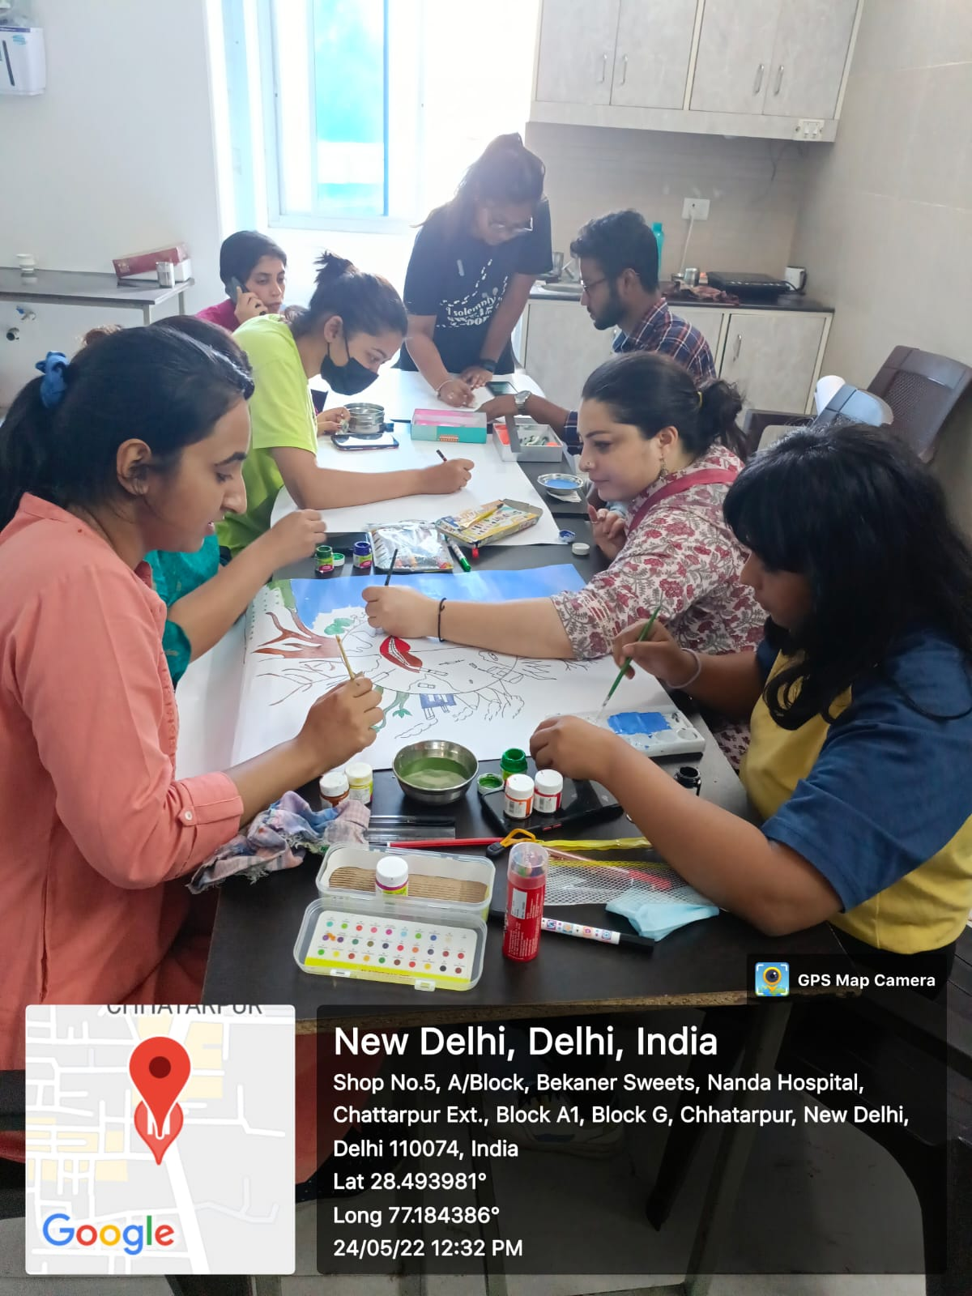
Internship Experiences
Overall self comments on Internship
What did you learn (skill/ topic)?
Nitty Gritty of Communication in Community
In depth exposure to vulnerable community
Work efficiently despite of challenges like weather conditions, animal attacks etc
Conducting an efficient Data Collection and Baseline Survey
Community Events planning
Conducting Research
Area Mapping and Sketching
Case Reports and Blog Writing
Household listing
Data Analysis
You are not allowed to add slides to this presentation

Slide 21

Suggestions Given to Organization
Maternal Health Care Facilities like Ultrasound
Educate women about importance of ANC Visits
Introduction of Family Support Unit in hospitals
Emergency Vehicle Assistance
Educate Women about Importance of Nutrition
Avail Immunization at time of Animal attacks at Dispensary or Private Vehicles
Enhance community engagement to work for their surroundings
Waste Disposal
You are not allowed to add slides to this presentation

Slide 22
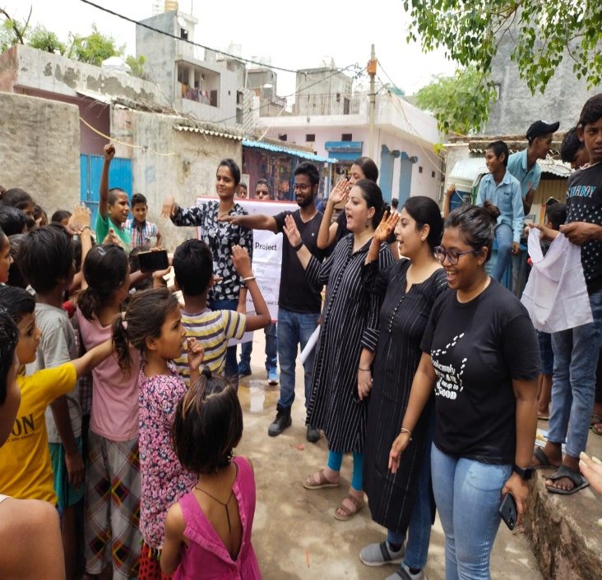
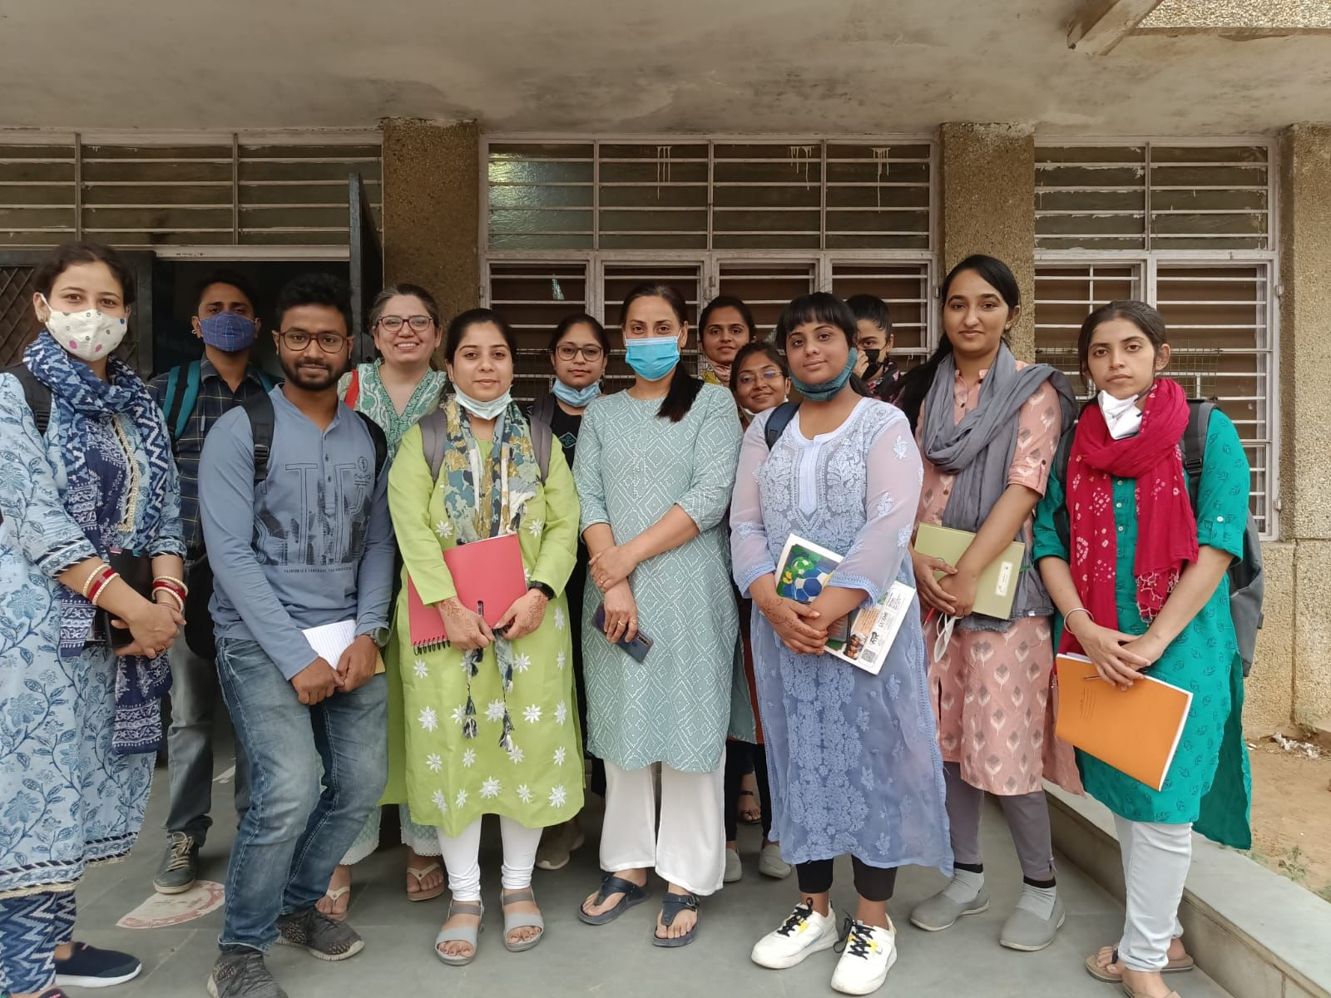
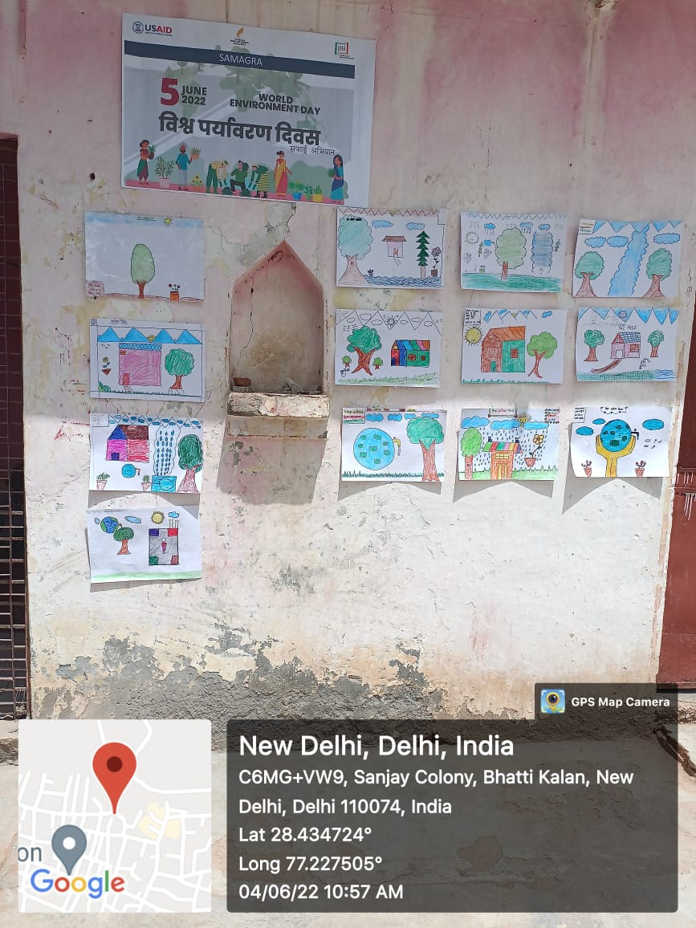

Pictorial Journey
You are not allowed to add slides to this presentation

Slide 23
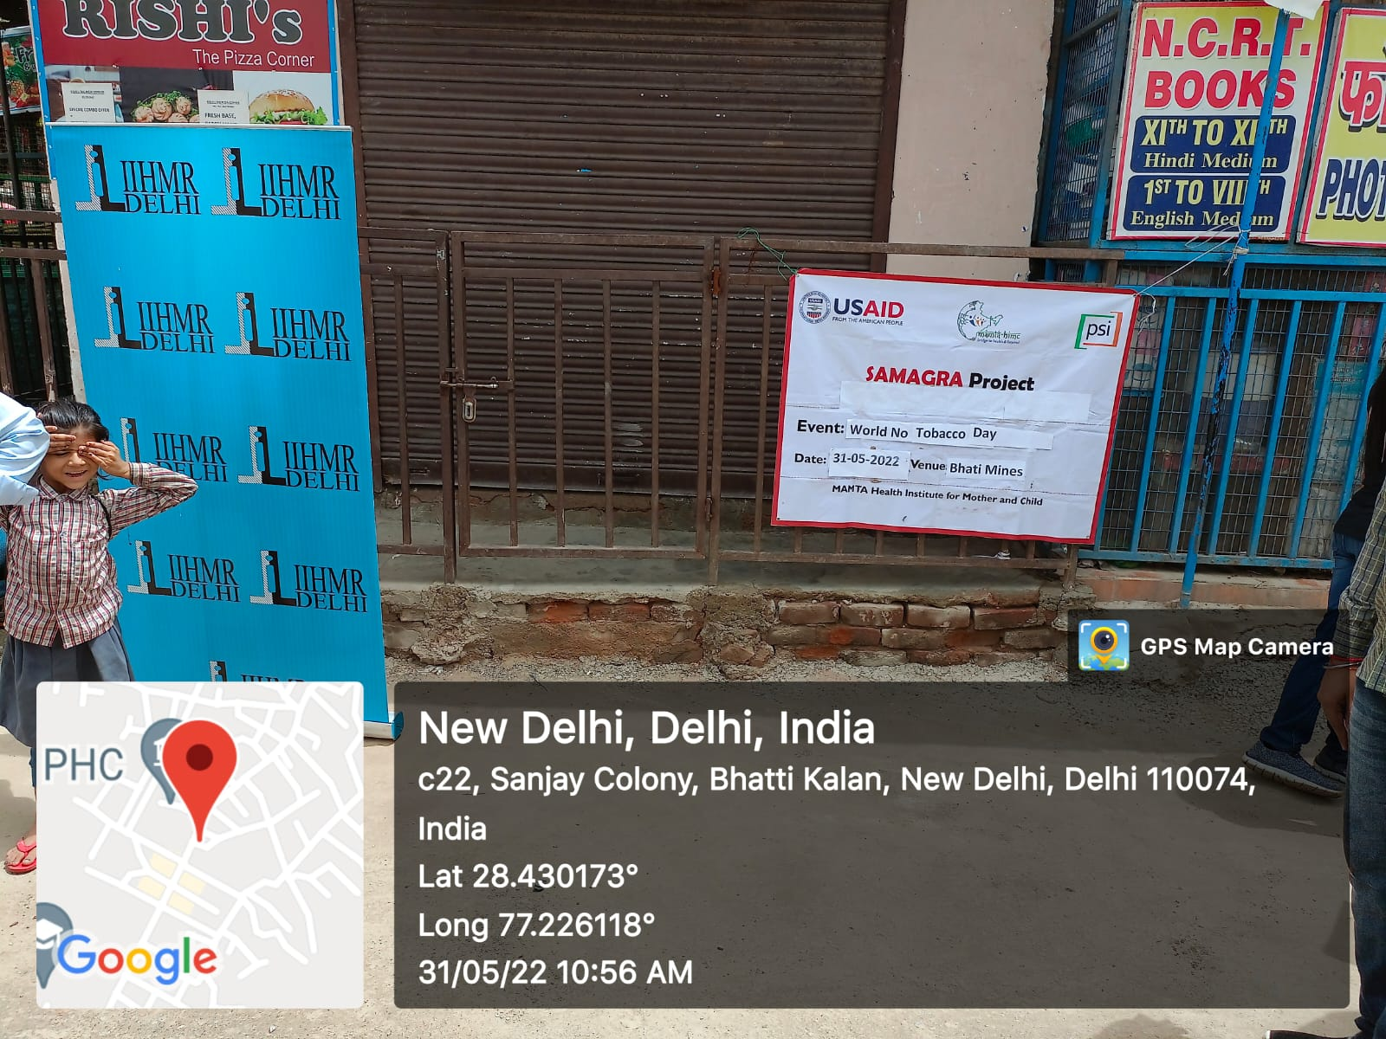
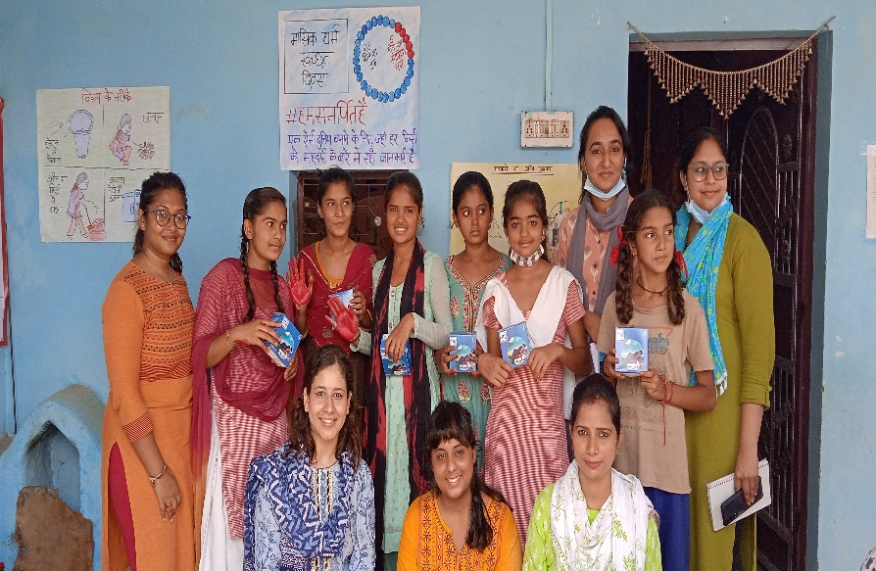
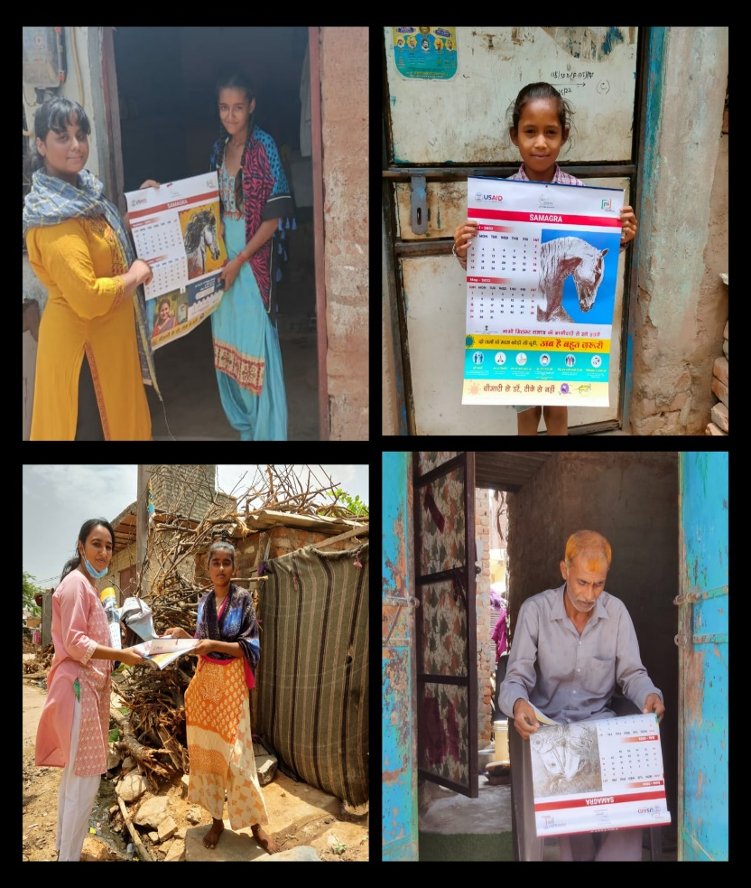
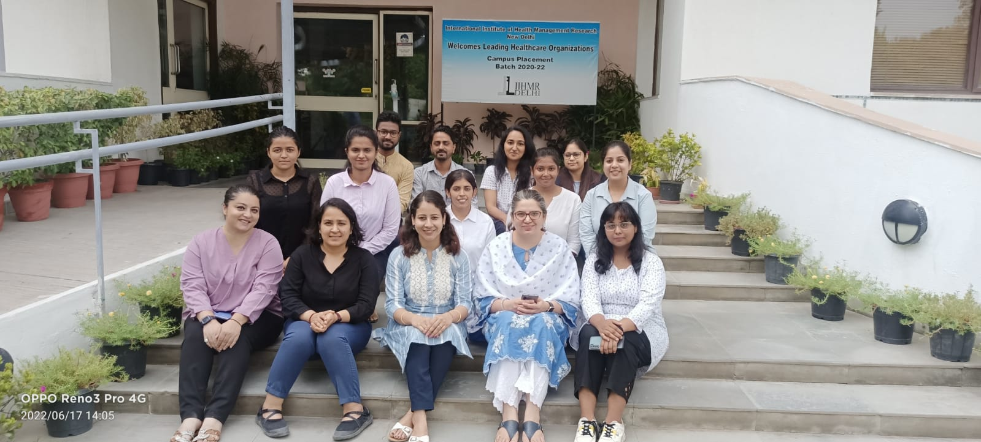
You are not allowed to add slides to this presentation

