Slide 1
HOSPITAL INFECTION CONTROL
AMONG
HEALTH CARE WORKERS
Dr. Pooja Kakkar
20/05/16

Slide 2
AGENDA
INTRODUCTION
AIM
METHODOLOGY
OBJECTIVE
RESULT
CONCLUSIONS
NEW INITIATIVES
HAND HYGIENE DRIVE
20/05/16

Slide 3
INTRODUCTION
What are hospital acquired infections?
Hospital acquired infection is also called Nosocomial infection or Healthcare-associated infections.
"nosus" = disease
"komeion" = to take care of
Nosocomial infections can be defined as infection acquired by the person in the hospital, manifestation of which may occur during hospitalization or after discharge from hospital. The person may be a patient, members of the hospital staff and/ or visitors.

Slide 4
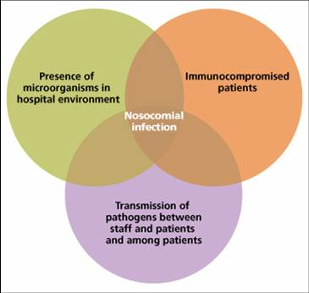

Slide 5
EPIDEMIOLOGICAL INTERACTION
HAI
HOST FACTORS
Suppresed immune system due to Age, Poor nutritional status, severity of underlying disease, complicated diagnostic & therapeutic procedure,therapeutic,
THE ENVIRONMENT
Everything that surrounds the patient in the hospital is his environment.
Other patients
Hospital staff and visitors
Eatables
Dust and other contaminated articles
THE AGENT
Varieties of organisms
Institutional and human
Reservoirs & their virulence

Slide 6
WHAT IS INFECTION CONTROL ?
Infection control is the discipline concerned with preventing nosocomial or healthcare-associated infection, a practical (rather than academic) sub-discipline of epidemiology.
MEASURES OF INFECTION CONTROL
1.Sterilisation
2.Hand Hygiene
3.Isolation
4.Gloves
5.Surface Sanitation
6.Antimicrobial Surfaces
7.Cleaning
8.Disinfection
9.Use of Personal Protective Equipments

Slide 7
METHODOLOGY
RESEARCH QUESTION:HOW TO IMPROVE INFECTION CONTROL PRACTISES AMONG HEALTH CARE WORKERS?
MODE OF DATA COLLECTION: 1.DAILY OBSERVATIONS
2. SELF PREPARED QUESTIONARES 3.INTERVIEWS , AUDITING 4.MEDICAL RECORDS 5. SURVEYS
METHODS OF DATA ANALYSIS:
1.FISH BONE ANALYSIS
2.THREAT OPPORTUNITY MATRIX
3.PDCA CYCLE
SAMPLING: RANDOM SAMPLING

Slide 8
AIM
TO INCREASE THE COMPLIANCE OF INFECTION CONTROL IN HOSPITALS
TO SENSITISE ALL STAFF REGARDING INFECTION CONTROL MEASURES

Slide 9
FOCUS AREA
Doctors
Nurses
To
Reduce
Hospital Acquired Infections
Houskeeping

Slide 10
OBJECTIVE
To ensure compliance to Infection Control Measures
To reduce the incidence of Hospital Acquired Infections
To reduce infection rates.
To sensitize the nursing staff, doctors, housekeeping and other staff regarding hospital infection control measures

Slide 11
SURVEYS DONE
1.FOLLOW UP OF NEEDLE STICK INJURY
2.WARD PERFORMANCE PARAMETERS
3.SURFACE SAMPLING
4.BIOMEDICA WASTE AUDIT
5.HAND HYGIENE COMPLIANCE

Slide 12
FOLLOW UP FOR NEEDLE STICK INJURIES
MONTHS | NAME OF STAFF | DATE OF NSI | REASON | FOLLOWED UP DATE | Remarks
JAN (1) | VIKAS | 30/1/15 | NEEDLE STICK INJURY DURING GARBAGE DISPOSAL | 30/3/15 29/6/15 | done
(2) | PRIYANKA | 5/1/15 | AFTER CANNULIZATION | EXIT | before exit,investigation done.Reports normal
FEB | DR. K. C. MALIK | 4/2/15 | BONE-MARROW NEEDLE | EXIT | before exit,investigation done.Reports normal
MAY | PUNAM KUMARI | 14/5/15 | SURGICAL BLADE | EXIT | before exit,investigation done.Reports normal
JUNE | SHANET | 22/6/15 |  | ALL READY DONE | TESTING DONE 4 DOSES (0,3,6,1YR)

Slide 13
MONTHS | NAME OF STAFF | DATE OF NSI | REASON | FOLLOWED UP DATE | Remarks
SEPT (1) | DR AMITA (PATH LAB) | 17/9/15 | WHILE DOING FNAC |  | DONE
(2) | RISHI (TECNICIAN CT) | 19/9/15 | WHILE TAKING BLOOD SUGAR | 19/9/15 | DONE
NOV (1) | ANILA | 19/11/15 | WHILE TAKING ABG | 20/11/15 20/2/16 | DONE
(2) | POONAM (2ND FLOOR) | 18/11/15 | WHILE SEGREGATING NEEDLE | EXIT | before exit, Investigation done. Reports normal
DEC | POOJA (NURSING STUDENT) | 5/12/15 | WHILE PRICKING THE NEEDLE IN THE NS 100 ml BOTTLE | EXIT | Before exit, investigation done. Reports normal

Slide 14
WARD PERFORMANCE PARAMETERS
BMW MANAGEMENT
SUCTION OXYGEN OUTLET
DRESSING TROLLEY MAINTAINCE
CSSD
MAINTENANCE OF ASEPTIC HAND HYGEINE
HANDLING OF LINES BY STAFF
CARE BUNDLES
WARD-WISE
PERFORMANCE
SWSF | 54.30%
ICU | 80.70%
NWTF | 89.50%
HDU | 72.50%
OT | 85.20%
SWTF | 77.40%
NWSF | 68.60%
BASEMENT | 94.50%
DAY CARE | 76.20%
OPD | 87.40%

Slide 15
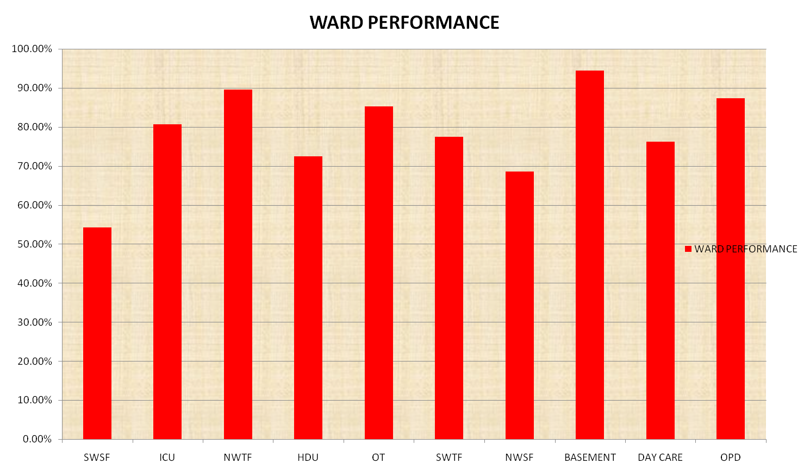

Slide 16
STATUS OF SURFACE SAMPLING
MONTH | DEPARTMENT | REPORT | Action taken
JAN’16 | OT IInd (ANESTHESIA MACHINE) | Heavy growth of aerobic spore bearer | Inform to the incharges of concerned area. Resampling after fumigation and moping. no growth found.
MAR’16 | BRACHY OT (OT TABLE) | Heavy growth of gram negative bacilli | Inform to the incharges of concerned area. Resampling after fumigation and moping. no growth found.
20/05/16

Slide 17
BMW AUDIT (JAN – MAR’16)
MONTH | COMPLIANCES
JAN’16 | 86%
FEB’16 | 83.5%
MAR’16 | 86.2%

Slide 18
Hand hygiene compliances (Jan’16)
Month | 04-05 JAN’16 (DAY CARE) | 11-12 JAN'16 (OPD) | 18-19 JAN’16 (NWSF) | 25-26 JAN’16 (SWSF) | Avg%
Doctors | 35% | 40% | 80% | 35% | 47.5%
Nursing staff | 45% | 47% | 47% | 44% | 45.75%
House keeping staff | 60% | 85% | 90% | 65% | 75%

Slide 19
Hand hygiene compliances (Feb’16)
MONTH | 01-02 FEB’16 (SWSF) | 08-09 FEB’16 (SWTF) | 15-16 FEB’16 (ER) | 22-23 FEB’16 (DAY CARE) | 29 FEB-01 MAR ’16 (SWSF) | Avg%
Doctors | 60% | 70% | 50% | 77% | 70% | 65.4%
Nursing staff | 58.3% | 67% | 60% | 60% | 65% | 62.06%
House keeping staff | 65% | 85% | 60% | 70% | 75% | 71%

Slide 20
Hand hygiene compliances (Mar’16)
Month | 07-08 MAR’16 (NWSF) | 14-15 MAR’16 (SWTF) | 21-22 MAR’16 (SWSF) | 28-29 MAR’16 (SWTF) | Avg%
Doctors | 60% | 35% | 50% | 40% | 46.25%
Nursing staff | 63% | 61% | 67% | 70% | 65.25%
House keeping staff | 70% | 55% | 95% | 85% | 76.25%

Slide 21
Default rate(non compliances Jan-Mar’16)
Moments | Doctors | Nurses | HK | Total | Avg%
Before touching patient | 43 | 55 | 09 | 107 | 48.8%
Before aseptic technique | 02 | 0 | 0 | 02 | 0.9%
After body fluid exposure | 0 | 0 | 0 | 0 | 0%
After touching patient | 04 | 06 | 03 | 13 | 5.9%
After touching patient surroundings | 49 | 40 | 08 | 97 | 44.2%

Slide 22
Alarming figures
 | JAN | FEB | MARCH
MRSA (Methicillin resistant staphylococcus aures) | 5 | 4 | 3
VRE (Vancomycin resistant enterococci) | 3 | 1 | 0
CRE (Carbopenam resistant enterobactiaceae) | 9 | 13 | 10

Slide 23
NEW INIATIVES
Hand hygiene drive
Implementation of new BMW guidelines
MRSA and CRE protocol
Information to health care staff for high risk patients
Protocol for prevention of CAUTI in bed ridden patients

Slide 24
HAND HYGIENE PROTOCOL

Slide 25
Health Care Associated Infections (HAI) affect hundreds of millions of people worldwide and are a major global issue for patient safety.
“
Though hand hygiene improvement is not a new concept; long lasting improvements remain difficult to sustain......
”

Slide 26
Probable Causes of Failure to Clean Hands in ACH
Health care workers forget.
Hand hygiene compliance data are not collected or reported accurately or frequently.
Lack of accountability and just-in-time coaching.
Safety culture does not stress hand hygiene at all levels.
Hands were full
Perception that hand hygiene is not needed if wearing gloves.

Slide 27
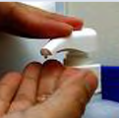
EFFECTIVE HYGIENE IS IN OUR HANDS
HABIT
ACTIVE FEEDBACK
NO ONE EXCUSED
DATA DRIVEN
SYSTEMS

Slide 28
CAUSES |  | SOLUTIONS
Inaccurate data collection or Under reporting |  | Scrutinize and question the data.
Lack of accountability and just-in-time coaching |  | Train leaders as just-in-time coaches to reinforce compliance. Implement employee contracts to be signed by all health care workers to reinforce their commitment to hand hygiene. Apply progressive disciplinary action against repeat offenders.

Slide 29
CAUSES |  | SOLUTIONS
Safety culture does not stress hand hygiene at all levels |  | Make hand hygiene a habit. Commitment of leadership to achieve hand hygiene compliance of 90+ percent. Hold everyone accountable and responsible – doctors, nurses, food service staff, housekeepers, technicians, therapists.
Hands full |  | Create a place for everything: for example, a health care worker with full hands needs a dedicated space where he or she can place items while performing hand hygiene.

Slide 30
PROTOCOL TO PREVENT CAUTI IN BED RIDDEN PATIENTS

Slide 31
Regularly assess the need of catheters during daily rounds.
Use sterile technique at insertion and removal.
Perform perineal care daily after bowel movements.
Keep urinary catheter always lower than patient’s bladder level.
Maintain closed drainage system.
Perform catheter irrigation with normal saline on catheter obstruction to avoid unobstructed urine flow.
Maintain hand hygiene before and after touching catheter.
Keep alerts or reminders to collect urine sample of bed ridden patients at regular intervals.
Obtain urine sample aseptically.
Educate nurses for proper nurse directed insertion and removal of catheters.
Prevent catheter and collecting tube from kinking.

Slide 32
BIOMEDICAL WASTE CATEGORIES
CATEGORY | Yellow | Red | White( Translucent) | Blue
TYPES OF WASTE | Human Anatomical Waste Animal Anatomical Waste Soiled Waste Expired and Discarded Medicine Chemical Solid Waste Chemical Liquid Waste Discarded linen, mattresses, beddings contaminated with blood and body fluid. Microbiology, Biotechnology and other clinical laboratory waste. | Contaminated waste ( Recyclable) like plastic bag, bottle, pipes or container | waste sharps including Metals. ( Scalpels, Blades, Needles, Syringes) | Broken glassware. Metallic Body Implants.

Slide 33
STATUS OF QUALITY INDICATOR
S. No. | QUALITY INDICATORS | JAN'16 | FEB’16 | MAR’16
1 | Surgical Site Infection | 00 | 01 | 02
2 | Central Line Associated Blood Stream Infection | 03 | 01 | 01
3 | Ventilator Associated Pneumonia | 00 | 00 | 00
4 | Urinary Tract Infection | 01 | 02 | 01
20/05/16

Slide 34
EQUIPMENTSS
PEOPLE
NOT FOLLOWING ASEPTIC MEASURES
LACK OF TRAINED STAFF
LACK OF AWARENESS
IMRPOPER STERILISATION TECHNIQUES
INFECTION CONOTROL MEASUREES
HANDWASHING
LACK OF PROPER ALERT SYSTERM
KNOWLEDGE
LACK OF IMPLEMENTATION OF POLICIES
PROCEDURES
MANAGEMENT
f

Slide 35
CONCLUSIONS
Infection Control is very important and integral part of hospital
Alll the hospital staff should follow all the necessary steps of infection control to increase the compliance
Hand hygeine is one of the important part of infection control,HCP should do hand hygiene frequenlty, including before and after contact with patients
To reduce the incidence of infections, line care should be taken proper care and random auditing should be done
Biomedical waste compliance should be increased and new Bio medical waste guidelines should be implemented
Infection control committee should take necessary steps for effective implementation of hand hygiene.

Slide 36
Suggestion to improve
Be our eyes
Mail us to improve

Slide 37

20/05/16

