Slide 1
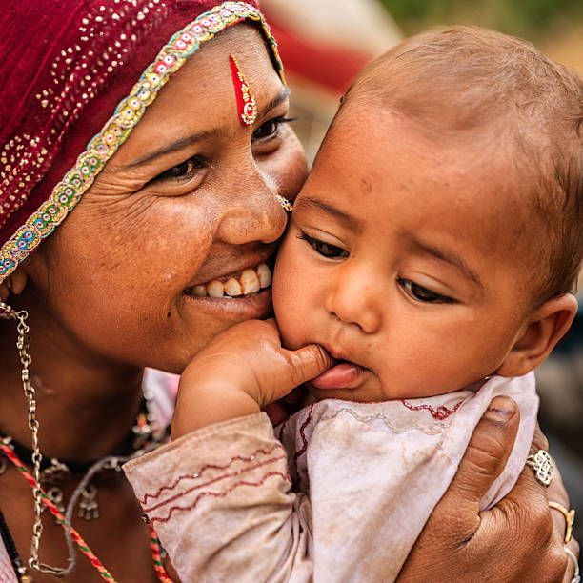

“Examining the Changes and Determinants of Antenatal Care Visits and Birth Preparedness Among Rural Women in Bihar: A Comparative Analysis of 2024 and 2025“
By – Shivam Kumar Sharma
Guided by – Dr. Preetha
IIHMR Delhi

Slide 2


Slide 3

Introduction
Antenatal care (ANC) is essential for protecting the health and well-being of both mothers and babies. Regular check-ups during pregnancy help in managing early complications. The World Health Organization recommends at least four ANC visits during pregnancy to promote regular check-ups to ensure safe pregnancies and deliveries.
But still, maternal deaths remain high—in 2020, nearly 287,000 women died from pregnancy-related causes, with 95% of these deaths happening in low- and lower-middle-income countries. the United Nations aims to reduce the global MMR to 70 per 100,000 live births by 2030.
The MMR of India has declined from 130 in 2014–2016 to 97 in 2018–2020. However, disparities persist across states. In Bihar, the MMR remains higher than the national average, reducing from 165 to 118 over the same period.
According to NFHS-5, 58.1% of women in India received four or more ANC visits. In contrast, Bihar lags significantly behind, with only 25.2% of women completing four or more ANC visits.
Bihar, one of India's most populous and economically challenged states where majority of population resides in rural areas with limited access to quality maternal healthcare.

Slide 4
Introduction
The Government of India has launched initiatives like Janani Suraksha Yojana (JSY) and Pradhan Mantri Surakshit Matritva Abhiyan (PMSMA) to promote institutional deliveries and ANC visits. However, Bihar still faces limited resources and poor infrastructure.
Birth preparedness is also an important issue in Bihar because of lack of essential plans for delivery. According to the World Health Organization (WHO), birth preparedness involves pre planning before normal birth, which includes identifying a place of delivery, arranging transport, saving money for delivery-related expenses, selecting a birth companion, and identifying a potential blood donor.
These actions are crucial for preventing delays in seeking, reaching, and receiving care during childbirth. However, in Bihar, low education levels, poverty, and gender norms inhibits these components which cause further complication.
there is a critical need to understand the patterns and determinants of antenatal care utilization and birth preparedness in Bihar to inform targeted interventions and improve maternal health outcomes in the state.

Slide 5
Objectives of Your Study
To Examine the changes In Antenatal Care visits And Birth Preparedness Among Women Of Rural Bihar across years 2024 and 2025.
To Examine The Factors Influencing The Antenatal Care Visits And Birth Preparedness.

Slide 6
Methodology
This Study Is Based On Secondary Data Which Is Collected In 2024 And Again In 2025 In Rural Bihar
STUDY AREA
13 districts of Bihar selected randomly from 9 Commissionerate
TARGET POPULATION
Mothers of 0-5 months old children
SAMPLE SIZE
2,250 mothers
DATA ANALYSIS TOOL
SAS SOFTWARE
STUDY DESIGN
A community based cross-sectional study

Slide 7
Data Analysis
Indicator Matrix Formation
Descriptive Analysis
Stratified Analysis
Regression Analysis

Slide 8
Study Variables
EXPOSURE
Outcome variables
Socio-demographic variables
Health-related variables
ANC and BP
Age of respondent
Caste
Religion
Wealth index
Marital status
Mother's Education
Mother's Occupation
Father's Education
Father's Occupation
gravida
Parity
ANC visits
First ANC visit
History of still birth
Pregnancy danger sign risk level
Anc Visits
identified place of delivery
identified skilled provider
saved money
identified transport
identified blood donor
Overall BP practice

Slide 9
Descriptive Analysis of indicators which shows changes across 2024 and 2025

Slide 12
Changes in Antenatal Care Visits and Birth-preparedness across 2024 and 2025

Slide 15
Determinants of Antenatal Care Visits and Birth-preparedness across 2024 and 2025

Slide 16
Determinants of Antenatal Care Visits
DETERMINANTS OF 4 OR MORE ANC VISITS
AGE
CASTE
TYPE OF FAMILY
WEALTH INDEX
MOTHER EDUCATION
FATHER EDUCATION
GRAVIDA
PARITY
FIRST ANC
These are the list of indicator which shows significant association with 4 or more ANC Visits at P-value less than 0.05
Religion, mother’s occupation, father’s occupation, history of still birth and advice on ANC did not show significant association with 4 or more ANC Visits

Slide 17
Variables | 2024 | 2025 | 2025
 | AOR | AOR | AOR
Age of mother (ref=15-24)
25-34 | 0.79 | 0.75
>=35 | 0.63 | 0.74
Caste (ref=marginalised)
marginalised | 1.40 | 1.39
Type of family (ref=nuclear)
joint | 0.73 | 0.67
Wealth index(ref=low )
middle | 1.56 | 1.43
high | 2.52 | 2.00
Mother's Education (ref=illiterate)
upto class 8th | 1.47 | 1.35
above class 8th | 1.79 | 1.92
AGE: Women belong to 25-34 and >=35 age group were less likely to complete 4 or more ANC visits as compared to 15-24 age group women.
CASTE: Women belong to marginalised group were more likely to complete 4 or more ANC visits as compared to women belong to marginalised group.
TYPE OF FAMILY: Women belong to joint family were less likely to complete 4 or more ANC visits as compared to women belong to nuclear family.
WEALTH INDEX: Women belong to middle and high wealth index were more likely to complete 4 or more ANC visits as compared to women belong to low wealth index.
MOTHER’S EDUCATION: Women who had education upto class 8th and above 8th were more likely to complete 4 or more ANC visits as compared to women who were illiterate.

Slide 18
Variables | 2024 | 2025
 | AOR | AOR
Father's Education (ref=illiterate)
upto class 8th | 1.22 | 1.22
above class 8th | 1.72 | 1.59
gravida(ref=1 gravida)
2 gravida | 0.49 | 0.363
3 gravida | 0.27 | 0.39
4 and more gravida | 0.26 | 0.33
Parity (ref=1 parity )
2 parity | 0.41 | 0.36
3 and above parity | 0.21 | 0.31
First ANC visit (ref=1st trimester)
2nd-3rd trimester | 0.60 | 0.59
4th and above | 0.38 | 0.30
FATHER’S EDUCATION: women whose husband had education upto class 8th and above 8th were more likely to attend 4 or more ANC visits as compared to those who were illiterate.
GRAVIDA: Women who were pregnant more than one times were less likely to attend 4 or more ANC visits as compared to those women who were pregnant for the first time.
PARITY: Women who had more than one baby were less likely to attend 4 or more ANC visits as compared to those women who had one baby.
FIRST ANC: Women who had their first anc visit in 2nd trimester and above were less likely to attend 4 or more ANC visit as compared to those women whose first anc visit occurred in 1st trimester.

Slide 19
Determinants of Birth-preparedness
DETERMINANTS OF BIRTH-PREPAREDNESS
WEALTH INDEX
MOTHER EDUCATION
FATHER EDUCATION
RELIGION
TYPE OF FAMILY
These are the list of indicator which shows significant association with overall-birth-preparedness at P-value less than 0.05
Age,caste,Religion, mother’s occupation, father’s occupation,gravida,parity, ANC visits, history of still birth and advice on ANC did not show significant association with 4 or more ANC Visits

Slide 20
Variables | 2024 |  | 2025
 | Preparedness |  | Preparedness
 | Average (1-2) | Good (3-5) | Average (1-2) | Good (3-5)
 | AOR
Religion(ref=Hindu)
non-Hindu | 1.00 | 0.91 | 1.48 | 0.66
Type of family (ref=nuclear)
joint | 0.78 | 0.73 | 0.83 | 0.87
Wealth index(ref=low )
middle | 0.86 | 1.03 | 0.92 | 1.21
high | 1.21 | 1.39 | 0.95 | 1.69
Mother's Education (ref=illiterate)
upto class 8th | 0.92 | 1.12 | 1.03 | 1.06
above class 8th | 1.16 | 1.85 | 1.15 | 1.40
Father's Education (ref=illiterate)
upto class 8th | 1.05 | 1.24 | 1.25 | 1.25
above class 8th | 1.07 | 1.41 | 1.23 | 1.70
RELIGION: Women belong to non-hindu were more likely to have average preparedness and less likely to have good preparedness as compared to hindu women only significant in 2025.
TYPE OF FAMILY: Women belong to joint family were less likely to have average and good preparedness as compared to nuclear family only in 2024.
WEALTH INDEX: Women belong to high wealth index were more likely to have good preparedness as compared to those women who belong to low wealth index in both the year.
EDUCATION: women who had education and whose husband had education above 8th were more likely to have good preparedness as compared to those women who were illiterate and whose husband were illiterate in both year.

Slide 21
DISCUSSION
Between 2024 and 2025, the proportion of rural women in Bihar receiving four or more ANC visits increased from 43.4% to 50.7%, while first-trimester initiation rose slightly from 52.8% to 56.4%. This improvement suggests growing awareness and the influence of ongoing government efforts to improve maternal healthcare access. Small gains were also seen in parental education levels and a decline in illiteracy. A shift toward nuclear families was also observed.
Women aged 25–34 were less likely to complete four or more ANC visits than younger women. Higher mother and father education (above class 8) significantly increased ANC visits, aligning with some of the previous studies. Women from non-marginalized and wealthier households, as well as those belong to nuclear families, were more likely to attend 4 or more ANC visits. Higher gravida and parity were associated with lower ANC visits. In 2025, receiving advice on ANC became a strong predictor of four or more visits, emphasizing the role of health communication. Delayed initiation of ANC visit was linked to low number of ANC visits.
4 or more ANC visits (43.4% to 50.7%) from 2024 to 2025.
Significant predictors: mother’s and father’s education, wealth status , maternal age, caste, gravida, parity, family type, early ANC
ANC advice became significant in 2025 → importance of health communication
Women 25–34 yrs, joint families, higher parity → lower chance of ANC visits.

Slide 22
DISCUSSION
The study found limited progress in birth preparedness among rural women in Bihar. While the proportion with average preparedness slightly increased (30.3% to 33.2%), poor preparedness remained nearly unchanged (29.8% to 29.9%), Notably, good preparedness declined from 39.9% to 36.9%. This suggests that while awareness may be growing, many women still face challenges in being fully ready for childbirth.
Women from higher-income households and those with mother and father education above the class 8th were more likely to be well prepared for childbirth in both 2024 and 2025, highlighting the role of economic and educational empowerment. However, education up to the 8th standard did not show a significant impact. Women from joint families showed lower preparedness, though this association was not evident in 2025. Similarly, non-Hindu women had higher odds of average preparedness but lower odds of good preparedness, with no such association in 2024. These findings suggest that higher education and income remain key enablers, while social structures may influence preparedness variably over time.
Good preparedness decreases (39.9% to 36.9%) from 2024 to 2025.
Significant predictors: Religion, family type, household wealth, mother and father education.
Joint families, high parity, low income → lower chance of birth-preparedness

Slide 23
CONCLUSION
This study shows a moderate improvement in antenatal care (ANC) visits among rural women in Bihar from 2024 to 2025, with a significant increase in the proportion of women receiving four or more ANC visits. Key factors like mother’s and father’s education, wealth status, maternal age, family type, and timing of the first ANC visit were significantly associated with 4 or more ANC visits in both years . In 2025, receiving advice on ANC also became a significant factor, highlighting the growing importance of health communication in rural areas.
Despite improved ANC coverage, birth preparedness showed limited progress, with a decline in the proportion of well-prepared women. Higher socioeconomic status and education were linked to better preparedness, while women from joint families and with multiple pregnancies were less likely to be adequately prepared for childbirth.
These findings call for comprehensive maternal health strategies that improve both ANC use and birth preparedness. Focus should be on raising health awareness, addressing social and economic barriers, and supporting vulnerable women—especially those with multiple pregnancies, low education, or limited income—to ensure safer pregnancies and better maternal and newborn outcomes.

Slide 24
1. Yadav AK, Jena PK, Sahni B, Mukhopadhyay D. Comparative study on maternal healthcare services utilisation in selected Empowered Action Group states of India. Health Soc Care Community. 2021;29(6):1948–59.
2. Enablers and Barriers to the Utilization of Antenatal Care Services in India - PMC [Internet]. [cited 2024 May 20]. Available from: https://www.ncbi.nlm.nih.gov/pmc/articles/PMC6747369/
3. Maternal mortality [Internet]. [cited 2024 May 20]. Available from: https://www.who.int/news-room/fact-sheets/detail/maternal-mortality
4. Puram RK. SAMPLE REGISTRATION SYSTEM.
5. Birth preparedness and complication readiness practice among women attending antenatal care follow up in Yirgalem general hospital, southern Ethiopia - PubMed [Internet]. [cited 2024 May 21]. Available from: https://pubmed.ncbi.nlm.nih.gov/36962557/
6. Pandey P, Srivastava RK, Kumari K, Pandey M. Status of Birth Preparedness and Complication Readiness of Pregnant Women and Recently Delivered Women in Rural Varanasi: Assessment of Current Scenario. Indian J Community Med Off Publ Indian Assoc Prev Soc Med. 2022;47(2):249–52.
7. Mulugeta AK, Giru BW, Berhanu B, Demelew TM. Knowledge about birth preparedness and complication readiness and associated factors among primigravida women in Addis Ababa governmental health facilities, Addis Ababa, Ethiopia, 2015. Reprod Health. 2020 Jan 29;17(1):15.
8. Ogbo FA, Dhami MV, Ude EM, Senanayake P, Osuagwu UL, Awosemo AO, et al. Enablers and Barriers to the Utilization of Antenatal Care Services in India. Int J Environ Res Public Health. 2019 Aug 29;16(17):3152.
9. WHO recommendations on antenatal care for a positive pregnancy experience [Internet]. [cited 2024 May 21]. Available from: https://www.who.int/publications-detail-redirect/9789241549912
10. Radovich E, Chaudhry M, Penn-Kekana L, Raju KRK, Mishra A, Vallabhuni R, et al. Measuring the quality of antenatal care in a context of high utilisation: evidence from Telangana, India. BMC Pregnancy Childbirth. 2022 Nov 25;22(1):876.
11. Singh L, Dubey R, Singh S, Goel R, Nair S, Singh PK. Measuring quality of antenatal care: a secondary analysis of national survey data from India. BJOG Int J Obstet Gynaecol. 2019 Aug;126 Suppl 4:7–13.
12. Bihar.pdf [Internet]. [cited 2024 May 22]. Available from: https://rchiips.org/nfhs/NFHS-5_FCTS/Bihar.pdf
13. Rajasthan.pdf [Internet]. [cited 2024 May 22]. Available from: https://rchiips.org/nfhs/NFHS-5_FCTS/Rajasthan.pdf

Slide 25
14. Uttar_Pradesh.pdf [Internet]. [cited 2024 May 22]. Available from: https://rchiips.org/nfhs/NFHS-5_FCTS/Uttar_Pradesh.pdf
15. Madhya_Pradesh.pdf [Internet]. [cited 2024 May 22]. Available from: https://rchiips.org/nfhs/NFHS-5_FCTS/Madhya_Pradesh.pdf
16. Joshi C, Torvaldsen S, Hodgson R, Hayen A. Factors associated with the use and quality of antenatal care in Nepal: a population-based study using the demographic and health survey data. BMC Pregnancy Childbirth. 2014 Dec;14(1):94.
17. Chanda SK, Ahammed B, Howlader MdH, Ashikuzzaman M, Shovo TEA, Hossain MdT. Factors associating different antenatal care contacts of women: A cross-sectional analysis of Bangladesh demographic and health survey 2014 data. Kabir R, editor. PLOS ONE. 2020 Apr 29;15(4):e0232257.
18. Yaya S, Bishwajit G, Shah V. Wealth, education and urban–rural inequality and maternal healthcare service usage in Malawi. BMJ Glob Health. 2016 Aug;1(2):e000085.
19. Yeoh PL, Hornetz K, Dahlui M. Antenatal Care Utilisation and Content between Low-Risk and High-Risk Pregnant Women. Ciccozzi M, editor. PLOS ONE. 2016 Mar 24;11(3):e0152167.
20. Singh P, Singh KK, Singh P. Maternal health care service utilization among young married women in India, 1992–2016: trends and determinants. BMC Pregnancy Childbirth. 2021 Feb 10;21(1):122.
21. Titaley CR, Dibley MJ, Roberts CL. Factors associated with underutilization of antenatal care services in Indonesia: results of Indonesia Demographic and Health Survey 2002/2003 and 2007. BMC Public Health. 2010 Dec;10(1):485.
22. Reynolds CME, McMahon LE, O’Malley EG, O’Brien O, Sheehan SR, Turner MJ. Maternal employment and pregnancy outcomes in a large European maternity hospital. Eur J Obstet Gynecol Reprod Biol. 2020 Jul;250:86–92.
23. Parija PP, Tiwari P, Sahoo SS. How much do we follow birth preparedness? A community-based snapshot study from rural Delhi, India. J Fam Med Prim Care. 2023 Sep;12(9):1901–7.
24. Arohee S, Dhatrak AA, Sundar RNS. Male Partner Involvement in Birth Preparedness, Complication Readiness and Obstetric Emergencies in Central Rural India: A Cross-Sectional Study. Cureus [Internet]. 2024 May 12 [cited 2025 Jun 10]; Available from: https://www.cureus.com/articles/251967-male-partner-involvement-in-birth-preparedness-complication-readiness-and-obstetric-emergencies-in-central-rural-india-a-cross-sectional-study
Bloom SS, Wypij D, Das Gupta M. Dimensions of women’s autonomy and the influence on maternal health care utilization in a North Indian city. Demography. 2001

Slide 26
Dissertation Experiences
During my dissertation at Piramal swasthya, I had the opportunity to develop a diverse set of skills that have significantly contributed to my professional growth.
ADVANCED EXCEL
TOOL VALIDATION(CAPI TESTING)
Overall, this internship experience has helped me with both technical and soft skills that are essential for a successful career in public health jobs. The use of hard skills in data management and analysis, along with the soft skills in time management, problem-solving, and teamwork, has prepared me to tackle future challenges with confidence.
SASS FOR DATA ANALYSIS
PROBLEM SOLVING SKILLS
RESEARCH METHODOLOGY & EPIDEMIOLOGY
TIME MANAGEMENT

Slide 27
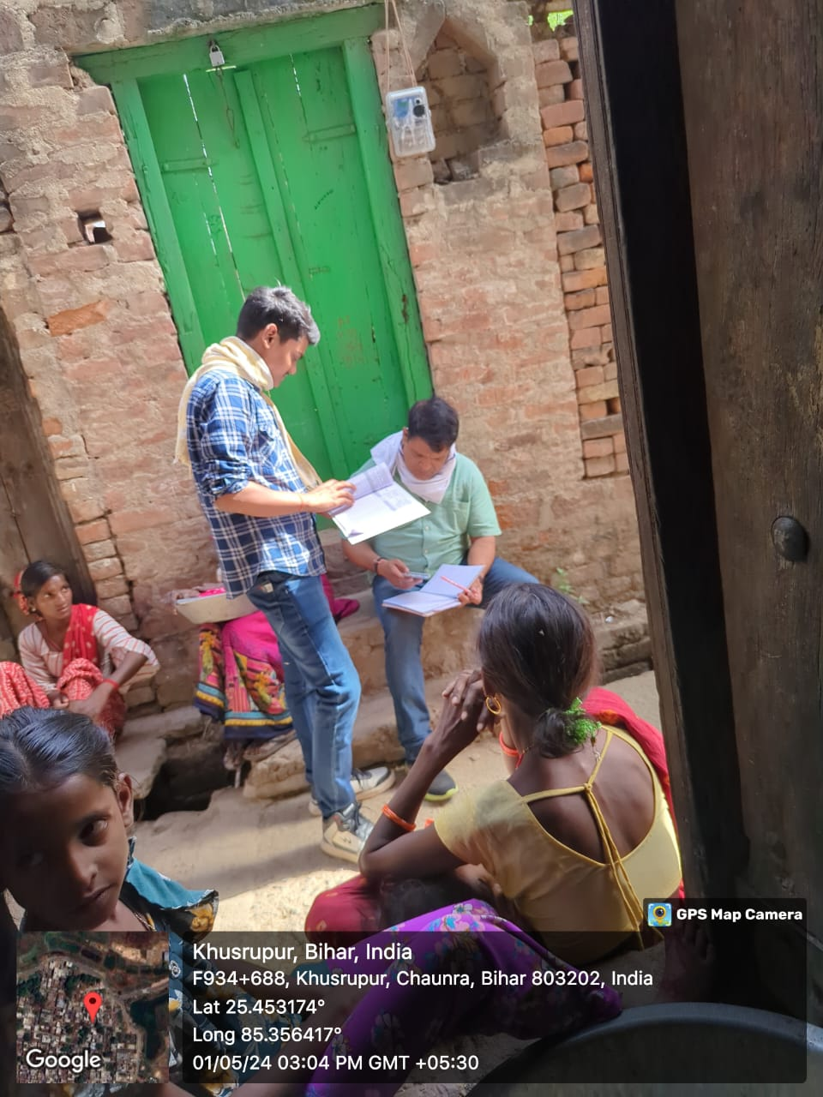
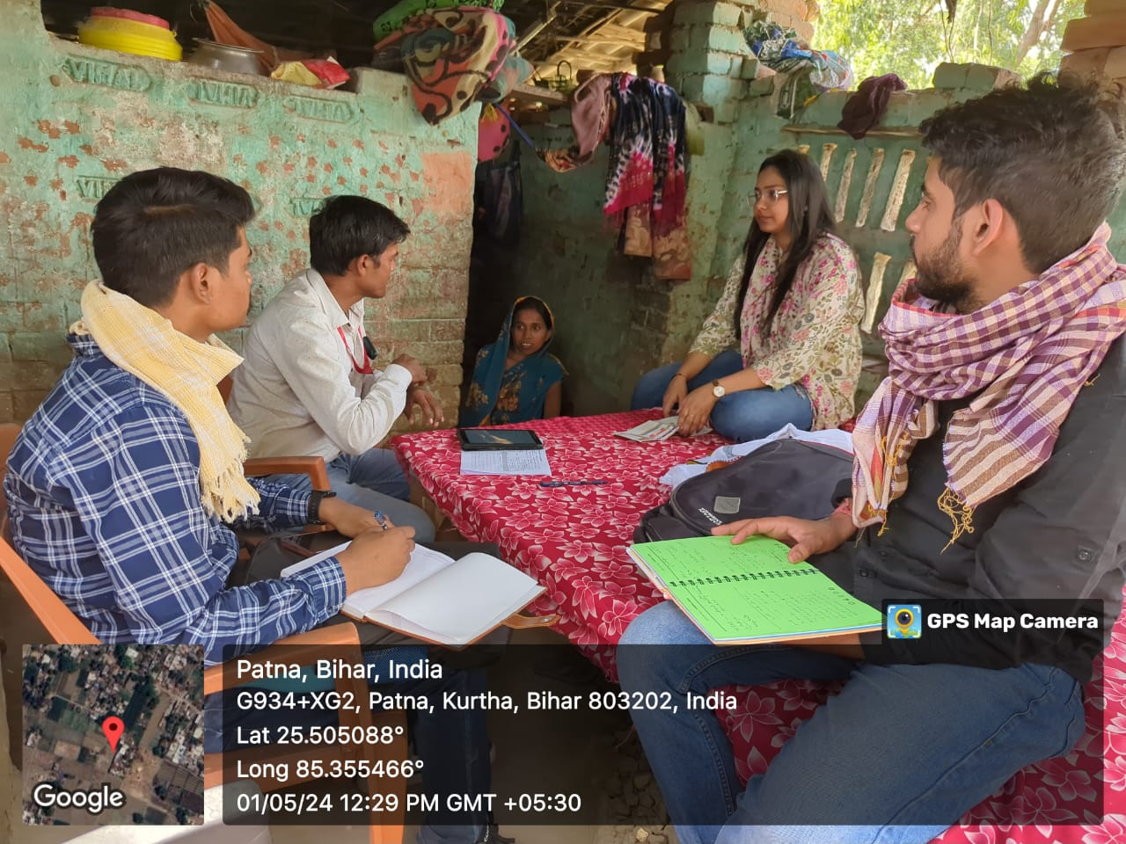
Pictorial Journey

Slide 28
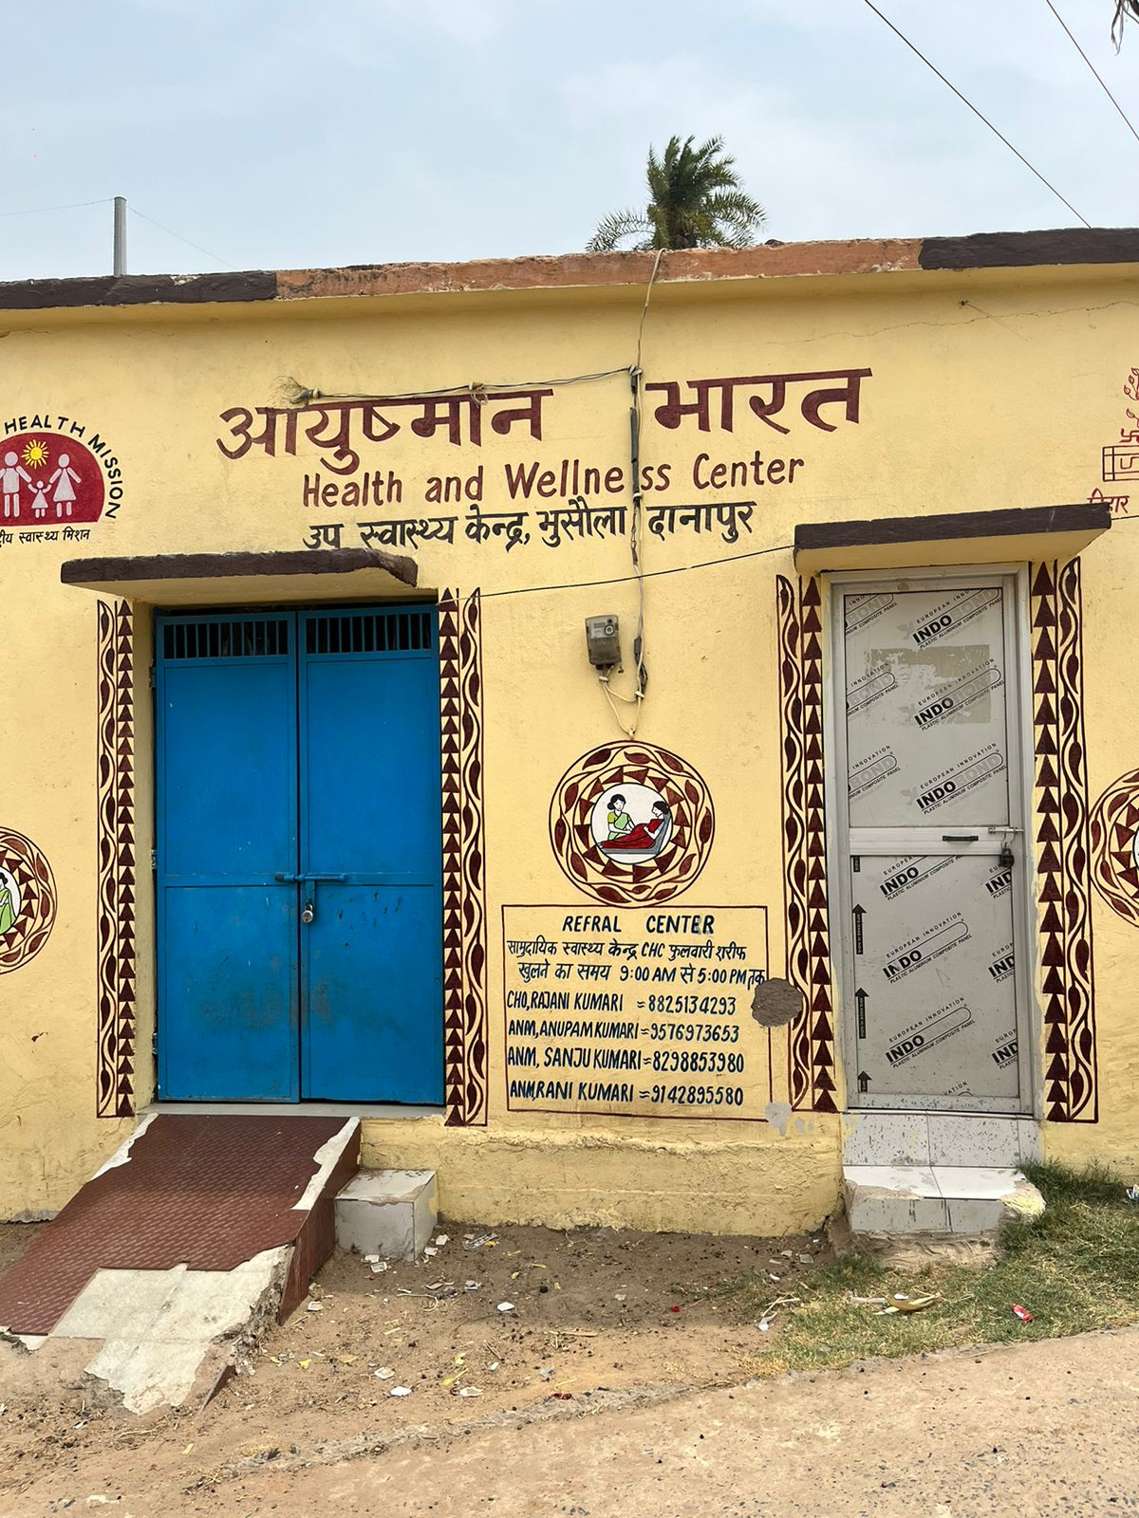
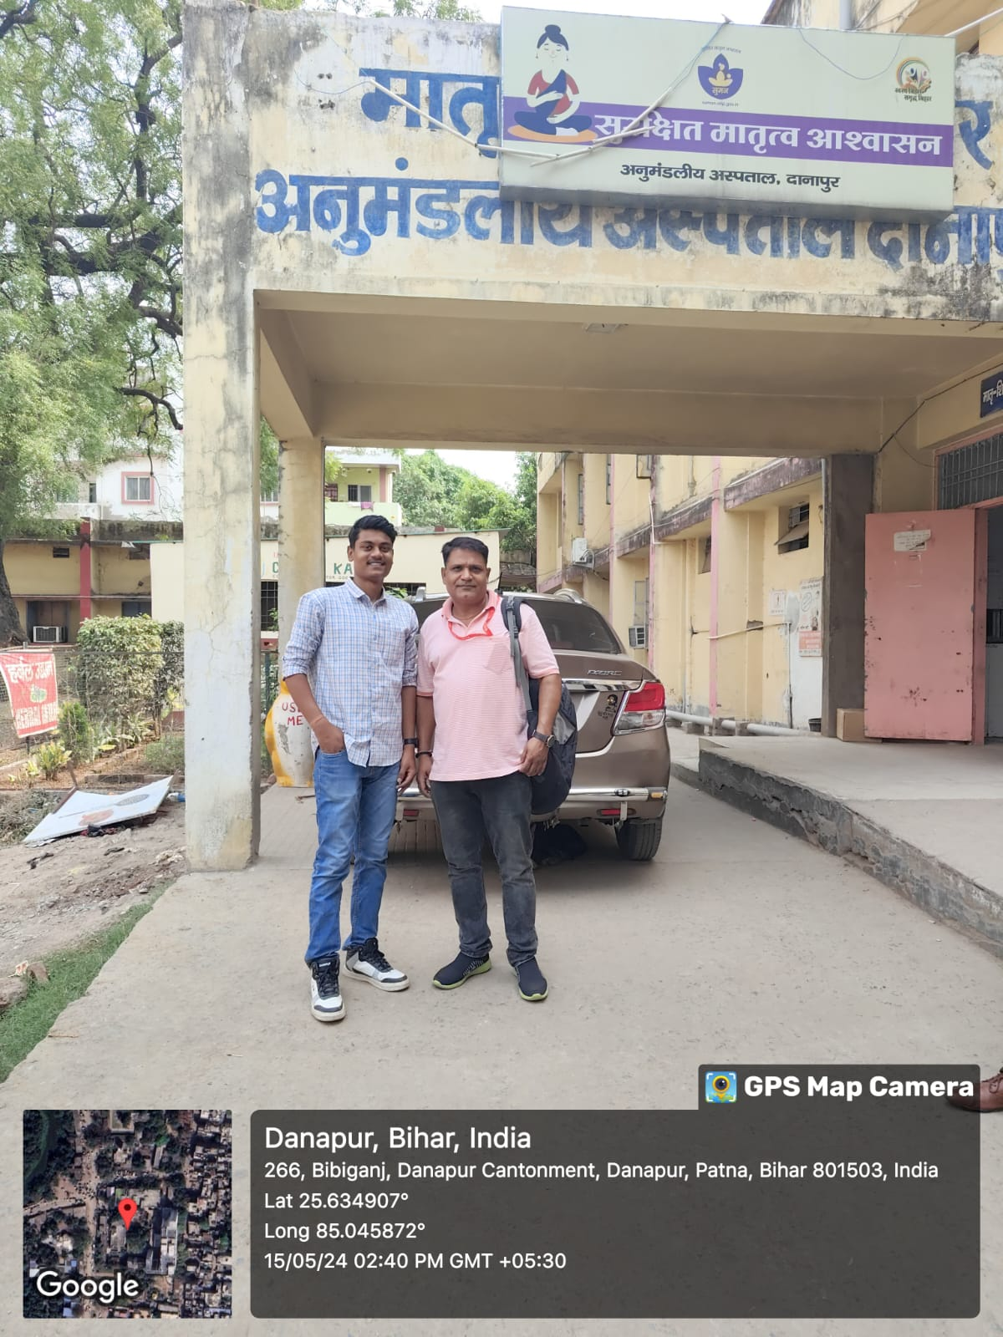
Pictorial Journey

Slide 29

THANKYOU

