Slide 1

Healthcare workers perception about the use of AI based applications to detect TB infection.
Presented By: Swadhapriya Das Chaudhuri
Dissertation Organization: Wadhwani AI
Dissertation Mentor: Dr. Anandhi Ramachandran

Slide 2

Mentor Approval

Slide 3
Introduction
As per the Global TB Report 2021, in 2020, Tuberculosis was responsible for an estimated 0.5 million deaths in India with an estimated 2.6 million incidental TB cases. The global estimate of ‘missing TB cases’ is 4 million.
A major priority for TB diagnostic research at a global level is a rapid, non-invasive triaging test to screen populations for TB. The WHO emphasizes that more proactive efforts are required to close this case-detection gap to move closer towards TB elimination.

Slide 4
Rationale
Given the condition of Tuberculosis in India, improved performance in scaling up of TB related activities is very much crucial. To reach the goal of TB eradication 5 years ahead of the global target of 2030 by 2025 .
It is very well possible to close the case detection gaps by advanced technological solutions providing faster, non-invasive solutions which may not require relying on expert and skilled personnel.
Artificial Intelligence and Machine learning algorithms are increasingly being used in primary healthcare. They are used for prevention screening, diagnosis, treatment, prediction and in other domains as well.

Slide 5
Objectives
To understand the perception of the healthcare workers towards the use of AI
To understand the knowledge and awareness of health care workers on TB and AI
To understand the perception of the healthcare workers towards the use of AI to detect TB.

Slide 6
Research Question
A cross-sectional study on the perception of healthcare workers' regarding the use of AI-based applications for detecting TB infection.

Slide 7
Methodology
Study Design: Cross- Sectional Study
Study Sample: Community Health Officers.
Sample Size: 137 (Study being conducted across 4 districts of Nagaland having collectively 137 CHOs, hence all considered.
Study Location: 4 districts of Nagaland (Dimapur, Kohima, Mon, Mokokchung)

Slide 8
Methodology
Inclusion Criteria:
CHOs working in Health and Wellness Centres.
Respondents should be working in the area of Tuberculosis.
Healthcare Workers who provide consent to the survey.
Exclusion Criteria:
Any Healthcare Worker who is not a CHO is not included in the study.
Data Collection Method:
Web-based Google Forms survey to be distributed to the healthcare workers.
Data Collection tool:
Semi structured questionnaire
Ethical Consideration:
The study did not collect any personal information hence approval from the SRB was enough to conduct the study.

Slide 9
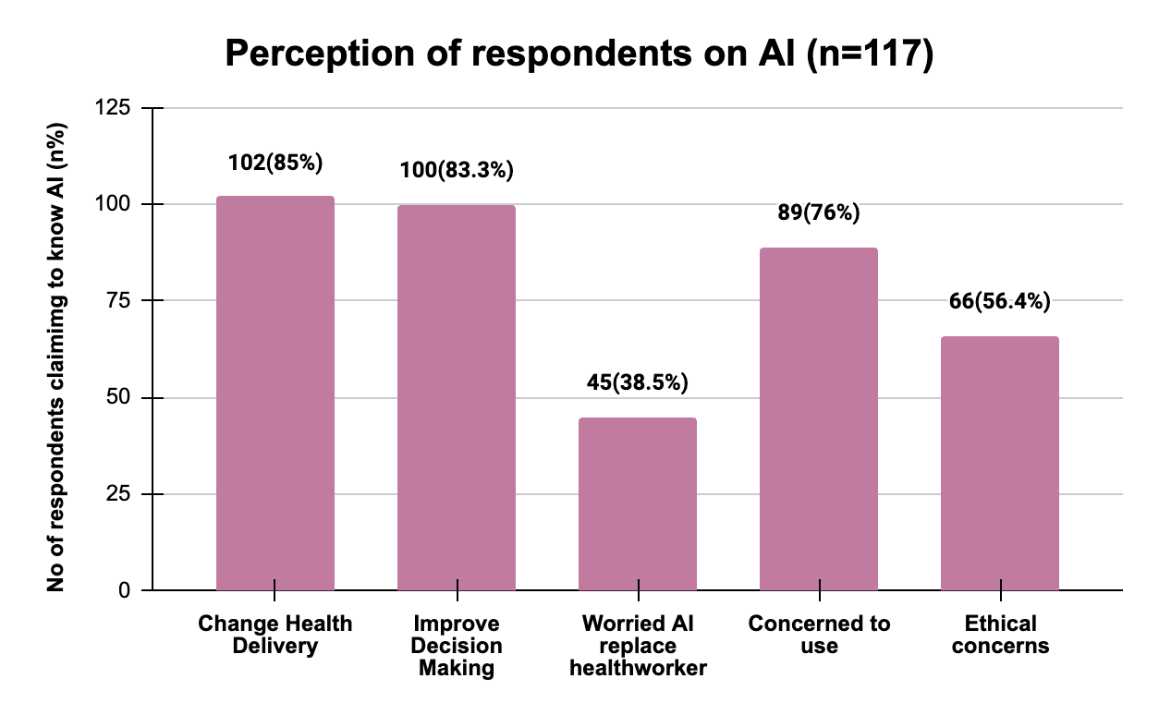
Results
(Perception towards use of AI)
Perceptions of respondents on AI | Respondents n (%)
Change Health Delivery | 102 (85%)
Improve Decision Making | 100 (83.3%)
Worried AI replace health worker | 45 (38.5%)
Concerned to use | 89 (76%)
Ethical concerns | 66 (56.4%)
 | N=117

Slide 10
Results
(Perception towards use of AI)
Responses Received
Q. Do you think AI will change how healthcare is delivered? | Q. Please mention your concerns (ethical) and worries.
It will give more accurate and precise data Proper treatment even in absence of health worker Automate things Operate complex machine without involvement Reduce treatment time Hassle free diagnosis More feasible with less time consume | AI will have sensitive information, can be misused Personal data needs to be given Misuse personal details Share patient information It is not fully accurate Consent needs to be taken before patient’s data is being used

Slide 11
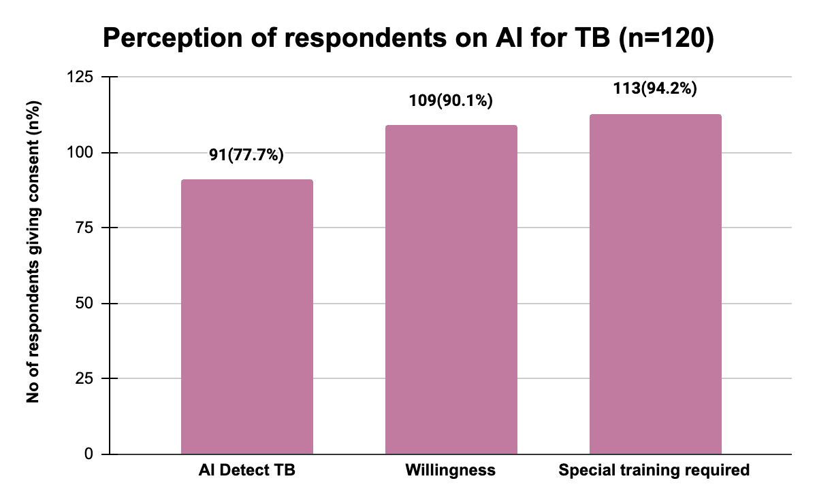
Results
(Perception towards use of AI to detect TB)
Perceptions of respondents on AI for TB | Respondents n (%)
AI Detect TB | 91 (77.7%)
Willingness | 109 (90.1%)
Special training required | 113 (94.2%)
 | N=120

Slide 12
Results
(Perception towards use of AI to detect TB)
Responses Received
Q. Do you think AI can be used to detect TB? Mention how | Q. What factors do you think would affect the adoption and use of AI?
Automatic screening To see who are more prone to get TB, to track TB patients and provide warning alerts for protection of other people On the spot screening Cough sound Actively find cases in population Portable X-Ray Reducing diagnosis or screening time Read tb reports fast I think AI can detect the data that is present in the form of reports in a better way to provide a treatment for the same by clinicians. | On spot identify and management of patient. Quality, Quantity, computing power of data Greater knowledge on the subject Easy and less time consuming Knowledge on the subject Point of care identift Awareness, security Security, confidentiality, awareness Easy to use, fast and reliable Management of patient, at the spot identify

Slide 13
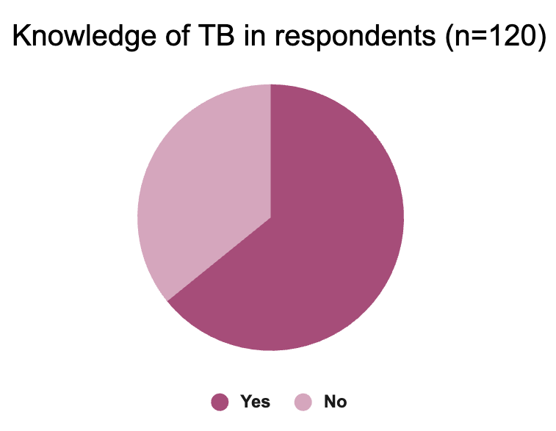
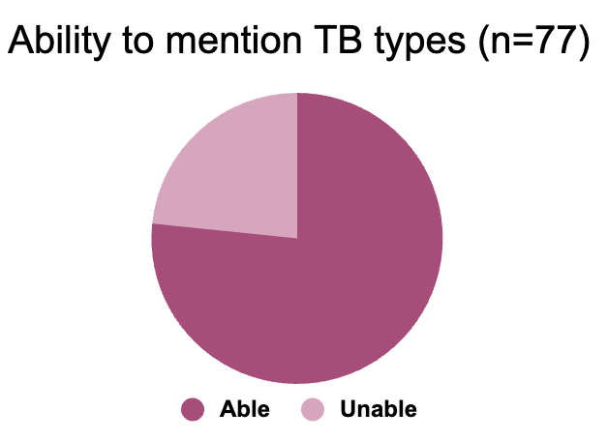
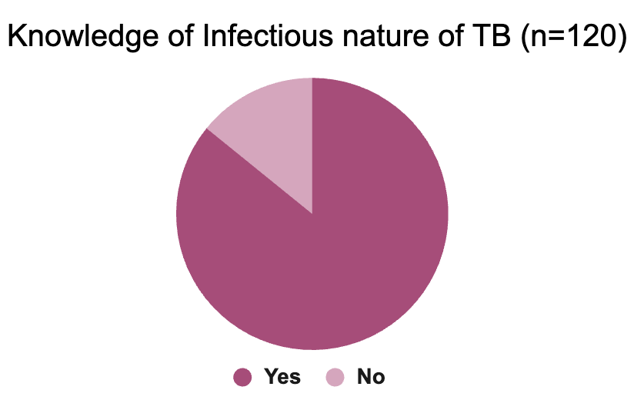
Results
(Knowledge About TB and AI)
Knowledge of TB | Respondents n (%)
Yes | 77 (64.2%)
No | 43 (35.8%)
 | N=120
Ability to mention Types of TB | Respondents n (%)
Able to mention | 59 (76.6%)
Unable to mention | 18 (23.4%)
 | N=77
Knowledge of Infectious nature of TB | Respondents n (%)
Yes | 103 (85.83%)
No | 17 (14.2%)
 | N=120
43 (35.8%)
18 (23.4%)
17 (14.2%)
77 (64.2%)
59 (76.6%)
103 (85.83%)

Slide 14
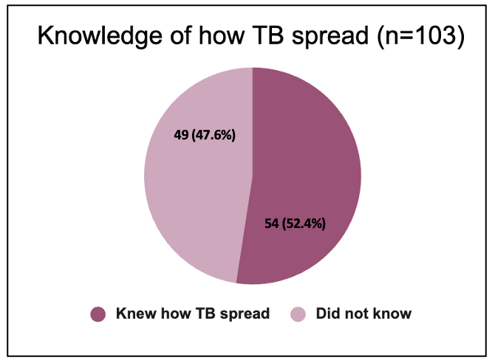
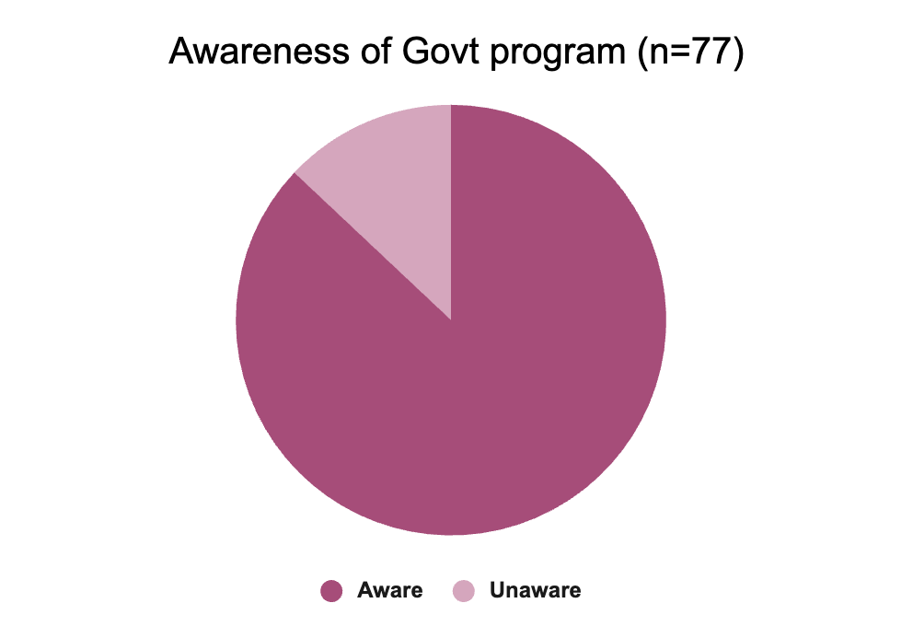
Results
(Knowledge About TB and AI)
Knowledge of how TB spread | Respondents n (%)
Knew how TB spread | 54(52.4%)
Did not know | 49(47.6%)
 | N=103
Awareness of Govt program | Respondents n (%)
Aware | 67(87%)
Unaware | 10(13%)
 | N=77
10 (13%)
67 (87%)

Slide 15
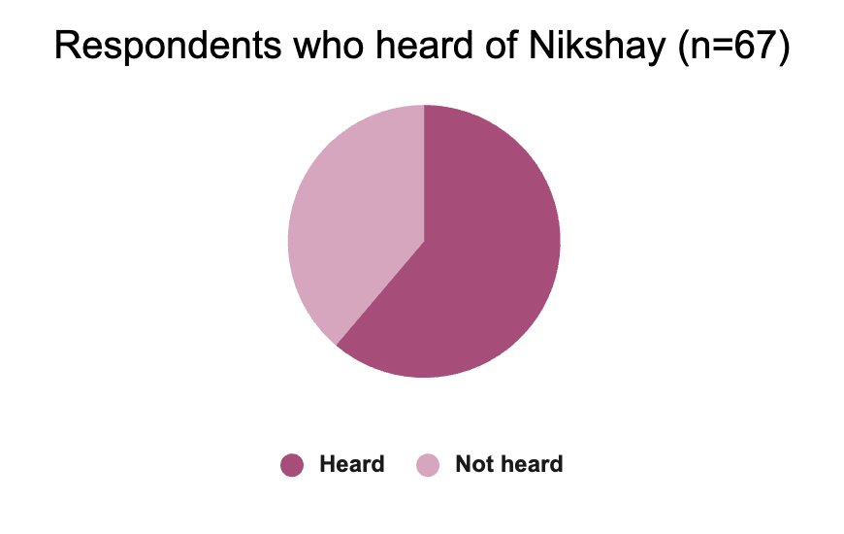
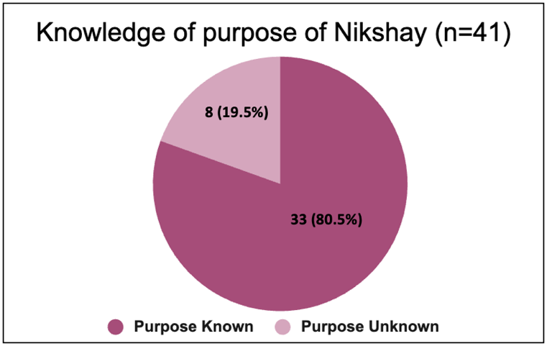
Results
(Knowledge About TB and AI)
Heard of Nikshay | Respondents n (%)
Heard | 41(53.2%)
Not heard | 26(47%)
 | N=67
Knowledge of purpose of Nikshay | Respondents n (%)
Known | 33(80.5%)
Unknown | 8(19.5%)
 | N=41
26 (47%)
41 (53.2%)

Slide 16
Results
(Knowledge About TB and AI)
Responses related to knowledge about TB
Q. Mention Types of TB | Q. Which types of TB is considered infectious and how do they spread. | Q. Mention purpose of Nikshay?
Pulmonary and Extra-pulmonary Active TB and latent TB It could be - Pleural, GIT, Brain, Skeletal, Miliary, Bladder and Kidney TB lungs and other area PTB and EPTB | Miliary TB, bacteria spread very rapidly to the lungs in this kind of TB. droplets, communicable Pulmonary Tuberculosis air, cough, sneeze TB disease in the lungs or throat can be infectious. Through air one person to another person | Patient management system for TB control TB Patient Management Adherence Patient Identify and give medicine Tracking tb patients and treat all Patient reporting and treatment monitoring register cases, monitor treatment

Slide 17
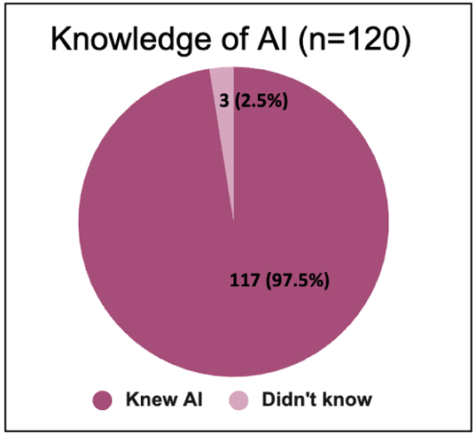
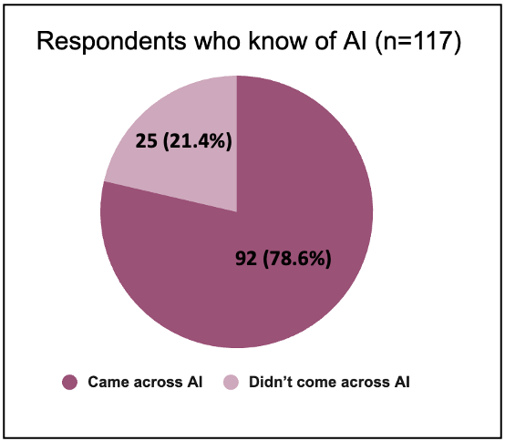
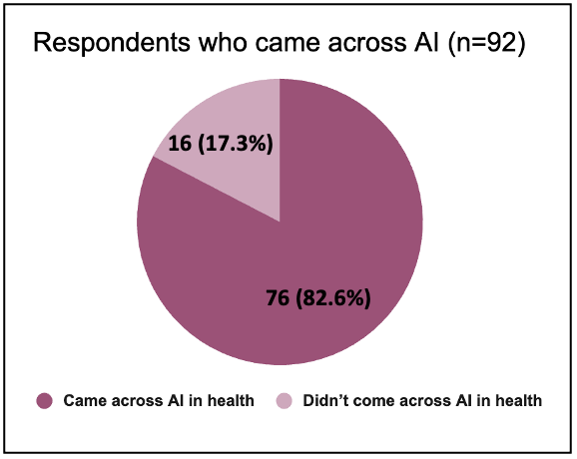
Results
(Knowledge About TB and AI)
Knowledge of AI | Respondents n (%)
Knew AI | 117(97.5%)
Didn’t know | 3(2.5%)
 | N=120
Respondents who know of AI | Respondents n (%)
Came across AI | 92(78.6%)
Didn’t come across AI | 25(21.4%)
 | N=117
Respondents who came across AI | Respondents n (%)
Came across AI in health | 76(82.6%)
Didn’t come across AI in health | 16(17.3%)
 | N=92

Slide 18
Discussion
Knowledge About TB :
A significant number of the CHOs did not have proper exposure or knowledge of TB. Even the officers claiming to know TB were unable to correctly mention the various types of TB present or about its infectious nature.
As per the study conducted it was also seen that respondents claiming to know TB were unclear/unaware of Nikshay even after claiming to know about Govt program. Even so, the CHOs who had heard about Nikshay were not entirely clear on its purpose.
Knowledge About AI :
From the study conducted it was evident that a majority of them were aware of AI or what it stood for.
The CHOs were not only aware of AI but a significant number of them could name few applications they believed to be using AI - Google Assistant, ChatGPT, Alexa, Siri etc. and also quite a few could relate its usage in healthcare like – reading test results/X-Rays, Siri3D imaging apps like Lenskart , Arogya Setu, Fitness apps etc.
This signifies that not necessarily they would come across or have used AI apps but could atleast understand its values or impact that it could make.

Slide 19
Discussion
Perception About AI :
According to the study a large number of the health workers showed their acceptance or interest to welcome AI as a solution the healthcare.
Majority of the CHOs believed that introduction of AI solution can be used to detect TB/ change healthcare delivery/ improve decision making. However a major portion of the workers suggested the requirement of awareness and special training to be using such a solution for better acceptance.
Also it was clear that even though a majority of the health workers showed willingness to use AI but were equally concerned about the use of such solution as highly confidential patient information maybe misused raising security concerns.

Slide 20
Conclusion
A good training and awareness on various aspects in the field on TB, extent of Govt Interventions, could surely create readiness for solution adoption leading to better case finding approach and TB eradication.
A detailed understanding and training on Nikshay might be necessary, its purpose, usage, identification and enrollment of patient following through the entire TB care cascade.
Taking into consideration all the views, beliefs and concerns of the healthcare workers for better acceptance of an AI based solution and therefore better scalability and usability.

Slide 21

References
Global tuberculosis report 2021 [Internet]. [cited 2023 Mar 17]. Available from: https://www.who.int/publications-detail-redirect/9789240037021
Tuberculosis | National Health Portal Of India [Internet]. [cited 2023 Mar 17]. Available from: https://www.nhp.gov.in/disease/respiratory/lungs/tuberculosis
WHO_HTM_TB_2014.18_eng.pdf [Internet]. [cited 2023 Mar 17]. Available from: https://apps.who.int/iris/bitstream/handle/10665/135617/WHO_HTM_TB_2014.18_eng.pdf?sequence=1&isAllowed=y
World Health Organization. Tuberculosis prevalence surveys: a handbook. 2011 [cited 2023 Mar 17]; Available from: https://apps.who.int/iris/handle/10665/44481
Pedrazzoli D, Lalli M, Boccia D, Houben R, Kranzer K. Can tuberculosis patients in resource-constrained settings afford chest radiography? Eur Respir J [Internet]. 2017 Mar 1 [cited 2023 Mar 17];49(3). Available from: https://erj.ersjournals.com/content/49/3/1601877
Yasobant S, Bhavsar P, Kalpana P, Memon F, Trivedi P, Saxena D. Contributing Factors in the Tuberculosis Care Cascade in India: A Systematic Literature Review. Risk Manag Healthc Policy. 2021 Aug 10;14:3275–86.
Lönnroth K, Migliori GB, Abubakar I, D’Ambrosio L, de Vries G, Diel R, et al. Towards tuberculosis elimination: an action framework for low-incidence countries. Eur Respir J. 2015 Apr;45(4):928–52.
Rong G, Mendez A, Bou Assi E, Zhao B, Sawan M. Artificial Intelligence in Healthcare: Review and Prediction Case Studies. Engineering. 2020 Mar;6(3):291–301.
Castagno S, Khalifa M. Perceptions of Artificial Intelligence Among Healthcare Staff: A Qualitative Survey Study. Front Artif Intell. 2020 Oct 21;3:578983.

Slide 22
THANK YOU

Slide 23
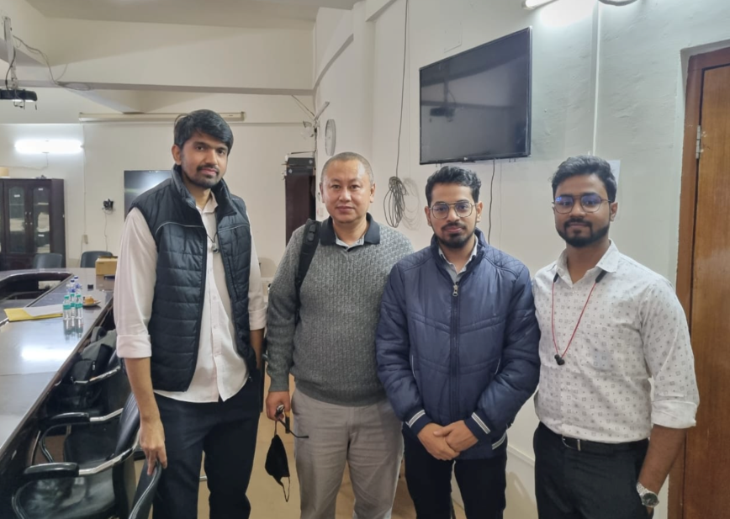
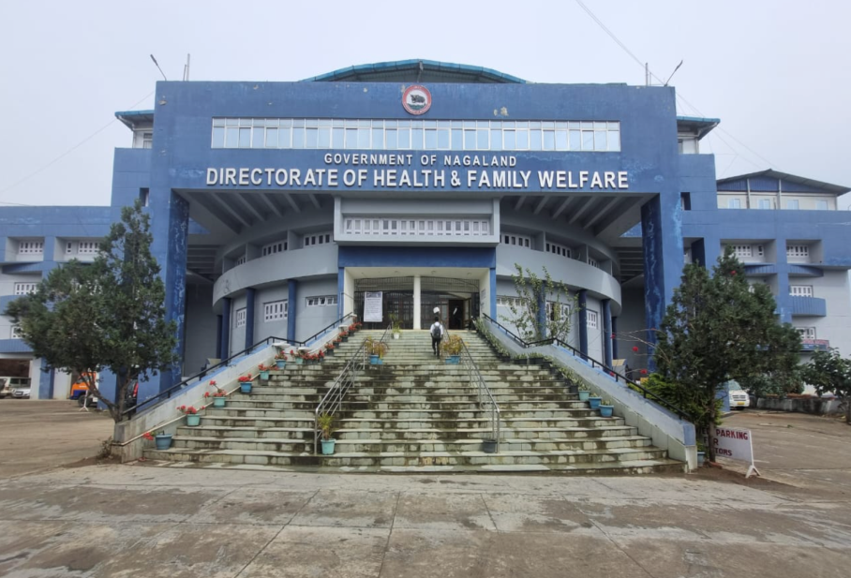
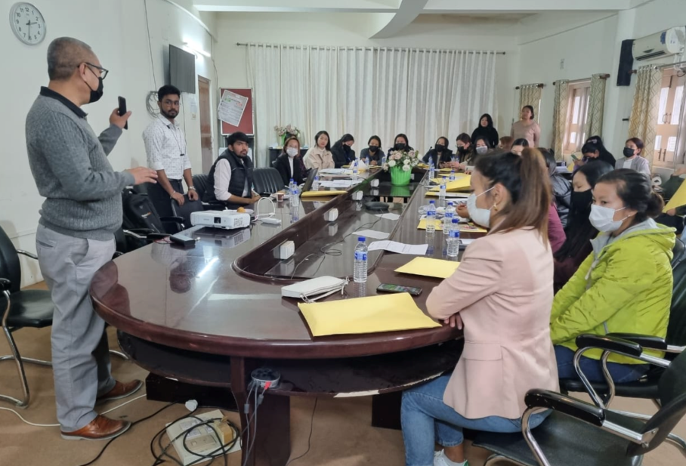
Pictorial Journey

