Slide 1

A Super Specialty Hospital
& Cancer Centre

Slide 2
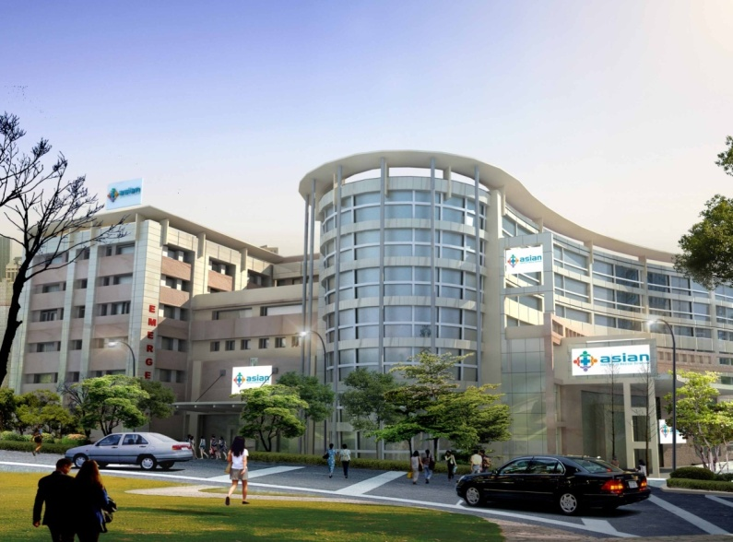
350 bedded Super specialty tertiary care hospital with cancer centre in sector 21A, Faridabad.
First hospital in Faridabad to offer a one stop healthcare solution.
Conveniently accessible from Delhi, NCR and other parts of North India.
- 5 Km From New Delhi
- 22 Km from Gurgaon
Hospital is managed & run by India’s most skilled medical professionals offering a patients & doctor friendly environment.
Bed Space ratio 1200 sq ft/ bed.

Slide 3
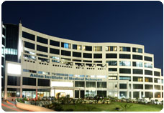
INTERNSHIP
Learn the whole process of NABH preparation
Formulating policies
Designing Of New Forms
Monitoring of quality indicators
Learned to Do Internal audit -Member Of Quality Assurance Team
Sensitization Of NABH to the Hospital Staff.
Worked in team for the closure of the Non – compliance identified during Pre – assessment.

Slide 4
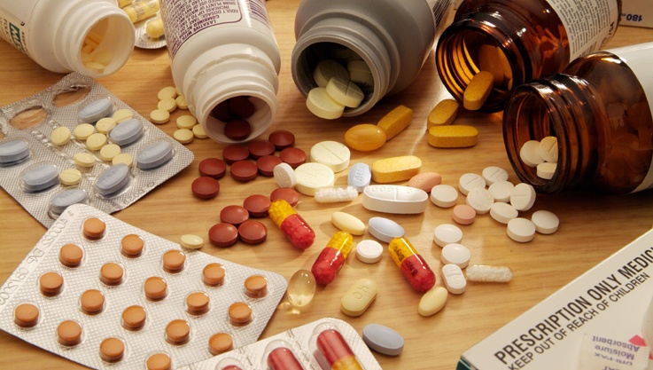
MEDICATION ERROR

Slide 5
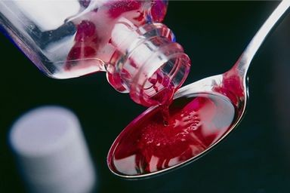
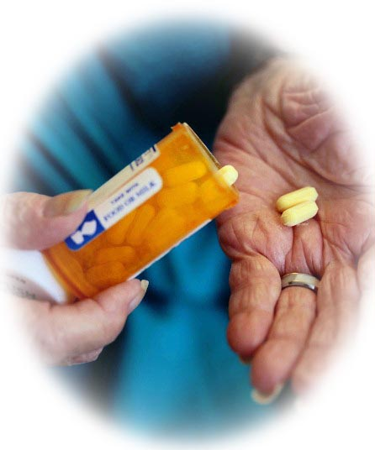
"A medication error is any preventable event that may cause or lead to inappropriate medication use or patient harm while the medication is in the control of the health care professional, patient, or consumer.

Slide 6
Medication-Use System
Prescribing
Dispensing
Administration

Slide 7
5 R Principle
Right “Drug”
Right “Dose”
Right “Time”
Right “Patient”
Right “Route”

Slide 8
AIM
An analysis of medication prescription practices in the hospital to find out the reasons of errors in medication prescription, dispensing and administration.
OBJECTIVE :
Understand the most common causes for error in the prescribing process.
Understand communication impact in reducing medication errors.
To develop a strategic plan within the organization for Effective reduction of the medication error.

Slide 9

FINDINGS

Slide 10
REASONS OF ERROR IN DOCTOR’S PRESCRIPTION :
  illegible handwriting,
  Prohibited abbreviations Eg. For micrograms – Doctor write mg and nurse misinterpret it as Milligram
  Communication of verbal orders
  Dosage miscalculations Eg. In Paeds patient
  Drug administration Route not clear Eg. Not specified whether I.v or I.m
  Special instruction not documented on the prescription sheet by the Doctor –
Eg. Whether to be given before food or after food.
  Lack of knowledge of the drug
    Wrong dose, choice, drug.
    Interaction
    Allergy checking

Slide 11
REASONS OF ERRORS AT PHARMACY
Mistakes in identifying drugs – Name,Packaging
Misreading in case of a Look A Like & Sound A like
Only a trainee available during Night Shift.
Less Staff available
6-8 drugs stored in a single box ,this causes confusion.
Oral Orders :Drug orders given orally can be misunderstood, especially if they involve a LOOK A LIKE & SOUND ALIKE .For example: Mellaril &Elavil , Cerebyx & Celebrex

Slide 12
REASONS OF ERRORS DURING ADMINISTRATION
Drug Chart not maintained properly
Instruction not read properly or if in doubt they are not confirmed neither by their team Leader nor by the Doctor.
Usually errors happen during the change of the Shift
Language Barrier – South Indian Nurses have problem in taking Verbal Orders.
Attrition Of staff during Jan and Feb.
More Patient Inflow in the month of Feb. as it was the foundation Month – Heavy Discounts on various Procedures.
Sometimes Confusion in Cut Tablets.

Slide 13

METHODOLOGY
Study Design - CROSS – SECTIONAL and QUANTITATIVE in nature.
PRIMARY DATA : Direct Observation of Various Opd’s, Pharmacy, Wards

Slide 14

RECOMMENDATIONS

Slide 15
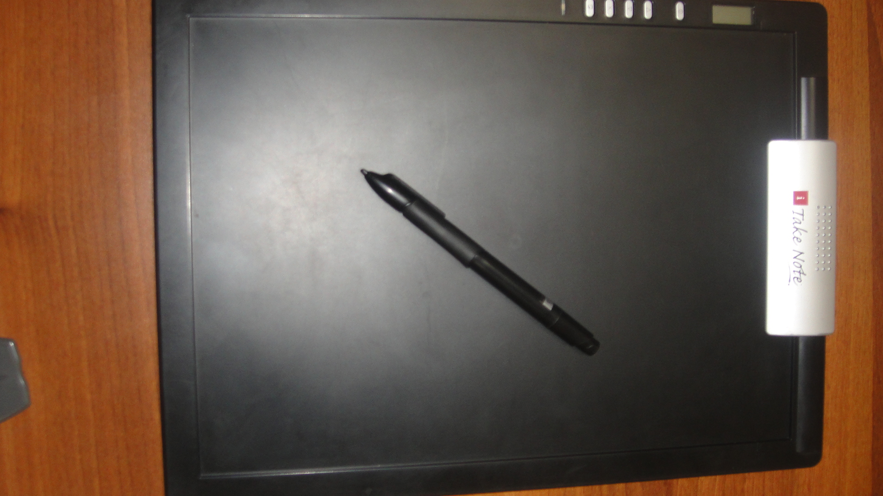
DOCTOR’S
No Verbal orders are allowed
Weekly File Audit
Electronic Pads were introduced.
Filter clinics
Use of Drug Formulary made compulsory.
PHYSICIAN PATIENT COMMUNICATION
TRAININGS ON SAFE PRESCRIBING

Slide 16
PHARMACY
1.Look Alike – Sound Alike Drug List to be displayed at relevant place at the Pharmacy.
2.Prescription to be checked by the clinical pharmacist and not Trainees.
3. Substitute Of Drugs should not be given.
4.Trained Staff to be kept for the night Shift.
5. Single Tablet not to be Dispensed
6. 2-3 drugs to be kept in the single Drug Box instead of Multiple Drugs.
7.Double Check should be done before dispensing and time to be taken to read labels.

Slide 17
NURSING
Drug Chart to be maintained properly – Signed and Timed
No verbal Orders to be taken.
Trainee nurses should not be given the task of administration of Drugs.
Proper training sessions
Shift Change Over Register to be Maintained .
Double Check of Drugs should be done – before administration of Drugs .

Slide 18
Implement “safe practices”
Design work so that it is easy to do it “Right” and hard to do it “Wrong”

Slide 19


