Slide 1




“A Study on Gap Analysis of District Women’s Hospital, Etawah”
ORGANIZATION SUPERVISOR
Dr. Bidhan Das
Managing Director,
Octavo Solutions Pvt. Ltd.
New Delhi
PROJECT BY
Dheeraj kanwar
IIHMR, Delhi
PROJECT GUIDE
Mr. Vinay Tripathy
INTERNATIONAL INSTITUTE OF HEALTH MANAGEMENT RESEARCH, MEW DELHI

Slide 2
CONTENTS
Organisation profile
Dissertation project- a study on gap analysis of District Women’s Hospital, Jhansi
Introduction
Objectives
Methodology
Study findings and analysis
Recommendations
Conclusion

Slide 3

ORGANISATON PROFILE
OUR MISSION
VISION
To become the Leader in Healthcare Consulting in India by providing value for money, effective, efficient solutions and hands on support.
To focus on continuous development of processes for understanding the needs and expectations of the Clients; leading to continual improvement and real time client satisfaction.
Our goal is to help build institutions that delight the customers and where providers enjoy to work

Slide 4
OUR SERVICES
Project & Strategic Planning
- Business Case Writing
- Facility Plan Draft, Architect Briefs
- Equipment Planning
- Equipment Procurement
Quality Healthcare Certifications
- Gap Analysis & Preparation for Accreditation
- NABH Accreditation
    - ISO 9001:2008 Certification
Public & Rural Health
-We take up advisory/ consulting role on boards of NGO/ Government/ PSU/ Corporate for planning, implementing or monitoring of their projects
Knowledge Management
-We collect, collate, analyze, store and share latest know how’s within domain of healthcare sector

Slide 5

“A Study on Gap Analysis of District Women’s Hospital, Etawah”

Slide 6
INTODUCTION OF STUDY
Gap analysis is the initial step in the review of the available service delivery system.
It is an efficient base to implement a modern management system.
It can be measured against pre set standards.
It reveals the areas of improvement in the existing service system.
It focuses on the components of the management services and how effective they are
It helps in measuring the performance of hospital. The performance can be measured once the standards or benchmarks for the same are available.

Slide 7
INTRODUCTION TO THE HOSPITAL
The hospital is located in the heart of the city, close to Jhansi fort. This hospital has got a new wing added to its old building. The hospital is located in two separate buildings connected through a corridor. There is no gate at the main entrance for ensuring safety & security. The hospital has 2 buildings. Floor directory is not displayed anywhere in the entire building. The campus extends over the area of 2826 square meters. The built-up area is 1979 square meters.

Slide 8
OBJECTIVES
To assess the existing service delivery standards of District Hospital, Jhansi
To identify the baseline levelHs of all quality indicators (structure, process and outcome)
To identify the gap, if any, as per NABH guidelines.
To suggest viable recommendations for bridging the gaps in departments based on customized requirements for the hospital.
To help the hospital management to take appropriate managerial actions to improve the quality of their services
To assess the level of compliance as per NABH standards through score analysis

Slide 9
METHODOLOGY
STUDY DESIGN:
Non-experimental observational study
DATA COLLECTION TOOLS:
Interview and discussions with staff and head of the departments.
Checklists
Observation Using available information
NABH tool kit
STUDY TIME:
3 months
PRIMARY DATA:
Direct observation
Interview
SECONDARY DATA:
Records of various departments

Slide 10
GAP ANALYSIS
MAJOR GAPS

Slide 11
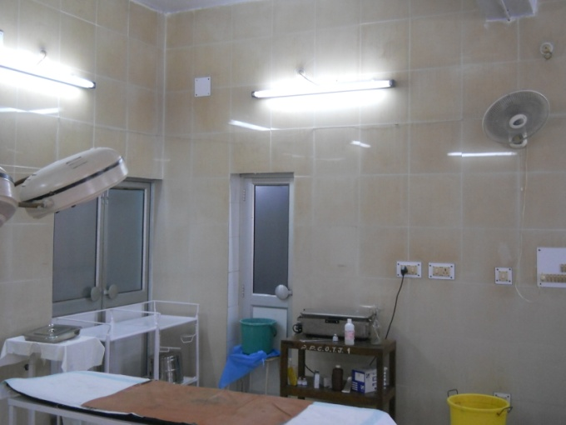
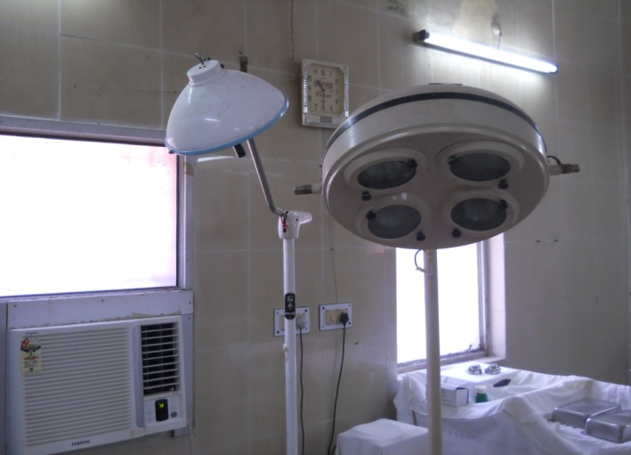
Ceiling fans and window AC in OT (Main)

Slide 12
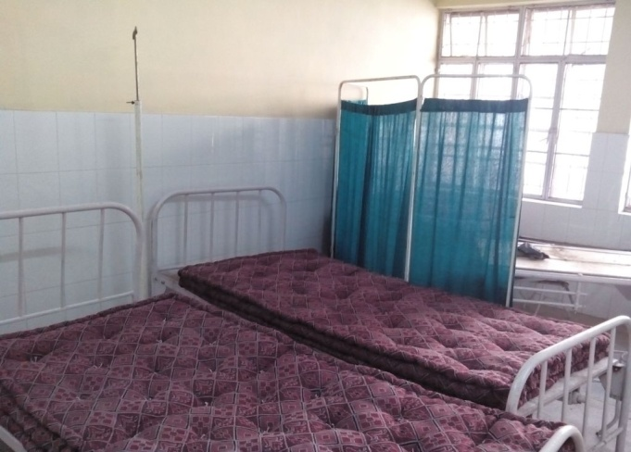
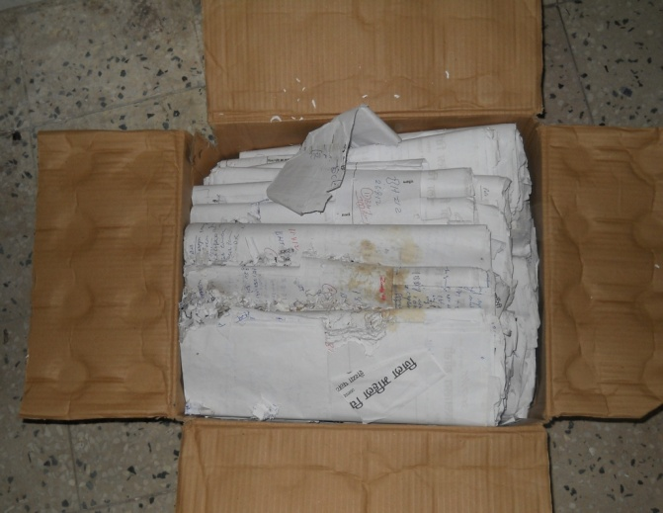
Non functional Post Op room due to lack of nurses
No system of indexing/filing of records

Slide 13

EMERGENCY
GAPS
Emergency department do not have a separate entrance
Emergency signage is not visible from the road with proper lighting and signs
Emergency Crash Cart , Defibrillator and cardiac monitor is not available
There is no system to review all imaging by a radiologist within 24 hours
Unavailability of facilities to perform acute blood test and receive results within one hour for Arterial blood gases, Full blood picture, urea and electrolytes, plasma, glucose, Blood levels for common overdose medication/agents, Coagulation studies
Staff is not trained in BLS/ACLS

Slide 14

RECOMMENDATIONS
Department should have a separate entrance
Emergency signage should be placed with proper lighting and signs so that it will be visible from the main road
Emergency crash cart, Defibrillator & Cardiac Monitor need to be purchased
Radiologist should be available 24x7
Acute blood test need to be performed and receive results within one hour for Arterial blood gases, Full blood picture, urea and electrolytes, plasma, glucose, Blood levels for common overdose medication/agents, Coagulation studies
Staff should be trained in BLS/ACLS

Slide 15
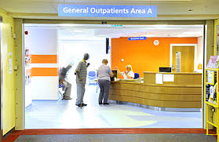
OPD
GAPS
Unavailability of enquiry counter
Unavailability of separate queue for differently able
Unavailability of separate and functional toilet for differently able
Citizen charter and Patient charter are not displayed
Unavailability of dedicated registration clerk
Unavailability of nurse to direct patients to specific OPDs
UHID not generated

Slide 16
RECOMMENDATIONS
Enquiry counter need to be constructed
Separate queue for differently able should be made available
Separate and functional toilet availability for differently able should be there
Citizen charter and Patient charter are to be displayed in the OPD
Dedicated registration clerk need to be appointed
Nurse should be made available to direct patients to specific OPDs
UHID need to be generated

Slide 17
LABORATORY
GAPS
No separate demarcation of sample collection area
Unavailability of pathologist
Scope of services not displayed
Critical results are not defined, reported and documented
Labelling of sample is not done properly
In radiology department AERB approval is not acquired

Slide 18
RECOMMENDATIONS
Separate demarcation of sample collection area need to be done
Pathologist need to be appointed
Scope of services need to be displayed
Critical results need to be defined, reported and documented
Samples need to be labelled

Slide 19
WARDS
GAPS
Emergency crash cart not available
Foot operated colour coded BMW bins not available
Wash basins not available in each ward
Vitals of patient not checked daily
Infection control practices are not being followed as per the guidelines

Slide 20
RECOMMENDATIONS
Emergency crash cart need to be procured
Foot operated colour coded bins need to be procured
Wash basins need to be constructed in each ward
Vitals of patient need to be checked daily and documented
Infection control practices need to be followed strictly as per the guidelines

Slide 21
LABOUR ROOM
GAPS
Separate area is not demarcated for septic and aseptic deliveries
No proper demarcation of New Born Care Area with appropriate equipments
Unavailability of Crash cart and ECG monitor
Partograms and APGAR SCORE are not being used for all the patients
RECOMMENDATIONS
A separate area should be demarcated for septic and aseptic deliveries.
New Born Care Area need to be demarcated properly with appropriate equipments
Crash cart and ECG monitor need to be made available
Partograms & APGAR SCORE need to be used for all the patients

Slide 22
OPERATION THEATER
GAPS
Unavailability of HVAC system
Crash cart, defibrillator, ECG monitor is not available in the OT
OT does not have shadow less
RECOMMENDATIONS
HVAC system need to be installed
Crash cart, Defibrillator & ECG monitor need to be purchased for the OT.
OT need to have shadow less OT light

Slide 23
PHARMACY
GAPS
No security system is not installed
Items storage areas are not marked and labelled
No proper demarcation of receiving, segregation and storing area
Refrigerator for storing medicines(2-8 degree C) not available
No provision for storage of Narcotic drugs is available
Inventory control practices are not followed (ABC, VED, FSN,FIFO)
Drugs and therapeutics committee not formed
Hospital drug formulary is not available

Slide 24
RECOMMENDATIONS
Security system need to be installed
Items storage areas need to be marked and labelled
Proper receiving, segregation and storing area need to be demarcated
Refrigerator for storing medicines(2-8 degree C) need to be made available
Proper provision for storing narcotic drugs need to be made available
Inventory control practices should be followed (ABC, VED, FSN,FIFO)
Drugs and therapeutics committee should be formed
Hospital drug formulary should be available

Slide 25
BMW
GAPS
Sodium hypochlorite solution and puncture proof boxes are not available
Separate route for transportation of waste is not demarcated
Regular health check-up of staff is not done
Submission of Annual reports is not done to UP PCB
Amount of BMW generated is not being monitored
RECOMMENDATIONS
Sodium hypochlorite solution and puncture proof boxes need to be procured
Separate route for transportation need to be demarcated
Regular health check-ups of staff need to be done
Annual reports need to be submitted to UP PCB
Amount of BMW generated need to be monitored

Slide 26
HOSPITAL INFECTION CONTROL
GAPS
No designated ICN & infection control officer
No policies and procedures for infection control
Standard precautions not followed in all departments
Tracking and analyzing of infection risks, rates and trends is not being done
No visit is being done by the hospital authority to the disposal site and also not being documented.
Hospital is not earmarks adequate funds from its annual budget for infection control activities.
In-Service training sessions for all the staff is not being conducted once in a year.

Slide 27
RECOMMENDATIONS
ICN & infection control officer need to be appointed
Policies and procedures need to be formulated for infection control
Standard precautions need to be followed hospital wide
Infection prevention and control programme should be updated
Tracking and analyzing of infection risks, rates and trends should be done
HAI rates should be monitored

Slide 28
BIOMEDICAL ENGINEERING DEPARTMENT
GAPS
Dedicated Biomedical engineering department not available in the hospital
Department not being managed by qualified personnel
Central supply system for bio medical gases does not exist Department not manned 24 hours
No documented procedure for equipment replacement
RECOMMENDATIONS
Dedicated Biomedical engineering department need to be constructed
Department need to be managed by qualified personnel
Central supply system for bio medical gases need to be constructed
Department should be manned 24/7
Equipments need to be inventoried and proper logs need to be maintained

Slide 29
ENGINEERING & MAINTAINANCE
GAPS
Various statutory requirements are not available
Up to date drawing, layout, escape route is not present and displayed
Designated individual for maintenance not available
Unavailability of staff round the clock for emergency repair
Unavailability of safety devices (Fire extinguishers, smoke detectors, sprinklers, grab bars, side rails, nurse CCTV, ALARMS ETC)
Water quality reports not maintained
No facility inspection in patient and non patient care areas

Slide 30
RECOMMENDATIONS
Various statutory requirements are to be obtained from the respective organizations
Up to date drawing, layout, escape route is to be prepared and displayed
Designated individual for maintenance need to be made available
Qualified staff need to be made available for emergency repairs 24/7
Safety devices need to be made available
Water quality reports should be maintained
Inspection facilities in patient care and non patient care areas need to ba made available

Slide 31
HUMAN RESOURCE
GAPS
No designated area and functional HR department available
HR induction and training is not done
HR welfare - staff and family not maintained
Pre-employment check-up not done
No training In-charge present in the hospital
RECOMMENDATIONS
Proper designated area and functional area for HR department need to be made available
Training and Induction of employees need to be done
HR welfare - staff and family need to be maintained
Pre-employment need to be done
Training in-charge should be available in the hospital

Slide 32
MRD
GAPS
Sufficient space & ventilation not available
Qualified and trained MRD technician not available
Functional flow at MRD not being followed
Deficiency checklist not being followed
MRD committee not available MRD audits not conducted
ICD codification of the records not done
RECOMMENDATIONS
Sufficient space & ventilation need to be made available
Qualified and trained MRD technician need to be appointed
MRD should follow functional flow
ICD coding of files should be done
Deficiency checklist should be followed
MRD committee should be formed

Slide 33
LINEN & LAUNDARY
GAPS
Separate covered trolley for transporting dirty linen & washed linen is not available
Heavy duty rubber gloves, mask is not available to the linen handlers
Linen not changed daily
Packing of the soiled & contaminated linens in separate bags & labelling/colour coding is not being done
Dirty linens & clean linens are not stored in separate areas
RECOMMENDATIONS
Separate covered trolleys for transportation of dirty and washed linen should be made available
Heavy duty rubber gloves, mask need to be made available to the linen handlers
Linen need to be changed daily
Packing of the soiled &contaminated linens in separate bags & labelling/colour coding should be done
Dirty linens & clean linens need to be stored in separate areas

Slide 34
SECURITY
GAPS
No telephone connectivity from the emergency
Unavailability of separate security guard in Emergency room
Main entrance of hospital and labour room not guarded by separate security guards
No restriction on unauthorized entry of patients and relatives to the restricted areas of the hospital
Outgoing items are neither checked nor entered on registers
RECOMMENDATIONS
Emergency need to be connected through telephone system
Separate security guard need to be appointed for Emergency room
Main entrance of hospital and labour room should be manned by security guards
Unauthorized entry of patients and relatives to restricted areas need to be monitored
Outgoing items need to be checked and entered on registers

Slide 35
SCORING

Slide 36
CHAPTER 1 : ASSESS, ASSESSMENT AND CONTINUITY OF CARE

Slide 37
CHAPTER 2 : CARE OF PATIENTS

Slide 38
CHAPTER 3 : MANAGEMENT OF MEDICATIONS

Slide 39
CHAPTER 4 : PATIENT’S RIGHTS AND EDUCATION

Slide 40
CHAPTER 5 : HOSPITAL INFECTION CONTROL

Slide 41
CHAPTER 6 : CONTINUOUS QUALITY IMPROVEMENT

Slide 42
CHAPTER 7 : RESPONSIBILITIES OF MANAGEMENT

Slide 43
CHAPTER 8 : FACILITY MANAGEMENT AND SAFETY

Slide 44
CHAPTER 9 : HUMAN RESOURCE MANAGEMENT

Slide 45
CHAPTER 10 : INFORMATION MANAGEMENT SYSTEM

Slide 46
AVERAGE SCORE CHART OF ALL CHAPTERS

Slide 47
INTERPRETATION
ON COMPARING THE HOSPITAL PRESENT STATUS WITH CRITERIA OF NABH PRE ACCREDITATION ENTRY LEVEL WE FIND:
There many standards with more than two zero
HIC and CQI have average score < 1
There is no individual chapter having average score more than 3.38
The overall average of all the standards meets the criteria < 2.5
With the above analysis it is clear that the hospital is not even partially fulfilling the pre-accreditation entry level criteria

Slide 48



CONCLUSION
STRUCTURE
PROCESS
OUTCOME
Land area
Building
Manpower
Licenses
Equipments
Policies
Procedures
Indicators

Slide 49


