Slide 1

Assessing KAP related to food eating habits and physical activity among Post Graduate Students in New Delhi
Under the guidance of DR Nidhi ma’am
BY-ANAMIKA SINGH

Slide 2
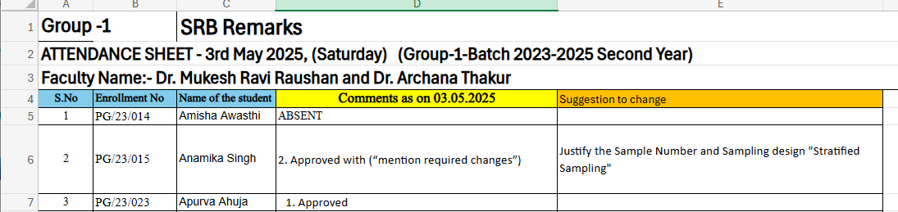
SRB Approval

Slide 3
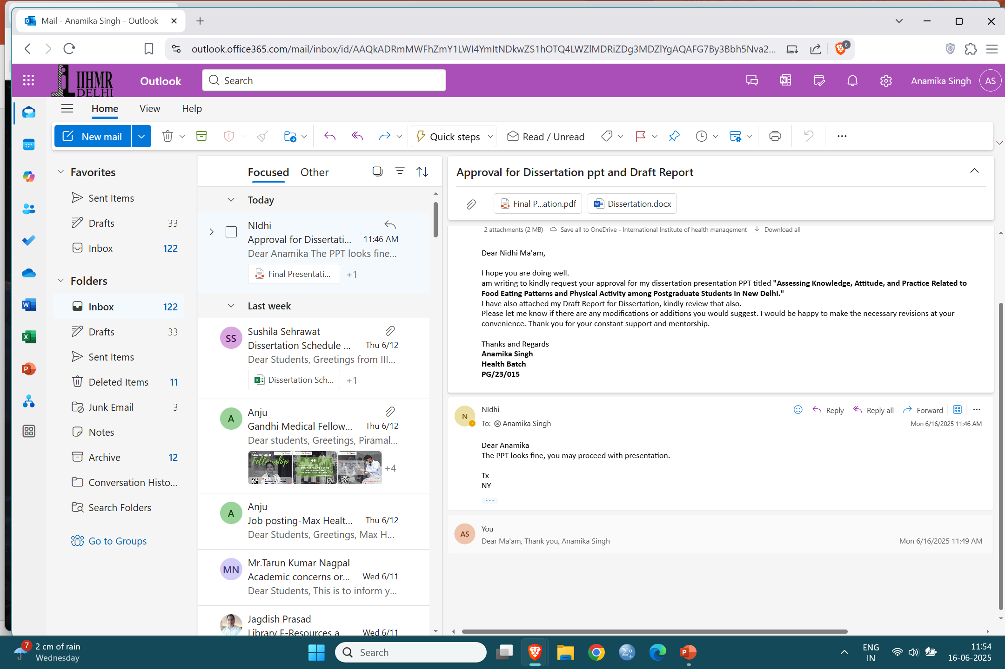
Mentor Approval

Slide 4
Introduction (1/2)
Food eating habits can be defined as the habitual decisions and patterns individuals develop regarding what, when, and how they eat. These habits include food preferences, portion sizes, meal timing, snacking behavior, and influences from culture, environment, emotions, and social settings. Eating habits are shaped over time and can have both positive and negative impacts on an individual’s nutritional status and overall well-being. [1]
The transition to higher education often leads to lifestyle modifications, where students face increased autonomy over their food choices, schedules, and physical activity. This demographic is particularly vulnerable to adopting unhealthy eating patterns due to academic stress, irregular routines, limited cooking skills, and easy access to Street Food.[2]
In recent years, diet and physical activity patterns of the Indian population have undergone major changes. This trend is exemplified in the urban setting where industrialization and global influences are more prevalent. [3]
Convenience food culture has led to the consumption of processed foods which are refined and high in sugars, fats and salt. Increased consumption of these foods coupled with decreased physical activity has contributed to the rising rates of chronic lifestyle diseases among young adults.[4]
Understanding the KAP among postgraduate students can help identify knowledge gaps, attitudinal barriers, and behavioral patterns that may hinder healthy eating and active living. For instance, its highlighted that although students often possess moderate knowledge about healthy eating, their practices do not reflect it, indicating a disconnection between knowledge and behavior.

Slide 5
Introduction (1/2)
Importance of Healthy Eating and Physical Activity
Healthy eating habits and regular physical activity are vital for long-term health and prevention of chronic diseases. However, unhealthy dietary behaviors and sedentary lifestyles are common among young adults, especially postgraduate students, due to increased autonomy, academic stress, and irregular routines [6]
According to the International Journal of Behavioral Nutrition and Physical Activity, 65% of individuals in urban areas were classified as physically inactive, compared to 50% in rural regions. This highlights an urban-rural divide in lifestyle behaviors. [7]
Data from the National Institute of Nutrition (NIN) show that North India, including Delhi, records lower intake of calories, protein, and carbohydrates than the national average. However, fat consumption is higher, with visible fats contributing 24% of total energy intake. Fruits and vegetables account for less than 3% of daily energy consumption, highlighting a poor dietary balance. [8]
According to the National Family Health Survey (NFHS-5, 2019–21), at the all-India level, obesity rates have increased compared to previous surveys. The data indicates a rising trend in both urban and rural populations, affecting people across all age groups. NFHS-5 also notes a rise in meat consumption, particularly among men, and that 52% of women consume green leafy vegetables daily. [9]
Understanding the KAP among postgraduate students can help identify knowledge gaps, attitudinal barriers, and behavioral patterns that may hinder healthy eating and active living. For instance, its highlighted that although students often possess moderate knowledge about healthy eating, their practices do not reflect it, indicating a disconnection between knowledge and behavior.

Slide 6
Objectives of Your Study
To assess the knowledge of postgraduate students in New Delhi regarding healthy eating patterns and physical activity.
To examine the attitudes of postgraduate students towards healthy eating and regular physical activity.
To analyze the eating and physical activity practices of postgraduate students.

Slide 7
Methodology (1/2)
Study Design | Cross-Sectional Study
Sample Size (n) | 96
Formula Used | n=Z²*p*(1-p)/d² where
Z-value | 1.96 (for 95% confidence level)
Prevalence (p) | 0.5 (based on previous studies)
Margin of Error (d) | 0.1 (10%)
Calculation | n=(1.96)^{2*}0.5*(1-0.5)/(0.1)² N=3.84*0.25/0.01 =96
Sampling Method | Convenience Sampling

Slide 8
Methodology (2/2)
Aspect | Details
Data Collection Tool | Structured, self-administered questionnaire
Questionnaire Sections | 1. Demographics: Age, gender, course of study, Smoking and Alcohol intake 2. Knowledge: Questions on nutrition guidelines, food groups, benefits of physical activity 3. Attitudes: Likert-scale items on beliefs and perceptions 4. Practices: Meal frequency, street food consumption, physical activity frequency and type
Data Analysis | Data will be entered and analyzed using SPSS software. Descriptive analysis of sociodemographic data, knowledge, and attitude and practice data was done using pie charts of frequency and percentage.
Study Area | IIHMR, DELHI AND IIT DELHI
Inclusion Criteria | Students currently enrolled in a postgraduate program. Individuals willing to participate and provide informed consent.
Exclusion Criteria | Individuals not willing to provide informed consent.

Slide 9
Demographic Profile
Demographics |  | Count | %
Gender | Female | 57 | 60.0%
 | Male | 38 | 40.0%
Year of Study | 1st Year | 9 | 9.5%
 | 2nd Year | 86 | 90.5%
Field of Post-Graduation Study | Arts | 2 | 2.1%
 | MBA | 60 | 63.2%
 | Medical Science | 7 | 7.4%
 | MTech | 6 | 6.3%
 | Others | 12 | 12.6%
 | Science | 8 | 8.4%
Name of College | IIHMR, Delhi | 48 | 50.5%
 | IIT, Delhi | 47 | 49.5%
Living place during study | College Hostel | 14 | 14.7%
 | PG/Flat/Others | 37 | 38.9%
 | With Family | 44 | 46.3%
Food Preference | Eggetarian | 11 | 11.6%
 | Non-vegetarian | 39 | 41.1%
 | Vegetarian | 45 | 47.4%
Smoking | Never | 73 | 76.8%
 | Occasional | 18 | 18.9%
 | Regular | 4 | 4.2%
Alcohol Frequency | Never | 52 | 54.7%
 | Occasional | 42 | 44.2%
 | Regular | 1 | 1.1%

Slide 10
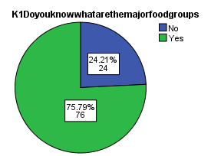
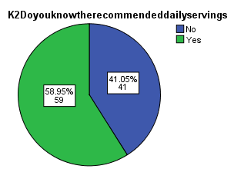
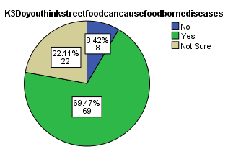
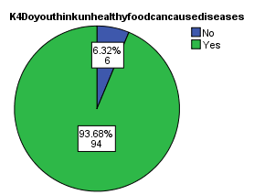
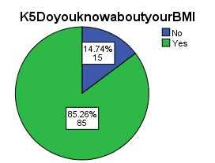
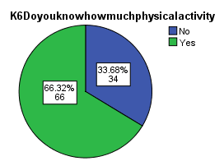
Results-Knowledge

Slide 11
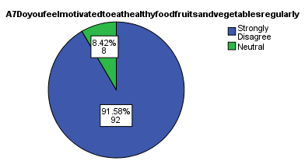
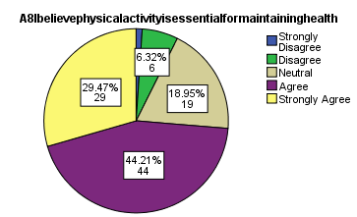
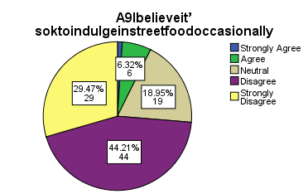
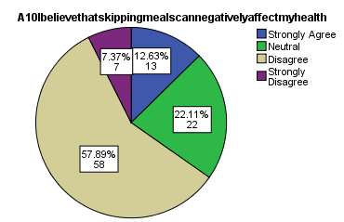
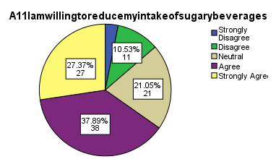
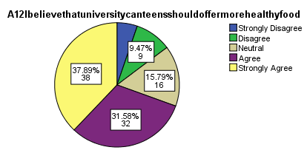
Results-Attitude

Slide 12
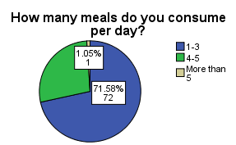
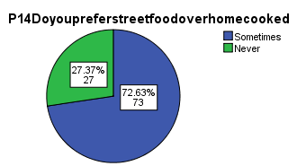
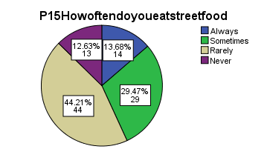
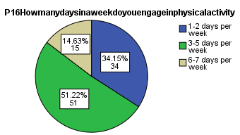
Results-Practice

Slide 13
Results
Domain | Score Range | Mean ± SD | Interpretation
Knowledge | 0 – 6 | 4.94 ± 1.42 | Moderate to Good Knowledge
Attitude | 7 – 35 | 19.92 ± 3.46 | Moderately Positive Attitude
Practice | 0 – 12 | 8.47 ± 2.11 | Good Practice
The study assessed knowledge, attitude, and practice (KAP) related to food habits and physical activity among 95 postgraduate students in New Delhi.
Knowledge: Students showed good awareness (mean score: 4.94/6) about healthy eating and exercise.
Attitude: Most had a positive mindset (mean: 19.9/26), recognizing the importance of healthy habits.
Practice: Despite this, actual behavior lagged (mean: 8.47/12), with many regularly eating unhealthy food and lacking physical activity.

Slide 14


Discussion(1/2)
The highest awareness was on the importance of breakfast intake (93.7%), followed by unhealthy diets causing diseases (89.5%), and knowledge of BMI (85.3%).
The lowest correct response rate was for recommended daily servings (58.9%), showing a possible gap in nutritional specifics.
Overall, knowledge appears to be good in general concepts (e.g., breakfast, BMI, and health risks) but relatively weaker in quantitative guidelines, such as servings per day or physical activity recommendations.
Participants show strongly positive attitudes toward physical activity, reducing sugary drinks, and improving campus food options (A8, A11, A12).
There's a general acceptance of occasional unhealthy eating (A9), which is realistic and common in student populations.

Slide 15
Discussion(2/2)
The lowest attitude score was for motivation to eat healthy regularly (A7), with a mean of just 1.17, indicating a significant gap between belief and action.
Moderate agreement exists for the negative effects of skipping meals (A10).
The mean practice score was 8.47, suggesting a moderate level of healthy practices among the participants.
The median score was 8.00, meaning that half of the participants had scores below or equal to 8.
The mode was 10.00, indicating that the most frequently occurring score was at the higher end of the scale.
The standard deviation was 2.11, reflecting a moderate spread in practice scores.

Slide 16
Conclusion
The study highlights a strong awareness and positive mindset among postgraduate students regarding healthy lifestyle choices.
However, a gap exists between what students know and how they behave, largely due to lifestyle constraints, convenience, and behavioral factors.
Statistically significant correlations suggest that enhancing knowledge and attitudes can support better practices, though additional motivation and support systems are required.
The findings emphasize the need for:
Targeted behavior change communication
University-level health programs
Practical tools to convert awareness into action
Overall, the study underscores that educated youth still require structured support to consistently adopt healthy eating and physical activity habits.

Slide 17

Limitations
Convenience sampling: This can introduce bias and limit generalizability.
Self-reported data: Responses may be influenced by social desirability or inaccurate recall.
Recommendations
Train
Train healthcare workers to educate families about obesity risks and healthy habits.
Integrate
Integrate obesity prevention into existing health programs (like NP-NCD, POSHAN Abhiyaan).
Launch
Launch national-level health campaigns to promote healthy eating and physical activity.
Use
Use simple, local-language messages to improve health literacy.
Enforce
Enforce strict food labeling for salt, sugar, and fat content.
Tax
Tax sugary and ultra-processed foods to discourage their consumption.
Ban or restrict
Ban or restrict unhealthy food marketing, especially to children.
Make
Make healthy foods more available and affordable in schools, workplaces, and public spaces.
Build
Build infrastructure to support physical activity in schools and offices.

Slide 18
References
1.Sethi S, Rastogi M. Perception of healthy eating: role of knowledge, attitude, and practices. SALT J Sci Res Healthc. 2023 Sep 11;3(2):16–23.
2.Ravula P, Kasala K, Das A. Knowledge, attitudes, and practices of vulnerable populations for achieving sustainable dietary practices in India. SAGE Open. 2024;14(3). doi:10.1177/21582440241266695
3.Hansaram NC, Sharma JK, Rani N, Sinha B. Food safety knowledge, attitudes, and practices (KAP) among nursing students: a cross-sectional survey. Indian J Nutri. 2022;9(1):246.
4. Liu KSN, Chen JY, Sun KS, Tsang JPY, Ip P, Lam CLK. Adolescent knowledge, attitudes and practices of healthy eating: findings of qualitative interviews among Hong Kong families. Nutrients. 2022 Jul;14(14):2857.
5. S, Murthy P, Arora M. Knowledge, attitude, and behaviours on diet, physical activity, and tobacco use among school students: A cross-sectional study in two Indian states. F1000Res. 2021 Jul 7;10:544. doi: 10.12688/f1000research.51136.2. PMID: 34745560; PMCID: PMC8543165.
6.Hansaram, Nemkholam C, Jitendra KS, Neelima R, Babita S. Food Safety Knowledge, Attitudes, and Practices (KAP) Among Nursing Students: A Cross-Sectional Survey. Indian J Nutri. 2022;9(1): 246.
7. Press Information Bureau. Towards a Fit and Healthy India: Combating Obesity Through Collective Action [press release]. 2024 May 29 [cited 2025 Jun 16]. Available from: https://www.pib.gov.in/PressReleaseIframePage.aspx?PRID=2107179**
8. Bauman AE, Reis RS, Sallis JF, Wells JC, Loos RJF, Martin BW. Correlates of physical activity: why are some people physically active and others not? Lancet. 2012 Jul 21;380(9838):258-71.
9.National Institute of Nutrition. Dietary Guidelines for Indians – A Manual. 2nd ed. Hyderabad: Indian Council of Medical Research; 2011.

Slide 19
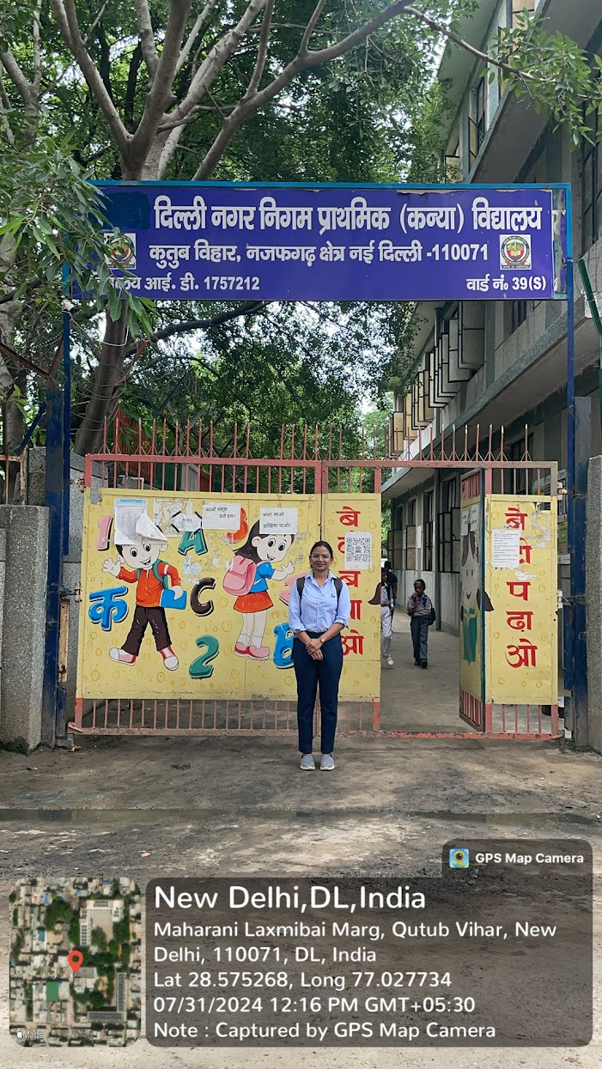
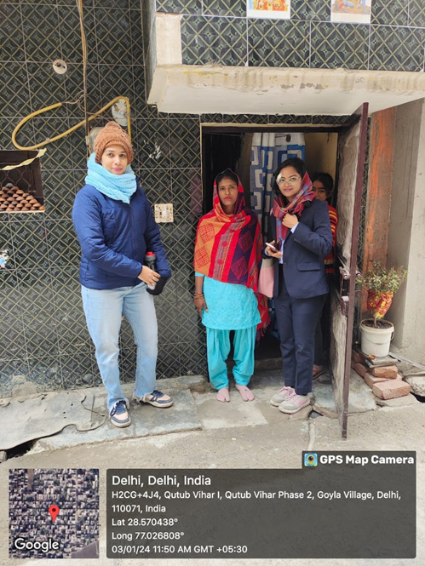
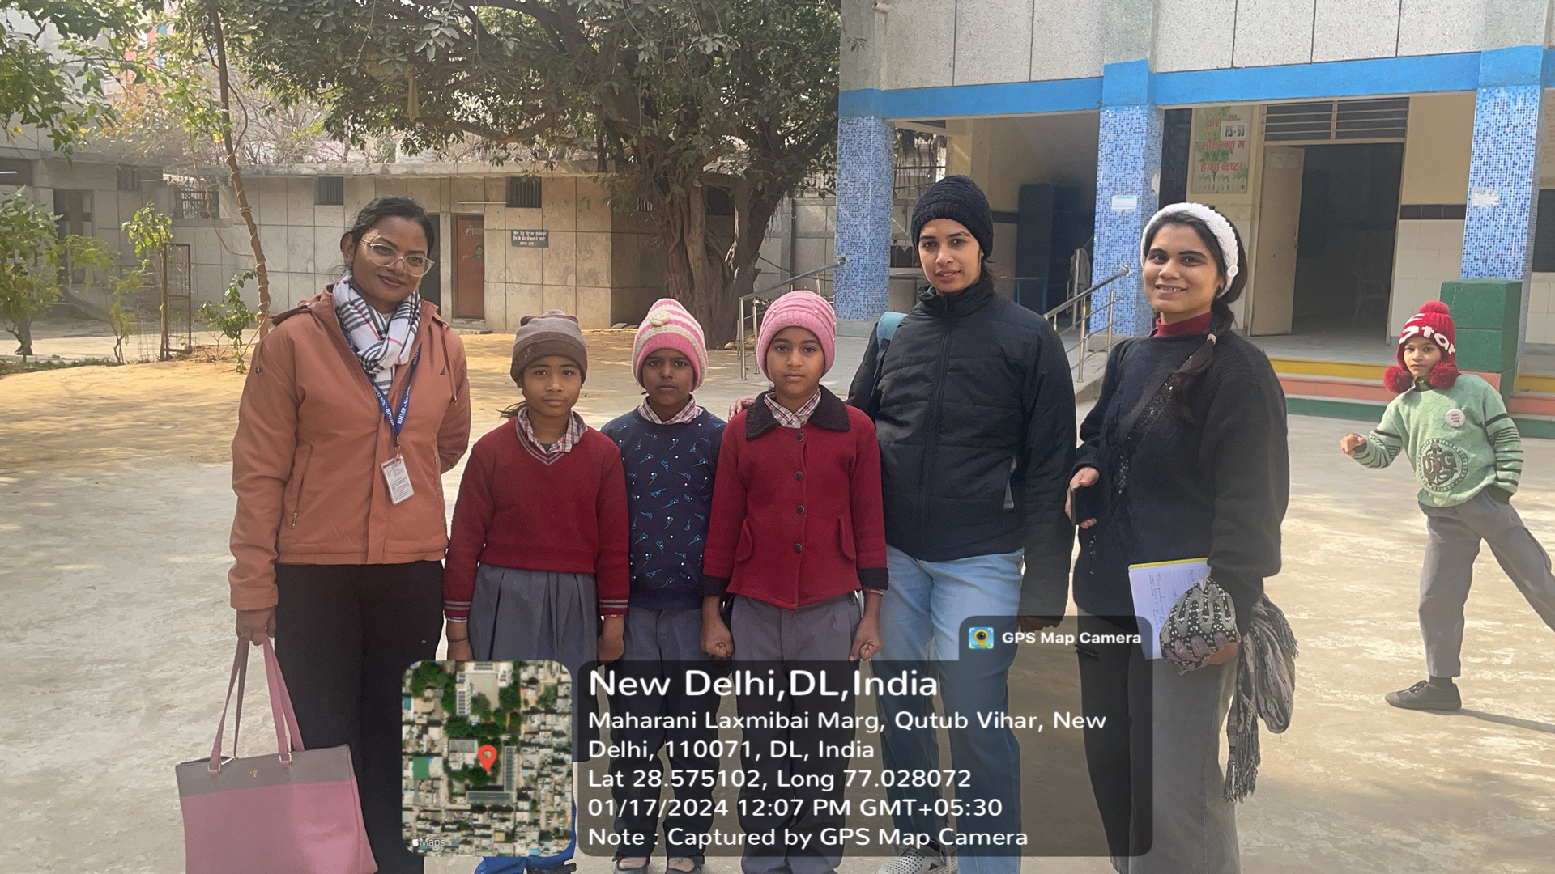
Community Outreach
Data collection in Goyla Dairy

Slide 20
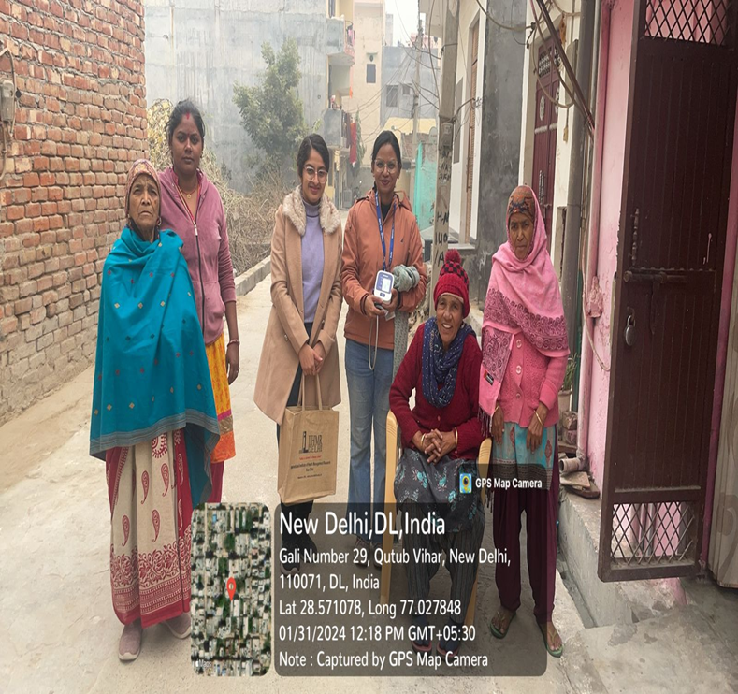
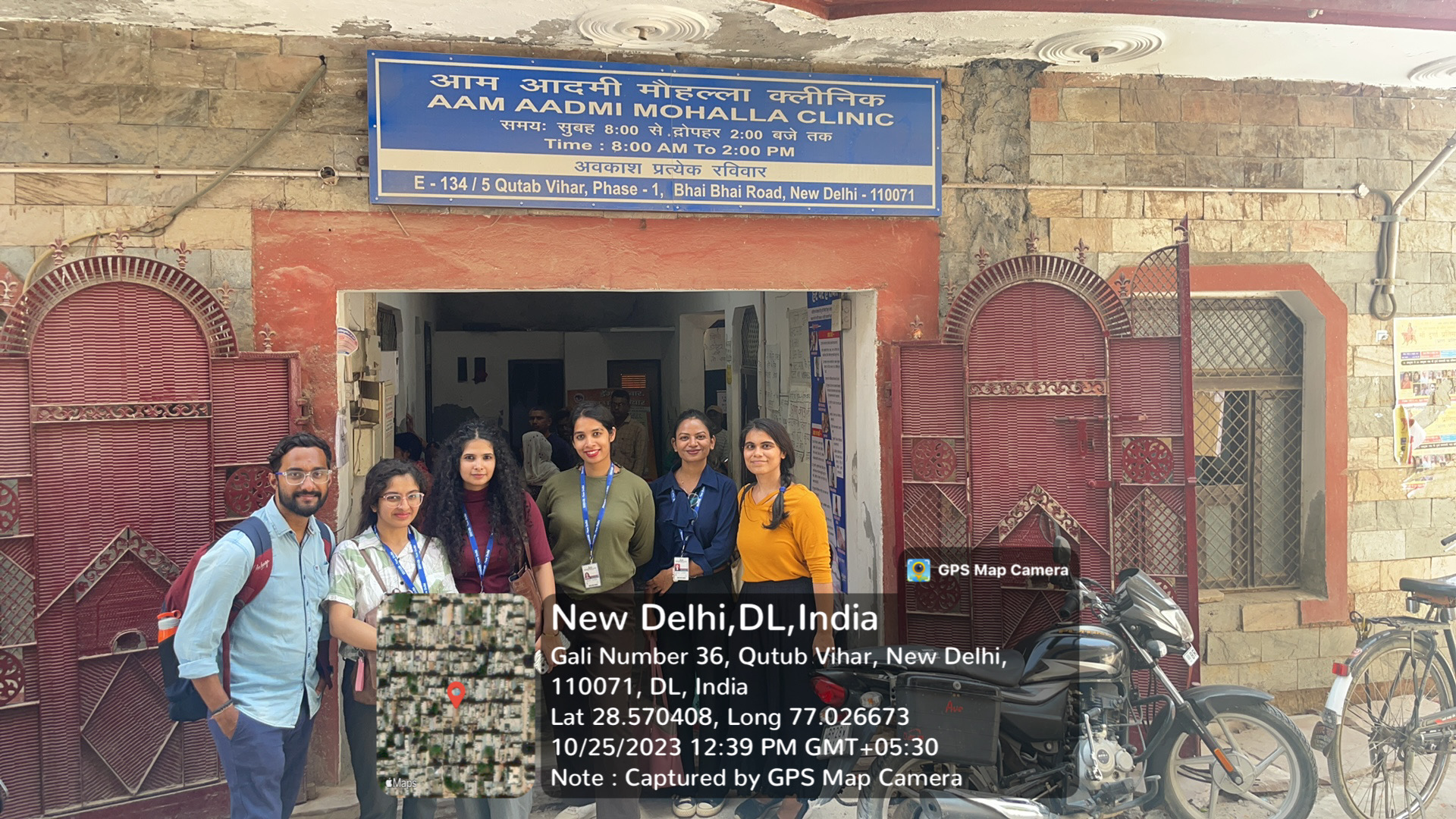
Community Outreach
Visit to Mohalla Clinic and Data Collection

Slide 21
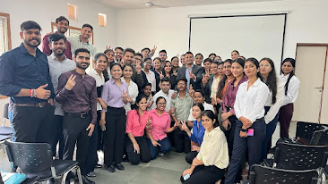
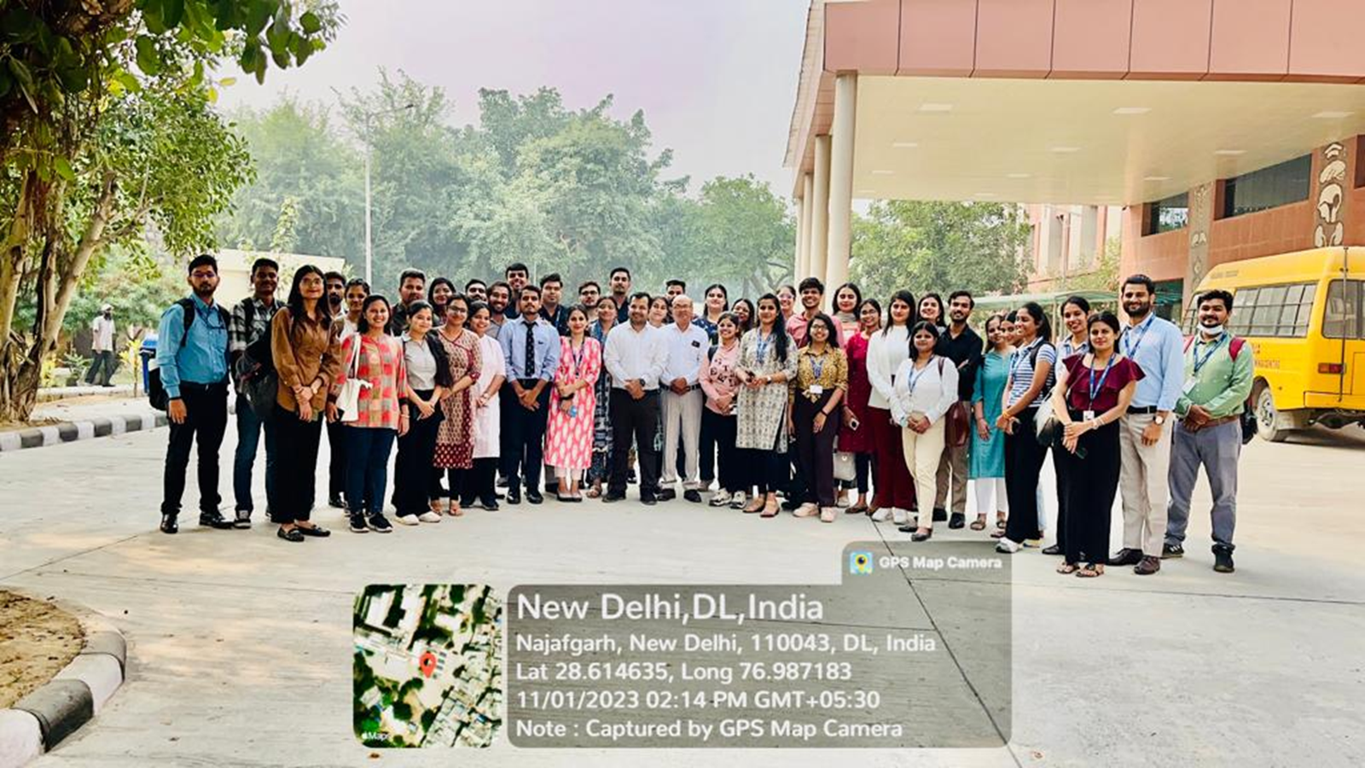
Pictorial Journey

Slide 22
Thank You
Any Questions?

