Slide 1

DISSERTATION ON
HEALTH TECHNOLOGY ASSESSMENT REPORT ON MOBILE EYE SURGICAL UNIT (MESU)
Submitted By:
Swati Sharan
PG/11/104

Slide 2
ORGANIZATION PROFILE
Healthcare Technology Innovation Centre (HTIC)
A joint initiative of Indian Institute of Technology Madras (IITM) and Department of Biotechnology (DBT), Government of India
AIM
Developing R&D Solutions
Joint Development of Technology Products
Technology Assessment And Evaluation
Capacity Building For The Healthcare Domain

Slide 3
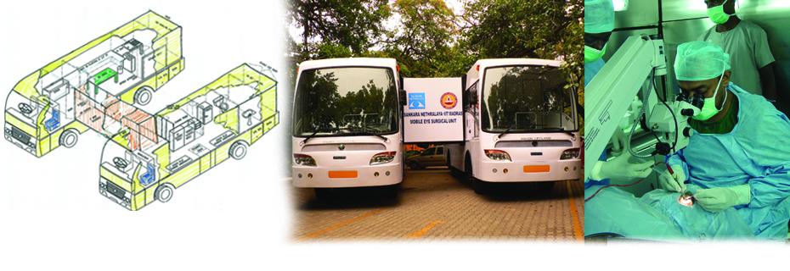
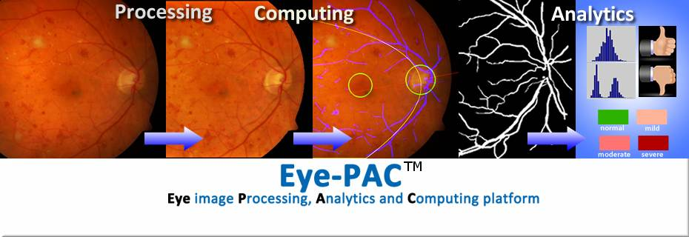
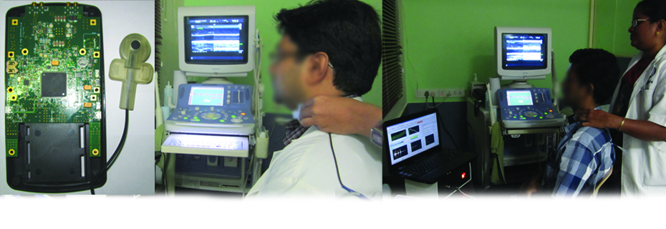
PROJECTS HANDLED
Mobile Eye Surgical Unit (MESU)
Eye-PAC- Eye Image Processing, Analytics and Computing Platform
ARTSENS- An Image Free Technology for Non-Invasive Evaluation of Arterial Stiffness

Slide 4
LESSONS LEARNT
To write a HTA Report
To organize an International Level week long Fellowship
To handle 60 people in a Fellowship

Slide 5
AREA OF INVOLVEMENT
To conceptualized innovative technologies at HTIC to be integrated in health systems and describe those efforts through scientific writings.
Management of the technical event organized by HTIC as 2nd International Fellowship on Health Technology Assessment in collaboration with WHO Country Office for India, National Health Systems Resource Centre (NHSRC), New Delhi, Quality Council of India (QCI), New Delhi and Joanna Briggs Institute of Evidence Based Medicine (JBI), Australia from 31st March to 6th April, 2013

Slide 6
WHAT IS HTA?
A multi-disciplinary field of policy analysis that examines the medical, economic, social and ethical implications of the technology in healthcare.
Conceptualization, Recommendation, Selection Of Health Technologies
Selection Of Interventions That Improve Healthcare Delivery
Harm Benefit Assessment Through An Integrated Patient Safety Approach
Developing Economic Models By Understanding Basics Of Health Economics.

Slide 7
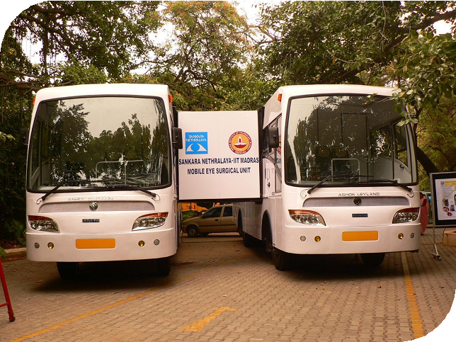

Slide 8
FIRST HTA REPORT ON MESU
Cataract is a major cause of blindness and visual impairment leading to
bilateral blindness in an estimated 20 million people worldwide.
Prevalence of 1% blindness in India (2006-07 survey).
The main cause being cataract (62.6%) (India,2012)
National Programme for Control of Blindness (NPCB) was launched by
Ministry of Health and Family Welfare, Government of India in 1976 to
reduce the prevalence of blindness from 1.4% to 0.3%.

Slide 9
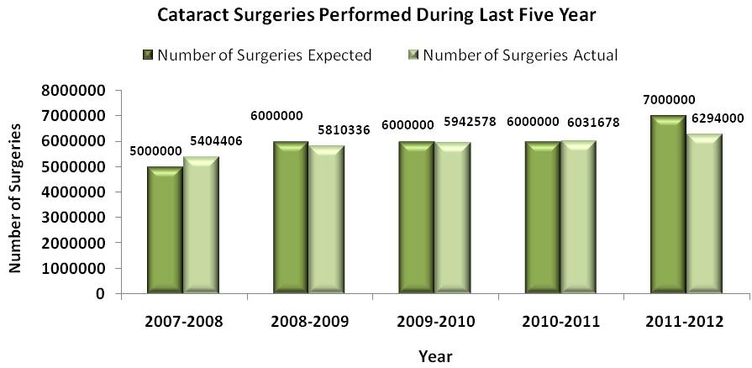
Data source: NRHM Report till June 2012 and NPCB India Newsletter, October-December, 2011

Slide 10
Year | Population aged 50+ | Cataract Blind per million 50+ (Prevalence + Incidence) | Estimated Cataract Blind 50+ (Prevalence + Incidence) | CSR/ million 50+ | Estimated Cataract Surgery in 50+ population
1991 | 109013840 | 88800 | 9680429 | 12483 | 1360820
2001 | 140701089 | 66094 | 9299498 | 24025 | 3380344
2005 | 167315204 | 54353 | 9094083 | 27059 | 4527382
2010 | 194190840 | 46952 | 9117648 | 28487 | 5531914
2015 | 227979697 | 40962 | 9338504 | 28595 | 6519079
2020 | 275134737 | 36106 | 9934015 | 27817 | 7653423
Data Source: Current Status of Cataract Blindness and Vision 2020: The Right to Sight Initiative in India, 2008

Slide 11
EXAMPLES OF MOBILE EYE UNITS IN INDIA
Sankara Nethralaya active in rural areas of Tamil Nadu, Karnataka, Maharashtra
and West Bengal for dispensing spectacles to the people.
Aravind Eye Care System, India for screening and diagnosis of diabetic
retinopathy.
The eye camps were banned in India by Uttar Pradesh High Court.
A very large number of cataract patients live in villages of India where access to even primary healthcare is an area of concern.
The Indian Institute of Technology (IIT), Madras with Sankara Nethralaya developed the Mobile Eye Surgical Unit (MESU)

Slide 12
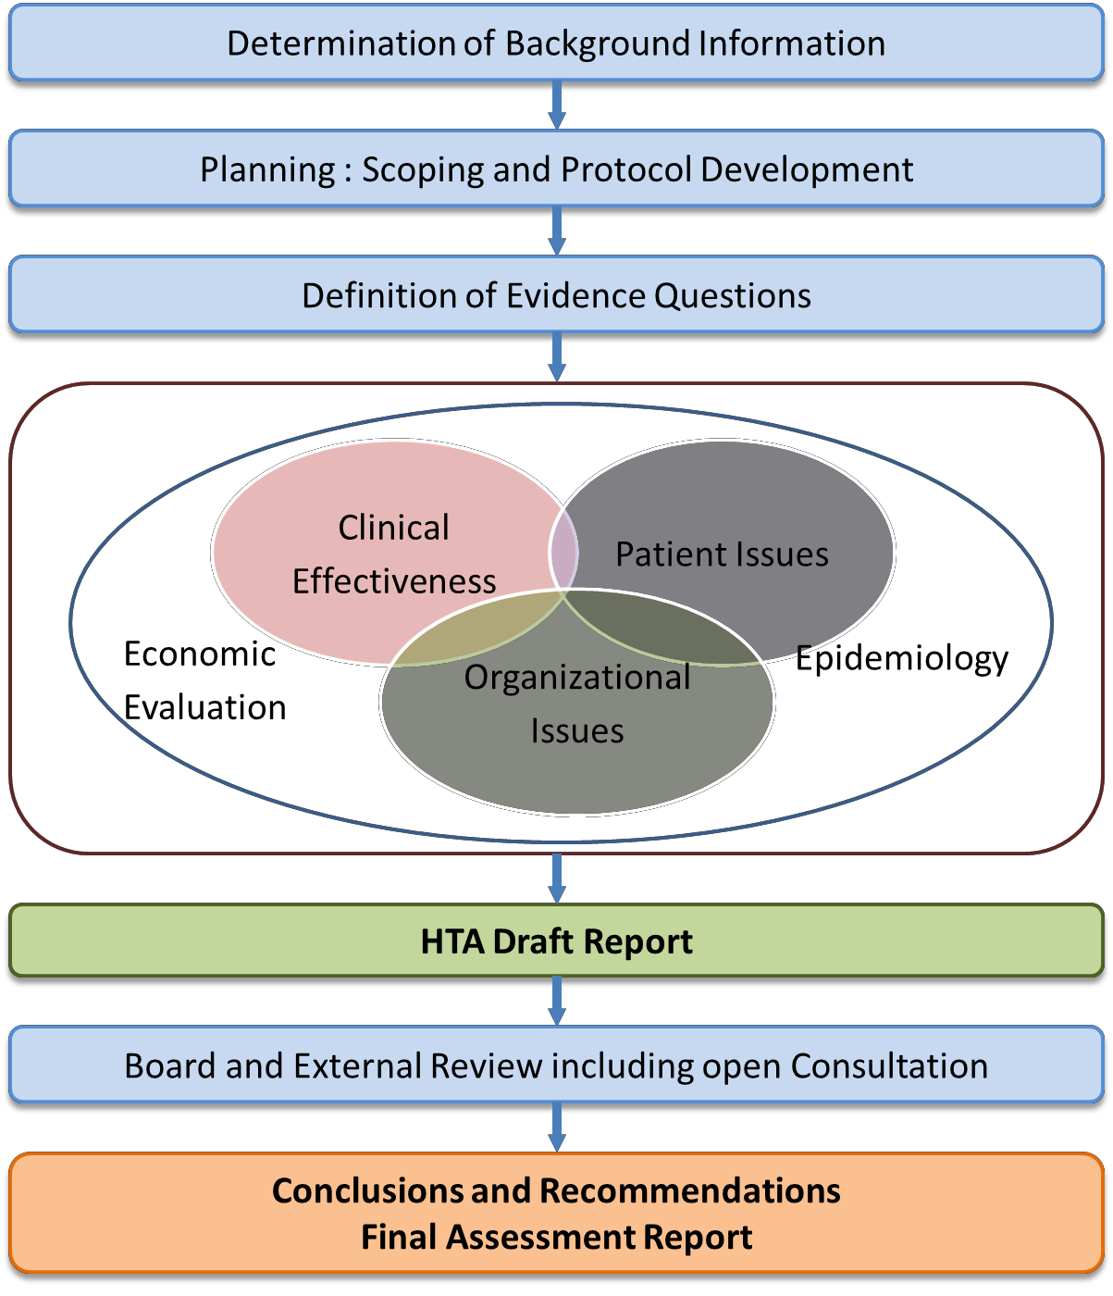
HOW TO DEVELOP HTA REPORT ?

Slide 13
DESCRIPTION OF TECHNOLOGY
Consists of two vehicles
Preparatory Vehicle
Surgical Vehicle.
Preparatory Vehicle (PV)
Has a couch, a change room and a toilet
20 kVA diesel generator set
Hydraulic cylinder system,
A set of retractable steps
An automated sensing and measurement system

Slide 14
Surgical Vehicle (SV)
Cataract operation theatre (OT)
A scrub area and a sterilization room
Has an AHU
3 kva uninterrupted power supply system (UPS)
An on-board sensing and monitoring system.
Interconnecting Vestibule
Establishes a pathway between the preparatory and surgical vehicles

Slide 15
CLINICAL OPERATING PROCEDURE OF MESU

Slide 16
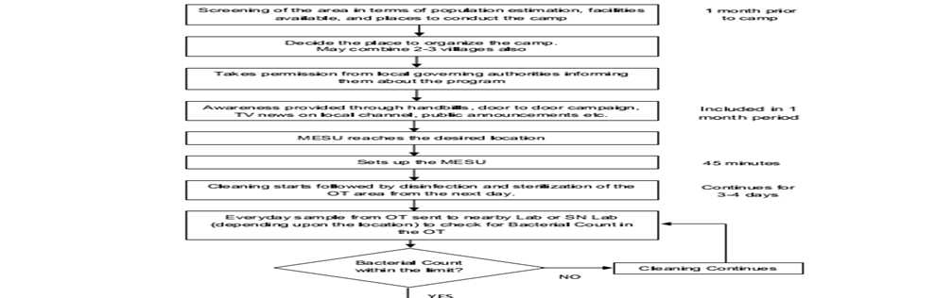

Slide 17
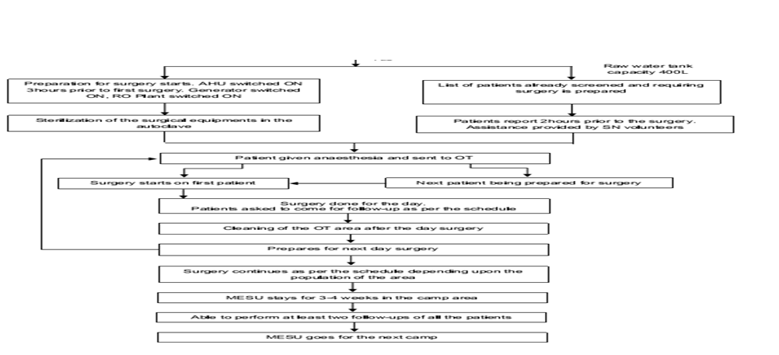
YES

Slide 18
TECHNOLOGY DESIGN FOR STERILITY AND SAFETY
Use of dedicated AHU to provide sterile air to the OT
Continuous monitoring of the maintenance of positive air pressure inside the OT environment
Use of air-curtains at both ends of the vestibule, to alleviate ingress of dust and reduce exposure to external environment
Use of 316 SS for the interiors of the vestibule and surgical vehicle
Cleaning and fumigation of the OT is also done routinely
Use of hydraulic jacks

Slide 19
SAFETY ISSUES
Design Safety-
Stainless steel surface to prevent the growth of bacteria
AHU with 3-stage air filtration process using 10 micron, 5 micron filters and 0.3 micron HEPA filter
A separate door for emergency exit
Continuous cleaning and fumigation of the OT.
Process Safety-
WHO surgical safety checklist adoption
A crash cart is maintained

Slide 20
Contd…
Device Safety-
Electrical appliances are connected to 3-pin electrical sockets
Has on-board 20 kVA diesel generator
Two fire extinguishers
Earthing done at the camp site
Employee Safety-
Appropriate bio-medical waste management
Containers for sharp disposals are also provided

Slide 21
METHODOLOGY
Economic Evaluation- Three main methodologies were identified:
Identifying the cost per patient treated coupled with prevalence rates for
cataract
Comparing cost-effectiveness of other healthcare interventions with MESU to calculate Incremental Cost-Effectiveness Ratios (ICER)
Modelling patients’ progression through cataract and their likelihood of blindness or morbidity associated with the disease
Clinical Evaluation-
Data of 486 patients operated during the pilot period were used.
Evaluated using reports of any adverse events intra- operatively and post-operatively.

Slide 22
Contd…
Organizational Strategy-
Addressed using existing health system models as applied in national and sub-national structures.
Epidemiology-
Analysed using published literature and reports from government and other agency

Slide 23
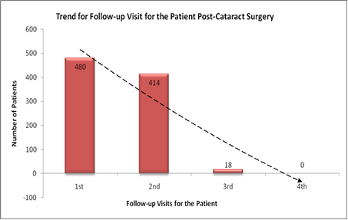
CLINICAL EFFECTIVENESS
Indicators include:
Sight restoration rate
Absence of adverse event/loss of vision
Reduced operation failure
Lack of improvement in vision after surgery
Post-operative morbidity

Slide 24
COST EFFECTIVENESS
Calculated by determining the number of DALYs averted by implementing an
intervention versus the base case of not doing anything
Cost-effectiveness ratios below ₨.10,000 per DALY or YLL averted are
considered as quite cost effective and should be included in a health
entitlement package for publicly funded programs
WHO recommends that intervention that costs per-DALY averted of less than
1GDP or GSDP per capita, be a highly cost-effective intervention from a public
policy perspective
MESU, as analysed in part–1 of the report, has a cost per DALYs averted
at ₨. 5,068.22

Slide 25
Interventions | Cost (in Rupees per DALY Averted)
Cataract surgery (MESU) | 5068.22 (all inclusive)
Structured Anti-retroviral therapy | 12700.00
HIV: HAART Plus + DOTS for TB | 20480.00
Human Papilloma Virus vaccination | 48300.00
Management of Severe Neonatal Asphyxia | 167920.00
Management of Neonatal Jaundice | 484064.00
HIV: School-based education (50% coverage) | 12640.00
Lower respiratory tract infections | 38900.00
Screening and treatment of Syphilis (50% coverage) | 58832.00
Breast cancer screening | 20400.00

Slide 26
HEALTH SYSTEMS INTEGRATION MODEL
Aim of NPCB is to provide services in rural/tribal and other difficult areas
In 11th Five Year Plan financial assistance that cover eye surgical care have been revised
MESU in the pilot phases itself conducted 486 surgeries over a 3-month period
Vision 2020: the Right to Sight approach is targeted towards the bilaterally
blind
Priority given to restoring vision to those already blind

Slide 27
But according to various literature poor visual outcome has been reported in
15-25% of eyes following cataract surgery in India.
Improving the quality of surgery is a major input that needs to be emphasized
now
For land-based hospital the cost-effectiveness of ECCE surgery is estimated at
about $60 per disability adjusted life year (DALY) in the South and East Asia
region which includes India.

Slide 28
Estimates And Strategy for a Model Up-scaled Project
Cataract surgery target for Tamil Nadu is 4,18,400 and 1,58,385 has been achieved
Land-based setting in Tamil Nadu are able to handle only 50% of the cataract cases
MESU in a phased manner could handle the rest 50% of cataract cases
 | Cases | Number of Districts | Total Cases
Phase I | 3000 | 10 | 30,000
Phase II | 3000 | 10 | 30,000
Phase III | 3000 | 12 | 30,000

Slide 29
BUDGET OUTLAY
Phase- I:
Total cost incurred in 10 districts in phase– I = ₨. 15.93 crores/annum
Phase- II:
Total cost incurred in 10 districts in phase–II= ₨. 14.36 crores/annum
Phase- III:
Total cost incurred in 10 districts in phase– III= ₨. 15.17 crores/annum
Total Budget for all the three phases:
₨. (15.93 + 14.36 + 15.17 crores) = ₨. 45.46 crores
Total State health budget for 2012-13 = ₨.5,569.28 crores
Total program cost in 1st year = 0.29 % of state health budget.
With only 3% increase in the outlay of state annual health budget every year, total program cost for all the three phases = ₨. 45.46 crores/(5,569.28 + 5,736.36 + 5,908.45) crores = 0.26 % of state health budget over three years

Slide 30
COUNTRY ESTIMATES AND POLICY
Prevalence of cataract blindness would decrease, but the number of cataract
blind would increase from 7.75 million in 2001 to 8.25 million in 2020.
For people aged 50+ years, cataract surgery would double (3.38 million in
2001 to 7.63 million in 2020)
Cataract Cases Expected till 2020 | Cataract Cases Expected till 2015 | Cataract load per annum for next 3 years (2013-2015) | Cataract load per annum (country wide)
82.52 lakhs | 78.28 lakhs | 78.28 lakhs | 26.06 lakhs

Slide 31
Contd..
If MESU can handle 50% of these cases in an outreach program, then number of cases = 13.04 lakhs/annum= 2,032 cases/district/annum
MESU capacity (throughput) = 3,000 cases
Total cost incurred at Net Present Value of money in phase-I (1st year - 64 districts)
= ₨. 15,171,653 x 64 = ₨. 1.517 crores x 64 districts = ₨. 97.088 crores
Total planned outlay in 2012-13 for health= ₨. 30,477 crores
Percentage of annual budget required towards MESU as part of NPCB = 0.32% of annual health budget

Slide 32
OPERATIONAL PLAN
Could be attached to each district hospital for proper upkeep
Cost effectiveness estimates suggest that it is desirable to have it performed
under USD60 (equivalent to ₨. 3,000) while in land-based hospital it is
₨.8,000 to ₨.35,000 in private hospitals.
A timely intervention of an MESU/outreach program mode will reduce the
burden of surgical load on Indian public hospitals
Will decline the out of pocket expenditure made by the rural population in
seeking such surgical care.

Slide 33
CASE STUDY
To Understand the Usability of m-Health among the IT Professionals of Chennai and their Health-Seeking Behaviour

Slide 34
OBJECTIVE
To study the prevalence of occupational diseases and the use of m-Health for IT professionals.
SPECIFIC OBJECTIVE
To understand the prevalence of occupational diseases in IT professionals.
To assess the knowledge level of professionals regarding m-Health.
To understand the health-seeking behaviour of IT professionals.

Slide 35
METHODOLOGY
Sample:
100 IT professionals candidates were selected as study participants.
Taken the first 50 responses only.
All samples were taken based on convenient sampling.
Primary data was collected.
Tools:
Survey was conducted with the help of a questionnaire.
Consists of 21 questions.
Data was coded and analyzed using SPSS and Microsoft Excel tool.

Slide 36
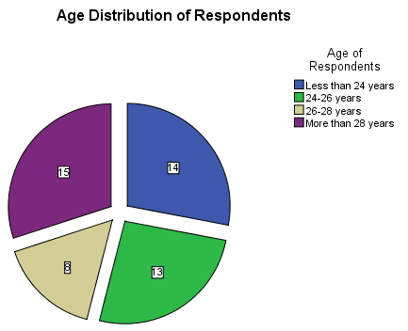
ANALYSIS

Slide 38
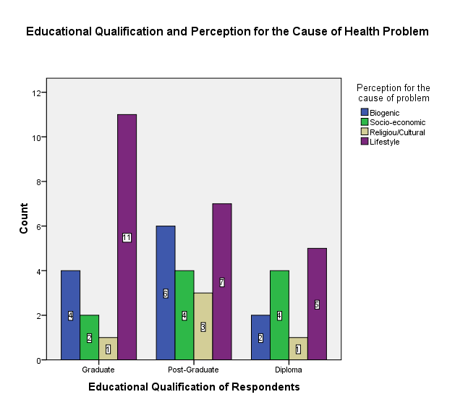

Slide 39
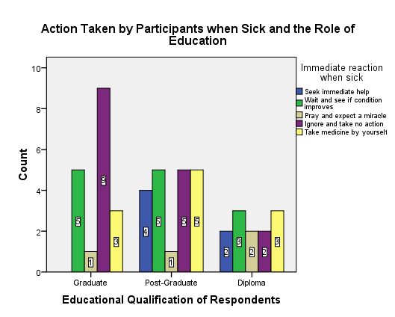

Slide 40
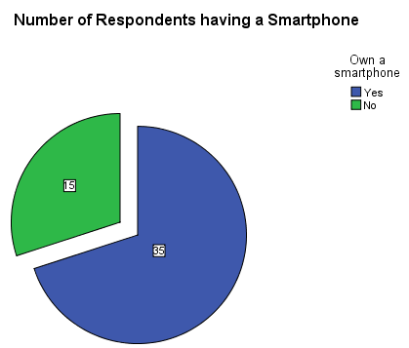

Slide 41
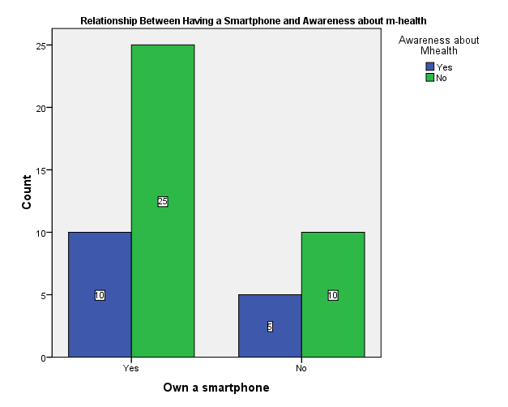

Slide 42
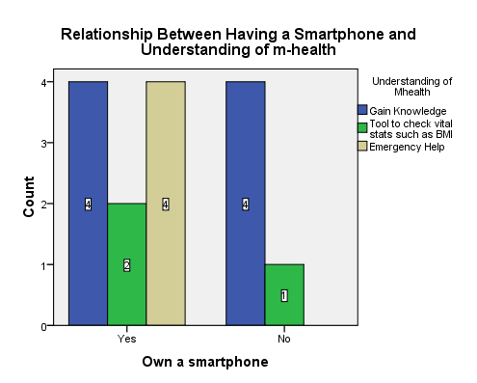

Slide 43
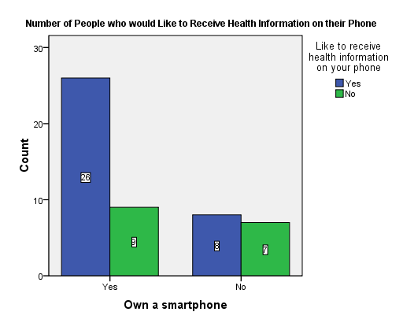

Slide 44
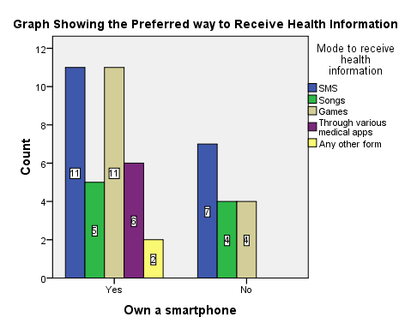

Slide 45
CONCLUSION
People working in IT sector are more prone to have occupational diseases in
one form or other the highest being the vision problem.
The most common disease found in all age group of people is obesity.
Education plays an important role as people now believe that the main reason
behind their problem is due to either their own lifestyle or it’s biogenic.
The health problem starts as soon as people join IT sector because of the work
pressure to achieve their project targets, pressure from their seniors and to
compete with their colleagues.
These people go for health checkup as and when problem occurs rather than
going for regular checkups.

Slide 46
Contd…
Most of the participants ignore their problem or take a medicine by themselves
which increases their problem rather than going for a medical treatment which
is opted only after they are unable to do their normal chores.
Most of these people have a smartphone and sound clarity is the important
criteria for them to buy a smartphone.
Awareness about m-health is very less among these people.
Those who are aware of m-health use it as a tool to gain knowledge about
various health conditions.

Slide 47
RECOMMENDATIONS
Companies can organize campaigns by experts to create awareness among
their employees for m-health.
Health education can be given to them through songs, games and animation.
Micro level awareness can also be created by sending these people email, SMS,
radio messages in the form of song jingles.
m-health can be used as a tool for these people as most of them have a
Smartphone and are ready to receive health information in the form of SMS or
songs or games.
Most of the people would like to receive health related information on their
phone in the form of SMS or Games.

Slide 48
REFERENCES
Baltussen R, Sylla M, M. S. Cataract surgery: a global and regional cost-effectiveness analysis. Bulletin of the World Health Organization, 338–344.
Chow, J., Darley, S., & Laxminarayan, R. (2007).Cost-effectiveness of Disease Interventions in India. Washington DC.
DGHS Scheme for participation of voluntary organizations in National Program for Control of Blindness.
India, Gov. of. (2012). National Programme for Control of Blindness. Retrieved September 21, 2012, from http://npcb.nic.in/
Murthy G, Gupta SK, John N, V. P. (2008). Current status of cataract blindness and Vision 2020: The right to sight initiative in India. Indian Journal of ophthalmology, 56(489), 94.
World Health Organization. (2012). WHO Guide to Cost Effectiveness Analysis (1st Ed.). Geneva.

Slide 49
Current status of cataract blindness and Vision 2020: The right to sight
initiative in India, G V S Murthy, Sanjeev K Gupta, Neena John, and Praveen
Vashist, 2008
Elimination of Avoidable Blindness Due to Cataract: Where Do We Prioritize and
How Should We Monitor This Decade?
http://www.ijo.intempIndianJOphthalmol605438-109913_030311.pdf
Supreme Court Decisions on medical Negligence - NCDRC Lawyers – National
Consumer Disputes Redressal Commission ban on mobile camps.html
Cost Effectiveness of Disease Intervention in India, 2007
http://www.rff.orgPublicationsDocumentsRFF-DP-07-53.pdf
Scheme for Participation of Voluntary Organisations, 11th Five Year Plan, July
2009 by National Programme for Control of Blindness
http://npcb.nic.inwritereaddatamainlinkfilefile108.pdf
India’s first mobile refraction van
http://www.sankaranethralaya.org/indias-first-mobile-refraction-van.html

Slide 50


