Slide 1

A Study of the Relationship Between Operational Challenges and the Experiences of New Nurses Working in Educational Institutions
Organization: Blue Circle Medi Services

Slide 2
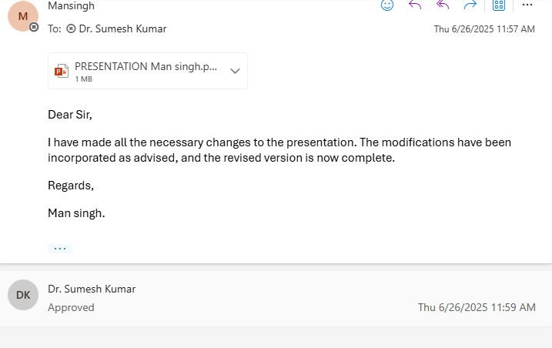
Mentor Approval

Slide 3
Introduction
Educational institutions are increasingly implementing on-site healthcare services through partners like Blue Circle Medi Services to ensure student well-being. However, newly deployed nurses often face operational challenges such as unclear roles, inadequate on boarding, scheduling inefficiencies, and limited support. These issues can affect their job satisfaction, performance, and integration into school environments. This study explores how such challenges impact the experiences of nurses during their initial deployment period, aiming to identify gaps and recommend improvements to enhance both staff retention and the quality of school health services.

Slide 4
Objectives of the study
To identify and describe the operational challenges encountered by Blue Circle Medi Services in the hiring and deployment of healthcare professionals to educational institutions.
To explore and describe the experiences of newly deployed nurses (within the first one year of employment) working in educational health services facilitated by Blue Circle Medi Services.

Slide 5
Key research questions
What are the primary operational challenges faced by Blue Circle Medi Services in the hiring and deployment of nurses to educational institutions?
What are the key experiences (e.g., workload, support, communication, integration) reported by newly deployed nurses working in the school health services facilitated by Blue Circle Medi Services?

Slide 6
Methodology (1/2)
Study design: Quantitative, descriptive, cross-sectional study.
Study location : Blue circle Medi services Pvt Ltd.
Data Collection Method:
- Two Structured Google Form questionnaire.
1) Nurse Form: Experience, stress, support, satisfaction
2) Operations Form: Challenges in hiring, scheduling, support
Sampling Technique: Purposive sampling method to include participants directly involved in nurse deployment and support.
Sample Size: 78 participants – 72 newly deployed nurses and 6 operations team members. Total 97 Nurses joined last year, Google form sent but only 72 responded.

Slide 7
Methodology (2/2)
Inclusion Criteria:
- Nurses with minimum one month of experience in schools/colleges.
- Operations team members involved in deployment/support.
- Consent provided by all participants.
Exclusion Criteria:
- Nurses not deployed in educational institutions.
- Nurses working more then 1 years in Blue Circle Medi Services .
- Unwilling participants or incomplete forms.
Data Analysis:
- Microsoft Excel used for data analysis.
- Descriptive statistics and visual graphs generated.

Slide 8
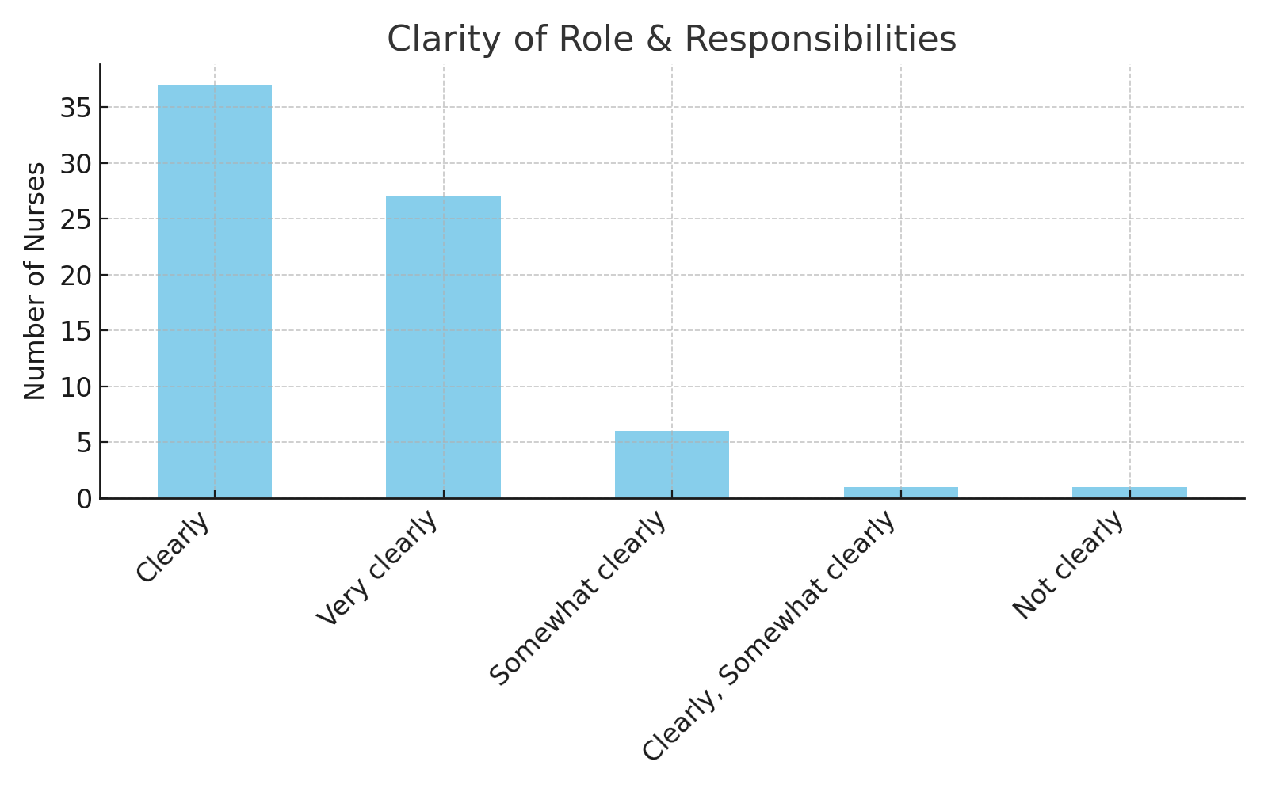
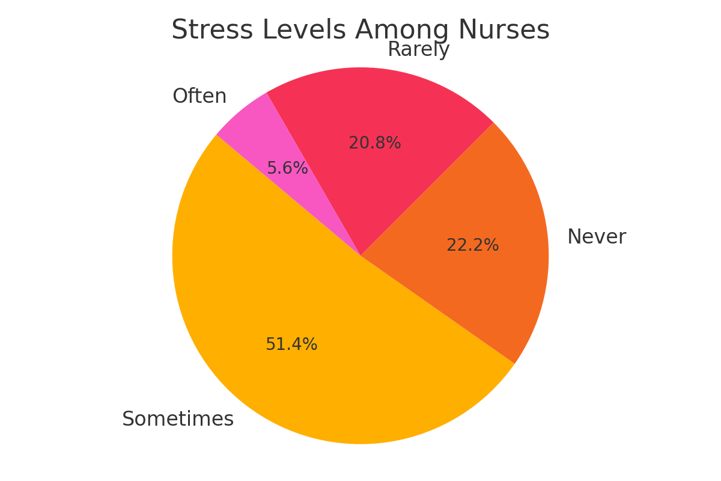
Results (1/5)

Slide 9
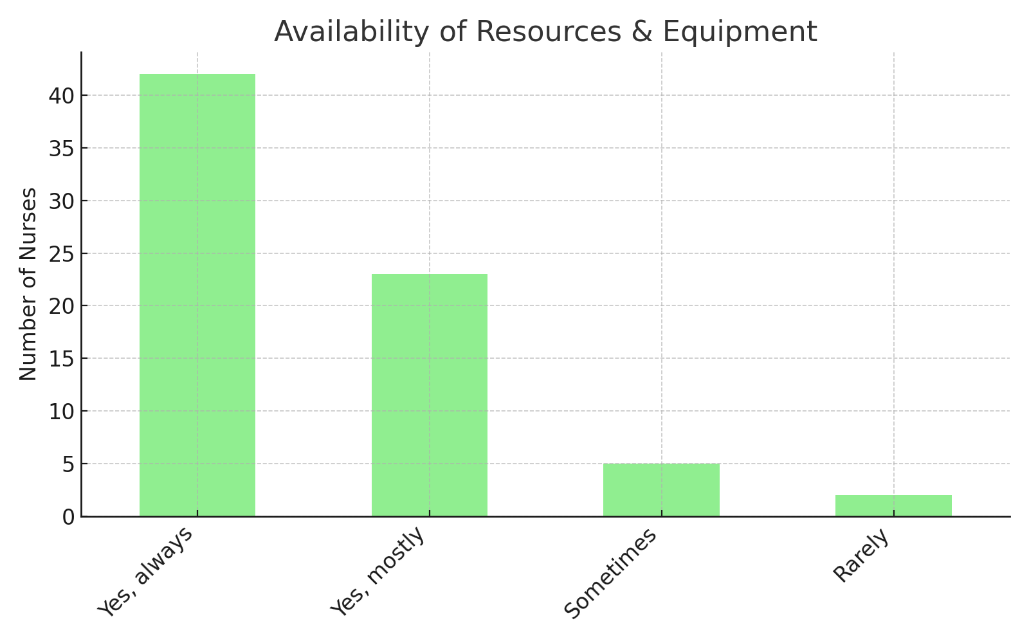
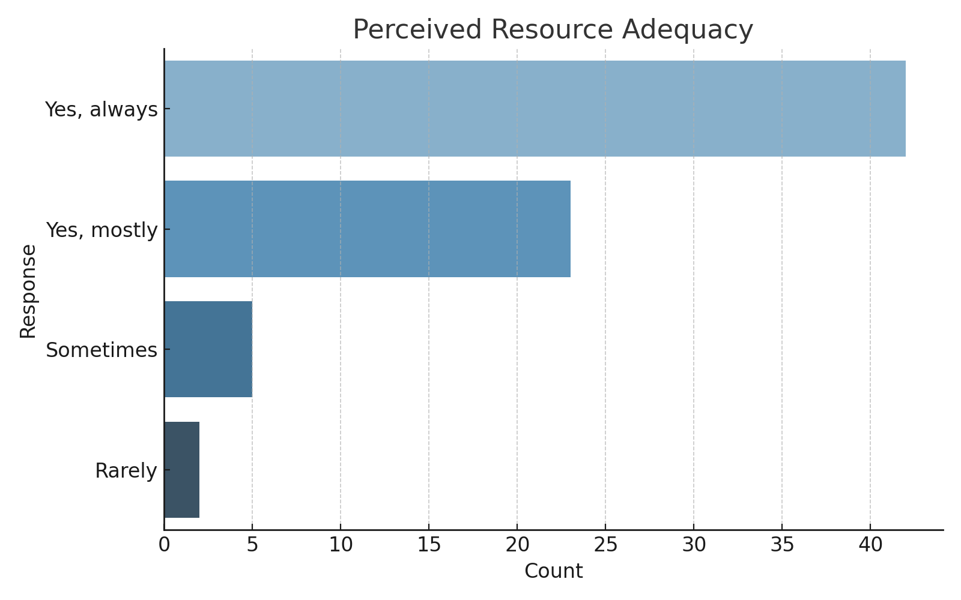
Results (2/5)

Slide 10
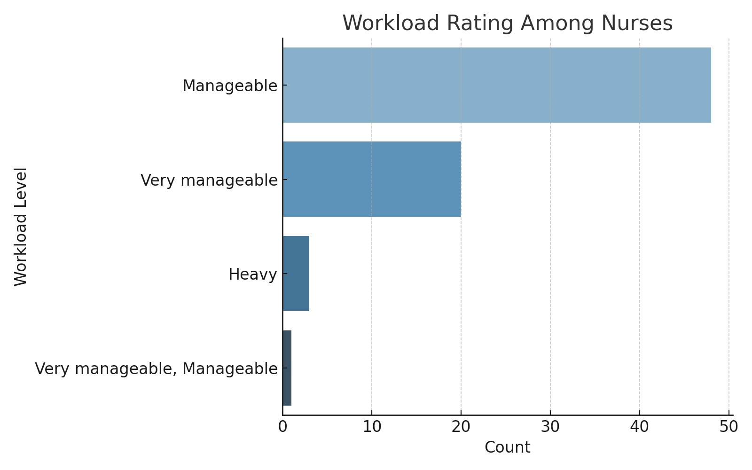
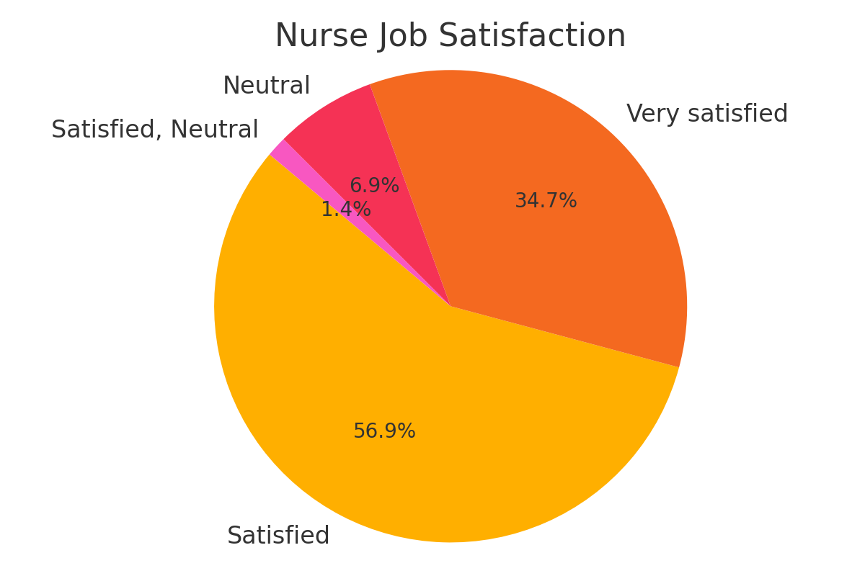
Results (3/5)

Slide 11
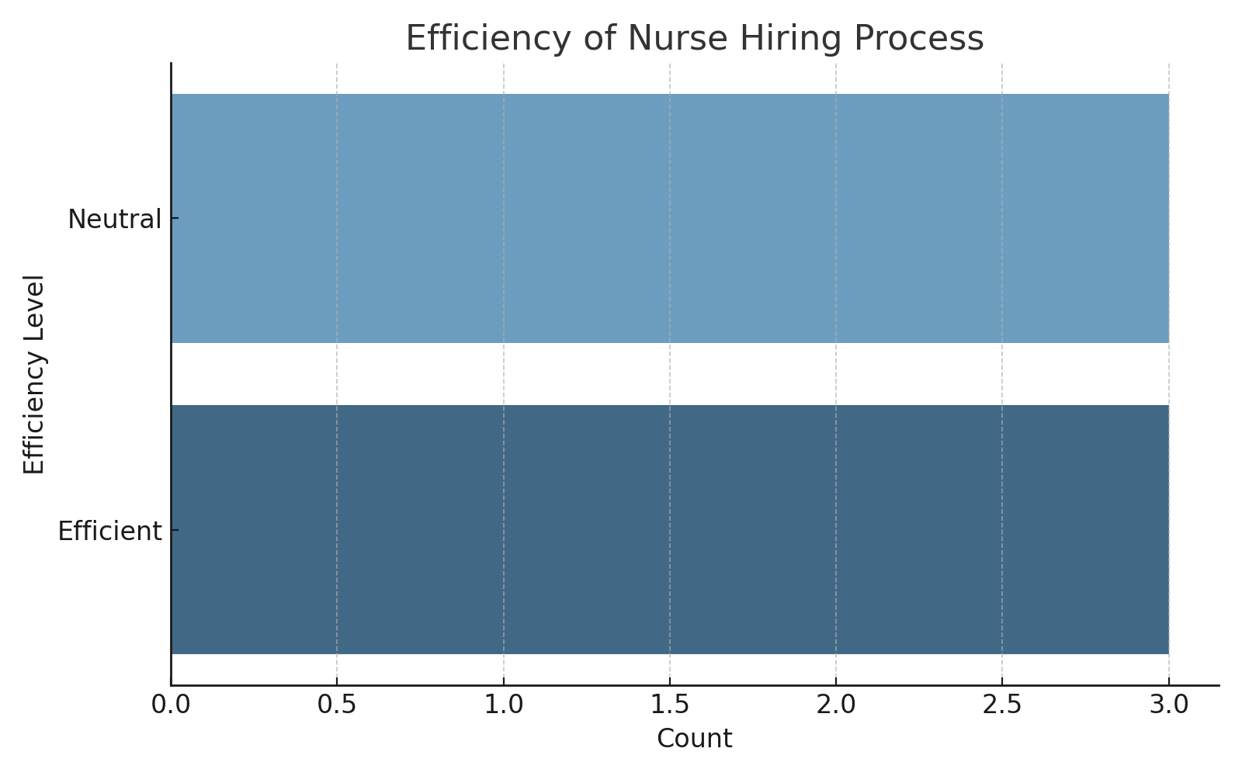
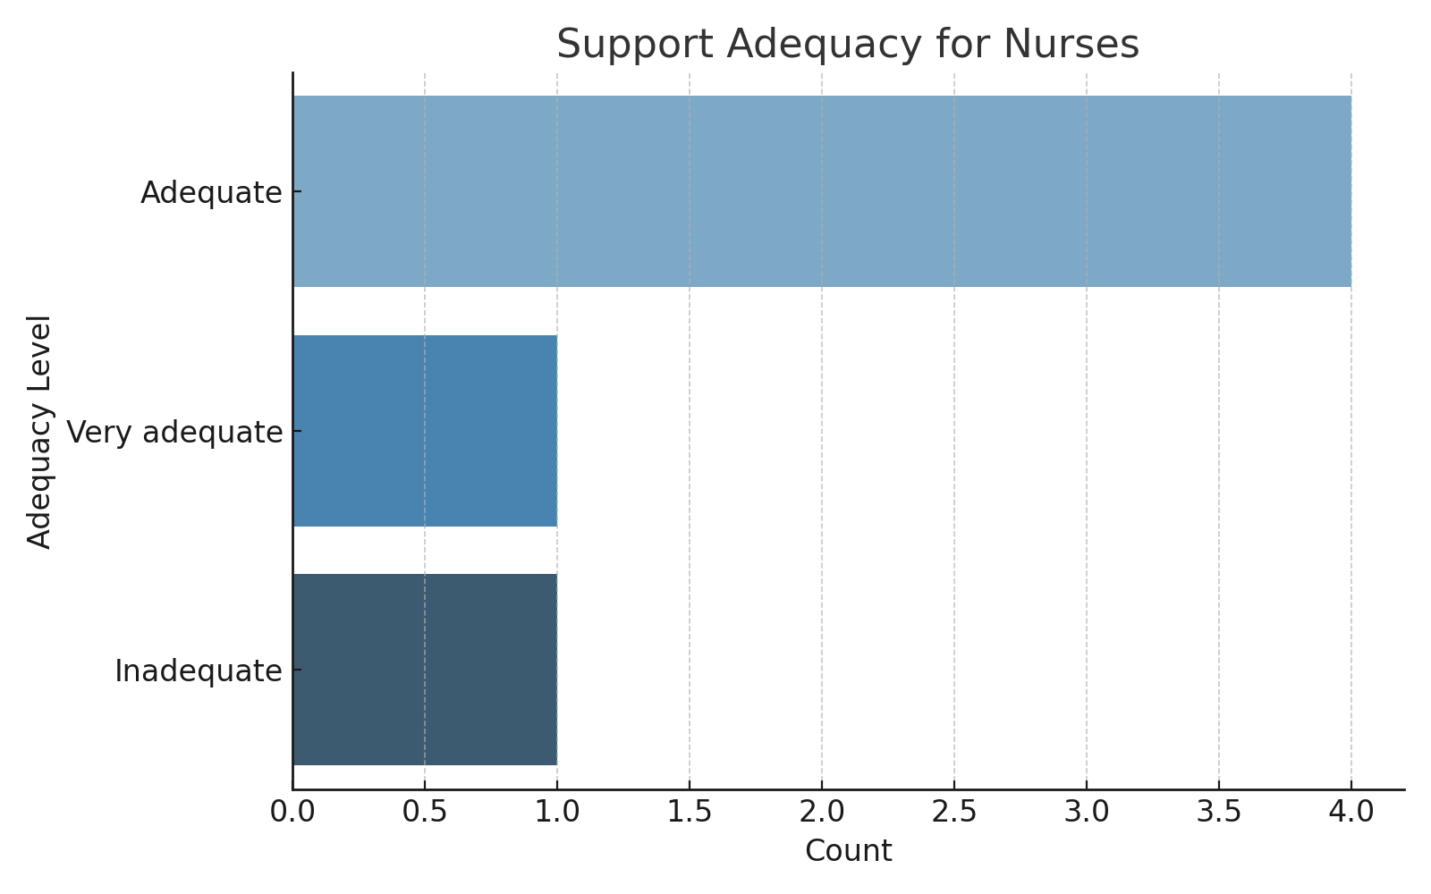
Results (4/5)

Slide 12
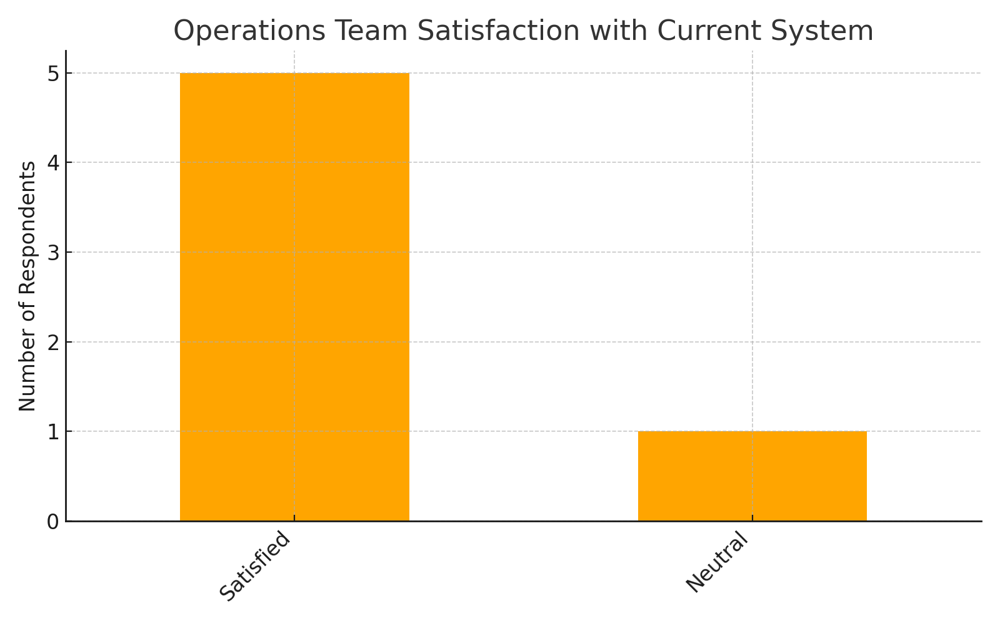
Results (5/5)
1
- Most nurses are satisfied but report occasional stress
2
Operations team rates hiring/scheduling as neutral to effective
3
4
Gaps found in role clarity and scheduling alignment
Support and resource provision seen as adequate by both groups

Slide 13
Discussion
1. Operational clarity impacts nurse stress and satisfaction
Supported by: Khan et al. (2019); Smith & Brown (2020)
Insight: Clear induction processes and defined roles reduce stress and enhance morale.
Interpretation: Structured orientation and predictable operations help new nurses feel secure and focused.
2. Alignment in resource perception reflects operational maturity
Supported by: Smith & Brown (2020); Thomas (2021)
Insight: When staff and management share views on resource adequacy, it signals strong communication and planning.
Interpretation: This alignment improves operational decision-making and workforce confidence.
3. Disparities in workload perception suggest need for feedback loops
Supported by: Khan et al. (2019); Shields & Watson (2021)
Insight: Nurses often experience higher stress due to unspoken workload pressures.
Interpretation: Regular two-way feedback can identify and correct mismatch in workload expectations.

Slide 14
Discussion
4. Limited use of systems contributes to inefficiencies
Supported by: Thomas (2021); Smith & Brown (2020)
Insight: Underutilized digital systems slow operations and increase manual tasks.
Interpretation: Proper training and integration of digital tools is crucial for streamlined processes.
5. Proactive communication improves nurse integration
Supported by: Benner (1984); Shields & Watson (2021)
Insight: Early communication helps nurses adapt to school settings with more confidence.
Interpretation: Communication bridges help reduce isolation and accelerate productivity.
6. Recognition and support enhance retention
Supported by: Benner (1984); Smith & Brown (2020)
Insight: Acknowledging nurses' work boosts job satisfaction and encourages long-term commitment.
Interpretation: Recognition and mentoring are key to nurse retention and professional growth.

Slide 15
Recommendations
Structured On boarding and Orientation
Role Definition and Communication Clarity
Digital Scheduling and Feedback Systems
Periodic Check-ins and Mental Health Support
Performance Recognition and Motivation
Joint Review Meetings
Resource and Infrastructure Audit

Slide 16
Limitations of the Study
Small Sample Size (Operations Team)
The study included only 6 members from the operations team, which may not fully represent the broader operational perspective.
Limited Geographic Scope
The data is specific to institutions partnered with Blue Circle Medi Services and may not reflect challenges in other regions or organizations.
Cross-Sectional Design
Data was collected at a single point in time, limiting the ability to observe changes or trends over an extended period.
Self-Reported Data
Responses were based on subjective perceptions of nurses and operations staff, which may carry personal biases or social desirability influences.
Focus on Operational Factors Only
The study does not account for external factors (e.g., institutional policies, student behavior, workload variability) that may also affect nurse experiences

Slide 17
Conclusion
Early challenges in deployment affect nurse morale and stress
Structured onboarding, tech upgrades, and communication strategies are needed
Strengthening operational feedback can align efforts across teams

Slide 18
References
Shields L, Watson R. The demise of nursing in schools: An international perspective. Journal of Clinical Nursing. 2021;30(3-4):e12–e19.
Khan R, Patel A, Mehta S. Scheduling practices and burnout in medical personnel: A cross-sectional analysis. J Occup Health. 2019;61(4):289–295.
Smith J, Brown L. Strategic healthcare staffing models and their impact on quality care delivery. Healthcare Journal. 2020;12(2):112–120.
Thomas E. Healthcare outsourcing in educational institutions: Gaps in support and continuity. Int J School Health Serv. 2021;5(1):22–28.
Benner P. From novice to expert: Excellence and power in clinical nursing practice. Am J Nurs. 1984;84(12):104–110.

Slide 19
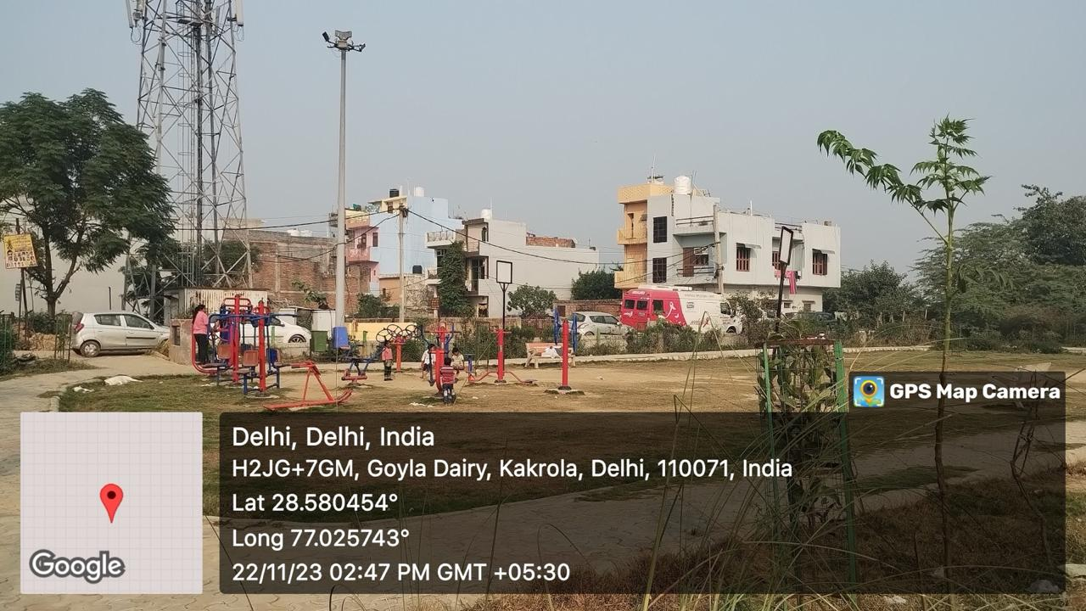
INVOLVEMENT IN COMMUNITY OUTREACH PROGRAMME (COP) ACTIVITIES
Total no. of visits done by the student: 7 (Goyala Dairy)
Activities done by student:
Mapping and listing of the area
Interaction with community FLWHs

Slide 20
KEY LEARNINGS FROM COP ACTIVITIES
Understood community layout
Patience and Persistence are Required
Building Trust is Essential
Communication Must Be Two-Way and Culturally Sensitive
Measuring Impact and Seeking Feedback is Vital

Slide 21
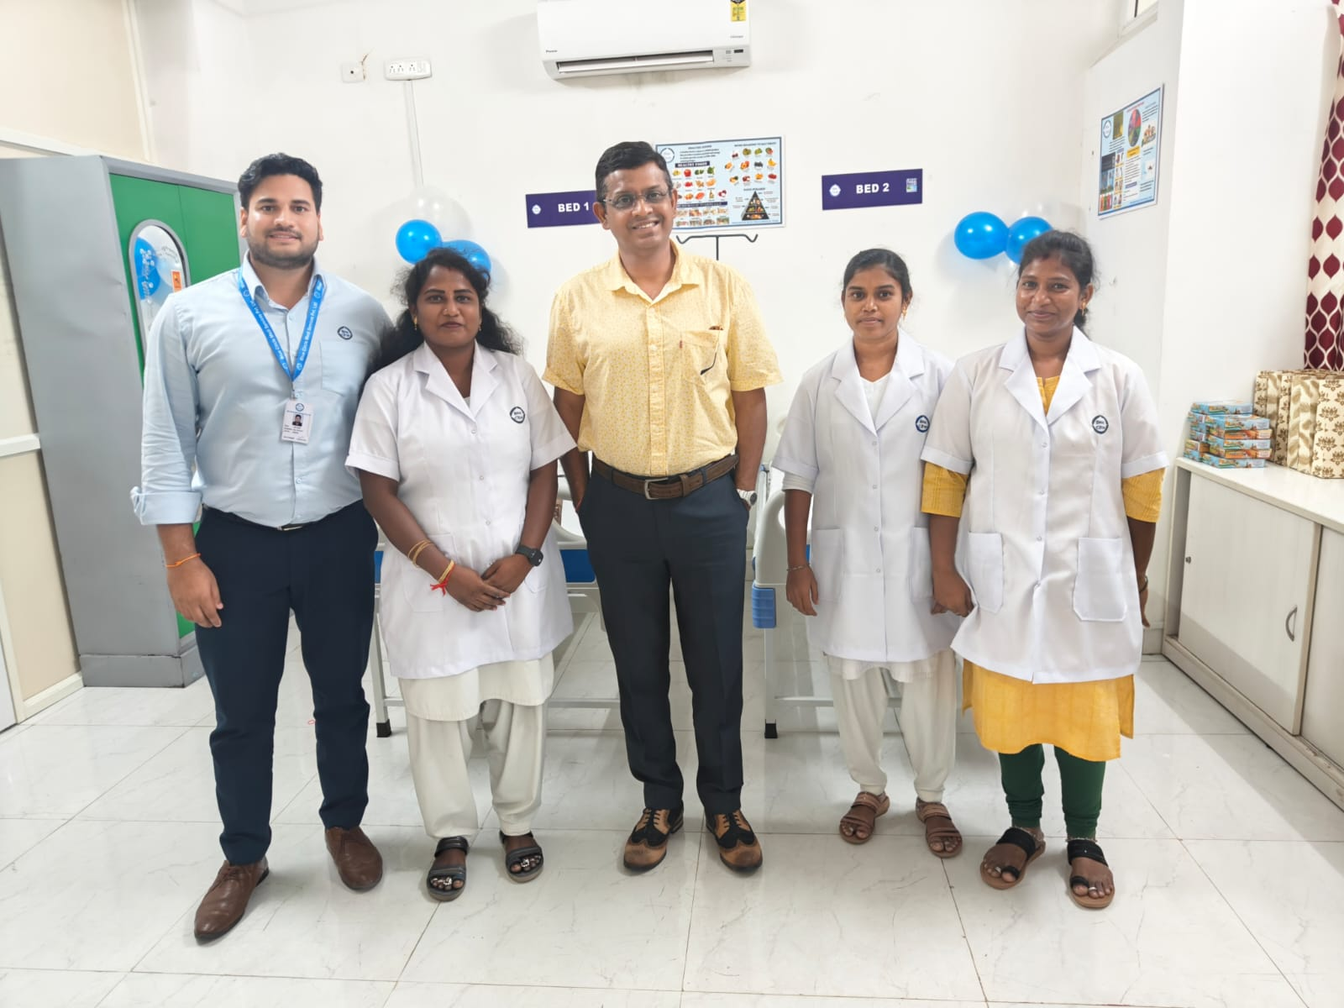
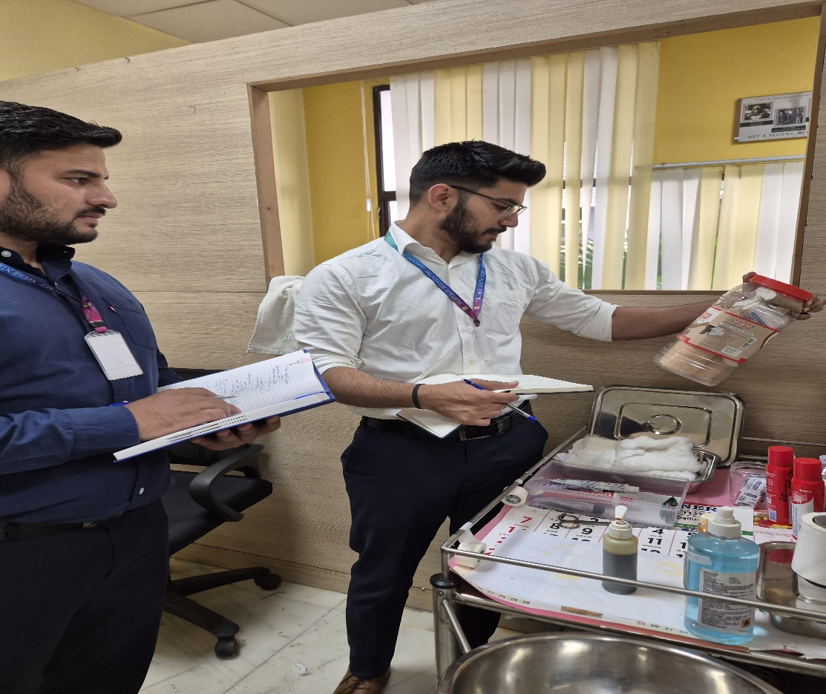
Pictorial Journey
New setup at Chennai location
Auditing at medical room

Slide 22
Thank You
Any Questions

