Slide 1

A Cross-Sectional Study on the Knowledge among Anganwadi Workers regarding services of ICDS(integrated child development services) in the Mandu Block of Jharkhand and Harichandanpur, Rangeilunda & Chatrapur Blocks of Odisha.
TATA STEEL FOUNDATION
ORGANIZATIONAL MENTOR – Ms Ruth Kerkatta
INSTITUTIONAL MENTOR – Dr. Sukesh Bhardwaj
SUBMITTED AND PRESENTED BY: DR. SARVESH GUPTA PG/21/92

Slide 2
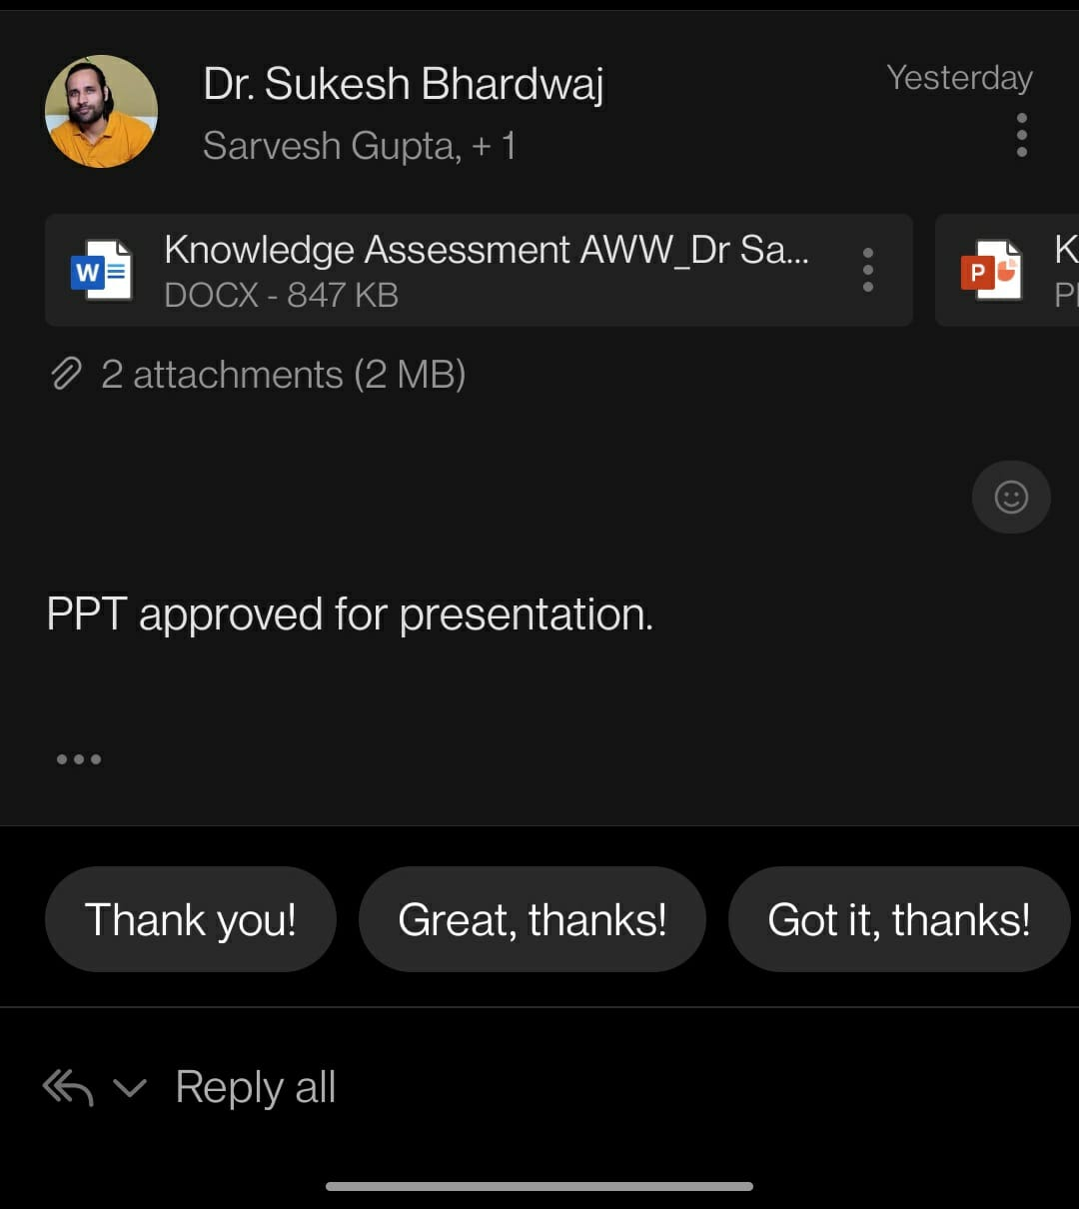
Mentor Approval

Slide 3
Introduction
The Integrated Child Development Services (ICDS) program in India aims to combat malnutrition among children aged 0-6 years, with a focus on those under 3, pregnant women, and lactating mothers.
It is a large community-based scheme sponsored by the Indian government, implemented nationwide. The government plans to expand the program to all 7076 blocks.

Slide 4
Objectives of Your Study
1. To assess the current level of knowledge of Anganwadi Workers (AWW) regarding nutrition-specific services of Integrated Child Development Services (ICDS) program in the Mandu Block of Jharkhand and Harichandanpur, Rangeilunda & Chatrapur Blocks of Odisha.
2. To identify the gaps in knowledge of AWW regarding ICDS services related to nutrition in the 4 Blocks of Jharkhand and Odisha.

Slide 5
Methodology
Study design:- Cross-sectional study
Sampling Method:- Simple Random Sampling
Sample Size Formula:- N= 4PQ/d ²
Where,
• P = Prevalence (from previous studies)
• Q = 100 – P
• d = allowable error (5-20% of P)
So our, P= 68, Q= 32 & d= 6.8 (10% of P).
Sample Size comes out to be 189.

Slide 6
Methodology
METHOD OF DATA COLLECTION AND ANALYSIS
The data will be collected through a Pen & paper personal interviews in the the Mandu Block of Jharkhand and Harichandanpur Block, Chatrapur block , & Rangeilunda Block of Odisha. A checklist is prepared for the same.
Tools to be used – MS Excel , PowerBI Desktop

Slide 7
Results
The majority of respondents are familiar with the program, its components, growth chart preparation, management of SAM and MAM in children, and the referral process to the NRC.
AWW have good understanding of the implications of different categories in the growth chart and the importance of supplementary nutrition under ICDS.
Respondents also demonstrated knowledge of the role of AWWs (Anganwadi Workers) in providing supplementary nutrition, promoting early childhood education, promoting immunization, and ensuring effective referral services under ICDS.
A lower percentage of respondents who are aware of the role of AWWs in assessing the nutrition status of beneficiaries, ensuring the quality of supplementary nutrition, and addressing common challenges faced by AWWs in implementing ICDS services.

Slide 8

5. In terms of training, a significant portion of respondents (42.02%) had their last training more than 7.5 years ago, while 23.41% had training between 5 to 7.5 years ago, and 18.62% had training between 2.5 to 5 years ago. Only 12.77% of respondents had training less than 2.5 years ago, and 3.72% have never received training.

Slide 9

DISCUSSION
The dataset shows good overall knowledge of the ICDS program among respondents. However, there is a need for improvement in certain areas, such as the role of AWWs in specific tasks and the need for more frequent and updated training. Targeted education campaigns and additional support for AWWs are recommended.

Slide 10

Conclusion
The survey results indicate that the majority of participants demonstrated good knowledge and understanding of the management of MAM children, growth chart interpretation, the importance of supplementary nutrition, and the roles of AWWs in various aspects of ICDS. However, there were some areas where participants displayed relatively lower awareness, such as the meaning of 2SD in the growth chart and the role of AWWs in promoting early childhood education. These findings highlight the need for targeted training and awareness programs to address the knowledge gaps and improve the overall effectiveness of ICDS services.

Slide 11
REFERENCES
Ministry of Women and Child Development. Integrated Child Development Services (ICDS) Scheme [Internet]. [cited 2023 Mar 22]. Available from: https://wcd.nic.in/schemes/integrated-child-development-services-icds-scheme
Ranjan R, Das M, Das S. Knowledge of anganwadi workers about integrated child development services: a study in Sitamarhi district of Bihar, India. Int J Res Med Sci 2019;7:4194-9.
Nair N, Gupta N, Arora N, Panda A. Nutrition Gardens: A Sustainable Model for Food Security and Diversity. ORF Issue Brief No. 363 [Internet]. 2021 [cited 2023 Mar 22]. Available from: https://www.orfonline.org/research/nutrition-gardens-a-sustainable-model-for-food-security-and-diversity-67933/
Dey D, Dey A. Anganwadi workers: on the forefront in the fight against malnutrition in India. J Family Med Prim Care. 2018;7(3):542-548. doi:10.4103/jfmpc.jfmpc_115_18
Patel A, Prakash AA, Das PK, Nayak S, Suchitra MR, Pani SP. Anganwadi Workers: Potential Soldiers Against Malnutrition. J Trop Pediatr. 2021;67(4):fmab028. doi: 10.1093/tropej/fmab028
Baxi R, Joshi R, Vadgama M, et al. Accelerating Actions Against Malnutrition: A Call for Strengthening the Capacity of Health and Nutrition Program Staff in Devbhumi Dwarka, Gujarat. Cureus. 2020;12(12):e10853. doi:10.7759/cureus.10853
Indian Journal of Health Sciences [Internet]. [cited 2023 Mar 22]. Available from: https://www.ijournalhs.org/temp/indianjhealthsci103241-3691028_101510.pdf.
Joshi K. Knowledge of Anganwadi workers and their problems in Rural ICDS block. J Paediatr Nurs Sci. 2018;1(1):8-14.
J Nutr Res [Internet]. 2019 [cited 2023 Mar 22];2:30-35. Available from: https://sciresol.s3.us-east-2.amazonaws.com/srs-j/jnutres/Volume-2/11-Article%20Text-30-1-10-20190425.pdf
Ministry of Women and Child Development. ICDS Mission - Broad Framework [Internet]. [cited 2023 Mar 22]. Available from: https://wcd.nic.in/sites/default/files/IcdsMission%20-%20Broad%20Framework.pdf

Slide 12
Thank You

Slide 13
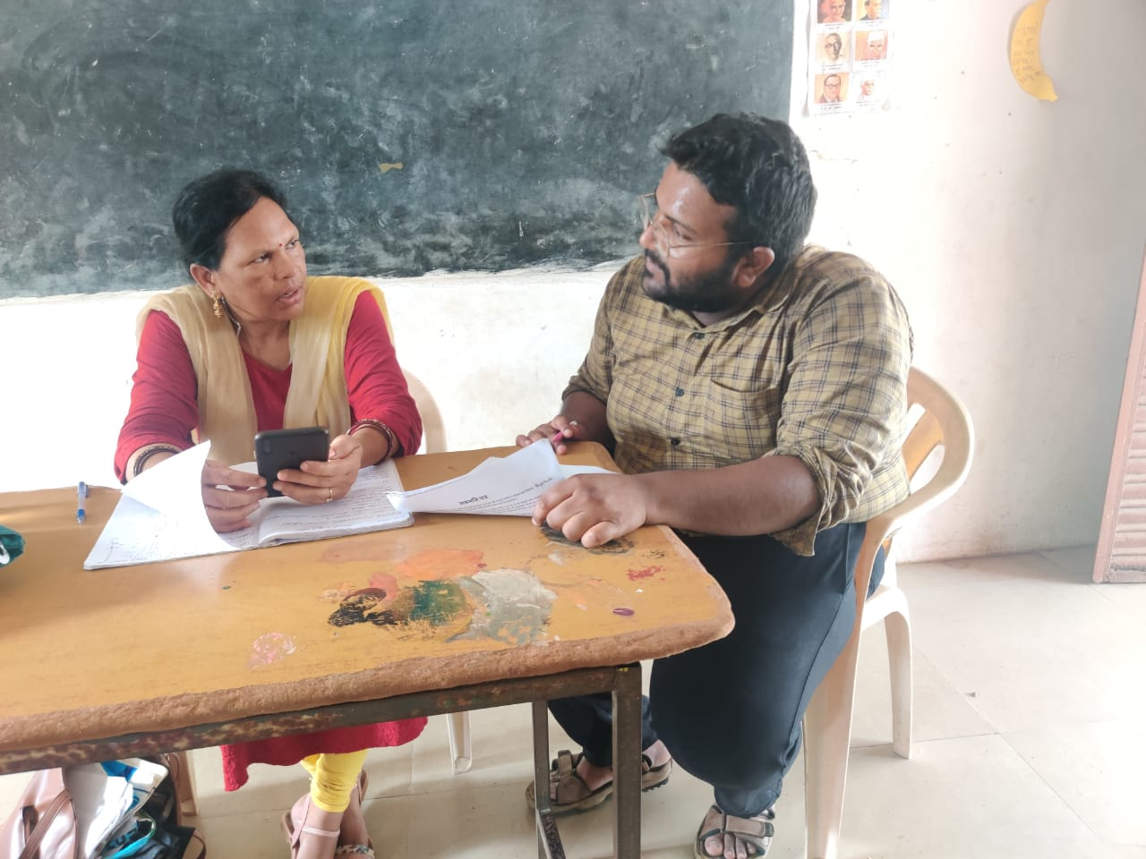
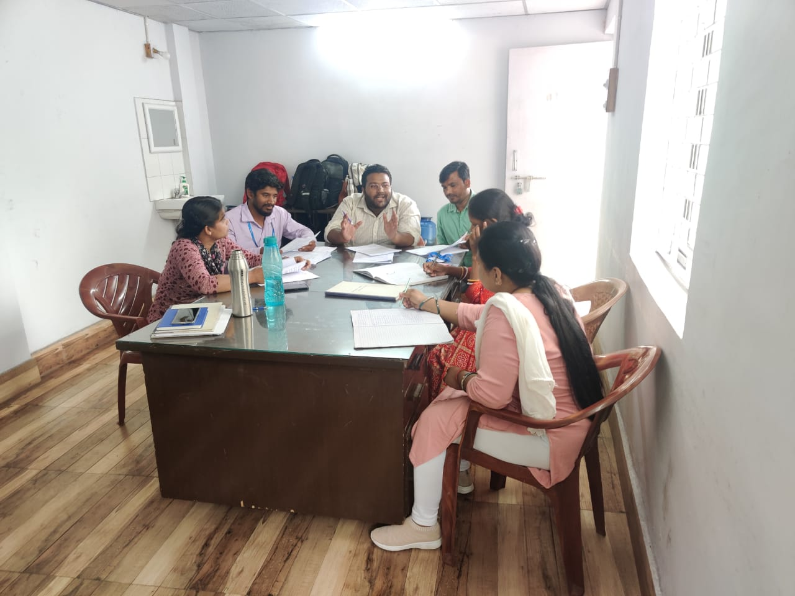
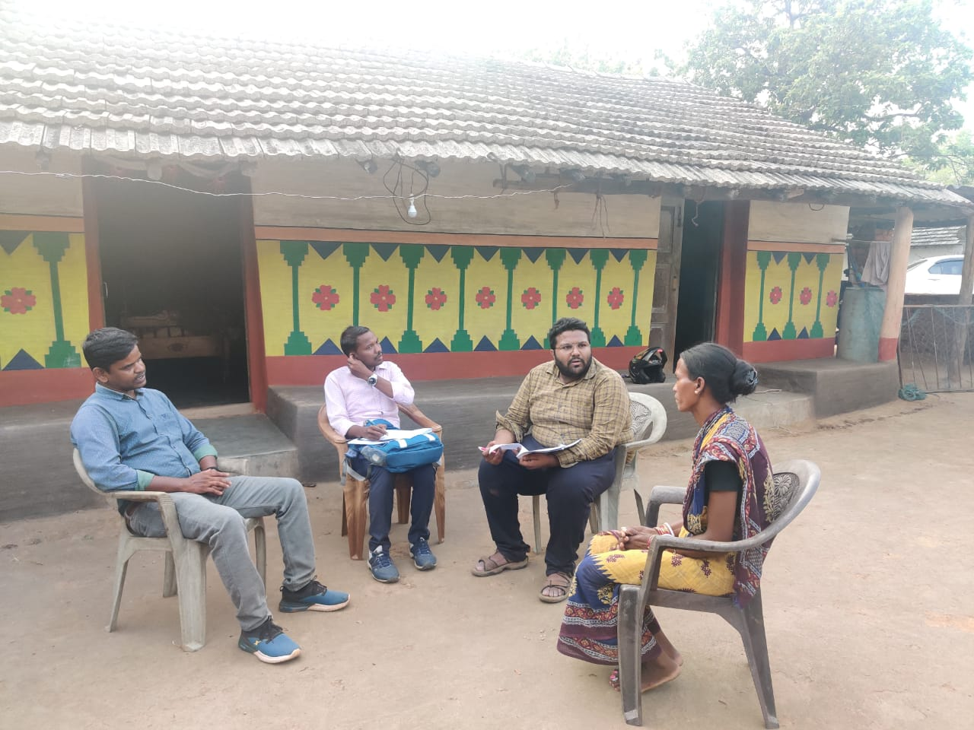
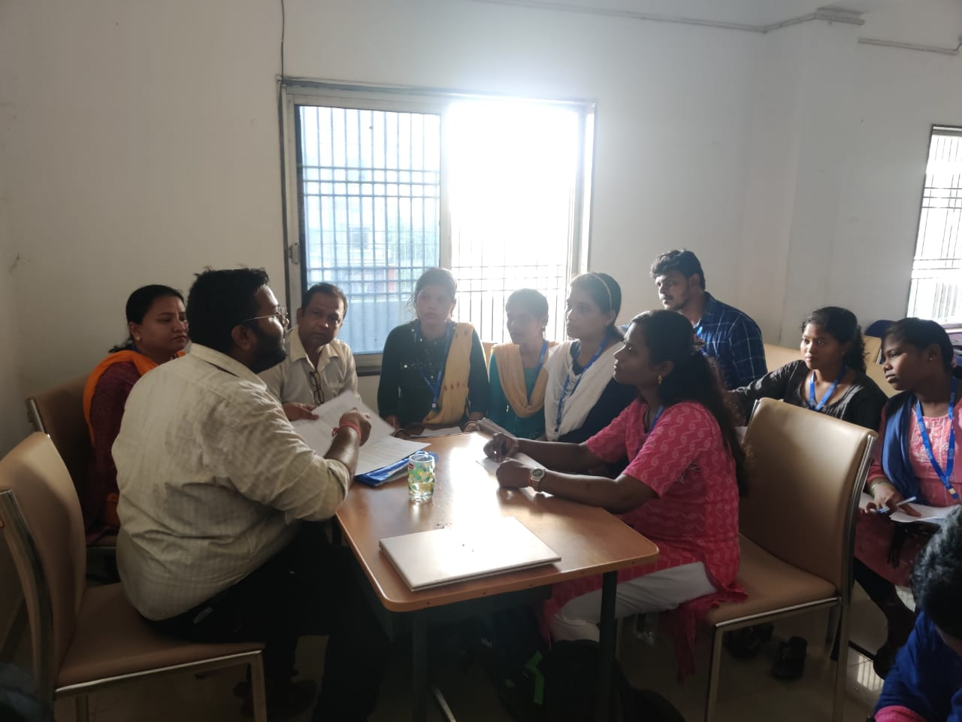
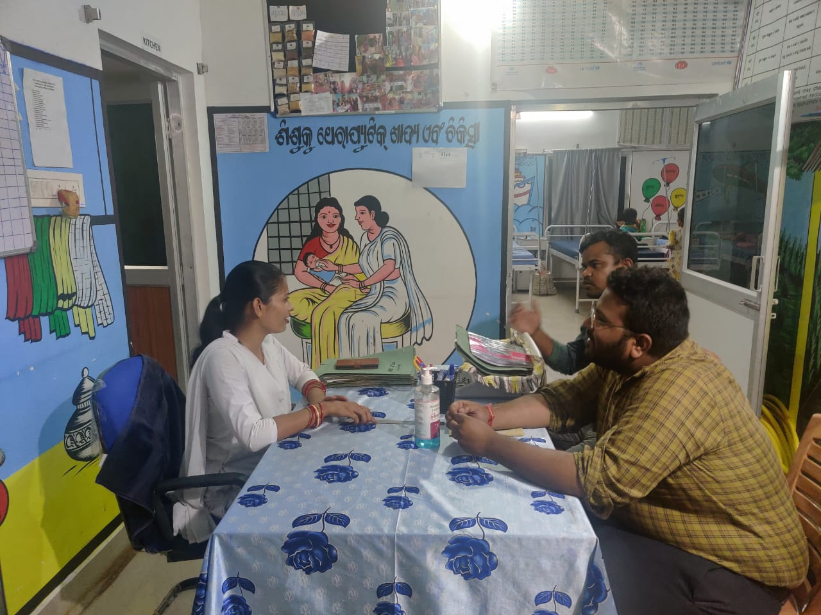
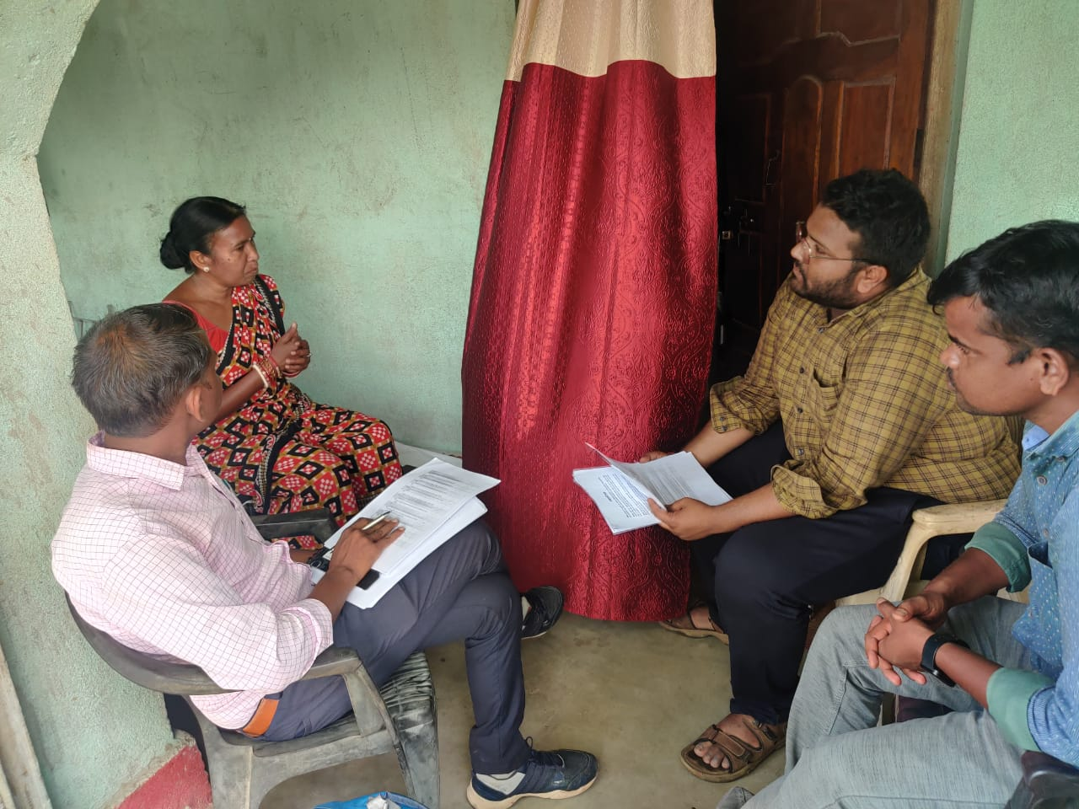
Pictorial Journey

Slide 14
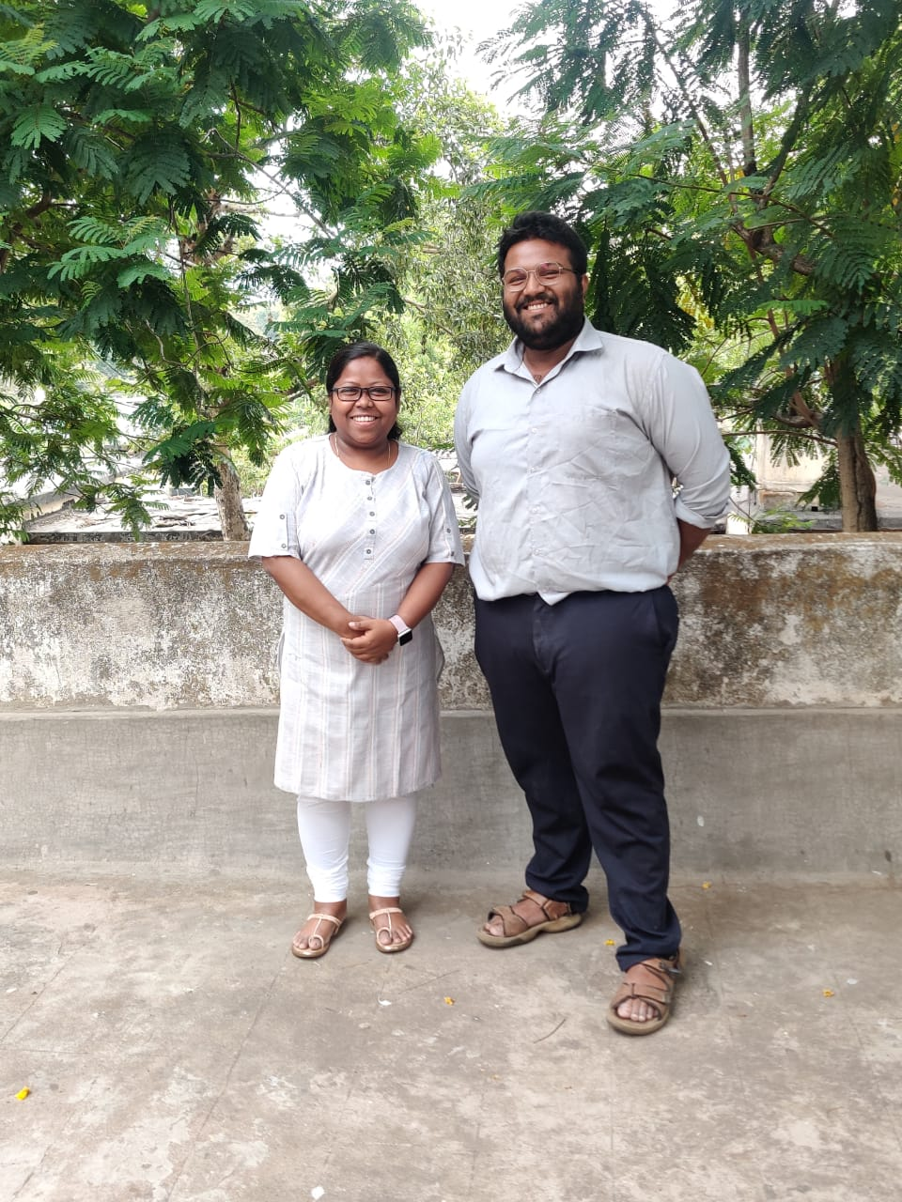
Pictorial Journey
Pictorial Journey

