Slide 1


A STUDY ON SUPPLIER SELECTION CRITERIA FOR INTRAOCULAR LENSES USING AHP METHOD
EYE-Q SUPER-SPECIALITY EYE HOSPITALS
ORGANIZATIONAL MENTOR – Mr. Ajay Singh Mr. Chandan Singh Rawat
INSTITUTIONAL MENTOR – DR. NIDHI YADAV
SUBMITTED AND PRESENTED BY: Mr. Prashant Pokhriyal PG/21/073

Slide 2

Mentor Approval

Slide 3

SUPPLY CHAIN
IOLs
MEDICINES
CONSUMABLES
OPTICAL
Supply chain management is the management of flow of goods and services and includes all processes that transform raw material into final product.
Right Product, Right Quantity, Right Time, Right Place, Right Cost.
4 PILLARS

Slide 4


OBJECTIVE OF THE STUDY
PRIMARY OBJECTIVE
SECONDARY OBJECTIVE
What specific criteria are used in the selection of suppliers?
What is the relative importance of these criteria?

Slide 5
Review of Literature
Sr. No. | AUTHOR OF THE LITERATURE | OBJECTIVE | CONCLUSION
1 | Elias Krop, Dr. Mike A. Iravo (PhD.) | EFFECTS OF SUPPLIER SELECTION ON PERFORMANCE OF PROCUREMENT FUNCTION IN PUBLIC SECTOR: A CASE OF WEST POKOT COUNTY GOVERNMENT | Finally the general conclusion is that supplier selection has significant effects on procurement function performance. The findings above provide evidence of proof that the components of supplier selection are related to procurement function performance either positively or negatively.(7)
2 | Arpan Kumar Kar, Ashis K. Pani | Exploring the importance of different supplier selection criteria | Findings indicate that seven criteria are of critical importance to Indian manufacturing industries. Also evaluation criteria like product quality, delivery compliance and price have maximum criticality, while criterion like e-transaction capability is gaining in importance, with the increased adoption of e-procurement platforms.(5)
3 | Manish Kumar Sagar1 , Deepali Singh | Supplier Selection Criteria: Study of Automobile Sector in India | In the supplier selection process, the most important issue is to determine suitable decision making criteria for selecting the right supplier. This research aimed to identify the most important criteria to be used as a baseline for a supplier selection process of automobile sector in India. The results are based on the feedback from automobile sector in India. The common questionnaire was used for data collection/ gathering. The findings can potentially be used as a baseline for an organization to strengthen supplier selection activities and to better understanding with its suppliers. Finally, the main findings about most important criteria are compared with previous studies.(4)

Slide 6
Review of Literature
Sr. No. | AUTHOR OF THE LITERATURE | OBJECTIVE | CONCLUSION
4 | Ahmet Beşkese, Cihan Evecen | SUPPLIER SELECTION IN HEALTHCARE SECTOR | In this research, one of the most popular research topics, supplier selection, is discussed in an untouched area of application, healthcare sector. One of the most distinctive characteristic of this sector is its unique nature compared to manufacturing and other service industries. Decisions cannot be made focusing solely on supply chain management concepts, but health and life of the customers in this sector should also be considered. Taking these into account, a new set of criteria is proposed in this study. These criteria were discussed with several managers from different healthcare organizations. Maybe the most interesting part of these discussions is the conclusion about the criterion “quality”. It is conceived as a stand-alone order-qualifier criterion. It means that there is a threshold for quality.(6)
5 | Pezhman Ghadimia *, Cathal Heavey | Sustainable Supplier Selection in Medical Device Industry: Toward Sustainable Manufacturing | The supplier selection problem is proven to be one of the most important and popular problems in the research domain of supply chain management. The number of research papers published in the area of traditional supplier selection where all the attentions were paid to consider the most important criteria such as price, quality, service and ranking the suppliers based on an assessment method. These approaches demonstrated to be competitive and practical until the emergence of the sustainability issues which has drawn the attention of mangers and CEOs of companies to incorporate sustainability vision in all aspects of their manufacturing and supply chain activities. Therefore, research directions in the supplier selection problem have been attracted to address and eradicate these challenges as much as possible. (1)

Slide 7
Review of Literature
Sr. No. | AUTHOR OF THE LITERATURE | OBJECTIVE | CONCLUSION
6 | Manish Kumar Sagar1 , Deepali Singh | Supplier Selection Criteria: Study of Automobile Sector in India | In the supplier selection process, the most important issue is to determine suitable decision making criteria for selecting the right supplier. This research aimed to identify the most important criteria to be used as a baseline for a supplier selection process of automobile sector in India. The results are based on the feedback from automobile sector in India. The common questionnaire was used for data collection/ gathering. The findings can potentially be used as a baseline for an organization to strengthen supplier selection activities and to better understanding with its suppliers. Finally, the main findings about most important criteria are compared with previous studies.(4)
7 | Mark A. Vonderembse, Michael Tracey | The Impact of Supplier Selection Criteria and Supplier Involvement on Manufacturing Performance | This research investigates the extent to which supplier selection criteria and supplier involvement are used by manufacturers. It also provides support for the claim that firms employing these practices have enhanced supplier and manufacturing performance. Most firms regard the use of supplier selection criteria as an important part of their supplier selection process. Supplier involvement in product design activities and continuous improvement efforts is much lower than the use of supplier selection criteria. The product quality and product performance dimensions of supplier selection criteria plus all of the dimensions of supplier involvement and supplier performance are positively correlated with manufacturing performance. When the sample is divided into high and low manufacturing performers, all the elements of supplier performance and supplier involvement and all but one of the four supplier selection criteria are significantly better for the high performing group than the low performing group. These results lend support to the statement that implementing supplier selection criteria and involving suppliers has a positive impact on performance.(2)

Slide 8
METHODLOGY
STUDY DESIGN: - DESCRIPTIVE STUDY
TYPE OF STUDY: - SECONDARY & PRIMARY
AREA OF STUDY: - EYE-Q SUPER-SPECIALITY EYE HOSPITALS
STUDY PERIOD: - 2 MONTHS
SAMPLE SIZE: - 100%
CRITERIA SELECTION: - CRITERIA THAT RELATABLE FOR INTRAOCULAR LENSES ARE INCLUDED IN THIS STUDY
METHOD: - ANALYTICAL HEIRARCHY PROCESS METHOD
TOOLS: - MS EXCEL FOR THE ANALYSIS, REVIEW OF LITERATURE, STAFF INTERVIEW

Slide 9
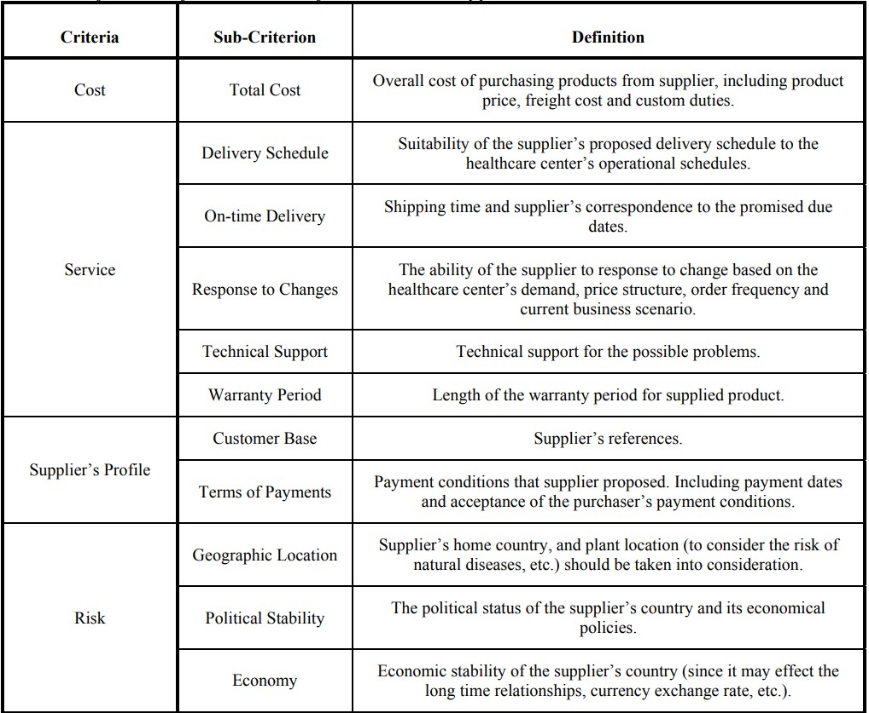
IDENTIFIED CRITERIA

Slide 10
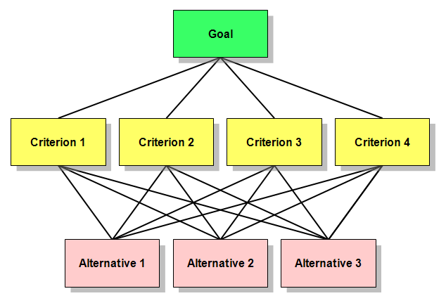
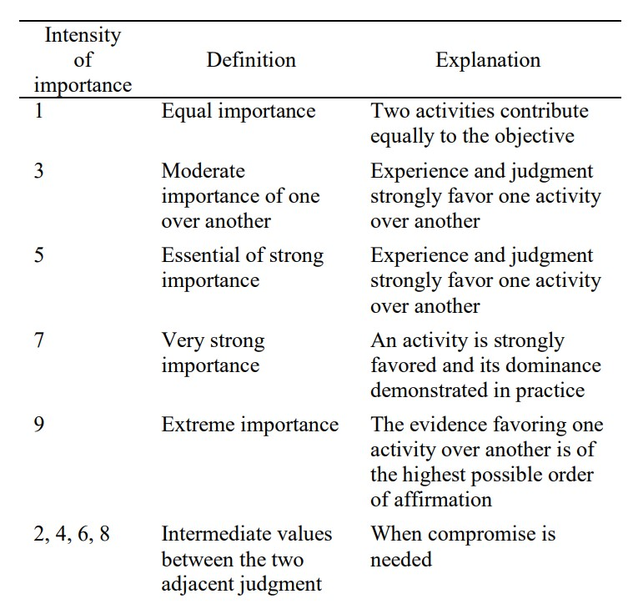
Analytical Hierarchy Process (AHP)

Slide 11
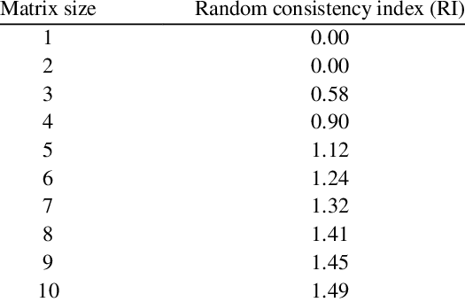
ANALYSIS
CALCULATION EXAMPLE :-
CR SHOULD BE <0.1

Slide 16





IMPORTANCE
Ready-to-use model for selecting the most appropriate suppliers.
Better Patient Care
Cost Saving
Right Product, in Right Quantity at the Right Time, Right Place and at the Right Cost to the customers.

Slide 17
DISCUSSION
First, the consistency ratio is calculated as -0.4. Since this value is less than 0.1, the evaluations are consistent. In the first stage, the evaluation was performed for Eight major criteria.
Terms of Payment was found to be the most important factor in selecting the best supplier.
On Time Delivery is also a major factor
Technical support – Major Factor
Cost – Major Factor
Geographical Location
Response to Change
Warranty
Customer Base
It means that Services, Supplier profile and Cost are the most important criterion. Potential suppliers must pay higher attention to service, their profile and its sub-criteria to be preferred.
*QUALITY IS ALWAYS CONSIDERED NO. 1 PRIORITY IN EVERY SCENERIO*

Slide 18
Conclusion
In this research, one of the most popular research topics, supplier selection, is discussed in an untouched area of application, healthcare sector.
The results show that, Terms of Payment, Ontime Delivery, Technical Support and Total Cost are Four most important sub-criteria in the evaluation process.
Because of the unique nature of the sector, the health services within a healthcare organization must be uninterrupted. It can be concluded that the significantly high importance of Technical Support, Ontime Delivery, Cost, Quality is a result of this.

Slide 19
LIMITATION
CRITRION MAY DIFFER FROM ORGANISATION TO ORGANISATION
HIGH COMPUTATIONAL REQUIREMENTS FOR EVEN SMALL PROBLEM
SUBJECTIVITY AND INCONSISTENCY: AHP HEAVILY RELIES ON SUBJECTIVE JUDGMENTS AND PAIRWISE COMPARISONS MADE BY INDIVIDUALS INVOLVED IN THE DECISION-MAKING PROCESS. THESE JUDGMENTS ARE OFTEN INFLUENCED BY PERSONAL BIASES AND CAN INTRODUCE INCONSISTENCIES.
THE CALCULATIONS AND TRANSFORMATIONS INVOLVED IN AHP MAY NOT BE EASILY UNDERSTANDABLE

Slide 20
References (Through Zotero)
1. Ghadimi P, Heavey C. Sustainable Supplier Selection in Medical Device Industry: Toward Sustainable Manufacturing. Procedia CIRP. 2014;15:165–70.
2. Vonderembse MA, Tracey M. The Impact of Supplier Selection Criteria and Supplier Involvement on Manufacturing Performance. J Supply Chain Manag. 1999 Jun;35(3):33–9.
3. Kannan VR, Tan KC. Supplier Selection and Assessment: Their Impact on Business Performance. J Supply Chain Manag. 2002 Sep;38(4):11–21.
4. Sagar MK, Singh D. Supplier Selection Criteria: Study of Automobile Sector in India.
5. Kumar Kar A, K. Pani A. Exploring the importance of different supplier selection criteria. Manag Res Rev. 2014 Jan 14;37(1):89–105.
6. Be A. SUPPLIER SELECTION IN HEALTHCARE SECTOR.
SCM Selection.pdf.
Evelyn E, EdmondYeboah N. RANKING AGRICULTURAL SUPPLY CHAIN RISK IN GHANA: AN AHP APPROACH.

Slide 21
Thank You
Any Questions ?

Slide 22
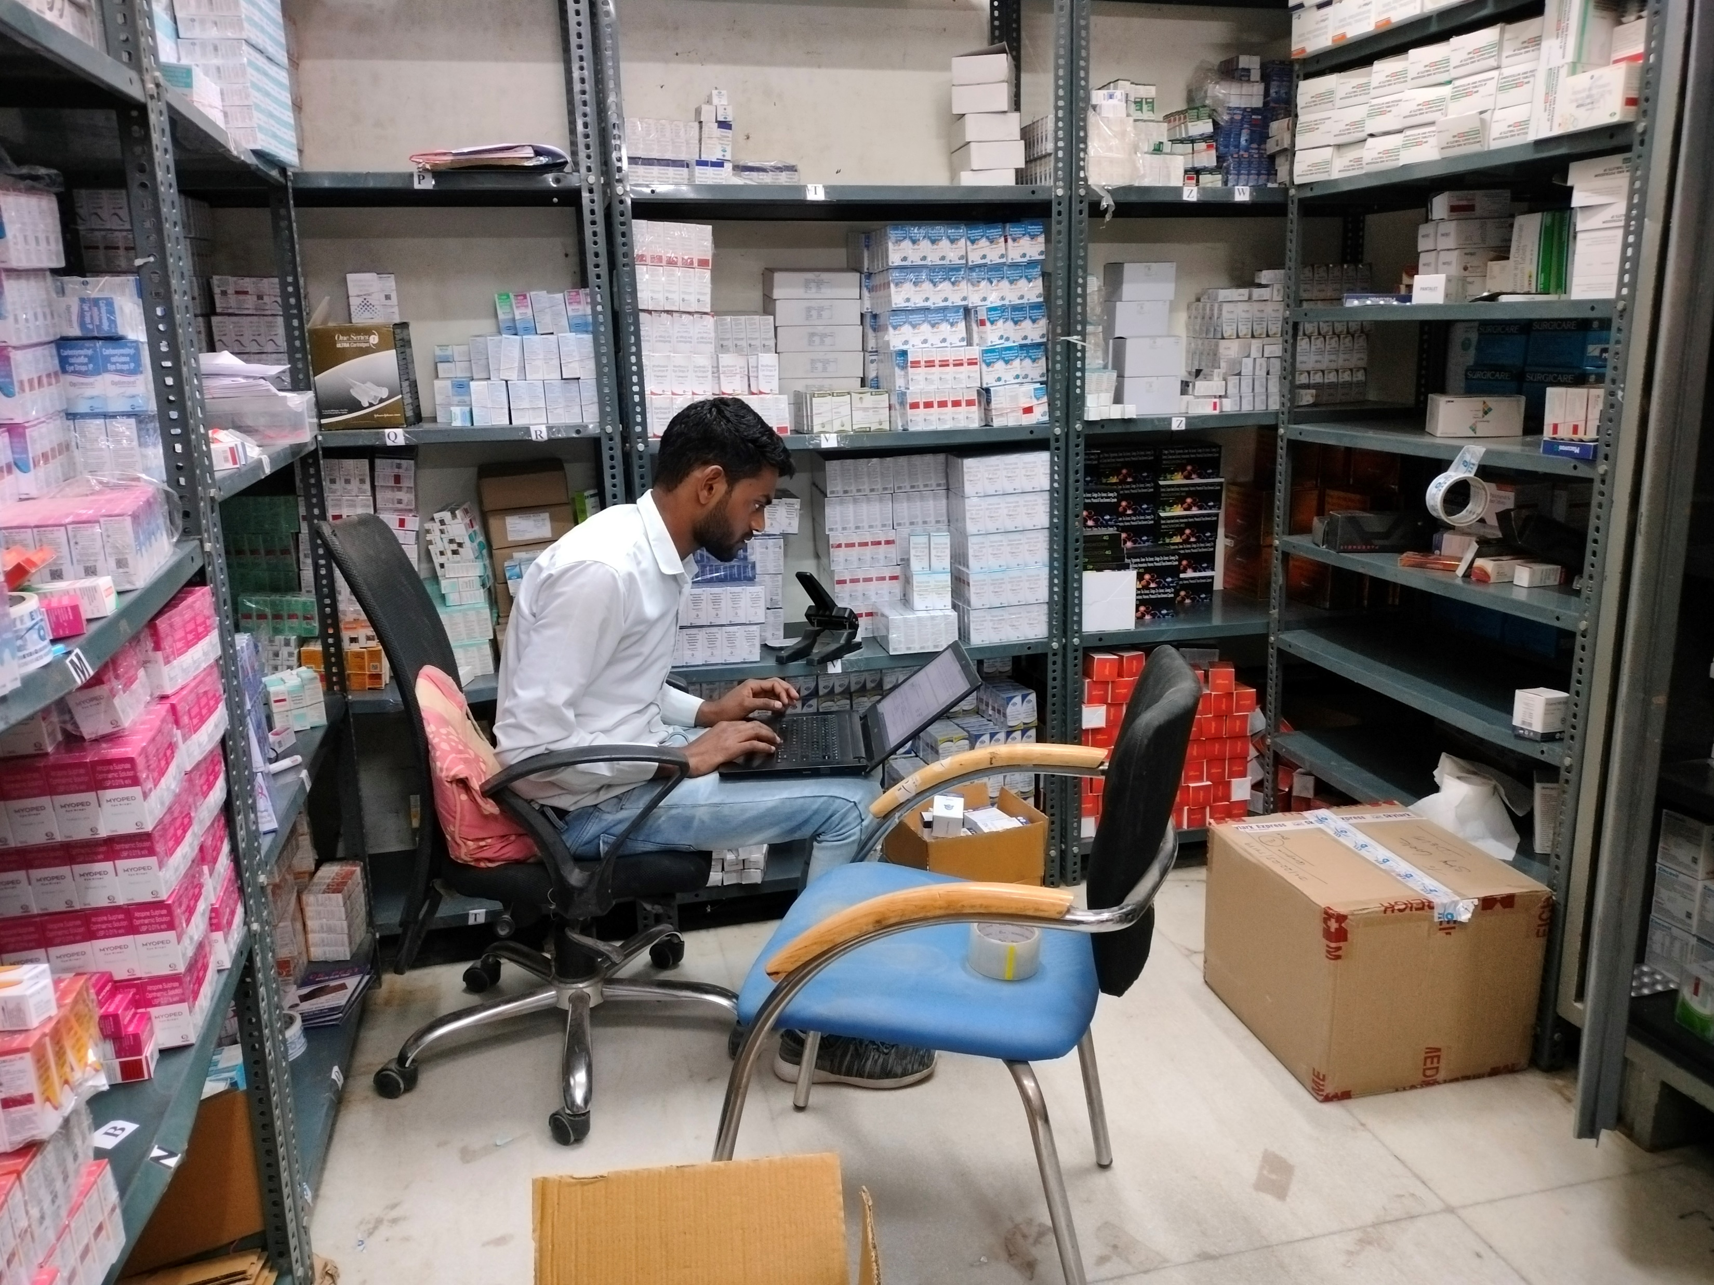
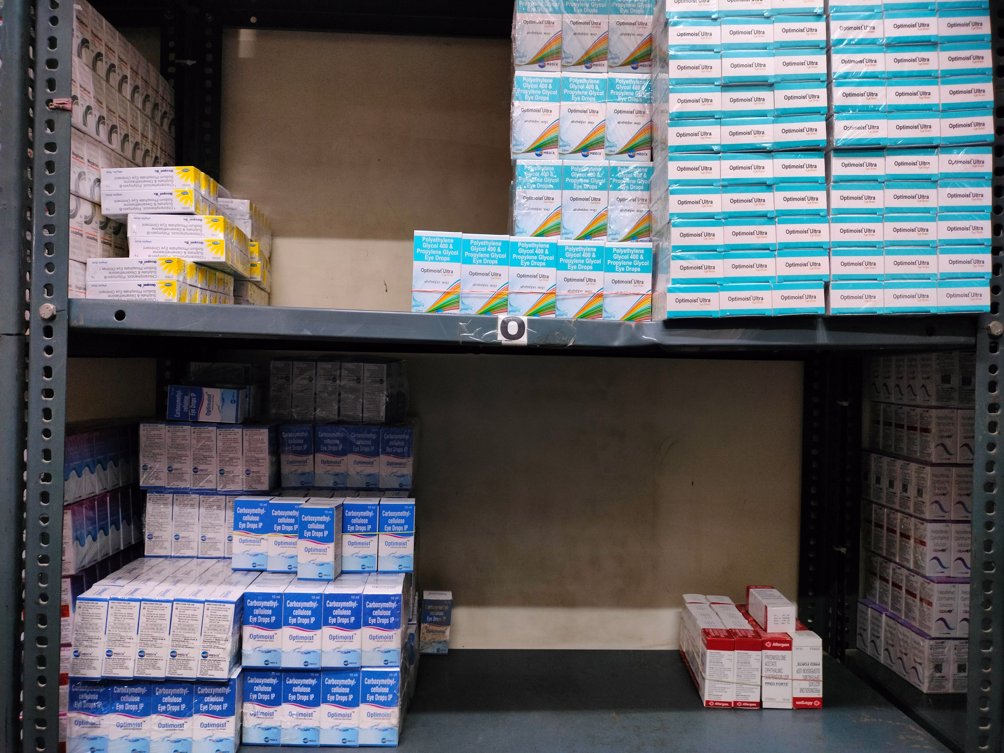
Pictorial Journey (1/2)

