Slide 1

CONCIERGE RIS/PACS WORKFLOW AUTOMATION IN EMERGENCY
REPORTING
BY:-
KAJOL AGRAWAL
Pg/17/25

Slide 2

About Us
Telerad Tech Private Limited was founded on 3rd April 2009 by the group of technology innovators and eminent radiologists. Telerad Tech Private Limited came into existence with an idea of doing something great, affordable and innovative in the country as well as across globe. Dr. Arjun Kalyanpur (Chief Radiologist) and Dr. Sunita Maheshwari (Paediatric Cardiologist), are the main people behind Telerad Tech. They saw a dream and it came true in 2009. Doctors turned into Healthcare Entrepreneurs made it possible with their hard work and dedication. Telerad Tech, a global healthcare IT company which is working in the area of RIS-PACS technology.
Telerad Tech Private Limited has the following services in the sector of Radiology:
1. RADSpa
2. VETSpa
3. CLINSpa
4. CARDIOSpa
Notes:
Image source:-
https://pixabay.com/en/computer-keyboard-apple-laptop-2563737/

Slide 3

Vision
To be the Preferred Technology Partner for providers in Tele-Health Globally.
Mission
“To provide Best-in-Class Technology Platforms in Radiology and Tele-Health Space.
“To develop Healthcare AI Technologies at Sustainable Costs to Impact Patient Care”.
Notes:
https://pixabay.com/photos/person-silhouette-sunset-rock-598191/

Slide 4
Information technology is perceived as a potential panacea for healthcare organizations to manage pressure and to improve services in the face of increased demand.
Over the last decade, there has been a series of changes in medicine, technology and healthcare services that assist the healthcare professionals to provide better treatment to the patients.
The conversion from analog to digital methods in the medical imaging world and the emergence of widely available mechanisms for the transmissions of digital data over large distances have fuelled the rapid growth of radiology in the healthcare field.
Radiology now has become the diagnostic tool for monitoring, treating and predicting the outcomes of the diseases.
INTRODUCTION

Slide 5


The introduction of Radiology Information System and Picture Archival Communication System in radiology has reformed their work practice.
Implementation of Radiology Information System for the workflow of radiology works as a database that medical professionals used to keep the track of patient data and to store enormous image files by integrating in PACS system.
PACS can be described as an application for electronic storage, retrieval, distribution, communication and processing of data associated with medical imaging.
With this Teleradiology Solutions forms a collaborative project with Telerad tech product i.e. AI enabled RADSpa to enhance efficiency and reduce TAT in radiology through implementation of Concierge workflow automation.
Teleradiology Solutions (TRS), providing Emergency Teleradiology Reporting for more than 100+ hospitals in USA and many more in other countries is in process to improve their productivity, efficiency and turnaround time (TAT) in Emergency Radiology (ER) Reporting to improve patient care.

Slide 6
ABOUT RADSpa
RADSpa provides a integrated RIS-PACS platform for radiology workflow management. It can be easily integrated with the existing standards EMR, EHR and HIS. This integrated system will transmit the data from the RIS to PACS which produces the digital images with patient data.
PACS streaming or DICOM routing capabilities can be used for real-time distribution of images. Thus it provides the radiologist with complete availability of information, maintains consistency, reduces medical errors, improves the workflow, allow a single desktop efficiency and thus maintains patient care. It has following features:-
Real time worklists
HIPAA compliant
Application workability at low internet bandwidth
Integrated RIS and PACS functions with inbuilt intelligent workflow
CD burning feature
HIS/EMR implementation with or without HL7
Support all DICOM modalities
Advanced application supporting MIP/ MPR/2D/3D viewer

Slide 7
PROBLEM FORMULATION
PROCESS
TECHNOLOGY
Priotrization of cases
Manual Assigning of cases
Macros
Check the cases on the basis of modalities, procedures, criticalities etc
Voice recognition
Colour codes
Alert for unassigned cases
Short Forms
Cause of TAT
Online Chats
Lack of radiologist
Diagnostic error
Error during assigning the cases
Lack of transcriptionist
Lack of assigners
Error during typing
No quality check for the report
MANPOWER
METHOD

Slide 8
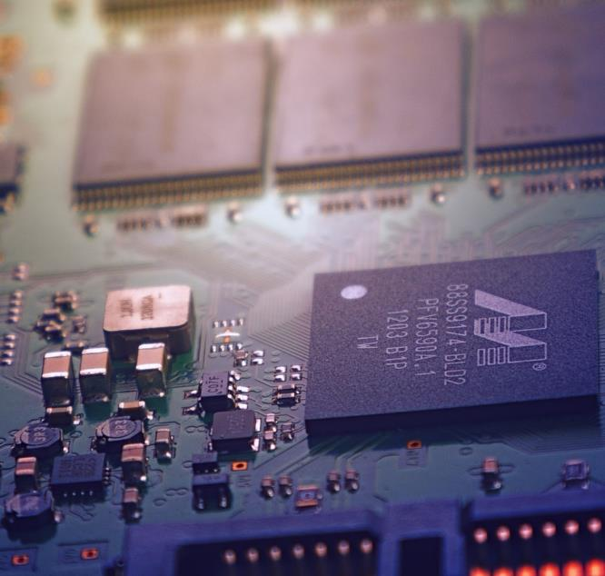
AIM & OBJECTIVE
1
AIM
The aim of this study is to analyze the impact of concierge workflow automation capabilities of RADSpa to improve Turnaround Time (TAT) in ER Reporting.
2
OBJECTIVE
To identify and reduce the turnaround time in
report generation according to the workflow of
teleradiology / radiology department.
Notes:
Image source:-
https://pixabay.com/en/technology-industry-big-data-cpu-3092486/

Slide 9
The study will be conducted in Teleradiology Solutions Bangalore with the collaboration of Telerad Tech
SAMPLE SIZE:- There will be the 45 respondents
37 American Board of Radiologist
6 coordinators
2 PACS administrators.
SAMPLING TECHNIQUE- Convenience Sampling
STUDY DESIGN- Descriptive
To analyse the turnaround time in report generation secondary data of the medical reports before the implementation and after the implementation of the feature will be collected from the database of the TRS and will be compared to measure the improvement in turn around time in report generation.
METHODOLOGY

Slide 10
MODE OF DATA COLLECTION
PERFORMANCE MEASURE | DATA SOURCE | SAMPLE SIZE Before After Automation Automation | WHO WILL COLLECT | WHEN DATA WILL COLLECT
Auto-assign | Logs | 20169 24501 | T2 Team | 1 Nov- 30 Nov 2018
Auto-assign | Logs | 19860 25095 | T2 Team | 1 Dec -31 Dec 2019
Auto-assign | Logs | 21654 23168 | T2 Team | 1 Jan- 31 Jan 2019
Auto-assign | Logs | 18900 25102 | T2 Team | 1 Feb-28 Feb 2019
Auto-assign | Logs | 22409 22016 | T2 Team | 1 Mar-31 Mar 2019
Auto-assign | Logs | 22301 23156 | T2 Team | 1 Apr- 30 Apr 2019

Slide 11
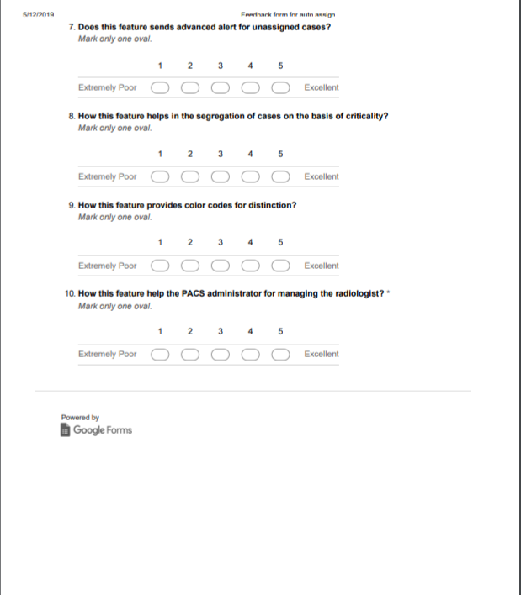
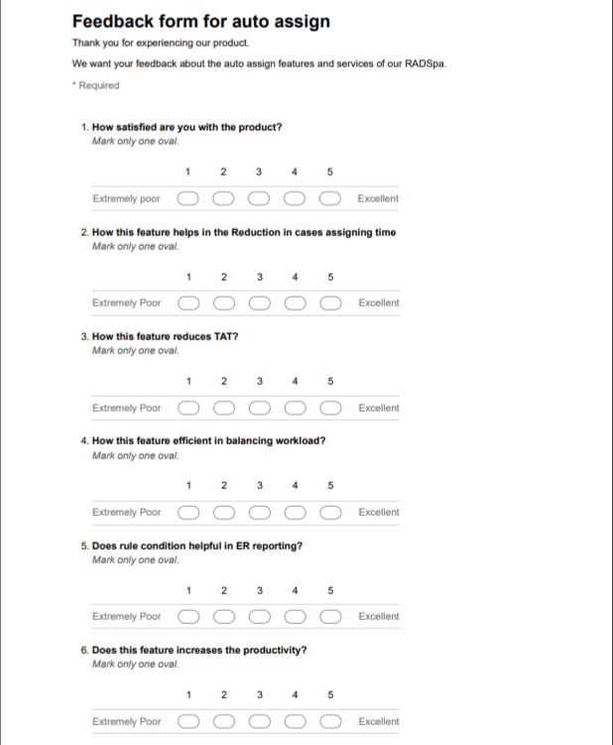
QUESTIONNARIE:-
Information regarding the smoothness of the auto assign feature was collected from the 45 respondents through questionnaire.
37 Radiologists
6 Coordinators
2 PACS administrators

Slide 12
PROJECT MANAGEMENT LIFE CYCLE
INITIATION PHASE
IMPLEMENTATION PHASE
03
01
01
02
04
EXECUTION PHASE
PLANNING PHASE

Slide 13
INITIATION PHASE
01
In this phase the goal and scope of the project is decided and decisions are made regarding who will carry out the project, who will be the stakeholders in the project and forming the budget of the project implementation.
PROJECT TITLE:- CONCIERGE RIS/PACS WORKFLOW AUTOMATION IN EMERGENCY REPORTING
PROJECT START DATE- 1 November 2018 PROJECT END DATE- 31 April 2019
BUDGET INFORMATION:- Can’t be disclosed
PROJECT MANAGER:- Shrinivas L. Bhatt
PROJECT OBJECTIVE:- To analyse the feature of auto assign in reducing the turnaround time in report generation according to the workflow of teleradiology / radiology department.
MAIN PROJECT SUCCESS CRITERIA:- the project should be completed in one year.
APPROACH:- To study the turn around time in ER reporting in radiology department before implementation. To study the feature of auto assign and its benefits in reducing TAT To gather the data from the logs of TRS to evaluate the TAT in ER reporting after implementation. Develop the survey to evaluate the satisfaction level of the users regarding the auto assign feature. Provide training to the users

Slide 14
PLANNING PHASE
02
This phase provides solutions to the projects objectives. It includes the following steps:-
Requirement gathering
This phase includes gathering the requirements from the users for the auto assign feature in RADSpa.
It will gather the requirement for setting the pre set rules such as the type of hospitals, type of modalities, type of cases and procedures and on the basis of criticality.
After the requirement gathering, a proposal is sent which includes the description about the business
plans, product features, hardware specifications, commercials and other deliverables.

Slide 15
Scope Statement
A project plan is created outlining the activities, tasks, dependencies, and timeframes i.e. a scope statement.
Telerad Tech Prepared By:- Kajol Agrawal Statement of project scope Date:-
General Project Information Project Name:- Concierge RIS/PACS workflow automation in ER Reporting Project Manager:- Shrinivas L. Bhatt
Problem Statement:- Radiologist face difficulties in reporting the large amount of cases in a shorter period of time. The coordinators/assigners take more time in monitoring and then assigning the cases to the radiologist.
Project Objective:- To analyse the feature of auto assign in reducing the turnaround time in report generation according to the workflow of teleradiology / radiology department
Project Description:- The auto assign feature of the Orchestration workflow of RADSpa automatically assigns the studies according to the convenience and availability of the radiologist which will reduce the time required in assigning the studies manually.
Business Benefits:- Reduces the manpower Increases study read rate Reduces the time in report generation
Project Deliverables:- Implementation of auto-assign feature in RADspa Monitoring the feature Providing training to the users Setting the pre set rules
Project Duration:- 6 months Duration

Slide 16
IMPLEMENTATION PHASE
03
In this phase the auto-assign feature is tested priory by the technical team and then implemented in various hospitals and diagnostic centers where the studies will be assigned according to their requirement of the type of cases, modalities, procedure and on the basis of criticalities. After the implementation one personnel client from Telerad Tech with IT knowledge will be nominated who will provide training to the users for a total of 80 hours.
04
EXECUTION PHASE
After the successful implementation of auto-assign feature evaluation is done to verify whether the defined criteria are met and reviewing the performance of the product. The detailed documentation (Signoff document) is prepared and feedback of the users is documented for future reference.

Slide 17
ABOUT AUTO-ASSIGN FEATURE:-
The auto assign feature of the Orchestration workflow of RADSpa automatically assigns the studies according to the convenience and availability of the radiologist.
The studies are assigned according to the type of cases (stroke cases, neuro cases etc.), types of orders (elective or emergency), types of modalities, availability of radiologist, scan timings, type of hospitals and institutions, on the basis of criticality and the type of procedure.
This auto-assign feature will automatically alert the radiologist about the task that was assigned to him thus reducing the delay in task assignment.
It works as an alternative of auto assigners thus improving the workflow of the radiology department and increasing the productivity of diagnostic services.

Slide 18
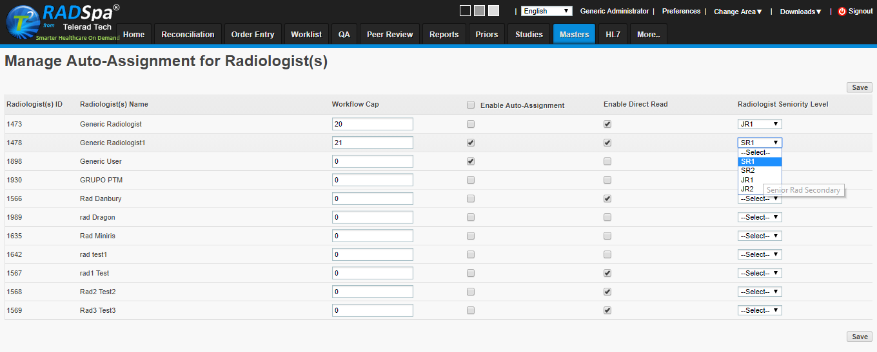
Case limitation and Radiologist Seniority management dashboard

Slide 19
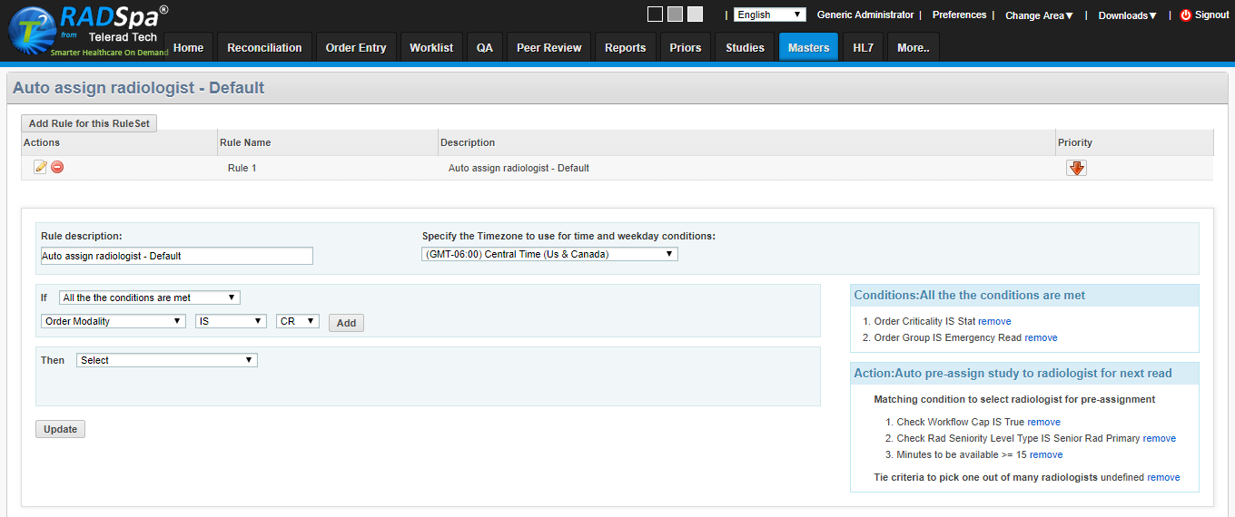
Auto- Assignment Rule creation dashboard.

Slide 20
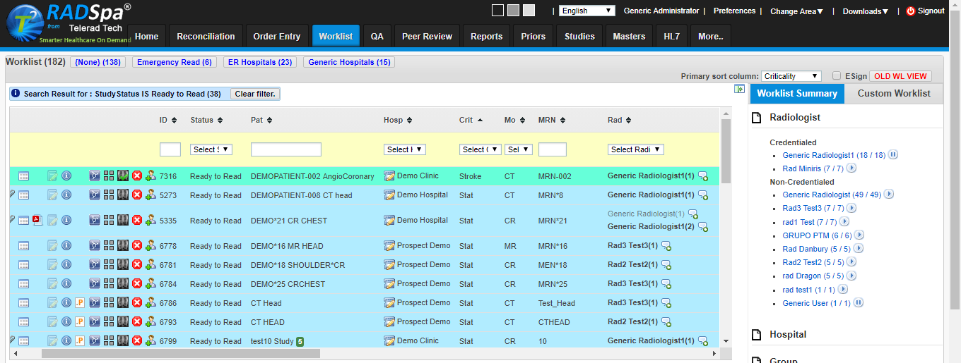
Auto- Assignment worklist summary to pause and resume auto-assignment

Slide 21
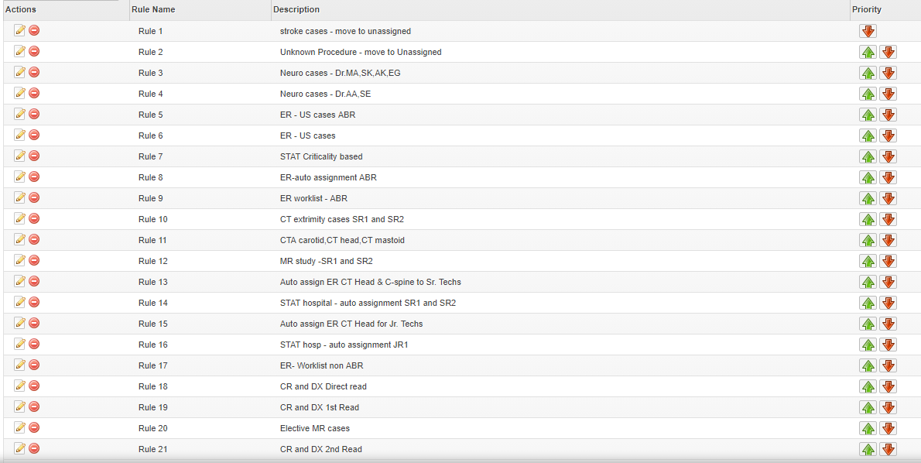
Custom Rule sets of the Auto-Assignment

Slide 22
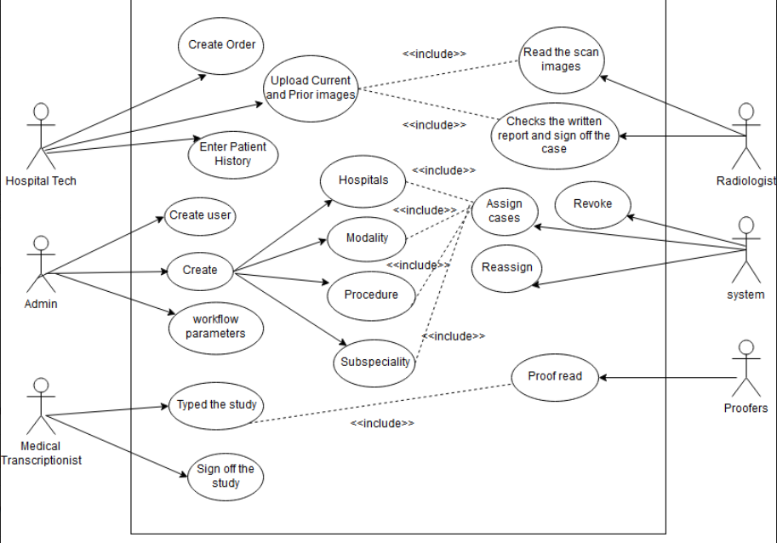
USE CASE DIAGRAM

Slide 23
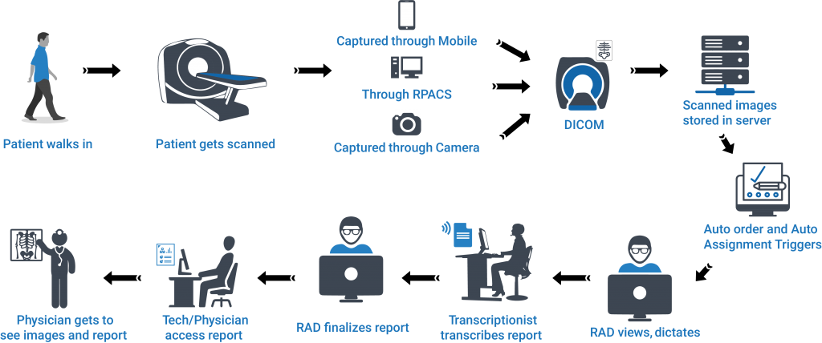
WORKFLOW OF THE PROCESS AFTER AUTOMATION

Slide 24
BEFORE AUTOMATION
ORDER CREATED | ORDER ASSIGNED | READ TO READ | READ COMPLETED | REPORT | GAP
10:33 pm | 10:36 pm | 10:36 pm | 11:28 pm | 11:28 pm | 3 Min
5:08 pm | 5:14 pm | 5:14 pm | 10:43 pm | 10:43 pm | 5 Min
2:45 pm | 3:00 pm | 3:18 pm | 10:17 pm | 10:17 Pm | 15 Min
7:40 Am | 8:04 am | 8:04 am | 10:14 PM | 10:14 pm | 25 Mins

Slide 25
AFTER AUTOMATION
ORDER CREATED | ORDER ASSIGNED | READ TO READ | READ COMPLETED | REPORT | GAP
7:09 PM | 7:09 PM | 8:17 PM | 9:22 PM | 9:22 PM | 1 Min
3:51 PM | 3:51 PM | 3:52 PM | 5:50 PM | 5:50 PM | 0 Min
3:47 PM | 3:47 PM | 3:47 PM | 4:00 PM | 4:00 PM | 0 Min
3:34 PM | 3:35 PM | 3:35 PM | 5:25 PM | 5:25 PM | 1 Min
7:20 PM | 7:20 PM | 7:20 PM | 8:00 PM | 8:00 PM | 2 Min

Slide 26
Why to opt for auto assign feature?
S.NO | SOLUTION CONSIDER | REMARKS | ACTION
1. | Increased the assigners | This will increase the cost of the manpower | NO
2. | Allow radiologist to pick cases by themselves | In this case the radiologist will pick easy studies or less critical studies | NO
3. | Set up software application for auto assignment | This will automatically assign the case to the radiologist according to the pre set rules | YES

Slide 27
FINDINGS
MONTH | AVERAGE NO. OF STUDIES | BEFORE AUTOMAMTION (TAT IN MINUTES) | AFTER AUTOMATION (TAT IN MINUTES)
Month 1 | 22335 | 45.21 | 32.21
Month 2 | 22477.5 | 44.3 | 30.3
Month 3 | 22411 | 43.12 | 29.59
Month 4 | 22001 | 43.3 | 29.3
Month 5 | 22212.5 | 44.5 | 28.4
Month 6 | 22728.5 | 44.25 | 29.1
Before automation of concierge workflow in ER reporting, the TAT was 44.28 min.
After the automation, the TAT in ER reporting reduces to 29.66 min

Slide 28
Satisfaction Level of the Respondents
Almost 80% of the respondents agreed that RADSpa’s Concierge Workflow automation helped them to reduce the TATs and increase productivity.
Statistical analysis of 6 months of logs before and after automation indicated 80% improvement in overall TAT for emergency cases.
Radiologist productivity per case improved by 82% as every case is auto-validated for images prior it is assigned.
Coordinators reported a massive 83% reduction in effort which used to go in manually eliminating errors, and there by more time in hand for handling greater workloads.

Slide 29
RECOMMENDATIONS
Radiologist should receive an alert about the assigned cases.
AI algorithms should be used for early detection of abnormalities.

Slide 30


