Slide 1

Corporate Office:
B-4/167, Basement,
Safdarjung Enclave, New Delhi-110029
Registered Office:
2/33, Third Floor,
Sarvapriya Vihar, New Delhi-17

Slide 2


THE JOURNEY
Every great journey starts with a single step. The same is true for
Octavo Solutions Pvt. Limited.
Started operations in April, 2007
Visioned, established and managed by Health & Hospital Management experts
Supported in its initiatives and efforts by experienced and reputed experts in field (like Architecture, Engineering, Public Health Experts, Bio-medical Engineering, Clinical Experts, Project Management, National and International Quality Gurus)
FIRST ORGANIZATION TO BE REGISTERED WITH NABET(QCI)
SE ASIA PARTNERS FOR
NABET
NATIONAL ACCREDITATION BOARD FOR EDUCATION & TRAINING (NABET)

Slide 3
QUALITY & ACCREDITATION – OUR VISION
OUR MISSION
GUIDING PRINCIPLES
OUR OBJECTIVES
To become the Leader in Healthcare Consulting in India by providing value for money, effective, efficient solutions and hands on support.
Customized Approach
Quality is a core value
Partnership in the journey to excellence
Trust and transparency
Timely, responsive, effective, efficient and value for money services
Endeavor to exceed expectations
Robust QMS and CQI programs
Service users delight
Sense of pride among stakeholders
Our goal is to help build institutions that delight the customers and where providers enjoy to work

Slide 4
OUR SERVICES
1. Project & Strategic Planning
Business Case Writing
Facility Plan Draft, Architect Briefs
Equipment Planning
Equipment Procurement
2. Quality Healthcare Certifications
Gap Analysis & Preparation for Accreditation
NABH Accreditation
ISO 9001:2008 Certification
ACHS International Certification
3. Public & Rural Health
We take up advisory/ consulting role on boards of NGO/ Government/ PSU/ Corporate for planning, implementing or monitoring of their projects
4. Knowledge Management
We collect, collate, analyze, store and share latest know how’s within domain of healthcare sector

Slide 5
KUKREJA HOSPITAL &
HEART CENTRE PVT. LTD
C-1, Vishal Enclave, Rajouri Garden, New Delhi -110 027

Slide 6


Slide 7
This 101 bed multispecialty services hospital in West Delhi.
The hospital caters to patients from all over Delhi and NCR area.
The Salient features of this Hospital is : specialized OPD with over 8 specialists and super specialists in various fields aided by a team of over 200 dedicated staff members.

Slide 8
Over the past 20 years, KHHC has become a well recognized referral centre for management of Heart Patients, while providing treatments for all types of cardiovascular diseases at affordable cost.

Slide 9
Vision statement
“We Care to Cure”

Slide 10
Mission Statement
“We commit to provide a service with a multi-disciplinary approach and valuable knowledge in medical care to patients of all ages in a relaxed, comfortable and clean environment.”

Slide 11
Gap analysisof front office, laboratory, imaging department of Kukreja Hospital as per NABH Norms.

Slide 12
Rationale of the study
As the above mentioned hospital is in the process of NABH accreditation.
A comparison of the present status of the hospital in terms of structure , processes with the laid down NABH Standards would immensely help the organization .

Slide 13
General Objective
To prepare Kukreja Hospital and Heart Centre , New Delhi for NABH accreditation ( in terms AAC)
Specific Objectives
To assess the existing service delivery status of the hospital.
To identify the gaps in AAC chapter of NABH as per NABH guidelines.
To give suggestions so as to meet the requirements

Slide 14
Scope of the study
This Gap analysis was carried out at Kukreja Hospital.
The focus was on Compliance to the standards of AAC chapter of NABH .
It was based on Observational analysis of the hospital.
To see what is the actual status of the hospital in terms of the standards
Limitations of the study
Not all chapters of NABH were assessed.

Slide 15
Data and Methods
Information regarding the organization, manpower, organizational hierarchy, and other details were collected from concerned Hospital authorities.
Various departments of the hospital were visited along with the coordinator of that respective department .
The observational findings and the information collected were compiled and a report is prepared
Study design – Descriptive study

Slide 16
Types of data collected:
1. Primary data
2. Secondary data
Data collection techniques:
For primary data –
Observation
Personal Interviews with concerned authorities
Departmental checklist
For secondary data –
Hospital manuals and records

Slide 17
Sample Size
In case of personal interview of staff
A list of all the staff is generated from the HR department & out of 200 staff members , every 10 th staff member is interviewed.
In case of interview of patients /staff
Every 5th patient/attendant was interviewed

Slide 18
Findings

Slide 19
Chapter 1 : Access, Assessment and continuity of care

Slide 20
Standard
AAC 1 : Services being provided by the hospital should be clearly defined , documented and displayed . And the staff is oriented to these services.
GAP
AAC 1 b : Services being provided by the hospital were not displayed .

Slide 21
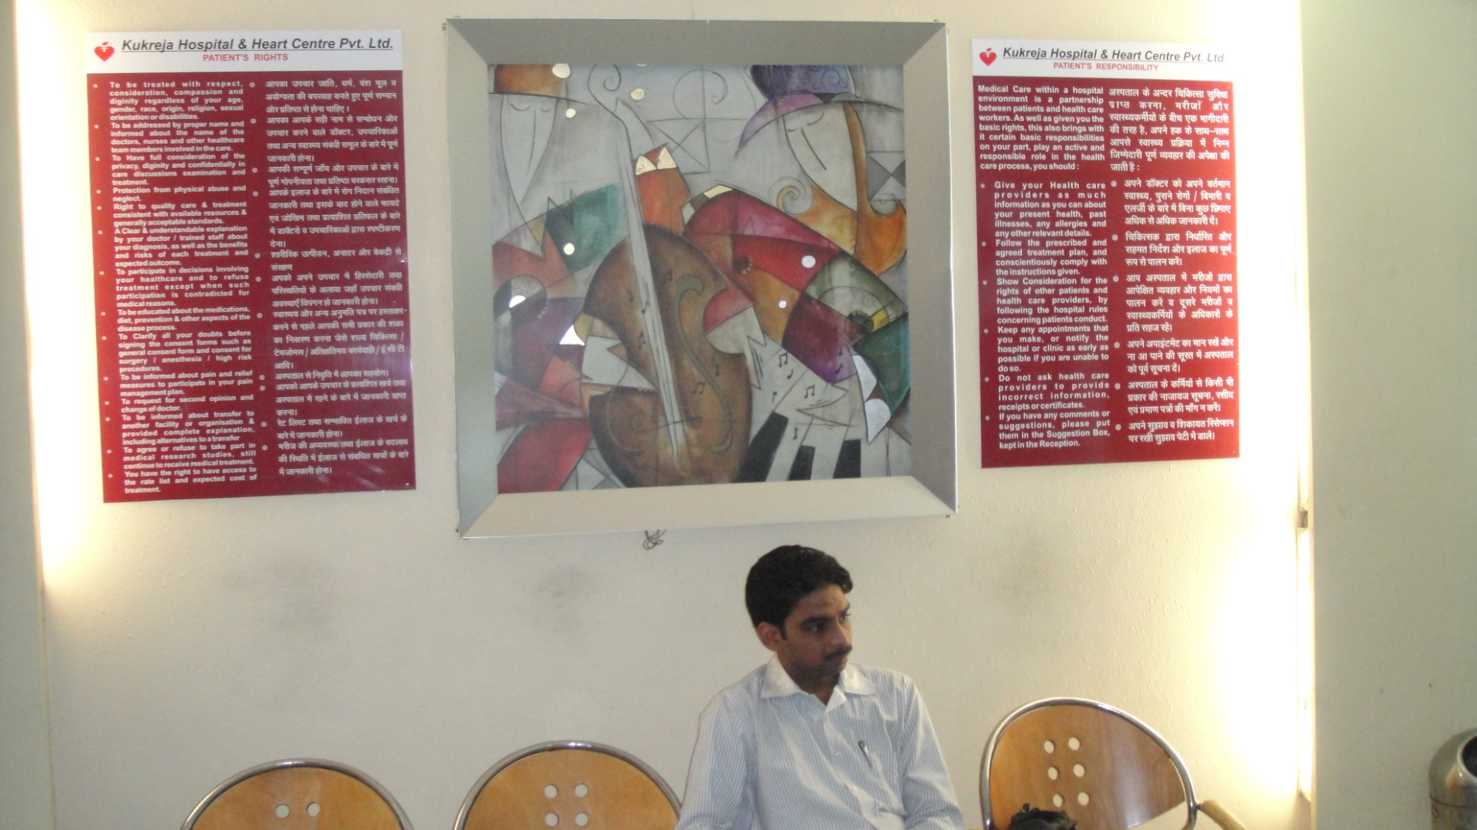
Recommendations/Action Taken
Arrangements were made to display the services provided by the hospital at the reception of the hospital.

Slide 22
AAC 2 :Standardized policies and procedure exist in the hospital for admission and registration of OPD,IPD & emergency patients. As well as in case of non availability of beds.
Patients are admitted only if hospital can provide the services. And the staff is aware of the services
GAP
AAC 2e: Staff was only partially aware of the services

Slide 23
Recommendations/Action taken
During the induction program staff member should be made aware of admission and discharge process .
Staff should be retrained on the same regularly and it should be included in the annual training calendar of the hospital.

Slide 24
AAC 4 c: The Patient and family members are explained about
Proposed care,
expected results,
possible complications
Expected cost
Gap : The patients were not explained about the possible complications of the treatment
Recommendations
The MS is recommended to address all the clinicians and nurses to make patient/relative explain about the possible complications.

Slide 25
AAC 7d:Laboratory results are available within a defined time frame.
Gap
Lab does not monitor turnaround time of test results in hematology , biochemistry and microbiology.
Recommended/ Action taken
The organization is recommended to monitor & define TAT for each test.

Slide 26
AAC 8e :The Laboratory quality assurance program includes the documentation of corrective & preventive actions.
Gap : There is no documentation for corrective and preventive measures in all sections of the lab.
Recommendation/Action:
The Laboratory staff is recommended to document the corrective and preventive measures in all sections of the lab.

Slide 27
AAC 10 a : The imaging services comply with legal and other requirement.
AAC 10 e : Imaging services are available within a defined time frame
Gap
AAC 10 a : HCO has applied for PCPNDT (renewal) certificate.
AAC 10 e :There is no monitoring of turnaround time for imaging results .
Suggestion /Action taken
The organization is recommended to monitor & define TAT for each test.

Slide 28
AAC 12 f : Imaging personnel are trained in Radiation safety measures
Gap
There is no documentation of training of imaging personnel in radiation safety measures.
Recommendation/ Action
There is an Radiation Safety Officer in the HCO who periodically trains all the imaging staff.
The organization is advised to keep the record of the training.

Slide 29
AAC 13 d :Information is exchanged and documented during each staff shift, between shifts and during transfers between units and departments
Gap
Transfer notes (handing over and taking over) among staff members during transferring of patients from wards to other procedural areas (Gen wards, Cath Lab & OT) was not there.

Slide 30
Recommendations /action taken
Staff members are retrained to fill patient transfer notes (handing over and taking over) among staff & properly documented and a transfer summary is maintained

Slide 31
AAC 15 e : The discharge summary incorporates instructions about when and how to obtain urgent care
Gap
Discharge Summary does not have how and when to obtain urgent care
Recommendation
A note is added in the discharge summary mentioning how and when to obtain urgent care

Slide 33
Discussion & Result
The study shows that there are some gaps in the hospital as per AAC Chapter of NABH.
As far as qualifying criteria is concerned the legal requirement of PC-PNDT Act is not met.
AAC 10 : has 2 zeroes..!!
But the average score of the chapter is 7.2 which is qualified.
Therefore hospital fulfills the required criteria only partially in terms of AAC.

Slide 34
Thank you

Slide 35
Chapter 2:
CARE OF PATIENT

Slide 36
Gap
COP 1d: Several care and treatment orders were not signed, named, dated and timed by concerned doctor.
COP 1e :The care plan was not countersigned by the clinician I/C within the defined time frame ( 24 hours )

Slide 37
Recommendation/Action taken
The treating consultants have been instructed to document the care plan with date, sign, name and time within the defined time frame.
The Medical Superintendant is advised to check the care plans periodically.

Slide 38
Gap
COP 3 f: In case of emergency patients, the patients transferred to another organization is not documented.
Recommendation/ Action taken
A column is added in the same emergency register for documenting the transferred patients

Slide 39
Gap
AAC 3e &3f : Equipment & medicines are not checked prior to dispatch of ambulance.
Recommendation / Action taken
Arrangements are made to load a new jump kit containing the emergency drugs into the ambulance every time before dispatch of the ambulance.
And also developed a checklist to check equipments on a daily basis.

Slide 40
Gap
COP 4c : Events during cardiac arrest are not being recorded.
COP 4b : Staff providing direct patient care is trained in CPR, but not updated periodically.

Slide 41
Recommendations/Action taken
CPR training is reinforced to all staffs.
A training schedule is recommended to be developed for Quarterly training of CPR of all the staff
All the events of are now being recorded through the ECG and the defibrillator recorder.

Slide 42
Gap
COP 5f: Blood transfusion reaction are being recorded but not analyzed for corrective and preventive actions.

Slide 43
Recommendations/Action taken
A blood transfusion committee is suggested to be formed and to note all the transfusion reactions.
All the transfusion reactions should be invariably tried to be ascertained & tested in the blood bank.
Then the results should be discussed in a meeting and corrective actions should be taken.

Slide 44
Gap
COP 8a : Scope of high risk OBG & GYN was not defined and displayed.

Slide 45
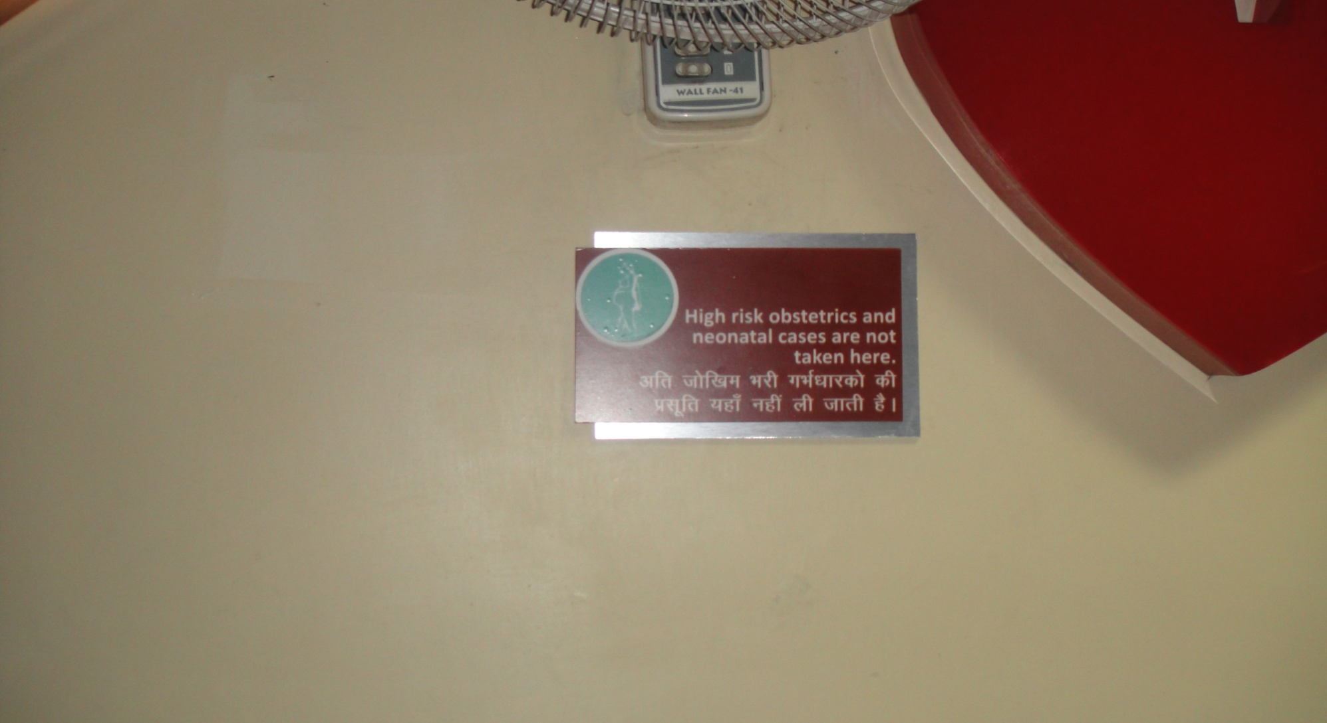
Recommendation & suggestion
The organization has now defined and displayed scope of high risk obstetrics patients.

Slide 46
Gap
COP 9 d : Provision for play area and breast feeding room was absent.
Suggestion/ recommendation
Recommendations for a play area and breastfeeding were made to the hospital authorities.

Slide 47
Gap
COP 11 g : The post anasthesia status are not monitored and documented by the anaesthetist.
COP11 h : The adverse anaesthesia events are also not recorded and monitored

Slide 48
Recommendations/Action taken
The organization is recommended to train the concerned staff on monitoring and documentation of post anesthesia status
As well as on adverse anesthesia events.

Slide 49
Gap
COP 17 a, c &f :The written orders for diet are not uniformly present in the patient’s case file. Patient food tray does not have patient identification, diet tag, etc.

Slide 50
Recommendations/Action taken
The dietician needs to be motivated to conduct the nutritional re -assessment for each patient daily and write the diet orders accordingly.
A system for patient identification through diet tags needs to be developed for the patient trays.

Slide 51
Chapter3:Management of medication

Slide 52
Gap
MOM 2a& 2d: Though the hospital formulary exists (2009) but the same has not been updated.
Process to obtain medicine which has not been mentioned in the formulary also not practiced.

Slide 53
Recommendations/Action taken
The organization is advised to update the hospital formulary.
A process to obtain the unlisted medicines in the formulary is suggested to be framed and same should be implemented.

Slide 54
Gap
Regular effective audit are not done to prevent loss or theft
Recommendation/ Action taken:

Slide 55
MOM 4d& f :The withholding or cancellation of an order is not clearly signed by the doctor Despite the availability of a list of high risk medications, staff awareness and implementation of the same was not evidenced.

Slide 56
Recommendation/Action taken
Doctors have been advised to write all the deletions and alterations and countersign the same by the clinician in-charge.
Staff is retrained about the high risk medications and the implementation of the same.

Slide 57
Gap
Proper records are not maintained for the usage, administration and disposal of these Narcotics & Psychotropic agents.
Recommendations/action taken
The hospital is recommended to maintain a register for the usage, administration and disposal of these agents.

Slide 58
Gap
MOM 12c :The batch and serial number of the orthopedic implants are not maintained as evidenced in the stores and OT.
Suggestions/Action taken
Recommended to maintain a register is maintained for recording the batch and serial number of the orthopedic implants being used.

Slide 59
Gap
MOM 13b & c : Fire safety measures were not appropriate at the liquid oxygen store area.
Suggestions/action taken
Fire extinguishers in adequate number have been placed around the liquid oxygen store and the staff has been informed about the same.

Slide 60
Patient Rights and education

Slide 61
Gap
PRE 2 f : The scope of general consent does includes that for blood transfusion and biopsies.
The consent forms are not printed on the hospital letter head.

Slide 62
Suggestion/Action taken
Recommendations to print the consent forms on the hospital letter head.
The component of risk involved should be incorporated in the informed consent.

Slide 63
PRE 4d : The possible complications and expected results are not explained in the consent form.
Suggestion/Action taken:
The component of possible complications should be incorporated in the consent form

Slide 64
Hospital infection control

Slide 65
Gap
HIC 5a & 5b: Hand wash facility was not available in the CCU and the sample collection facility.
Suggestion /action taken
Provision has been made for handwashing in the CCU and the sample collection facility.

