Slide 1

A study to analyze the factors that are affecting the loss of follow up of TB Patients in a multispecialty hospital in Gurugram.
At
Artemis Hospital, Gurugram
Name - Dr. Sakshi Aggarwal
Faculty Mentor – Dr. Nidhi Yadav
IIHMR Delhi

Slide 2
Mentor Approval

Slide 3
Introduction
Tuberculosis (TB) remains a significant global health challenge, with millions of new cases reported annually. One critical aspect of TB management is ensuring patient adherence to treatment, including follow-up appointments and medication regimens.
However, loss to follow-up—where patients fail to attend their first scheduled follow-up visit after initiating treatment—poses a significant barrier to successful TB control programs.

Slide 4
Objectives
This dissertation aims to investigate the factors contributing to loss of follow-up among TB patients and improve patient adherence to TB treatment.
To propose effective strategies to address this issue in a multispecialty hospital in Gurugram.

Slide 5
Methodology
Study Design: Cross-Sectional Study
Study Area: A Multispecialty Hospital in Gurugram
Data Collection: Patient Records and Interviews
Sampling Technique: Systematic Sampling

Slide 6
Methodology
Sample size: 43 Patients
Inclusion Criteria: All IPD and OPD Patients
Exclusion Criteria: Patients coming for regular follow up

Slide 7
Methodology
Data Collection Tool:
S.no. | GNID | Date of TB Diagnosis | Follow up (Y/N) | Factors affecting follow up

Slide 8
Results
S.No. | Factors affecting follow up in TB Patients | No. of cases
1. | Acceptance | 09
2. | Financial | 07
3. | Location | 10
4. | Age | 05
5. | Medications | 07
6. | Others (Death, Not willing to answer) | 05
 | Total | 43

Slide 9
Results

Slide 10
Results

Slide 11
Discussion
From the results shown, Factors affecting TB followup:
Location: Patients who were from different cities were recommended to visit either the branches of our hospital or to any other healthcare facility.
Age, Acceptance: Patients were counselled that TB is not age specific disease and it can happen to anyone.

Slide 12
Discussion
Financial: Patients having financial constraints were told to visit government healthcare facilities.
Medications: Patients who developed some kind of side effects were checked for intolerance of ATT drug regime and switched to Modified ATT.

Slide 13
Conclusion
This dissertation analyzed factors to loss of follow up of TB Patients.
Major factors include: Location constraints, financial constraints, acceptance issue and age factors and some patients discontinued medicines due to side effects.

Slide 14
References
Mwansa-Kambafwile JRM, Jewett S, Chasela C, Ismail N, Menezes C. Initial loss to follow up of tuberculosis patients in South Africa: perspectives of program managers. BMC Public Health. 2020 May 6;20(1):622. doi: 10.1186/s12889-020-08739-w. PMID: 32375743; PMCID: PMC7201771.
Nissen TN, Rose MV, Kimaro G, Bygbjerg IC, Mfinanga SG, et al. (2012) Challenges of Loss to Follow-up in Tuberculosis Research. PLoS ONE 7(7): e40183. doi: 10.1371/journal.pone.0040183.
Soedarsono S, Mertaniasih NM, Kusmiati T, Permatasari A, Juliasih NN, Hadi C, Alfian IN. Determinant factors for loss to follow-up in drug-resistant tuberculosis patients: the importance of psycho-social and economic aspects. BMC Pulm Med. 2021 Nov 10;21(1):360. doi: 10.1186/s12890-021-01735-9. PMID: 34758794; PMCID: PMC8579625.

Slide 15
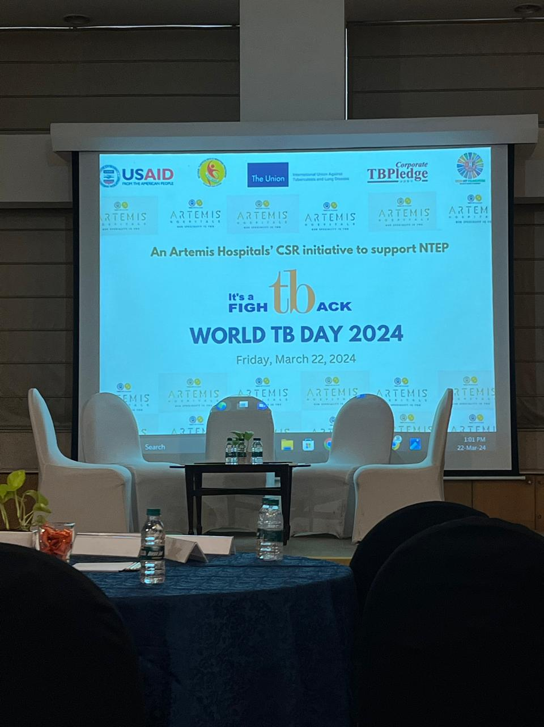
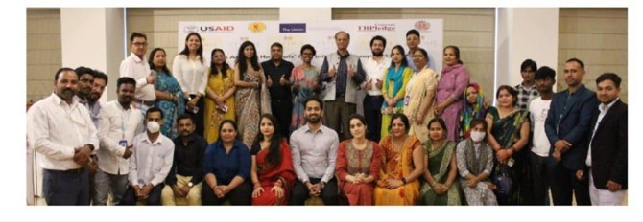
Pictorial Journey

Slide 16
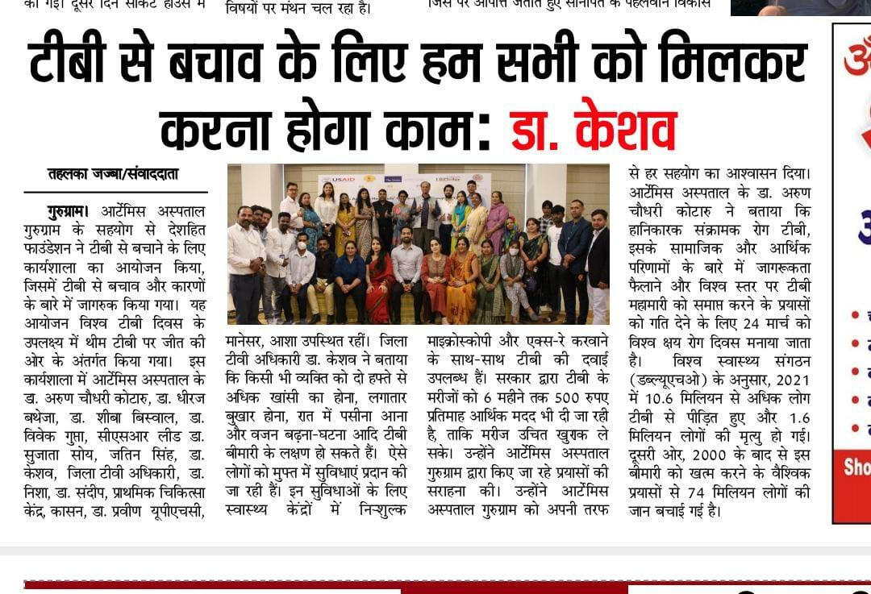
Pictorial Journey

Slide 17
Thank You
Any Questions

