Slide 1

Predicting development of Acute Kidney Injury (AKI) during Inpatient Admission
IIHMR
Akanksha Kumari (PG/23/007)
Dr Nishikant Bele
IIHMR Delhi

Slide 2
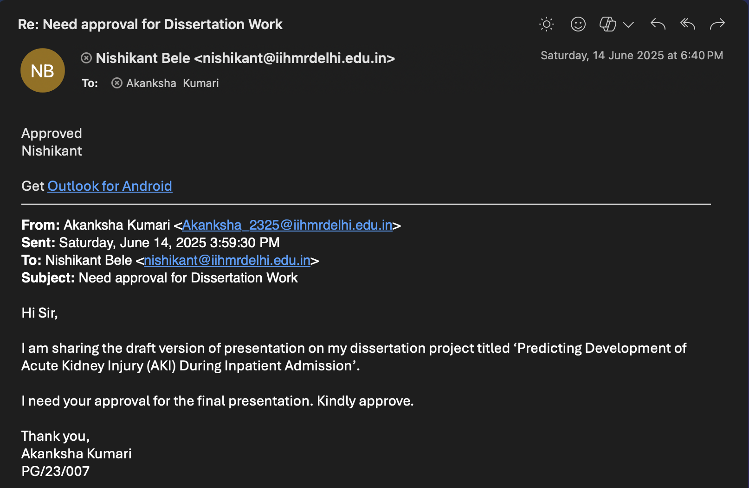
Mentor Approval

Slide 3
Introduction
Acute Kidney Injury (AKI) is a sudden and rapid decline in kidney function over hours to days, resulting in the inability of the kidneys to filter waste products, balance fluids, and maintain electrolyte levels effectively. It is not a disease itself but a clinical syndrome that occurs due to various underlying conditions.
Key Characteristics:
Rapid onset of renal dysfunction
Elevated serum creatinine or decreased urine output
Can occur in hospitalized and critically ill patients
Often reversible if diagnosed and treated promptly

Slide 4
Introduction
Diagnosis:
AKI is primarily diagnosed using:
  Serum creatinine levels (increase ≥0.3 mg/dL within 48 hours or ≥1.5× baseline)
  Urine output (<0.5 mL/kg/hr for more than 6 hours)
  KDIGO Criteria (Kidney Disease Improving Global Outcomes)
Clinical Significance:
Increases hospital stay, morbidity, and mortality
May lead to chronic kidney disease (CKD) or end-stage renal disease (ESRD) if untreated
Early detection and risk prediction models are critical for improving outcomes

Slide 5
Literature Review
1. Introduction to AKI and its Clinical Impact
Acute Kidney Injury (AKI) is a sudden decline in renal function, commonly observed in critically ill hospitalized patients. It affects approximately 10–20% of hospitalized individuals, with significantly higher incidence in intensive care settings. AKI is associated with increased mortality, longer hospital stays, and higher healthcare costs. Early identification is critical to initiate preventive or therapeutic measures, yet AKI often goes undetected until significant damage occurs.
  Kellum JA, Lameire N. Diagnosis, evaluation, and management of acute kidney injury: a KDIGO summary. Crit Care. 2013.
  Hoste EA et al. Epidemiology of AKI in critically ill patients. Kidney Int. 2015.
Traditional detection methods rely on thresholds of serum creatinine or urine output, which are delayed indicators. This has led to increasing interest in the application of machine learning (ML) and deep learning (DL) to identify subtle patterns in clinical data for early AKI prediction.
2. Use of Electronic Health Records and Synthetic Data
The adoption of Electronic Health Records (EHRs) has enabled the large-scale analysis of patient data for predictive modeling. Notably, the MIMIC-III dataset has served as a foundational source in many AKI-related studies. To preserve privacy and allow experimentation, researchers have also turned to synthetic data generation tools like Synthea, which simulate realistic patient trajectories.
Studies such as Goncalves et al. (2020) demonstrated that synthetic datasets, when well-structured, can serve as effective stand-ins for model development.

Slide 6
Literature Review
3. Support Vector Machine (SVM) in AKI Prediction
Support Vector Machines are classical ML models that perform well on structured, tabular data. SVMs are particularly effective in binary classification and are robust to small and medium-sized datasets.
  Robu R (2019) provided an accessible introduction to SVMs and emphasized their effectiveness in high-dimensional medical datasets.
  Tomasev et al. (Nature, 2019) applied various ML models (including SVM) on EHR data and achieved early AKI detection in ICU patients.
  In AKI studies, SVMs have shown decent performance when trained on flattened clinical features, such as lab values and vitals aggregated over time (e.g., via mean or max).
4. LSTM for Temporal Pattern Recognition in Clinical Data
Long Short-Term Memory (LSTM) networks are a class of Recurrent Neural Networks (RNNs) designed to learn long-range dependencies in sequential data. In healthcare, LSTMs have been widely used for time-series modeling of EHR data.
  Huang et al. (2020) applied LSTMs on ICU datasets and reported significant improvement in early detection of AKI, especially when vital signs and labs were recorded at high temporal resolution.
  Olah (2015) provided an intuitive explanation of how LSTMs maintain memory across time steps, making them ideal for monitoring progressive physiological changes.
LSTMs excel in situations where multi-variable trends over time contribute to outcomes like AKI. They are especially useful for continuous monitoring systems that generate real-time risk scores.

Slide 7
Objectives
To design and implement a machine learning model that accurately predicts the risk of Acute Kidney Injury (AKI) in patients during their hospital stay.
The model aims to support early detection, allowing clinicians to initiate timely interventions and improve patient outcomes through proactive management.

Slide 8
Methodology
Study Type: Retrospective study using synthetic data (500 patients)
Sampling: Vitals and labs every 12 hrs over 3 days (6 time steps)
Features: 5 per step (e.g., BP, WBC, Creatinine, Temp, HR)
Label: 1 = AKI in next 12 hrs, 0 = No AKI
Data Features: For the purpose of model demonstration, a synthetic patient dataset was created based on vital signs and lab parameters inspired by MIMIC-III structure and simulated using Synthea logic. This approach enables safe testing without compromising patient confidentiality.
Preprocessing
Handled missing values (forward fill/median)
Normalized data (Z-score)
SVM: flattened data (6×5 = 30 features)
LSTM: used full sequential time-series format
Models
SVM: Simple, fast, uses flattened input
LSTM: Captures patterns over time, better for sequences
Evaluation
80% training, 20% testing
Metrics used: Accuracy, Precision, Recall, F1 Score

Slide 9
Methodology
LSTM Model:
  Prepare Time-Series Data
  Build the LSTM Model (with Keras/TensorFlow)
  Train the Model
  Evaluate the Model
  Strengths:
    AKI develops gradually; LSTM captures trends
    LSTM can handle patients with more/less data points
    Multiple vital signs and labs can be used together
    An LSTM model can continuously monitor a patient’s condition.
    If risk score > threshold (e.g., 0.7), raise an early warning alert to doctors.
    Helps prevent AKI rather than just diagnose it.
Notes:
LSTM is a type of Recurrent Neural Network (RNN) that is very good at learning patterns over time—for example, how a patient’s blood pressure and creatinine levels change every 12 hours.
It is useful when temporal relationships between values matter, which is common in clinical scenarios.

Slide 10
Methodology
SVM Model:
  Data Preparation
    Collect features: Lab values (e.g., creatinine, WBC), vital signs, demographic info.
    Labelling: Assign binary labels—1 for AKI onset within the next 12 hours, 0 otherwise.
    Handle missing data: Use imputation methods (mean, median, forward fill).
  Feature Selection - Remove highly correlated features.
  Splitting the data - Divide into training (e.g., 70%), validation (15%), and testing sets (15%).
  Model Training
  Prediction and evaluation - Evaluate performance using Accuracy, Precision, Recall, and F1-score.
  Model Tuning
  Strengths:
    Effective in High-Dimensional Data.
    Works Well with Small and Medium Datasets.
    Fast Training and Inference.
    Robust to Outliers (with Regularization).
Notes:
SVM is a classification algorithm that finds the best boundary (hyperplane) that separates data points into different classes (e.g., AKI vs non-AKI). It works well in high-dimensional spaces, especially when the number of features is more than the number of samples.

Slide 11
Results
Metric | SVM | LSTM
Accuracy | 0.78 | 0.82
Precision | 0.76 | 0.80
Recall | 0.75 | 0.83
F1 Score | 0.75 | 0.81

Slide 12
Results
Confusion Matrix
  SVM:
LSTM:
 | Predicted No AKI | Predicted AKI
Actual No AKI | 40 | 10
Actual AKI | 12 | 38
 | Predicted No AKI | Predicted AKI
Actual No AKI | 42 | 8
Actual AKI | 7 | 43

Slide 13
Results
If we notice, the confusion matrix only includes about 100 patients, while the total dataset consists of 500 patients.
This is because the dataset was split into:
- 80% for training (400 patients)
- 20% for testing (100 patients)
The confusion matrix shows results only for the test set.
It helps understand how well the model generalizes before applying it in real settings.

Slide 14
Discussion
1. Accuracy
LSTM (82%) > SVM (78%)
This suggests that LSTM is slightly better at correctly predicting both AKI and non-AKI cases.
LSTM’s memory units help it learn time-based changes in vitals/labs that are missed by SVM.
2. Precision
Precision reflects how many predicted AKI cases were actually AKI.
SVM = 76%, LSTM = 80%
Both models avoid too many false alarms, but LSTM is slightly better. This matters clinically to avoid unnecessary interventions.

Slide 15
Discussion
3. Recall (Sensitivity)
This is critical in healthcare—it tells how many true AKI cases were correctly identified.
LSTM = 83% > SVM = 75%
LSTM performs better at catching patients before they deteriorate, making it ideal for early warning systems.
4. F1 Score
A balance between precision and recall.
LSTM = 81% > SVM = 75%
LSTM handles the trade-off better, especially under class imbalance (if AKI is rare).

Slide 16
Conclusion
Both SVM and LSTM are viable models for predicting AKI from clinical data.
SVM is faster and simpler, and can be effective when time-series data is limited or when a quick prototype is needed.
LSTM outperforms SVM in most metrics because of its ability to learn from sequential patterns, making it a better choice for continuous monitoring in hospitals.
Implementing an LSTM-based early warning system could significantly reduce AKI-related complications by enabling timely intervention.

Slide 17
References (Only Vancouver Style)
Johnson AEW, Pollard TJ, Shen L, et al.
MIMIC-III, a freely accessible critical care database.
Sci Data. 2016;3:160035.
DOI: 10.1038/sdata.2016.35
Goncalves A, Ray P, Soper B, Stevens J, Coyle L, Sales AP.
Generation and evaluation of synthetic patient data.
NPJ Digit Med. 2020;3:23.
DOI: 10.1038/s41746-020-0223-y
Huang C, Clayton S, Mathew J, et al.
Predicting acute kidney injury in critical care using recurrent neural networks.
Int J Med Inform. 2020;141:104231.
DOI: 10.1016/j.ijmedinf.2020.104231
Robu R.
Support Vector Machines (SVM) - Introduction and Applications.
Medium. 2019.
Available from: https://medium.com/@RobuRishabh/support-vector-machines-svm-27cd45b74fbb
Olah C.
Understanding LSTM Networks.
Colah’s Blog. 2015.
Available from: http://colah.github.io/posts/2015-08-Understanding-LSTMs/

Slide 18
KEY LEARNING FROM COP ACTIVITIES
Infrastructure
  Good Infrastructure
  Services include Maternal and Child Health Services, Laboratory Services, Adolescent Health Services, Senior Citizen Care.
Human Resources
  Very few staffs available
  No of doctors: 3
Patient Attendance - Moderate
Diagnostics Availability - Laboratory Services Available

Slide 19
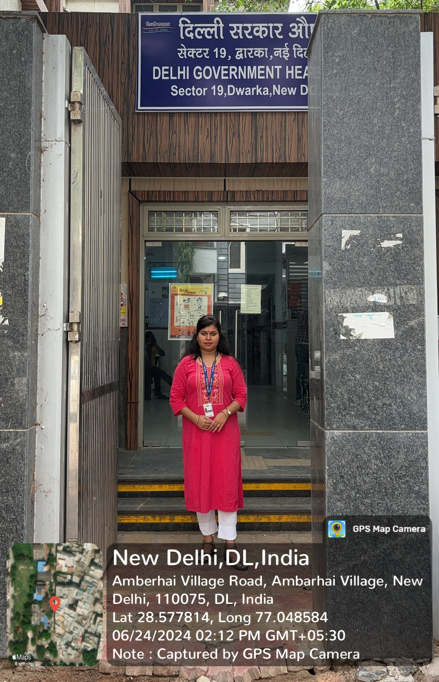
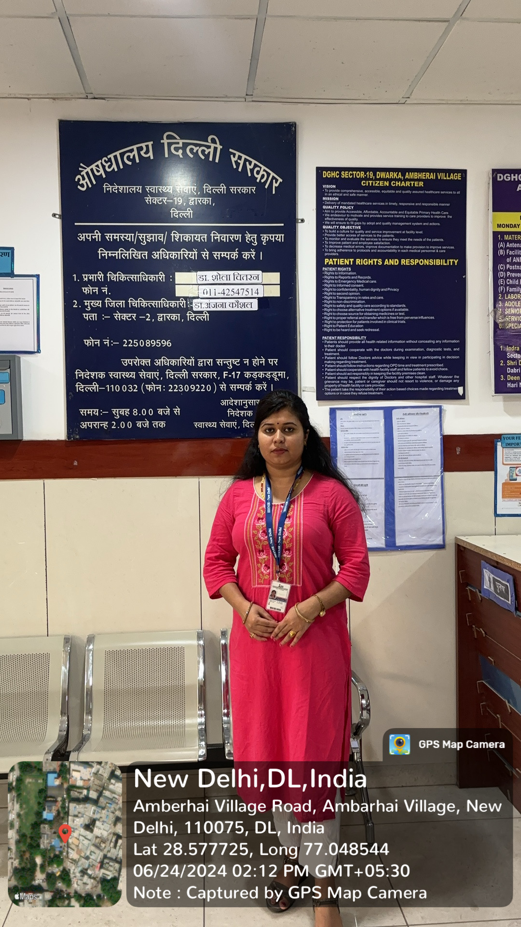
COP FIELD ACTIVITIES PHOTOGRAPHS

Slide 20
Thank You
Any Questions

