Slide 1
Assessment of Effectiveness of Online Training Programs of Adolescent Health Counsellors in 6 States in India.
Mentored by,
Dr. Sumesh Kumar
Associate Professor IIHMR Delhi
Mr. Abhishek Tupe
Project Manager
IQVIA
Submitted by
Dr. Arpita Dhawan
Roll no- Pg/19/016

Slide 2
Introduction
The World Health Organization (WHO) defines adolescents as individuals ageing between 10 and 19 years
Out of the 7.2 billion people worldwide, there are approximately 1.2 billion adolescents.
Adolescence is a unique and overwhelming stage of human development.
Adolescent Health (AH) counsellors under Rashtriya Kishor Swasthya Karyakram (RKSK) are the front-line staff for adolescents in rural and tier 2 & 3 cities working at AFHCs (Adolescent Friendly Health Services).
These counsellors are critical in addressing the needs and challenges of adolescents as they educate and provide counselling services to the adolescents and refer to health facilities in case of requirements

Slide 3
The key objectives of the training program are detailed as follows
To develop comprehensive training package national adolescent health counselors with MoHFW and WHO.
To work with MoHFW and identify presenters and calendar with a list of participants from selected states as identified by MoHFW and ensure optimum participation.
To train and build capacities of Adolescent Health Counsellors from chosen states to provide holistic adolescent-friendly services through e-learning sessions.

Slide 4
Relevance of the study
The importance of training has been emphasized always but its effect must also be assessed properly. So, one of the most critical parts of implementing training programs is accurately assessing their impact.
Approximately 1600 adolescent health counsellors are registered with MoHFW across the country which need to be trained in a phase wise manner.
If this model is proved successful in imparting knowledge and skills to counsellors, it can be scaled up to reach 1600 counsellors and representatives across country and can be adopted for other programs as well.
Rationale- this study is conducted to evaluate effectiveness of online training program, where efficiency is measured in terms of increase in knowledge and skill of the counsellors
Objective of the study
To evaluate the effectiveness of online training Program for Adolescent health counsellors.
To assess success of the online training program in terms of how many people have attended the session and completed successfully.

Slide 5
Methodology
This study is quasi experimental study. It used a pre and posttest design consisting of pre-session survey and post session survey.
Study population | 510 adolescent health counsellors and 31 adolescent health representatives from 6 states (113 districts) in India. The targeted states included Andhra Pradesh, Assam, Kerala, Maharashtra, Tamil Nadu and Telangana.
Data collection | A questionnaire was completed by participant 3 days before training start and 3days after training ends. The questionnaire contains overall 25 questions divided into 2 sections based on study objectives. It contains -12 General question which consisted of socio demographic details for pre session and 11 question in post session consisting of feedbacks and challenges faced detail and 13 Content specific question to assess knowledge of participants. Content specific question are same for both session.
Session implementation /Time period | A total of 48 online sessions were conducted between 5th April to 14th May 2021 in addition to the inaugural and 6 nontechnical sessions. 16 hours of training sessions for each state.

Slide 6
Methodology Cont..
This study is quasi experimental study. . It used a pre and posttest design consisting of pre-session survey and post session survey.
Assessing Training Activities | Shared questionnaire link with the counsellors via emails/WhatsApp Followed up with absentees
Analysis | Data cleaning done Collated and analyzed attendance records and pre-post surveys to examine the participation rate, and feedback
Total Participants
510
Pre session survey filled by
522
After Removing duplicates and others
416
Post Session Survey filled by
432
After Removing duplicates and others
386
After mapping for participants who has filled both survey
362
After mapping for participants who has filled both survey
362

Slide 7
Results
We evaluated three indicators to assess the outcomes of the session quantitatively. These indicators were participation rate, survey competition rate and knowledge acquisition rate.
Participation rate: The participation rates were calculated using attendance records.
State | Nominated counsellors | Overall attendance (>= 1 sessions) | Mental Health | Substance Abuse | SRH | Injuries & Violence including GBV | NCDs | Nutrition and lifestyle | Social Media | Overview of RKSK program, App, and dashboard
Andhra Pradesh | 76 | 60 | 24 (40)* | 25 (41.7) | 27 (45) | 37 (61.7) | 53 (88.3) | 43 (71.2) | 47 (78.3) | 47 (78.3)
Assam | 64 | 64 | 61 (95.3) | 61 (95.3) | 61 (95.3) | 61 (95.3) | 63 (98.4) | 59 (84.3) | 59 (92.2) | 62 (96.9)
Kerala | 71 | 51 | 48 (94.1) | 48 (94.1) | 47 (92.1) | 46 (90.2) | 49 (96.0) | 46 (90.2) | 44 (86.3) | 44 (86.3)
Maharashtra | 131 | 126 | 99 (76.7) | 88 (69.8) | 90 (71.4) | 79 (62.6) | 90 (71.4) | 77 (61.1) | 92 (73.0) | 92 (73.0)
Tamil Nadu | 148 | 117 | 77 (65.8) | 78 (66.7) | 77 (65.8) | 108 (92.3) | 83 (70.9) | 98 (83.8) | 78 (66.7) | 101 (86.3)
Telangana | 20 | 19 | 15 (78.94) | 17 (89.5) | 17 (89.5) | 16 (84.2) | 17 (89.5) | 17 (89.5) | 17 (89.5) | 17 (89.5)
Total | 510 | 437 | 324(74.1) | 317 (72.5) | 319 (73.0) | 347 (79.4) | 355(81.2) | 340 (77.8) | 337 (77.1) | 363 (83.0)
*No in bracket () are percentage of attendance calculated

Slide 8
One of my objective is to measure how many people have successfully attended and completed training which is measured by Participation and survey response rate
Survey response rate- From pre-session to post-session surveys, the respondents' percentage decreased for every state except Andhra Pradesh and Assam. 100 % responses were received from Telangana for both the surveys.
State | Nominated counsellors | Pre-session completion n (%) | Post-session completion n (%) | Both survey completion rate n
Andhra Pradesh | 60 | 58 (96.7) | 60 (78.9) | 51
Assam | 64 | 62 (96.9) | 64 (100) | 62
Kerala | 71 | 55 (77.5) | 54 (76.1) | 52
Maharashtra | 131 | 105 (80.2) | 94 (71.8) | 83
Tamil Nadu | 148 | 116 (78.4) | 94 (63.5) | 94
Telangana | 20 | 20 (100) | 20 (100) | 20
Total | 510 | 416 (81.6) | 386 (75.7) | 362 (71)

Slide 9
The primary goal of this study is to assess effectiveness of online training. This is achieved by calculating knowledge acquired by participants from this training and calculated with score obtained by participants through content specific questions
Knowledge Acquisition- Overall average score increased from 73.8% in pre-session survey to 80.7% in post session survey. Also, an increase in average score was observed for all states individually maximum being in Tamil Nadu (11.5%) followed by Kerala (10.4%).
State | Pre-session survey score (%) | Post-session survey score (%)
Andhra Pradesh | 77.4 | 80.0
Assam | 84.8 | 91.1
Kerala | 81.1 | 91.5
Maharashtra | 67.8 | 71.5
Tamil Nadu | 63.3 | 74.8
Telangana | 68.5 | 75.6

Slide 10
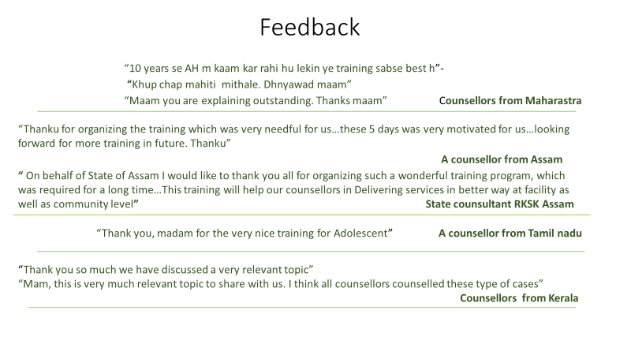
Feedback and Challenges
Positive and negative feedbacks were collected from participants to know the challenges faced by them during training.

Slide 11
Conclusion
The online training provided direction to adolescent health counsellors and representatives and contributed successfully to knowledge dissemination amidst COVID-19 second wave. With no face-to-face instruction, online training provided a safe and effective alternative to in-person training.
An average participation rate of 77.3% was observed
Through online sessions, the skills and knowledge of the counsellors and representatives were upgraded quickly and effectively. Also, they were encouraged to build resilience, thrive, and adapt under the new realities.
Despite a few limitations, the online sessions have proven to be a good model with lesser resource mobilization. Moving forward, this intervention may be scaled up to reach out to ~1600 registered counsellors and representatives across the country and can be adopted or simulated for other health program as well.
Notes:
Limitations of the study- Due to Lockdown imposed bcuz of 2nd wave of COVID survey was done online, which has some of its own restrictions.
Sample was already given by ministry.
very less studies available to assess effectiveness of training program, if we have similar studies done for offline training we could compare difference in effectiveness of online and offline training given

Slide 12
Program Outcome
1- Slight (low) 2- Moderate (medium) 3- Substantial (High)
Internalize the concepts of management such as healthcare delivery system, strategic planning, HR, marketing, Financeand operations | Apply knowledge of research and management techniques and functions in an integrated mannaer in healthcare setup | Use appropriate skills to support healthcare organizations to take informed decision in planning, building and managing healthcare organizations | Utilize learning acquired from trainings and practical exposure in real time situations.
2 | 3 | 3 | 3

Slide 13
THANK YOU

