Slide 1
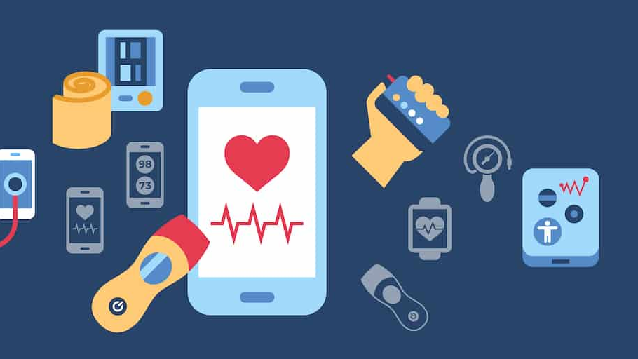




Digital Overdose? Evaluating User Adoption, Perceived Burden, and Effectiveness of Proliferating Health Apps and Websites in India
By:- Dr. Shefali Gupta
PG/23/107

Slide 2



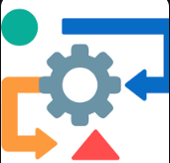




Content
Background
Research Question
Objective
Methodology
Results
Discussion
Conclusion
Reference

Slide 3
Background
India has witnessed a rapid rise in digital health platforms in recent years, largely driven by the COVID-19 pandemic. Government initiatives like Ayushman Bharat Digital Mission (ABDM) and eSanjeevani, along with numerous private apps, aimed to modernize healthcare, improve access, and reduce strain on physical infrastructure. These platforms allow users to book appointments, access lab reports, store electronic health records, and consult doctors remotely. However, this surge has led to a fragmented and overcrowded digital health ecosystem, with many overlapping apps causing user confusion, excessive notifications, and poor interoperability—resulting in what is now referred to as “digital overdose.”
Research Question
Objective
Methodology
Expected Outcomes
Questionnaire

Slide 4
Background
Emerging evidence points to growing user fatigue and dissatisfaction. Studies from different regions of India report low awareness, lack of trust in data security, and usability challenges, particularly among older adults and youth. Despite their potential, these tools are often underutilized or misunderstood.
This study aims to evaluate user adoption, perceived burden, and the effectiveness of health apps and websites in India. By understanding user experiences, both positive and negative, it seeks to inform the design of more integrated, user-friendly digital health solutions. Ultimately, the goal is to ensure that digital health remains a tool for empowerment, not a source of stress, in India’s evolving healthcare system.
Research Question
Objective
Methodology
Expected Outcomes
Questionnaire

Slide 5
Background
Research Question
What is the relationship between the multiplicity of digital health platforms in India and users' perceived cognitive/operational burden ('app fatigue'), and how do usability, usefulness, and demographic factors (age, digital literacy, socioeconomic status) moderate this relationship?
Objective
To evaluate users’ perceptions of digital health platforms by assessing the cognitive and operational burden ('app fatigue') caused by their multiplicity, alongside the perceived usefulness, usability, and overall satisfaction with these services.
To analyze the correlation between demographic/digital literacy factors (e.g., age, education, economic status, tech-familiarity) and user burden, adoption, or satisfaction.
Methodology
Expected Outcomes
Questionnaire

Slide 6
What is the relationship between the multiplicity of digital health platforms in India and users' perceived cognitive/operational burden ('app fatigue'), and how do usability, usefulness, and demographic factors (age, digital literacy, socioeconomic status) moderate this relationship?
Research Question
Objective
The broad objective of the study is:
To evaluate how the increasing number of health apps and websites in India affects user adoption, experience, and overall digital burden.
Specific objectives of the study are as follow:
To assess the relationship between the multiplicity of digital health platforms and users’ perceived burden or “app fatigue.”
To examine how usability, usefulness, and demographic factors (such as age, digital literacy, and socioeconomic status) influence user adoption and sustained engagement with health apps.
Methodology

Slide 7
Objective
Methodology
Data:
The study will utilize the data for primary survey using self-administered research tools.
Tool: Digital questionnaire (Microsoft Forms, 25–30 questions).
  Variables:
    Demographics: Age, gender, income, education, location.
    Digital engagement: Smartphone/internet access, self-reported literacy.
Outcomes: Usage frequency, satisfaction, fatigue, drop-off rates
Methods
Study Design
Type: Cross-sectional, mixed-methods (quantitative primary insights).
Approach:
Quantitative: Structured questionnaire (Likert scales, multiple-choice).

Slide 8
Objective
Methodology
Methods:
Population & Sampling
Target Population: Adults (≥18 years) in India who used ≥1 digital health platform (app/website/chatbot) in the last 12 months.
Sampling:
  Primary: NCR (Delhi, Gurugram, Noida, Ghaziabad, Faridabad).
  Supplementary: Urban/semi-urban areas (Jaipur, Mumbai, Chandigarh, Alwar).
  Technique: Stratified (socioeconomic/age/digital literacy) + Snowball (via WhatsApp/Telegram/social media) + Quota (gender/age balance).
  Sample Size: 100–250 respondents (convenience).

Slide 9
Methodology
Inclusion Criteria:
Used ≥1 digital health platform (teleconsultation, e-pharmacy, EHR, appointment booking, lifestyle tracking) in past 12 months.
Resides in target geographical areas (NCR + supplementary cities).
Willing to provide digital consent.
Exclusion Criteria:
Never used any digital health platform.
Under 18 years old.
Incomplete/inconsistent survey responses.
Results

Slide 10
Methodology
Results
Chapter 1: Demography
No. of Respondents
Agree | 146
Don't Agree | 5
Total | 151
Questionnaire

Slide 11
Methodology
Results
Chapter 2 : Digital Health App Usage Patterns
Questionnaire

Slide 12
Methodology
Results
Chapter 3 : Digital Health Platform Experiences
Questionnaire

Slide 13
Methodology
Results
Questionnaire

Slide 14
Methodology
Results
Chapter 4 : App Fatigue and Digital Burden
Questionnaire

Slide 15

Methodology
Results
Chapter 5 : Perceived Usefulness and Satisfaction
5.74
On a scale of 1-10, how would you rate the overall usefulness of health apps/websites in managing your health
Discussion

Slide 16
Results
Methodology
Discussion
I) Adoption and Fatigue in Digital Health Use
The study reveals that digital health apps and websites have seen widespread adoption, particularly in urban and semi-urban India. Most users reported having at least one health app on their devices, with fitness trackers, e-pharmacy services, and hospital apps being the most commonly used. Despite this reach, daily or consistent use remains low, with the majority interacting with these platforms only occasionally. This pattern points to a gap between initial curiosity and sustained utility.
One of the most striking insights was the extent of app abandonment, over three-fourths of users had uninstalled or stopped using at least one health app, often citing that the apps failed to meet their needs, asked for too much personal information, or simply became annoying due to excessive notifications. These findings reflect a growing sense of digital fatigue, where more options are not necessarily translating into better outcomes or continued engagement.

Slide 17
Results
Methodology
Discussion
II) Stress, Preferences, and Accessibility Challenges
The experience of using multiple health platforms is not just tiring, but it is stressful for a significant proportion of users. Many respondents described feeling overwhelmed and even needing breaks from app use, which signals that these platforms may be contributing to mental load rather than alleviating it. Importantly, a large majority expressed a preference for a single, consolidated platform that could serve multiple health needs, as opposed to navigating between fragmented, specialized apps.
Even among those who rated themselves as digitally literate, helping family members, especially elderly relatives, was a common experience. This indicates that digital health access remains uneven within households, and user interfaces may still be too complex for vulnerable groups. Design, not just access, remains a barrier.
Questionnaire

Slide 18
Results
Methodology
Discussion
III) Notification Fatigue, Technical Friction, and User Expectations
A recurring concern among users was the constant stream of notifications from health apps, which many found intrusive and exhausting. While notifications are intended to promote engagement, the study shows they often have the opposite effect, more than half the respondents admitted to ignoring them altogether. This points to a growing desensitization where excessive reminders become digital noise, not meaningful prompts
Interestingly, there was strong support for tighter regulation of the digital health space. Most participants felt that some form of government oversight was necessary, especially to ensure standardization, secure data handling, and to simplify the user experience. There is a growing perception that unchecked platform growth, without coherence or accountability, is becoming more of a burden than a benefit.
Conclusion

Slide 19
Discussion
Conclusion
This study underscores an important paradox in India’s digital health landscape: while technological solutions have become more accessible, the increasing number of platforms has started to overwhelm users. The core issue is not a lack of innovation but a lack of integration and user-centered design. For digital health to truly serve its promise, the focus must shift toward platforms that are simple, trustworthy, and respectful of user time and privacy.
Rather than more apps, users are asking for smarter systems. This means consolidating functionalities, strengthening data safeguards, and building digital tools that are as empathetic as they are efficient. As India continues its push toward digital health, these insights call for a recalibration, one that prioritizes experience and equity alongside innovation.
Reference

Slide 20
Discussion
Conclusion
Reference
Ministry of Health and Family Welfare. Ayushman Bharat Digital Mission Dashboard [Internet]. 2024 [cited 2025 May 6]. Available from: https://abdm.gov.in/dashboard
Shilpa DM, Naik PR, Shewade HD, Sudarshan H. Assessing the implementation of a mobile app-based electronic health record: A mixed-method study from South India. J Educ Health Promot. 2020;9:147.
Purty AJ, Purty AG, Krishnan A, Singh N, Ved R. Health impact of mHealth interventions in India: A systematic review. J Family Med Prim Care. 2023;12(12):3167–74.
Grover S, Avasthi A, Kate N, Malhotra S. Digital health ID uptake and perspectives on a national EHR system: A cross-sectional study from Chandigarh, India. Asian J Psychiatr. 2024;65:103275.
Dsouza KM, Pinto A, Kamath V. Perceptions and barriers among students regarding digital health initiatives: A qualitative study from Coastal Karnataka. Healthcare (Basel). 2023;13(4):382.
Haleem A, Javaid M, Singh RP, Suman R. Telemedicine for healthcare: Capabilities, features, barriers, and applications. Sens Int. 2021;2:100117. doi: 10.1016/j.sintl.2021.100117. Epub 2021 Jul 24. PMID: 34806053; PMCID: PMC8590973.
Bassi A, Arfin S, John O, Jha V. An overview of mobile applications (apps) to support the coronavirus disease 2019 response in India. Indian J Med Res. 2020 May;151(5):468-473. doi: 10.4103/ijmr.IJMR_1200_20. PMID: 32474557; PMCID: PMC7530460.
Joshi K, Modi B, Katoch CS, et al. Utilization of telemedicine services of Institute of National Importance in the western region of India: A mixed-method study. J FamilyMed Prim Care. 2024;13(9):3782–7.

Slide 21
Discussion
Conclusion
Reference
Das D, Sengar A. A fuzzy analytic hierarchy process-based analysis for prioritization of barriers to the adoption of eHealth in India. Int J Med Inform. 2022 Sep;165:104830.
Rasekaba TM, Pereira P, G Vinaya R, et al. Exploring telehealth readiness in a resource limited setting: Digital and health literacy among older people in rural India (DAHLIA). Geriatrics (Basel). 2022;7(2):28.
Neogi SB, Pagaria V, Dutta S, et al. Scan and share to register outpatients, India. Bull World Health Organ. 2024 Dec 3. doi:10.2471/BLT.24.292828.
Venkataramanan R, Pradhan A, Kumar A, et al. Digital inequalities in cancer care delivery in India: An overview of the current landscape and recommendations for large-scale adoption. Front Digit Health. 2022 Jun 27;4:916342.
Sharma P, Rao S, Krishna Kumar P, et al. Barriers and facilitators for the use of telehealth by healthcare providers in India—A systematic review. PLoS Digit Health. 2024;3(12):e0000398.
Jose NK, Vaz C, Chai PR, et al. The acceptability of adherence support via mobile phones for antituberculosis treatment in South India: Exploratory study. JMIR Form Res. 2022 May 13;6(5):e37124.
Karishiddimath P, Srikanth TK, Mehrotra S, et al. Preliminary evaluation of an indigenous mental health app for Indian users. JMIR Ment Health. 2025; (accepted Mar 9). doi:10.2196/37124.
Sujarwoto S, Maharani A. Facilitators and barriers to the adoption of mHealth apps for COVID-19 contact tracing: A systematic review of the literature. Front Public Health. 2023 Dec 7;11:1222600.
Mair JL, Hashim J, Thai L, et al. Understanding and overcoming barriers to digital health adoption: a patient and public involvement study. Transl Behav Med. 2025 Jan 16;15(1):ibaf010.
Questionnaire

Slide 22
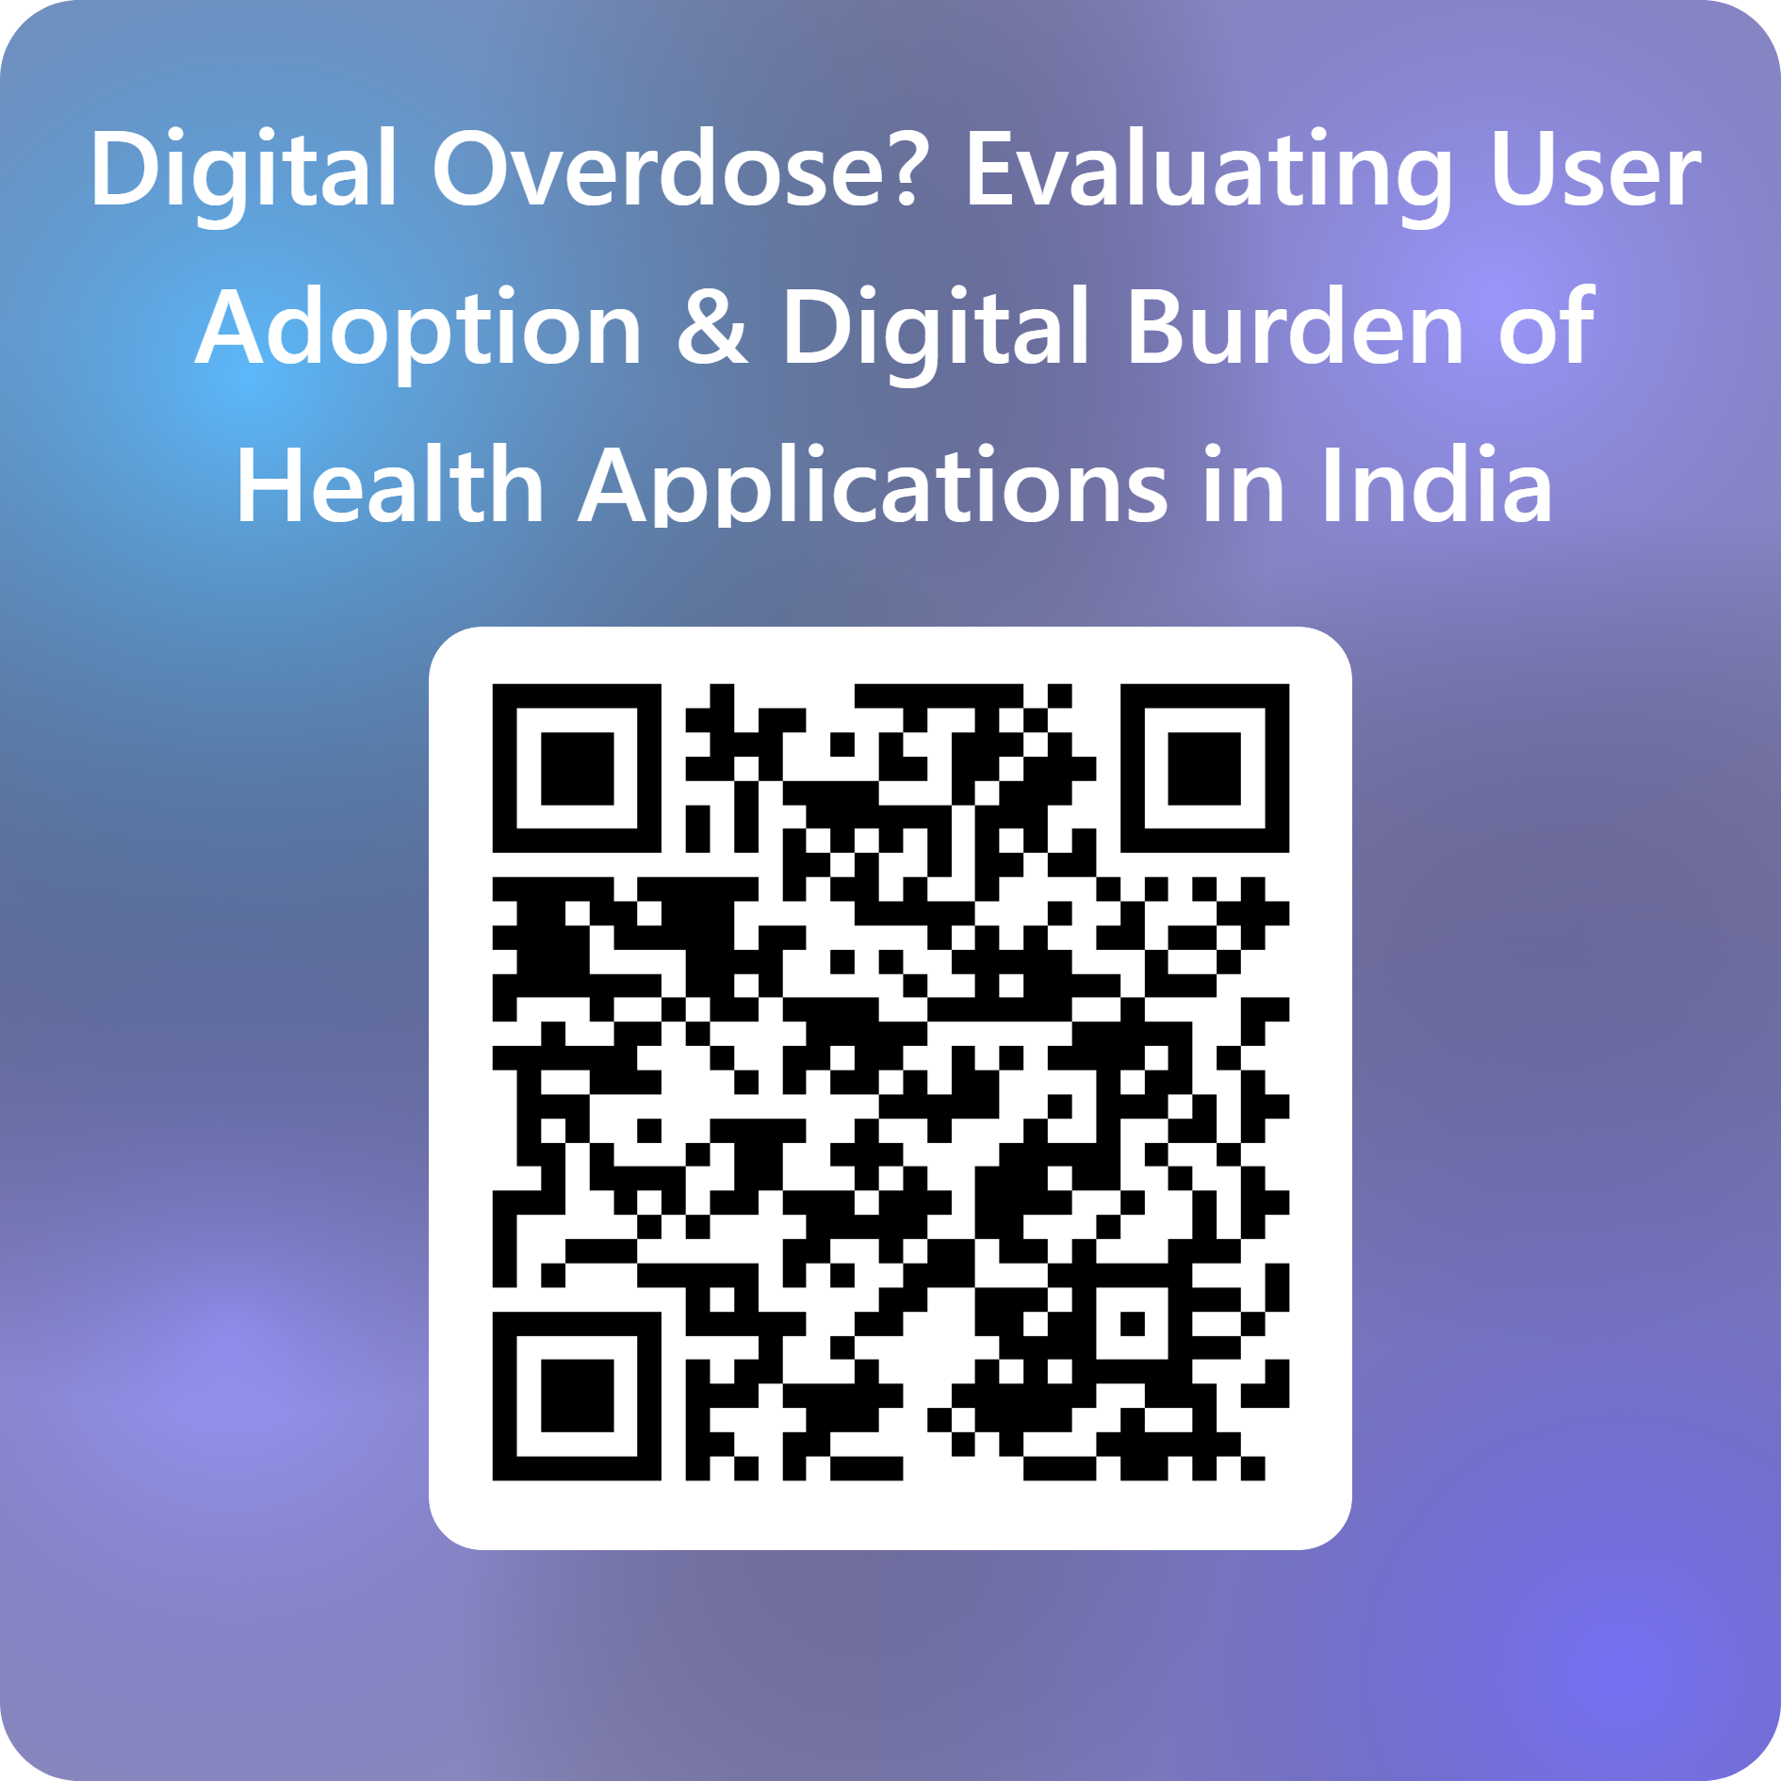
Microsoft From Link
Questionnaire
https://forms.cloud.microsoft/r/Q1tcqKPzw5

Slide 23
Thank You

