Slide 1

Assessment and Observational Study of Waste Disposal in a Semi-Urban Area of Goyla Dairy (Delhi NCR)
Presented by Akhil Saraswat (Roll No: PG\23\010) under the supervision of Dr. Punit Yadav

Slide 2
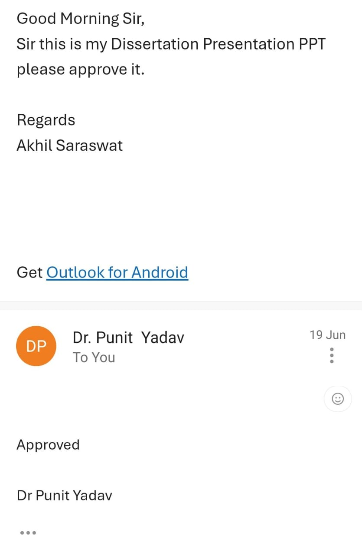
Mentor Approval

Slide 3
Introduction
Liquid waste, including used water from kitchens, bathrooms, and toilets, poses serious health and environmental risks—especially in semi-urban areas. Improper disposal of grey and black water can lead to groundwater contamination, mosquito breeding, and the spread of diseases like diarrhea and typhoid. In this area, most households release wastewater into open drains or soak pits without any form of treatment . Although government programs like the Swachh Bharat Mission–Urban (SBM-U) aim to improve waste and sanitation management across India, areas like Goyla Dairy often remain excluded from effective implementation. This study was conducted to evaluate the current status of liquid waste disposal in Goyla Dairy, New Delhi, and assess whether the existing practices align with national sanitation norms. A total of 59 sites were surveyed, and geotagged photographs were collected to document drainage conditions, septic systems, and wastewater overflow, which were then compared with SBM guidelines.

Slide 4
Objectives of Your Study
To identify whether proper systems like drains are available and working or not.
To check if the current methods of waste water disposal follow the standards and guidelines given by the government (like under Swachh Bharat Mission).
To document the problems seen during field visits and collect visual evidence (photos) of drains and wastewater sources.

Slide 5
Methodology (1/2)
Study Design: The study followed a Cross-sectional observational design.
Study Area: The study was conducted in Goyla Dairy, a semi-urban locality located in the South-West District of New Delhi.
Sample Size: 59 sites were selected where used water was seen coming from houses or public areas into drains.
Sampling Method: Purposive sampling method.
Data Collection Methods: 59 geotagged photos were taken using a mobile phone.

Slide 6
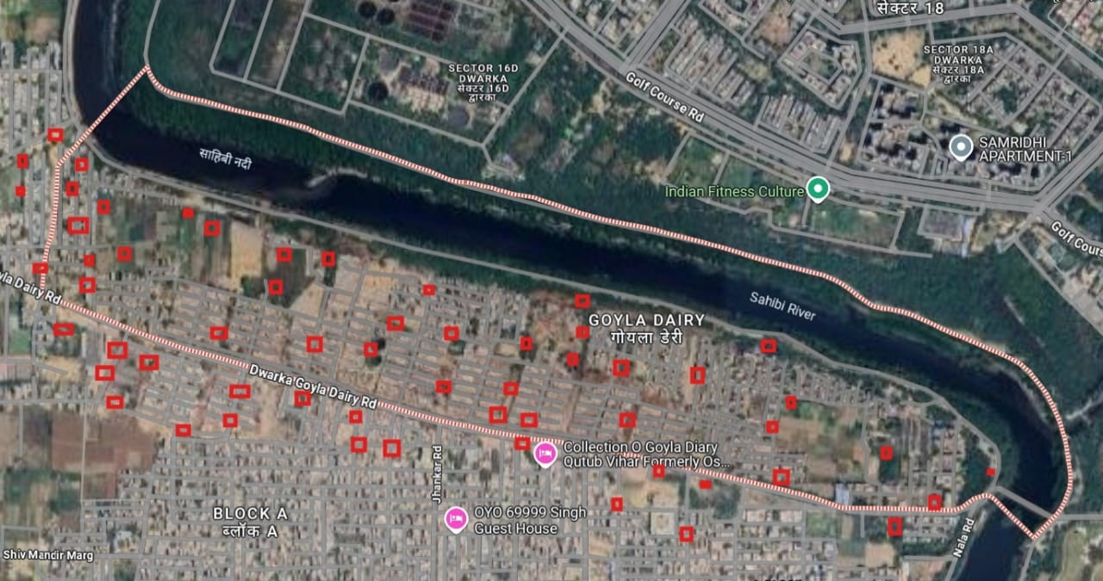
Results (1/3)

Slide 7
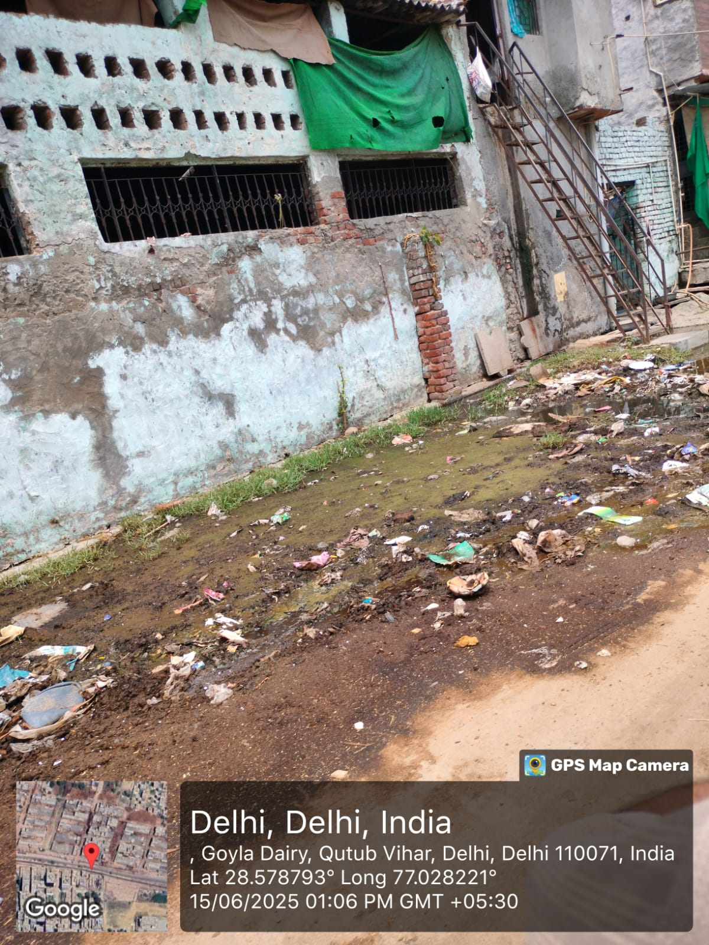
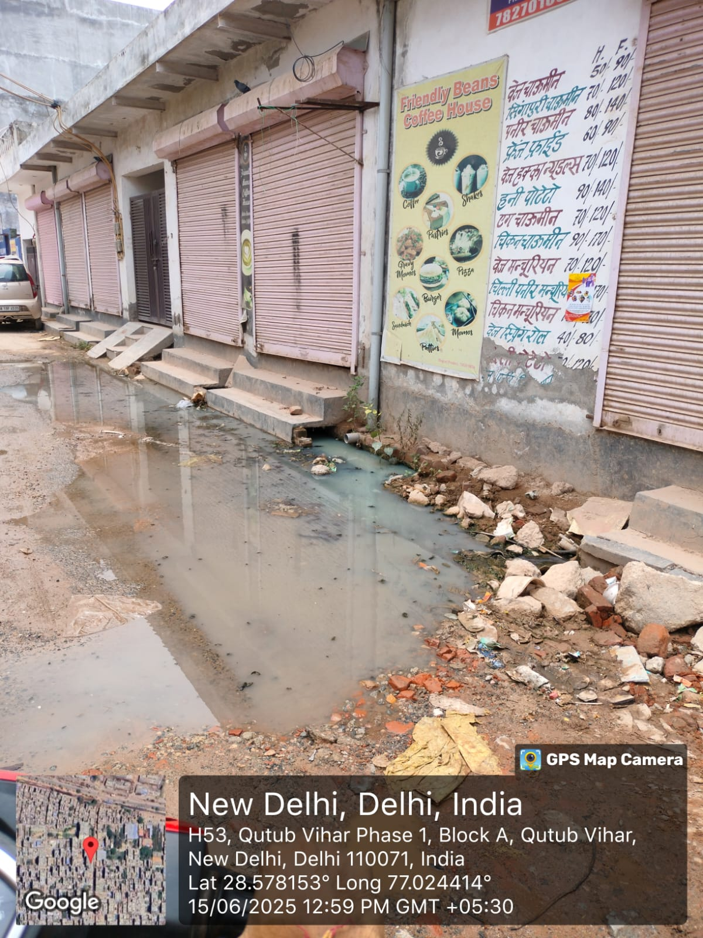
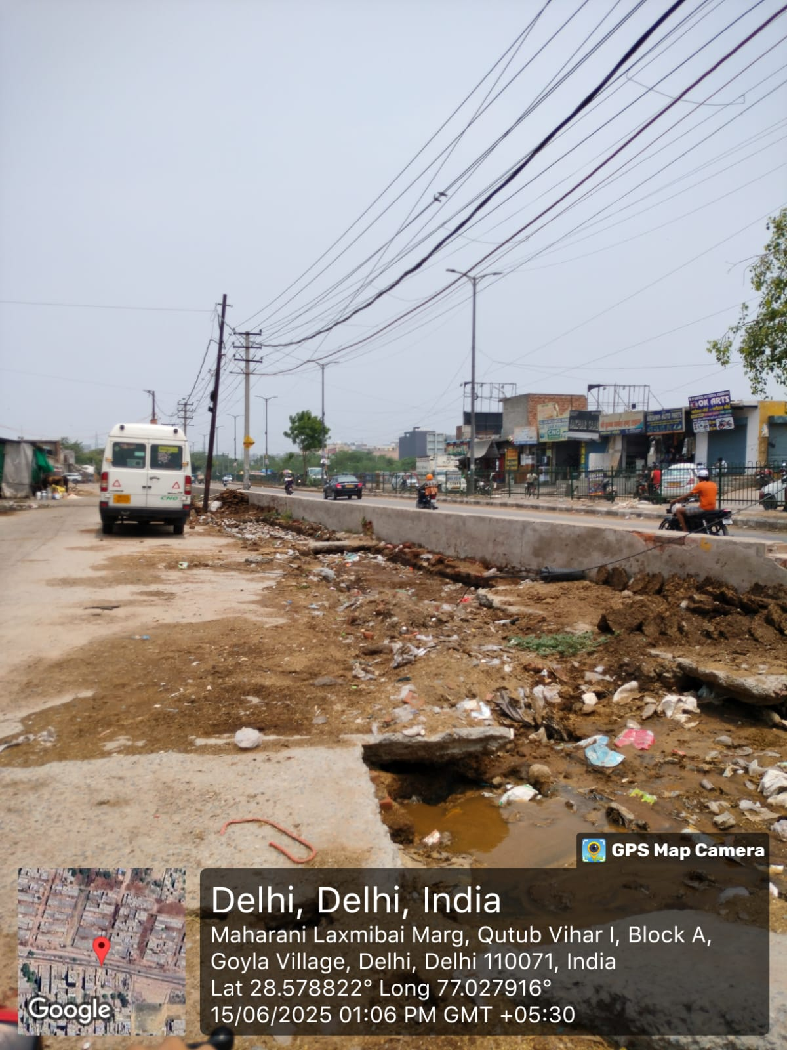
Results (2/3)

Slide 8
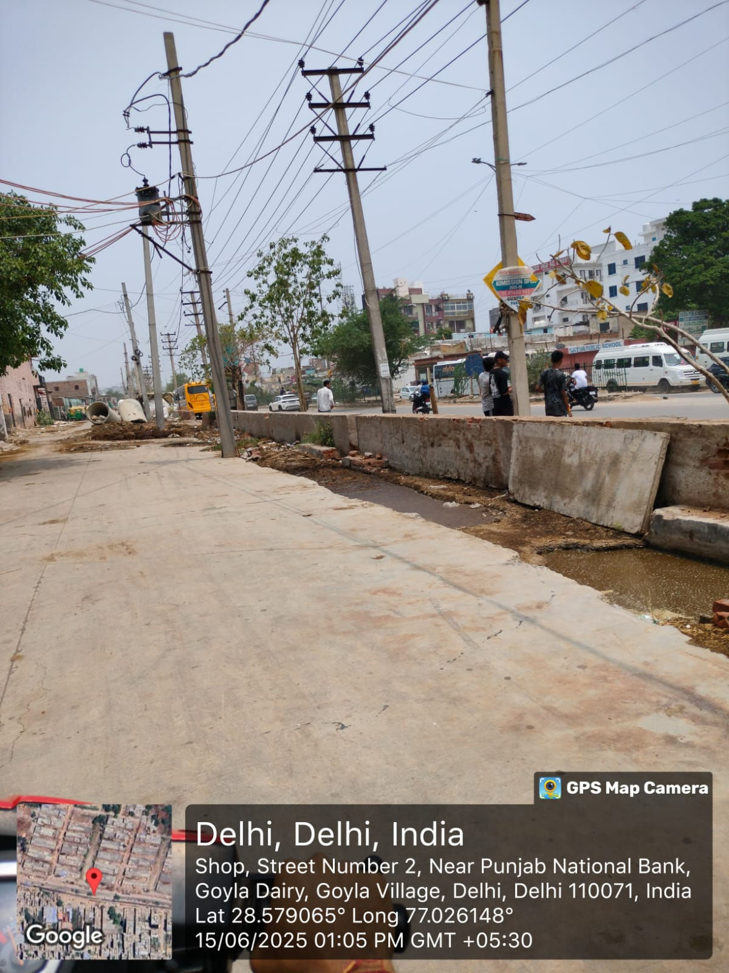
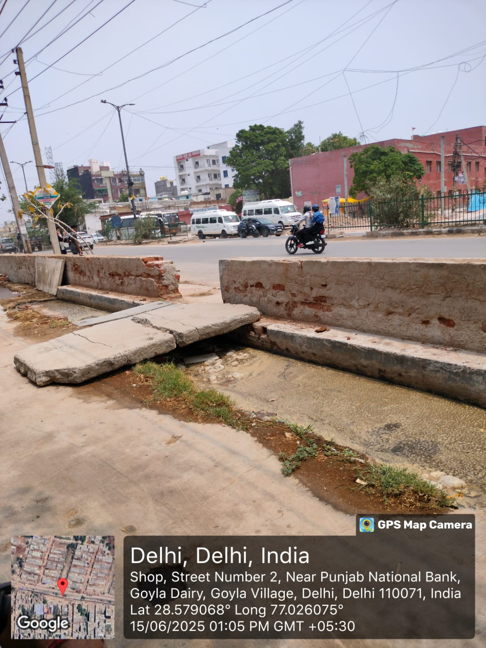
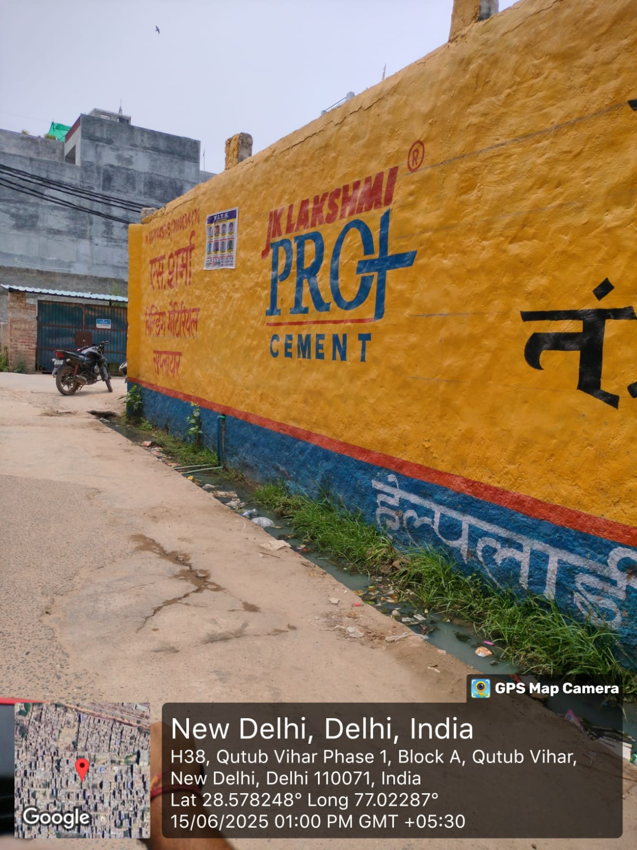
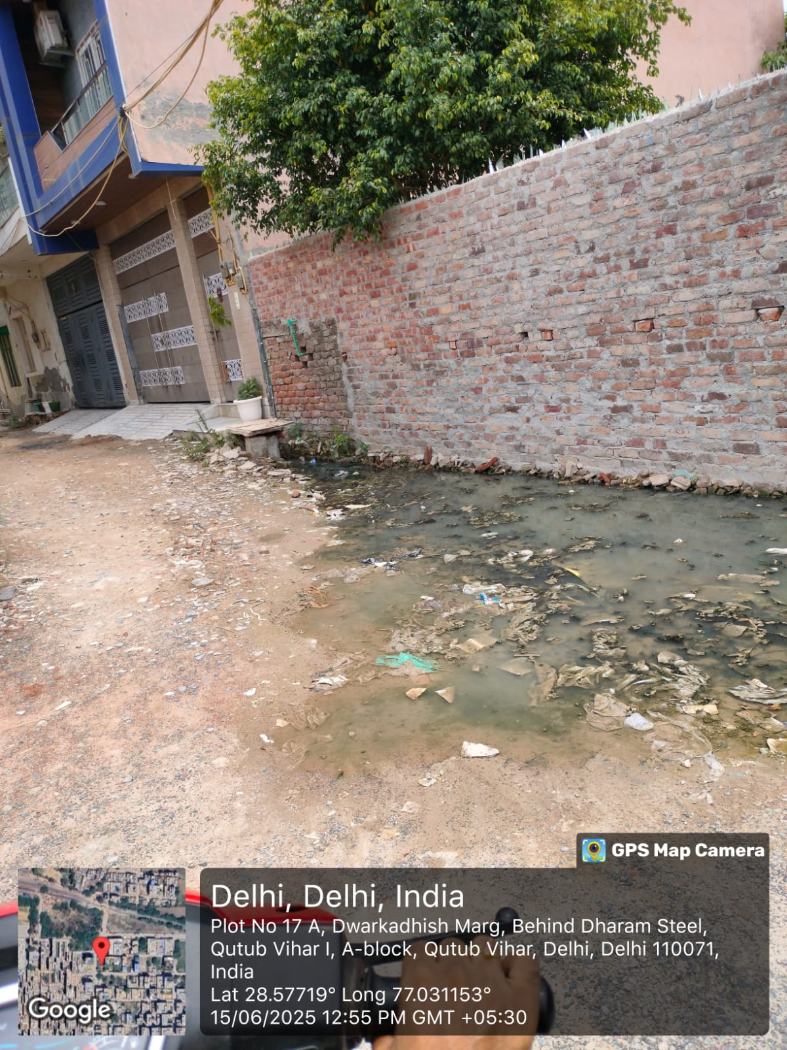
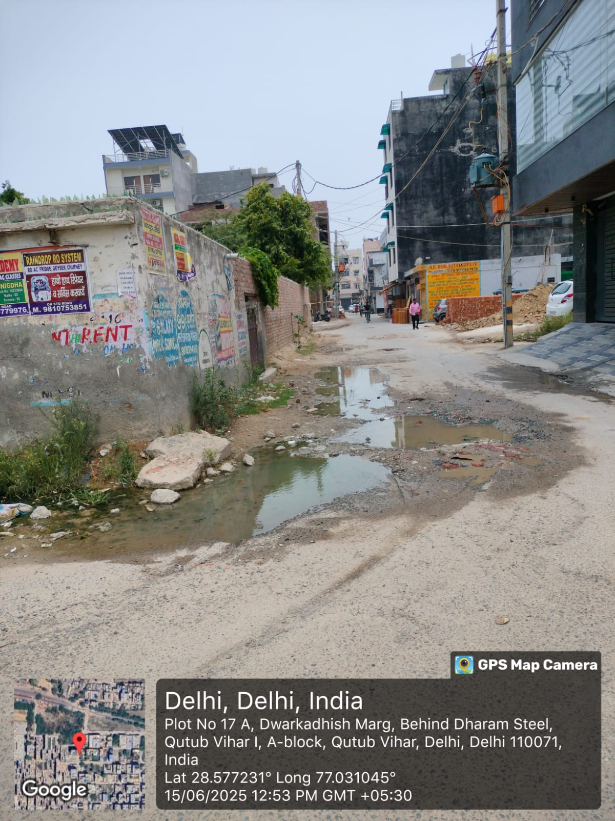
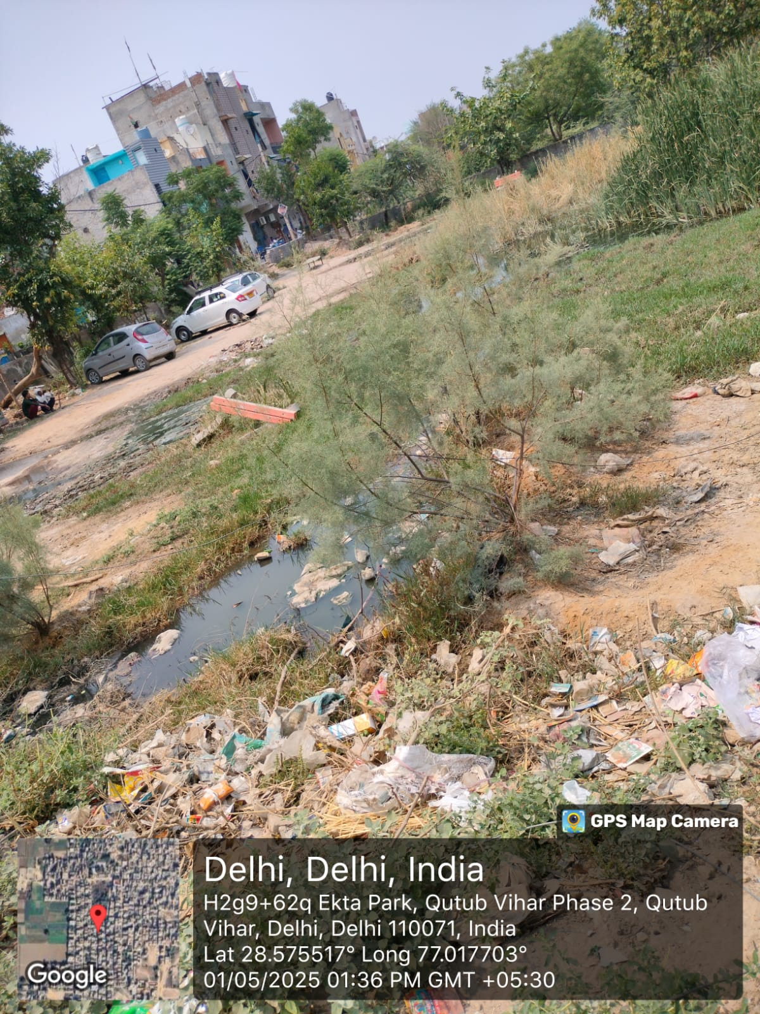
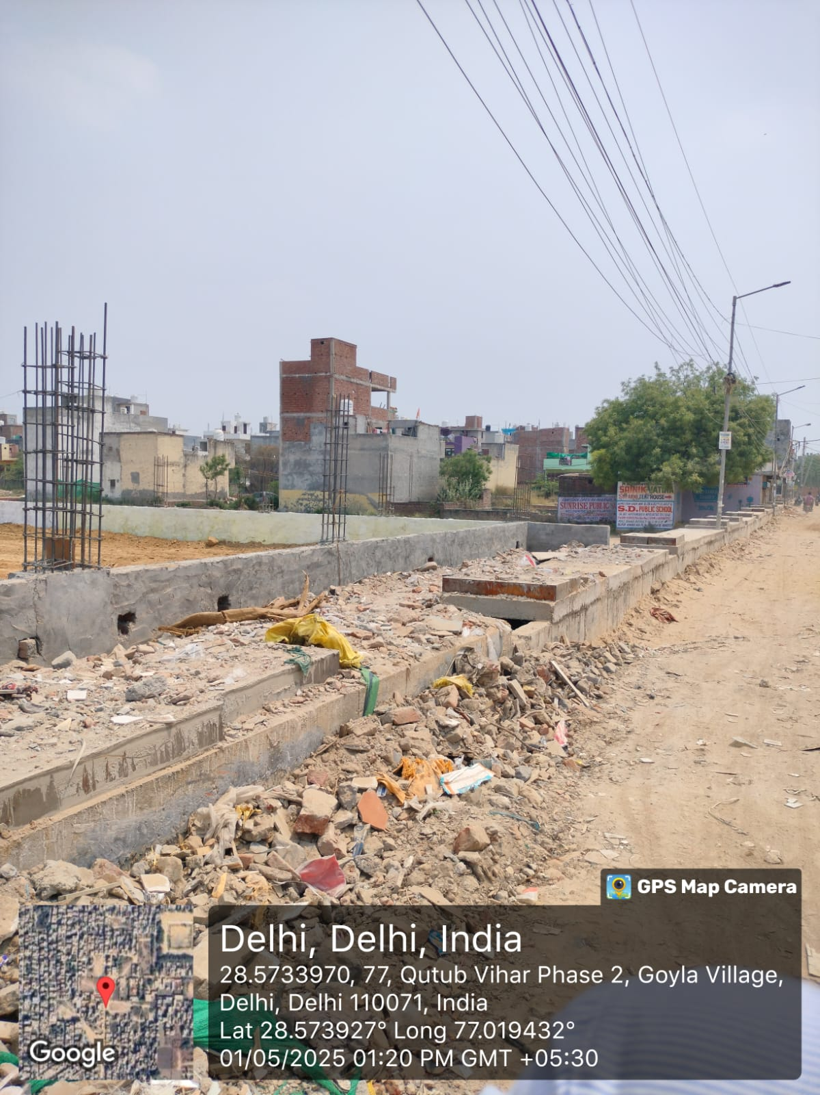

Slide 9
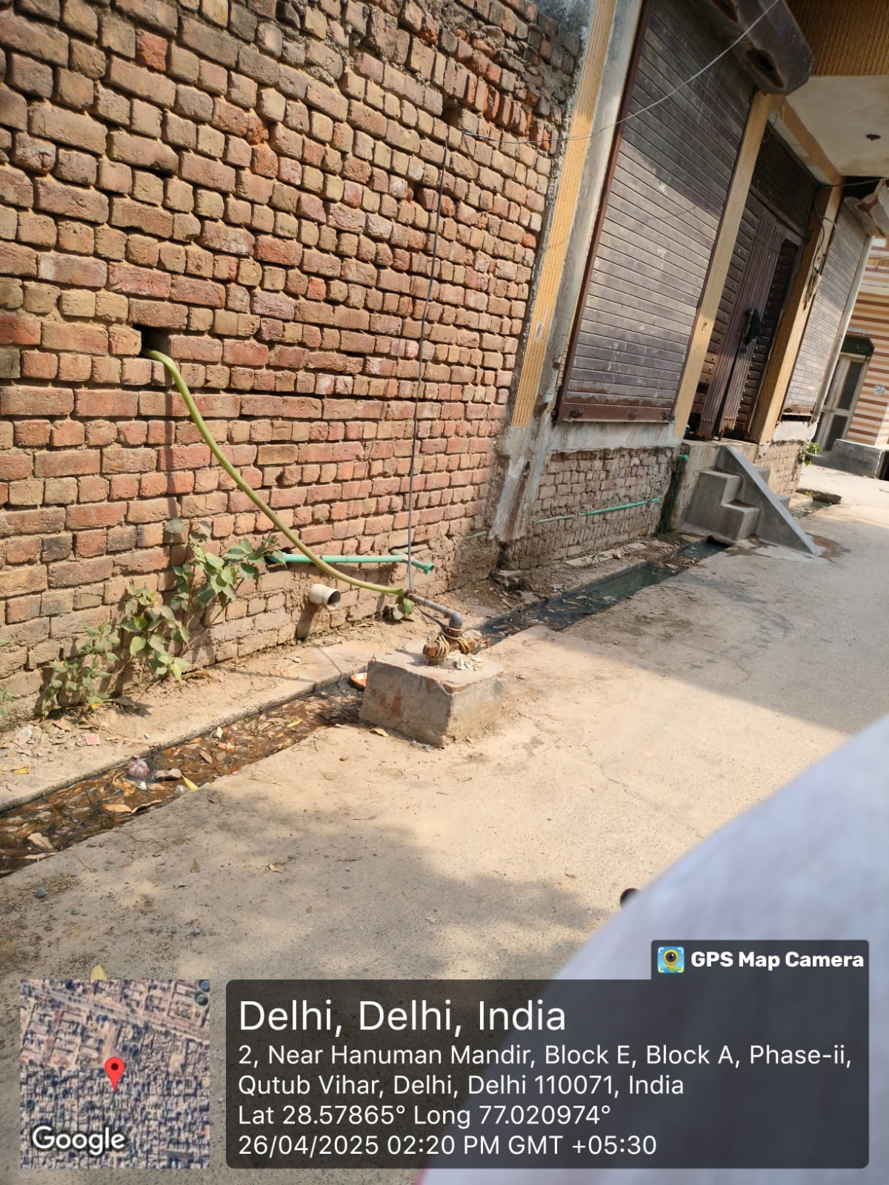
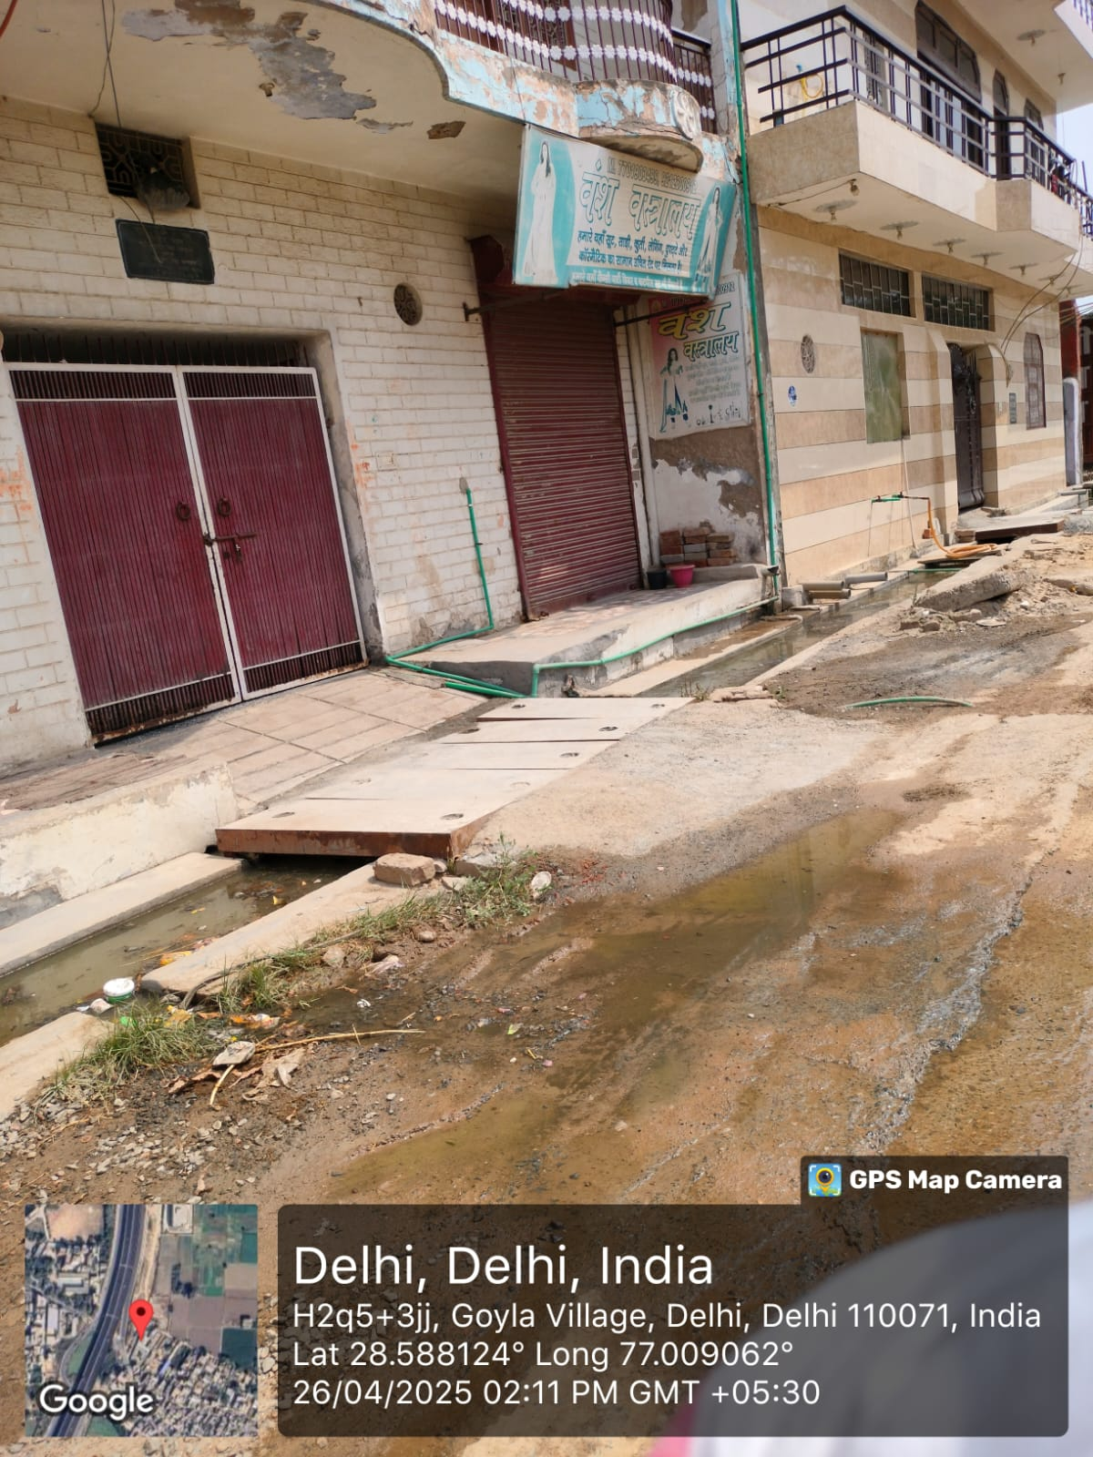
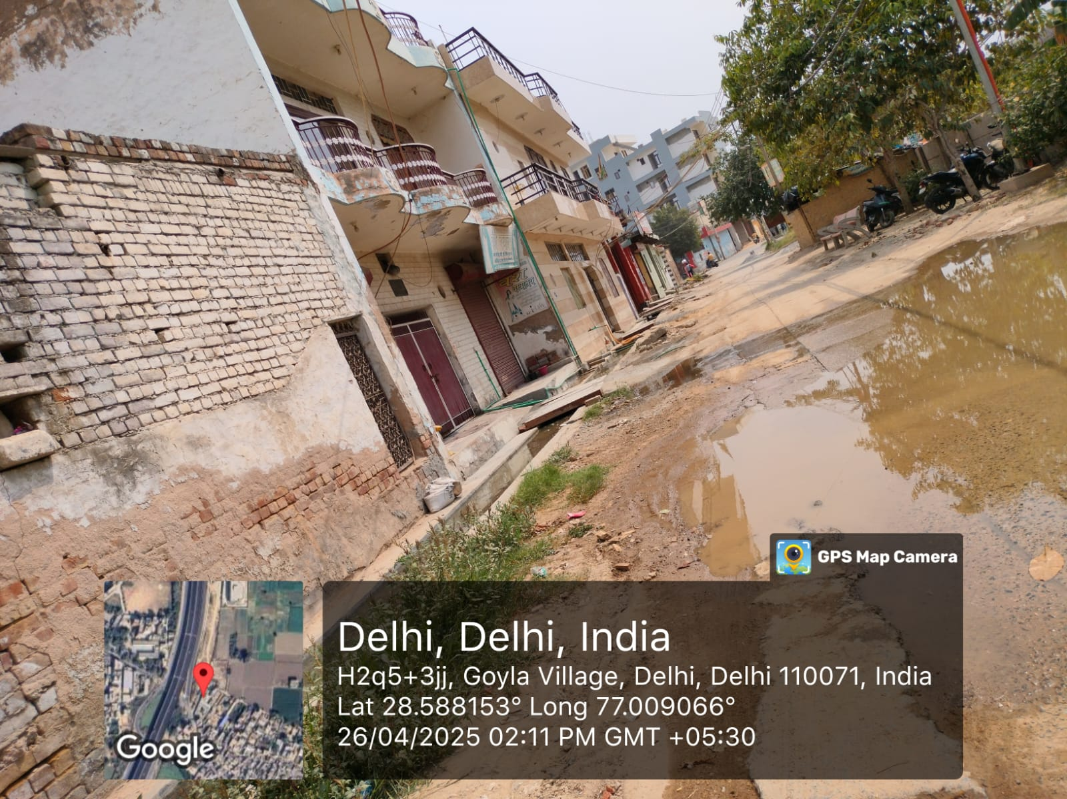
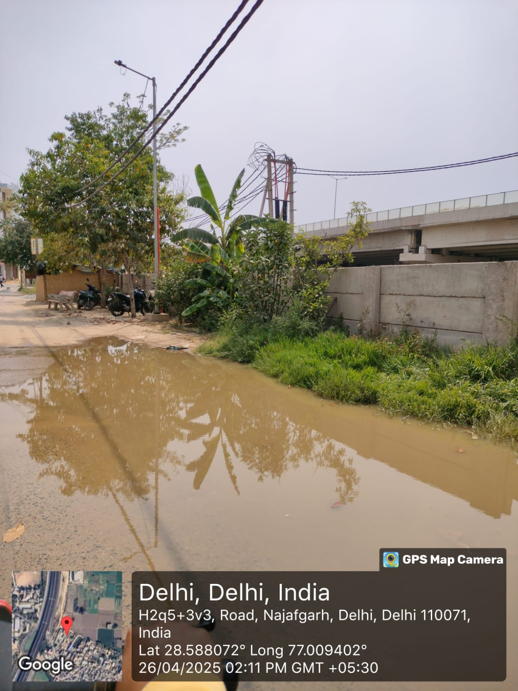
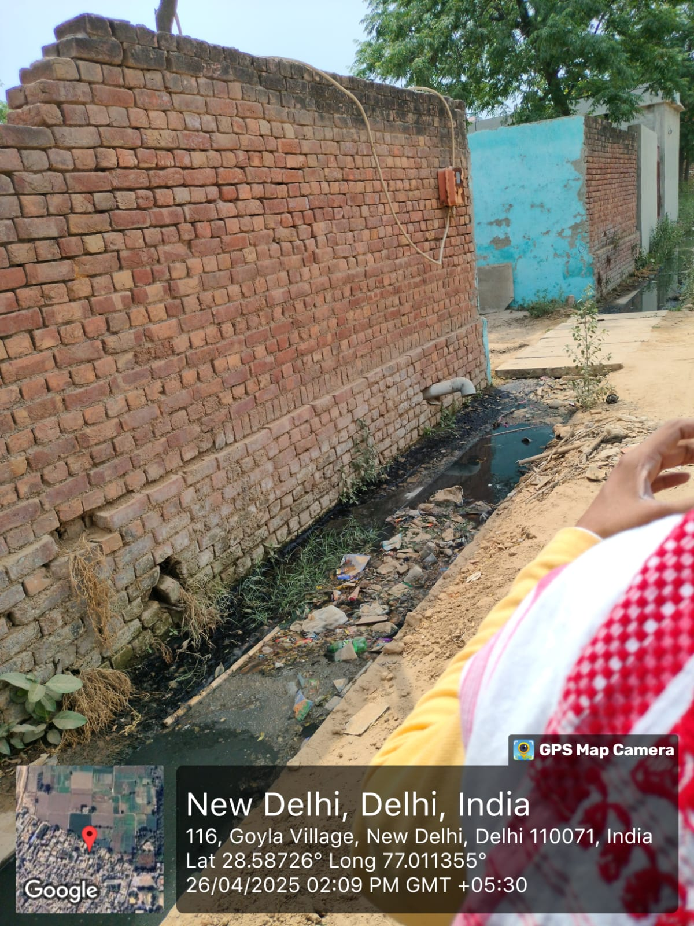
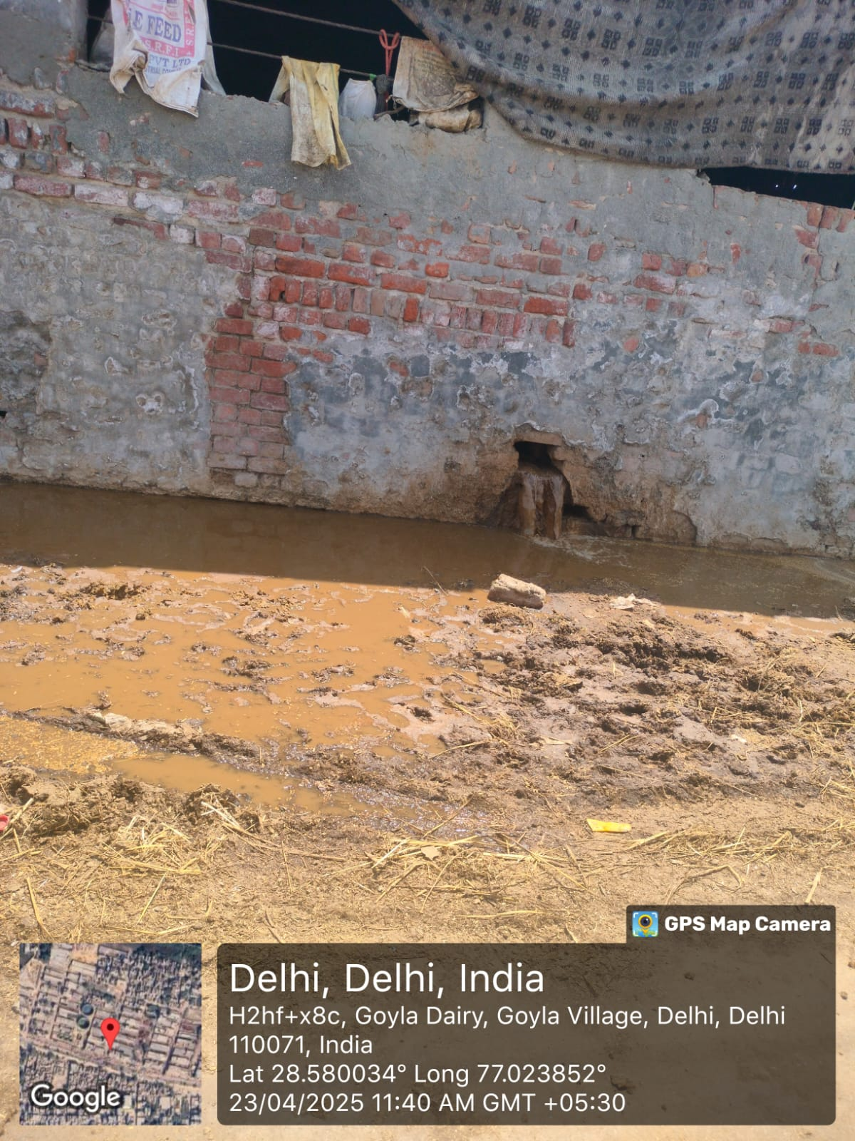
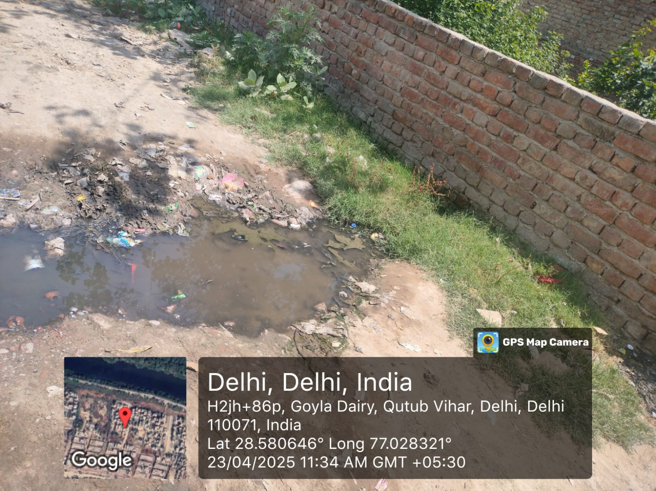
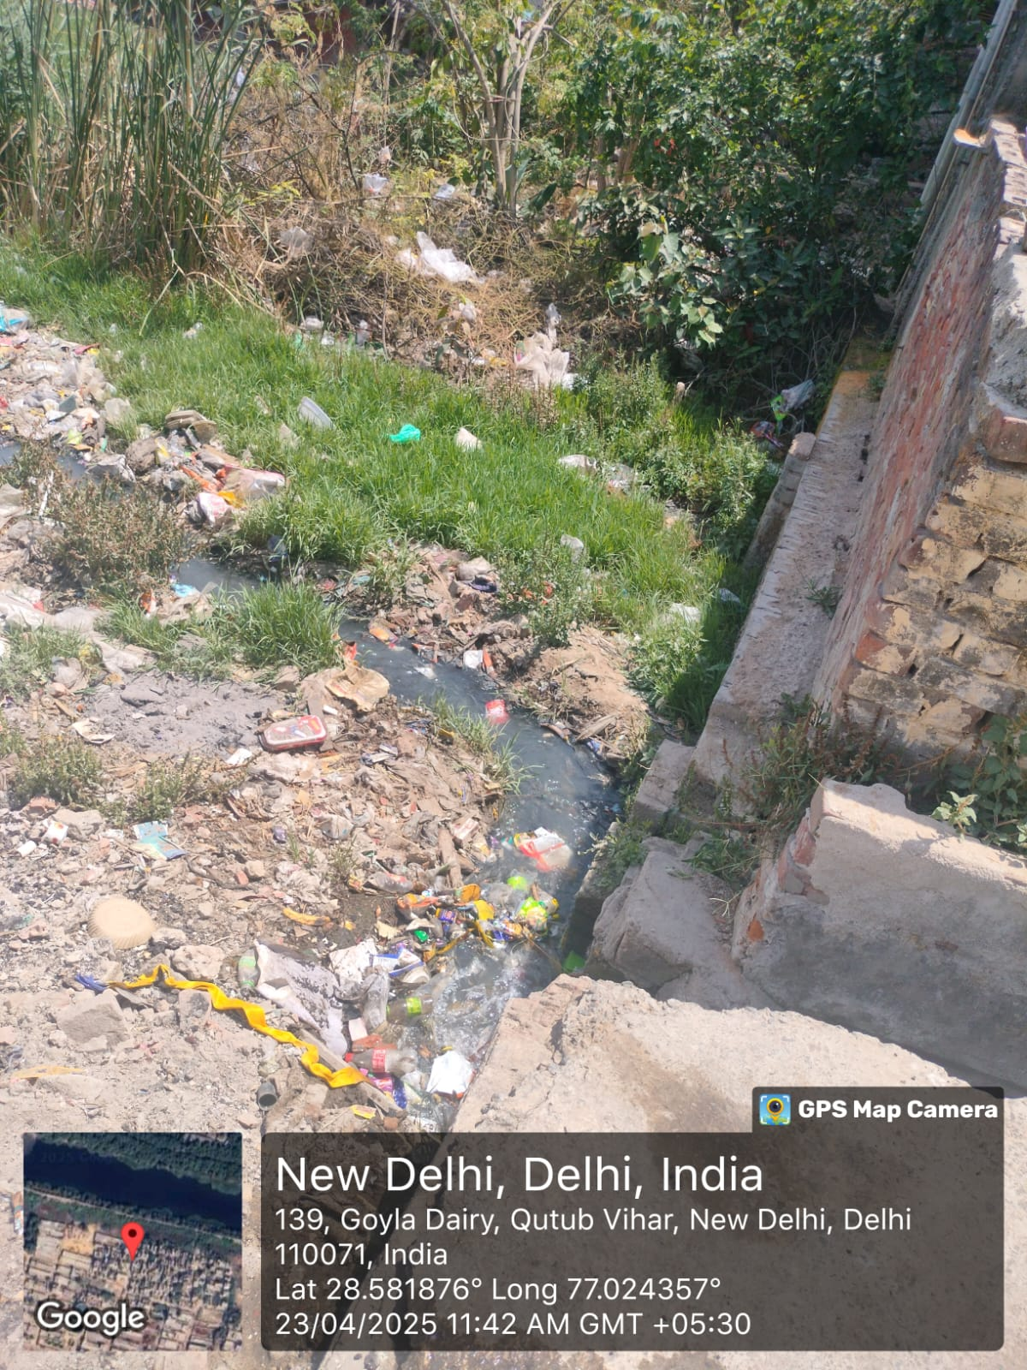

Slide 10


S.No. | Components | Description | Remarks
1. | Sewage (Used Water) | Used Water comprises of the following two components: Grey Water from kitchens, bathrooms, wash basins etc. Black Water from toilets & urinals. These may sometimes be mixed with other municipal flows such as surface water and storm water. | Grey and black water observed, but often mixed with stormwater.
2. | Generation of Domestic Used Water | Generation of Domestic Used water: GOI/States/UTs endeavor to provide 135 Litres per capita per day (LPCD) of potable water through various Missions/ programmes. Of this, 80% (108 LPCD) is expected to be generated as used water. | Estimation based on population norms; not physically measured.
3. | Management of Used Water | Management of Used Water includes collection, conveyance, treatment & recycling/ disposal of all the above stated flows. | No proper system for collection and treatment in many observed areas.
4. | Collection | Grey water from kitchens, bathrooms, wash basins etc. and black water from toilets shall be collected and let into the nearby sewer (i.e off-site sanitation system) or into the onsite sanitation systems (septic tanks with soak pits). | There was no such system to collect waste water there.

Slide 11


5. | Conveyance
5.1. | Off-site System | Offsite System consists of sewage conveyance and treatment at STP | Nothing like this system was seen
5.1.1 | Interception & Diversion drains | This is a system of intercepting & collecting sewage from municipal drains (where sewer network is absent) and to divert it to STP for treatment. | No separate diversion mechanism seen; wastewater flows into drains.
5.1.2 | Sewer network | Sewer network consists of continuous pipes laid underground, mostly along roads, to collect sewage from households and other establishments. Central portion of city area often characterized by high population density is designated as Core Sanitation Zone (CSZ) which is suitable/ viable for laying of sewer network. The outskirts of a city often characterized by sparse population density is designated as fringe areas. These areas are often based on on-site sanitation system, as laying of sewer network is often unviable. | Network seen in core areas but lacking in fringes and slum zones
5.2. | Sewer network | Onsite treatment system (OTS) is a privately owned and maintained sewage disposal system (other than municipal body) that treats used water and produces partially treated water. However, some packaged onsite sewage treatment systems are also available. | There was nothing like it to be seen

Slide 12
Compliant | 4
Partially Compliant | 20
Non-Compliant | 35

Slide 13
Recommendations
Conduct regular IEC (Information, Education & Communication) activities in community to raise awareness.
Train sanitation workers and community members on safe liquid waste handling.
Assign local monitoring teams to track drainage conditions and service gaps.
Upgradation of Drainage Infrastructure

Slide 14
References
Ministry of Housing and Urban Affairs (MoHUA). Swachh Bharat Mission – Urban: Guidelines and Strategy. New Delhi: Government of India; 2017.
Central Pollution Control Board (CPCB). Performance Status of Sewage Treatment Plants (STPs). New Delhi: CPCB; 2019. Available from:
National Institute of Urban Affairs (NIUA). Faecal Sludge and Septage Management in Urban India. New Delhi: NIUA; 2020.
World Health Organization (WHO), UNICEF. Progress on Household Drinking Water, Sanitation and Hygiene 2019. Geneva: WHO and UNICEF; 2019.
Ministry of Housing and Urban Affairs (MoHUA). Advisory on On-site and Off-site Sewage Management. New Delhi: Government of India; 2021. Available from: https://sbmurban.org/storage/app/media/uploaded-files/advisory-on-onsite-and-offsite-sewage-management.pdf

Slide 15
INVOLVEMENT IN COMMUNITY OUTREACH PROGRAMME (COP) ACTIVITIES
Total no. of visits done by the Student: 8
Activities done by the student:
Mapping and listing of the area.
Interaction with the community and frontline healthcare workers.
Conducted IDI with the ASHA on High Risk pregnant women (Group project).

Slide 16
KEY LEARNING FROM COP ACTIVITIES
1. Interaction with Community & FLHWs
Observed field-level challenges
Gained clarity on roles of ASHA, ANM, and AWW.
Learned community engagement.
2. IDI with ASHA on High-Risk Pregnancies
Understood criteria for identifying high-risk pregnancies.
Learned about referral and coordination systems.

Slide 17
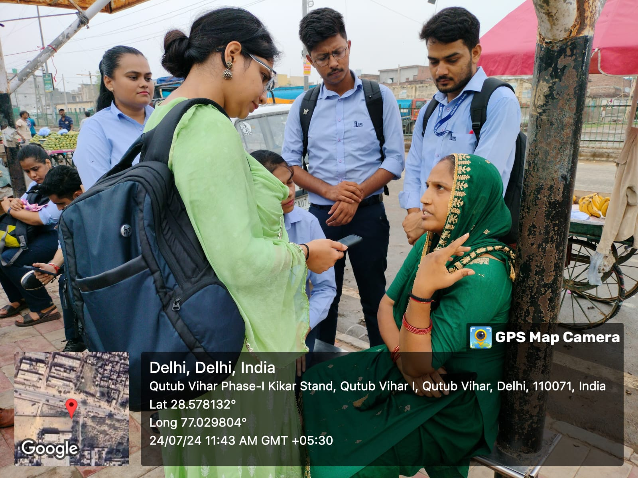
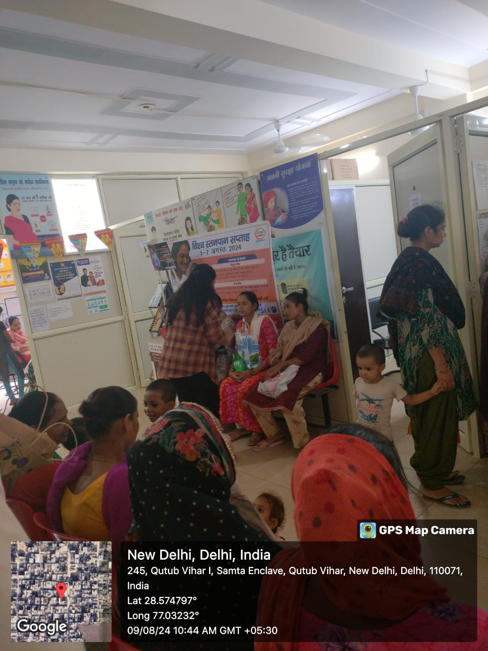
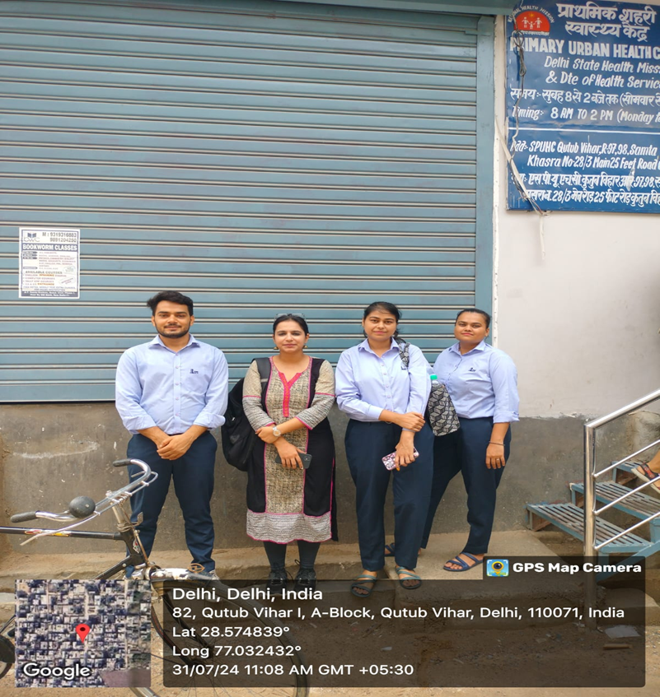
COP FIELD ACTIVITIES PHOTOGRAPHS

Slide 18

Thank You

