Slide 1
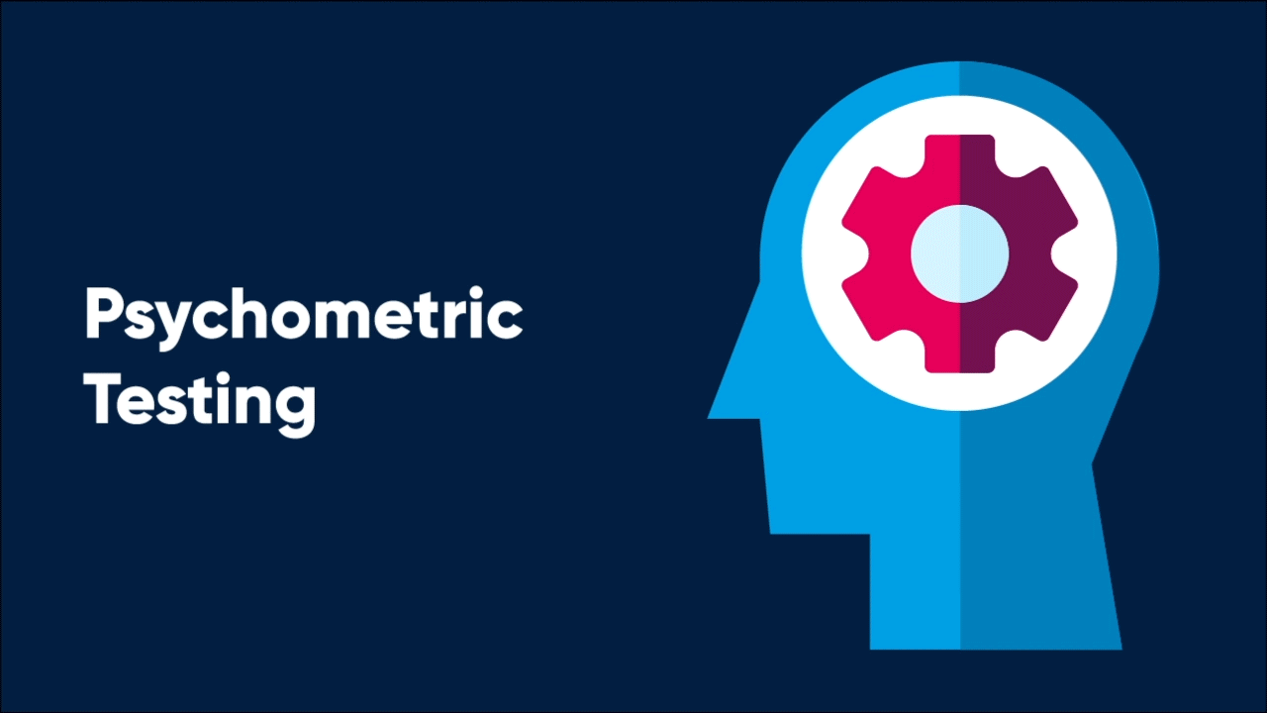



To implement and assess the effectiveness of
Psychometric Assessment
as a part of Talent Acquisition Process at Artemis Hospitals, Gurugram
Dr. Simranjeet Kaur
Under the guidance of
Dr. Nishikant Bele
IIHMR Delhi

Slide 2

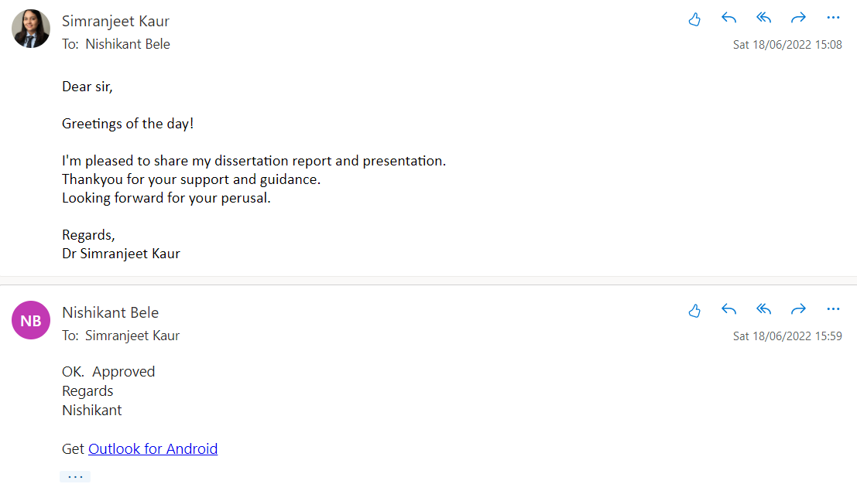
Screenshot of Approval

Slide 3

Introduction (1/3)
When
Benefits
Its helps in highlighting the skills and abilities of the candidate
Objective
& Measurable data
Manpower Planning & Recruitment
Right person for the right job
Talent Sourcing
Psychometric Assessment
Screening & Shortlisting
To assess Behavior of the candidate at certain situation
Psychometric tests can be used to create well defined career paths for the employees for their success.
Interviewing
Selection & Onboarding

Slide 4
Review of Literature (2/3)
The first formal personality inventory in 1917 was
Woodworth Personal Data.
According to Society for Human Resource Management 75% of Fortune 500 companies use psychometric test
Psychometric
assessment started 85years ago. It actually started in the year 1910 and was used by military to eliminate the candidate who have behavioral and mental issue.
Twentieth century personality assessment instruments: were Rorschach, TAT, and MMPI
Big 5 Personality was originally developed in 1949 & in 1993 it was extended and organization used this theory in recruitment.
4

Slide 5
Big 5 Personality Test
Types
What
High |  | Low
▪ Creative thinker ▪ Looks to the future | O | ▪ Appreciates specifics ▪ Experience-based approaches
▪ Structured work style ▪ Identifies key goals | C | ▪ Flexible work style ▪ Quick to pivot goals
▪ Approachable ▪ Dives right in | E | ▪ Independent worker ▪ Not distracted by social complications
▪ Trusts other people ▪ Non-confrontational | A | ▪ Stressed over emotional responses ▪ Wants to win
▪ Calm style ▪ Quickly lets go of criticism | N | ▪ Tuned into the world ▪ Doesn’t hide or mask feelings
1
Myers-Briggs
Type Indicator
2
Cattell’s 16 Personality Test
3
DISC Personality Test
4
Big 5 Personality Test

Slide 6
Introduction (3/3)
Why
Output Behaviors | Personality Traits | Values of Artemis that can be mapped
Agreeableness | Cooperative, warm, agreeable | Care for Customers (C) Respect for Associates (R)
Extraversion | Gregarious, assertive, sociable | Excellence through team work (E)
Openness to experience | Creative, curious, cultured | Always learning (A)
Emotional stability | Calm, self-confident, cool | Trust mutually (T)
Conscientiousness | Hardworking, organized, dependable | Ethical practices (E)
High
Psychometric Assessment focusses here in the purple zone
C
O
M
P
E
T
E
N
C
I
E
S
Expectations - ↓
Performance - ↑
Expectations - ↑
Performance - ↑
A traditional recruitment would happen in the green zone
Expectations - ↓
Performance - ↓
Expectations - ↑
Performance - ↓
Low
High
CERTIFICATE
CREATE represents the Values of Artemis Hospital, Gurugram

Slide 7
Objectives of the Study
To implement Big 5 Personality Test as a part of Talent Acquisition process at Artemis Hospitals, Gurugram.
To understand the personality trait of top performers of Artemis Hospitals, Gurgaon above Senior Executive level by using Big 5 personality Test.
To Benchmark the personality trait of new joinee’s viz-a-vis the top performers of Artemis Hospitals, Gurgaon by using Big 5 Personality Test.

Slide 8

Methodology (1/2)
Key Research Question: While there are multiple objectives that needs to be achieved through this study, there is still one key research question which is ‘To check the effectiveness of Talent Acquisition Process of Artemis Hospitals, Gurugram by implementing Big 5 Personality Test.’
Research Design: A Prospective and Experimental study design
Study Period: The overall study was conducted over a period of 3 months from March 15, 2022 – June 15, 2022.
Study Area: The study was conducted all throughout within the ambit of Artemis Hospitals, Gurugram
Scope: The scope of the study was limited to the following:
  Selected permanent employees including Paramedical and administration staff (Performers who received Top 2 ratings in the performance appraisal process) above Senior Executive Level
  New joinee’s at Artemis Hospitals during effective 1st June 2022 in paramedical & Admin Department
Data Collection: Primary Data with questionnaire

Slide 9
Methodology (2/2)
Sample Size:
  100+ Selected Employees of Artemis Hospitals
  25+ new joinee’s who joined Artemis Hospitals post 1st June 2022
  As a part of Annual Performance Assessment Review at Artemis Hospitals, Gurugram, each employee is rated out of 5 point scale namely Needs Improvement, Meets Expectation, Average +, Good and Excellent (from lowest to highest) based on his/her annual performance. This survey has pulled out employees who have received top 2 ratings i.e. either ‘Good’ or ‘Excellent’ from work level ‘Senior Executive’ and above. Survey was sent out to only to employees meeting these criteria. Around 100 employees have undertaken the survey.
Research Instrument: Big 5 personality tools assessment questionnaire.
Data Analysis: Big 5 personality test has a score calculation which shall be used for analysis. The scores of each parameter which is undertaken by an individual is calculated by using Big 5 personality Assessment Question

Slide 10
Results (1/3)
Average score of employees with Top 2 ratings.
Median Score of Employees with Top 2 Ratings.
Average score of New Joinee’s at Artemis Hospitals effective
1st June 2022
Median score of New Joinee’s at Artemis Hospitals effective
1st June 2022

Slide 11
Results (2/3)
Comparison of Average Score of Employees with Top 2 rating with that of New joiness’s
Comparison of Median Score of Employees with Top 2 rating with that of New joiness’s

Slide 12

Results (3/3)
Extraversion
Agreeableness
Conscientiousness
Neuroticism
Openness to Experience

Slide 13
Discussion (1/2)
The new joinees having the individual score above or equal to the average score will fit into the culture of Artemis and will perform good and prove to be a good asset to the organization in long run.
The median score of selected employees which means 50% of the employees who have undertaken the Big 5 personality test are above the below mentioned score and the remaining 50% is below the score.
When the comparison of average score is made between the selected top 2 rating Employees and new joiness it shows that the average score of Big 5 test of all 29 new joinee’s is at par with that of employees.
The average score of these new joinee’s are higher in Extroversion (E) and Neuroticism (N) i.e. they would be easily approachable. They can read the social situation well and are energetic. They may also have a structured way to do the work. They would be seen identifying key goals as a part of their work area.
The new joinee’s and the employees with good score would also be seen trusting others which would encourage the team culture and enhance teamwork at work.

Slide 14
Discussion (2/2)
The plotting of actual scores highlights the fact that it’s the new joinee who has scored the highest in Extraversion and in Openness to experience i.e. it can be expected that new joinees may set a benchmark in terms of approachability and being creative at work.
Their would be higher sense of ownership within the new joinee’s who have a higher score

Slide 15
Limitations of the Study
Artemis employs people across level and then there are few who do not understand English well. Questionnaire was in English which made it difficult for them to understand.
All top performers of last year may not be top performers next year. Hence, the benchmark score should be conducted year on year.
People who are below Sr. Executive level got missed out in this study.
Survey is long and takes long time for participants.

Slide 16
Conclusion
Objective of the study has been achieved based on the primary research conducted at Artemis Hospitals, Gurugram.
The initial study was tested with the existing employees and especially the top performers of Artemis Hospital to identify the benchmark and at the same time determine that what it takes to become a top performer at Artemis Hospital
Not only did the new joinees bring in those personality traits of a performer but also, they exceeded in some parameters.
It sends a very strong message that the talent acquisition process is extremely robust.
Next level of this study is to consider the outcome of this Big 5 personality test as an input to the training need identification process of the same new joinee for the initial 1 year.
For existing employees, the same test could be used to identify the high potentials within the organization

Slide 17
References
Magro B, Vella M. Understanding the Use of Psychometric Testing by Maltese Organisations for the Purpose of Recruitment and Selection. MCAST Journal of Applied Research &amp; Practice.
Thomas. The Advantages of Psychometric Testing in Recruitment [Internet]. Thomas International. 2020. Available from: https://www.thomas.co/resources/type/hr-blog/advantages-psychometric-testing-recruitment
T E. Why Healthcare Recruitment is Asking for the Big 5 [Internet]. www.retorio.com. [cited 2021 Aug 31]. Available from: https://www.retorio.com/blog/why-healthcare-recruitment-is-asking-for-the-big-5
Kruse K. The Ultimate Guide to the DiSC Assessment and Personality Test [Internet]. LEADx. 2019. Available from: https://leadx.org/articles/the-ultimate-guide-to-the-disc-assessment-and-personality-test/
Myers-Briggs Type Indicator: The 16 Personality Types [Internet]. www.simplypsychology.org. Available from: https://www.simplypsychology.org/the-myers-briggs-type-indicator.html
Psychometric Tests and Evaluation | Best Psychometric Assessment Test for Recruitment | Online Psychometric Test [Internet]. mettl.com. [cited 2022 Jun 16]. Available from: https://mettl.com/psychometric-tests
Top 8 Personality Assessment Tools For Recruiting Awesome Talent [Internet]. mettl. 2020. Available from: https://blog.mettl.com/personality-assessment-tools-for-hiring/
‌What Are The Best Psychometric Tests To Use For Recruitment? [Internet]. Picked. Available from: https://www.picked.ai/magazine/what-are-the-best-psychometric-tests-to-use-for-recruitment/

Slide 18
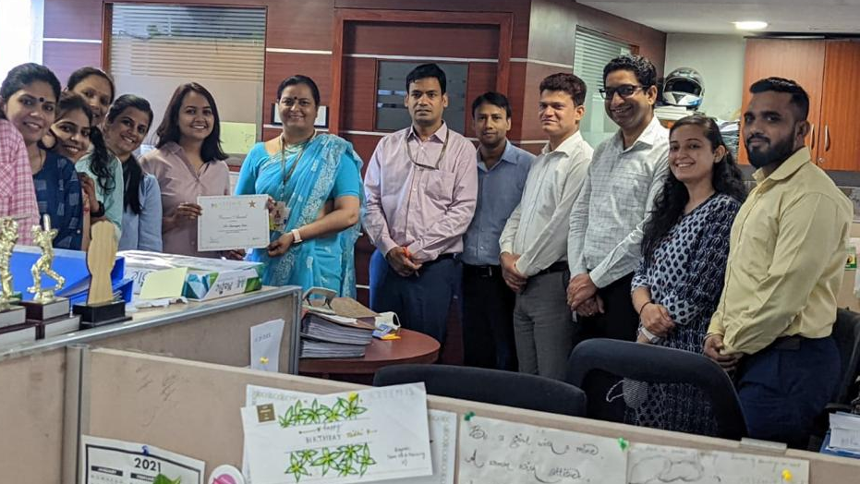
Received an Appreciation – Bronze Award for ‘Design & Implementation of Psychometric Assessment at Artemis Hospital’ from Ft. Lt. Saras Malik, Chief People Officer, Artemis Hospitals
Thank You

Slide 19
Suggestions to the Organization where the Study was Conducted
Big 5 personality test should be made compulsory for all new joinee’s.
Regular analysis should be done on the data of outcome of survey and job rotations should be promoted using this analysis.
Training Needs for employees should be taken from outcome of this survey.
Talent Management (Hi-Potential identification process & Succession Planning) should be done based on the outcome of this survey

Slide 20
Dissertation Experiences
What did you learn (skill/topic)?
Overall self comments on Dissertation
Design & Implementation of Psychometric Assessment
Data Analysis
Networking with top performers of Artemis Hospitals, Gurgaon
The study kicked off a new culture at Artemis Hospitals and cultural assessment of new joinee’s.
A step further in hiring a right person for the right job
This would also reduce the attrition rate as it would give a meaningful job to new joinee’s

Slide 21

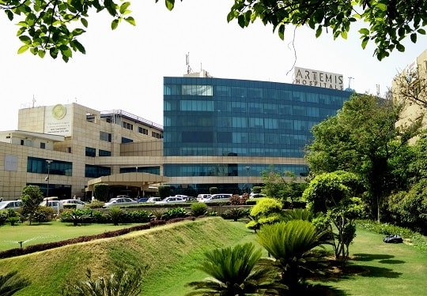
Women’s Day Celebration at Artemis Hospitals, Gurugram

