Slide 1

“To Study VETSpa and its workflow in order to create Brand Awareness in European Radiology Market by using Digital Marketing strategy”
Presented by
Shreyshi Varshney
PGDHM- Health IT Management 2nd year
IIHMR, New Delhi – PG/016/58

Slide 2
Contents
Brief Overview about Telerad Tech Private Limited, Bangalore
Objective of the study
Introduction
Background
Reasons to Target European Countries
About VETSpa and its workflow
Methodology
Results
Conclusion
Snaps for BSAVA Event 2018
Notes:
How presentation will benefit audience: Adult learners are more interested in a subject if they know how or why it is important to them.
Presenter’s level of expertise in the subject: Briefly state your credentials in this area, or explain why participants should listen to you.

Slide 3
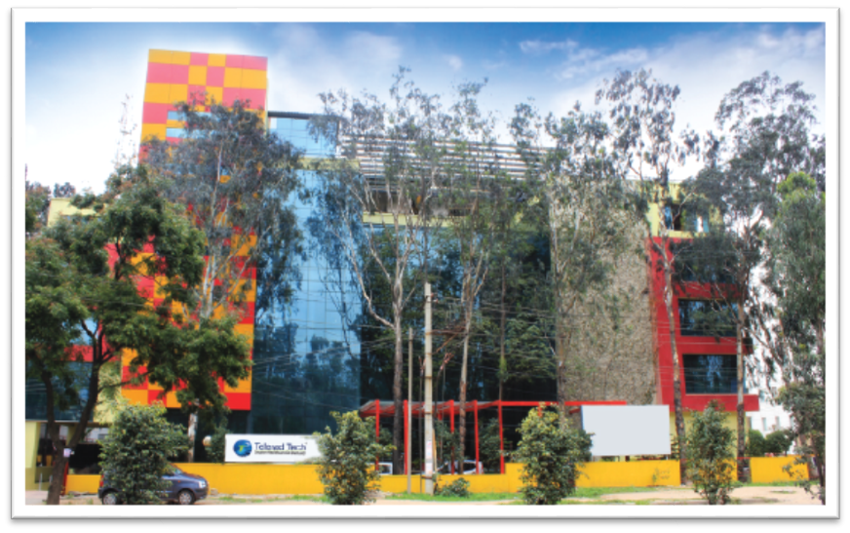
Telerad Tech Private Limited, Bangalore
Established in 2009 with the goal of optimizing radiology productivity and improving patient care
Amongst the market leaders in providing RIS-PACS integrated software solutions for teleradiology, medical imaging centers etc.
Company’s solutions cater to workflows needed across the departments which includes Radiology, Cardiology, Podiatry, Orthopedic, Chiropractic, Oncology and Veterinary Radiology.
Notes:
Lesson descriptions should be brief.

Slide 4
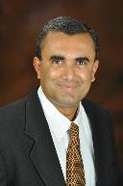
Our Founders
Dr. Arjun Kalyanpur - MD, DABR
Modern Medicare’s Entrepreneur Of The Year Award, 2007 Express Healthcare’s 50 Pathfinders In Healthcare In India, 2009 Healthcare Executive One Of 25 Healthcare Influencers, 2015 Frost & Sullivan’s Healthcare Entrepreneur Of The Year, 2015
Notes:
Example objectives
At the end of this lesson, you will be able to:
Save files to the team Web server.
Move files to different locations on the team Web server.
Share files on the team Web server.

Slide 5
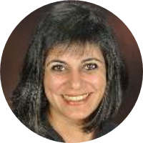
Dr. Sunita Maheshwari - ABP, ABPC(USA)
Young Clinician Award From The American Heart Association
Best Teacher Award At Yale University . Top 20 Women Achievers In
Medicine In India In 2009 Times Now ‘Amazing Indian’, 2014Wonder women of Healthcare, Healthcare Executive, 2016

Slide 6







Our Group Companies
“Building a Complete Eco-System”
We are not just Telemedicine providers or Scientists or Techies…
We are enablers of a better future of people, patients and doctors, globally…!

Slide 7






Our Products
Transforming Radiology Across Borders
The Next Generation AI Integrated Radiology Platform
Smart Cardiology Workflow
RIS-PACS Workflow for Veterinary Radiology on the Cloud
Accelerate Drug Development Trials at the Right Speed
Enabling Healthcare… Anytime, Anywhere

Slide 8
Objectives
To study VETSpa and its workflow in order to create Brand Awareness in European Veterinary Radiology Market by using Digital Marketing strategy.
Specific Objectives:-
To study the workflow of VETSpa in order to understand the software.
To use Digital Marketing channels effectively to reach out to the Target Audience in European Countries
To advertise/promote VETSpa in order to create Brand Awareness
To measure the outreach of our Digital Marketing efforts at the booth

Slide 9
Introduction
Veterinary Imaging is of much importance in today’s era in order to reduce Zoonotic Burden across the world
Zoonotic Burden contributes somewhat to Global Burden of Diseases
27 percent of livestock showed signs of current or past infection with bacterial food-borne disease that causes food contamination
12 percent of animals have recent or current infections with brucellosis
7 percent of livestock are currently infected with Bovine TB
26 percent of livestock show signs of current or past infection with leptospirosis
To reduce the burden – only way to help is first to Diagnose!
Better Diagnosis will lead to early cure

Slide 10
Background
The vital factors contributing to Veterinary Imaging Market are many as followed: -
Rise in animal healthcare expenditure.
Rise in Pet’s Healthcare Insurance
Rise in the business of Animal Products
Rise in the growth of Pet parlours and spa.
Few important reasons to focus on Veterinary Imaging Area: -
  Veterinary Imaging Market will be touching USD 1.90 Billion by 2022.
  Increase in the expenditure of Animal Healthcare by the people across the globe.
  Increase in the awareness about Animal Healthcare
  Increasing demand about Pet Insurance in Developed Countries

Slide 11
Reasons to Target European Countries!
  People living there are more attached and have emotions for their pets.
  People living their like to spend more on their pet’s wellbeing.
  Europe has the largest number of Pet Food Industry, ParaVet Clinics/Labs etc.
  European Countries have Global Access to Healthcare Business since, The Netherlands, Germany, Belgium, Italy etc are being the fastest growing places in terms of Healthcare.
  Europe has almost 90% multilingual population.
  Europe being in the middle of the globe provides fastest connectivity to all the people living there or living away from there.
  Largest number of the population owns pet there.
  Germany, Netherlands, Iceland, Switzerland, Luxembourg and Denmark are among the Top 9 Highest Paying Countries for Veterinarians across the world.

Slide 12
About VETSpa !!
Telerad Tech’s VETSpa is a RIS-PACS Workflow for Veterinary Radiology on the cloud.
VETSpa can be used to share, upload, acquire, view, diagnose, annotate, transfer and access the veterinary medical images and reports
VETSpa can be connected fast and effortlessly with all imaging devices in the clinics, hospitals, or radiological labs.
Telerad Tech offers flexible licensing models on VETSpa and that enables Veterinary Imaging Center to buy and use the solution according to their need and budget.
VETSpa Enterprise
VETSpa Cloud
VETSpa has the following mentioned USPs: -
Easy to access.
Ease of Use
Low Entry Cost
Vendor Neutral Archive
Saves Time
Multiple Viewers
Smart Image Sharing
Round the Clock Support

Slide 13
VETSpa has many features which are mentioned below: -
One Click Veterinary Information View
Zero Foot Print Viewer
Long term security and world-wide availability
Includes Patient portal
Contains Image Processing tools
Multilingual Support
Scalable and Upgradable
Comparison of Multiple Studies
CD Burning
Study Link Sharing

Slide 14
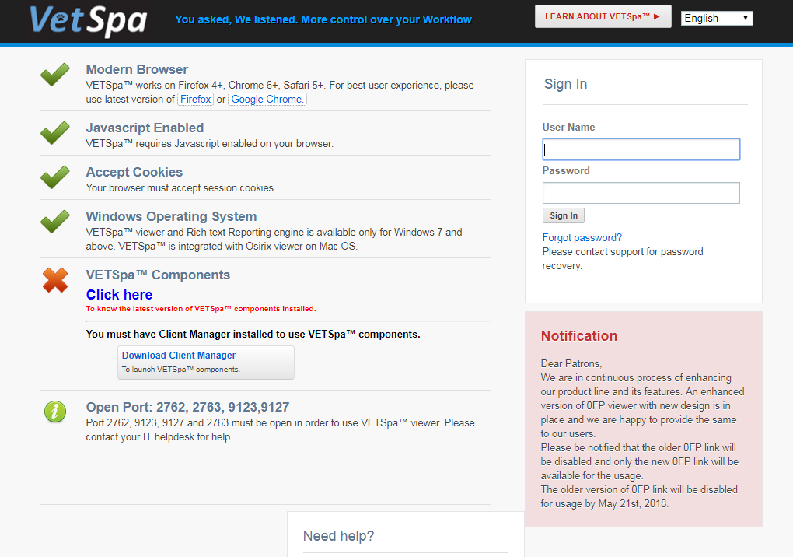

Slide 15
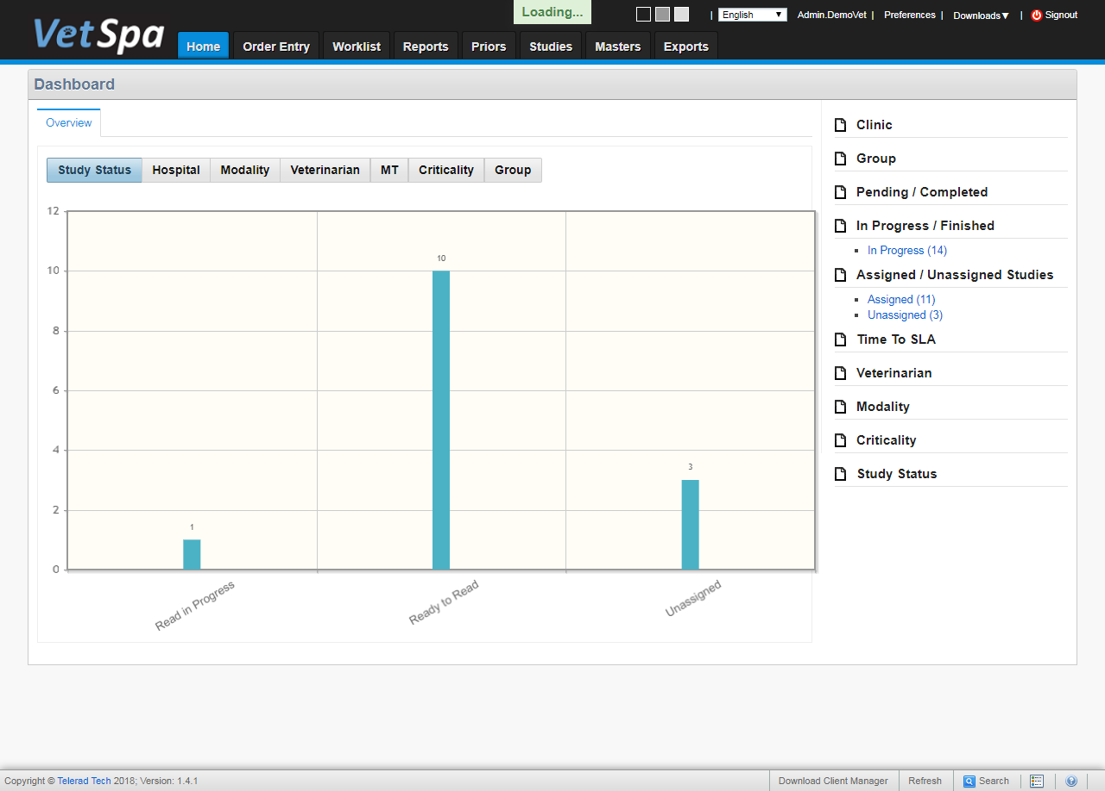

Slide 16
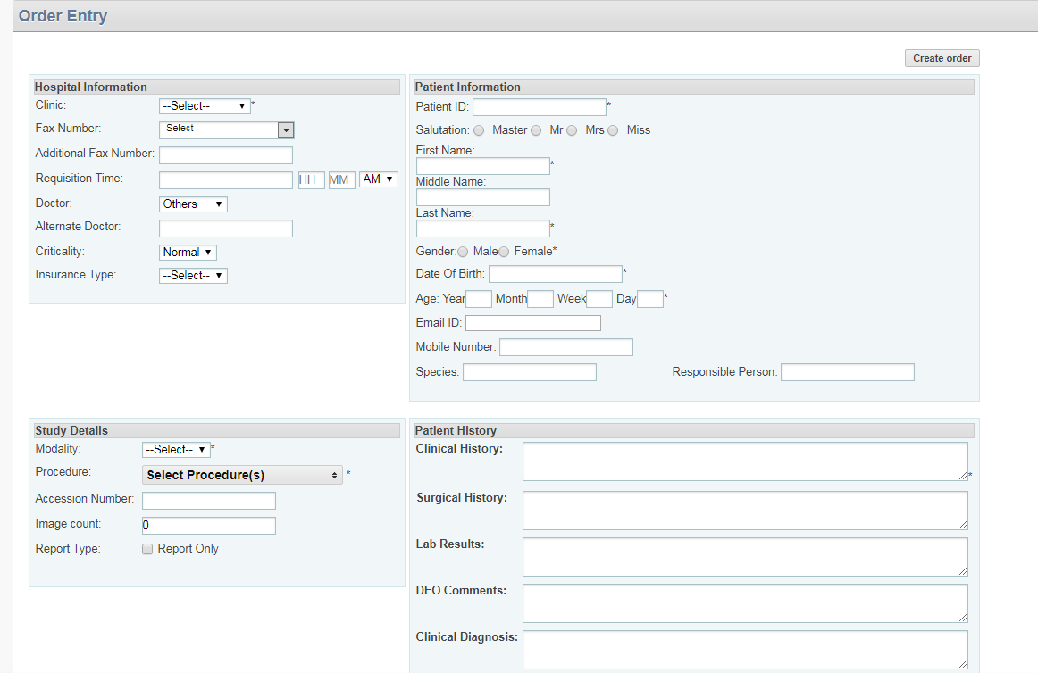

Slide 17
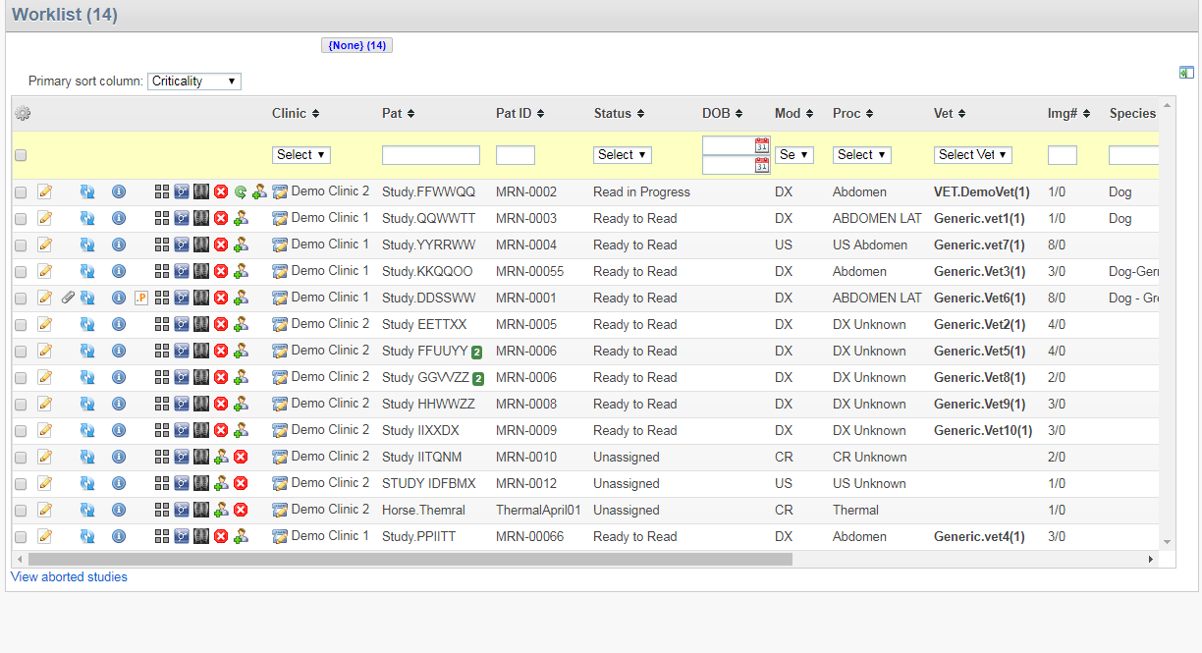

Slide 18
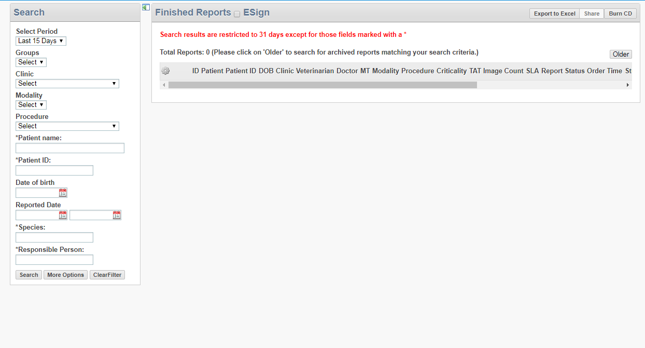

Slide 19
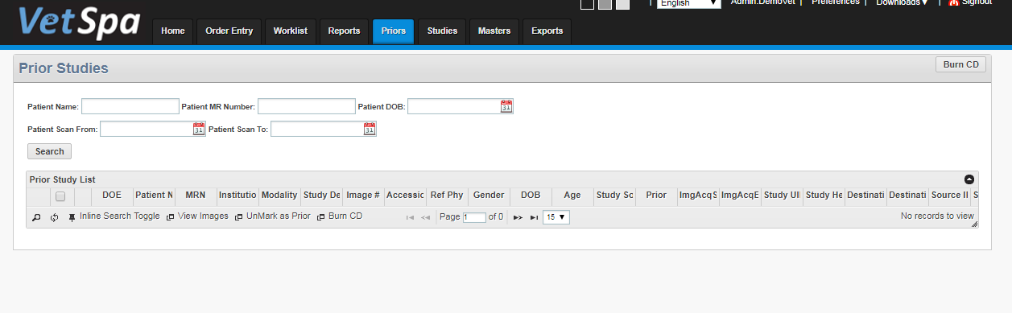

Slide 20
Methodology
Workflow for VETSpa
Workflow for creating Brand Awareness using Digital Marketing Strategy

Slide 21
Workflow for VETSpa:-
Patient comes for scan and order entry is created
Order Entry goes in Worklist and scan starts
Scan is transferred via DICOM router to server
Scanned images are stored in server and Auto assignment triggers
Vet. Radiologists views the Reports and finalize it
Report gets transferred from Worklist Finalized Reports

Slide 22
Workflow for creating Brand Awareness using DM
BOOTH
RESEARCH & ANALYSIS
Decided to participate in BSAVA Event 2018 to get an exposure for VETSpa (RIS-PACS for Veterinary)
First Event attended by Telerad Tech for VETSpa !
Found out the reasons to target European Countries and near by
Understood the market status for Veterinary Radiology in Europe and near by as well
Collected Primary Database for BSAVA Event which contains lists of Veterinary Radiologists, Veterinary Nurses, Veterinary Imaging Labs, Veterinary Care centers etc. and Secondary Database was used from company’s past conferences/seminars leads.

Slide 23
DIGITAL MARKETING EMAIL CAMPAIGNS
SOCIAL MEDIA PAID CAMPAIGNS
Email Campaigns were sent to Targeted Audiences (Primary Database + Secondary Database) via Leadsquared Marketing Automation .
Generic social Media posts were made related to VETSpa been showcased in BSAVA Event 2018.
Social Media paid campaigns were shot on LinkedIn and Facebook in order to engage maximum number of participants.
Telephonic Calls were made to people who opened the email invitation sent in previous step under email campaign.

Slide 24
MEASURING OUTREACH AT BOOTH IN BSAVA EVENT 2018 FOR VETSPA
To measure the outreach at the booth, visitors were requested to fill the feedback form.
Feedback Form usually contained Name, Address, Contact number and the source from they came to know about our booth

Slide 25
Sample Size:- Primary Database (4928) + Secondary Database (7933)
Sampling Method:- Random Sampling
Targeted Area for Research:- European Countries and near by regions to Europe as well
Duration:- 2.5 Months
Budget spent on Booth:- 1.5 lakhs
Budget Spent on Paid Campaigns for Social Media:- 14000- 16000
Transport, Logistics and Accommodation for 2 peoples for 5 days:- 4 – 5 lakhs
Floor Plan Budget to set the booth:- 1.5 Lakhs
Team Size:- 4 People
Mr. Ashwani Kumar Sinha- Global Head BD Mr. Mohan Mysore – Vice President Sales (US and UK) Mr. Rajesh Murthy – Digital Marketing Executive Ms. Shreyshi Varshney- Management Trainee- BD

Slide 26
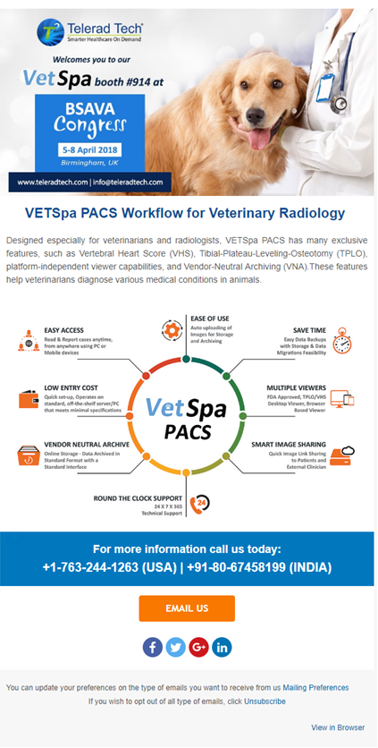
Email Flyer Content for BSAVA Event:-

Slide 27
Results
1. RESEARCH & ANALYSIS :- Primary Database of 4928 was collected manually based on Direct Search on Google, Facebook, LinkedIn.
Secondary Database (7933) was already available with the company which included Past conferences attended, Brochures received etc.
2. DIGITAL MARKETING EMAIL CAMPAIGNS :- Email campaigns were sent through Leadsquared tool between 22 March 2018 to 29 March 2018. For each email campaign, Open Rates for emails were observed.

Slide 28
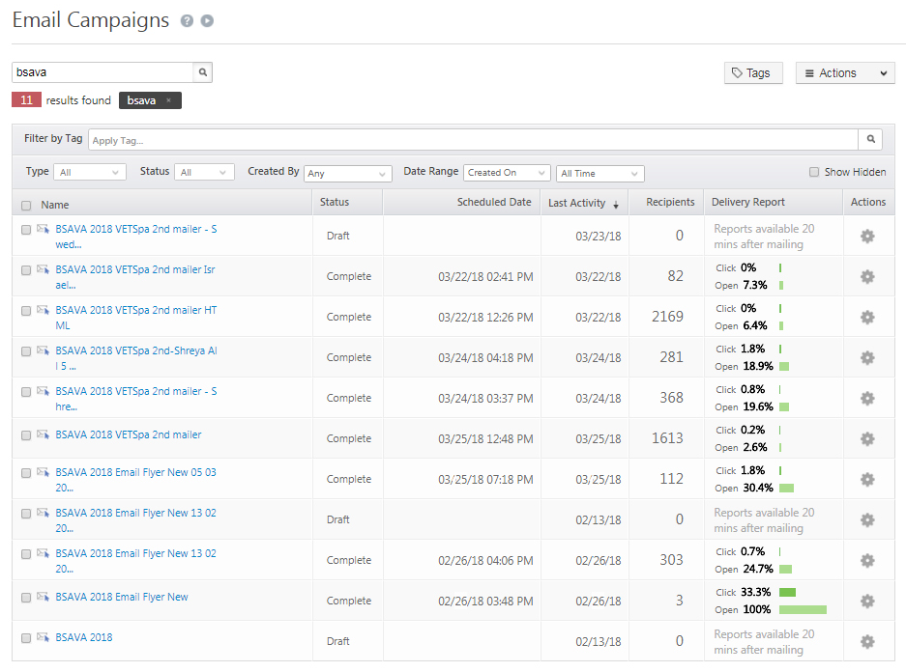

Slide 29
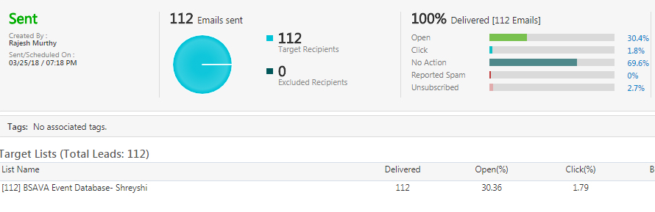
Open Rates for email campaigns

Slide 30
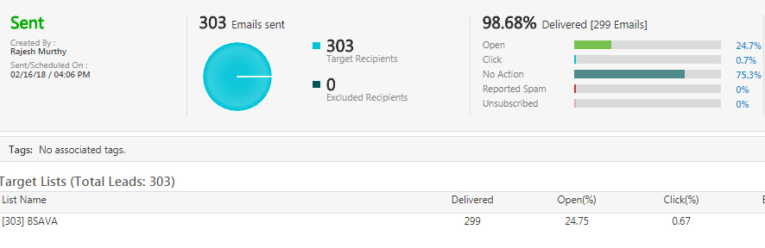

Slide 31
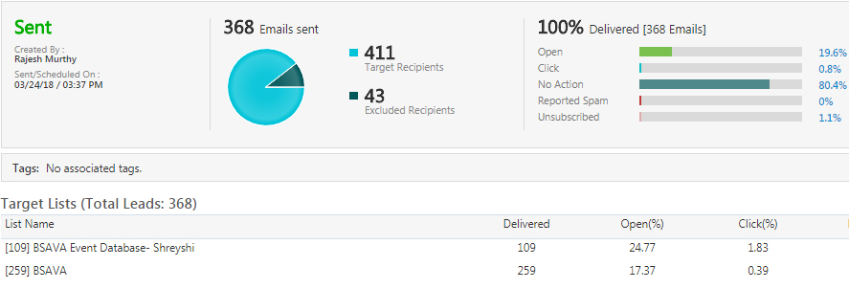

Slide 32
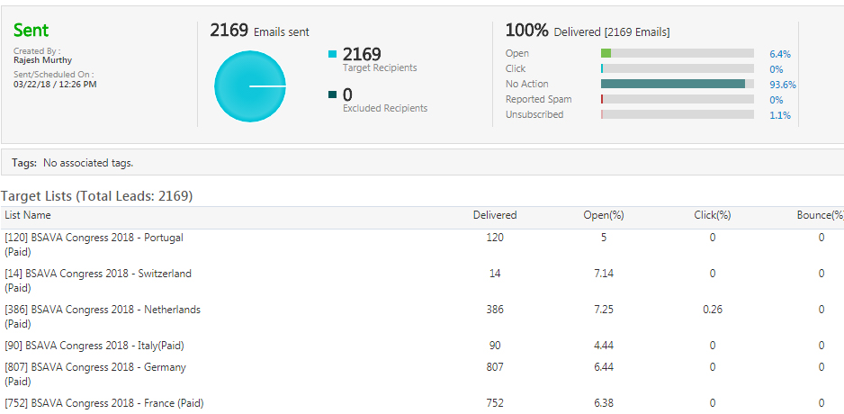

Slide 33
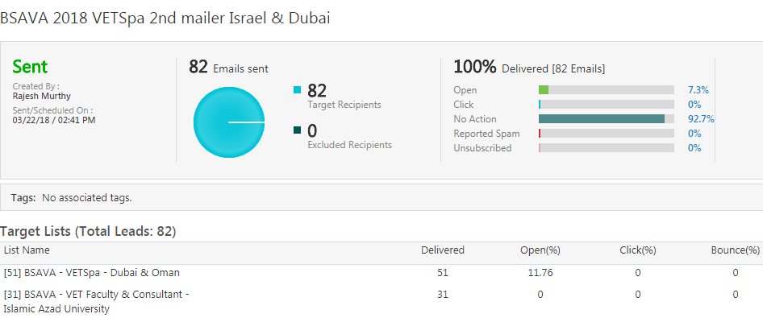

Slide 34
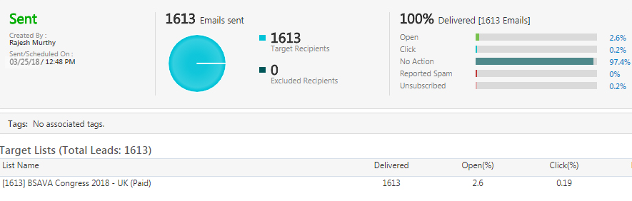

Slide 35
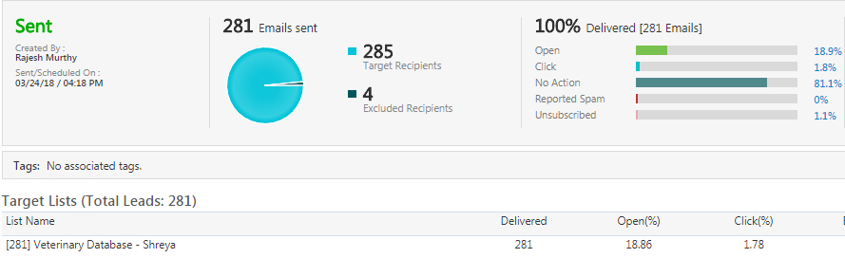

Slide 37
Observation Table
S. No: - | Email Campaign sent to total number of Email Ids | Observed Open rates for each Email campaign | Email flyers opened by the number of Email Ids | Date
1 | 112 Email Ids | 30.4% | 34 Email Ids | 25 March 2018
2 | 303 Email Ids | 24.7% | 74 Email Ids | 26 March 2018
3 | 368 Email Ids | 19.6% | 72 Email Ids | 24 March 2018
4 | 2169 Email Ids | 6.4% | 138 Email Ids | 22 March 2018
5 | 82 Email Ids | 7.3% | 6 Email Ids | 22 March 2018
6 | 1613 Email Ids | 2.6% | 41 Email Ids | 25 March 2018
7 | 281 Email Ids | 18.9% | 53 Email Ids | 34 March 2018
8 | 7933 Email Ids | 2.4% | 190 Email Ids | 29 March 2018

Slide 38
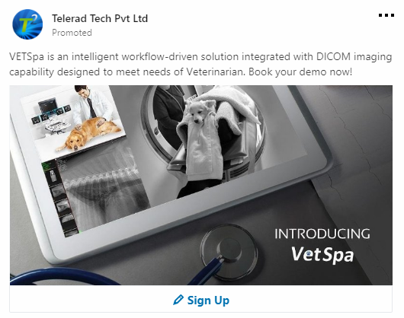
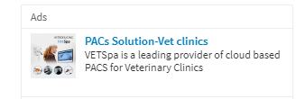
SOCIAL MEDIA PAID CAMPAIGNS VIA LINKEDIN
Campaign Name | Campaign Type | Total Engagements | Impressions
BSAVA 2018 Lead Generation | Sponsored Update | 4 | 403
BSAVA 2018 - VETSpa Text Ads | Text Ad | 3 | 10072

Slide 39
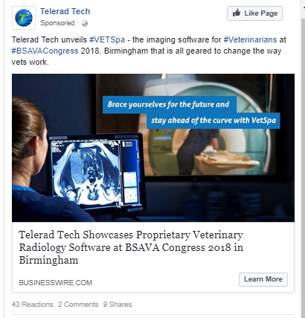
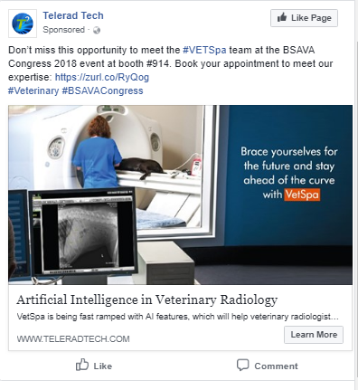
SOCIAL MEDIA PAID CAMPAIGNS VIA FACEBOOK
Campaign Name | Total Engagements | Impressions
Post: "Telerad Tech unveils #VETSpa - the imaging..." | 98 | 4804
BSAVA 2 days | 0 | 2274

Slide 40
Telephonic Callers List from Observed Open Rates (608) | (In numbers) | (In Percentage)
Contacted+ Confirmed | 180 | 29%
Not Interested | 118 | 19%
Didn’t Pick up | 58 | 10%
Contacted+ Not Confirmed | 252 | 42%

Slide 41
Twitter Generic Posts

Slide 42
Google+ Generic Posts

Slide 43
LinkedIn Generic Posts

Slide 44
Social Media Posts during the event

Slide 46
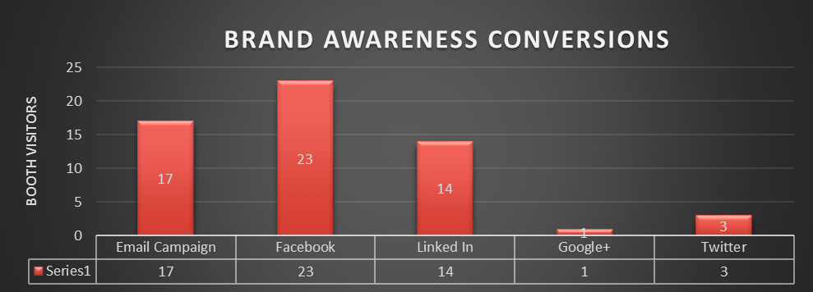
OUTREACH MEASURED FROM FEEDBACK FORMS

Slide 47
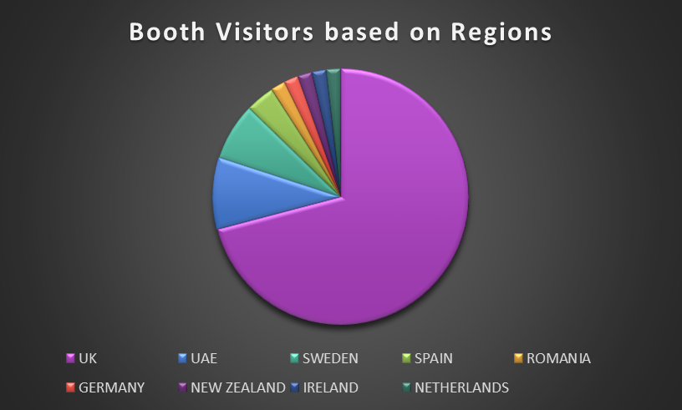

Slide 48
Conclusion
BSAVA Event which took place from 5th April to 8th April 2018 at United Kingdom was a successful event for Telerad Tech Private Limited, Bangalore. Also, the company was able to partnership successfully with 6 Veterinary Clinics/Hospitals located in Europe as well as near European region. 3 Veterinary Hospitals – UK 2 Veterinary Clinics- Romania Also, the company was able to develop 4-5 potential customers for VETSpa as well.

Slide 49
Recommendations
Digital Marketing at least needs 6 months- 8 months to capture maximum number of leads
Employee/Company should be actively involved on Social Media to improve the lead captures

Slide 50
Glimpses from BSAVA 2018

