Slide 1


Identifying Key Operational Challenges in Health Camp Management: A Study at
U4RAD XRAI Digital.
PRESENTATION
BY
MUDASSHIR KHAN
DR ALTAF YOUSUF MEER .
IIHMR DELHI.
2023-2025

Slide 2
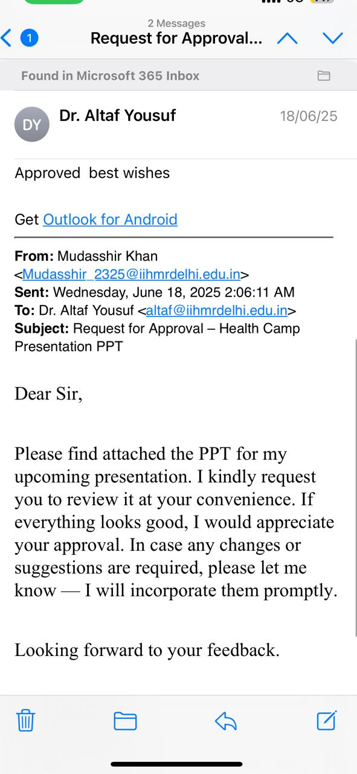
Mentor Approval

Slide 3
Introduction
U4RAD (You For Radiology and Diagnostics) is a pioneering digital healthcare company committed to enhancing diagnostic services through technology-driven solutions. It focuses on improving access, affordability, and efficiency of radiology and preventive health screening services across India.
The core mission of U4RAD is to bring diagnostic services closer to the people, especially in underserved and semi-urban areas, by organizing health camps and point-of-care diagnostic solutions. Their model combines B2B and B2C partnerships to offer comprehensive health check-up packages, including:
Digital X-rays
ECG (Electrocardiogram)
PFT (Pulmonary Function Test)
Blood Tests
Vitals
Audiometry
Physician consultation
These services are delivered in collaboration with trained healthcare staff, diagnostic technicians, and radiologists. The company uses a tech-enabled ecosystem to manage camp logistics, patient registration, report generation, and delivery through digital platforms.

Slide 4
Objectives of Your Study
‘To identify key challenges that negatively impact the operational flow of health camp management at U4RAD XRAI Digital.’

Slide 5
Methodology (1/2)
Study Setting
Health camps conducted by U4RAD XRAI Digital across various locations
Includes both B2B (corporate) and B2C
Study Population:
Employees & patient involved in health camps,

Slide 6
Methodology (2/2)
Study Design:
Mixed-method, descriptive study
Includes retrospective (past data) and prospective (real-time observation) components
Sampling Method:
Convenience sampling based on available camp data
Data Collection Tools:
Operational data sheets (Excel-based camp records)
Field observation checklists (patient flow, service delays, staff coordination)
Semi-structured interviews with camp employees
Staff feedback forms to gather insights on workload and challenges

Slide 7
Results (1/3)

Slide 8
Results (2/3)

Slide 9
Results (3/3)

Slide 10
RESULT4/4

Slide 11
Discussion (1/2)
Camp 1: Retrospective Data Analysis (200 Patients)
• Registration: 193 completed, 7 pending
• PFT (Pulmonary Function Test): 193 completed, 7 pending
• X-Ray: 190 completed, 10 pending
• Pathology: 84 completed, 116 pending
• Audiometry: 170 completed, 30 pending
• ECG: 181 completed, 19 pending
• Vitals: 176 completed, 24 pending

Slide 12
Discussion (2/2)
Key Observations & Issues Identified:
• Lack of clear communication between staff and patients.
• No signboards or visible instructions explaining the process flow.
• Patients were unaware of where to go first and often got confused.
• No tracking system to confirm which tests were done.
• Overcrowding occurred at certain testing points due to poor crowd management.
• Equipment failures and delayed staff reporting further impacted smooth operations.
• Some patients missed tests unintentionally; others skipped them by choice.

Slide 13
DISCUSSION

Slide 14
Camp 2: Improvements After Process Redesign Actions Taken Based on Camp 1 Findings:
• Introduction of TRF Form (Test Requisition Form):Patients received a TRF form at the registration desk. At each testing point, staff marked the completed test on the form. At the end, patients returned the form at registration to verify test completion and avoid missed procedures.
• Improved Staff Allocation: Adequate staff deployed for each service point, along with backup staff in case of absenteeism to ensure smooth workflow.
• Better Communication & Guidance: Clear signboards were installed and dedicated volunteers/staff guided patients throughout the process.
• Crowd Management: Structured patient movement with controlled flow to avoid overcrowding and confusion.
• Equipment Backup: Extra machines were arranged on-site to ensure uninterrupted service in case of equipment malfunction. Outcome of Camp 2:
• Almost all patients successfully completed their tests.
• Only a few test cases were left incomplete, and these were due to patient choice—not process failure
. • The new system significantly reduced confusion, improved service flow, and enhanced overall patient satisfaction.

Slide 15
Conclusion
The comparative analysis of two health camps revealed significant operational challenges in the first camp, primarily due to poor communication, lack of proper workflow guidance, and inadequate resource planning.
• The absence of a structured process led to missed tests, patient confusion, crowding, and inefficient staff utilization.
• After identifying these gaps, corrective measures such as TRF form implementation, proper staff allocation, signage, equipment backup, and process orientation were introduced in the second camp.
• As a result, test completion rates improved, patient confusion reduced, and overall camp efficiency increased significantly.
• This demonstrates that systematic planning, communication, and patient flow management are critical to the successful execution of health camps.

Slide 16
Recommendations
• Implement TRF Form in all future camps to ensure no test is missed.
• Standardize the patient flow process with a clear step-by-step sequence.
• Install signboards and visual aids in local language at all stations.
• Ensure adequate and trained staff at every service point.
• Deploy backup staff in case of last-minute absenteeism.
• Conduct pre-camp staff briefing to define roles and workflow.
• Carry backup equipment for critical diagnostic services.
• Assign an operations coordinator to monitor real-time execution.
• Collect and review patient feedback to continuously improve.

Slide 17
References (Only Vancouver Style)
World Health Organization India. Health Camp Toolkit – Quality Assurance and Service Delivery. WHO India; 2015. Available from: https://www.who.int/india/docs/default-source/default-document-library/health-camp-quality-toolkit.pdf.
Patil VN, Pandey B, Joshi M. Organising a health camp and its management. J Emerging Technol Innov Res (JETIR). 2021 Aug;8(8):e584–e590. Available from: https://www.jetir.org/papers/JETIR2108558.pdf.
Agarwal AK, Dash S, Biswal S, et al. Organizing health camp: opportunities for building public health skills. Indian J Community Med. 2024;49(1):228–230. doi:10.4103/ijcm.ijcm_52_23. Available from: https://journals.lww.com/ijcm/fulltext/2024/49010/organizing_health_camp__opportunities_for_building.39.aspx.

Slide 18

INVOLVEMENT IN COMMUNITY OUTREACH PROGRAMME (COP) ACTIVITIES
Total no. of visits done by the student: 7 (Goyala Dairy)
Activities done by student:
Mapping and listing of the area
Interaction with community FLWHs

Slide 19
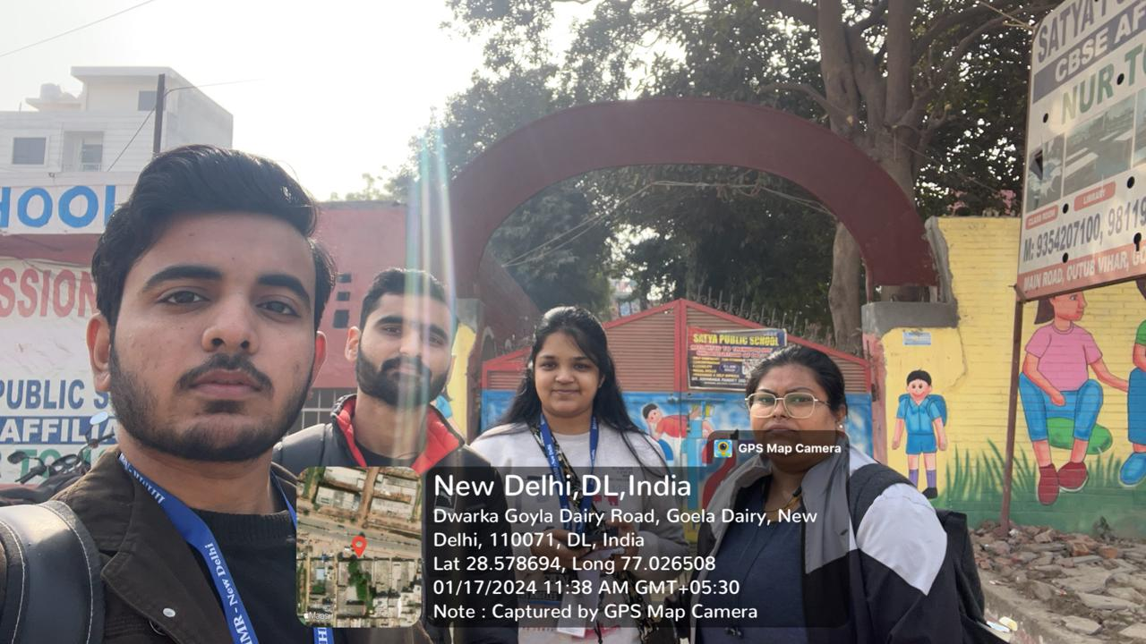
KEY LEARNINGS FROM COP ACTIVITIES
Understood community layout
Patience and Persistence are Required
Building Trust is Essential
Communication Must Be Two-Way and Culturally Sensitive
Measuring Impact and Seeking Feedback is Vital

Slide 20
Thank You
Any Questions

