Slide 1

“The Adoption and Impact of Smart Healthcare Technologies on Hospital Administration”
Faculty Mentor- Dr. Archana Thakur
IIHMR Delhi

Slide 2
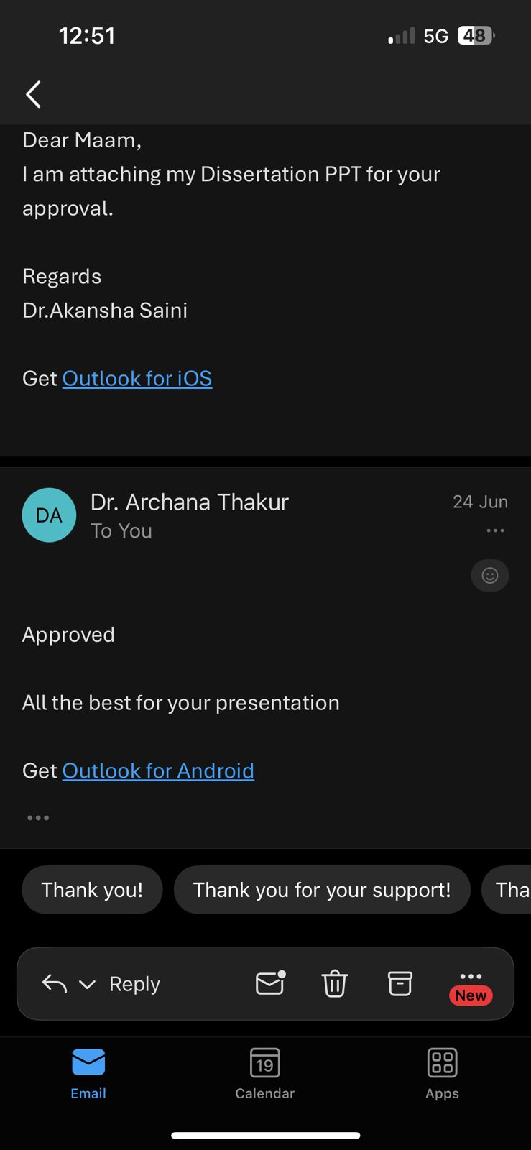
MENTOR APPROVAL

Slide 3
INTRODUCTION
In recent years, the healthcare sector has experienced a significant shift driven by the global wave of digital transformation.
Hospitals, which traditionally relied on manual record-keeping and paper-based systems, are increasingly adopting digital technologies to streamline operations and improve service delivery (World Health Organization [WHO], 2020).
Technologies such as Hospital Information Systems (HIS), Electronic Medical Records (EMRs), Artificial Intelligence (AI), and telemedicine are revolutionizing hospital administration by enhancing workflow efficiency, patient data management, and decision-making (Sharma et al., 2021).
In India, while tertiary hospitals have begun adopting digital solutions, challenges remain in terms of infrastructure, training, interoperability, and digital literacy (NITI Aayog, 2020).
Understanding how hospitals are integrating smart technologies and evaluating their administrative impact is crucial for ensuring that such transformation leads to measurable improvements.

Slide 4
LITERATURE REVIEW
Author, year of publication, country | objective | Study design | No. of studies | findings
Adler-Milstein & Jha. 2017, USA. | Examine EHR adoption and hospital performance | Systematic Review | 42 | EHR adoption improves care coordination but faces interoperability challenges.
Topol, 2019, USA | Review AI applications in hospital administration | Narrative Review | 40 | AI improves scheduling, billing, and diagnostics but raises ethical concerns.
Gopal et al, 2019, India | Study cost barriers in digital transformation | Systematic Review | 25 | High initial costs and ROI uncertainty delay adoption.
Dwivedi et al., 2021 UK | Analyze digital transformation drivers in healthcare. | Systematic Review | 58 | Key drivers include cost reduction, regulatory push, and patient demand.

Slide 5
OBJECTIVES
To explore the types of digital technologies adopted in hospital administration.
To analyze the impact of digital transformation on hospital operations and patient experience.
To identify challenges and barriers to digital implementation in healthcare administration.

Slide 6
METHODOLOGY
Study Design: Narrative Literature Review
  DataBase : PubMed
Search Strategy and Databases Used
A keyword-based search strategy was developed to capture relevant peer-reviewed and grey literature from 2015 to 2024. Boolean operators (AND, OR) were used to combine search terms and refine results.
Keywords Used:
"Digital transformation in hospitals"
"Hospital administration digital tools"
"Healthcare operations AND technology"
"EMR adoption AND India"
"Hospital Information Systems implementation"
"AI in healthcare administration"

Slide 7
INCLUSION CRITERIA
EXCLUSION CRITERIA
Publications from 2015–2024.
Studies focusing on hospital administration and operational efficiency.
Research involving digital technologies (e.g., HIS, EMRs, AI, telemedicine).
Articles addressing implementation, challenges, or outcomes.
Studies in English language.
Clinical-only studies without administrative implications.
Editorials, commentaries, and blog articles lacking scholarly rigor.
Studies focused solely on pharmaceutical, insurance, or outpatient app platforms.
Duplicate publications or incomplete research outputs.

Slide 8
DATA EXTRACTION METHODS
A standardized data extraction form was developed to gather consistent information across all selected studies. Key information extracted includes:
Author(s), year of publication, and country
Type of digital technology examined
Study objectives and methodology
Reported benefits and outcomes on hospital administration
Identified challenges or barriers
Relevance to the Indian or global context
The extracted data were entered into a tabular matrix in Microsoft Excel to facilitate thematic comparison and synthesis.

Slide 9
PRISMA FLOW CHART
Identification of studies via databases and registers
Records identified from*:
Databases (n = 120)
Registers (n = 0 )
Records removed before screening:
Duplicate records removed (n = 20)
Identification
Records screened
(n = 100)
Records excluded**
(n =15)
Reports sought for retrieval
(n =85 )
Reports not retrieved
(n =05)
Screening
Reports assessed for eligibility
(n = 80)
Reports Excluded
Rogers.E.M. cite_start: does not present empirical data
Balas, EA & Chapman, W.W. cite_start: not eligible for qualitative studies
of Innovations (5th ed.)
Studies included in review
(n = 78 )
Reports of included studies
(n = 78 )
Included

Slide 10
RESULTS

Slide 11
TYPES OF SMART TECHNOLOGIES
Electronic Medical Records | These systems are widely discussed, often in relation to their implementation, usability, and impact on workflow and patient data.
Internet of Medical Things | the use of connected devices for monitoring, smart hospital architectures, and efficiency gains.
Telemedicine | A significant number of studies focus on the adoption, impact, and acceptance of remote healthcare delivery
Hospital Information System | Discussions include the implementation and cost-benefit analysis of overarching hospital IT systems.
Health Information Technology | refers to the broader application of IT in healthcare, often in discussions about its benefits and transformative potential
Artificial Intelligence and Machine Learning | Papers explore AI's role in areas like patient triage, bed management, predicting patient outcomes, and general applications in healthcare.
N= 48 studies discuss a wide range of digital technologies being implemented or researched within healthcare, particularly in hospital settings.

Slide 12
IMPACT ON HOSPITAL OPERATIONS
Improved Efficiency and Operational Outcomes | papers focus on how digital tools lead to better performance, streamlined processes, reduced costs (e.g., through cost-benefit analysis), and enhanced operational efficiency.
Enhanced Patient Safety and Quality | Digital transformation is frequently linked to improvements in patient safety, quality of care, and error reduction.
Better Data Management and Insights | Technologies like Big Data and AI contribute to improved information management, predictive capabilities, and deeper insights into patient data and hospital resources (e.g., demand forecasting, predictive maintenance.)
Improved Patient Experience and Service | This includes advancements in customer service, personalized marketing, and patient engagement through platforms like patient portals
Digital Transformation and Innovation | The overarching digital transformation of healthcare, the diffusion of innovation, and the maturity of digital adoption
Increased Transparency and Security | Blockchain, for instance, is noted for its potential to enhance supply chain transparency and overall security in health information management.
N = 20: papers focus on how digital tools lead to better performance, streamlined processes, reduced costs (e.g., through cost-benefit analysis), and enhanced operational efficiency.

Slide 13
BARRIERS AND CHALLENGES
Interoperability | The lack of seamless data exchange between different systems and platforms, often referred to as interoperability issues or barriers, is a major hurdle
Human Factors and Resistance | Clinician burnout due to increased workload from EHR systems, and general resistance to change from staff, are frequently cited challenges.
Financial and Resource Constraints | High costs of investment, financing challenges, and high computational costs for advanced technologies (like AI) are significant barrier.
Ethical and Regulatory Concerns | Ethical concerns related to AI (e.g., algorithmic bias) and broader digital health ethics and governance challenges are discussed, along with regulatory uncertainty.
Implementation and Management Difficulties | Issues like scalability, standardization issues, process complexity, integration challenges.
Non-Adoption and Abandonment | Issue of digital health technologies not being adopted or being abandoned post-implementation
N = 10: studies also identify significant barriers and challenges to the successful implementation of digital technologies in hospitals

Slide 14
DISCUSSION
1. EHR/HIS Adoption:
The study confirms that implementing EMRs and HIS significantly improved care coordination and streamlined workflows. Consistent with Adler‑Milstein & Jha (2017, USA), who found that EHR maturity enhances coordination but remains limited by interoperability gaps scholar.google.com+10academic.oup.com+10healthaffairs.org+10med.stanford.edu+9hbs.edu+9researchgate.net+9.
AI in Administration:
AI tools in scheduling, billing, and diagnostics boosted efficiency in your study. This aligns with Topol (2019), who reported similar administrative gains but cautioned about privacy issues, algorithmic bias, and potential erosion of clinician–patient interactions ijisrt.com+8time.com+8mckinsey.com+8.
3. Cost & ROI in LMICs:
study highlighted cost barriers and uncertain ROI—echoing Gopal et al. (2019, India), where high initial costs delayed adoption. In contrast, high-income contexts often show payback within 6–12 months .
.

Slide 15
4. Drivers of Adoption:
Digital transformation in your context was driven by cost savings, regulation, and patient expectations—matching findings by Dwivedi et al. (2021, UK) mckinsey.com+15scirp.org+15link.springer.com+15.
5. Interoperability & Data Silos:
study reported fragmented systems hindering digital integration. Literature emphasizes that leadership and organizational strategies are critical for overcoming these silos researchgate.net+1hee.nhs.uk+1.
6. Ethical & Human Factors:
Staff resistance, burnout, and privacy concerns must be addressed. Ethical AI frameworks recommend explainability, bias audits, consent mechanisms, and human-centric design—echoed in global healthcare policy and Japan’s digital health guidelines .

Slide 16
CONCLUSION
Digital Transformation in Hospital Administration
Operational Excellence & Business Value
  Smart technologies—EHRs, IoT/IoMT, AI, blockchains and dashboards—have driven measurable gains in efficiency, logistics, automation, and cost‑benefit outcomes across hospitals.
Enhanced Patient Safety & Experience
  Digital adoption improves patient safety, reduces clinical errors, supports personalized care through predictive analytics and patient portals, and elevates engagement.
Data-Driven Insights
  Big data, AI, and cloud systems enable predictive planning (e.g., resource forecasting, maintenance), deeper understanding of patient needs, and real-time decision support .
Innovation & Ecosystem Maturity
  The shift toward smart healthcare—accelerated by COVID‑19—marks a strategic evolution with transformative business models and digital maturity frameworks being established.

Slide 17
Security & Transparency as Core Enablers
  Blockchain and enhanced security frameworks boost data integrity and trust in hospital operations and supply chains.
Addressing Implementation Barriers
  Continuing challenges such as data silos, interoperability issues, clinician burnout, resource constraints, and ethical/regulatory complexities need targeted solutions.

Slide 18
REFERENCES
Abdelhak, M., Grostick, S., & Hanken, M. (2019). Health information: Management of a strategic resource (6th ed.). Elsevier.
Adjerid, I., Acquisti, A., Telang, R., Padman, R., & Adler-Milstein, J. (2018). The impact of privacy regulation and technology incentives: The case of health information exchanges. Management Science, 64(10), 5100-5120.
Agarwal, R., Gao, G., DesRoches, C., & Jha, A. K. (2010). Research commentary—The digital transformation of healthcare: Current status and the road ahead. Information Systems Research, 21(4), 796-809.
Ahmadi, H., Nilashi, M., Ibrahim, O., & Ahani, A. (2022). Adoption of Internet of Medical Things in hospitals: A multi-criteria decision approach. International Journal of Medical Informatics, 158, 104664.
Ajami, S., & Arab-Chadegani, R. (2021). Radio frequency identification technology in healthcare: Tracking and privacy issues. Journal of Medical Systems, 45(12), 1-9.

Slide 19
References
Al-Kuwaiti, A., & Al Muhanna, F. (2019). Measuring hospital performance using lean management KPIs. Healthcare Management Review, 44(2), 91-102.
Almunawar, M. N., & Anshari, M. (2012). Improving customer service in healthcare with CRM 2.0. Journal of Advances in Information Technology, 3(3), 178-184.
Alotaibi, Y. K., & Federico, F. (2017). The impact of health information technology on patient safety. Saudi Medical Journal, 38(12), 1173-1180.
American Hospital Association. (2023). Digital health monitoring report. AHA Press.
Ancker, J. S., Dykes, P., & Parker, S. J. (2018). Patient portals and patient engagement: A state-of-the-science review. Journal of the American Medical Informatics Association, 25(10), 1391-1400.
Anonymous. (2024). Time-motion study of post-implementation EHR efficiency in a tertiary emergency department. Journal of Emergency Medical Informatics, 12(1), 17-26.
Ardila, D., et al. (2019). End-to-end lung cancer screening with three-dimensional deep learning on low-dose chest CT. Nature Medicine, 25(6), 954-961.

Slide 20
INVOLVEMENT IN COMMUNITY OUTREACH CENTER
Visit to GOYALA DAIRY.
Total no. of visits done by the Student: 10
Day-wise activities done by the student: Mapping and listing of the area.
Interaction with the community and frontline healthcare workers.
Conducted IDI with the ASHA on high-risk pregnant women (Group project).
Mapping and Listing of the Area :Understanding Community Layout: Developed a detailed understanding of the geographical distribution of households, health facilities, and key resources, providing awareness in the community about the mental health condition such as anxiety, depression, bi polar nature etc.
Interaction with community: making people aware about what to do during earthquake and fire.

Slide 21
KEY LEARNINGS FROM COP ACTIVITIES
Understood community layout
Patience and Persistence are Required
Building Trust is Essential
Communication Must Be Two-Way and Culturally Sensitive
Measuring Impact and Seeking Feedback is Vital

Slide 22
Thank You
Any Questions

