Slide 1


Return on Investment for a case of buying Medical Imaging AI
CARPL.ai Pvt. Ltd.
  Presenter - Dr. Diya Gouchwal
        Mentor - Prof. Divya Agarwal
(Associate Dean- Admissions, Accreditations and Marketing)
(International Institute of Health Management Research, New Delhi)

Slide 2
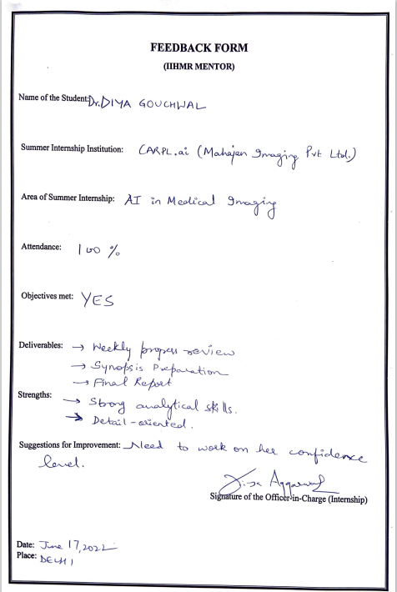
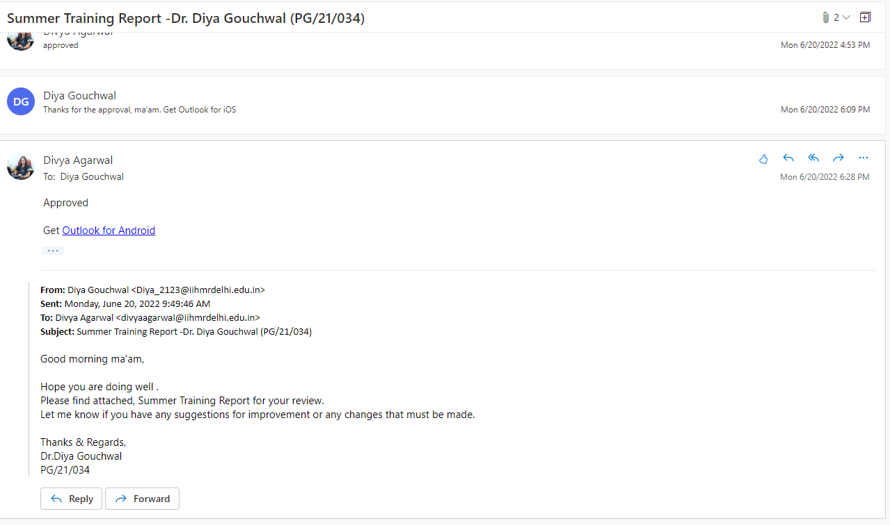
Screenshot of Approval

Slide 3
INTRODUCTION
What is AI ?
Artificial intelligence (AI) is a subfield of computer science concerned with the creation of intelligent machines that operate and react in the same manner as humans do.
The simulation of human intellectual processes by computers, particularly computer systems, is known as artificial intelligence (AI).
AI in Medical Imaging ?
The demand for improved clinical treatment quality and efficacy was a driving force for the introduction of AI in medical imaging.
Radiology was one of the earliest medical specialties to use digital technologies.

Slide 4
INTRODUCTION
Making a case for buying Medical Imaging AI :
How to define the ROI
There have been many claims about technologies making healthcare better (Quality & Efficiency) and more affordable. Artificial intelligence (AI) is one of the few innovations that can deliver on these promises.
In this Study, let’s look at how AI can improve healthcare systems, without compromising on quality and costs.
The main barrier for AI adoption in clinical practice is the limited examples of return on investment. Healthcare providers must justify using their budget to buy an AI solution. It is also an essential step to getting any innovative tool to help patients.
The medical AI industry needs evidence of a positive business case, showing cost-effective improvements.

Slide 5
OBJECTIVES OF THE STUDY
The goal is to determine the Return on Investment in terms of Monetary, Efficiency, and Quality Gain while purchasing medical imaging AI for the Biggest Hospital in North India.
Furthermore, the objective was also to identify barriers and facilitators to the implementation of artificial intelligence (AI) applications in clinical radiology in the Biggest Hospital in North India.

Slide 6
METHODOLOGY
METHODOLOGY
Secondary Data Analysis was done to define the ROI for a case of buying Medical Imaging AI & to address the Facilitating & Hindering Factors in the Implementation of AI applications in Radiology.
Research Methodology
Research Design – Descriptive study
Sources of Data – Secondary Data
Data Type – Secondary Data
Data Collection Method – Literature Survey & Interviews (Unstructured)
Data Sources –Published articles , Websites, Blogs ,Radiologists Interviews
Data Analysis- The data was complied, tabulated & analysed in Ms-Excel
Search Terms – Artificial Intelligence, Chest X-rays, Quality Gain, Efficiency Gain, Quality Gain

Slide 7
DEFINING THE CASE
DEFINING & PROVING The RETURN ON INVESTMENT FOR MEDICAL IMAGING AI
    ( 3-STEP APPROACH )
    1- Understand the incentives of the Healthcare System
    2- Define the AI’s benefits-
      Insight CXR by LUNIT
      Chest Eye CAD by OXIPIT
      qXR v3.0 by Qure.ai
    3- Match the benefits with incentives

Slide 8
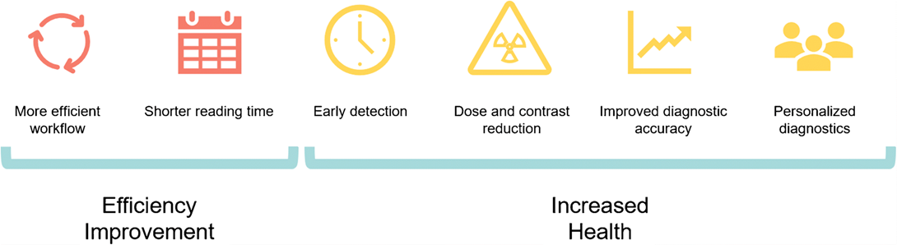
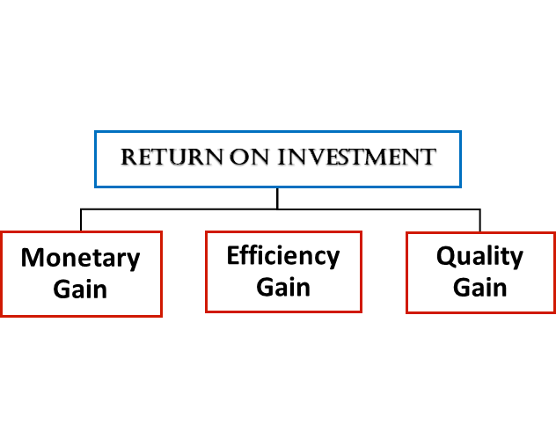
RESULTS
The promise of AI in radiography has been that it will improve health care while decreasing expenses.
Six clinical goals can be aided by AI for a more effective process.

Slide 9
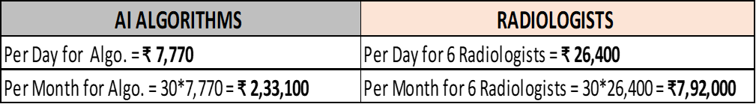
RESULTS
Monetary Gain
Now, the Headcount of the Radiologist reporting Chest X-rays has reduced, because AI detected normal.
Total Monetary Gain for a Month, by reducing the number of Radiologist from 6 to 3 in headcount.
                = ₹ 7, 92,000 - 3, 96,000
                = ₹ 3, 96,000
Now as we can check, for AI Algorithm it is ₹2,33,100 & For Radiologists it is ₹3,96,000 per month.
RESULT
Headcount of the Radiologists reporting CXR’s have been reduced.

Slide 10
RESULTS
Efficiency Gain
Interpretation of Chest Radiographs to aid in the Triage of patients during COVID-19
      CASE 1 – Case of a COVID-19 suspected patient
      CASE 2 - Case of a Patient planning for a surgery due to some other reason during the
      COVID-19 outbreak (Emergency Surgery)
Case of Mammography of a Patient, with Biopsy done same day without delay
RESULT
By using AI in Radiology, EFFICIENCY GAIN/ OPERATIONAL GAIN can be seen as follows:-
    Increased No. of scans
    AI auto reports normal scans & Radiologist reports abnormal
    Triaging
    Case Rating by Prioritization
    Work List Prioritization
    Auto reporting
    Patient Experience Increases
    Patient Satisfaction Increases

Slide 11

RESULTS
Quality Gain
A simplified way to look at the quality gain is by estimating how many actionable findings were missed by radiologists.
A well-performing AI algorithm spots these easy-to-miss early-stage findings such as lung cancers, later-stage treatments may no longer be necessary.
AI is helping Us Fight the War Against TB- DeepTek.ai, Inc.
AI helps to detect what human misses.

Slide 12

CONCLUSION
AI ALGORITHM - Insight CXR by LUNIT - Chest Eye CAD by OXIPIT - qxr v3.0 by Qure.ai | MONETORY GAIN | EFFICIENCY GAIN | QUALITY GAIN
 | ~No. of Radiologists reporting CXR'S have been reduced (Headcount of the radiologists reduced from 6 to 3 in no.) | ~AI autoreports normal scans & Radiologist reports abnormal | ~AI helps detects what human misses
 |  | ~Increased no. of scans | ~Reduces False Negatives
 |  | ~Triaging
 |  | ~Case rating by Prioritization
 |  | ~Work list Prioritization
 |  | ~Autoreporting
Biggest challenges in AI adoption
Success of AI adoption in Healthcare (Clinical Radiology)
Failure of AI adoption in Healthcare (Clinical Radiology)
Facilitating factors
Hindering Factors
In order for AI applications to contribute to the improvement of the quality and efficiency of clinical radiology, implementation processes need to be carried out in a structured manner, thereby providing evidence on the clinical added value of AI applications.

Slide 13
REFERENCES
(Geis, J. Raymond, et al. ‘Ethics of Artificial Intelligence in Radiology: Summary of the Joint European and North American Multisociety Statement’. Journal of the American College of Radiology: JACR, vol. 16, no. 11, Nov. 2019, pp. 1516–21. PubMed,https://doi.org/10.1016/j.jacr.2019.07.028
(Bitencourt, Almir, et al. ‘AI-Enhanced Breast Imaging: Where Are We and Where Are We Heading?’ European Journal of Radiology, vol. 142, Sept. 2021, p. 109882. PubMed, https://doi.org/10.1016/j.ejrad.2021.109882),https://doi.org/10.1016/j.ejrad.2021.109882
(Strohm, Lea, et al. ‘Implementation of Artificial Intelligence (AI) Applications in Radiology: Hindering and Facilitating Factors’. European Radiology, vol. 30, no. 10, 2020, pp. 5525–32. PubMed Central), https://doi.org/10.1007/s00330-020-06946-y
“Making a Case for Buying Medical Imaging AI: How to Define the Return on Investment.” Aidence, 22 Feb. 2021, https://www.aidence.com/articles/medical-imaging-ai-roi/.
Larson, David B., and Giles W. Boland. “Imaging Quality Control in the Era of Artificial Intelligence.” Journal of the American College of Radiology: JACR, vol. 16, no. 9 Pt B, Sept. 2019, pp. 1259–66. PubMed, https://doi.org/10.1016/j.jacr.2019.05.048.
https://www.researchgate.net/publication/359006926_Quality_use_of_artificial_intelligence_in_medical_imaging_What_do_radiologists_need_to_know
“Benefits of Implementing AI in Medical Imaging.” VITech, 15 Sept. 2021, https://vitechteam.com/benefits-of-implementing-ai-in-medical-imaging-most-significant-use-cases/.

Slide 14
Final Poster of
Internship Presentation

Slide 15


“ Return on Investment for a case of buying Medical Imaging AI ”
Author: Dr. Diya Gouchwal Guide: Prof. Divya Agarwal
INTERNATIONAL INSTITUTE OF HEALTH MANAGEMENT & RESEARCH , DELHI
Keywords: Artificial Intelligence, Deep Learning, Computer- Aided Detection(CAD), Chest X-rays
INTRODUCTION
DEFINING & PROVING
The RETURN ON INVESTMENT FOR MEDICAL IMAGING AI
CONCLUSION
There have been many claims about technologies making healthcare better or more affordable. Artificial intelligence (AI) is one of the few innovations that can deliver on both these promises.
AI can improve healthcare systems, without compromising on quality and costs. The main barrier for AI adoption in clinical practice is the limited examples of return on investment. Healthcare providers must justify using their budget to buy an AI solution. It is also an essential step to getting any innovative tool to help patients.
The demand for improved clinical treatment quality and efficacy was a driving driver for the introduction of AI in medical imaging.
Biggest challenge in AI adoption
The lack of instances of return on investment is the biggest impediment to AI adoption in clinical practise. Healthcare providers must be able to justify spending money on an AI solution. It's also a prerequisite for obtaining any unique patient-assistance gadget.
Another obstacle for establishing clinical value with AI is the actual technical implementation and deployment of these algorithms.
Although many AI products have FDA clearance and CE certification, this does not ensure the increased therapeutic value.
Success of AI adoption in Healthcare
"Radiology is not a standalone“ Because radiology is used in almost every area, the return on investment may not be limited to radiology.
Failure of AI adoption in Healthcare
Although AI has the potential to improve radiology's efficiency and accuracy, it also has flaws and biases.
The widespread application of AI-based intelligent and autonomous systems in radiology has the potential
to increase the danger of systemic mistakes with serious consequences, as well as raise significant ethical
and societal challenges.
( 3-STEP APPROACH )
1- Understand the incentives of the Healthcare System
2- Define the AI’s benefits-
  Insight CXR by LUNIT
  Chest Eye CAD by OXIPIT
  qXR v3.0 by Qure.ai
3- Match the benefits with incentives
Return on Investment
Monetary Gain
Efficiency Gain
Quality Gain
OBJECTIVE
The goal is to determine the Return on Investment in terms of monetary, efficiency, and quality gain while purchasing medical imaging AI. Furthermore, The Biggest Hospital in North India will identify impediments and facilitators to the implementation of artificial intelligence (AI) technology in clinical radiology for reporting Chest X-rays.
RESULTS
METHODOLOGY
AI ALGORITHM - Insight CXR by LUNIT - Chest Eye CAD by OXIPIT - qxr v3.0 by Qure.ai | MONETORY GAIN | EFFICIENCY GAIN | QUALITY GAIN
 | ~No. of Radiologists reporting CXR'S have been reduced (Headcount of the radiologists reduced from 6 to 3 in no.) | ~AI autoreports normal scans & Radiologist reports abnormal | ~AI helps detects what human misses
 |  | ~Increased no. of scans | ~Reduces False Negatives
 |  | ~Triaging
 |  | ~Case rating by Prioritization
 |  | ~Work list Prioritization
 |  | ~Autoreporting
Bibliography
Secondary Data Analysis was done to define the ROI for a case of buying Medical Imaging AI & to address the Facilitating & Hindering Factors in the Implementation of AI applications in Radiology.
https://doi.org/10.1016/j.jacr.2019.07.028 (Geis, J. Raymond, et al. ‘Ethics of Artificial Intelligence in Radiology: Summary of the Joint European and North American Multisociety Statement’. Journal of the American College of Radiology: JACR, vol. 16, no. 11, Nov. 2019, pp. 1516–21. PubMed
https://doi.org/10.1016/j.ejrad.2021.109882 (Bitencourt, Almir, et al. ‘AI-Enhanced Breast Imaging: Where Are We and Where Are We Heading?’ European Journal of Radiology, vol. 142, Sept. 2021, p. 109882. PubMed, https://doi.org/10.1016/j.ejrad.2021.109882)
https://doi.org/10.1007/s00330-020-06946-y (Strohm, Lea, et al. ‘Implementation of Artificial Intelligence (AI) Applications in Radiology: Hindering and Facilitating Factors’. European Radiology, vol. 30, no. 10, 2020, pp. 5525–32. PubMed Central)
Sources of Data | Secondary Data
Study Design | Descriptive Study
Data Analysis | The data was complied, tabulated & analysed in Ms-Excel.

Slide 16

ANY QUESTIONS ?
15

Slide 17
INTERNSHIP EXPERIENCES
What did I learn ?
Overall self comments on Internship
ROI in a case of Medical Imaging AI
AI Ecosystem in Imaging
AI- Onboarding
Deployments
Clinical Trials for Regulatory Approval
Business case Identification
Learning of AI Algorithm
CARPL Analytics Platform
Relationship Building
R&D
It was my 1st experience of working in an Organizational setup.
Learned a lot throughout these 3 months.
Professional communications
Teamwork Skills
Software Education
Networking

Slide 18
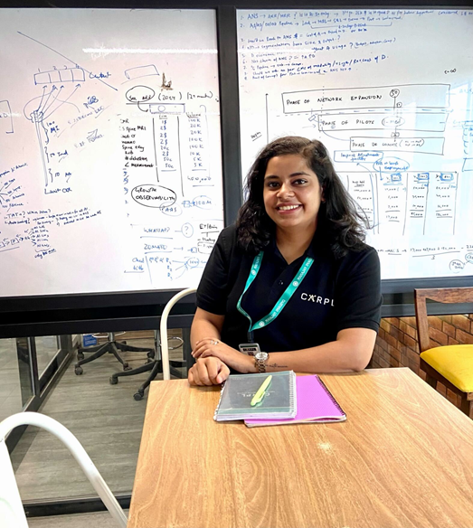
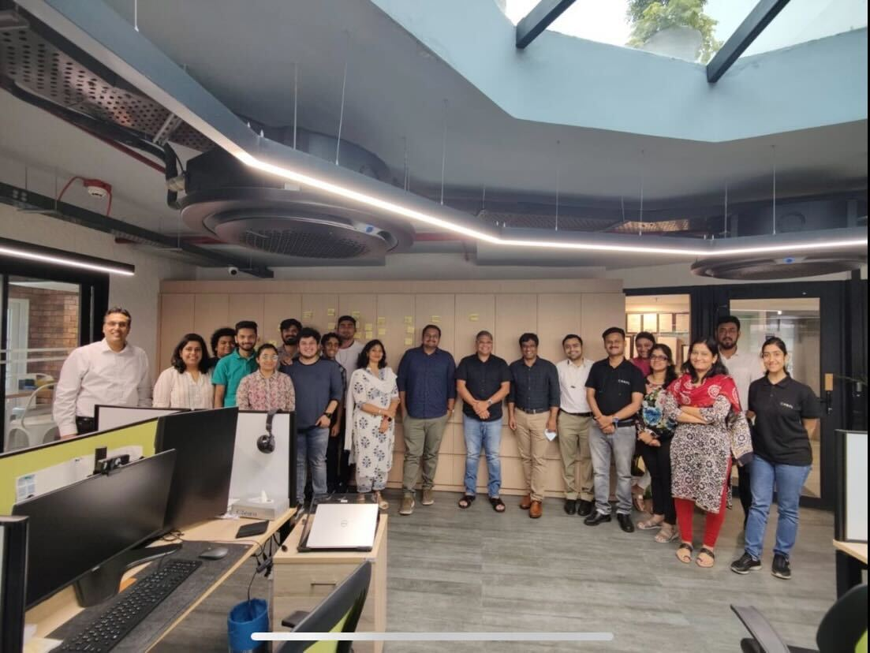
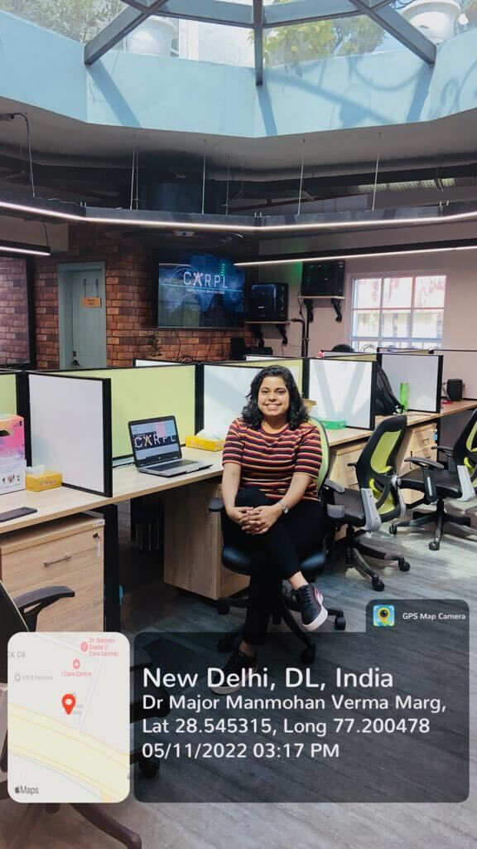
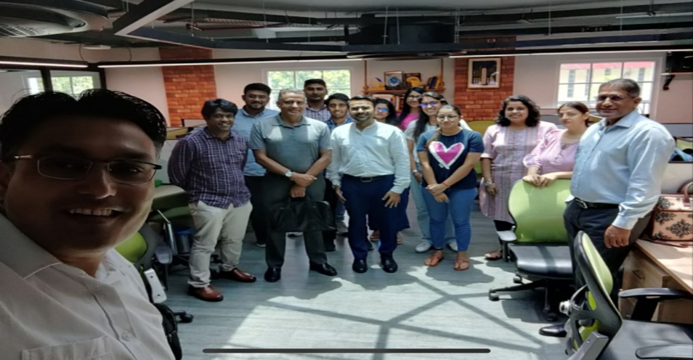
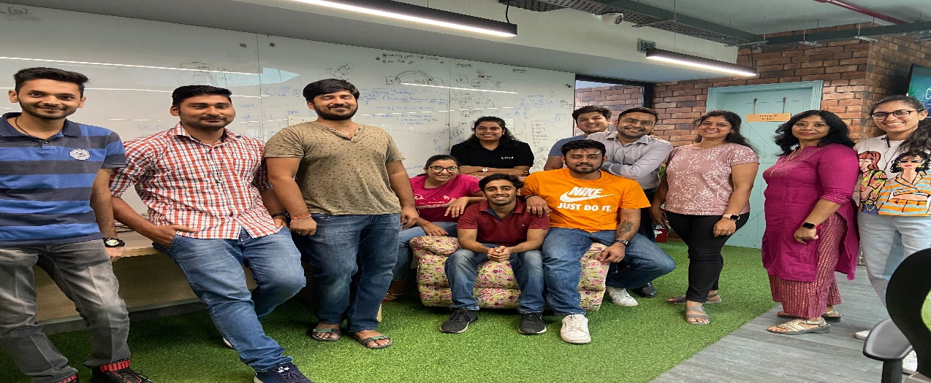
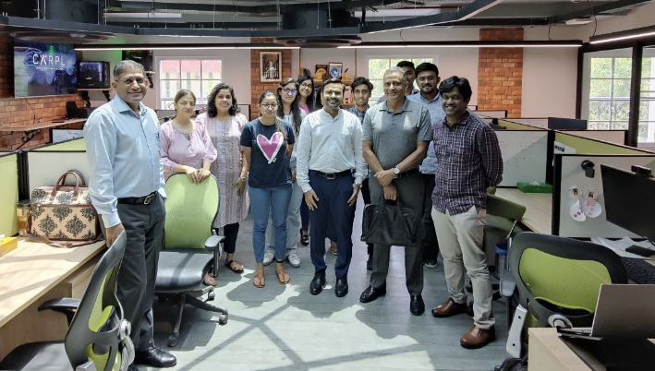
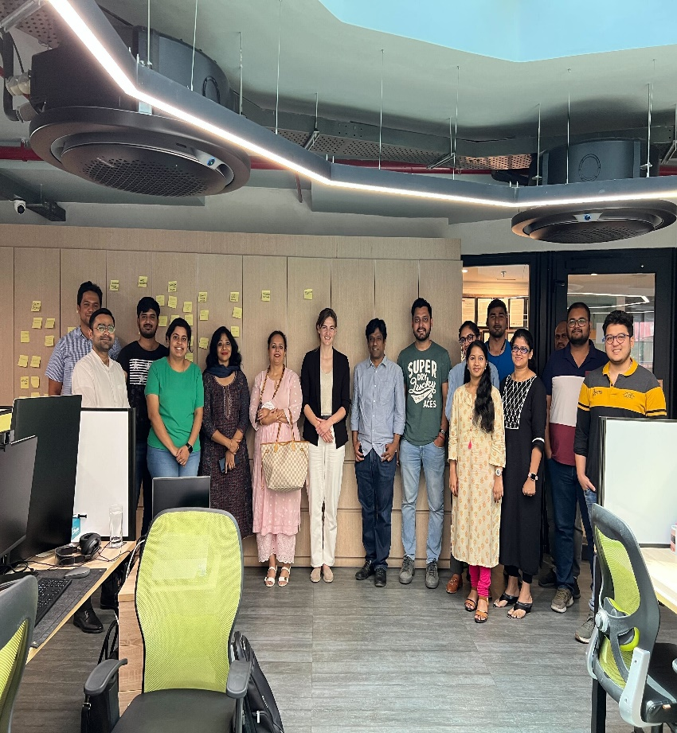
PICTORIAL JOURNEY

Slide 19


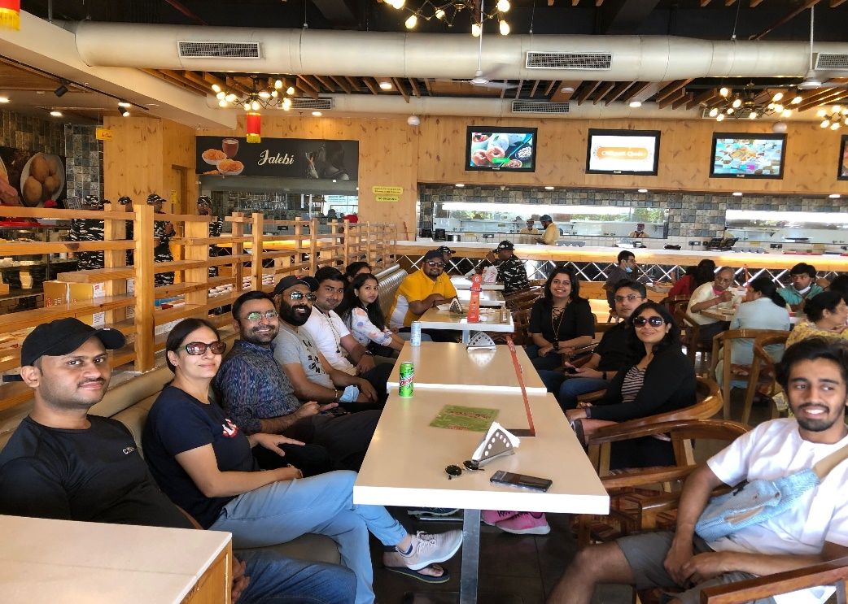

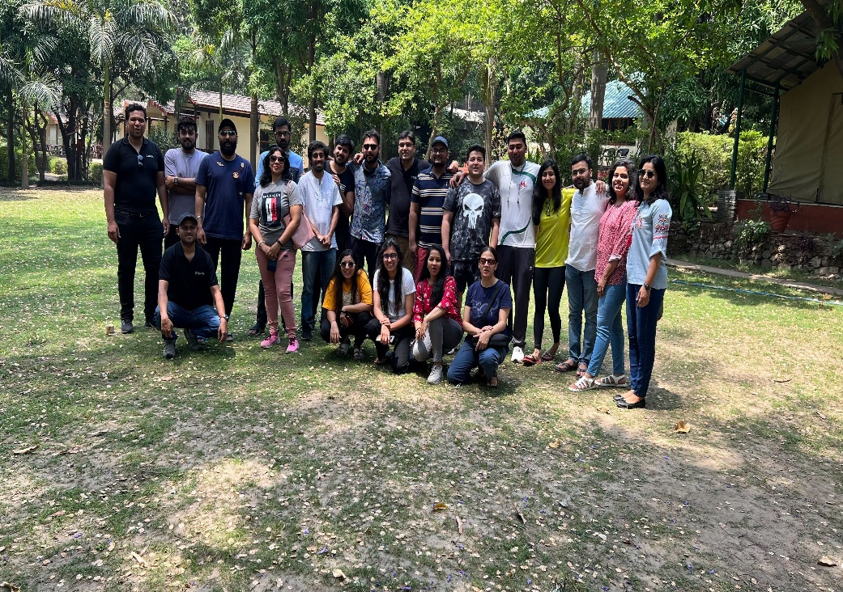

PICTORIAL JOURNEY

