Slide 1
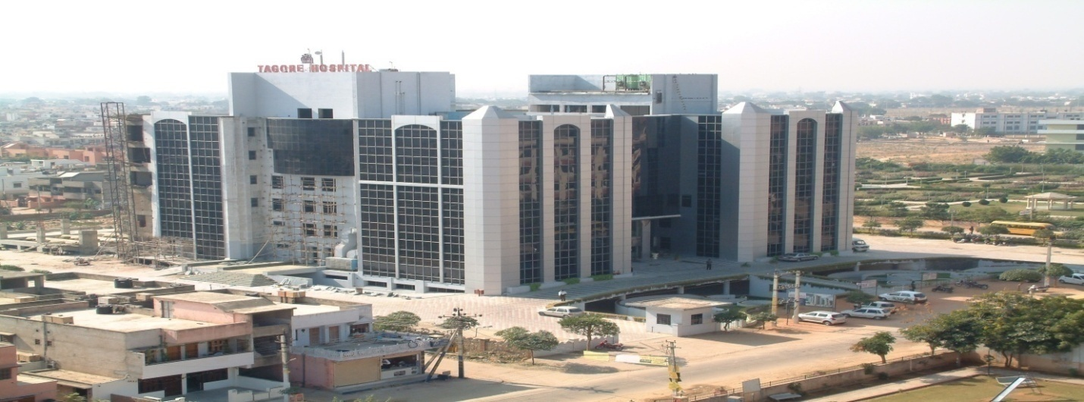

“UNDERREPORTING OF ERRORS COMPROMISING PATIENT SAFETY”
Tagore Hospital & Research Centre,Jaipur(THRI)

Slide 2
Reflection from Internship
Practical exposure is an integral part of our Postgraduate Diploma in Hospital and Health Management (PGDHM).
With the similar objective in mind I joined the Tagore Hospital & Research Institute as a quality manager on dated 1st January 2011.
The learning that I extracted from the experience,not only enriched me in terms of
providing knowledge as to how an established private hospital runs and prepares for NABH,but also
gave me insights into my ownself,
Imparted priceless lessons of patience,
dedication and
importance of good behavioural communication.

Slide 3
Introduction
The simplest definition of patient safety is the prevention of errors and adverse effects to patients associated with health care(WHO).
There is a problem of practice whereby errors are not reported. Unreported errors and misattribution of errors not only affect patient safety and health, but may increase the risk for patient harm in the future.
To Err Is Human: Building a Safer Health System” (Kohn, Corrigan, & Donaldson, 2000
Learning from mistakes is key to maintaining and improving the quality of care.

Slide 4
Rationale of Study
according to NABH,the standard of 6th chapter of NABH that is Continous Quality Improvement(CQI) demands that sentinel events are reported by hospital.The standard of the chapter is as follows:
“Sentinel Events are intensively analyzed”

Slide 5
Objectives of the Study.
The general objective of this study is
To find out the barriers in event reporting and thus improving the quality of services provided at hospital on basis of Patient safety survey. To improve patient safety and quality of care through implementation of safety systems and creating a culture of safety.
The specific objectives are:
To analyse the error reporting level in hospital.
Attempt to explain why errors are underreported or barriers of underreporting.
The study was conducted to assess the need for developing a system & encourage error reporting in indoor patient.
To assess and understand the issues at the time of delivery of care to patient.
Study will help raise safety awareness throughout the organization and
To develop a strategic plan to improving the patient safety standards.

Slide 6
Methodology of Study
descriptive & quantitative research methodology.
Cross Sectional Study (Quantitative).
The Hospital Survey on Patient Safety Culture (HSOPSC) instrument was used to measure perceptions of nurses on patient safety culture.The instrument contains 42 items which will measure 12 dimension.
AHRQ(Agency for health care research and quality) tool was used for data entry and its analysis.
The entire study was conducted in following steps-
Primary Data-
Secondary Data-
Sample Size-includes all registered nurses working in clinical areas of Tagore hospital.It was 100% coverage of nursing staff and thus sample size is 100% representative of staff.
Copies of the surveys were distributed to 80 RNs. A total of . The total response rate for this study was 83%.

Slide 7
Findings(Composite Frequency)
Teamwork Within Units
Supervisor/Manager Expectations & Actions Promoting Patient Safety
Organizational Learning--Continuous Improvement
Management Support for Patient Safety
Overall Perceptions of Patient Safety
Feedback & Communication About Error
Communication Openness
Frequency of Events Reported
Teamwork Across Units
Staffing
Handoffs & Transitions
Nonpunitive Response to Error

Slide 8
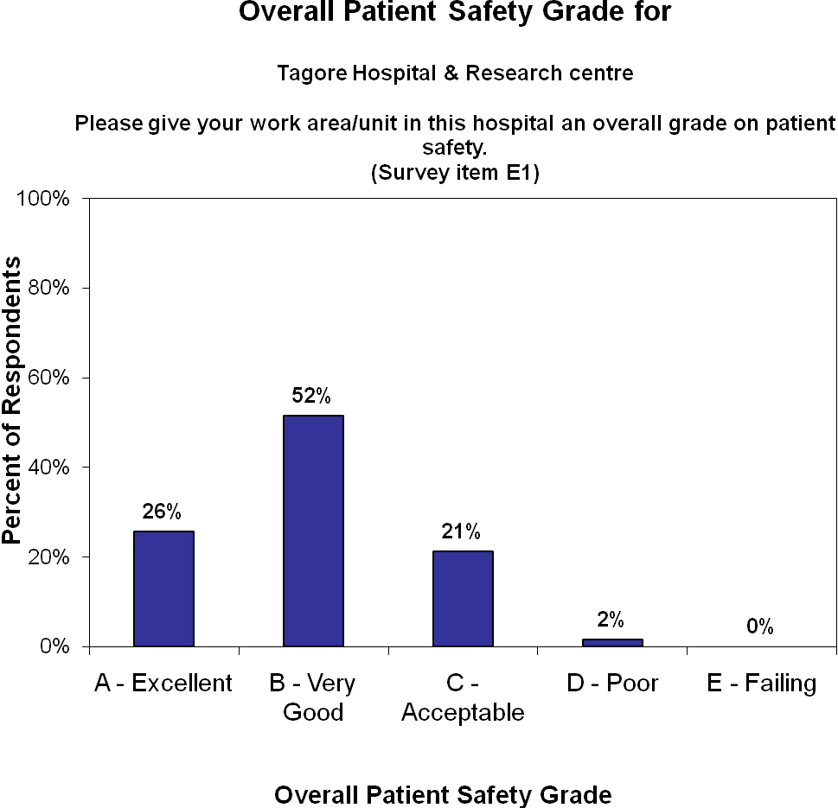

Slide 9
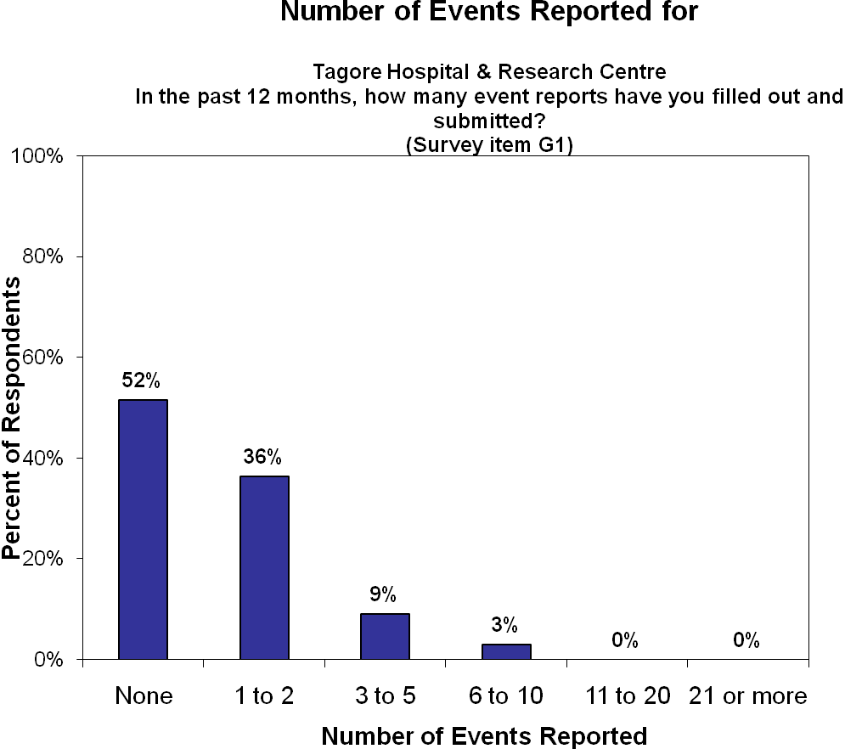

Slide 10
Patient Safety Strength & weakness based on data analysis
(a) Measures of Strengths
great teamwork within units.
97% nurses agree that People support one another in this unit
100% people treat each other with respect in hospital
77% staff give positive response that supervisor says a good word when he sees a job done according to established patient safety procedures.
79% staff say that supervisor seriously considers staff suggestions for improving patient safety.
83% nurses say that we are actively doing things to improve patient safety.
86% staff feel that hospital management provides a work climate that promotes patient safety.
88% staff agree that We have enough staff to handle the workload
Shift changes are never problematic in Tagore Hospital.

Slide 11
(b)Measures of Weaknesses-
52% staff feel that whenever pressure builds up, my supervisor wants us to work faster, even if it means taking shortcuts and supervisor overlooks patient safety problems that happen over and over.
68% staff complain that we are not given feedback about changes put into place based on event reports.
53% staff disagree that we are informed about errors that happen in this unit.
Only 27% nurses give positive response that staff feel free to question the decisions or actions of those with more authority
58% staff accept that staff are afraid to ask questions when something does not seem right
Frequency of event reporting is not up to the mark in Tagore hospital.
55% staff say that hospital units do not coordinate well with each other.
When an event is reported, it feels like the person is being written up, not the problem,90% staff agree to it.
92% staff is worry that that mistakes they make are kept in their personnel file.

Slide 12
Recommendation-
To establish a well defined error reporting system in hospital which is not only easy to follow but also have easy access to reporting formats from every department.
The reporting process starts when an adverse event occurs involving a patient.
To train and develop an understanding in staff about reporting an error following policies, procedures, and guidelines on who, what, when and how to report errors provided by the hospital.
To start a new system of giving “THANK YOU CARD” to staff on every error reporting and at the end of every month who has maximum no. of cards will be given GIFT VOUCHER.
To instruct supervisor to give in written if they find shortage of staff in any unit and should not build pressure on units if workload suddenly increases.
To conduct training of all unit incharges and informed them about errors that can happen in their unit.
To eliminate the “name, blame, and shame” culture because Staff fear that error data will be used to blame rather than to improve patient delivery care.For this management needs to take regular meetings and honour staff in front of everyone in the meeting if they report any sentinel event.

Slide 13
HR department should facilitate teamwork and interdiversity discipline among employees of different unit.
HR department can conduct different game sessions on particular day which will give employee a chance to know each other.
To instruct staff to come 15 minutes prior to given time so that they can take patient over in details and ask their doubts regarding patients.
To introduce new patient over register which comprises all details of patient condition.
Examine and address through education and training those behaviors that inhibit open communication.
Medical Audit-It is a way of checking, by a group of peers, whether all the processes and practices have been followed diligently.
The mindset has to change and unless every staff member in the hospital thinks and believes they are there for patient’s safety and care, accreditation alone cannot improve a hospital’s performance.

Slide 14

Thank You

