Slide 1


Assessment of Knowledge, Treatment Adherence, and Satisfaction Among Participants of ENT Health Camps: A Descriptive Study
DR RAOS ENT SUPER SPECIALITY
C.HARSHAVARDHAN
Mentor: DR.ANANDHI
IIHMR Delhi

Slide 2
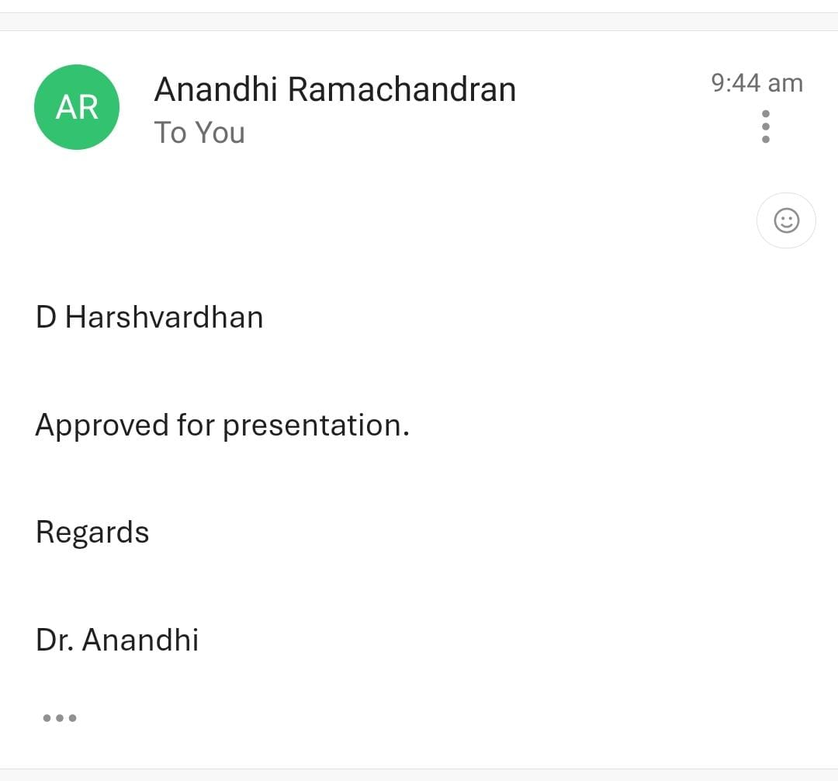

Slide 3
Introduction
Ear, Nose, and Throat (ENT) disorders form a significant portion of the global disease burden and are often under-recognized despite their high prevalence and impact on quality of life. These disorders include a wide range of conditions such as ear infections, hearing loss, sinusitis, nasal polyps, throat infections, and voice disorders. According to the World Health Organization (WHO), over 430 million people worldwide require rehabilitation to address their hearing loss, and this number is expected to rise to over 700 million by 2050 if no action is taken. In India alone, it is estimated that 6.3% of the population suffers from significant hearing loss, and about 7%–8% of outpatient visits in general hospitals are related to ENT conditions.
Community-based health camps serve as effective outreach tools to bridge this gap in healthcare delivery. These camps provide opportunities for early diagnosis, on-spot management or referrals, and patient education. Health camps focused on ENT care have the potential to address both the clinical and educational needs of the population by bringing services to the doorstep of the underserved.

Slide 4
REVIEW OF LITERATURE
Umesh Pradhan, MD1 , Somjin Chindavijak, MD2, and Napas Tanamai, MD (2021) A Descriptive study The Thai Rural ENT foundation has been conducting ear camps in Bhutan. The study enrolled patients with ear disorders who presented to the mobile ear camp at Monggar Regional Referral Hospital, Bhutan, from January 6, 2020, to January 8, 2020. The following data were recorded: demographic details, preoperative clinical symptoms and otoscopic findings, preoperative audiogram, treatment or surgery done, postoperative middle ear and mastoid infection, wound infection, graft condition, any complications, and postoperative audiogram of operated cases. Patients who underwent surgery were followed up at 1 day, 6 weeks, and 2 months postoperatively. Two hundred ten patients presented with otologic conditions and 43 underwent surgeries. Otitis media was the commonest disease detected, and tympanoplasty was the commonest surgery performed. The tympanic membrane closure rate was 92.1%, and the rate of hearing improvement was 63.2%. The ear camp had beneficial effect and showed good results.

Slide 5
Salman Ahmed Taher Hamid a*, Md. Mahmudul Hasan a and Imtiaj Hossain Chowdhury (2024) Eye Camp and its Impact on the Patients and Community Eye camps are vital for enhancing eye health in underserved communities. Eye camp organizers meticulously plan, promote, and provide comprehensive eye care services, addressing common conditions and offering health education. Patients benefit from improved access, early detection, and treatment, leading to enhanced vision and increased awareness. Eye camps also positively impact patients' emotional well-being, foster community support, and alleviate financial burdens. At the community level, they contribute to improved access, awareness, and education, reducing visual impairment, enhancing productivity, and fostering economic empowerment. These initiatives create lasting positive changes, with sustainability ensured through partnerships with local healthcare providers. In conclusion, eye camps are integral to community-based eye health, offering temporary solutions with lasting impacts on well-being and development.

Slide 6
Objectives
To analyze the knowledge and self-care skills gained by participants in managing common ENT conditions through health camps.
To understand participants’ perceptions regarding adherence to follow-up care, medication, and lifestyle recommendations.
To assess participants’ satisfaction with camp services and their perception of care quality.

Slide 7
Methodology
Study Design
This study follows a descriptive cross-sectional design aimed at assessing patient knowledge, adherence, and satisfaction regarding the management of common ENT problems through community-based health camps.
Study Setting
The study was conducted at ENT health camps organized by Dr. Rao’s ENT Super Specialty Hospital, including both community outreach locations. 2 Camps, IT Company.(Virtusa and Dark matter Technologies)
Study Population
The population included individuals who attended the ENT health camps.

Slide 8
Inclusion criteria:
Patients aged ≥18 years
Willing to participate and able to provide informed consent
Completed both the pre- and post-camp sections of the questionnaire
Exclusion criteria:
Individuals unwilling to participate
Those unable to comprehend or complete the questionnaire
Sampling Technique and Sample Size
A non-probability convenience sampling method was used to select participants. A total sample size of 120 patients was targeted based on expected attendance at the health camps and feasibility.

Slide 9
Data Analysis
The data collected were entered into Microsoft Excel and analyzed using descriptive statistical methods:
Demographic data were summarized using frequencies and percentages.

Slide 10
DEMOGRAPHIC DATA
AGE
GENDER
EDUCATION
AGE | FREQUENCY | PERCENTAGE
21-30 | 56 | 46.67
31-40 | 49 | 40.83
41-50 | 15 | 12.50
GENDER | FREQUENCY | PERCENTAGE
male | 64 | 53.33
female | 56 | 46.67
EDUCATION | FREQUENCY | PERCENTAGE
graduate | 48 | 40.00
Post graduate | 72 | 60.00

Slide 11
OCCUPATION
RESIDENCE
OCCUPATION | FREQUENCY | PERCENTAGE
analyst | 16 | 13.33
QA | 7 | 5.83
BUS DRIVER | 1 | 0.83
HR | 1 | 0.83
IT | 11 | 9.17
SALES | 2 | 1.67
SE | 79 | 65.83
TECHNICIAN | 3 | 2.50
AREA | FREQUENCY | PERCENTAGE
rural | 36 | 30.00
urban | 20 | 16.67
semi urban | 64 | 53.33

Slide 12
Have You Previously Consulted Any ENT Specialist Before this Camp?
Can you name any three common ENT problems?
06.Have you previously consulted any ENT specialist before this camp? | frequency | percentage
yes | 62 | 51.67
no | 58 | 48.33
7.Can you name any three common ENT problems? | frequency | percentage
no answere | 55 | 45.83
cold | 5 | 4.17
ear pain | 9 | 7.50
nose bleeding | 6 | 5.00
nose block | 4 | 3.33
sinus | 20 | 16.67
TONSILS | 6 | 5.00

Slide 13
What symptoms were you experiencing before attending the camp?
What are some symptoms of an ear infection?
08.What symptoms were you experiencing before attending the camp? | frequency | percentage
ear pain | 15 | 12.50
hearing loss | 2 | 1.67
nasal block | 8 | 6.67
no complain | 33 | 27.50
others | 9 | 7.50
sinus | 21 | 17.50
throat pain | 25 | 20.83
no answer | 7 | 5.83
9. What are some symptoms of an ear infection? | frequency | percentage
difficult in hearing | 18 | 15.00
discharge from ear | 43 | 35.83
ear pain | 48 | 40.00
fever | 11 | 9.17

Slide 14
What might cause them?
What are some things you can do at home to help manage ear infection at home?
10. What might cause them? | frequency | percentage
Allergy | 12 | 10.00
bacterial and viral | 68 | 56.67
change of whether | 31 | 25.83
self injury | 6 | 5.00
others | 2 | 1.67
no answer | 1 | 0.83
11. What are some things you can do at home to help manage ear infection at home? | frequency | percentage
NO ANSWER | 21 | 17.50
CLEAN WAX | 14 | 11.67
CLEANING EAR WITH BUDS | 20 | 16.67
EAR DROPS | 17 | 14.17
H2O2 | 6 | 5.00
HYGIENE | 3 | 2.50
tablets | 13 | 10.83

Slide 15
What are the reasons for sore throat?
What steps can you take to prevent a sore throat? What are some things you can do to manage a sore throat at home?
12.What are the reasons for sore throat? | frequency | percentage
allergy | 1 | 0.83
bacteria and viral Infection | 44 | 36.67
change of whether | 13 | 10.83
drinking chilled water | 48 | 40.00
exposure to smoke | 14 | 11.67
13. What steps can you take to prevent a sore throat? What are some things you can do to manage a sore throat at home? | frequency | percentage
cofsils | 8 | 6.67
more fluids | 6 | 5.00
hot water | 41 | 34.17
ginger tea | 6 | 5.00
vicks | 8 | 6.67
no answere | 13 | 10.83

Slide 16
How did you learn about this ENT camp?
On a scale of 1 to 5, how would you rate your knowledge about ENT problems before attending the camp?
14.How did you learn about this ENT camp? | frequency | percentage
friend and family | 29 | 24.17
poster flyer | 53 | 44.17
social media | 38 | 31.67
15.On a scale of 1 to 5, how would you rate your knowledge about ENT problems before attending the camp? | frequency | percentage
1 | 4 | 3.33
2 | 32 | 26.67
3 | 38 | 31.67
4 | 26 | 21.67
5 | 20 | 16.67

Slide 17
Do you feel more informed about ENT conditions after attending the camp?
Were you provided with demonstrations or educational materials during the camp?
16.Do you feel more informed about ENT conditions after attending the camp? | frequency | percentage
yes | 89 | 74.17
no | 31 | 25.83
17.Were you provided with demonstrations or educational materials during the camp? | frequency | percentage
yes | 103 | 85.83
no | 17.00 | 14.17

Slide 18
Did the camp teach you how to manage minor ENT issues at home?
On a scale of 1 to 5, how would you rate your knowledge about ENT problems after attending the camp?
18.Did the camp teach you how to manage minor ENT issues at home? | frequency | percentage
yes | 91 | 75.83
no | 29.00 | 24.17
19.On a scale of 1 to 5, how would you rate your knowledge about ENT problems after attending the camp? | frequency | percentage
2 | 2 | 1.67
3 | 16 | 13.33
4 | 71 | 59.17
5 | 31 | 25.83

Slide 19
Do you ever forget to take your prescribed medicine?
Do you find it difficult to remember when and how to take your medication?
20.Do you ever forget to take your prescribed medicine? | frequency | percentage
yes | 84 | 70.00
no | 36 | 30.00
21.Do you find it difficult to remember when and how to take your medication? | frequency | percentage
yes | 60 | 50.00
no | 60 | 50.00

Slide 20
When you feel better do you stop taking medication before completing the full course?
Sometimes if you feel worse when you take your prescribed medicine, do you stop taking it?
22.When you feel better do you stop taking medication before completing the full course? | frequency | percentage
yes | 84 | 70.00
no | 36 | 30.00
23.Sometimes if you feel worse when you take your prescribed medicine, do you stop taking it? | frequency | percentage
yes | 75 | 62.50
no | 45 | 37.50

Slide 21
How satisfied were you with the services at the camp?
How was your interaction with the doctors and staff?
24. How satisfied were you with the services at the camp? | frequency | percentage
2 | 3 | 2.50
3 | 18 | 15.00
4 | 56 | 46.67
5 | 43 | 35.83
25. How was your interaction with the doctors and staff? | frequency | percentage
average | 10 | 8.33
good | 60 | 50.00
excellent | 50 | 41.67

Slide 22
Would you recommend these camps to others?
26. Would you recommend these camps to others? | frequency | percentage
yes | 101 | 84.17
no | 19 | 15.83

Slide 23
Knowledge Score Comparison
Pre-camp average score (Q15): 3.22
Post-camp average score (Q19): 4.09
Percentage increase: 27.02%
Interpretation
Significant rise in participants’ self-rated knowledge after attending the camp.
Demonstrates the effectiveness of educational sessions, and doctor interaction

Slide 24
Discussions
This study aimed to evaluate the knowledge gained, treatment adherence, and satisfaction among participants attending an ENT health camp organized by Dr. Rao’s ENT Super speciality International Hospital at an IT company. The findings provide valuable insights into the effectiveness of camp-based interventions in promoting ENT health awareness and influencing health behaviour, particularly in an educated and working population.
Despite 60% of participants holding postgraduate qualifications, the baseline awareness regarding ENT conditions was relatively low. Nearly 45.83% of participants could not name three common ENT problems, and only a small proportion could identify early signs or causes of ENT infections. This aligns with the findings of Alassaf et al. (2023), who reported that while 78.6% of participants in the Qassim region of Saudi Arabia had fundamental knowledge of ENT problems, earlier studies in Riyadh showed that only 18.4% had good knowledge and 2.3% had exceptional knowledge of ENT-related illnesses. Similarly, a study in Bhutan evaluating outcomes of an ENT outreach camp observed that although the surgical success rate was high, pre-operative awareness about hearing loss and ENT hygiene was poor among rural participants (Pradhan et al., 2020). These results collectively indicate that despite different educational backgrounds and settings, ENT health awareness remains suboptimal and requires structured community-level interventions.

Slide 25
Encouragingly, the post-camp knowledge scores in this study showed substantial improvement. After receiving health education and demonstrations during the camp, 74.17% of participants reported feeling more informed about ENT conditions. This mirrors the positive impact observed in the Qassim study, where female participants—often primary caregivers—demonstrated higher post-intervention awareness, a trend also noted in this study. Additionally, in Bhutan's ENT camp, patient education efforts were directly associated with improved follow-up compliance and treatment success, emphasizing the value of combining clinical services with education.
A critical finding of the present study was the high rate of poor medication adherence. Seventy percent of participants reported stopping medications early or forgetting doses, often due to perceived improvement or side effects. This finding is concerning and aligns with studies conducted in other contexts. For example, Mishra et al. (2021) reported over 50% non-adherence in rural diabetic populations in Uttarakhand, and Ravi et al. (2024) found 57.6% non-compliance in NCD patients in Tamil Nadu. While these studies are not ENT-specific, the behavioral patterns reflect a broader challenge in long-term medication adherence, even among educated groups. In contrast, the Bhutan ENT camp reported higher adherence, partly due to structured post-operative counseling and community health worker follow-ups. The absence of such mechanisms in the present study may explain the lower adherence rate despite high satisfaction.

Slide 26
Participant satisfaction with the camp services was high. Over 84% of respondents stated they would recommend the camp to others, and 80% rated their interaction with doctors and staff as good to excellent. These findings are consistent with Singh et al. (2022), who found that 82% of participants in ENT and dental camps in rural India expressed satisfaction with camp services. The high satisfaction observed in the present study further reinforces the effectiveness of short-term, workplace-based outreach programs in meeting both preventive and promotive health needs.
Comparing the present study with international findings, such as those from Saudi Arabia and Bhutan, highlights both congruence and divergence. While awareness and satisfaction rates align well, treatment adherence emerged as a key area of divergence. The disparity suggests that even well-educated, urban populations may require additional behavioral support beyond knowledge transfer. Incorporating reminders, simplified regimens, and reinforcement strategies may bridge this gap. The study has several strengths. Conducting the camp in a corporate IT environment provided access to a highly educated yet time-constrained population—often underrepresented in community health research. generalizability.
In conclusion, ENT health camps are effective platforms for increasing disease awareness and improving participant satisfaction. However, they must be strengthened with post-camp behavioral interventions to address persistent challenges in treatment adherence. Comparing the present findings with recent studies confirms that while knowledge gains are achievable through educational outreach, translating awareness into sustained health behavior requires continued engagement and system-level support.

Slide 27
Conclusion
In conclusion, the ENT awareness camp successfully fulfilled its objective of enhancing public knowledge and engagement regarding ENT health. It not only educated participants about common conditions, symptoms, and causes but also instilled a greater sense of confidence in managing minor issues at home. The positive feedback and satisfaction levels affirm the importance of such initiatives in community outreach. However, challenges related to medication adherence and delayed health-seeking behaviour remain prevalent and call for more sustained awareness efforts. The camp proved to be a step in the right direction, but the path toward lasting behavioural change requires continuous efforts.

Slide 28
COMMUNITY OUTREACH PROGRAMME (COP) ACTIVITIES
Total no. of visits:6
Activities
Mapping and listing of the area.
Understanding Community Layout: Developed a detailed understanding of the geographical distribution of households, health facilities, and key resources.
Interaction with the community and frontline healthcare workers.
Observed field-level challenges (resource gaps, cultural barriers).
Gained clarity on roles of ASHA, ANM, and AWW.
Learned community engagement and trust-building skills.
Monitoring the vitals, measurement of height, weight.
Colleting the demographic data and past history and present complaints.

Slide 29
Hospital visit
Indira Gandhi hospital sec-8 dwaraka. Monitored the Disaster preparedness and Audit by using Hospital safety index book
Akash health care Hospital visit of CSSD department, waste management.

Slide 30
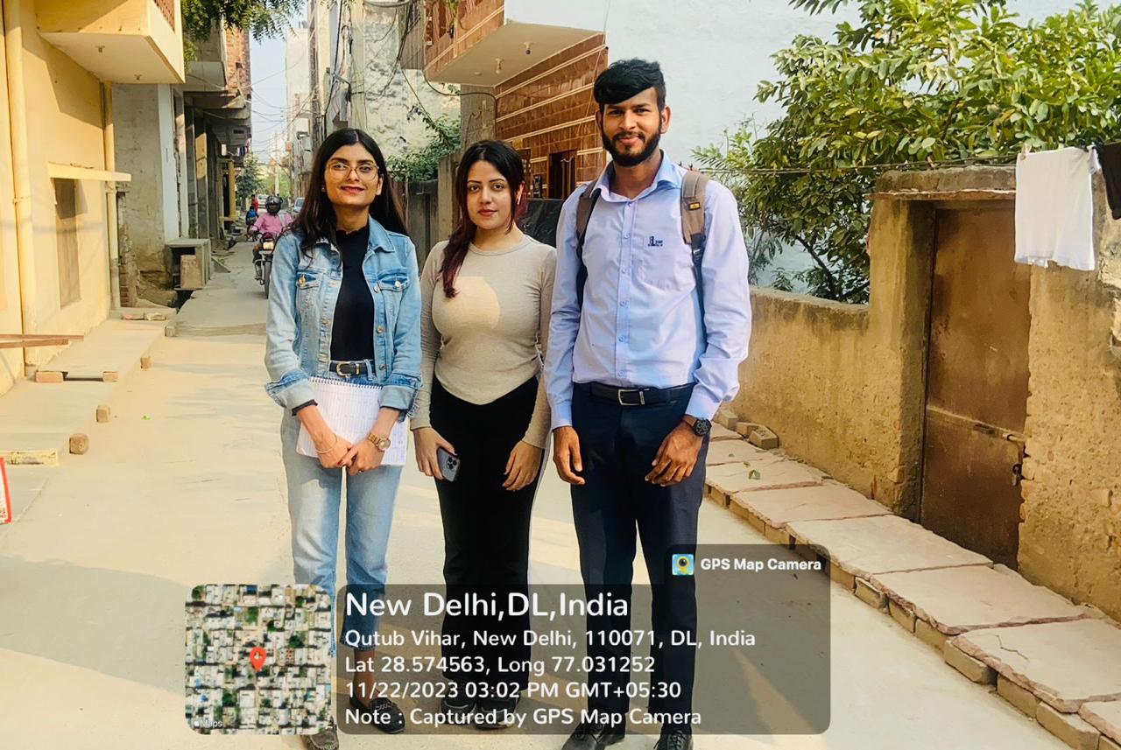
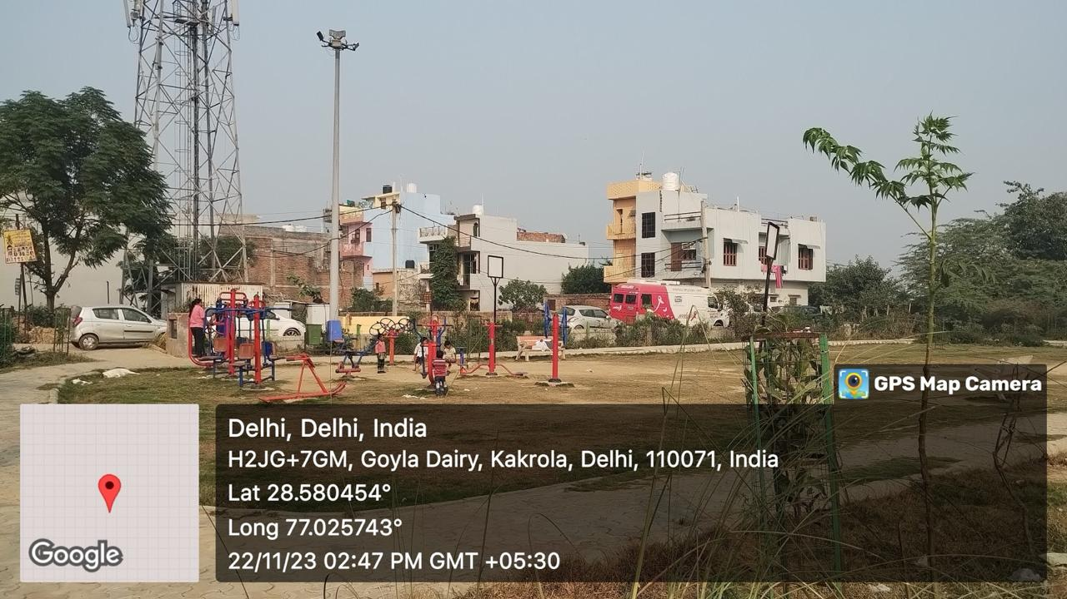
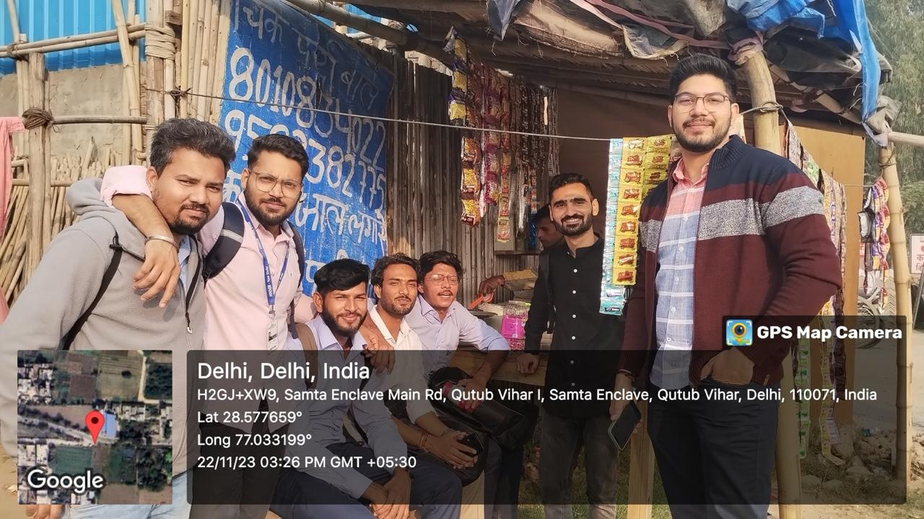
COP FIELD GLIMPES

Slide 31
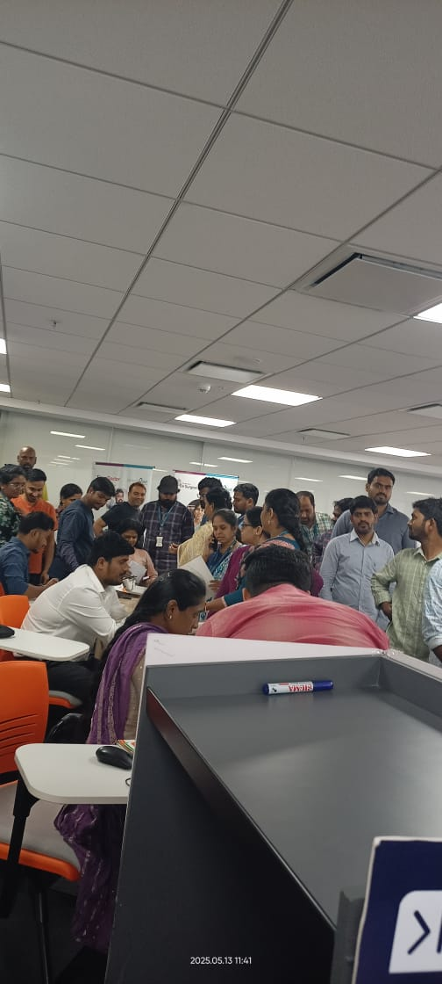
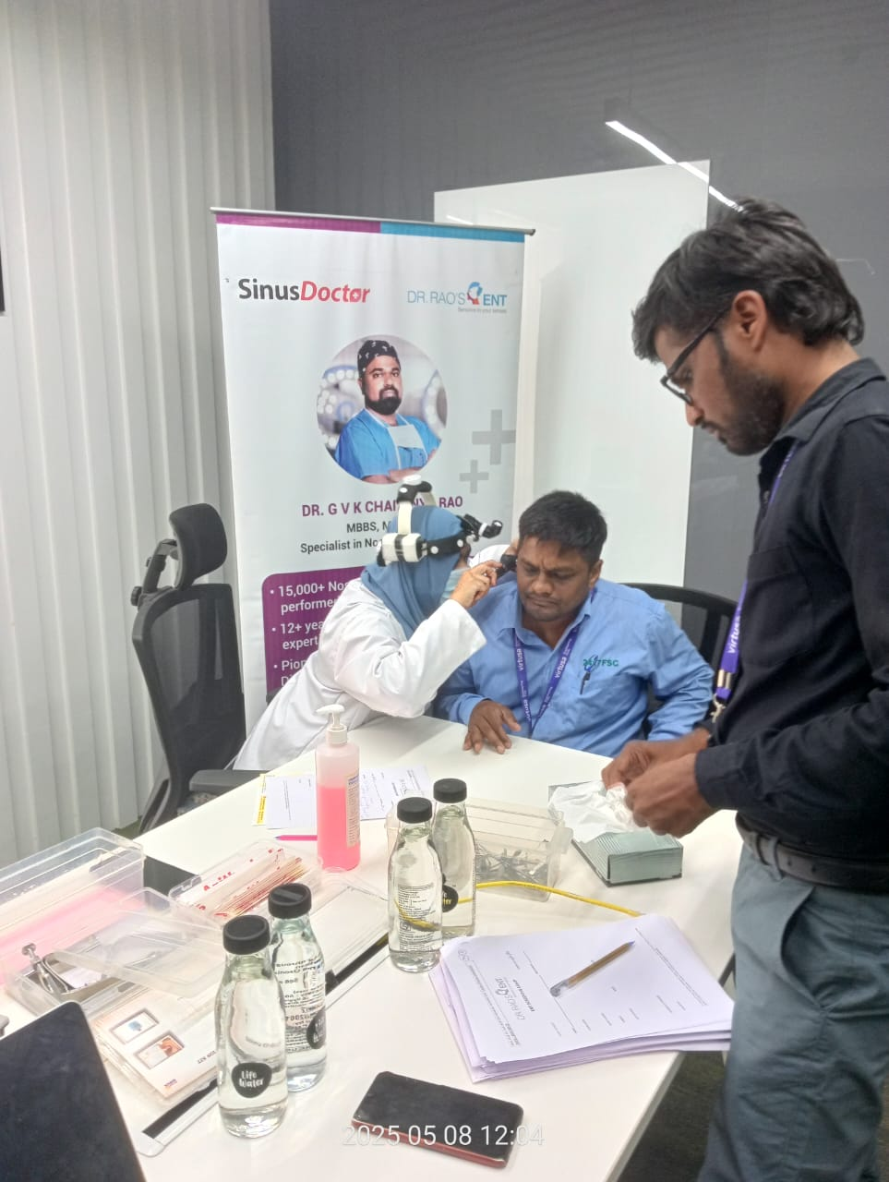
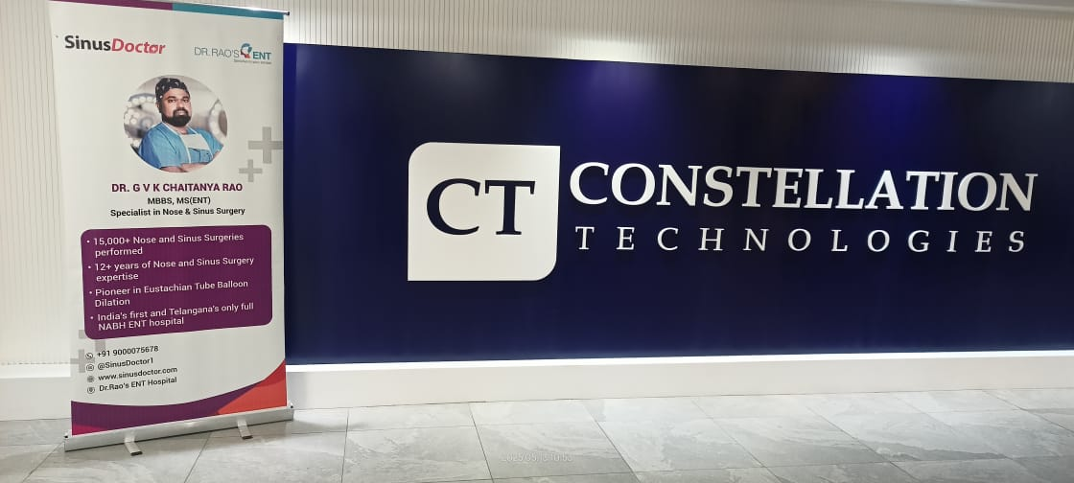
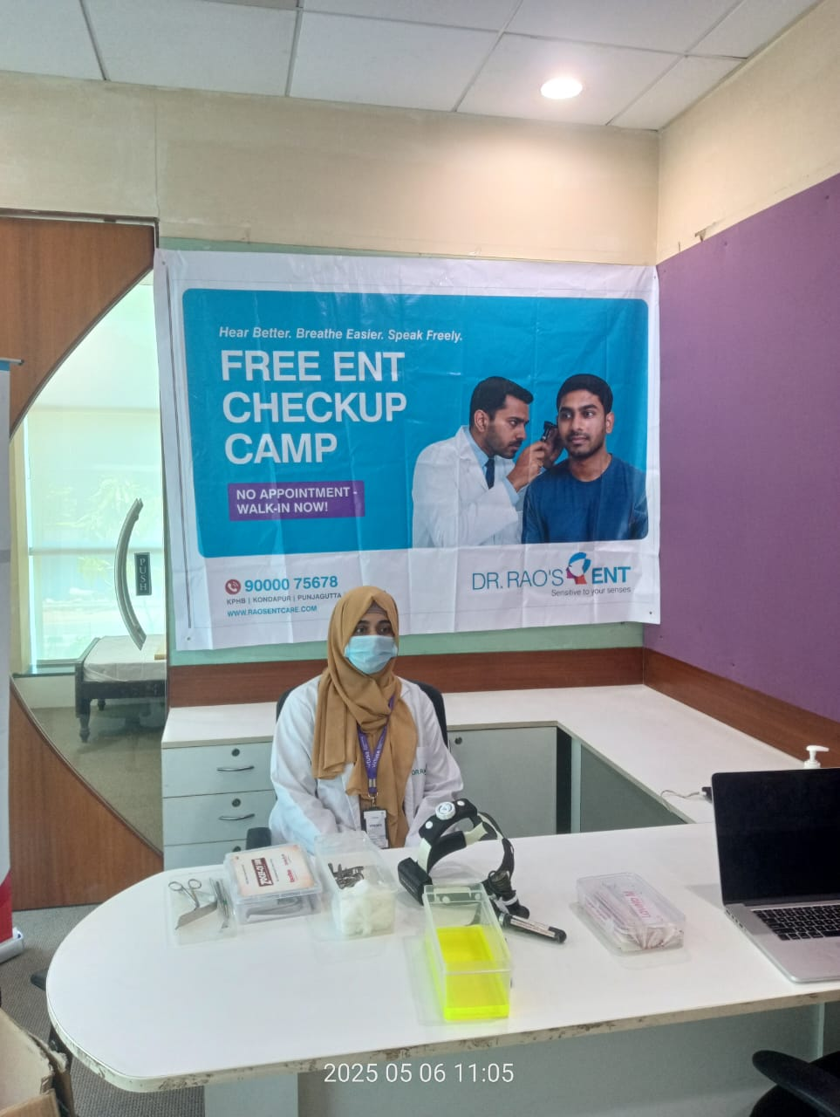
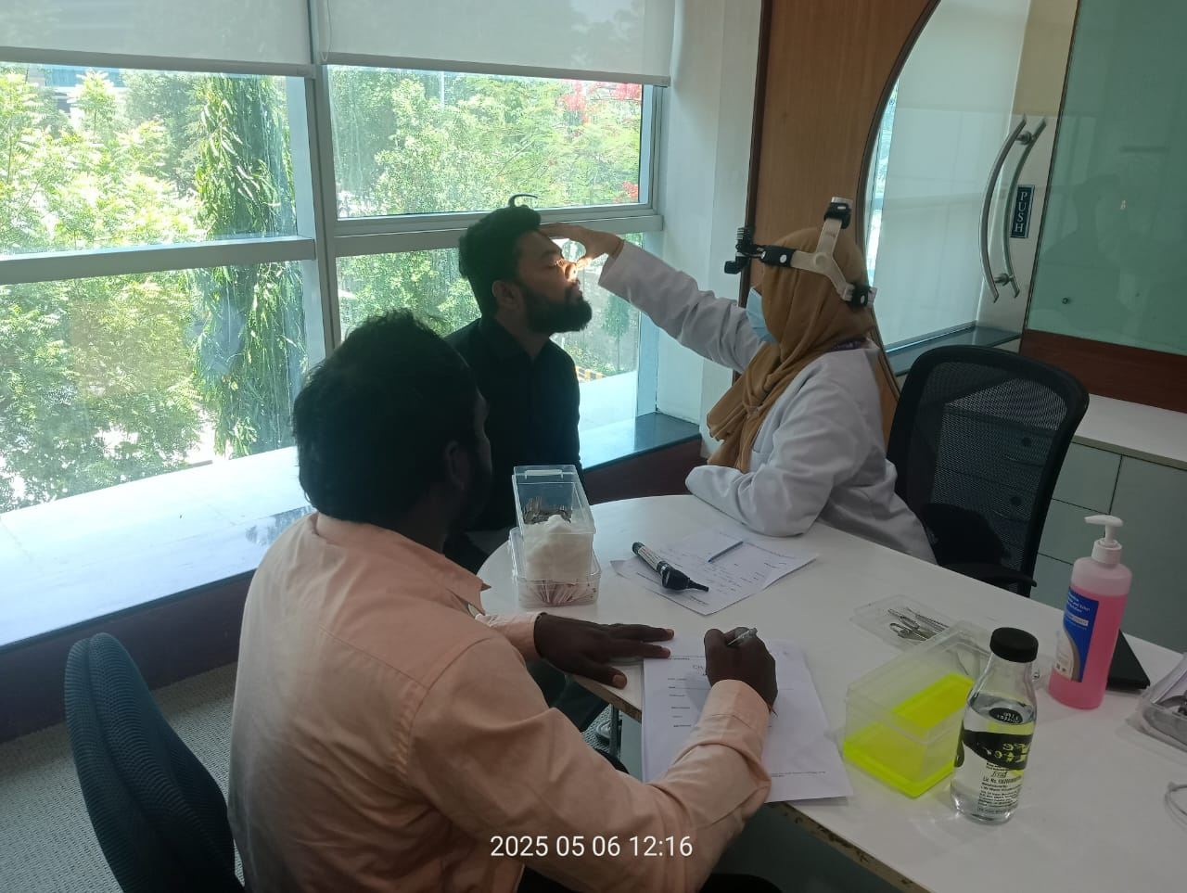
PICTORIAL JOURNEY

Slide 32
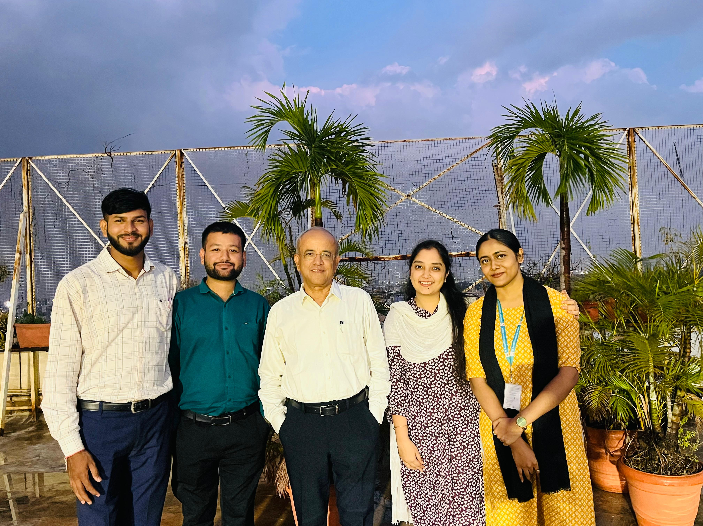
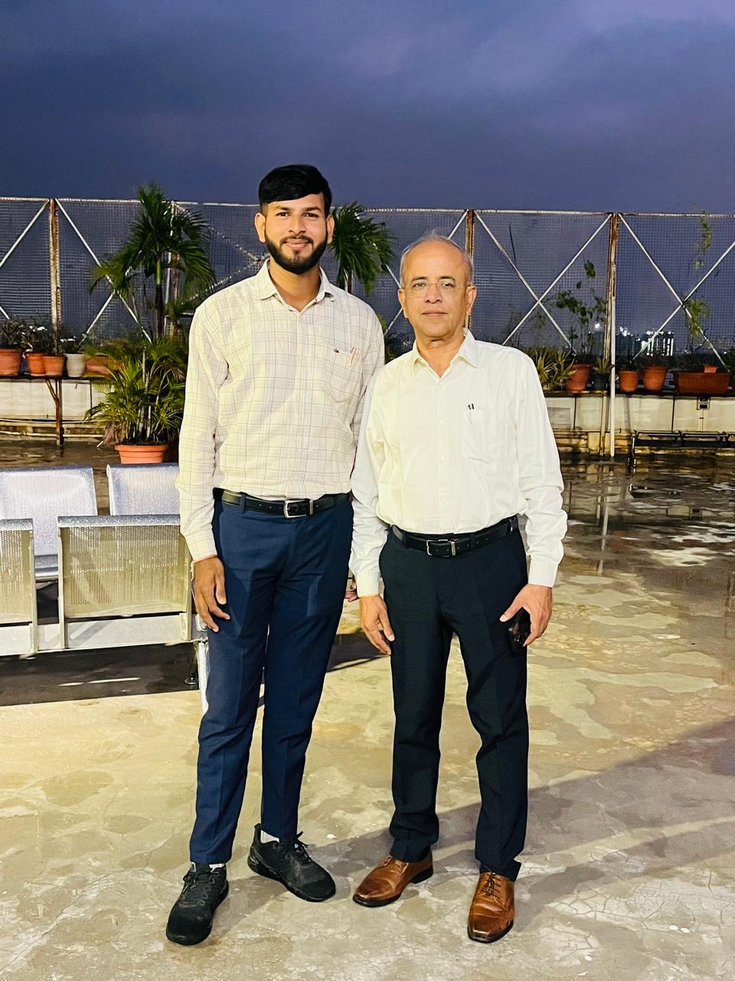
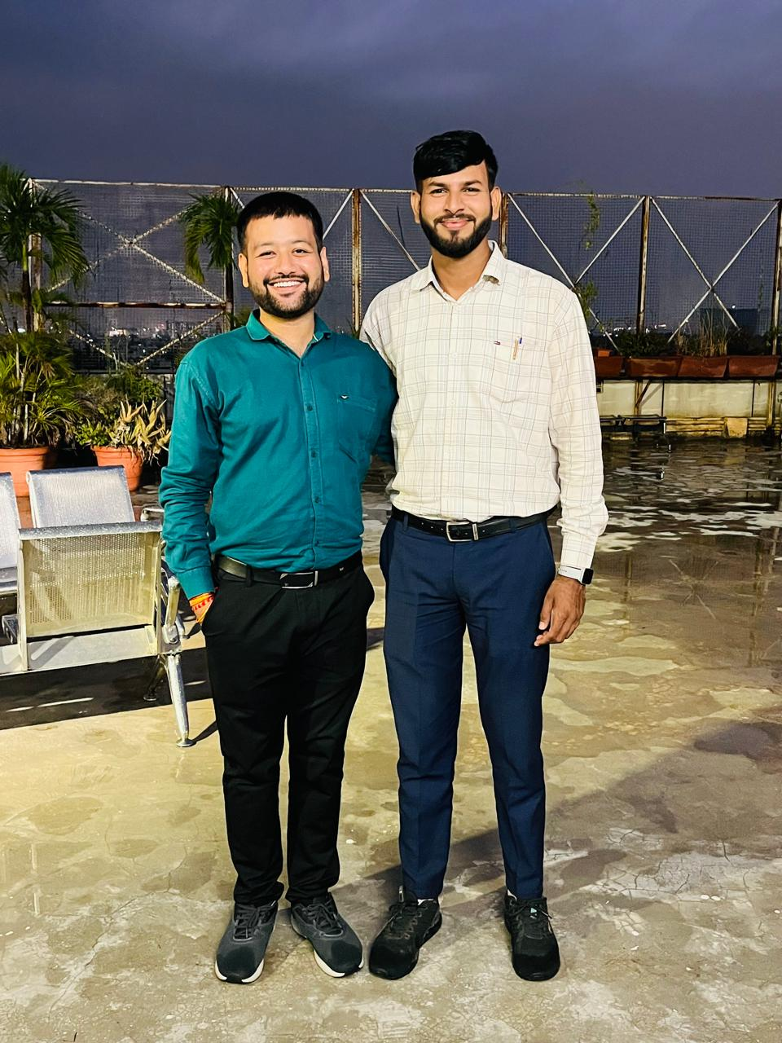
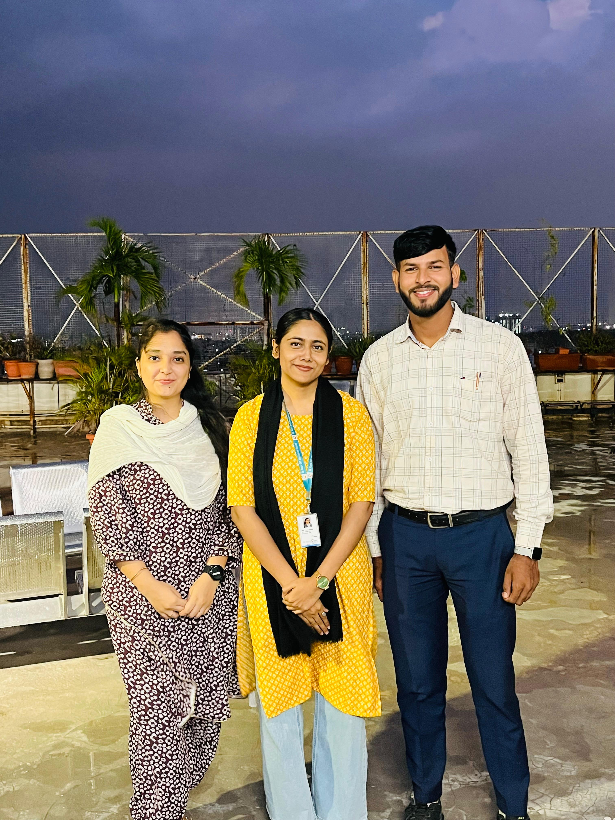

Slide 33
REFERENCES
Parthasarathy, M., Mishra, D., Prabhu, A., Jayarani, S., & Palanivel, G. (2024). Impact of the Methodology of Breast Cancer Screening Camps: A Community Based Observational Study. J Oncology, 4(2), 1144.
Ezhumalai, S. (2024). Outcome of Camp Approach in Treatment of Alcohol Use Disorder: A Non-randomized Controlled Study. Journal of psychiatry spectrum, 3(2), 101-109.
Nanda, M. S., Chadha, S., & Chadha, S. C. (2023). Door-to-door health camps versus traditional health camps in rural areas of Himachal Pradesh–A comparative analysis. Natl J Physiol Pharm Pharmacol, 13, 1289-92.
Bhondve, A., Pathak, B., & Manapurath, R. M. (2019). Mixed-method analysis of community health camps: A novel approach beckoning. Indian Journal of Community Medicine, 44(3), 233-237.
Maharjan, S., Shrestha, R., Shrestha, P. R., Acharya, S., Khadka, S. K., Thapa, S., & Chaudhary, A. (2024). A specialized health camp (Orthopedics) in rural set up: an experience from a tertiary care institution in Nepal. IJS Global Health, 7(1), e0383.
Pradhan, U., Chindavijak, S., & Tanamai, N. (2024). Outcomes of an Ear Camp Conducted in Bhutan by Thai Rural ENT Foundation—A Descriptive Study. Ear, Nose & Throat Journal, 103(3), NP158-NP163.

Slide 34
Thank You
Any Questions

