Slide 1


THE IMPACT OF MATERNAL COMPLICATIONS DURING PREGNANCY ON MATERNAL AND FETAL HEALTH OUTCOMES
Organization-
Name- Arpita Halder (PG/22/015)
Faculty Mentor- Dr. Sumesh Kumar
IIHMR Delhi

Slide 2

Mentor Approval

Slide 3
Introduction (1/2)
Maternal mortality persists as a significant global health challenge, with an estimated 223 deaths per 100,000 live births reported worldwide in 2020.
In India, the maternal mortality ratio (MMR) currently stands at 97 deaths per 100,000 live births.
Maternal complications during pregnancy contribute significantly to maternal mortality rates
According to available data, approximately 800 women lose their lives daily due to pregnancy-related complications. (as per WHO data 2020)

Slide 4
Introduction (2/2)
High-Risk Pregnancy/Maternal complications during pregnancy include:
Age <18 years & >35 years
Height (<145cm)
Severe Anemia (<7 gm/dl)
Gestational diabetes,
Preeclampsia/ Eclampsia
Gestational hypertension,
Antepartum hemorrhage (APH)
Grand multipara
Multiple pregnancy
Mal presentation
Previous Lscs
Rh-negative women with Rh positive husband
Infection
Premature rapture of membrane
obstructed labor,
Prematurity,
Uterine rupture
Placenta previa
Maternal complications refer to health problems that occur during pregnancy, childbirth, or the postpartum period. These complications can affect both the mother and the baby.
Among Indian women, the prevalence of high-risk pregnancies was reported at 49.4%.
Of these, 33% experienced a single high-risk factor, while 16.4% had multiple high-risk factors.
Pregnant women from Bihar notably displayed a higher prevalence, with 57% experiencing one or more high-risk factors.

Slide 5
Objectives of Your Study
Generalized Objective:
The study sought to assess the effect of maternal complications during pregnancy on maternal and fetal outcomes among individuals aged 15 to 49 years in Purnia, Bihar.
Specific Objectives:
To assess the prevalence of various maternal complications during pregnancy.
To identify potential risk factors associated with maternal complications during pregnancy.

Slide 6
Methodology (1/2)
Study Design
A cross-sectional study was conducted among deliveries at GMCH Hospital, spanning from February,24 to May,24
Study Area
Medical College in Purnea, Bihar
Study Population
Pregnant women who were identified as high-risk pregnancies/complications during pregnancy at Sadar Hospital.
Sample size and sampling:
n = Z² p (1 – p) / e²
Where ‘z’ is the confidence interval of 95% (z score- 1.96), ‘p’ is the prevalence of the proportion population from the previous study (57%), and ‘e’ is the margin of error of 5%.
The sample size of this study is 377
Finally, for operation ease sample size was 420.
Inclusion criteria
Pregnant women who had at least one complication during their antepartum period.
Pregnant women aged between 15-49 years.
Exclusion criteria
Pregnant women aged between 15-49 years who have not had any complications during their antepartum period.

Slide 7
Methodology (2/2)
Sampling strategy
Through purposive sampling, ANC & Labour room records at Sadar Hospital were accessed to identify eligible participants.
At first based on their maternal complication during pregnancy, pregnant women were identified.
After identification, history was taken from the registration log books and individual cards.
This process facilitated through a structured data collection checklist.
Study Variables:
Dependent Variable: Maternal and fetal outcomes (e.g., maternal mortality, maternal morbidity, fetal birth weight, neonatal complications).
Independent Variable: Maternal complications during pregnancy (e.g., Age of the woman, height of the woman, Anemia, gestational diabetes, preeclampsia, gestational hypertension, placental abnormalities, preterm labor, etc.)
Data analysis:
The data analyzed using the MS Excel.
Data Analysis summarize the prevalence of maternal complications and adverse outcomes.

Slide 8
Results (1/3)
Total deliveries | Maternal complication | Percentage
2053 | 420 | 20.36
Total pregnant women who had maternal complications during their antepartum period Out of total deliveries.
Age & Parity of mother distribution of mother with maternal complication

Slide 9
Results (2/3)
In maternal complications prevalence of PROM cases is high, followed by Anemia which indicates poor health status among pregnant women
In maternal outcomes, a high percentage of postpartum hemorrhage (PPH) cases were observed. Further analysis revealed that most PPH incidents occurred in women with premature rupture of membranes (PROM), followed by those with breech presentation.

Slide 10
Results (3/3)
Further analysis of pregnant women with complications revealed poor antenatal care (ANC) and inadequate iron and folic acid (IFA) intake during the intrapartum period, contributing to their maternal complications and impacting maternal & fetal outcomes
Maternal complication during pregnancy have high impact on fetal outcomes,

Slide 11
Discussion (1/2)
Globally almost 75% of those maternal deaths occur during & following childbirth.
Maternal complications have a high impact on maternal & fetal outcomes
Most Prevalence cases in maternal complications included obstructed labor (51.7%), hemorrhage (44.7%), eclampsia (24.1%), and sepsis (6.9%).
Most Prevalence cases among newborns are birth asphyxia (54.6%) followed by Premature birth(48.9%), neonatal infections(22.6), and congenital anomalies(13.5%).

Slide 12
Discussion (2/2)
In India, maternal complications during pregnancy are becoming an increasing concern.
Studies in Uttar Pradesh revealed that 38% of women suffer from maternal complications during pregnancy, with 7.0% experiencing postpartum hemorrhage following delivery, and notably, 5.4% reporting postpartum pre-eclampsia
The prevalence of high-risk pregnancies (HRPs) is notably high in Indian states such as Meghalaya (67.8%), Manipur (66.7%), and Mizoram (62.5%). Other states with significant HRP rates include Bihar (57%), Uttar Pradesh (55.2%), and Jharkhand (51.7%).

Slide 13
Conclusion
High maternal complications among pregnant women indicate the urgent need for improved screening and awareness during antepartum periods.
There is a critical need to identify high-risk pregnancy (HRP) patients during their first trimester to ensure timely and appropriate treatment, improving both maternal and fetal health outcomes.
Low antenatal care (ANC) rates among these women highlight the necessity for strengthening all government programs aimed at maternal health.
The low intake of iron and folic acid (IFA) tablets suggests the need for enhanced ANC services and better utilization of Village Health, Sanitation, and Nutrition Days (VHSND).
During the Pradhan Mantri Surakshit Matritva Abhiyan (PMSMA), these women require special attention and care from healthcare providers.

Slide 14
References
Adil Barut, D. O. (2023). The association of maternal anemia with adverse maternal and fetal outcomes in Somali women: a prospective study. BMC Womens Health.
Barbosa, I. R. (2015). Maternal and fetal outcome in women with hypertensive disorders of pregnancy: the impact of prenatal care. Therapeutic Advances in Cardiovascular Disease.
Huda, F. A. (2012). Profile of Maternal and Foetal Complications during Labour and Delivery among Women Giving Birth in Hospitals in Matlab and Chandpur, Bangladesh. Journal of Health, Population and Nutrition.
Kuppusamy, P. (2023). Pregnancy outcomes among Indian women: increased prevalence of miscarriage and stillbirth during 2015-2021. BMC Pregnancy and Childbirth.
Luke, B. (2007). Elevated risks of pregnancy complications and adverse outcomes with increasing maternal age. Human reproduction.
Mesfin Tadese. (2022). Assessment of the adverse pregnancy outcomes and its associated factors among deliveries at Debre Berhan Comprehensive Specialized Hospital, Northeast Ethiopia. PLOS ONE.
Periyasamy Kuppusamy. (2023). High-risk pregnancy in India: Prevalence and contributing risk factors – a national survey-based analysis. Journal of Global Health.
Tamirat, K. S. (2021). Determinants of adverse birth outcome in Sub-Saharan Africa: analysis of recent demographic and health surveys. BMC Public Health.
WHO, U. U. (2023). VI. Trends in maternal mortality 2000 to 2020: estimates by WHO, UNICEF, UNFPA, World Bank Group and UNDESA/Population Division. WHO.

Slide 15
Thank You
Any Questions

Slide 16


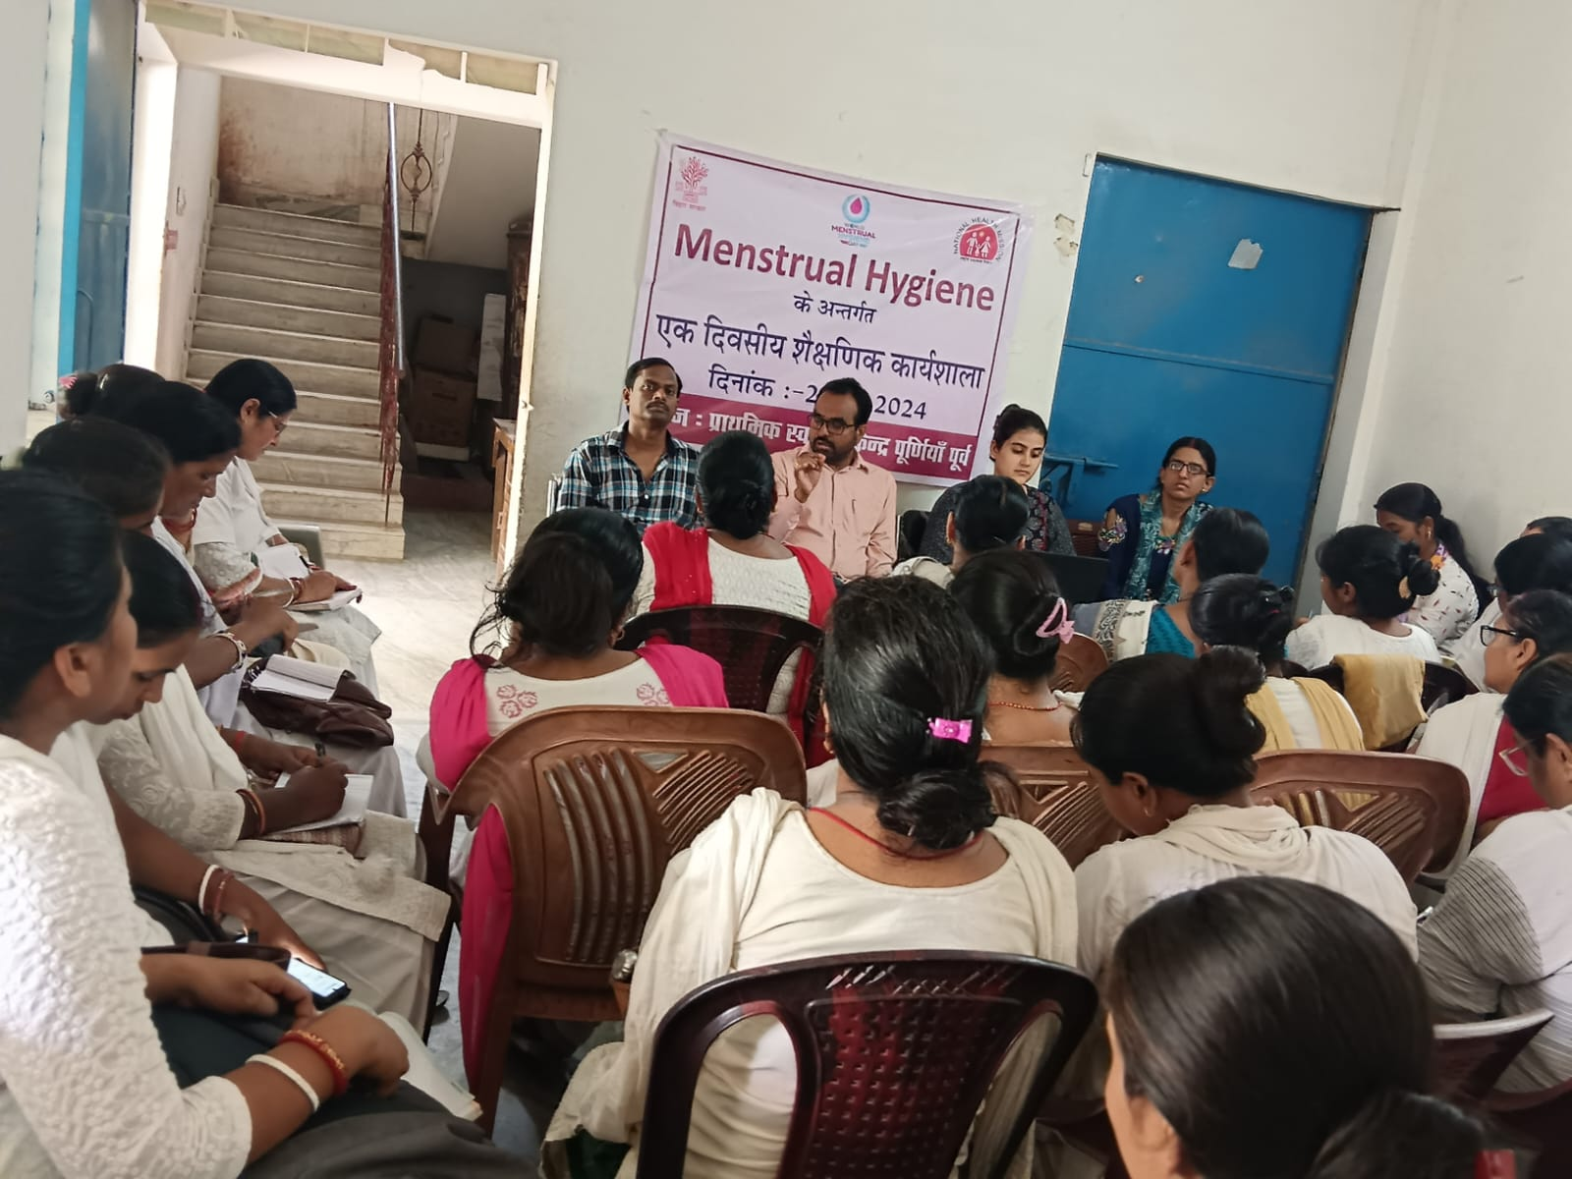
Pictorial Journey (1/2)

Slide 17
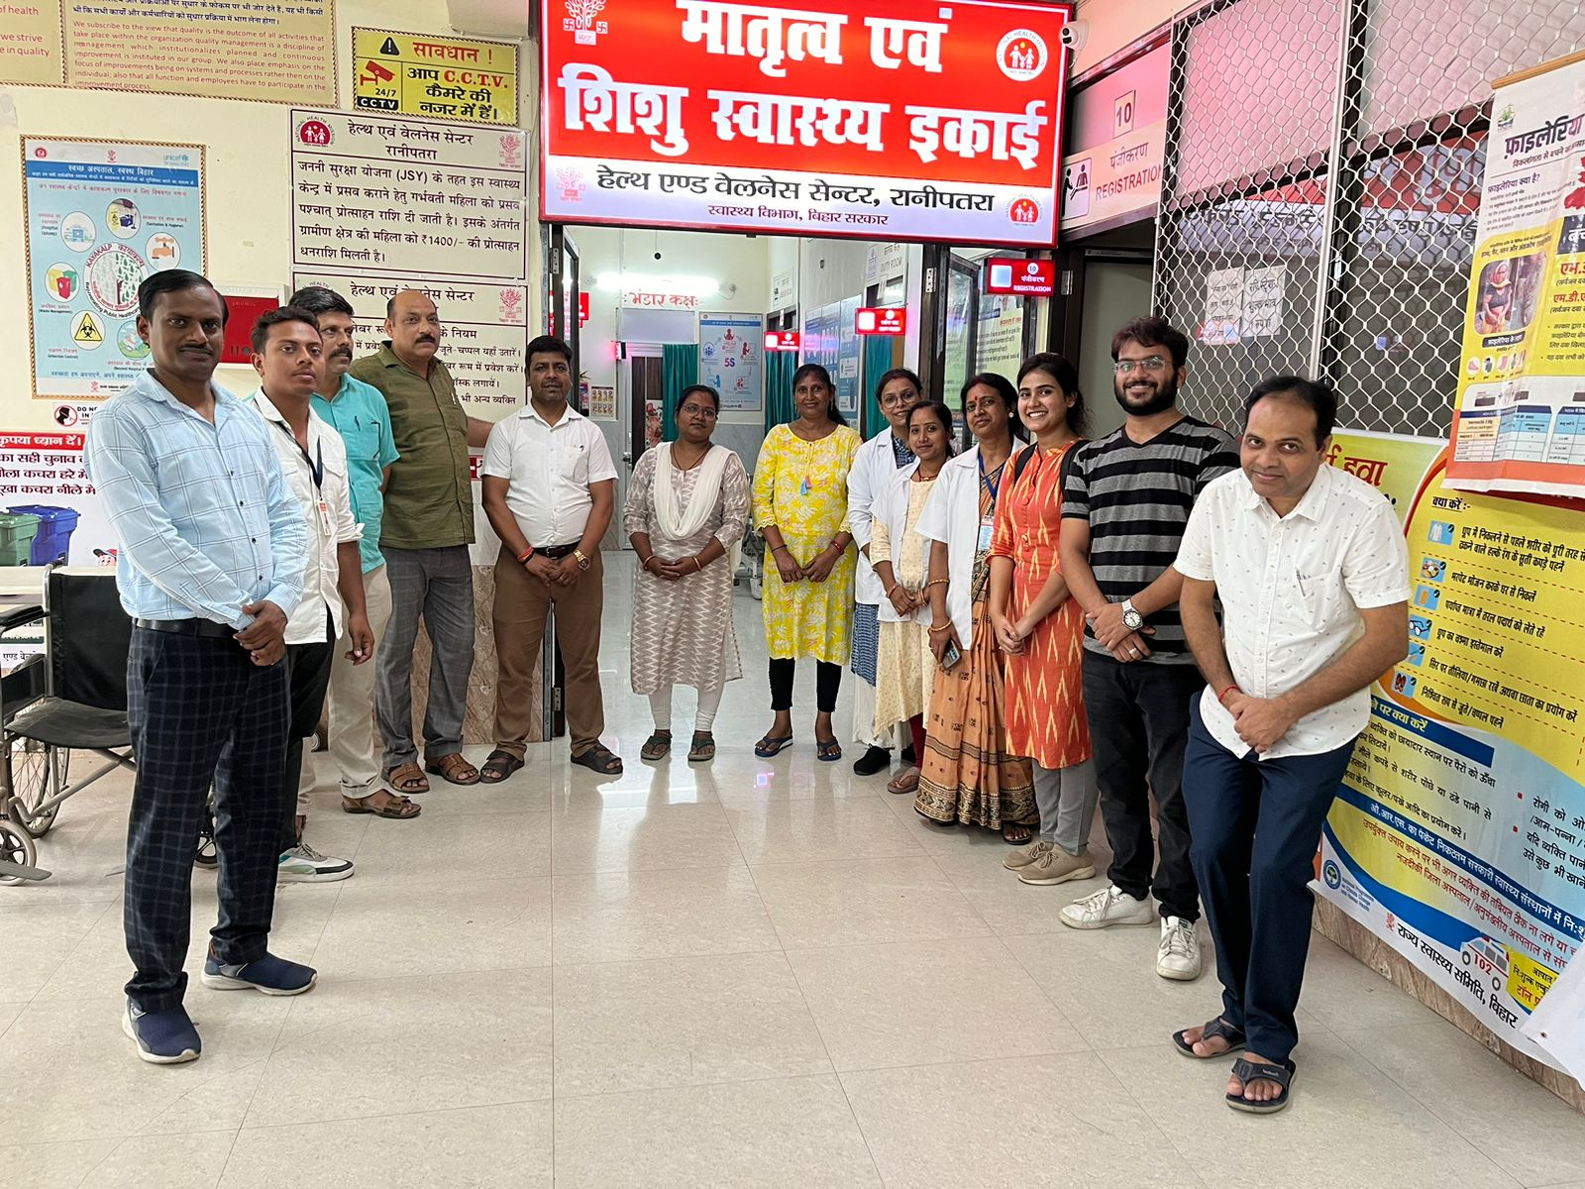
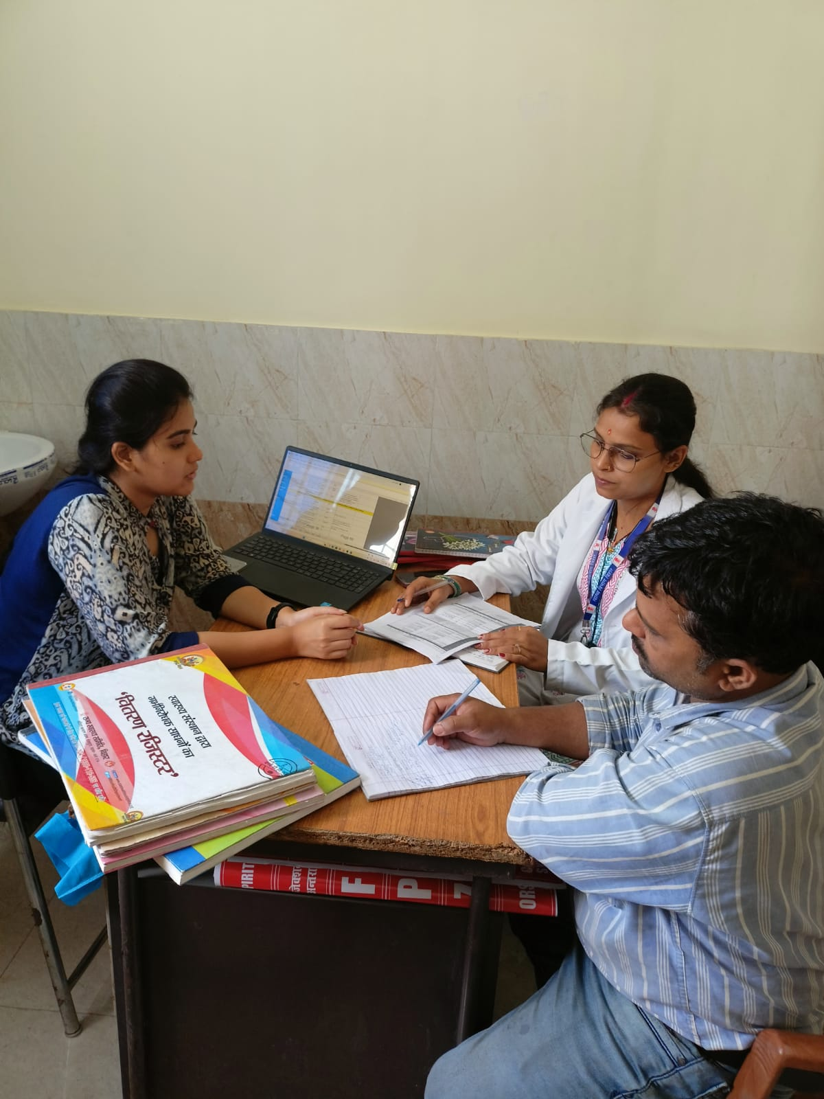
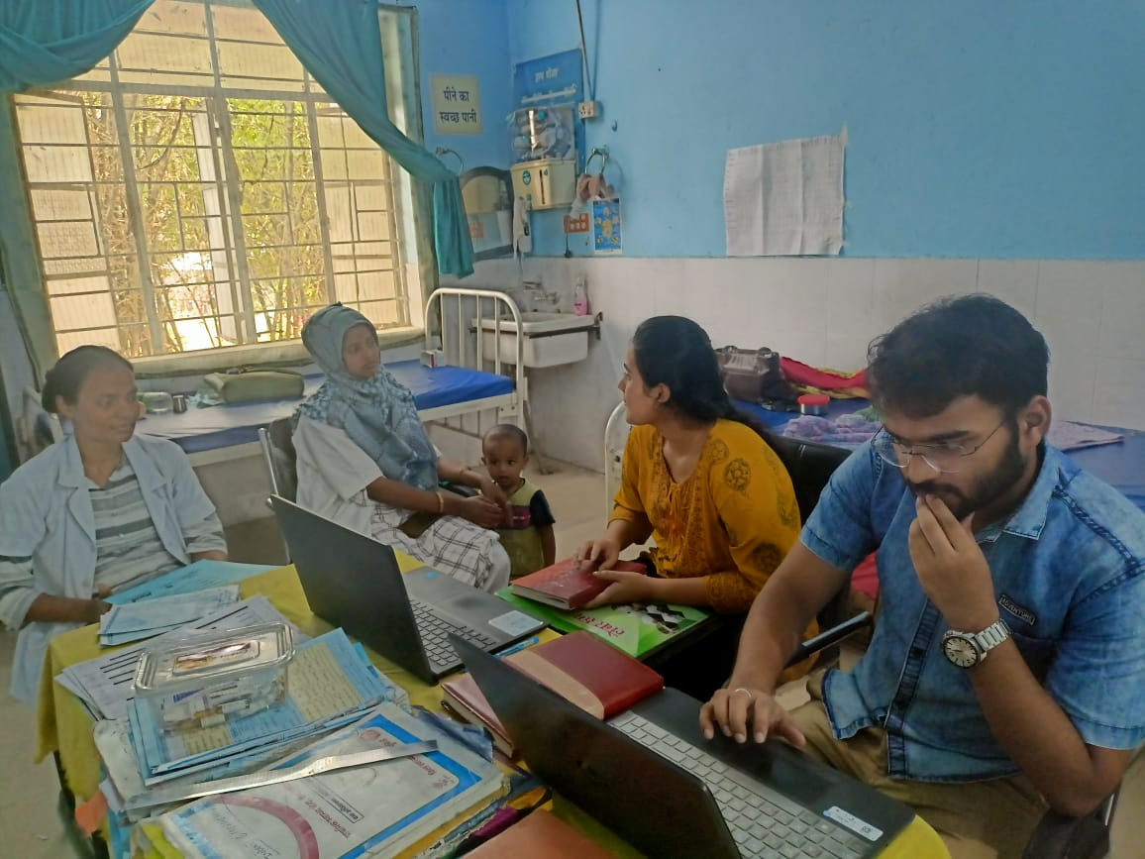

Pictorial Journey (2/2)

