Slide 1

Internship & Dissertation Project Report
Presented by
Madhavi Sawaitul
Batch E (2012-14)

Slide 2
I
Agenda
Internship report-
  Organization profile
  Work at Medanta Mediclinic
  Key learning
  Project plan
Dissertation project-
  Title and problem statement
  Objective & Methodology
  Result
  Summary & Recommendations

Slide 3
Internship Report

Slide 4
  Organization profile, Medanta , Mediclinic
Medanta – The Medicity is one of India's largest multi-super specialty institutes located in Gurgaon, founded by eminent cardiac surgeon, Dr. Naresh Trehan.Spread across 43 acres, the institute includes a research center, medical and nursing school. It has 1250 beds and over 350 critical care beds with 45 operation theatres catering to over 20 specialties
Vision & Values
"The Institute is governed under the guiding principles of providing affordable medical services to patients with care, compassion & commitment.
Mission
"Our mission is to deliver world class health care by creating institutes of excellence in integrated medical care, teaching and research. We aspire to create an ethical & safe environment to treat all with respect and dignity."
Medanta Mediclinic Cybercity
In keeping with mission to deliver superlative healthcare, Medanta has partnered with DLF and launched the Medanta Mediclinic in DLF Cybercity,. The Mediclinic, an extension of our commitment to provide medical excellence, is a multi-super speciality clinic and outpatient facility that will deliver healthcare services to corporates in Cybercity. With over 2.5 lakh individuals working everyday in Cybercity, premium corporate healthcare is essential. Thus, as DLF's official health partner, Medanta will care for the health and safety of every single member of the DLF Cybercity workforce.

Slide 5
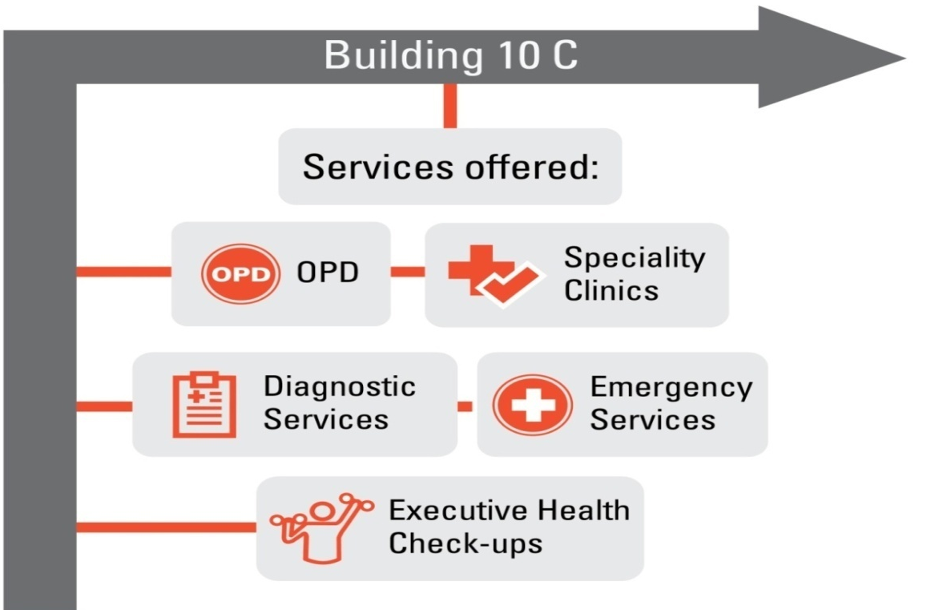
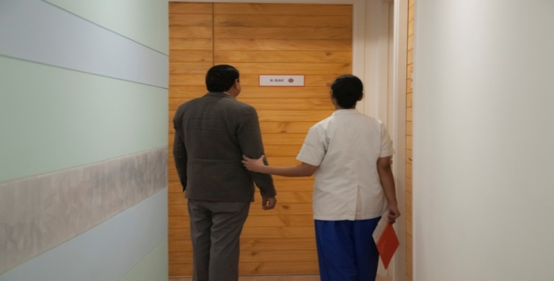
Facilities at Mediclinic, Cyber City
Executive Health Check-ups:
Basic Health Check up
Executive Health Check – Men
Executive Health Check – Women
Whole body Check – Men
Whole body Check – Women
Pre Employment check
Your neighborhood Medanta Mediclinic: Services

Slide 6

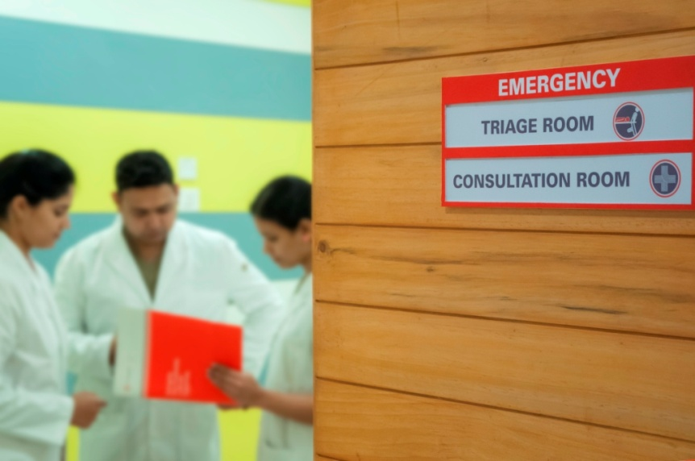
Facilities at Mediclinic, Cyber City
Emergency Services
ER on site
Emergency and Triage at Mediclinic
Your neighborhood Medanta Mediclinic: Services

Slide 7
Facilities at Mediclinic, Cyber City
Neurosciences (neurology & neurosurgery)
Mental health and quality of life
ENT and head & neck surgery
Ophthalmology
Cardiology and
cardiovascular surgery
Dental and oral health (including oral and maxillofacial surgery)
Plastic and reconstructive surgery
Breast Services
Liver transplant and regenerative medicine
Gastroenterology and Hepatobiliary sciences (including GI surgery, GI oncology & bariatric surgery)
Kidney & urology (including transplant)
Advanced paediatrics, neonatology, gynaecology and obstetrics
Oncology (medical, radiation and surgical )
Endocrinology & diabetes
Musculo-skeletal (orthopedics, joint replacements, rheumatology & physical medicine)
Peripheral vascular and endovascular sciences
Internal medicine and respiratory medicine
Integrative medicine and holistic therapies

Slide 8
Work at Organization
Scope
Observation
Analysis
Measure

Slide 9
Dessertation Report

Slide 10

Project Title
“Preventive health assessment analysis for Corporate lifestyle.”

Slide 11
Background And Need Of The Study
The burden of cardiovascular disease is rising in the Cyber-city day by day due to unhealthy lifestyle habits and workload
So, need of study to find out cause and implement good health among the corporate employee by assessing their preventive health checkup result by comparing their lifestyle habits and age group
Problem Statement : Increase in lifestyle diseases in corporate.

Slide 12
Objectives Of The Study
“Preventive health assessment analysis for corporate lifestyle.”
Specific Objectives
To Understand the risk factors associated with non-communicable diseases and life-style disorders
To Understand the concept of health promotion
Management of life style disorders.
Scope of the study.
To sensitize and enhance the capacity of the health personnel in the management of life-style disorders.

Slide 13
Review Of Literature
World Health Organization (WHO). Sedentary lifestyle: a global public health problem. The WHO's World Health Report 2002 identified five important risk factors for non-communicable disease in the top ten leading risks to health. These are raised blood pressure, raised cholesterol, tobacco use, alcohol consumption, and overweight
Workplace Wellness Programs Can Generate Savings By Katherine Baicker, David Cutler, and Zirui Song doi: 10.1377/hlthaff.2009.0626HEALTH AFFAIRS 29, NO. 2 (2010).the wider adoption of such programs could prove beneficial for budgets and productivity as well as health outcomes and reduce lifestyle diasese
Preventive Health Programme Understanding Preventive Health Check market dynamics, competition benchmarking and recommendations for product and process improvement.byASHISH KUMAR GUPTA PGDM 2009-11in 2009 – 09DM028 Birla Institute of Management Technology .proof that corporate Wellness is a uniquely specialized, highly qualified resource bank..Help you deliver wellness programs that save time and money, conserve valuable staff resources and offer your employees high-quality employee health and wellness services.

Slide 14
Limitations of the study
Inclusion Criteria:
Corporate employee below 50 year age
Exclusion Criteria:
Corporate employee above 50 year age.

Slide 15
Methodology
STUDY AREA | Medanta mediclinic cybercity,Gurgoan,Haryana
STUDY DESIGN | Cross-sectional &analytical study
STUDY POPULATION | Corporate Employee.( below age 50) .
SAMPLING METHOD | Non probability randome sampling
SAMPLE & SAMPLING | 75 emaployees of various corporates at Cybercity
DATA COLLECTION TOOL | Patient assessment form and report portal
STUDY PERIOD | March -April 2014
DATA ANALYSIS | MS Excel 2007

Slide 16
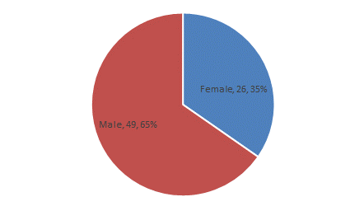
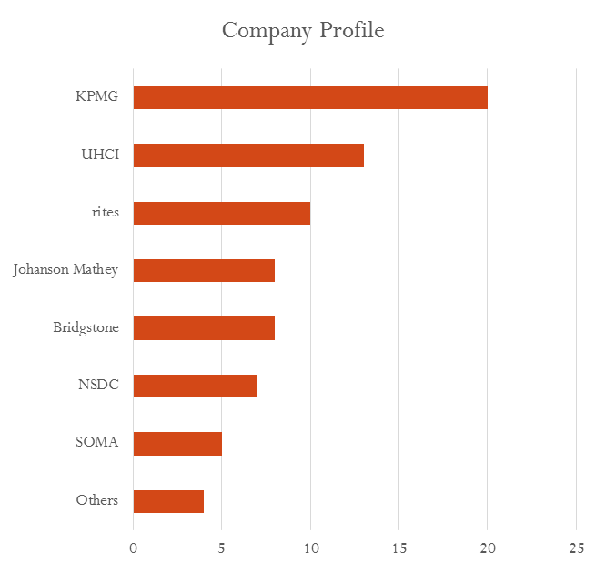
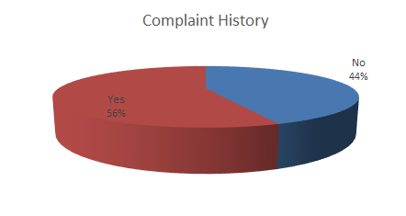
Data Analysis : Demographic Details
Sample Size 75 Patients

Slide 17
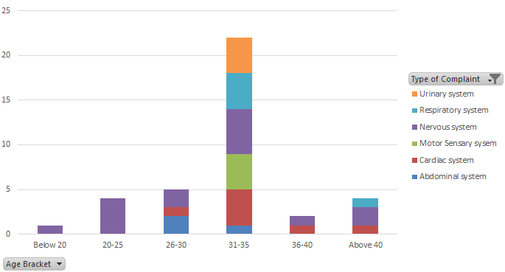
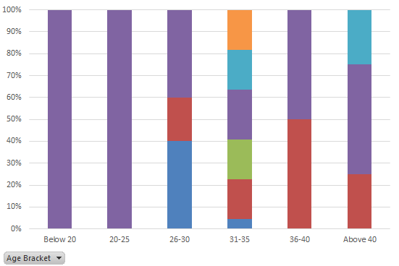
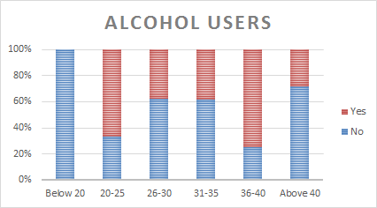
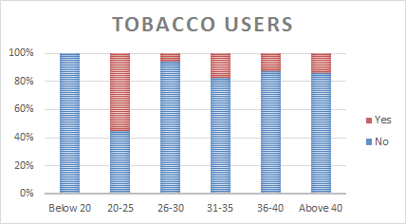
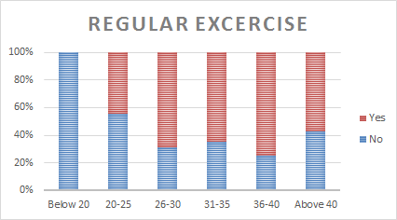
Data Analysis : Patient History

Slide 18
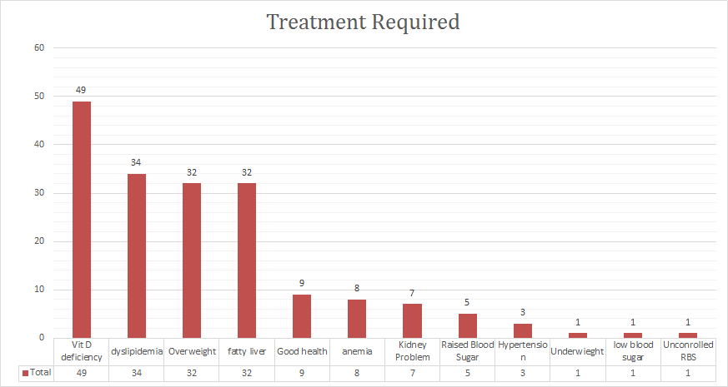
Data Analysis: Post Evaluation results

Slide 19
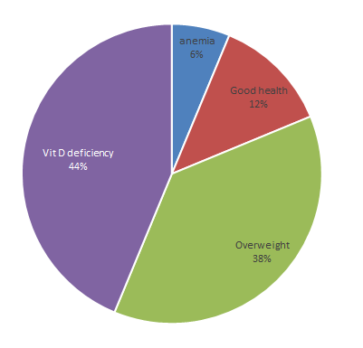
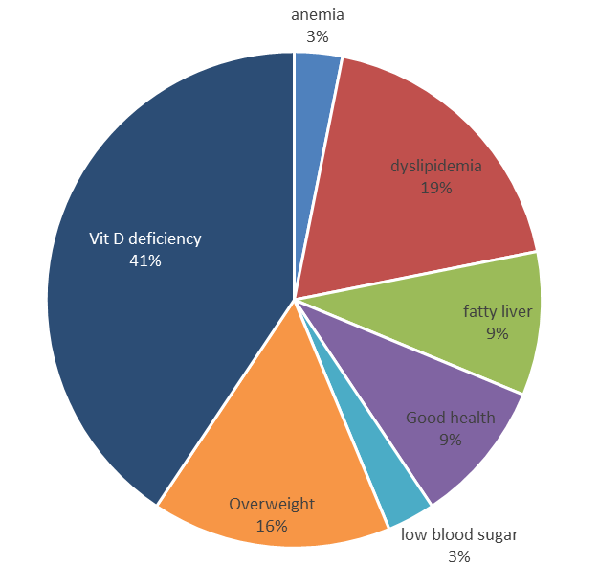
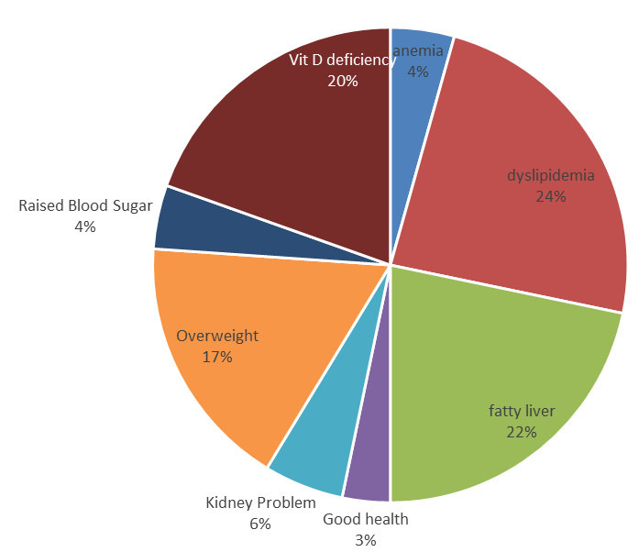
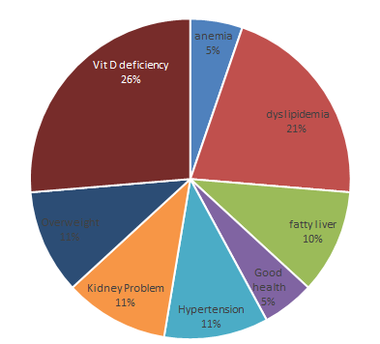
Data finding : Age wise Observations
Age Bracket
20-25
26-30
Age Bracket
31-35
36-40

Slide 20
Discussion of the study findings
In this study , total sample of employee is 75 ,among that 35% (n= 26)are female and 65% (n=49)male. There are 5 age group in study , maximum age group employee are between31-40 year is around 46% (n=34) . There are many big corporate company in cyber-city among them 65% employee are coming health check-up from KPMG, UHCI & RITES.
There are 56% employee has medical past history among them maximum has cardiac system and nervous system(table 8). As comparing day to day habit of employee , maximum 75% employee are alcohol user among age group 20-25 and 36-40(table 9.) , 55% smoking among 20-25 age group , minimum percentage of regular exercise are 20-25 age group.
After health check-up assessment result, among 75 employee major 4 results has maximum like 51% employee has Vitamin D deficiency, 34% has dyslipedimia , 32% has overweight, 32% has fatty liver. According to many review of literature, these above 4 are major risk factor for lifestyle diseases especially cardiac problem.
As per age group wise study finding, between age group 26-30 has 41% Vit D deficiency ,19% dyslipedemia ,16% overweight , between age group 31-35 has 20% Vit D deficiency ,24% dyslipedemia , 22% fatty liver ,17% overweight , between age group 36-40 has 26% Vit D deficiency ,21% dyslipedemia ,11% overweight, hypertension, kidney problem.

Slide 21
Summary & Conclusion
The cardiovascular mortality and hospitalisation will be largely concentrated in the prime working age group and the cost of hospitalisation is expected to increase substantially in coming years. This calls for mobilising resources, increasing access to health insurance and devising strategies for the prevention, control and treatment of cardiovascular diseases in India.
In corporate employee results , especially 75% age group below 40 suffering from life style diseases which indicate very unhealthy life style habits and workload. For them health awareness and promotion strategies should implement. To increase life expectancy of people and productivity of corporate organization

Slide 22
Recommendation
Health Awareness Events
Health Camps
Health Talks by Specialists
Training and Workshops
Stress management
Counseling for important role of diet
Management for alcohol , smoke abuse

Slide 23



Recommendations

Slide 24
References
1.World Health Organization (WHO). Sedentary lifestyle: a global public health problem. Available from URL: http://ww.who.int/hpr/physactiv/sedentary.lifestyle1.shtml
2. Workplace Wellness Programs Can Generate Savings By Katherine Baicker, David Cutler, and Zirui Song .doi: 10.1377/hlthaff.2009.0626HEALTH AFFAIRS 29, NO. 2 (2010)
3.Preventive Health ProgrammeUnderstanding Preventive Health Check market dynamics, competition benchmarking and recommendations for product and process improvement.by ASHISH KUMAR GUPTA PGDM 2009-11in 2009 – 09DM028 Birla Institute of Management Technology
4.Akhil Kant Singh, Ankit Maheshwari, Nidhi Sharma, Anand K. Lifestyle associated risk factors in adolescents, Indian Journal of Pediatrics, 2006, 73, 901.

Slide 25

Thank You

