Slide 1

Evaluating the Effectiveness of WhatsApp-Based Interventions for Lifestyle Behaviour Modification in Hypertension Patients: A Narrative Review
Aman Gulati | PG/23/013 | IIHMR Delhi | May 2025
This presentation critically examines the role of WhatsApp as a digital platform for lifestyle behavior modification in patients with hypertension. With over 1.28 billion people affected worldwide and significant mortality rates, effective interventions are crucial. The narrative review aims to consolidate current evidence on WhatsApp-based strategies, assessing their impact on lifestyle changes, medication adherence, and blood pressure control in hypertensive individuals.

Slide 2
Introduction to Hypertension and Digital Interventions
Hypertension affects over 1.28 billion individuals globally and accounts for approximately 10 million deaths annually. Its management demands not only pharmacological treatment but also essential lifestyle modifications such as diet, physical activity, and stress management.
WhatsApp, a widely accessible and low-cost communication platform, facilitates real-time engagement between healthcare providers and patients. Its ubiquity in many populations, including those in resource-limited settings, makes it a promising medium for health behavior interventions.
However, barriers such as psychosocial factors, limited education, and systemic challenges often impede adherence to these lifestyle changes. Digital tools offer innovative opportunities to address these issues.

Slide 3
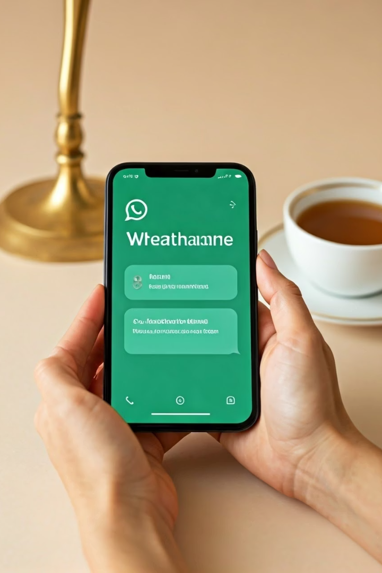
Rationale for the Study: Why Focus on WhatsApp?
High Usage in LMICs
WhatsApp boasts widespread penetration in low- and middle-income countries (LMICs), where hypertension prevalence is rising rapidly and health resources are limited.
Health Messaging and Motivation
The platform effectively delivers educational content and motivational messages, encouraging patient engagement and behavior change.
Fragmented Early Evidence
Initial studies suggest potential benefits but remain scattered and lack synthesis in the hypertension context.
Need for Consolidation
A comprehensive review can clarify effectiveness and guide future research and practice strategies.

Slide 4

Research Objectives of This Review
1
Review Existing Studies
2
Assess Effectiveness
3
Identify Gaps
Critically examine studies employing WhatsApp-based lifestyle interventions for hypertension management.
Medication adherence improvement
Highlight limitations in current literature and recommend areas for future research development.
Follow-up compliance enhancement
Modification of lifestyle behaviors (diet, exercise)
Blood pressure control outcomes

Slide 5
Core Research Questions Guiding the Review
Effectiveness
Specific Impact
Implementation Challenges
How effective are WhatsApp-based interventions in managing hypertension-related behaviors and clinical outcomes?
Which lifestyle and clinical outcome measures are most influenced by these digital interventions?
What obstacles and limitations exist when deploying WhatsApp-based health programs in hypertensive populations?

Slide 6

Methodology: Literature Review Approach
Design
Databases Searched
Narrative literature review synthesizing current evidence.
PubMed
Google Scholar
Web of Science
JGate
Search Terms
Combination of terms related to WhatsApp, social media, lifestyle behaviors, and hypertension.

Slide 7



Inclusion and Exclusion Criteria
Inclusion Criteria
Peer-reviewed studies from 2018 onward
English language publications
WhatsApp-based lifestyle interventions targeting hypertensive or mixed populations
Exclusion Criteria
Studies not focused on hypertension
Interventions not involving WhatsApp or digital platforms
Editorials, abstracts without full data, pre-2018 studies

Slide 8
Data Extraction and Analytical Framework
Thematic Analysis
Intervention Types
Evaluation Metrics
Identify recurring themes across studies regarding intervention characteristics and outcomes.
Comparison of text-only messaging versus multimedia (video) content for effectiveness.
Assess intervention effectiveness, feasibility, and implementation challenges from compiled data.

Slide 9

Expected Outcomes of the Review
Effectiveness Insights
Implementation Challenges
Research Gaps
Clarify how WhatsApp-based interventions can modify hypertension-related behaviors.
Highlight areas lacking sufficient evidence to inform future interventions and studies.
Identify practical barriers healthcare providers face in deploying such interventions.

Slide 10
Significance and Future Directions
Guidance for Professionals
Scalable mHealth Strategies
Informing Intervention Design
Provides evidence-based insights to healthcare professionals and policymakers to optimize hypertension management using digital tools.
Supports the development of scalable, cost-effective mHealth programs leveraging widely accessible platforms like WhatsApp.
Informs future research and innovation in intervention design, evaluation, and implementation in hypertension care.

Slide 11
Conclusion
• WhatsApp is a promising tool for lifestyle modification in HTN patients.
• This review aims to synthesize evidence for practical and research implications.

Slide 12
References
• Bonoto, B. C., de Araújo, V. E., Godói, I. P., de Lemos, L. L. P., Godman, B., Bennie, M., Diniz, L. M., & Guerra Júnior, A. A. (2017). Efficacy of mobile apps to support the care of patients with diabetes mellitus: A systematic review and meta-analysis of randomized controlled trials. JMIR mHealth and uHealth, 5(3), e4. https://pubmed.ncbi.nlm.nih.gov/32155382/
• Sankaran, S., et al. (2020). A WhatsApp-based intervention to promote healthy behaviors in patients with hypertension and diabetes in South India: A randomized controlled pilot study. BMJ Open, 10(7), e036005. https://pubmed.ncbi.nlm.nih.gov/32477434/
• Kumar, N., & Sinha, P. (2018). Mobile technology for health communication: A study on WhatsApp-based interventions for hypertension. Journal of Clinical and Diagnostic Research, 12(8), 1–6. https://pubmed.ncbi.nlm.nih.gov/29943647/
• Gonzalez, C. J., et al. (2023). Digital health tools for lifestyle modification in hypertensive patients: A narrative review. Journal of Medical Internet Research, 25, e11410229. https://pmc.ncbi.nlm.nih.gov/articles/PMC11410229/

