Slide 1

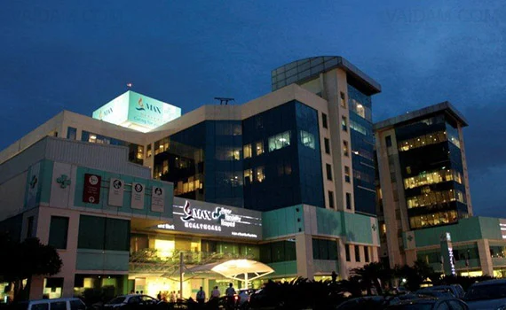
An Assessment of Operational Efficiency of GI Endoscopy Services
Centre for Gastroenterology, Hepatology & Endoscopy
Institute of Liver & Gastrointestinal Sciences
Max Super Specialty Hospital, Saket, New Delhi
Under the Guidance of
Dr Nitish Dogra
MD, MPH (Johns Hopkins University),
Associate Professor, IIHMR, Delhi
Presented
By
Col Vikram

Slide 2
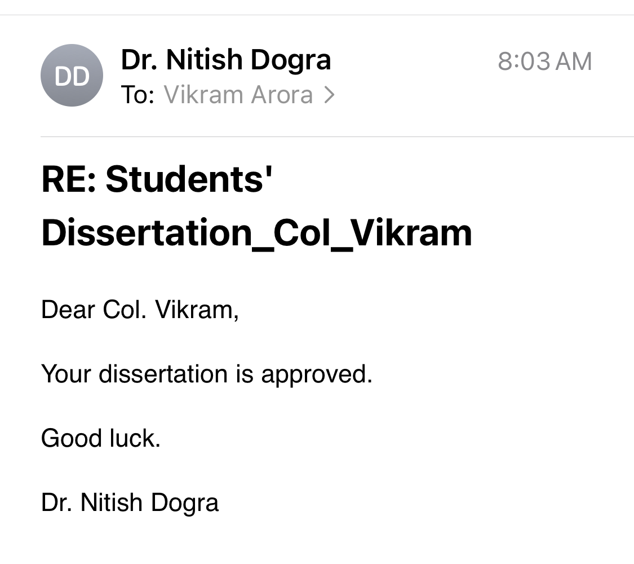
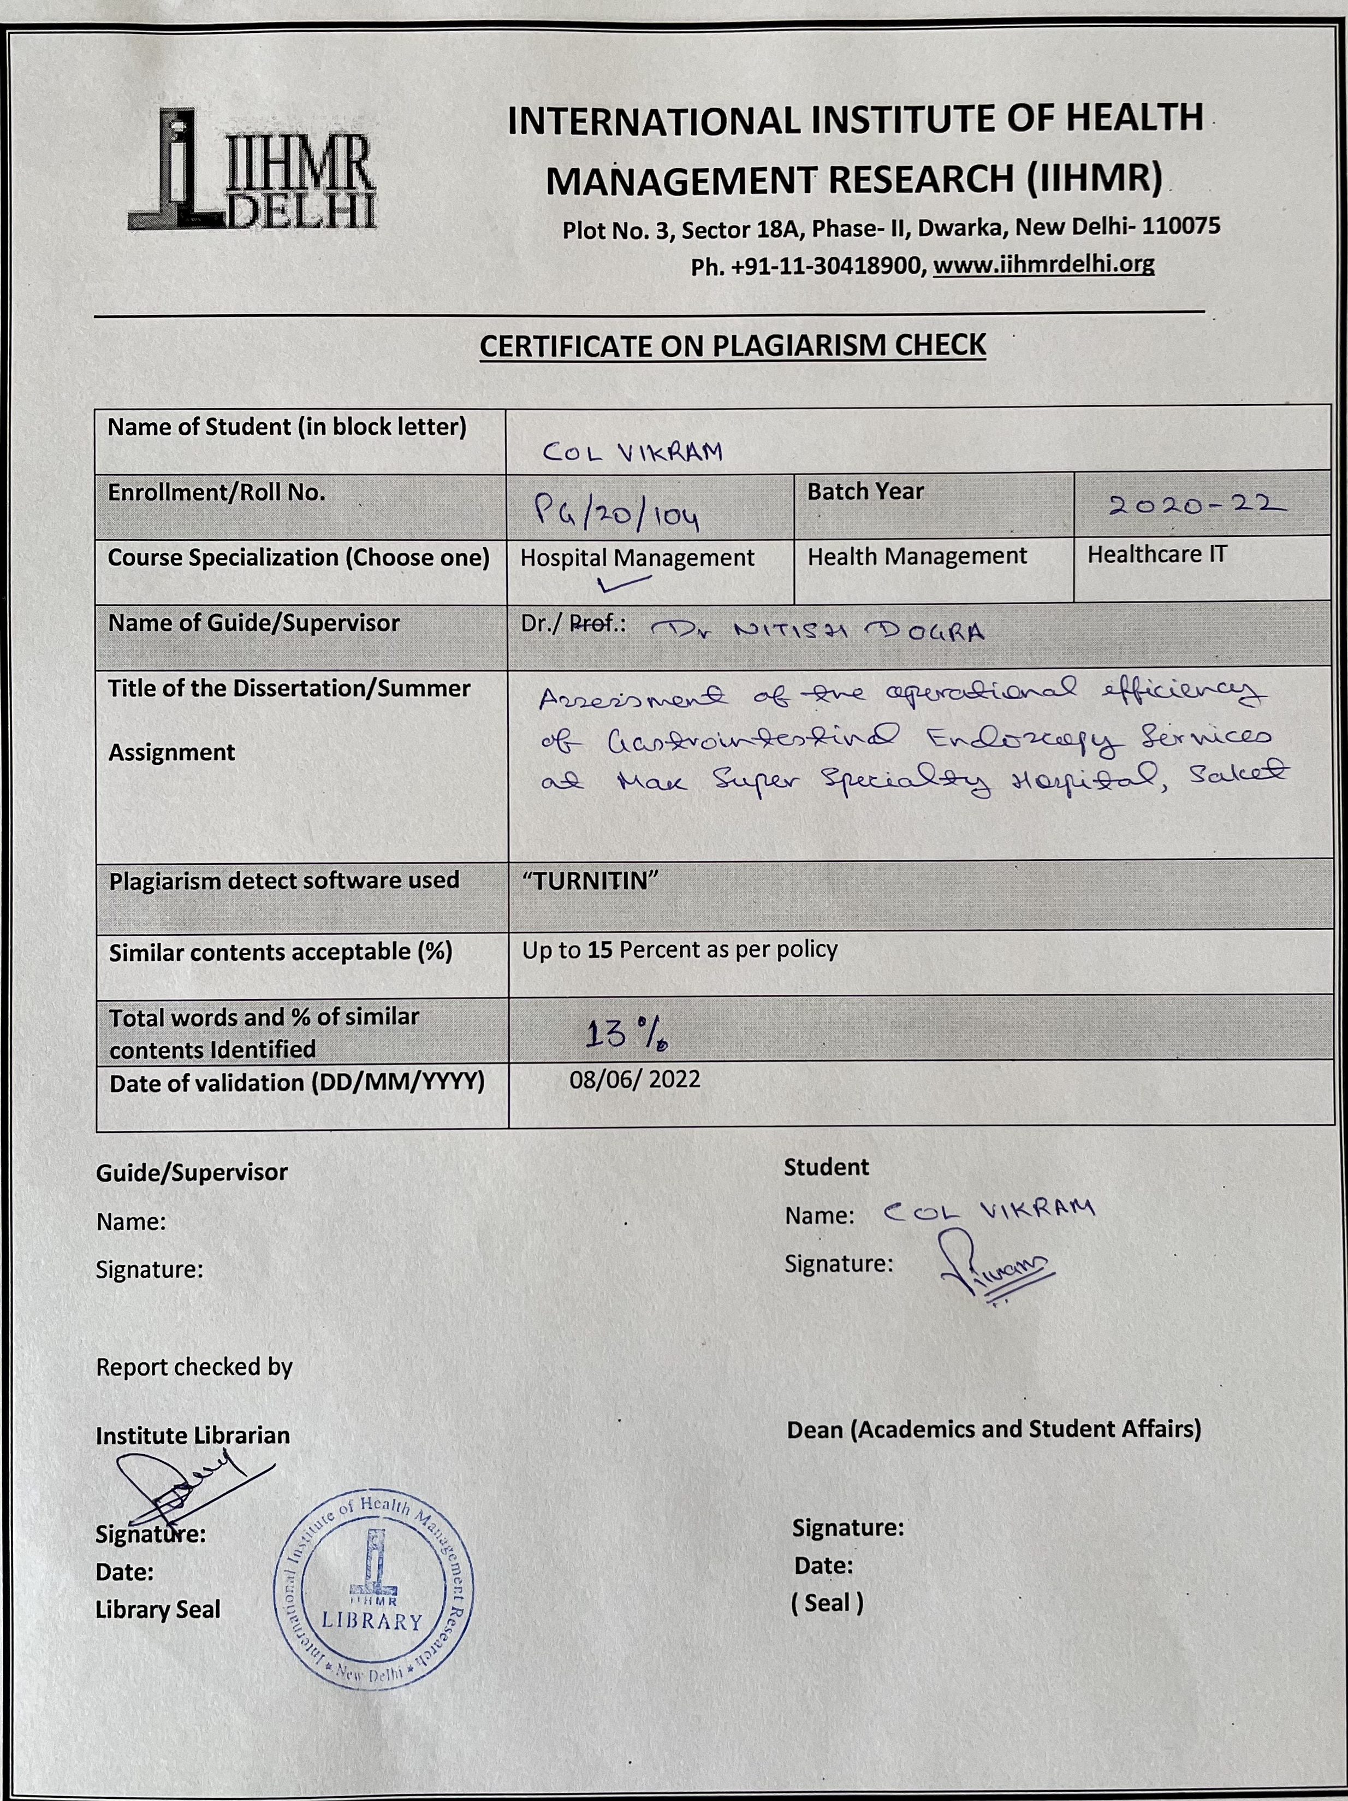
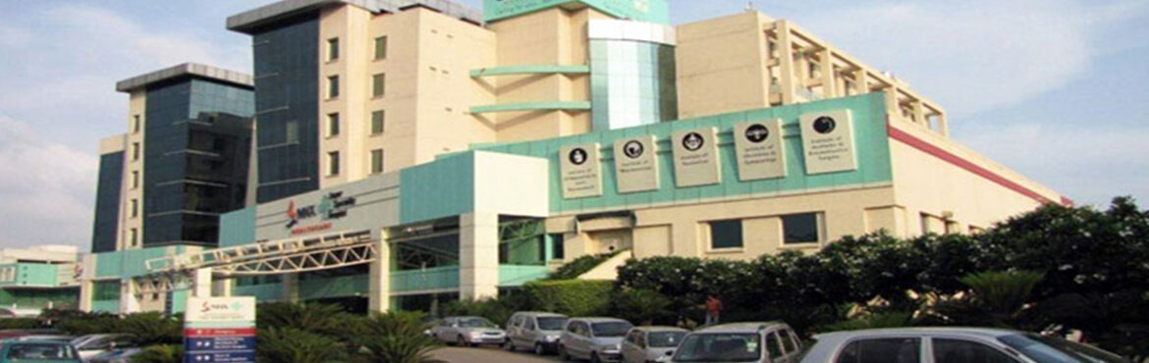
SCREEN SHOT OF APPROVAL

Slide 3
INTRODUCTION
Efficiency – referred to providing, prompt, timely and cost-effective care
Core elements of high quality care – optimal efficacy, safety, comfort and patient satisfaction
Efficiency and quality are mutually advantageous outcomes
High quality gastrointestinal endoscopy – specialty endeavour for nurses and physicians
Many stakeholders place high value on efficiency
Endoscopy used to investigate digestive issues

Slide 4
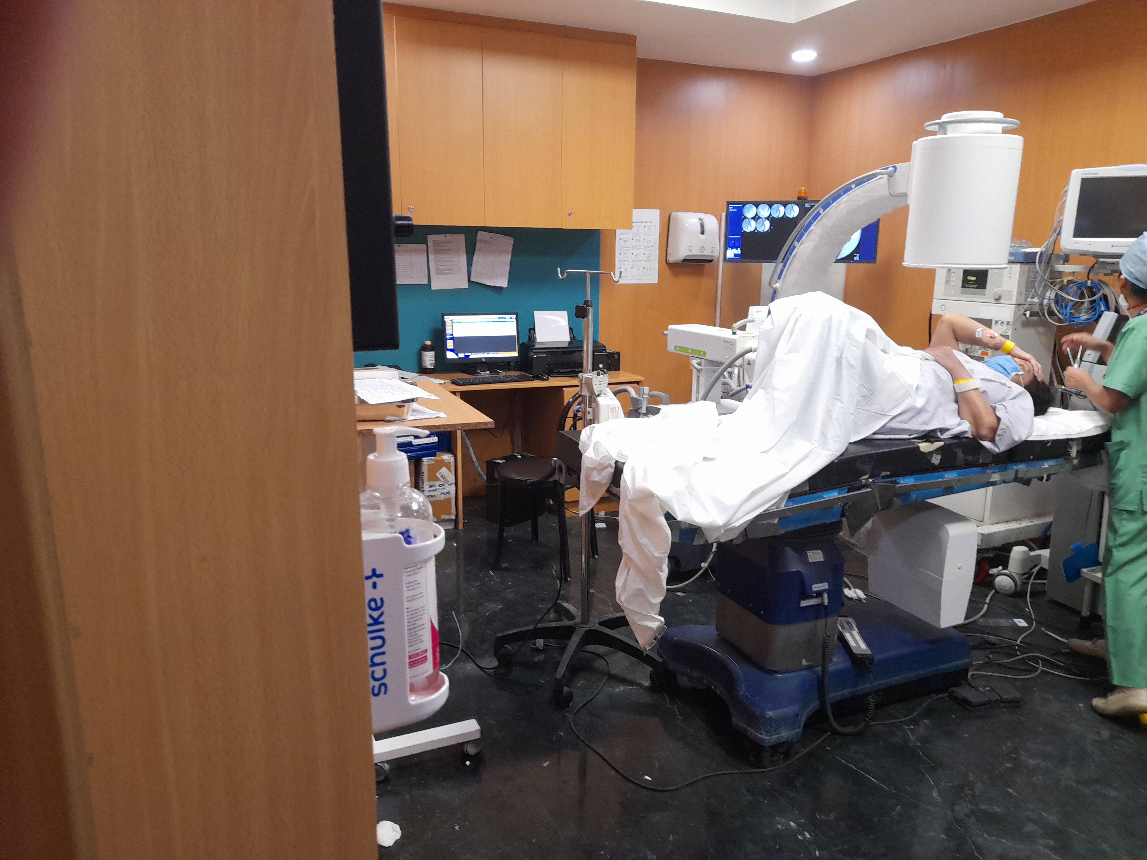
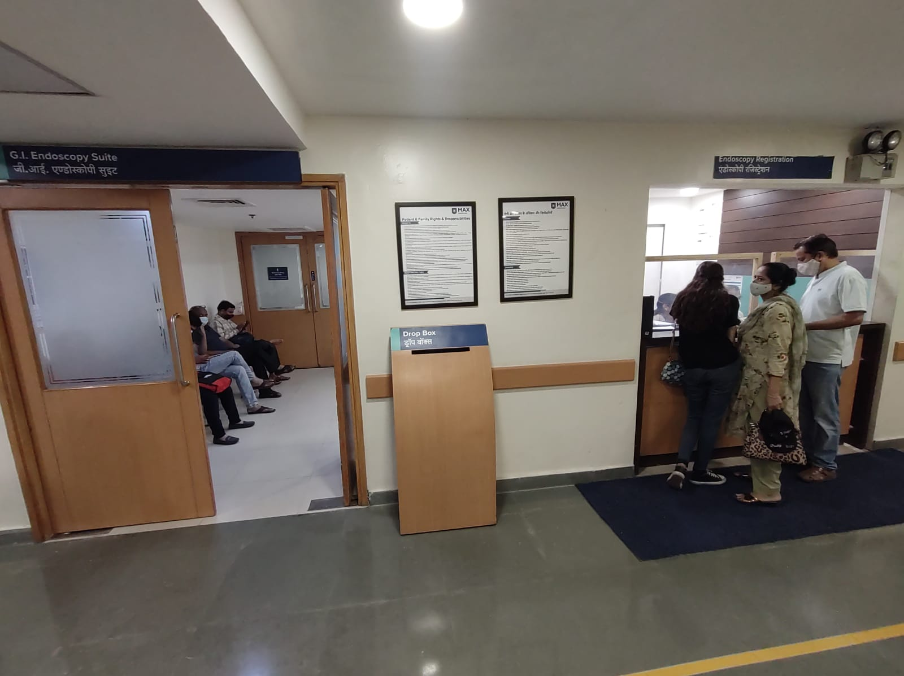
INTRODUCTION
Research Question
An assessment of adequacy of GI Endoscopy Services at Max Super Specialty Hospital, Saket, with respect to operational quality, performance and standardisation
Aim of the Study
Assessment of the operational efficiency of Gastrointestinal Endoscopy Services at Max Super Specialty Hospital, Saket

Slide 5
INTRODUCTION
Aim of the Study
Assessment of the operational efficiency of Gastrointestinal Endoscopy Services at Max Super Specialty Hospital, Saket

Slide 6
OBJECTIVES OF THE STUDY
To measure the operational quality compliance of Endoscopy department with respect to “JCI standards for IPSG and ASC”
To measure compliance in standardisation in “Informed Consent” forms
To measure the performance of the department in respect of “Patient Waiting Time” for the said services, as a measure of patient satisfaction and promptness in the levels of care
To suggest recommendations for improvement

Slide 7
LITERATURE REVIEW
S No | Author | Objective | Sample Size | Methodology | Result
1 | Simon M Everett, Helen Griffiths (2018) | Guidance and explicit recommendations for obtaining valid consent for both elective and acute or emergency endoscopic procedures | - | Systematic review of the related studies on the topic was done by the author to draw out and analyse the results | The recommendations are divided into consent for patients with and without capacity and also provide sections on provision of information and the consent process for patients in a variety of situations.
2 | SP Pereira, SH Hussaini, M Lwilkinson (2011) | To determine what proportion of patients referred to the endoscopy unit of a London teaching hospital are given sufficient information before upper GI endoscopy so as to satisfy the criteria of informed consent. Assess the patients'’ acceptance of a new proposed consent form and its signing procedure. | 200 | Patients were asked to complete an initial questionnaire. In the first 100 patients, consent was obtained in the usual manner. In the second 100 patients, a new endoscopy consent form, which was simpler and sent out two to four weeks before endoscopy. | Of the first 100, only 54% had actually read the form before signing it. Of the second 100, 95% read it and 88% signed it, before coming to the unit. 84% found the new form easier to read and understand.

Slide 8
LITERATURE REVIEW
S No | Author | Objective | Sample Size | Methodology | Result
3 | Bret T. Petersen (2006) | Understanding of efficiency in the management and performance of gastrointestinal (GI) endoscopy, namely enhancement of productivity, or work performed per unit of time or expense. | - | Systematic review of the related studies on the topic was done by the author to draw out and analyse the results | Efficiency can be planned for and assessed on multiple levels and in the context of many components of the endoscopic services. Perhaps foremost when considering improvements in any aspect of health care is the means for development of reliable and consistent data on an on- going basis. Several design elements of the procedure area contribute to efficiency of the units. The processes used in the delivery of care provide the major opportunities for improving efficiency An efficient scheduling mechanism is important for both patients and referring physicians. The optimal staffing for an endoscopy suite varies primarily with the volume and mix of services provided. Procedural techniques and decisions also can be assessed for their potential contribution to efficiency.
4 | Sekar Bhavani (2016) | The need for non–operating room anesthesia (NORA) in order to provide the same levels of safety and standardization that are provided in the operating room environment. | - | Systematic review of the related studies on the topic was done by the author to draw out and analyse the results | Claims arising from NORA locations have been shown to have a higher proportion of death compared with those from the operating rooms (54% vs 29%, respectively; P<.001) and were primarily caused by an adverse respiratory event due to oversedation (44%). GI suites accounted for 32% of these claims. These are preventable by better monitoring techniques.

Slide 9
LITERATURE REVIEW
S No | Author | Objective | Sample Size | Methodology | Result
5 | Akash Verma, Mui Yok Lee (2014) | To assess the efficiency of performing pulmonary procedures in the endoscopy unit in a large teaching hospital. | 65 | A prospective study from May 20 to July 19, 2013, was designed. The main outcome measures were procedure delays and their reasons, duration of procedural steps starting from patient’s arrival to endoscopy unit, turnaround time, total case durations, and procedure wait time. | 65 pulmonary procedures were scheduled between May 20 and July 19, 2013, of which 51 were performed. Average procedure wait time was 76±69 hours. Thirty-four of 65 (52.3%) had the wait time >48 hours, 22/65 (33.8%) had wait time >=96 hours, and 7/65 (11%) had it >=144 hours. In total 35/65 (53.8%) cases were delayed. Twenty-seven of 51 (53%) procedures started >30 minutes after their schedule time.
6 | Elaine Yong, Olga Zenkova (2006) | To assess the efficiency of the endoscopy unit in a large tertiary care teaching hospital. | 675 | Prospective study from May 16 to September 5, 2003. Collected these data for all patients she observed undergoing endoscopy at the hospital during the study period: scheduled and actual procedure start times, time elapsed between the end of one procedure and the start of the next, type of procedure done. | 675 endoscopic procedures done for 625 patients (207 inpatients [33%]). Procedures for 193 (30.9%) of the 625 patients were delayed (>15 minutes between procedures), 70.5% (136/193) because the physician was not available to start the procedure. The time elapsed between procedures was longer than 30 minutes for 47 of the 193 delayed procedures (24.4%). The duration of procedures was prolonged for about 22% (130/593) of procedures.

Slide 10

METHODOLOGY
Study Location
Centre for Gastroenterology, Hepatology & Endoscopy, Institute of Liver & Gastrointestinal Science, Max Super Specialty Hospital, Saket
Study Period
15 Apr to 14 May 2022 (30 days)
Study Design
It is a ‘Cross Sectional’ observational study based on secondary data collected over 30 days with respect to collection of data of 10 cases per day by randomized sampling method

Slide 11

METHODOLOGY
Study Sample
The study will be performed on the patients undergoing various procedures performed in Endoscopy
Sample Size
260 patients
Sample Method
Random sampling

Slide 12

METHODOLOGY
Selection Criteria
Inclusion Criteria
All the IPD and OPD patients of the Unit-1 of Endoscopy department
All the elective procedures
Exclusion Criteria
The patients of Unit-2 of the Endoscopy department
All the emergency procedures

Slide 13

METHODOLOGY
Sources of Data
Primary Data
  Unstructured interviewing of staff and technicians
  Time and Motion study
Secondary Data
Records of patients in GI Endoscopy

Slide 14


METHODOLOGY
Data Analysis
  Data was collected and analysed using Microsoft Excel

Slide 15
METHODOLOGY
Expected Outcome
Study the existing process flow of the Endoscopy in the hospital and identify the problem areas
To measure performance as a measure of compliance towards JCI (IPSG & ASC)
To assess adequacy of various pathways in the continuum of care such as informed consent
Waiting time estimation with a sample of patients from IPD and OPD
Recommend strategies that could improve the service components in the endoscopy services

Slide 16
METHODOLOGY
Timelines
Ser No | Phases | Activities | Timelines
1 | Phase 1 | Observation and understanding of the services and process flow of the Endoscopy department. | 15 Mar to 31 Mar 2022
2 | Phase 2 | Understanding the JCI standards and criteria related to IPSG and ASC and assessment and data collection. | 01 Apr to 14 Apr 2022
3 | Phase 3 | Assessment of JCI standards and criteria related to IPSG and ASC data collection. To measure compliance in standardisation in informed consent Time and motion study in order to collect data for waiting time. | 15 Apr to 15 May 2022
4 | Phase 4 | Data analysis and Result compilation | 16 May to 14 Jun 2022

Slide 17
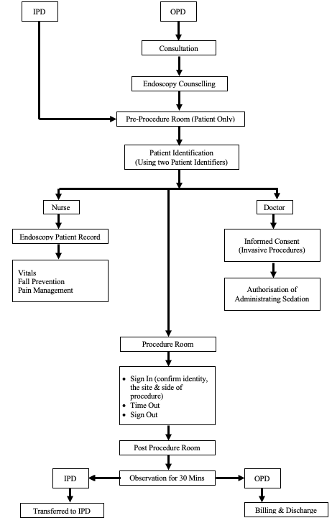
RESULTS
Process Flow

Slide 18
RESULTS
Monthly Work Load
Steady increase in the number of procedures performed over the months
From Jan to Mar 22 there has been an increase of 48%
Decline of 9% in the number of procedures form Mar to May 22
Overall increase of 43% from Jan to May 22

Slide 19
RESULTS
Procedures Based on the Type of Registration
In Jan the IPD cases almost same as the OPD cases
However, over the months this trend has changed
OPD cases for the month of May are 58% of the total cases and greater than the IPD.

Slide 20
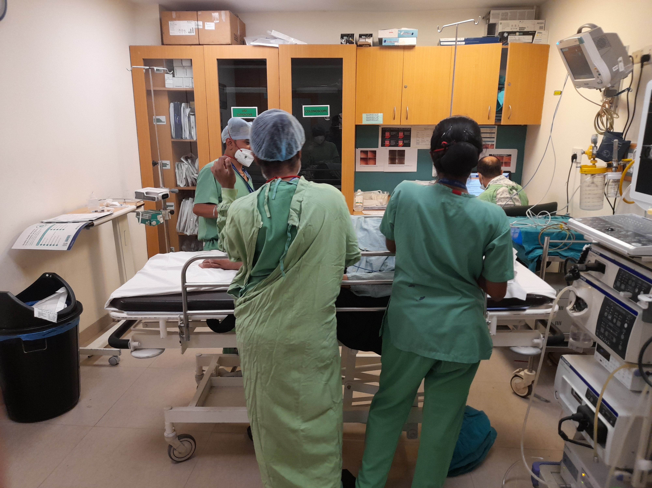
RESULTS
Breakup of Cases Based on the Type of Procedures

Slide 21
RESULTS

Slide 22
RESULTS
Compliance to JCI Measurable Elements
IPSG Compliance
Standards obtained for compliance – Fully Met score(10) | Standards obtained for compliance – Partially Met score(5) | Standards obtained for compliance – Not Met score(0)
33 | 06 | 00
Total score = 330 | Total score = 30 | Total score = 00
Maximum score obtained out of the total score of 390 = 360 Percentage of compliance achieved = 360/390 * 100 = 92.30% Average score achieved = 9.23

Slide 23
RESULTS
Compliance to JCI Measurable Elements
ASC Compliance
Standards obtained for compliance – Fully Met score(10) | Standards obtained for compliance – Partially Met score(5) | Standards obtained for compliance – Not Met score(0)
29 | 03 | 00
Total score = 290 | Total score = 15 | Total score = 00
Maximum score obtained out of the total score of 320 = 305 Percentage of compliance achieved = 305/320 * 100 = 95.31% Average score achieved = 9.53

Slide 24
RESULTS
Compliance to Informed Consent
216 patients (83%) confirmed that the procedural benefits and risks were explained to them while obtaining the informed consent form by the Gastroenterologist
44 patients (17%) had responded that the informed consent was explained by the Procedure Room Executive

Slide 25
RESULTS
Waiting Time Estimation
The average waiting time is 87 mins (01hrs 27 mins)
Maximum patients (57) waiting time is between 80-100 mins
Only 01 patient had to wait for 220-240 mins
Total Waiting Time (Mins) | No of Patients
20-40 | 17
40-60 | 52
60-80 | 45
80-100 | 57
100-120 | 34
120-140 | 24
140-160 | 15
160-180 | 11
180-200 | 2
200-220 | 2
220-240 | 1
Grand Total | 260
Frequency Table

Slide 26
RESULTS
Descriptive Statistics
Total Wait Time (Mins)
Mean | 87.44230769
Standard Error | 2.455194377
Median | 85
Mode | 80
Standard Deviation | 39.58881977
Sample Variance | 1567.274651
Kurtosis | 0.3185062
Skewness | 0.741868481
Range | 205
Minimum | 20
Maximum | 225
Sum | 22735
Count | 260
Largest(1) | 225
Smallest(1) | 20
Confidence Level(95.0%) | 4.834684201
Time in Pre-Procedure Room (Mins)
Mean | 45.53846154
Standard Error | 1.666528822
Median | 40
Mode | 30
Standard Deviation | 26.87196982
Sample Variance | 722.1027621
Kurtosis | 1.186546826
Skewness | 1.124428467
Range | 150
Minimum | 5
Maximum | 155
Sum | 11840
Count | 260
Largest(1) | 155
Smallest(1) | 5
Confidence Level(95.0%) | 3.281671156
Time in Waiting Area (Mins)
Mean | 41.90384615
Standard Error | 1.746618763
Median | 35
Mode | 15
Standard Deviation | 28.16338131
Sample Variance | 793.1760469
Kurtosis | 2.16600793
Skewness | 1.437597687
Range | 140
Minimum | 10
Maximum | 150
Sum | 10895
Count | 260
Largest(1) | 150
Smallest(1) | 10
Confidence Level(95.0%) | 3.439381508

Slide 27
RESULTS
t-Test: Two-Sample Assuming Equal Variances
 | Time in Waiting Area (Mins) | Time in Pre-Procedure Room (Mins)
Mean | 41.90384615 | 45.53846154
Variance | 793.1760469 | 722.1027621
Observations | 260 | 260
Pooled Variance | 757.6394045
Hypothesized Mean Difference | 0
df | 518
t Stat | -1.505562745
P(T<=t) one-tail | 0.066394487
t Critical one-tail | 1.647800566
P(T<=t) two-tail | 0.132788973
t Critical two-tail | 1.964554196

Slide 28
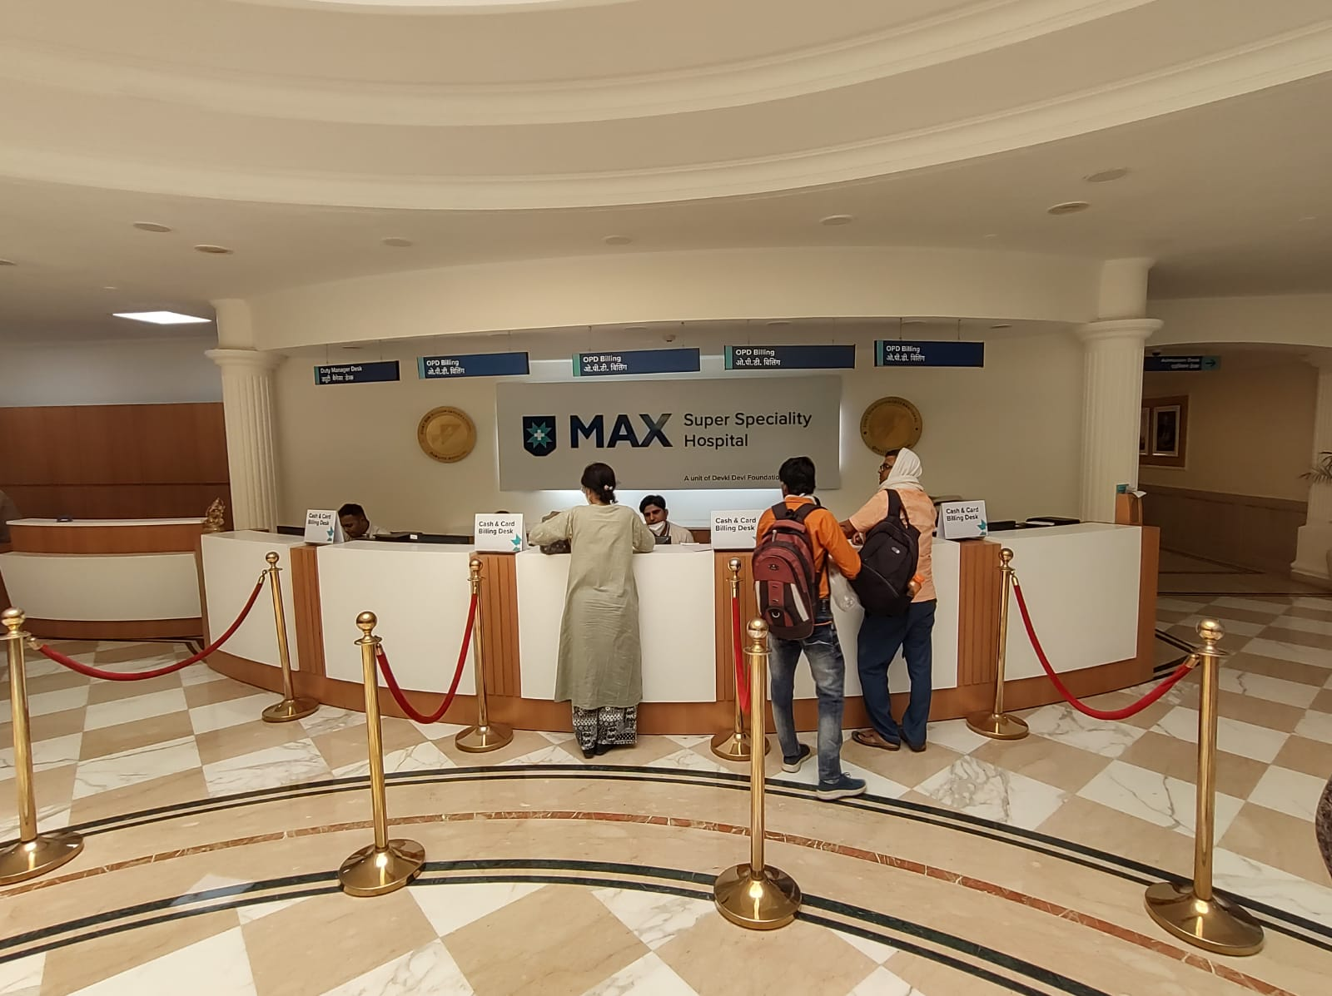
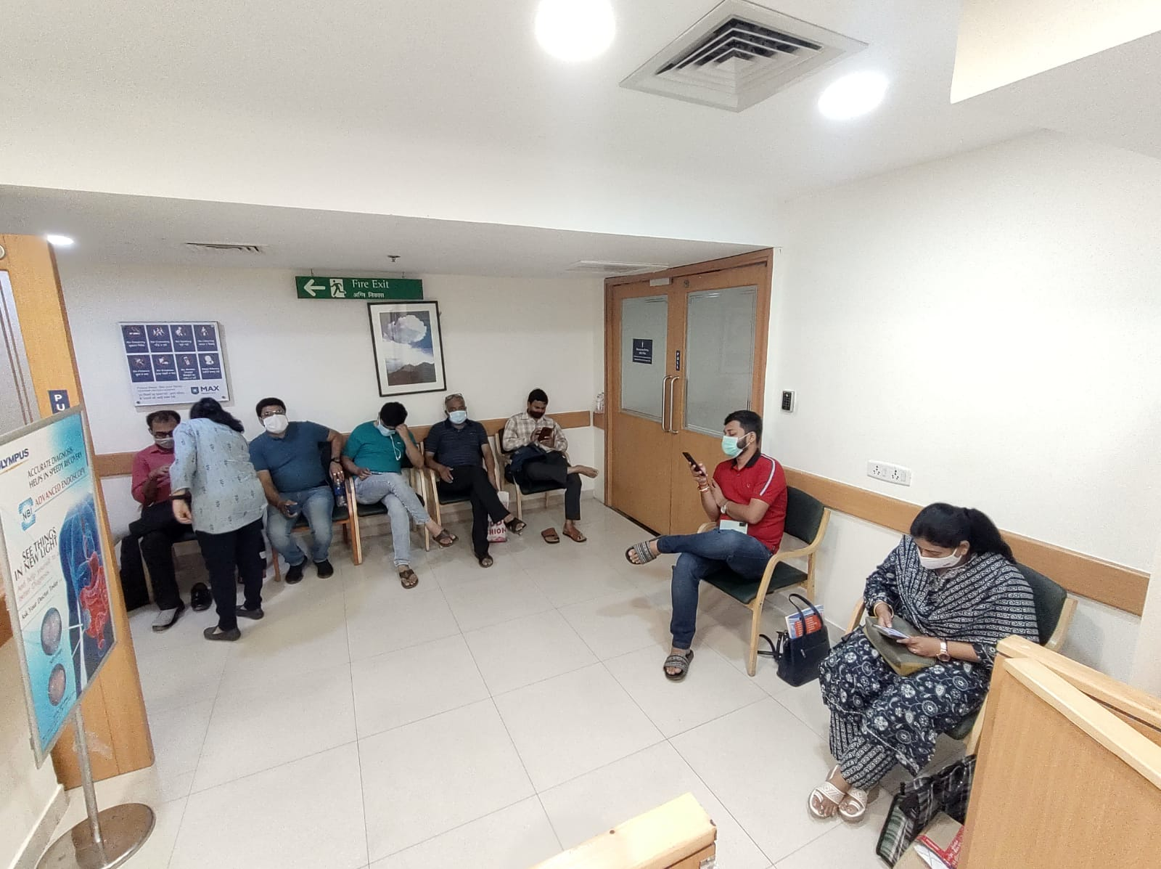
DISCUSSION
Compliance to JCI
The compliance to JCI standards with regards to IPSG and ASC has been achieved to the desired acceptable levels, average score of 9.23 and 9.53 respectively
Informed Consent
17% of patients (44 out of 260) had responded that the informed consent was explained by the Procedure Room Executive
Gastroenterologist not present while obtaining their signature, is partly due to
  Time constraint imposed by a busy endoscopy procedure list in the department
  Busy OPD schedule of the department

Slide 29
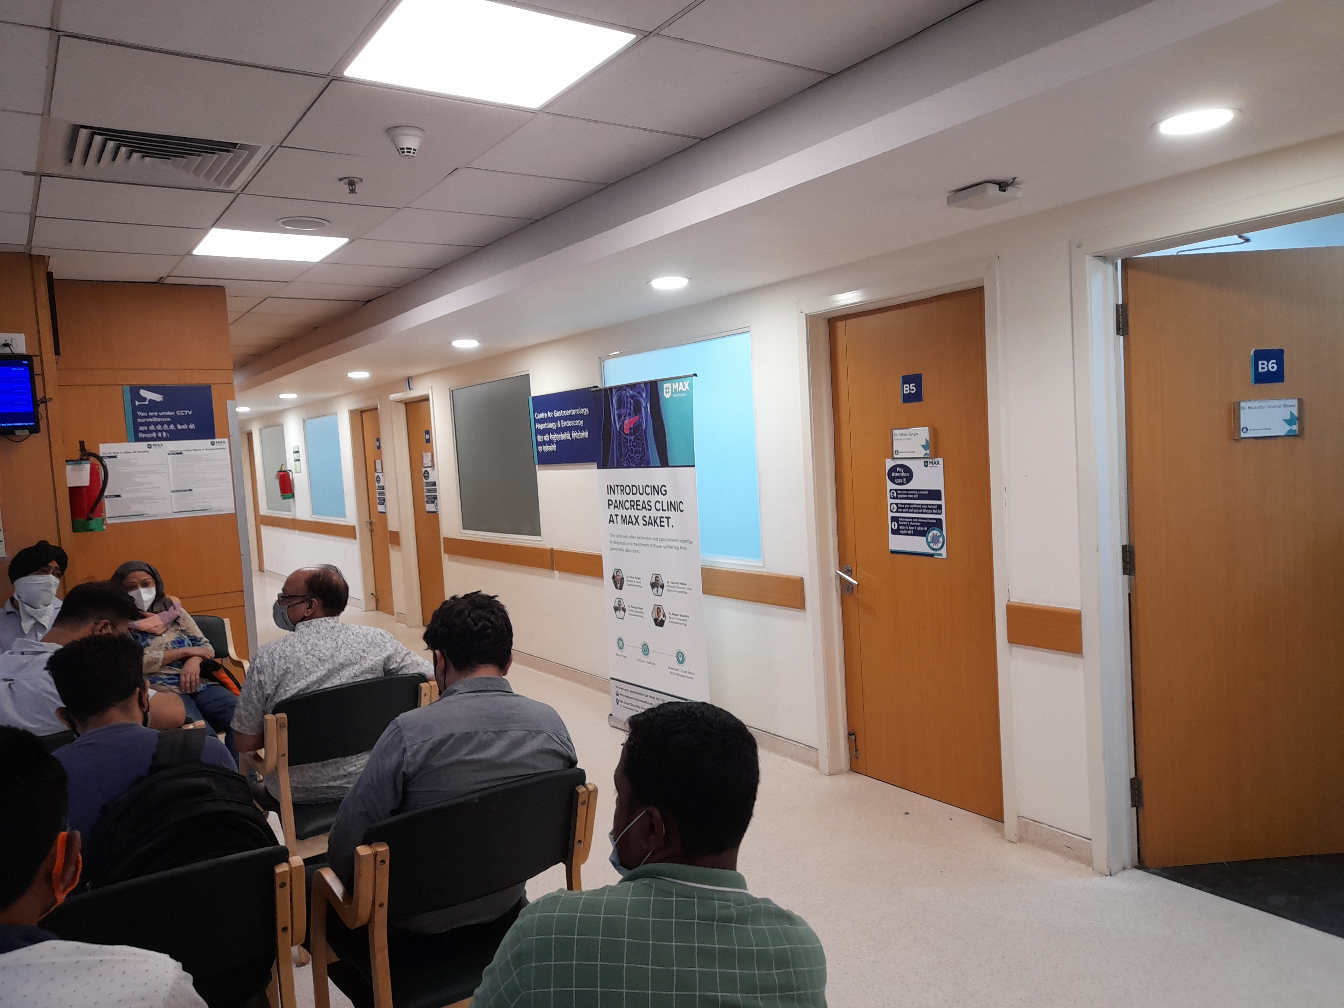
DISCUSSION
Wait Time Estimation
Average wait time for a patient to undergo an endoscopy procedure is 1 hour 27 minutes (87minutes)
It is quite satisfactory considering the availability of only 5 procedure rooms wherein both the units of Endoscopy department perform on sharing basis
Out of these 5 rooms
  1 room is dedicated for fibroscan and manometry
  1 room for ERCP
  3 rooms for balance of the procedures
Delay in the availability of the gastroenterologist
  ERCP procedure, alone can take around 3-4 hours
  No separate days for OPD and these non OT procedures
Availability of only 1 duty anaesthetist

Slide 30
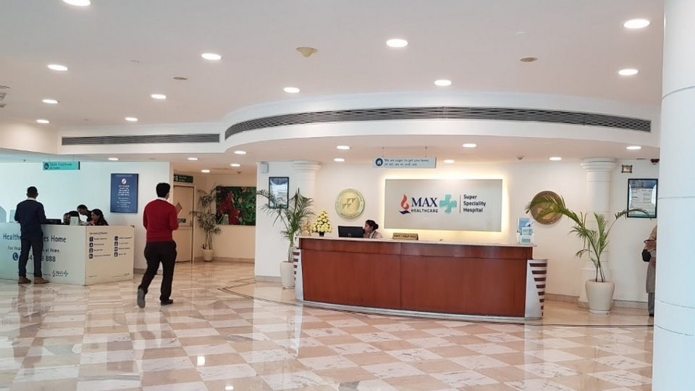
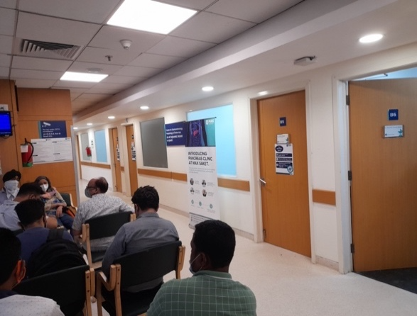
DISCUSSION
Strength of the Study
No study has been conducted to assess the operational efficiency of this department
Help to improve the operational quality, performance and standardisation
Streamline and reduce the waiting time for patients undergoing Endoscopy
Streamline the procedure of obtaining the informed consent by the Gastroenterologist

Slide 31
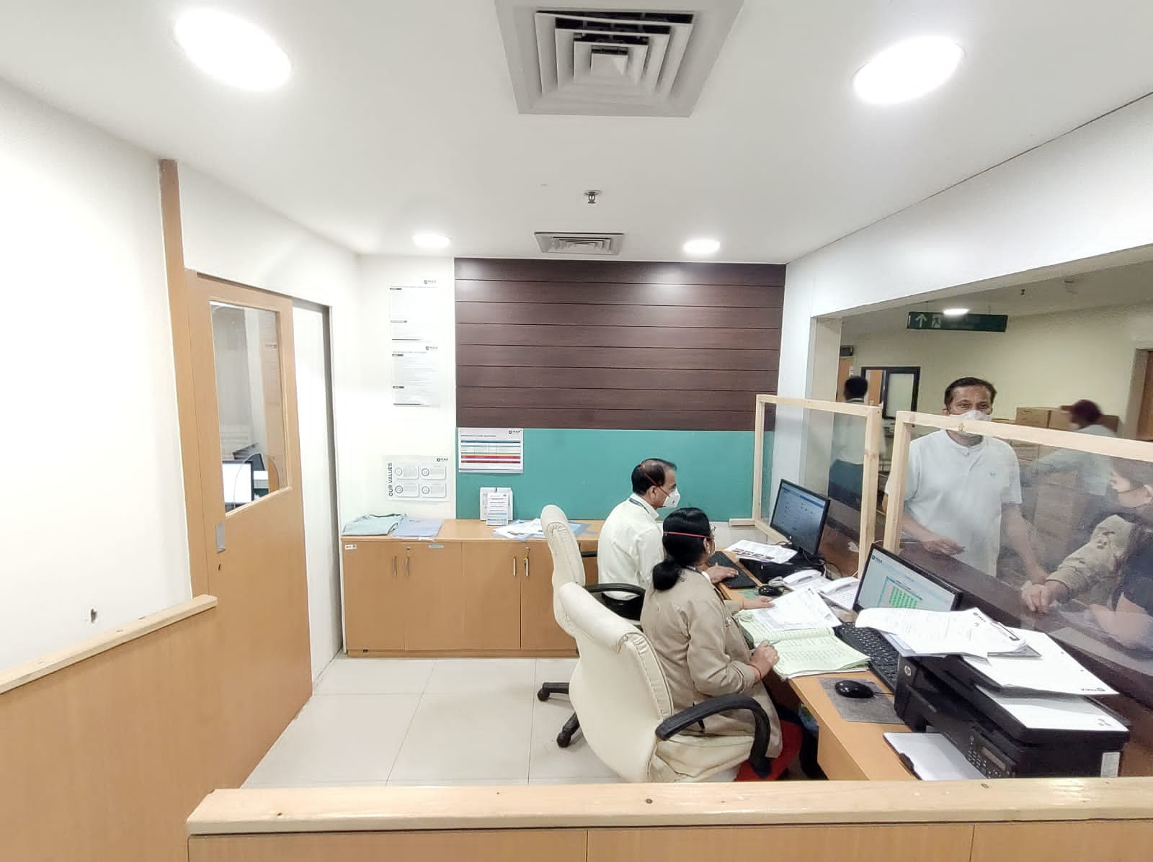
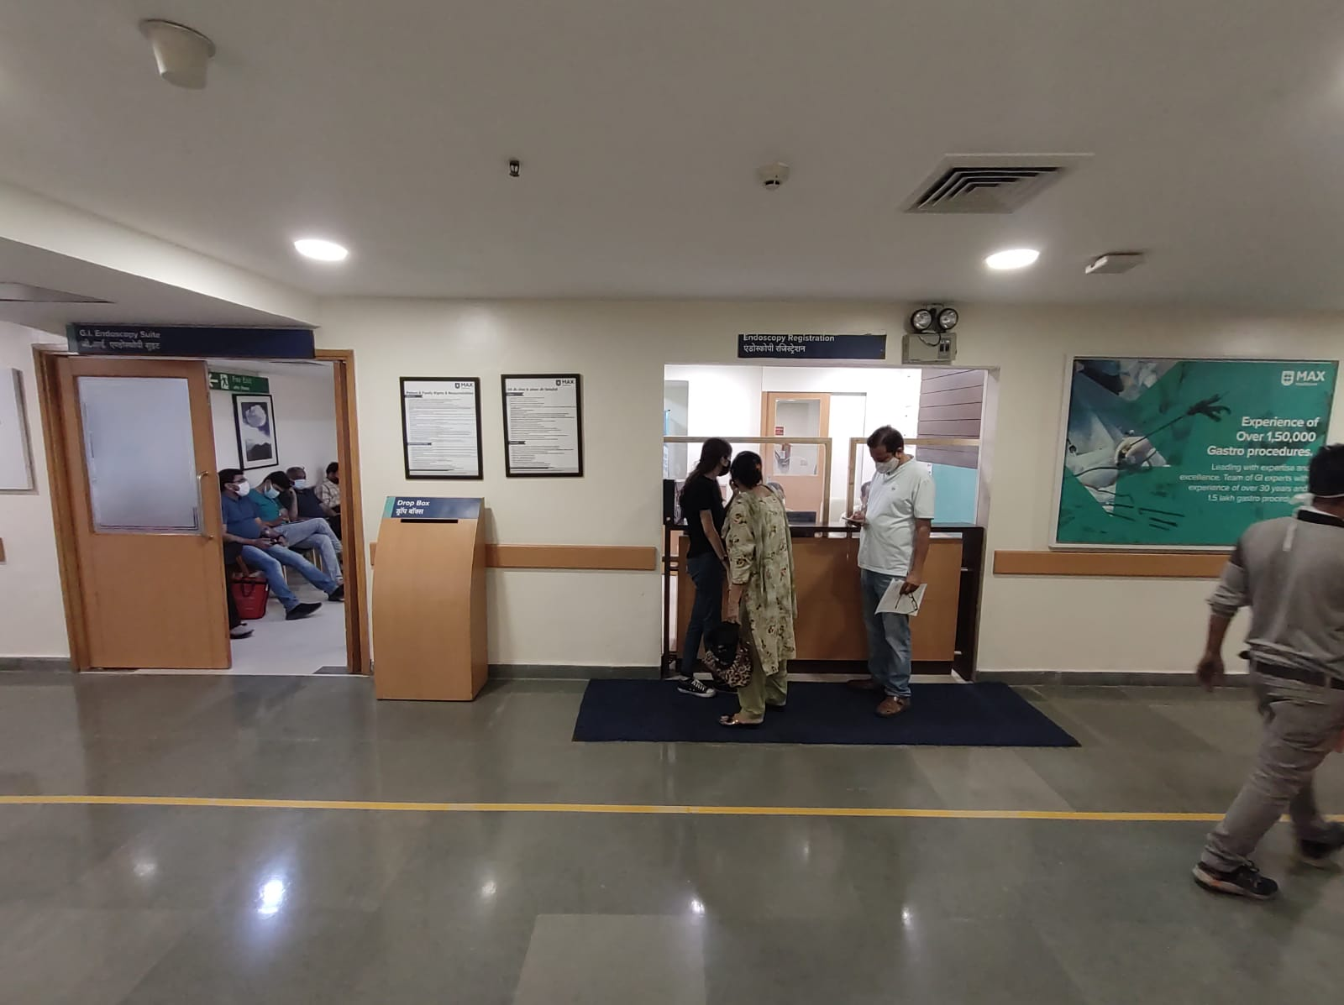
LIMITATIONS OF THE STUDY
Only IPSG and ASC chapters were considered
Renewal of JCI accreditation in Dec 2022
Average waiting time estimation not done separately for morning and afternoon

Slide 32

CONCLUSION
Opportunities to improve efficiency
  Initial design of the facility
  Scheduling of the procedures and the staff duties
  Variety of process related issues
    Endoscopist's and assistants intraprocedural activities
    Purchasing
    Use, and reprocessing of the equipment
    Billing processes
Improving efficiency requires an understanding of processes and awareness of present performance
Recognising chances for growth requires more targeted and detailed assessments

Slide 33
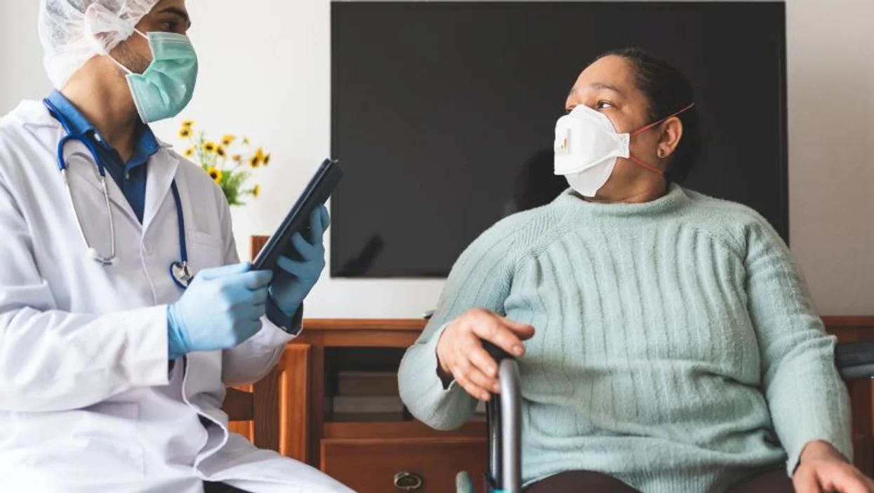

RECOMMENDATIONS
ME of JCI standards as applicable to the Endoscopy department, need to be evaluated next year after the JCI accreditation is complete
A Gastroenterologist be detailed as per the time schedule and mandated to brief the patients in the waiting area
Develop a time schedule for all the major procedures, by forming time slots for various procedures and earmarking rooms for a set of procedures

Slide 34
REFERENCES
Tsai MH, Cipri LA, O'Donnell SE, Matthew Fisher J, Andritsos DA. Scheduling non-operating room anesthesia cases in endoscopy: Using the sandbox analogy. J Clin Anesth. 2017 Aug;40:1-6. doi: 10.1016/j.jclinane.2017.03.010.
Bhavani S. Non–Operating Room Anesthesia in the Endoscopy Unit. Gastrointest Endosc Clin N Am. 2016 Jul;26(3):471-483. doi: 10.1016/j.giec.2016.02.007.
Lightdale C J. Sedation for Gastrointestinal Endoscopy: An Uneasy State of the Art. Gastrointest Endosc Clin N Am. 2016 Jul;26(3):xiii-xiv. doi: 10.1016/j.giec.2016.04.001.
Verma A, Lee M Y, Wang C, Hussein N B M, Selvi K, Tee A. Efficiency of Performing Pulmonary Procedures in a Shared Endoscopy Unit. J Bronchology Interv Pulmonol. 2014 Apr;21(2):135-141. doi: 10.1097/LBR.0000000000000050.
Yong E, Zenkova O, Saibil F, Cohen L B, Rhodes K, Rabeneck L. Efficiency of an endoscopy suite in a teaching hospital: delays, prolonged procedures, and hospital waiting times. Gastrointest Endosc. 2006 Nov;64(5):760-764. doi: 10.1016/j.gie.2006.02.047.
Muthusamy V R. Tips and pearls on running an endoscopy unit in a cost-efficient manner. Gastrointest Endosc. 2020 Nov;92(5):1111-1114. doi: 10.1016/j.gie.2020.06.011.
Gellad Z F. Endoscopy unit efficiency. Gastroenterol Hepatol (N Y). 2014 May;10(5):315-317.

Slide 35
REFERENCES
Marcus S N. Efficiency in endoscopy centers. Gastrointest Endosc. 2006 Nov;64(5):765-767. doi: 10.1016/j.gie.2006.07.028
Vicari J J. Sedation in the ambulatory endoscopy center: optimizing safety, Expectations and throughput. Gastrointest Endosc Clin N Am. 2016 Jul;26(3):539-552. doi: 10.1016/j.giec.2016.02.005.
Navidi B, Kiai K. Efficiency and scheduling in the nonoperating room anesthesia suite: implications from patient satisfaction to increased revenue operating room: a common (Dollars and Sense) approach. Curr Opin Anaesthesiol. 2019 Aug;32(4):498-503. doi: 10.1097/ACO.0000000000000744.
ASGE Standards of Practice Committee, Early DS, Lightdale JR, Vargo JJ 2nd, Acosta RD, Chandrasekhara V, Chathadi KV, et al. Guidelines for sedation and anesthesia in GI endoscopy. Gastrointest Endosc. 2018 Feb;87(2):327-337. doi: 10.1016/j.gie.2017.07.018.
Igea F, Casellas JA, González-Huix F, Gómez-Oliva C, Baudet JS, Cacho G, et al. Sedation for gastrointestinal endoscopy. Endoscopy. 2014 Aug;46(8):720-731. doi: 10.1055/s-0034-1377561.
Smallman B, Dexter F. Optimizing the arrival, waiting, and NPO times of children on the day of pediatric endoscopy procedures. Anesth Analg. 2010 Mar 1;110(3):879-887. doi: 10.1213/ANE.0b013e3181ce6bbc.

Slide 36
REFERENCES
Petersen BT. Promoting efficiency in gastrointestinal endoscopy. Gastrointest Endosc Clin N Am. 2006 Oct;16(4):671-685. doi: 10.1016/j.giec.2006.08.011.
Harewood GC, Chrysostomou K, Himy N, Leong WL. A "time-and-motion" study of endoscopic practice: strategies to enhance efficiency. Gastrointest Endosc. 2008 Dec;68(6):1043-1050. doi: 10.1016/j.gie.2008.03.1116.
Hendrick LM, Harewood GC, Patchett SE, Murray FE. Utilization of resource leveling to optimize ERCP efficiency. Ir J Med Sci. 2011 Mar;180(1):143-148. doi: 10.1007/s11845-010-0570-7.
Muthusamy VR. How to measure endoscopy unit performance: some metrics for dummies. Endosc Int Open. 2016 Feb;4(2):E149-150. doi: 10.1055/s-0042-102249.
Everett S M, Griffiths H, Nandasoma U, Ayres K, Bell G, Cohen M, et al. Guideline for obtaining valid consent for gastrointestinal endoscopy procedures. Gut. 2018 Feb;65(10), 1585–1601. doi:10.1136/gutjnl-2016-311904.
Pereira S P, Hussaini S H, Wilkinson M L. Informed consent for upper gastrointestinal endoscopy. Gut.1995 Aug; 37(1):151-153. Doi:10.1136/gut.37.1.15.

Slide 37


Slide 38

DISSERTATION EXPERIENCES
Learning
Overall Comments
Enrichment of skills and knowledge
On the job training
Understanding workplace culture
Critical thinking & problem solving skills
Taught more about the career path I need to pursue
Opportunity to gather experience from a highly skilled professionals
Gain valuable work experience

Slide 39
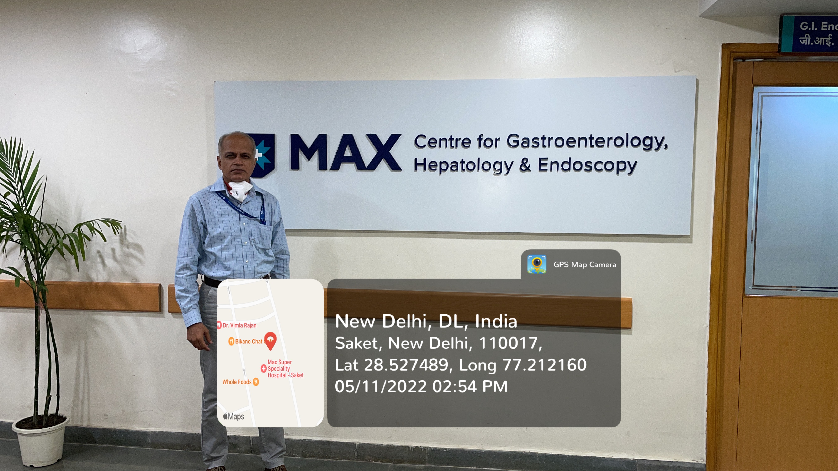
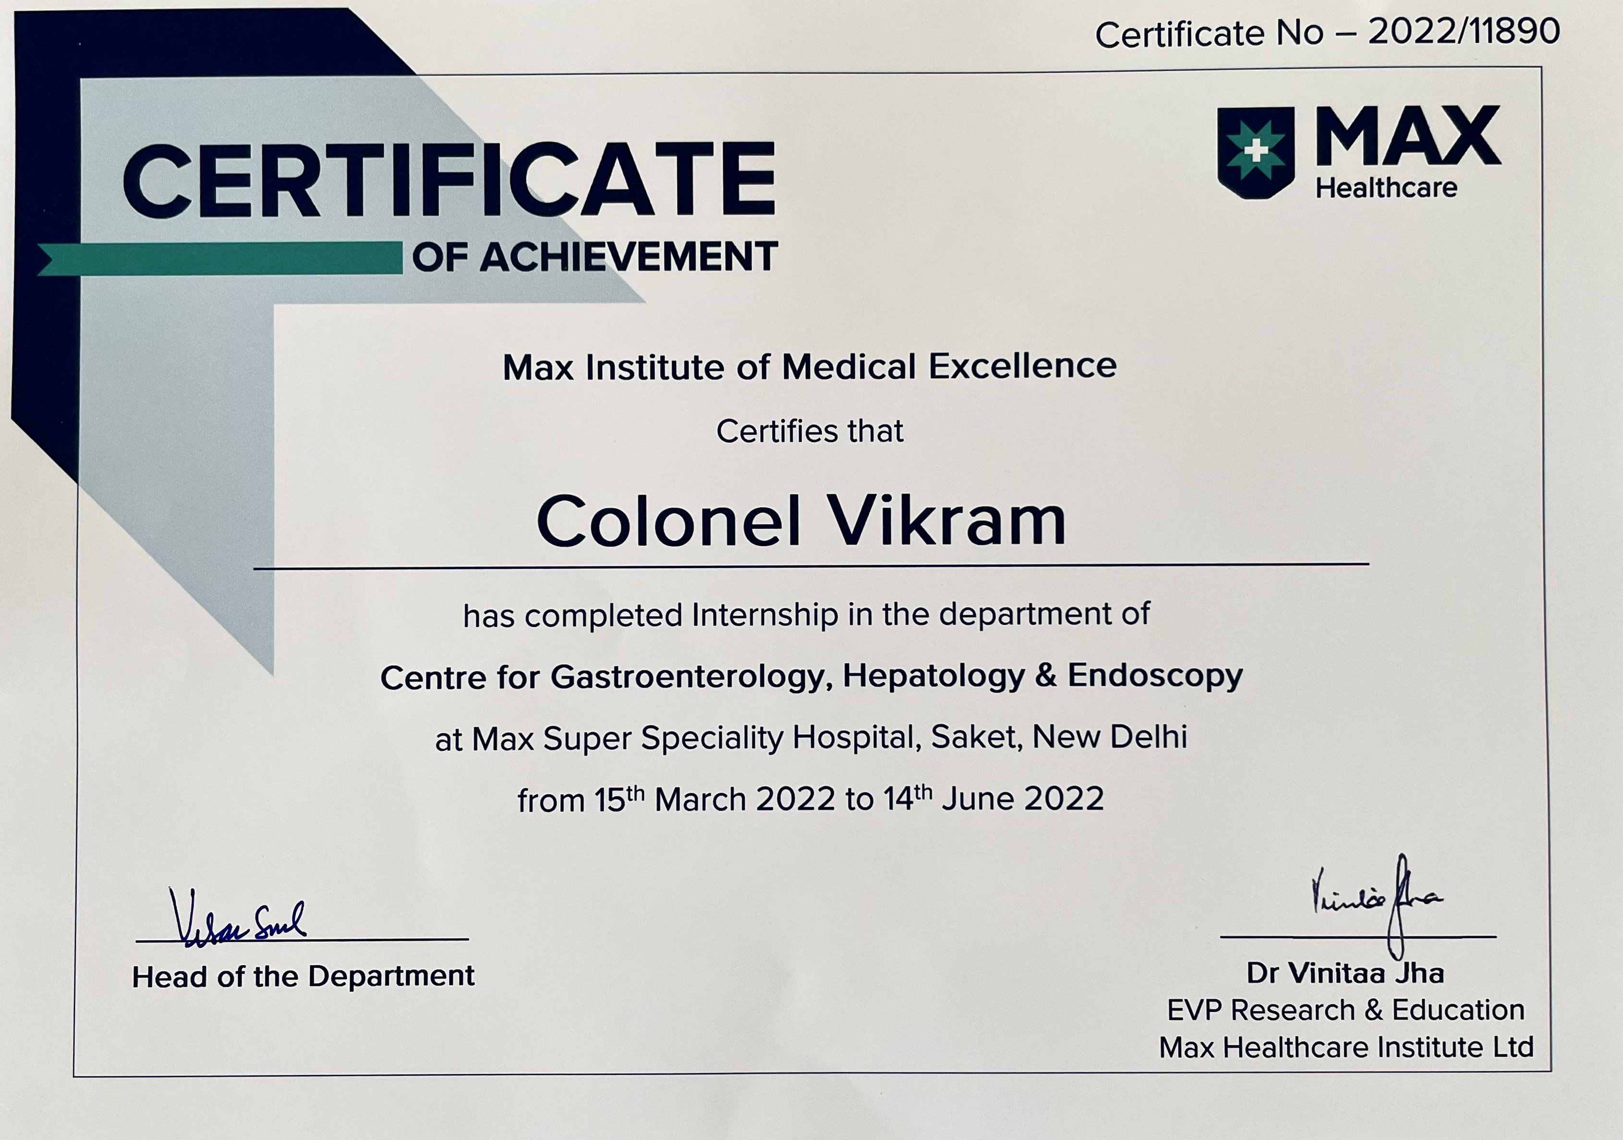
PICTORIAL JOURNEY

