Slide 1
Utilization, acceptance, refusal and intervention of PPIUCD usage in India:
A scoping review
Name: Dr Bhumika Hooda
Faculty: Dr Rupsa Banerjee
Roll no: PG/23/131
Organization name: CARPL.AI

Slide 2

Introduction
The postpartum period presents a crucial window for family planning interventions, with the postpartum intrauterine contraceptive device (PPIUCD) emerging as an effective long-term, reversible contraceptive option.
Short interpregnancy intervals (<24 months) significantly raise maternal–newborn morbidity and mortality.
Postpartum contraception is crucial to prevent rapid repeat pregnancies, given that around 80% of women resume fertility within months of delivery. Immediate postpartum insertion offers an ideal opportunity for long-acting reversible contraception before hospital discharge. ^{[2]}
Copper-T IUCD is a highly effective, reversible method offered free at government facilities, but uptake in India has been very low (NFHS-4: only 1.5% of women use IUDs). ^{[2]}
India launched a national PPIUCD program in 2000 (piloted in select states) and scaled it up by 2010​.
By 2023, PPIUCD coverage across states ranged widely (1.2 - 40.2%), with a national average acceptance of around 16%​. ^{[2]}
Despite its proven efficacy, safety, and inclusion in national health programs, PPIUCD utilization remains suboptimal due to various socio-cultural, medical, and systemic factors. While some women opt for PPIUCD due to its convenience and effectiveness, others decline due to misconceptions, lack of awareness, or personal and societal influences.
This scoping review aims to map the available literature systematically on PPIUCD utilization, the factors driving acceptance, and the reasons behind refusal, along with highlighting the interventions leading to increased uptake.

Slide 3
Research question
What are the patterns of utilization, acceptance factors, barriers to the adoption of postpartum intrauterine contraceptive devices (PPIUCD) in postpartum women, and interventions improving acceptance as identified in existing literature?
Objectives of the study
To analyze trends in PPIUCD utilization across different populations and healthcare settings.
To identify factors contributing to the acceptance of PPIUCD.
To explore the reasons for refusal or discontinuation of PPIUCD.
To identify interventions improving acceptance of PPIUCD.
To identify gaps in the literature and suggest areas for further research

Slide 4
Methodology
Identification
Records identified through database (n=534)
Study Design
This research was conducted as a scoping review using the Arksey and O’Malley 6-stage scoping review framework, enhanced by the PRISMA-ScR checklist, which includes identifying the research question, searching for relevant studies, selecting studies, charting the data, and summarizing the results
Data Sources and Search Strategy
A systematic search was conducted across electronic databases such as PubMed, Scopus, Web of Science, Google Scholar, and Cochrane Library. Grey literature, Journals, government reports, and policy documents will also be included.
Additional records identified through other sources (n=42)
Records after duplicates removed (n=512)
Records screened by title and abstract (n=512)
Records excluded (n=480)
(Studies not based in India and with clinical outcomes along with results not focusing on PPIUCD primarily were excluded)
Full-text articles assessed for eligibility (n=32)
Full-text articles excluded (n=5)
Studies included in the final analysis (n=27)

Slide 5
Methodology
The search terms included:
Postpartum IUCD/PPIUCD/postpartum intrauterine contraceptive device/postpartum copper T/T/ T/Family planning postpartum contraception/Long-acting reversible contraception adoption
Barriers/challenges/obstacles/factors affecting /Determinants
Utilization/uptake/acceptance/coverage/adoption
Intervention/program/strategy/awareness/training/counseling)
Boolean operators (AND, OR) were used to refine database searches.

Slide 6
Inclusion Criteria:
Studies focusing on PPIUCD insertion (within 48 hours of delivery)
Peer-reviewed studies, reviews, observational studies, and qualitative research papers published in English from 2010 onwards, focusing on PPIUCD utilization, acceptance, refusal, and interventions to enhance uptake of PPIUCD.
All study designs (qualitative, quantitative, mixed methods)
Exclusion Criteria:
Studies on IUCD insertion outside the postpartum period, non-human studies, and studies without relevant data on utilization or influencing factors.
Studies focusing solely on clinical outcomes without addressing utilization factors
Studies focusing exclusively on interval IUD insertion (not postpartum)
Studies based out of India
Data Extraction and Analysis
Selected studies were be reviewed, and key data was extracted using a structured data extraction format, including:
Study characteristics (author, year, study design, location)
Utilization rates
Factors Influencing Acceptance
Reasons for Refusal
Previous interventions used to increase PPIUCD utilization
Recommendations for policy and practice. Data will be analyzed thematically, and findings will be categorized based on identified themes.
Data Extraction sheet

Slide 7
Results: Synthesis of PPIUCD Utilization Metrics Across Key Studies in India
Study (Author, Year) | Location (State) | Study Design | Sample Size (Accepted/Counseled) | Acceptance Rate (%) | Continuation Rate | Expulsion Rate (%) | Key Complications Reported (%)
Mishra S. (2014) | Odisha | Prospective Observational | 564 / 3,209 | 17.6 | 81.1% (at follow-up) | 9.0 | Bleeding (23.5), Missing Strings (11.3)
Gupta S. et al. (2023) | Punjab | Prospective Observational | 180 / 300 | 60.0 | 65.6% (at 6 months) | 5.6 | Abnormal Uterine Bleeding (10.7)
Kumar S. et al. (2014) | 8 states + Delhi | Prospective Observational | 2,733 (accepted) | Not specified | ~94% (at 6 weeks) | 3.6 | Cramps (8.9), Infection (5.4)
Vishwakarma S. et al. (2020) | Uttar Pradesh | Prospective Interventional | 1,586 (inserted) | Not specified | 88.8% (at 6 months) | 3.4 | Missing Strings (22.2 at 6 wks), Bleeding (11.9 at 6 wks)
Srivastava A. et al. (2024) | Odisha, Chhattisgarh | Prospective Cohort | 916 (enrolled) | Not specified | 60.1% (at 1 year) | 12.0 | Pain, Bleeding, Discharge
Kumar S. et al. (2019) | 6 states | Retrospective Cohort | 844 (interviewed) | Not specified | 62.8% (at 1 year) | 7.5 | Pain, Bleeding, Discharge (37.2)
Shukla M. et al. (2014) | 6 states | Prospective Multicentric | 8,582 (accepted) | 49.7 | 87.6% (at 6 months) | 3.6 | Missing Strings (6.8), Infection (0.5)
Rajput N. & Bangal VB. (2024) | Maharashtra | Cross-sectional | 79 / 351 | 22.5 | Not assessed | Not assessed | Not assessed (reasons for refusal studied)
Jairaj S. & Dayyala S. (2016) | Telangana | Cross-sectional | 73 / 370 | 19.7 | Not assessed | 6.8 | Pain (17.2), Bleeding/Discharge (17.2)
Nigam A. et al. (2018) | Delhi | Cross-sectional | 50 / 550 | 9.1 | Not assessed | Not assessed | Not assessed (reasons for refusal studied)
Nayak K. et al. (2025) | Gujarat | Prospective Analytical | 19 / 350 | 5.4 | Not assessed | Not assessed | Not assessed (reasons for refusal studied)
Sharma A. & Gupta V. (2017) | Rajasthan | Observational | 546 / 18,550 | 2.9 | Not assessed | Not assessed | Not assessed (reasons for refusal studied)

Slide 8
Results: Reasons for PPIUCD Acceptance
Theme | Sub-theme | Description / Examples | Studies
Counseling & Awareness | Timing and frequency of counseling | Women counseled antenatally or before labor were more likely to accept PPIUCD. | 4, 10, 11, 12, 14
 | Content and clarity | Clear explanation of IUCD mechanism, benefits, side effects improved confidence. | 9, 13, 14
 | Provider skills and training | Skilled communication and counseling by ANMs/doctors increased acceptance. | 4, 11, 22
Method-related Factors | Long-acting reversible nature | Viewed as convenient due to long protection and ability to remove later. | 1, 2, 6, 12, 14, 16, 18
 | Safety and non-hormonal | Perceived as safe for breastfeeding and hormone-free. | 2, 3, 14, 16, 18, 19
 | Immediate postpartum insertion | Convenience of inserting during cesarean or post-delivery was motivating. | 3, 4, 19, 21
Sociodemographic Factors | Higher education | Educated women better understood benefits and opted for IUCD. | 10, 18
 | Multiparity or completed family | Those with ≥2 children or wanting no more children showed higher acceptance. | 1, 5, 6, 7
 | Lower socioeconomic status (in some studies) | Acceptance was nearly twice as high among poorer women due to limited access to other alternatives. | 12,22
Partner & Family Support | Husband involvement | Women with supportive spouses were more confident in choosing IUCD. | 6, 10, 13, 16
 | Family/in-law encouragement | Encouragement from mothers-in-law or other relatives also helped. | 13, 22
Health System Factors | Free and available at delivery | Free access during institutional delivery encouraged acceptance. | 3, 4, 6, 7, 8, 14
 | Trust in health worker recommendations | Women accepted due to belief in doctor’s/nurse’s advice. | 1, 6, 11, 18

Slide 9
Results: Reasons for PPIUCD Refusal
Theme | Sub-theme | Description / Examples | Studies
Fear and Misconceptions | Myths about IUCD | Fears of cancer, infertility, IUCD moving to heart or abdomen. | 1, 2, 6, 11, 14–22
 | Fear of pain or bleeding | Concerns about heavy bleeding, painful insertion, or discomfort. | 1, 2, 6–8, 11–12, 16–22
Lack of Information | Inadequate counseling | Women not properly counseled or counseled only after delivery refused IUCD. | 7, 10, 13–15
 | No knowledge about PPIUCD | Some had never heard of IUCD before being approached. | 10, 22
Sociocultural Barriers | Partner or family disapproval | Husbands or in-laws did not approve IUCD use; woman followed their wishes. | 1, 4, 6, 14, 16, 17, 19, 22
 | Religious/cultural norms | Religious taboos or traditional beliefs against IUCDs. | 2, 18–21
Alternative Preferences | Preference for other methods | Preference for condoms, pills, or injectables over IUCD. | 1, 2, 16, 19–21
 | No contraception needed | Women planning another pregnancy soon or felt they didn’t need contraception. | 1, 16, 20
Health System Barriers | Service availability or follow-up gaps | IUCD not available at the facility, lack of follow-up care, or no assurance of support. | 9, 12, 14

Slide 10
Results: Key Recommendations from Studies
Theme | Sub-theme | Description / Examples | Studies
Improve Counseling | Early (antenatal) counseling | Counseling during ANC visits is more effective than postpartum counseling. | 4, 7, 10, 11, 12
 | Address myths & side effects | Directly address common misconceptions and explain potential side effects clearly. | 6, 10, 12, 14, 22
 | Use visual aids, interactive tools | Flipcharts, videos, and illustrative counseling improve comprehension. | 9, 13
Involve Family | Male engagement | Include husbands in counseling sessions to build shared understanding and support. | 10, 13, 14, 16
 | Family/in-law sensitization | Extend education to mothers-in-law and close family members. | 13, 22
Provider Capacity | Skill-building for insertions | Train nurses and doctors to insert IUCDs safely, especially during cesarean. | 4, 6, 11, 13
 | Counseling communication skills | Providers need soft skills to counsel without coercion. | 11, 14
System Strengthening | Ensure availability | IUCD should be available in all labor wards and health centers. | 3, 7, 8, 14, 19
 | Establish follow-up mechanism | Scheduled follow-up at 6 weeks improves satisfaction and reduces removals. | 6, 12, 14, 18
Community Engagement | Outreach and health promotion | Conduct awareness drives via ASHAs, community health talks, or local media. | 6, 10, 12, 18, 21
Policy Recommendations | Integrate into maternal care package | Include PPIUCD in routine maternity care, with dedicated staff. | 1, 11
 | Tailored strategies by context | Adapt counseling and delivery models to suit rural/urban, literate/illiterate audiences. | 3, 12

Slide 11
Results
Acceptance: Influencing Factors
Acceptance of PPIUCD was through a combination of method-related benefits, counseling quality, and social support. Antenatal counseling, especially when delivered with clarity, empathy, and visual aids, was a major facilitator across multiple studies ^{[4, 10, 11, 12, 13, 14, 22]}. Women who received counseling before labor were more likely to make informed decisions and accept the IUCD immediately after delivery.
The method’s appeal as a long-acting, reversible, and non-hormonal form of contraception was emphasized in several studies [2, 3, 6, 12, 14, 16, 18, 19, 22]. Its safety profile and compatibility with breastfeeding made it especially attractive in the postpartum period. Women also appreciated the convenience of immediate postpartum insertion, eliminating the need for additional clinic visits ^{[1, 2, 3, 4, 11, 14]}.
Social support significantly influenced uptake. Women who received approval or encouragement from their partners or family were more confident in their choice. Moreover, trust in health workers, particularly doctors, nurses, and ANMs, was repeatedly reported as a key factor in decision-making ^{[1, 6, 11, 18]}.

Slide 12
Results
Reasons for Refusal: Influencing Factors
Despite these advantages, many women declined PPIUCD due to misinformation, fear, and sociocultural opposition. Myths about IUCDs causing cancer, infertility, or migration within the body were widely reported ^{[1, 2, 6, 8, 10–12, 14–22]}. These misconceptions, often reinforced through community narratives, highlighted the need for stronger, evidence-based counseling.
Fear of side effects, including excessive bleeding, pain, and infection, was another dominant concern ^{[1, 2, 6–8, 11–12, 16–22]}. Inadequate counseling was a common problem; several studies reported that women either received no information or were counseled too late (e.g., post-delivery) ^{[7, 10, 13,15]}.
Sociocultural influences also played a major role. Opposition from husbands or in-laws was frequently cited as a barrier to use ^{[1, 4, 6, 14, 16–17, 19, 22]}. Religious or traditional norms that discourage contraception or promote early repeat pregnancies were also deterrents ^{[2, 18–21]}.
Women simply preferred other methods, such as pills, condoms, or injectables, or planned to have another child soon ^{[1, 2, 16, 19–21]}. Others mentioned logistical barriers, such as lack of follow-up, limited availability of devices, or concerns about removal support ^{[9, 12, 14]}.
Health System and Programmatic Gaps
Many studies pointed to systemic challenges, including inconsistent device availability, lack of trained personnel, and poor integration of PPIUCD services into routine obstetric care ^{[3, 4, 7, 8, 14, 19]}. Follow-up services critical for managing side effects and ensuring continuation were either absent or inaccessible for many women ^{[6, 12, 14, 18]}.
Counseling was often insufficient, rushed, or biased, further discouraging use. Provider biases, limited time, and high caseloads during labor and delivery contributed to missed opportunities ^{[4, 7, 13]}.

Slide 13
Results
Recommendations for Program Strengthening
The included studies suggested a range of interventions to improve PPIUCD uptake and continuation. Strengthening antenatal and postpartum counseling was a widely endorsed strategy ^{[4, 7, 10, 11, 12, 13, 14, 22]}. Effective counseling should be clear, timely, non-coercive, and include visual aids ^{[9, 13]}.
Many studies recommended involving male partners and family members in the counseling process to reduce interpersonal resistance ^{[10, 13, 14, 16, 22]}. Skill-based training for healthcare providers, both in insertion techniques and client-centered communication, was also emphasized ^{[4, 6, 11, 13]}.
At the system level, integrating PPIUCD into routine delivery services, ensuring 24/7 availability of devices and trained staff, and instituting follow-up mechanisms were considered critical ^{[3, 7, 8, 14, 19]}. Several studies also stressed the importance of community-level education campaigns to address persistent myths and normalize IUCD use ^{[6, 10, 12, 18, 21]}.

Slide 14
Discussion
Programmatic interventions can substantially boost PPIUCD uptake.
Quality-improvement initiatives (focused on counseling, supply, and training) have yielded rapid gains. A study on a tertiary hospital QI project in Delhi raised PPIUCD insertions from ~5% of deliveries to ~19% within 3 months and sustained 30–35% coverage over 1½ years. Key steps included daily antenatal counseling, training residents (via WhatsApp groups and skills lab), and ensuring uninterrupted IUCD supply.^{[28]}
Scaling up provider skills (e.g., authorizing nurses and midwives to insert PPIUCD) has also widened access.^{[29]}
Community-level strategies include linking PPIUCD counseling into antenatal care and postnatal home visits. Studies repeatedly highlight that enhancing women’s education and tailored antenatal counseling dispel myths. All study participants who accepted PPIUCD and reported satisfaction with counseling had been counseled in their antenatal period. ^{[2]}
The studies have also strongly highlighted that counseling during ANC visits is more effective than postpartum counseling.^{[4]}
Involvement of male partners through couple counseling has been recommended to address male-dominated decision-making.^{[2]}
Multimedia tools (like video counseling) can supplement staff efforts.^{[30]}

Slide 15
Discussion
Implications for Policy and Practice
The findings of this review highlight the need for a comprehensive, multi-level approach to promoting PPIUCD use in India. Policy efforts should focus on mainstreaming PPIUCD into maternal and reproductive health programs, supported by adequate provider training, community awareness, and client-centered counseling. Addressing sociocultural barriers through inclusive and gender-sensitive strategies is essential to expand contraceptive choice and reduce unmet need in the postpartum period.
Scope of future research and gaps identified
Despite emerging evidence, significant gaps remain. Many studies are facility-based and cross-sectional; community-level and long-term follow-up data are sparse. Most Indian studies have short follow-ups, leaving unanswered questions about continued use beyond 6 months.^{[2]}
Further research on sustained use, managing side effects, and integrating PPIUCD into routine maternal-child health programs. Quality of counseling has not been systematically evaluated; future work could assess counseling quality and its link to uptake. Male perspectives on PPIUCD are under-studied, as are strategies to engage religious and community leaders. Comparative trials of different counseling models (e.g., digital tools, community health worker–led counseling) would be valuable.
There is also little data on the cost-effectiveness of PPIUCD relative to other spacing methods in the Indian context. Finally, state-level disparities in uptake merit targeted implementation research in low-acceptance areas.

Slide 16
Conclusion
This review highlights the complex interplay of factors influencing PPIUCD utilization in India. While acceptance is facilitated by timely antenatal counseling, perceived method benefits, and supportive provider and family engagement, uptake remains limited due to entrenched socio-cultural norms, inadequate counseling quality, and systemic service delivery constraints.
Critically, PPIUCD program performance demonstrates marked regional variation, reflecting disparities in health system capacity and sociocultural context. Family influence, particularly from male partners and in-laws, frequently supersedes women’s contraceptive preferences. High rates of early discontinuation, often due to unmanaged side effects, further weaken the program’s impact, producing a scenario in which method abandonment is not followed by transition to alternative contraception. This creates a significant contraceptive gap, placing many women at risk of unintended pregnancy in the extended postpartum period.
Addressing these challenges will require context-sensitive, gender-responsive strategies that strengthen counseling, provider competence, and post-insertion support while addressing the broader structural and normative constraints that shape contraceptive decision-making.

Slide 17
References
1. Mishra S. Evaluation of Safety, Efficacy, and Expulsion of Post-Placental and Intra-Cesarean Insertion of Intrauterine Contraceptive Devices (PPIUCD). J Obstet Gynecol India. 2014;64(5):337–43.
2. Gupta S, et al. Correlates of Post-Partum Intra-Uterine Copper-T Devices (PPIUCD) Acceptance and Retention: An Observational Study from North India. Contraception and Reproductive Medicine. 2023;8(25).
3. Kumar S, Sethi R, Balasubramaniam S, Charurat E, Lalchandani K, Semba R. Women’s experience with postpartum intrauterine contraceptive device use in India. Reprod Health. 2014;11:32.
4. Vishwakarma S, Verma V, Singh M, Mittal N. Experience on Safety, Expulsion, and Complication of Intracesarean Post-Partum Intrauterine Copper Device. Cureus. 2020;12(9):e10647.
5. Srivastava A, Sharma S, Lalchandani K, et al. One-year continuation of postpartum intrauterine contraceptive device: Findings from a prospective cohort study in India. PLOS ONE. 2024;19(6):e0304120.
6. Singal S, Sikdar SK, Kaushik S, et al. Understanding factors associated with continuation of intrauterine device use in Gujarat and Rajasthan, India: A cross-sectional household study. Sex Reprod Health Matters. 2021;29(2):301–16.
7. Kumar S, Srivastava A, Sharma S, et al. One-year continuation of postpartum intrauterine contraceptive device: findings from a retrospective cohort study in India. Contraception. 2019;99(3):212–6.
8. Mishra S. Tale of the Tails: The Missing Postpartum IUCD Strings. J Obstet Gynecol India. 2017;67(3):202–7.
9. Shukla M, Pradhan T, Tiwari VK, Choudhary A, Sinha R. Comparison of outcomes at 6 weeks following postpartum intrauterine contraceptive device insertions using Kelly’s forceps versus manual technique among women delivering vaginally at a tertiary hospital in India. Int J Reprod Contracept Obstet Gynecol. 2022;11(6):1614–20.

Slide 18
References
10. Makins A, Taghinejadi N, Hulton L, Machiyama K. Factors influencing the likelihood of acceptance of postpartum intrauterine contraceptive device: A facility-based cross-sectional study in Ethiopia. Int J Gynecol Obstet. 2018;143(Suppl 1):13–9.
11. Bhadra B, Das S, Mitra A, et al. The impact of using nurses to perform postpartum intrauterine device insertions. Int J Gynecol Obstet. 2018;143(S4):13–20.
12. Mehta S, Grover V, Bansal N, Tandon R. Acceptance rate, probability of follow-up, and expulsion of post-partum intrauterine contraceptive device: A prospective study in a tertiary care centre. Int J Reprod Contracept Obstet Gynecol. 2017;6(10):4592–7.
13. Sethi R, Gupta S, Dubey P, Shukla M, Minz S, Arora A. Critical factors influencing the postpartum intrauterine contraceptive device (PPIUCD) uptake in India: a hospital-based mixed-method study. BMC Pregnancy Childbirth. 2017;17(1):320.
14. Sinha T. Barriers and Challenges in the Acceptance and Continuation of Postpartum Intrauterine Contraceptive Device. In: Contemporary Challenges in Postnatal Care. IntechOpen; 2023. p. 179–95.
15. United Nations Population Fund (UNFPA). Pilot study on postpartum intrauterine contraceptive device (PPIUCD) services in India. New Delhi: UNFPA India; 2012.
16. Shukla M, Qureshi S, Chandrawati. A prospective multi-centric study of acceptance, insertion and follow-up of postpartum intrauterine contraceptive device (PPIUCD) in India. J Obstet Gynecol India. 2014;64(6):426–9.
17. Chawla R, Ahuja R, Sharma P. Awareness of postpartum intra uterine contraceptive device and reasons for its low acceptance in an urban Indian population. Int J Res Med Sci. 2020;8(2):701–5.

Slide 19
References
18. Rajput N, Bangal VB. Factors associated with acceptance and refusal for PPIUCD at tertiary care teaching hospital in Maharashtra. Int J Adv Res. 2024;12(6):163–7.
19. Jairaj S, Dayyala S. Cross sectional study on acceptability and safety of IUCD among postpartum mothers at tertiary care hospital, Telangana. J Clin Diagn Res. 2016;10(1):LC01–4.
20. Nigam A, Ahmad A, Sharma A, Saith P, Batra S. Postpartum intrauterine device refusal in Delhi: reasons analyzed. J Obstet Gynaecol India. 2018;68(2):111–7.
21. Sharma A, Gupta V. A study of awareness and factors affecting acceptance of PPIUCD in South-East Rajasthan. Int J Community Med Public Health. 2017;4(8):2706–10.
23. Mohanty S, Tripathy R, Sethi S. Barriers and Acceptance of Intrauterine Contraceptive Devices (IUCD) Among Married Women of Reproductive Age in Odisha, India. Cureus. 2023;15(7):e41535.
24. Kant S, Archana S, Singh AK, Ahamed F, Haldar P. Acceptance rate, probability of follow-up, and expulsion of postpartum intrauterine contraceptive device offered at two primary health centers, North India. J Family Med Prim Care. 2016;5(4):770-6.
25. Tricco AC, Lillie E, Zarin W, O’Brien KK, Colquhoun H, Levac D, et al.PRISMA extension for scoping reviews (PRISMA-ScR): Checklist and explanation. Ann Intern Med. 2018;169(7):467-73.
26. Arksey H, O'Malley L. Scoping studies: Towards a methodological framework. Int J Soc Res Methodol. 2005;8(1):19-32.
27. World Medical Association. WMA Declaration of Helsinki–Ethical Principles for Medical Research Involving Human Subjects. JAMA. 2013;310(20):2191-4.
28. Ministry of Health & Family Welfare, Government of India. Postpartum IUCD Reference Manual. New Delhi: Family Planning Division, Ministry of Health & Family Welfare; 2010.

Slide 20
References
29. Agrawal S, Puri M, Singh A, Sehrawat S, Sood S, Choudhary K, et al. Increasing postpartum IUCD coverage through a QI initiative: a step towards reducing the unmet need of postpartum contraception. BMJ Open Qual. 2021 Jul;10(Suppl 1):e001346. doi:10.1136/bmjoq-2021-001346
30. Yadav V, Balasubramaniam S, Das S, Srivastava A, Srivastava A, Kumar S, et al. Comparison of outcomes at 6 weeks following postpartum intrauterine contraceptive device insertions by doctors and nurses in India: a case-control study. Contraception. 2016 Apr;93(4):347–55. doi:10.1016/j.contraception.2015.12.012. PMID: 26738620; PMCID: PMC4796038.
31. Bharti A, Agarwal G, Bansal I, Kansal R, Yeolekar J. To study the impact of counseling through pre-made video on knowledge, attitude and practice of post partum intrauterine contraceptive devices. Int J Acad Med Pharm. 2024;6(1):1123–7. doi:10.47009/jamp.2024.6.1.223.

Slide 21
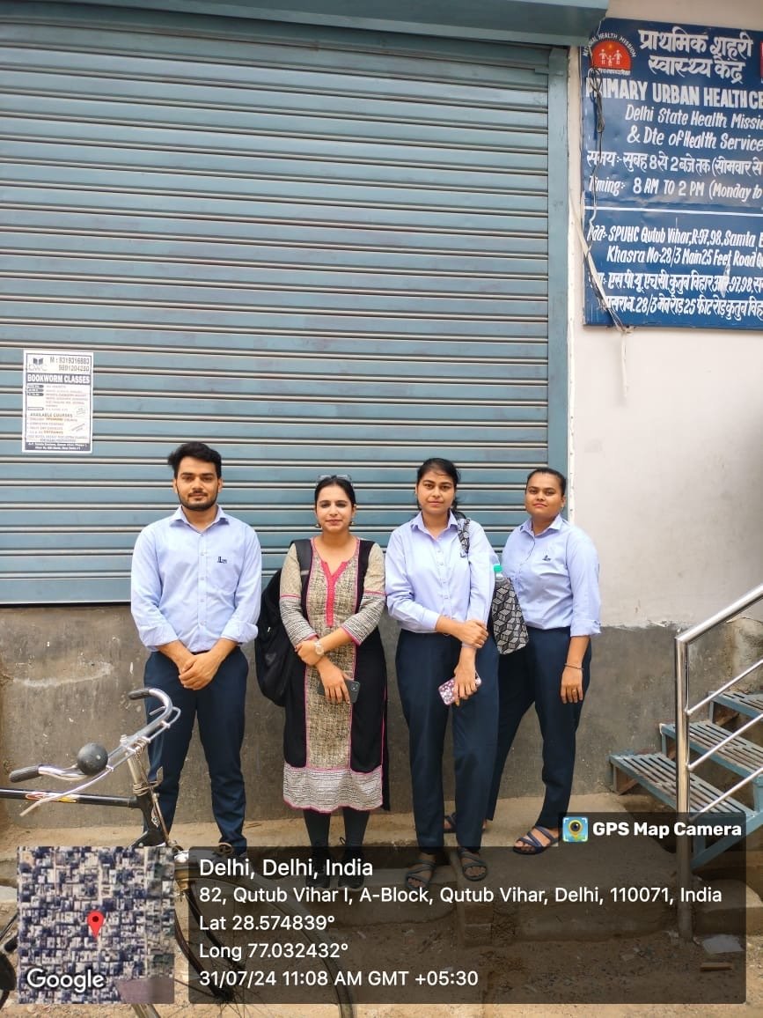
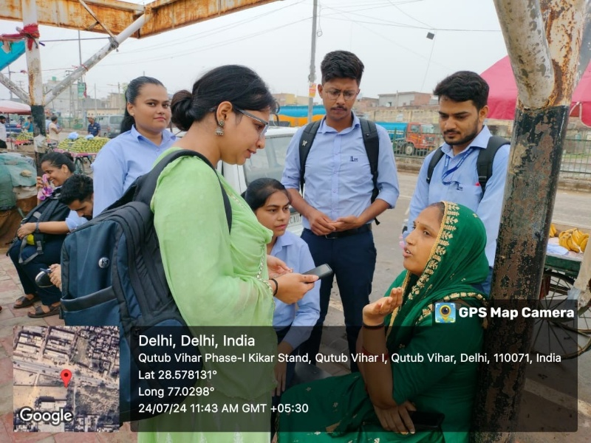
Involvement in Community outreach programs
Total no of visits: 14
Activities done for the community outreach program in Goyla Dairy, Dwarka, Delhi:
Area mapping and identification of key zones and stakeholders.
Community profiling and finalization of data collection tools.
Household-level data collection through structured questionnaires.
Continuation of household surveys and interviews with key informants.
Completion of needs assessment and analysis of survey findings.
Did a survey for maternal and child healthcare
Shared findings with related stakeholders.

Slide 22
THANK YOU

