Slide 1



To identify drug Literacy, causes of its Illiteracy and need for one-platform drug Registry
Ernst and Young
Submitted by: Yogita Sharma, PG/20/094
Mentor: Dr Sumesh Kumar
IIHMR Delhi

Slide 2

As studies have shown, utmost people take to drug habits but also are ignorant of the long-term effects of their conduct.
Some medicinal drugs are so dangerous that their use is restricted by law: only doctors and pharmacists may prescribe them to patients. Their use or manufacture is prohibited by law.
However, there are certain drugs that are dangerous, have no medicinal value, and yet are legally produced
There are several sources from which drugs and other substances can be obtained like quack doctors; (illegal), drug stores; (legal/illegal), hospitals & clinics: (legal), etc.
Ayushman Bharat Digital Mission’s Drug registry which is a central database of the approved drugs sold in the market will serve multiple benefits.
introduction

Slide 3
OBJECTIVES
To survey the extent of knowledge consumer has about their prescribed drugs.
To determine the major cause of drug illiteracy.
To determine the need for one platform drug registry for drug literacy.

Slide 4
Methodology
Study population:
People who are on prescribed drugs.
People who consume any kind of drugs without a prescription.
Study design: Cross-sectional study design.
Study Period: The study is conducted from 1st April 2022 to 1st June 2022
Research Instrument: A survey with a semi-structured questionnaire
Sample Size: Convenience sampling of up to 100 participants surveyed through a Google form
Data Analyse Tool- Excel is being used for data analysis.
Study Ethics: The study has been approved by the Student Research Board of the IIHMR.

Slide 5
Results & Discussions
There are a lot of people who consume medicine prescribed by doctors, some of them seek knowledge of the drugs they have been prescribed from the doctor whereas the majority google for the information regarding the medicine
Communicating with a doctor regarding your prescribed drugs is a positive way. Whereas the Internet is among the main sources of health- and medical-related information as everything and anything is available on Internet. So there should be some safer authenticated platform to search information.

Slide 6
Results & Discussions
Self-prescription of medication to solve health problems without expert help or opinion the use of former prescriptions for themselves or friends and family members, re-use of existing drugs at home, and noncompliance with the prescribed treatment program or the prescribed dose change. Self-medication cannot be regarded as a fully safe action, rather, it has potential risks, including misdiagnosis, increased use of medications, long-term use of medication, etc

Slide 7
Results & Discussions
There are so many pharmacies in India, some of them have valid medical degrees whereas some drug stores are illegal. This could be one of the major causes of selling the potentially dangerous drug. There are studies that have shown that banned drugs are freely available in medical stores.
There are many people who had an encounter with quack doctors. According to a study it has been reported that the number of quacks is increasing in India, both in urban and rural areas. It is estimated that about 10 lakh quacks are practicing allopathic medicine, out of which 4 lakhs belong to practitioners of Indian Medicine

Slide 8
Results & Discussions
Having a Drug Registry of India will help in the authentication of drugs available in the Indian market. Registries help improve health care quality and safety.

Slide 9
Discussions
According to the study population, below are the major causes of drug illiteracy
Lack of awareness & education
No proper instruction to the patient by doctors.
No curriculum in schools.
Self-diagnosis & internet searches
People using the internet to find details of drugs that are not always correct
People consult chemists for medicines.
Encounter with quack doctors.
Increased fraudulent medicines and unknown diseases
Lack of initiative by the government to educate people about drugs their effects and the precautions to be taken.
Poor infrastructure of Pharmacies in India.
The drug traffickers and the doctors who are overprescribing these substances should be prosecuted.

Slide 10
Limitations of the Study
The sample size is small to determine significant areas of the study
Research on Drug Literacy is complex, and it requires a comprehensive approach.
Considering the studies short duration its scope was limited.
The study was restricted and not precise due to the nature of the online mode of research

Slide 11
RECOMMENDATIONS
Drug Education in school curriculums can promote safety, such as how to use anti-opiated in overdose situations, and what the dangers of varied substances are.
Drug Education assesses the complex ways in which drugs impact the health and wellbeing of individuals, families, communities, and societies.
Awareness drives related to the reasons people use drugs, the impact of drug use, and the social attitudes toward the various drugs.
Use of authentic one-platform drug registries to search drug details.

Slide 12
Drug education has suffered from a lack of clear goals.. The only solution is drug literacy
Drug education should provide students with the knowledge and skills they need to avoid harm from alcohol and drugs in the real world. We can still teach them to avoid certain substances or to only use substances at certain times.
Government initiatives like ABDM’s Drug Registry having a one-platform drug registry to search for all the drugs present in the Indian Market will help people to have access to knowledge of authenticated drugs present in the Indian market
CONCLUSION

Slide 13
References
Nagaraj, Anup et al. “Counterfeit medicines sale on online pharmacies in India.” Journal of research in pharmacy practice vol. 3,4 (2014): 145-6. doi:10.4103/2279-042X.145397
Lombardo, S., & Cosentino, M. (2016). Internet Use for Searching Information on Medicines and Disease: A Community Pharmacy-Based Survey Among Adult Pharmacy Customers. Interactive journal of medical research, 5(3), e22. https://doi.org/10.2196/ijmr.5231
Beck, J. (1998). 100 years of “just say no” versus “just say know:: Re-evaluating drug education goals for the coming century.” Evaluation Review, 22(1): 15-45.
Banned drugs freely available in medical shops Banned drugs freely available in medical shops (deccanchronicle.com)
Rethinking Drug Education Rethinking Drug Education | Here to Help

Slide 14
Thank You

Slide 15
Suggestions to the Organization where the Study was Conducted
In the healthcare industry establishing a tech consulting company could be challenging However, EY has done well in it, and they should keep hiring good resources and invest in as many digital projects for development and have a good understanding of technology
With EY being a part of Big4, It has excelled in all the four core departments, Being a part of healthcare IT, EY should invest more in human resource who have good understanding of Healthcare technology.

Slide 16
Dissertation Experiences
What did you learn (skill/ topic)?
Overall self comments on Dissertation
Worked on documents like Functional Requirement Specification, Software Requirement Specification, Gap Analysis Report, RFP, Wireframes, Pursuit Summary
Got a chance to interact with many leads
My experience with EY was amazing with a lot of learning. On my first project I get a chance to work with government. Having the opportunity to work closely with the government was rewarding and provided many opportunities for learning.

Slide 17
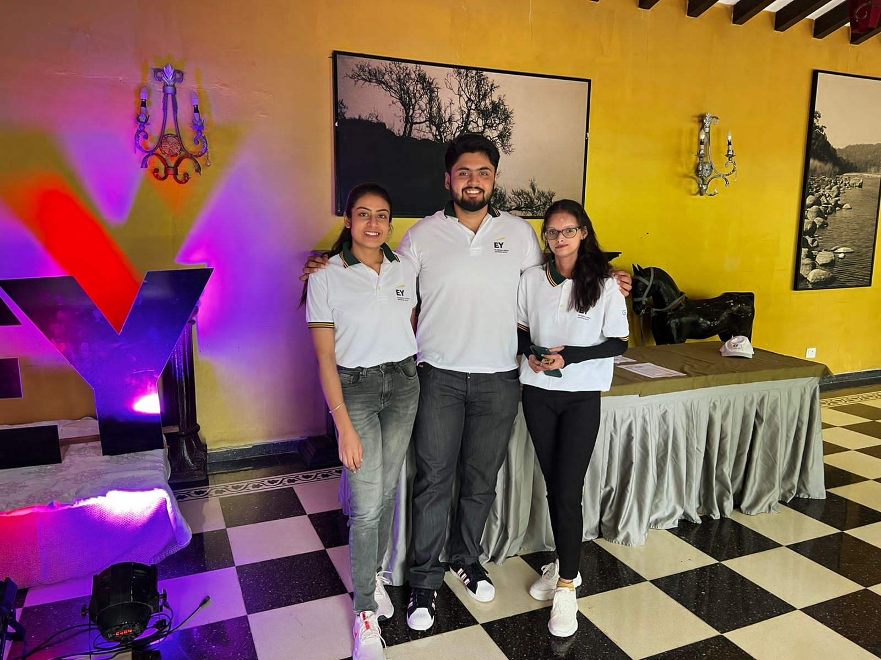
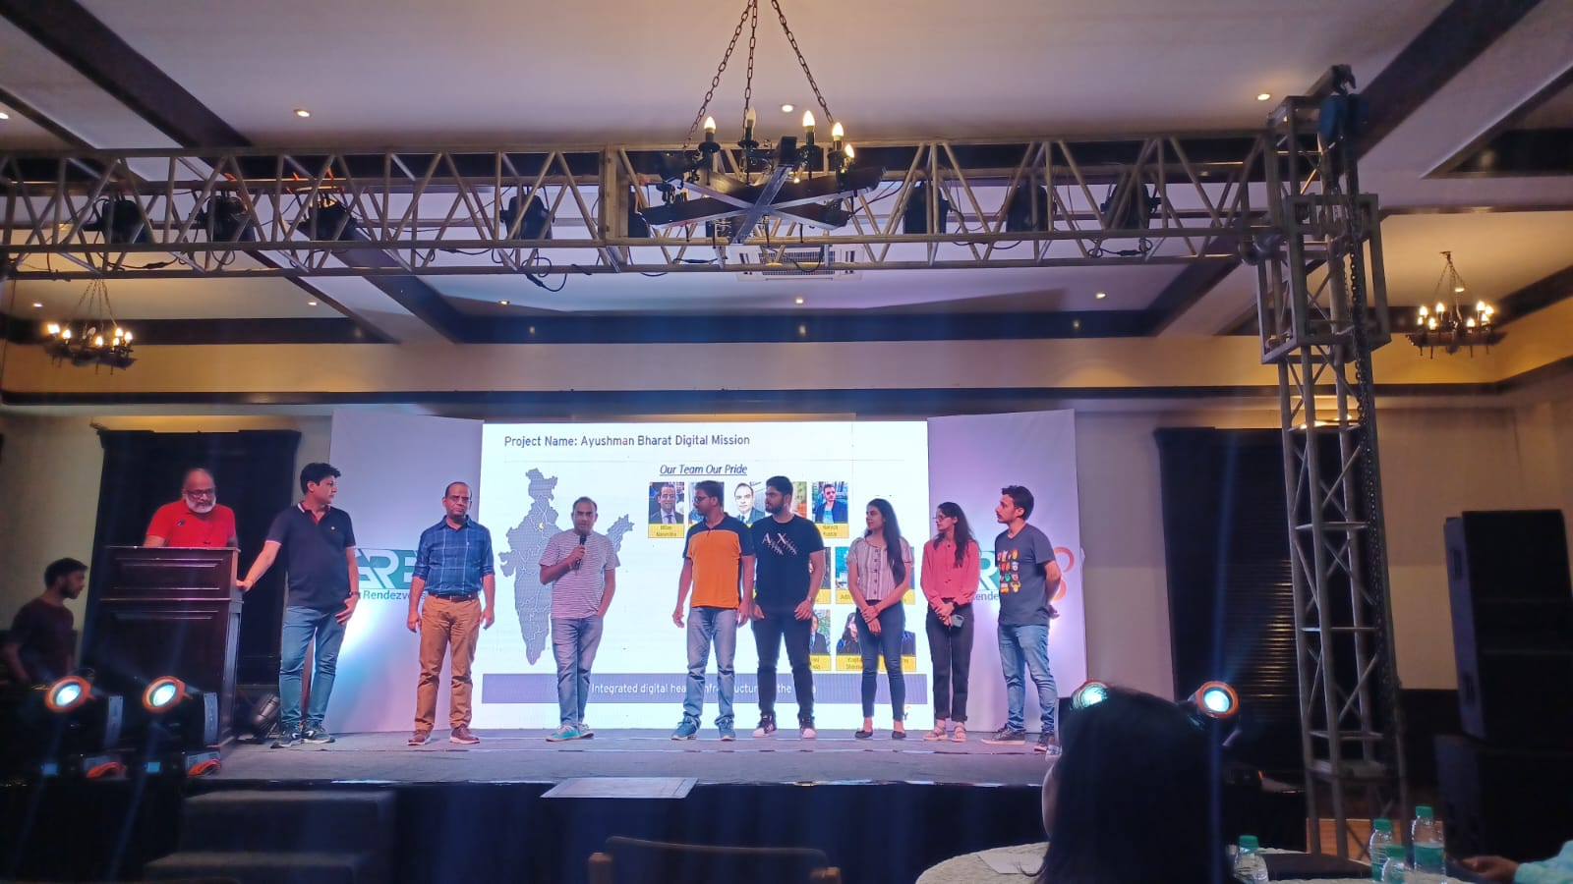
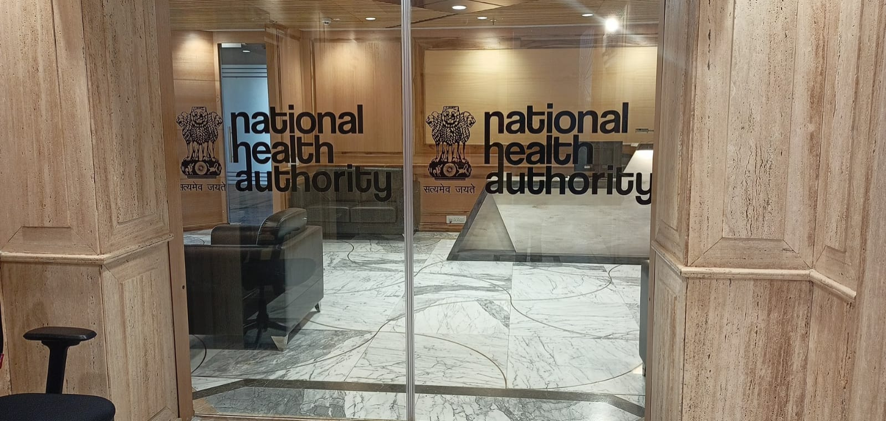
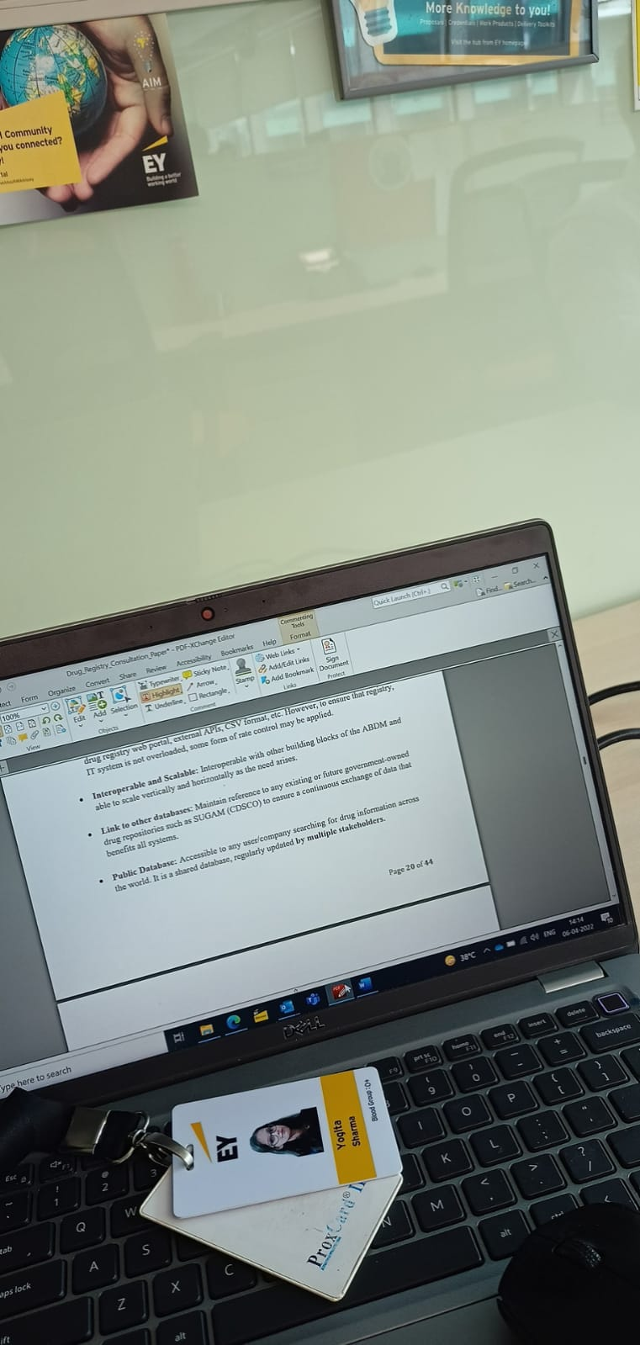
Pictorial journey

