Slide 1
“Study on Assessment of Food Safety and Hygiene Practices among Street Food Vendors in West Delhi”
Chander Pal Thakur,
PGDHHM,
PG/09/011

Slide 2

Reflection From Internship
ORG- Centre for Social Research
Duration
Work Allocated
- Analysis Plan and Data Interpretation
- Report Writing and Designing
- Training of Trainers
- Questionnaire formatting
- Field Work
Involvement with the Projects
- A baseline Research for India, Nepal and Bangladesh- Emphasis- Study for Care Nepal
- Labor Demand study in Carpet Industry- Study for Macro International
- KAP study on Polio and RI- Round 2- Study for UNICEF, India

Slide 3
Introduction and Rationale
Street Food
Why?
How?
Govt. Role
Indian Scenario

Slide 4
Research Objectives
General Objective:
-To assess food safety and hygiene practices among street food vendors
Specific Objectives:
- To examine hygiene status of street food vendors.
- To observe the use of water and waste disposal practices among the street food vendors.
- To assess the environmental conditions around the place of selling street food

Slide 5
Research Methodology
Study Design
- Quantitative and Qualitative Methodology
- Questionnaire Based Study
Sample Population
- West Delhi Zone of Delhi State
- Sample of 100 Respondents
Data Collection and Analysis
- Eligible Respondents were interviewed
- Data was entered into MS- excel sheets
- Checked for completeness, correctness and consistency

Slide 6
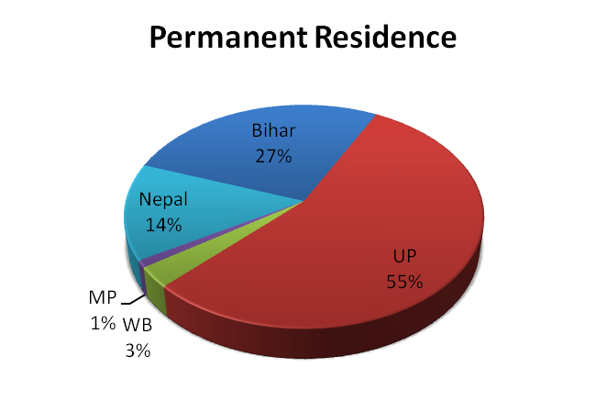
Study Findings: Socio Demographic Profile
VARIABLES | RESPONDENTS
Age
Below 15 years | 02 %
15+ years | 07 %
20+ years | 22 %
25+ years | 33 %
35+ years | 30 %
45+ years | 06 %
Gender
Male | 97 %
Female | 03 %
Religion
Hindu | 93 %
Muslim | 03 %
Sikh | 04 %
Education
Never been to school | 24 %
Primary | 42 %
Metric | 34 %
Marital Status
Married | 71 %
Un married | 29 %
Type of Vending Carried Out by Vendors | Percentage (%)
Full time | 95 %
Part Time | 05 %
Number of People From Family
One | 85 %
Two | 10 %
Three | 05 %
Monthly Income (In Rupees)
1000- 3000 | 06 %
3000- 5000 | 26 %
5000- 10000 | 28 %
10000 and above | 40 %

Slide 7
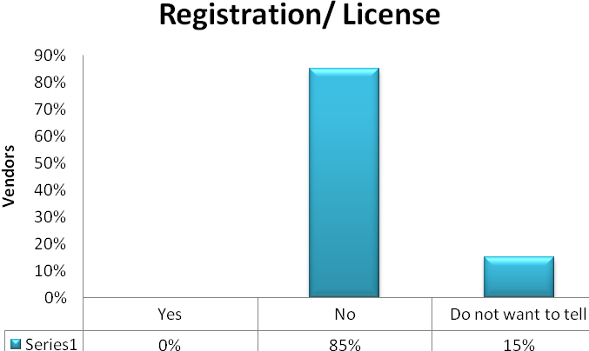
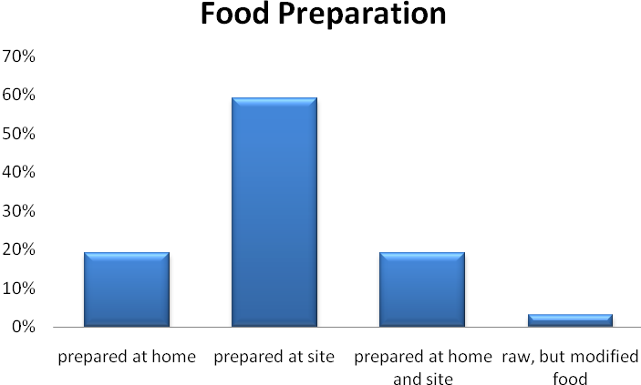
Vending Details
Variable | Status | Percentage
Type of Plates Used To Serve Food To The Customers | Metal Plates Plastic Plates Paper/ Disposable plates | 37 % 06 % 57 %
Kind of Water Used For Cleaning The Utensils | Soapy Water Clean Water NA(paper/ disposable) | 36 % 07 % 57 %
Disposal of Garbage | Open Lid Bin Closed Lid Bin On Road In Polythene Bags | 72 % 11 % 16 % 01 %
Type of vending
Use of additives/ artificial colors
Disposal of garbage

Slide 8
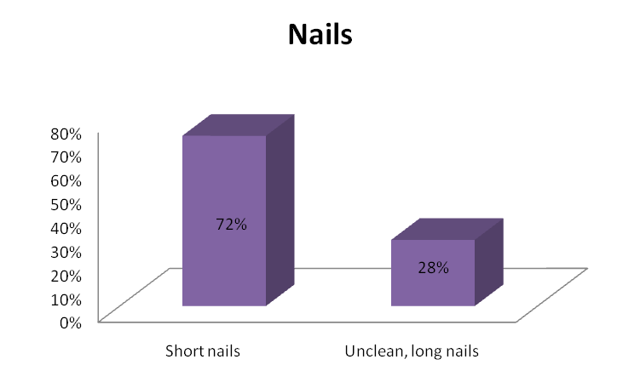
Personal Hygiene
Observed Hygiene Practices | Status | Percentage
Use of Apron | Yes No | 02 % 98 %
Use of Hand Gloves | Yes No | 03% 97 %
Use of Head Cover | Yes No | 05 % 95 %
Hair of the Vendor | Well combed Un combed Trimmed NA | 57 % 26 % 12 % 05 %
Present Illness ( 04 %)
Open wounds ( 04 %)

Slide 9
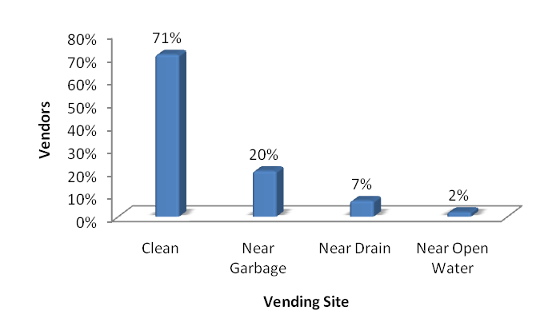
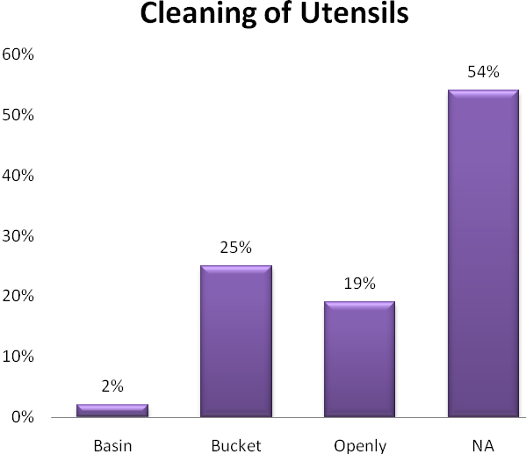
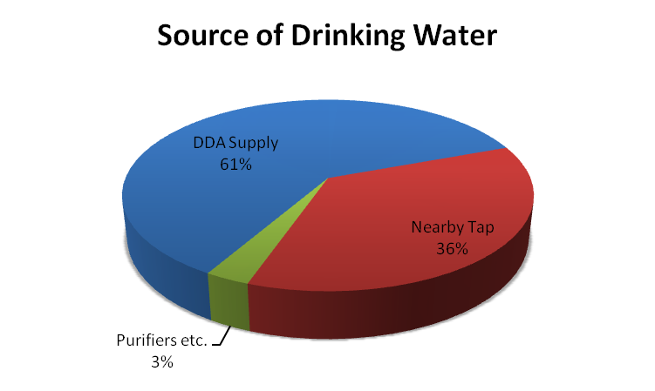
Environmental conditions
Presence of flies/ mosquitoes (45 %)
Presence of dust/ vehicles (40 %)
Presence of stray animals/ waste (13 %)

Slide 10
Recommendations
Implementation of Street Vending Policy
Interventions
Education
Adapting the Five Keys to Safer Food to address the street food sector

Slide 11
Street Food Consumption Patterns
School children – if not carrying lunch
Mostly men working outside home
Families with patients
Mobile population – bus/ taxi drivers
families/ individuals outing

Slide 12
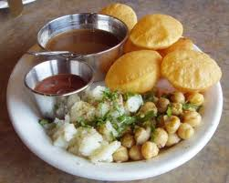
Thank You

