Slide 1
A Comparative Study of Indian and Omani Healthcare Systems: Insights and Recommendations from Migrant Indian Doctors
Trio Tree Technologies
Dissertation Presentation
By Sweksha Gupta (PG/23/121)
Mentor: Dr. Ratika Samtani
IIHMR Delhi

Slide 2
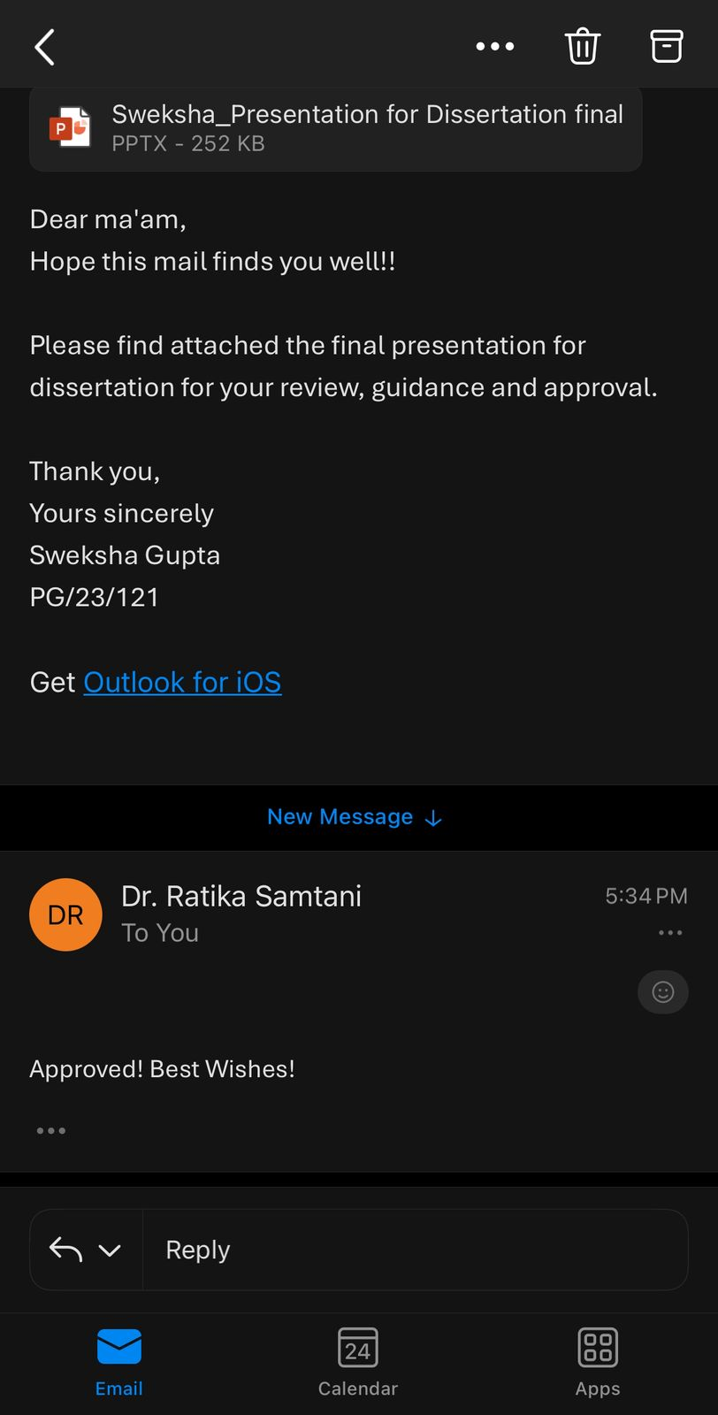
Approval from Mentor

Slide 3
Introduction
Healthcare systems are shaped by diverse socio-economic, cultural, and policy contexts. India’s healthcare system follows a mixed model, government-funded services alongside a dominant private sector. Despite initiatives like Ayushman Bharat, longstanding challenges such as infrastructure gaps, unequal access, and high out-of-pocket costs remain ^{(1,2)}.
Oman, on the other hand, has invested heavily in public healthcare. Under national strategies like Oman Vision 2040, the country emphasizes strong primary care, equitable access, and continuous quality improvement. Most citizens receive healthcare that is free or heavily subsidized through public facilities ^{(3,4}).
With growing globalization, cross-border mobility of healthcare professionals has increased. A considerable number of Indian-trained doctors now practice abroad, especially in Gulf countries such as Oman ^{(5,6)}.
These doctors, having worked within both systems, are uniquely positioned to provide grounded, comparative perspectives on healthcare delivery and structure ⁽⁷⁻⁹⁾.
This study aims to explore these comparative experiences through the qualitative lens of migrant doctors currently practicing in Oman who have previously practiced in India, By capturing their reflections, the study aims to highlight system-level contrasts and areas for improvement. Their insights contribute to a deeper understanding of operational realities and guide more context-appropriate health system improvements.

Slide 4
Objectives
To explore the experiences of respondents practicing in both India and Oman regarding healthcare system operations.
To identify key differences in healthcare infrastructure, patient care, and working conditions between the two countries.
To gather insights into system strengths and challenges as perceived by respondents.
To suggest recommendations for healthcare improvements based on cross-country learnings.

Slide 5
Methodology
COMPONENT | DETAILS
Study Design | Qualitative, exploratory research
Study Setting | Multispecialty Hospital, Oman
Participants | 10 respondents currently practicing in Oman with prior clinical experience in India
Sampling Method | Purposive selection
Inclusion criteria | Respondents currently engaged in clinical practice in Oman Minimum one year of prior clinical experience in India Willingness to participate and provide informed consent
Exclusion criteria | Respondents without prior clinical experience in India Non-clinical healthcare professionals
Data Collection Tool | Semi-structured open-ended interviews
Data Collection Mode | In-person interviews conducted by the researcher.
Data Analysis Method | Thematic analysis based on Braun and Clarke’s (2006) framework

Slide 6
Data Collection Process
Respondents were identified from among the clinical staff at a multispecialty hospital in Oman, specifically doctors with prior practice experience in India.
After obtaining informed consent, semi-structured, open-ended interviews were conducted in person, each lasting approximately 20 to 30 minutes.
With the respondent’s permission, all interviews were audio-recorded and subsequently transcribed for thematic analysis.
An interview guide comprising eight main thematic questions, each supported by probing questions was used.
The guide broadly explored experiences related to healthcare delivery, infrastructure, clinical autonomy, cultural interactions, and doctor–patient dynamics in both the Indian and Omani healthcare systems.

Slide 7
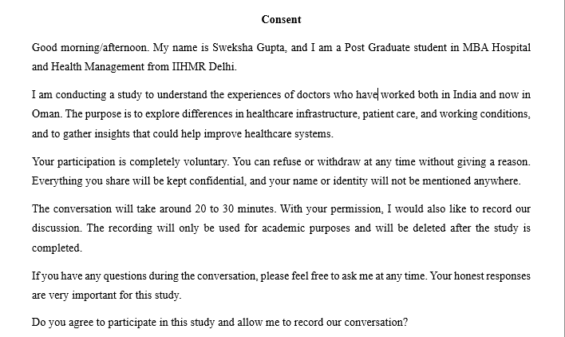
Consent Form

Slide 8
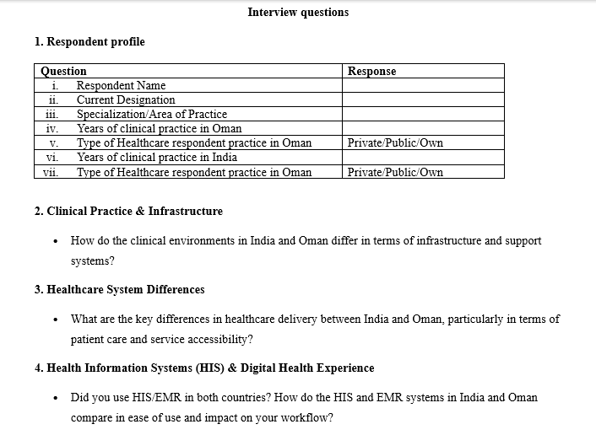
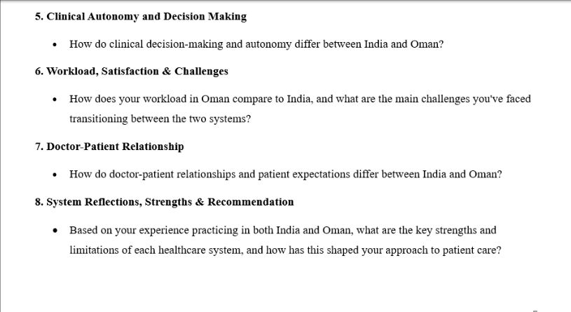
Sample Interview questions

Slide 9
Data Analysis Process
The collected data were analyzed using thematic analysis, following Braun and Clarke’s (2006) six-phase approach.
The steps involved:
Familiarization with the interview transcripts
Generation of initial codes
Searching for potential themes
Reviewing and refining the themes
Defining and naming the finalized themes
Producing the final report with illustrative verbatim excerpts
This method enabled a systematic and rigorous exploration of patterns and themes aligned with the study objectives, ensuring depth in qualitative interpretation.

Slide 10
Questions | Responses
Average years of clinical practice in Oman | 4 years
Type of healthcare respondent practice in Oman (Public/Private) | Private – 100%
Average years of clinical practice in India | 5 years
Type of Healthcare respondent practice in India (Public/Private) | 30% – Public 70% – Private
Result – Respondent Profile (1/5)

Slide 11
Result - Key Takeaways (2/5)
Clinical Practice & Infrastructure
  India’s infrastructure quality varies widely by geography and sector, with private and urban centers being better equipped.
  Oman offers more consistent infrastructure, even in smaller government hospitals, driven by insurance support.
Healthcare System Differences
  Healthcare access in India is highly dependent on socioeconomic status, with cost-related delays being common.
  Oman’s insurance-backed system enables more timely care and equitable access, even at early stages.
Health Information Systems (HIS) & Digital Health Experience
  India’s health information systems are still largely manual or inconsistent, leading to delays and documentation gaps.
  Oman has standardized EMR systems that improve accuracy, traceability, and workflow efficiency.
Administrative and Workflow Efficiency
  Greater clinical autonomy exists in India, allowing faster but often unregulated decisions.
  Oman follows insurance-based protocols with stricter oversight, which ensures safety but slows down decision-making.

Slide 12
Result - Key Takeaways (3/5)
5. Workload Comparison & Transition Challenges
  Doctors in India report significantly heavier workloads, leading to fatigue and reduced quality of life.
  Oman offers a structured and balanced work schedule, contributing to better mental health and job satisfaction.
6. Patient Expectations & Communication
  India allows for more expressive communication, often driven by family involvement and cultural openness.
  Oman reflects a more reserved, respectful tone, with patient interactions shaped by language, gender norms, and formality.
7. Comparative System Strengths & Weaknesses
  Participants viewed India’s strength in clinical expertise and exposure, while also acknowledging gaps in regulation and safety.
  Oman’s system was praised for standardization, discipline, and safer practices, though with limited opportunities for skill diversification.
8. Reflections & System Improvement Suggestions
  Participants called for greater investment in research and specialist services in Oman.
  In India, concerns around malpractice and systemic inefficiencies were raised despite recognition of clinical talent.

Slide 13
Result - Verbatims (4/5)
Clinical Practice & Infrastructure
  Indian infrastructure is very good, but it's only in the tertiary centers... if you go to the interior... infrastructure is very bad...Oman... even the government hospitals have better infrastructure.
2. Healthcare System Differences
  In Oman… 8 people out of 10 will get better treatment… In India, it’s like 4 people get the best, 6 may not.
  India..delayed care due to cost; Oman..early access due to structured appointments and support.
3. Health Information Systems (HIS) & Digital Health Experience
  In India... manual work. Here [Oman], all digital. Digital documentation is the best thing... everything is online... no manipulation.
4. Administrative and Workflow Efficiency
  In Oman… through insurance… have to follow protocols. In India, you can call someone for a test, and they’ll come home.
  India — full clinical freedom; Oman — cautious, insurance-based limitations.

Slide 14
Result - Verbatims (5/5)
5. Workload Comparison & Transition Challenges
  In India, per day I used to see 50-60 patients... Here [Oman], it's like 1/10th... better work-life balance.
  Similar by choice as consultant, but Oman offers more structure and balance.
6. Patient Expectations & Communication
  Here [Oman], people are more free... speak to the doctor... in other parts like Salalah, it's more restricted. I didn’t face difficulty.
7. Comparative System Strengths & Weaknesses
  Oman – Government is taking care... malpractice is less... India – top-notch doctors and facilities like Tata Cancer Center..
  India — needs regulations; Oman — structure good but limited job opportunities.
8. Reflections & System Improvement Suggestions
  I got fed up with the malpractice in India... One strength in India is top-notch experts... Oman should invest in cancer research centers..

Slide 15
Discussion
Research Gap | Much of the existing literature focuses on health systems from a policy or structural lens, often overlooking the day-to-day realities of practitioners. This study adds to the discourse by bringing in the lived experiences of doctors who have worked across both India and Oman, offering practical, ground-level insights that are rarely documented.
Policy implications | The reflections from participants underscore the need for policies that prioritize clinical autonomy, streamline technology integration, and strengthen care delivery models in ways that support both patient outcomes and provider well-being. These practitioner-informed perspectives can guide more context-sensitive health reforms.
Limitation | As with many qualitative studies, the findings are shaped by individual recall and perception, which may introduce bias. Additionally, the sample is limited to Indian-origin doctors, which restricts the diversity of perspectives and may limit broader generalizability.

Slide 16
Conclusion
This study captures the lived experiences of doctors who have practiced in both India and Oman, revealing key differences in infrastructure, digital health systems, clinical autonomy, and workload. India is known for its clinical expertise and advanced tertiary care, while Oman offers more structured systems, digital integration, and better work-life balance.
These practitioner insights highlight areas for cross-system learning and context-specific improvement. Strengthening digital health in India and expanding specialized care in Oman are among the key opportunities. Importantly, involving healthcare professionals in policy reform can lead to more responsive, balanced and effective healthcare systems.

Slide 17
Ethical Consideration
Participation will be entirely voluntary, and informed consent will be obtained prior to interviews.
Respondent confidentiality and anonymity will be strictly maintained; no identifying information will be shared.
Data will be securely stored and used solely for academic purposes.
Ethical clearance will be obtained as per institutional requirements if applicable.
There is no anticipated physical, emotional, or psychological risks to participants.

Slide 18
Significance of the study
By focusing on the lived experiences of healthcare professionals who have worked in both systems, this study will contribute to a deeper understanding of international healthcare dynamics.
The findings could be valuable for healthcare administrators, policymakers and practitioners interested in enhancing the effectiveness, equity, and quality of healthcare services.

Slide 19
References
THE WHO INDIA COUNTRY COOPERATION STRATEGY 2019-2023: A TIME OF TRANSITION THE WHO INDIA COUNTRY COOPERATION STRATEGY 2019-2023: A TIME OF TRANSITION [Internet]. Available from: https://cdn.who.int/media/docs/default-source/searo/india/publications/ccs.pdf?sfvrsn=8a603abc_2.
Central Bureau of Health Intelligence . National Health Profile 2020 [Internet]. 15th Issue. Central Bureau of Health Intelligence , editor. 2020. Available from: https://cbhidghs.mohfw.gov.in/WriteReadData/l892s/7978230361621594008.pdf
‌Annual Health Report 2021 [Internet]. Moh.gov.om. 2021. Available from: https://moh.gov.om/en/statistics/annual-health-reports/annual-health-report-2021/
‌Mullan F. Doctors For The World: Indian Physician Emigration. Health Affairs. 2006 Mar;25(2):380–93.
Samir N, Karim S. An Insight: Medical Tourism, Local and International Perspective. Oman Medical Journal [Internet]. 2011 Jul 1;26(4):215–8.
Mohamed NA, Abdulhadi NN, Al-Maniri AA, Al-Lawati NR, Al-Qasmi AM. The trend of feminization of doctors’ workforce in Oman: is it a phenomenon that could rouse the health system? Human Resources for Health. 2018 Apr 27;16(1).
Stilwell B, Diallo K, Zurn P, Marko Vujicic, Adams O, Poz MD. Migration of health-care workers from developing countries: strategic approaches to its management. Bulletin of the World Health Organization [Internet]. 2004 Sep 13 [cited 2025 Jun 23];82(8):595. Available from: https://pmc.ncbi.nlm.nih.gov/articles/PMC2622931/
‌Nair M, Webster P. Health professionals’ migration in emerging market economies patterns, causes and possible solutions. Journal of Public Health. 2012 Oct 24;35(1):157–63.
‌George G, Rhodes B. Is there a financial incentive to immigrate? Examining of the health worker salary gap between India and popular destination countries. Human Resources for Health. 2017 Oct 19;15(1).

Slide 20
Involvement in Community Outreach Program (COP) Activities
Total Number of Visits: Approximately 7–8 visits to Goyala Dairy.
Number of Activities Conducted:
As part of the Community Outreach Program, I conducted 7–8 field visits to Goyala Dairy, working alongside the assigned ASHA worker to identify the target area. Using a structured questionnaire, I collected data on demographic details, health status, lifestyle, living conditions, and access to healthcare services—focusing on affordability and acceptability.
Residents were surveyed for awareness and possession of ABHA (Ayushman Bharat Health Account) cards. I also measured basic health parameters (height, weight, BP), assessed chronic illnesses, and documented family and social histories. Additional insights included how households meet daily needs, their preferred healthcare facilities (mostly free services), sources of water supply (mainly government vehicles), and the lack of proper drainage in the area.
Each visit covered 50–60 households, with data systematically recorded and submitted for further analysis.

Slide 21
Key Learnings
Key Learnings:
Field Data Collection Skills: Gained hands-on experience in conducting household surveys using structured questionnaires, enhancing my ability to gather reliable community-level data.
Community Engagement: Understood the importance of establishing rapport with community members and local health workers (ASHA) for effective information gathering.
Understanding of Social Determinants of Health: Recognized how factors like environment, income, education, and social conditions influence health-seeking behavior and access to healthcare.
Awareness on Public Health Schemes: Observed the level of awareness and adoption of government health initiatives like the ABHA card and Ayushman Bharat, identifying key knowledge gaps.
Basic Health Screening Practice: Learned how to conduct basic health assessments (height, weight, BP) and interpret preliminary findings related to chronic illnesses.
Data Management: Improved skills in documenting and submitting field data in an organized and consistent manner.
Health Infrastructure Challenges: Became more aware of infrastructural issues such as poor drainage and inconsistent water supply, and how they impact community health.
Team Coordination: Worked effectively with peers and local health workers to meet daily visit targets and complete household coverage goals efficiently.

Slide 22
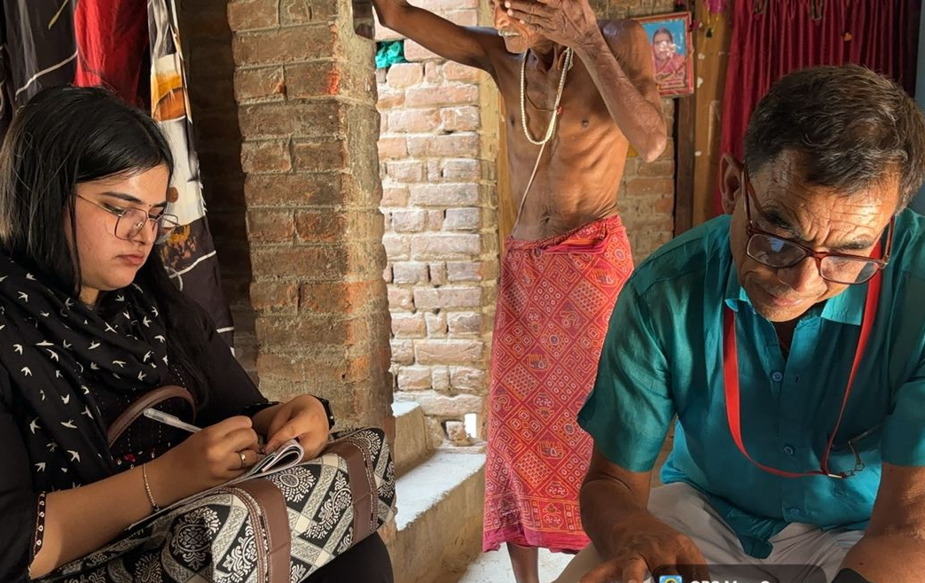
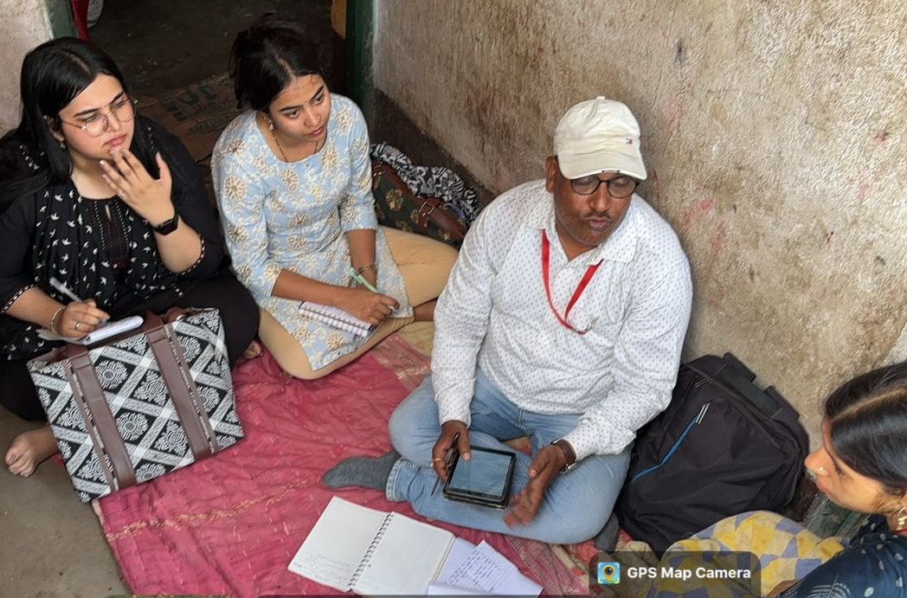
Pictorial Journey

Slide 23
Thankyou

