Slide 1

TOPIC- EVALUATION OF NUTRITIONAL REHABILITATION CENTERS IN 11 DISTRICTS OF HARYANA
Haryana State Health Resource Centre, Panchkula
TEAM:
Dr. Akanksha | Ms. Ambhi Singh | Mr. Kinshuk Jain | Dr. Kriti Mathur | Ms. Kritika Singh | Dr. Nancy Modi | Dr Priyanka Joshi | Mr. Rajdeep Dey | Dr. Shivam Kalia
Faculty Mentor: Dr. Rupsa Banerjee | Assistant Professor, IIHMR Delhi

Slide 2
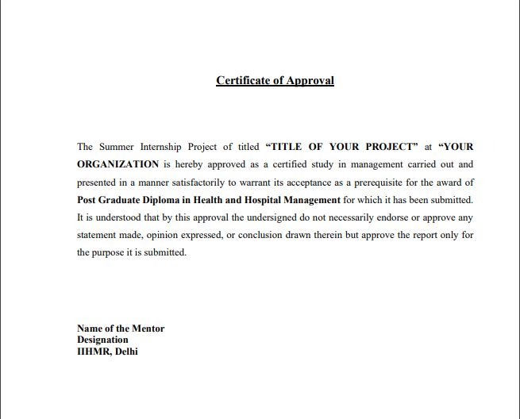
APPROVAL

Slide 3
INTRODUCTION
Malnutrition is a global public health problem, it causes 45% of children’s death under the age of 5 years.
According to WHO, malnutrition refers to deficiencies, excesses or imbalances in a person’s intake of energy and/or nutrients.
In India, 2019-2021 NFHS 5 was conducted that shows 35.5% U-5 children are stunted, 19.3% are wasted and 7.7% are severely wasted.
32.1% U-5 children are underweight according to NFHS 5.
Nutrition Rehabilitation Centers (NRC) are established in Health Facilities to provide appropriate and facility based case management to children with SAM for all under 5 children.

Slide 4
INTRODUCTION
Government of India’s MOHFW launched 1151 NRCs countrywide to cater SAM children by providing therapeutic and nutritional care to the SAM children.
In Haryana, there are total of 11 NRCs across Ambala, Jind, Hisar, Karnal, Panipat, Narnaul, Panchkula, Mewat, Bhiwani, Palwal and Faridabad.
The U-5 nutrition status of Haryana’s children has improved from 21.2%(2015-2016) in NFHS 4 to 11.5%(2019-2021) in NFHS 5.
However, the continuing high levels of undernutrition is a major problem in the state of Haryana.
Thus, a need to evaluate the functioning of services being provided in nutritional rehabilitation centres is important.

Slide 5
OBJECTIVES OF THE STUDY
PRIMARY OBJECTIVE
To evaluate the facility-based management of NRC during a period of two-months in 11 districts of Haryana.
SECONDARY OBJECTIVE
To assess the quality of services provided by the NRC on SAM (Severe Acute Malnutrition) children during a period of two-months in 11 districts of Haryana.

Slide 6
METHODOLOGY
STUDY SITE: Nutritional Rehabilitation Centres situated across 11 districts of Haryana.
The study duration was from April 2022 to June 2022.
A cross-sectional study was conducted.
STUDY SAMPLE AND SAMPLING TECHNIQUE
STUDY SAMPLE | SAMPLING TECHNIQUE
11 NRCs | Purposive Sampling
Staff Nurses (N=44) | Convenience Sampling
35 Mothers | Convenience Sampling

Slide 7
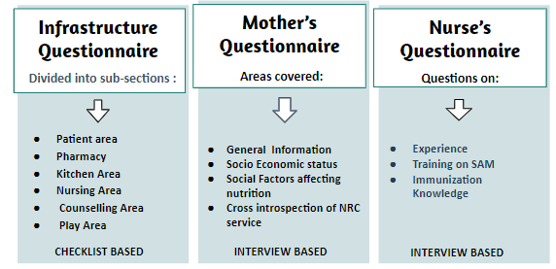
METHODOLOGY
DATA COLLECTION TOOL
DATA ANALYSIS
The data collected across the 11 districts were then put into Excel to digitize the data.
MS Excel was used for data analysis.
Descriptive analysis was used to quantitatively summarize the collected data.

Slide 8
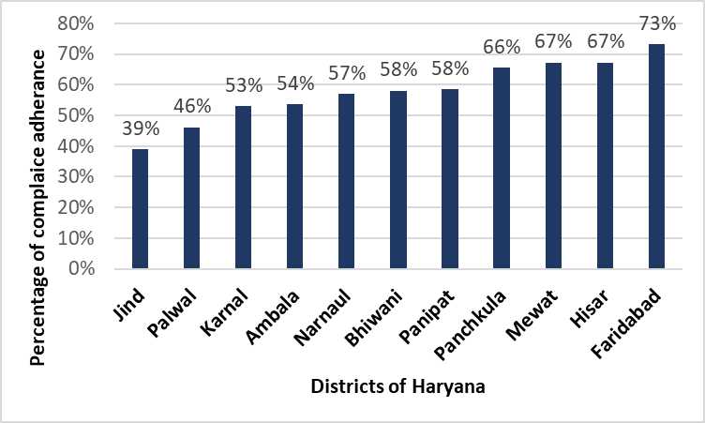
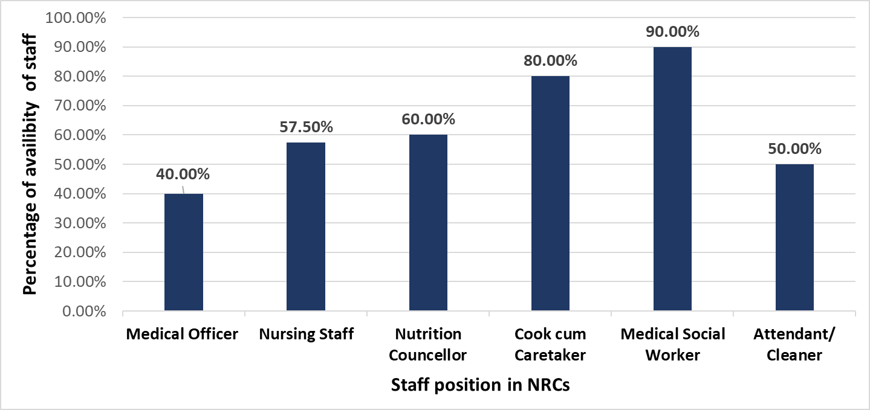
RESULTS
Figure 1: Infrastructure and services - compliance adherence of all the areas of the NRC.
Figure 2: Availability of human health resource in all the NRCs.

Slide 9
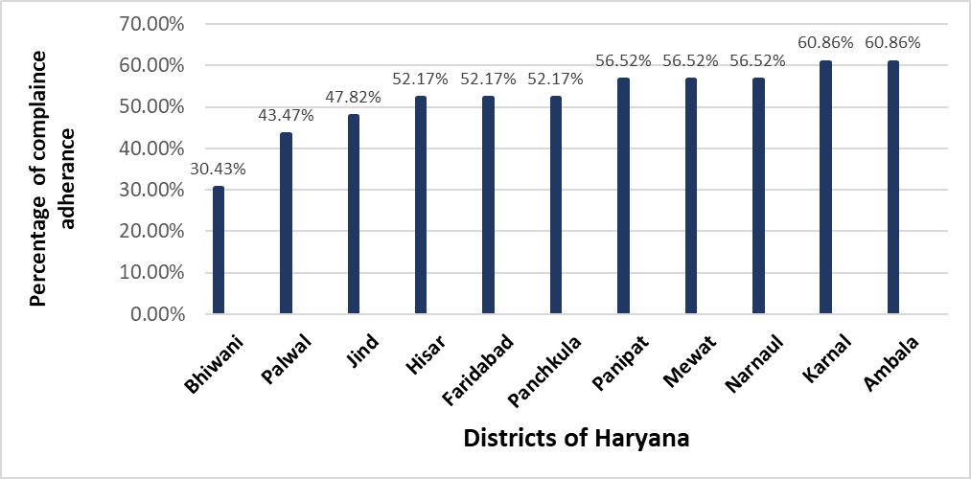
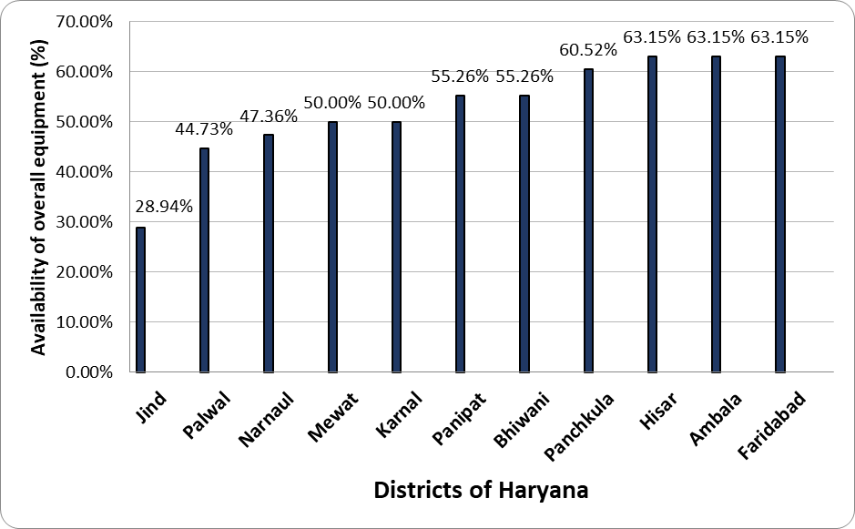
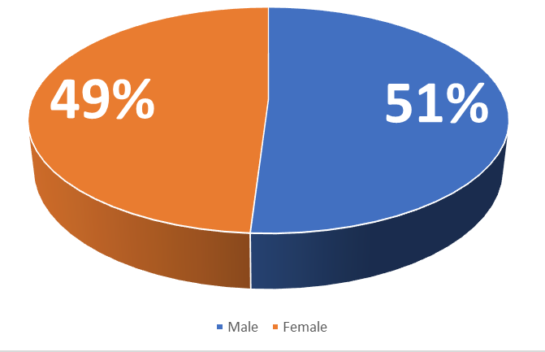
RESULTS
Figure 3: Compliance for Hygiene and Cleanliness practices.
Figure 4: Availability of equipment in 11 districts of Haryana.
Figure 5: Gender ratio amongst admitted children

Slide 10
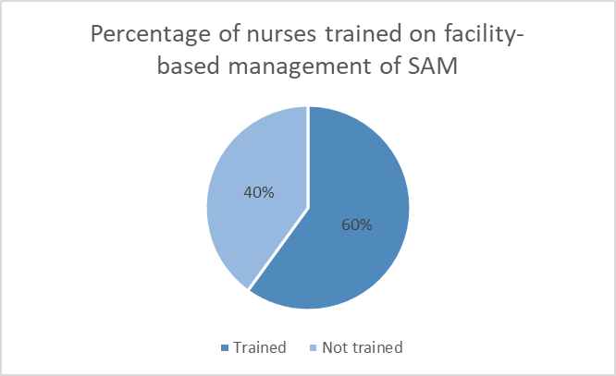
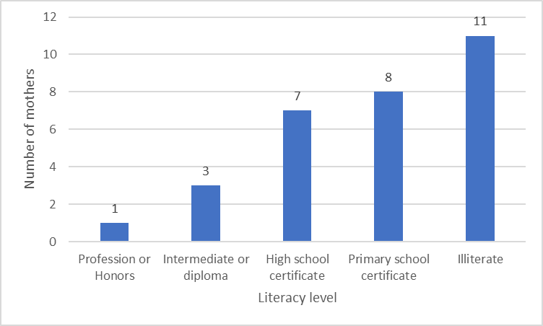
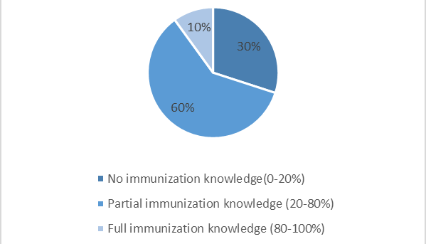
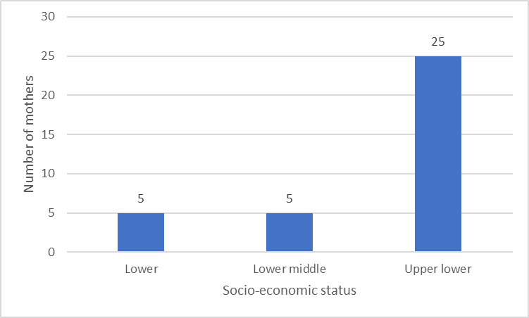
RESULTS
Figure 6: Nurses trained on facility based management of SAM
Figure 8: Educational status of mothers
Figure 7: Percentage of nurses and their awareness on immunization schedule
Figure 9: Socio-economic status of the mothers

Slide 11
DISCUSSION
Results sections shows varied levels of compliances. ( NRC Jind lowest (39%) towards highest Faridabad (73%) )
Cumulative compliance rate for Haryana's 11 district NRCs is 58%.
This signals towards the lack of compliance of various areas in NRCs.
The NRCs functioning and effectiveness are based on the inter-coordination of all areas.
Children's nutritional status has improved since NFHS-4.
AREA | FACTORS THAT CONTRIBUTED TO LOW COMPLIANCE
Patient Area | Hand washing area | Power/ Water backup | Essential equipments | Bed area | Cleanliness
Pharmacy | Dedicated pharmacy | Adequacy of drugs | Availability of drugs as per EDL
Kitchen Area | Functionality | Utensils & raw materials availability | Food storage | Sink drainage
Nursing Area | Location from the ward | Records/case sheets maintenance | Height,weight & vitals measurement
Counselling Area | Functional equipments | Anthropometric evaluations | Counselling to mothers
Play | Safety mats | Age wise toys | IEC materials
Health Workforce | Dedicatedly assigned staff | SAM training | Vacant sanctioned posts

Slide 12
DISCUSSION
Majority of the interviewed mothers were illiterate and from Lower class Socioeconomic status.
77% of these mothers had a family monthly income in the range of 6,174-18,496 Rupees.
Poor socio economic and educational status, the mothers potentially affected:
The households of the admitted children lacked proper :
Nurse had additional duties assigned
All of them were on contract basis
SAM based training is not done for 60% of nurses, contributing to the lower compliance rates of Nursing area.
Breastfeeding Practices | Nutritional food preparation awareness | Awareness about maintaining hygiene
Pucca house | Sources of drinking water | Toilet Facility | Sewage system | Cooking methods

Slide 13
LIMITATIONS OF THE STUDY
TIME CONSTRAINT
UNAVAILABILITY OF HEALTH WORKFORCE DURING VISIT
05
01
04
LOW INTRADISTRICT MOTHER SAMPLE SIZE
LIMITED BUDGET DATA ACCESS/ INCOMPLETE MONTHLY PATIENT RECORDS
LIMITED PREVIOUS RESEARCH STUDIES ON NRC INFRASTRUCTURE EVALUATION
02
03

Slide 14
CONCLUSION
Cleanliness and hygiene maintenance of the patient ward, toilet and washing area was found to be a matter of concern.
The health workforce was not dedicatedly working for the NRCs
Adequacy and availability of required drugs was lacking
Dedicated kitchen area was seen in all the districts
Effective monthly records maintenance was lacking.
Functionality and calibration issues of equipments in NRC was noted.
No required trainings were being provided to the staff.
No gender based discrimination was seen in admission upto the treamtement.
Play area was not being maintained properly.

Slide 15
REFERENCES
Malnutrition [Internet]. Who.int. [cited 2022 June 9]. Available from: https://www.who.int/news-room/questions-and-answers/item/malnutrition
.Tandon M, Qureishi J, Prasanna R, Tamboli AF, Panda B. Performance of Nutrition Rehabilitation Centers: A case study from Chhattisgarh, India. Int J Prev Med [Internet]. 2019; Available from: http://dx.doi.org/10.4103/ijpvm.IJPVM_194_17
Malnutrition [Internet]. Who.int. [cited 2022 June 9]. Available from: https://www.who.int/news-room/questions-and-answers/item/malnutrition
Tandon M, Qureishi J, Prasanna R, Tamboli AF, Panda B. Performance of Nutrition Rehabilitation Centers: A case study from Chhattisgarh, India. Int J Prev Med [Internet]. 2019; Available from: http://dx.doi.org/10.4103/ijpvm.IJPVM_194_17
Choedon T, Dinachandra K, Sethi V, Kumar P. Screening and management of maternal malnutrition in nutritional rehabilitation centers as a routine service: A feasibility study in Kalawati Saran Children Hospital, New Delhi. Indian J Community Med [Internet]. 2021 [cited 2022 Jun 9]; Available from: http://dx.doi.org/10.4103/ijcm.IJCM_491_20
Das K, Das S, Mohapatra S, Swain A, Mahakud NK. Risk and adverse outcome factors of severe acute malnutrition in children: A hospital-based study in odisha. Cureus [Internet]. 2021 [cited 2022 June 9]; Available from: http://dx.doi.org/10.7759/cureus.18364
Rchiips.org. [cited 2022 June 9]. Available from: http://rchiips.org/nfhs/NFHS-5Reports/Haryana.pdf
Nawani NP. Indian experience on household food and nutrition security. Regional Expert Consultation of the Asia‑Pacific Network for Food and Nutrition on Household Food Security with Respect to Desirable Dietary Pattern,Bangkok,Thailand;1994. Available from: https://agris.fao.org/agris-search/search.do?recordID=XF9548099

Slide 16
Thank You
We Will Take Your Questions Now.

Slide 17
INTERNSHIP EXPERIENCES
Skills
Overall comments on internship
Formulating data collection tools
Knowledge about malnutrition
Working of NRCs in district hospital
Observational skills
Analytical Skills
Micro management
Team work
Interpersonal communication
Working ethics

Slide 18
SUGGESTIONS GIVEN TO ORGANIZATION
Assigning the health workforce dedicatedly working for NRC, would ultimately lead to effective working of NRCs
Providing SAM based training for the newly appointed nursing staff, and refresher training for the existing staff.
Carrying various immunization drives and various interventions related to sanitation i.e. maintenance of washrooms / toilets for the wards and safe drinking water can help to improve the health of low-birth-weight children.
Proper calibration and maintenance of equipments as per standard guidelines
Maintaining separate pharmacy dedicated to the NRC ward.
Proper maintenance of records and budget according to the standard format given by NRCs
Community based assessment could be done in future for digging deeper into the reasons behind children lying under SAM criteria.
Nutrition Garden availability.

Slide 19
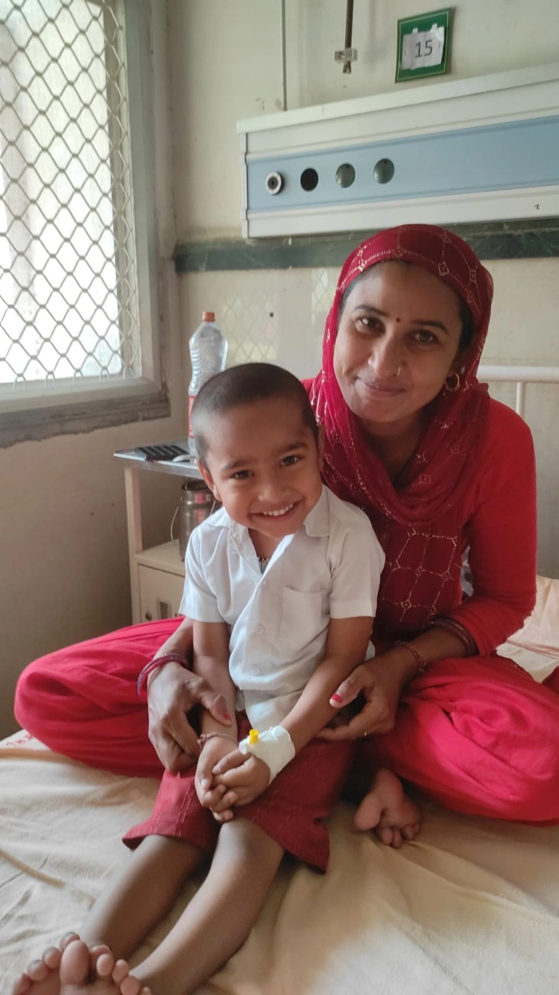
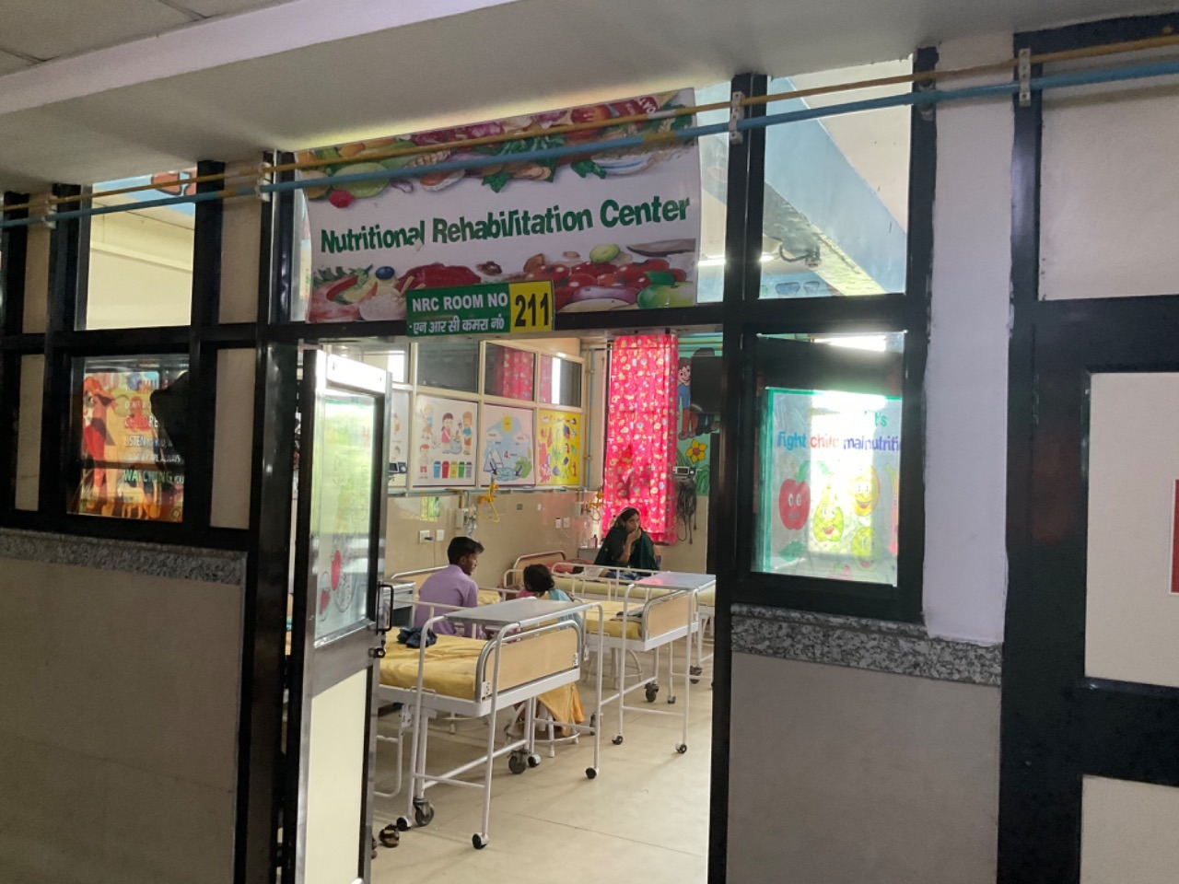
PICTORIAL JOURNEY
Mother with the admitted child in Bhiwani District Hospital
NRC ward of Panchkula District Hospital

Slide 20
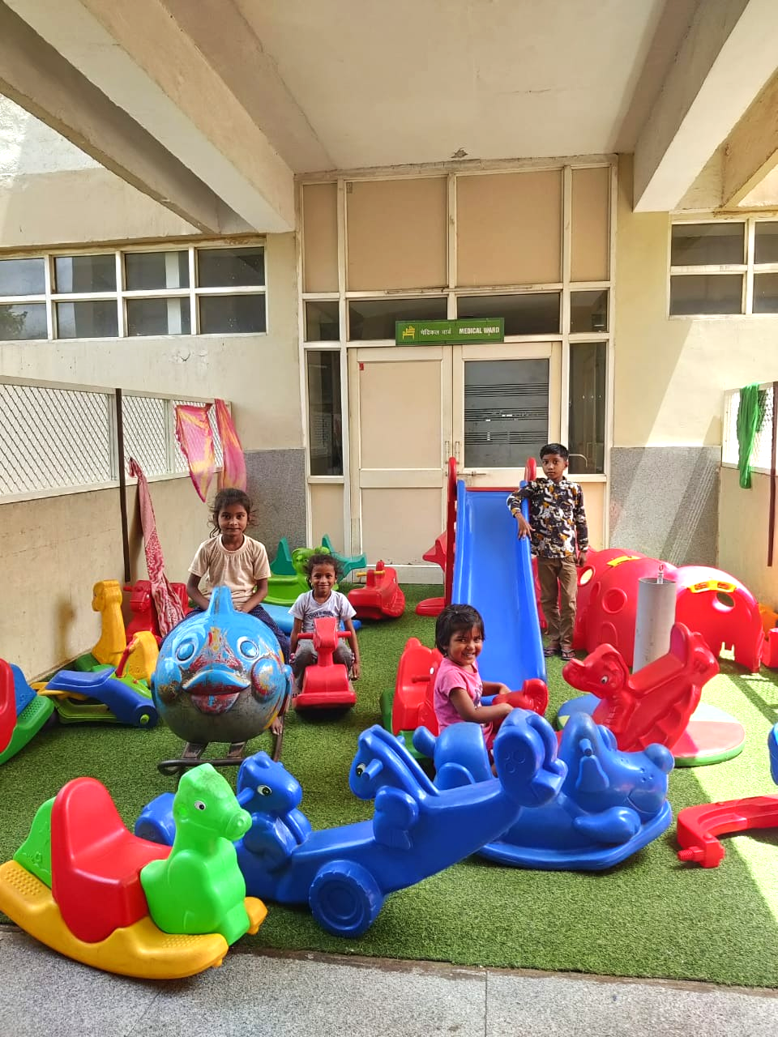
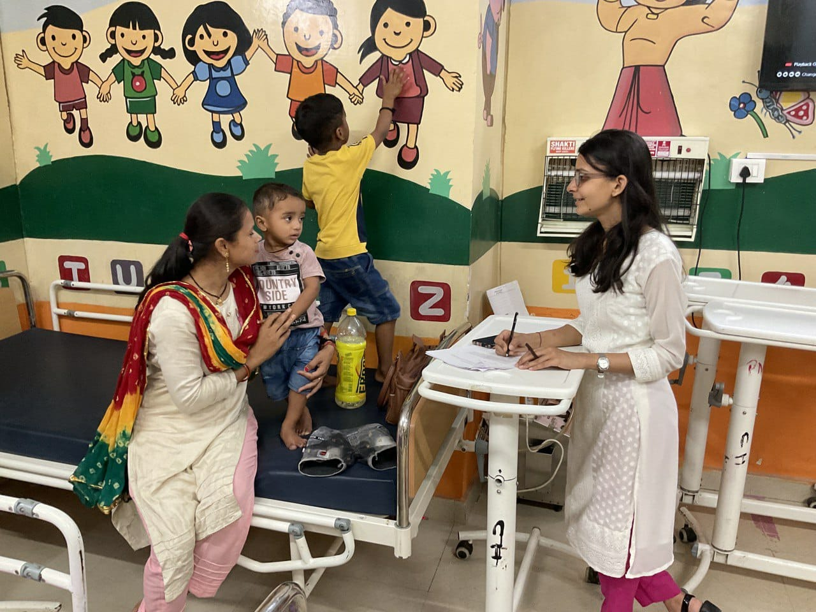
PICTORIAL JOURNEY
Play area in District Hospital of Panchkula
Interviewing the mother in District Hospital of Karnal

