Slide 1

Compliance assessment: Documentation of Non - OR Invasive Procedures
Presented By: Leepika Sharma
(PG/22/049)
Mentor: Dr. Sukesh Bhardwaj
IIHMR Delhi

Slide 2

Mentor Approval

Slide 3

Agenda
Introduction
Objective and Rationale
Review of Literature
Research Methodology
Results
Discussion
Ethical Consideration and Limitations
Annexures
References

Slide 4
Introduction
List of some of Invasive Procedures:
CVP Line: A central line is a type of catheter (flexible tube) that allows fluids to flow in and out of your body. It is placed in a large vein so blood can be drawn, and various intravenous (IV) fluids can be delivered directly into a vein
Arterial Line: Arterial lines are most used in intensive care medicine and anesthesia to monitor blood pressure directly and in real-time and to obtain samples for arterial blood gas analysis
Tracheostomy: A tracheostomy (also called a tracheotomy) is a procedure where a hole is made at the front of the neck. A tube is inserted through the opening and into the windpipe (trachea) to help patient breathe.
Intubation: Intubation-Intubation is a procedure that can help save a life when someone can’t breathe. A healthcare provider uses a laryngoscope to guide an endotracheal tube (ETT) into the mouth or nose, voice box, then trachea. The tube keeps the airway open so air can get to the lungs. Intubation is usually performed in a hospital during an emergency or before surgery.
Compliance is the process of following rules, regulations, and laws set by the governing bodies. For the patient's safety, every action taken for them in the hospital must be documented. Certain procedures are crucial for patient and must be carried out even outside of an operating room when patient safety is at risk.
Invasive procedures outside the operating room are becoming more common due to advancements in technology and increased demand for less invasive interventions. These procedures include non-invasive diagnostic procedures, electro physiologic procedures for cardioversion and cardiac ablation, and critically ill children undergoing invasive procedures. Studies have shown the effectiveness of implementing surgical safety check policies and checklists for invasive procedures outside the operating room, leading to improved patient safety and increased compliance with safety checks.

Slide 5
Objective and Rationale
Text
Rationale
This study aims to enhance the quality and authenticity of documentation for invasive procedures performed outside the operating room. It will investigate the percentage of staff and attendants who conformed to hospital's predetermined process and policies for documentation.
Objective
To streamline the documentation process in ICU.
To analyse gap and scope of operation improvement in the documentation.
Notes:
Sophia 35

Slide 6
Review of Literature
According to Parth Shah; Imani Thornton; Danielle Turrin; John E. Hipskind -Informed consent is the process in which a health care provider educates a patient about the risks, benefits, and alternatives of a given procedure or intervention. The Joint Commission requires documentation of all the elements of informed consent "in a form, progress notes or elsewhere in the record Physician-patient relationship is the key-point for an optimal management of any medical procedure. Before performing any diagnostic or therapeutic procedure, clinical communication with patients is necessary. It should regard the nature and purpose of a proposed procedure including potential risks and benefits. Thus, a complete physician-patient clinical communication is the basis of "shared decision-making" and plays a clinical-therapeutic role in the informed consent process to improve patient care
According to Van Ruiswyk J, Erdmann M.-Documentation of the decision-making process leading up to an outcome of procedures is essential for assessing quality of patient care, supporting reimbursement, determination of appropriate utilization, and discernment of practitioner competence. Currently, doctors document interventions conducted outside the operating room in narratives within the daily progress notes. The free-form narrative typically includes the practitioner directly involved, procedure performed, technique used and outcomes. While hospitals encourage conformity to these documentation standards, the quality and content of the narratives vary greatly by practitioner, frequently leaving significant information missing. Therefore, to improve both quality of documentation in procedure notes and ease of monitoring non-operating room procedures, we developed a multicopy standardized procedure note. The form contains lines for recording the type, location, indication, anesthesia, findings, and complications of the procedure, plus the persons performing, supervising and undergoing the procedure.
According to Cleary R, Beard R, Coles J, Devlin B, Hopkins A, Schumacher D, Wickings I.-The existing hospital systems extracted insufficient detail from case notes to conduct clinical comparative analyses for medical and surgical cases. The research abstractors at least doubled the diagnostic codes extracted. Interabstractor agreement of about 70% was obtained for primary diagnosis and assignment to diagnosis related group. These data were sufficient to create a comparative database and apply high level quality indicators designed to flag topics for further study. For obstetric-specific indicators the rates were comparable for abstractors and the hospital information systems, which in each case was a departmentally based system (SMMIS) producing more detailed and accessible data.

Slide 7
Research Methodology
Study Design: The study is both prospective and quantitative
Area of Study: ICU, Sri Balaji Action Medical Institute
Sample Size: 100
Sampling Method: Convenience sampling
Duration of Study: April 2024 – June 2024
Data Collection Tool: Checklist

Slide 8
Results
Overall Compliance Rate of documentation for Invasive Procedures is 50%
Staff Compliance Rate is better in comparison to Doctor Compliance Rate but still Compliance Rate of both Doctor and Staff is way below than the benchmark of 95% Compliance Rate

Slide 9
Results
Approximately in 50% of the cases there is either Missing Time or Date or both within Informed Consent form contributing majorly towards overall Non-Compliance by Staff
In 14% of the cases, there is Missing relationship of Attendant

Slide 10
Results
Staff Compliance Rate is lowest (29%) for all department agnostic procedures such as CVP LINE, INTUBATION, ARTERIAL LINE and MIDLINE
Staff Compliance Rate is 50% in GI Surgery department

Slide 11
Results
Staff is not following the compliances within procedures like MIDLINE, CVP LINE, BIOPSY
Staff Compliance Rate is less than 50% within procedure like PIGTAIL INSERTION AND ARTERIAL LINE

Slide 12
Results
Major factors contributing to the Non-Compliance by Doctors are Missing Time, Missing Date and Missing Doctor’s Sign which collectively contributed to approximately 75% Non-Compliance

Slide 13
Results
Doctor Compliance Rate is lowest (10%) for all department agnostic procedures such as CVP LINE, INTUBATION, ARTERIAL LINE and MIDLINE
Doctor Compliance Rate is 54% within Respiratory department

Slide 14
Results
Doctors are not following the compliances within procedures like MIDLINE, CVP LINE, BIOPSY and ARTERIAL LINE
Doctors Compliance Rate is less than 60% within procedure like COLONOSCOPY, BRONCHOSCOPY AND INTUBATION

Slide 15
Discussion (1/2)
There are various reasons of not compliant documentation in ICU -
Time Constraints: Sometimes doctors were very busy that’s why they may not dedicate enough time for thorough informed consent discussions
Emergency Situations: In life-threatening emergencies, there may not be enough time to sign the informed consent. Doctors will prioritize to perform the procedure rather than signing the form
Communication barrier: Sometimes staff nurses not explain the proper documentation of informed consent to the attendant
Lack of understanding: Even after the staff members thoroughly explained the form many attendants are in rush and failed to fill it out properly
Lack of knowledge: Since many staff nurses in the ICU are new hires, they may not be aware of all the documents that need to be filled out for the process, which might lead to the filling of the procedure notes and checklists on occasion.

Slide 16
Discussion (2/2)
Recommendations for the organization-
Training for Staff: Provide regular training for staff on conducting informed consent discussions effectively. This includes training on active listening, addressing patient concerns, and documenting the conversation.
Dedicated Time: Ensure staff have sufficient time allocated for informed consent discussions with each patient.
Audit and Feedback: Regularly audit informed consent documentation and provide feedback to staff on areas for improvement.
Training of doctors: Ensure that physicians receive consistent and enough training so they can accurately complete the procedure notes and sign the informed consent.
Appropriate training of staff : Make sure that all newly hired employees receive the appropriate training regarding which forms need to be completed prior to the procedure.

Slide 17
Ethical Consideration and Limitations
Ethical Consideration –
  Transparency is maintained with staff about the purpose of the data collection and how the findings will be used.
  Patient’s consent was obtained before their data was collected.
  The collected data are stored securely to prevent to prevent unauthorized access or breaches.
  Streamline data collection to minimize disruption to patient care and staff workflow.
Limitations –
  The sample size might be limited. This could affect the generalizability of findings.
  Even after collecting the data, CAPA (Corrective Action Preventive Action) is not followed.

Slide 18
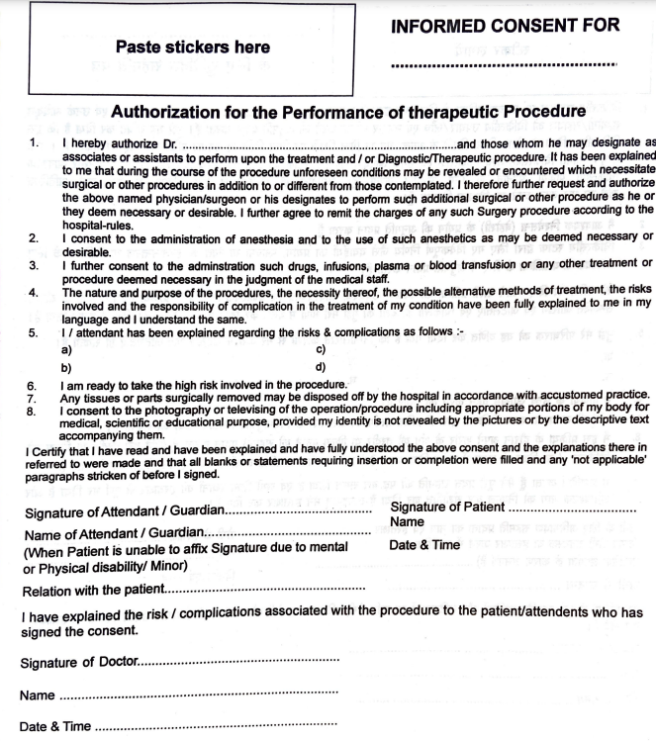
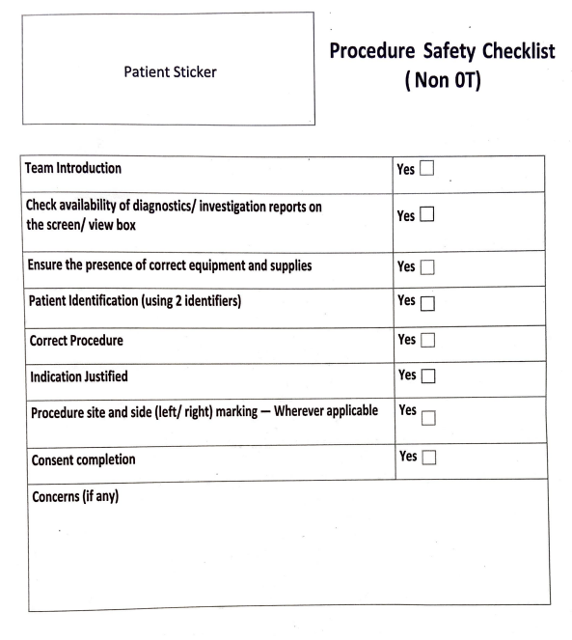
Annexure (1/2)

Slide 19
Annexure (2/2)
NAME OF THE PATIENT | <patient 1> | <patient 2>
UHID
DATE OF ADMISSION
PROCEDURE PERFORMED
A.) CONSENT FORM
A.1 SIGN. OF ATTENDANT
A.1.1 Relation with Patient
A.1.2 TIMED
A.1.3 DATED
A.2 SIGN. OF DOCTOR
A.2.1 TIMED
A.2.2 DATED
B.) PROCEDURE FORM FILLED
B.1 TIMED
B.2 DATED
C) Safety Checklist

Slide 20
References
Giampieri M. Communication and informed consent in elderly people. Minerva Anestesiol. 2012 Feb;78(2):236-42. Epub 2011 Nov 18. PMID: 22127308
Van Ruiswyk J, Erdmann M. Improving the quality and ease of tracking invasive procedures. Med Educ. 1993 Jan;27(1):86-90. doi: 10.1111/j.1365-2923.1993.tb00234.x. PMID: 8433667
Cleary R, Beard R, Coles J, Devlin B, Hopkins A, Schumacher D, Wickings I. Comparative hospital databases: value for management and quality. Qual Health Care. 1994 Mar;3(1):3-10. doi: 10.1136/qshc.3.1.3. PMID: 10136257; PMCID: PMC1055
Feinstein MM, Adegboye J, Niforatos JD, Pescatore RM. Informed consent for invasive procedures in the emergency department. Am J Emerg Med. 2021 Jan;39:114-120. doi: 10.1016/j.ajem.2020.01.035. Epub 2020 Jan 28. PMID: 32037122
Abolfotouh MA, Adlan AA. Quality of informed consent for invasive procedures in central Saudi Arabia. Int J Gen Med. 2012;5:269-75. doi: 10.2147/IJGM.S29599. Epub 2012 Mar 20. PMID: 22505825; PMCID: PMC332501
Kinnersley P, Phillips K, Savage K, Kelly MJ, Farrell E, Morgan B, Whistance R, Lewis V, Mann MK, Stephens BL, Blazeby J, Elwyn G, Edwards AG. Interventions to promote informed consent for patients undergoing surgical and other invasive healthcare procedures. Cochrane Database Syst Rev. 2013 Jul 6;(7):CD009445. doi: 10.1002/14651858.CD009445.pub2. PMID: 23832767

Slide 21
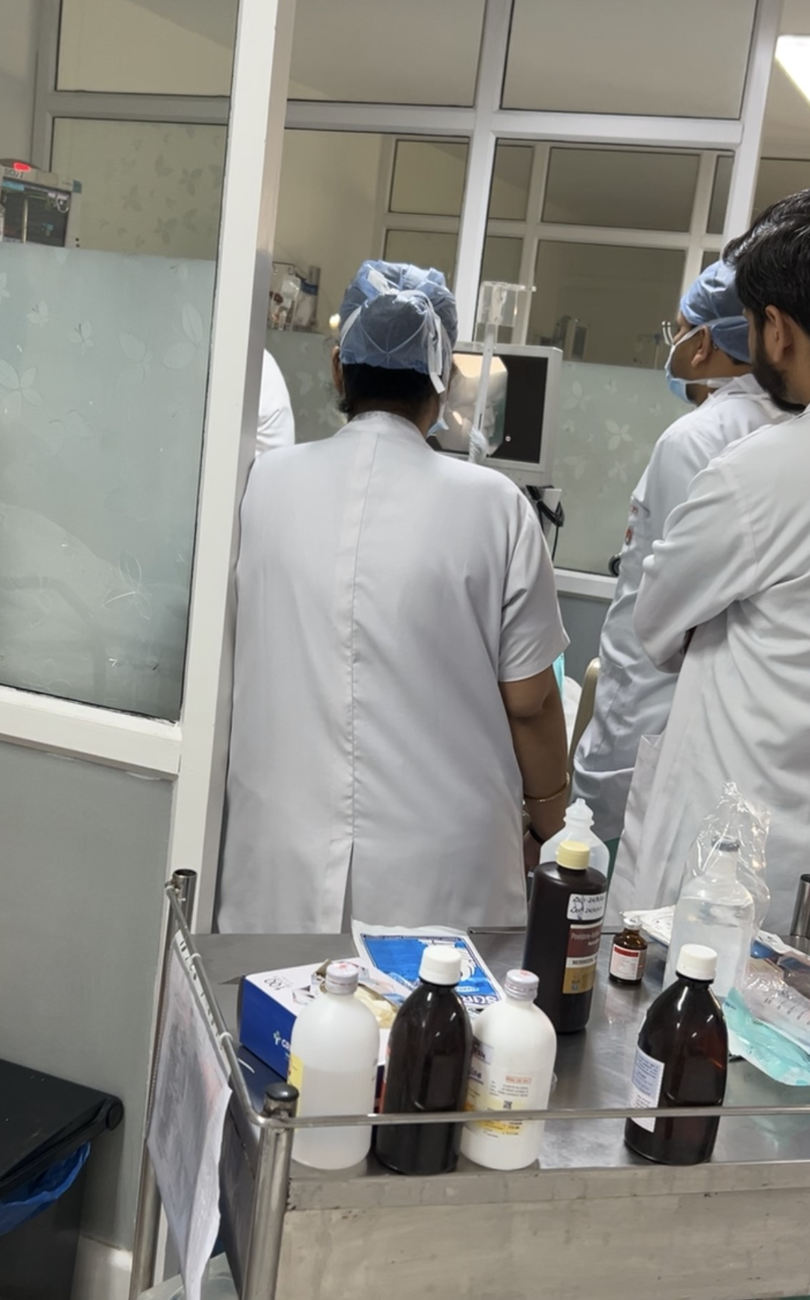
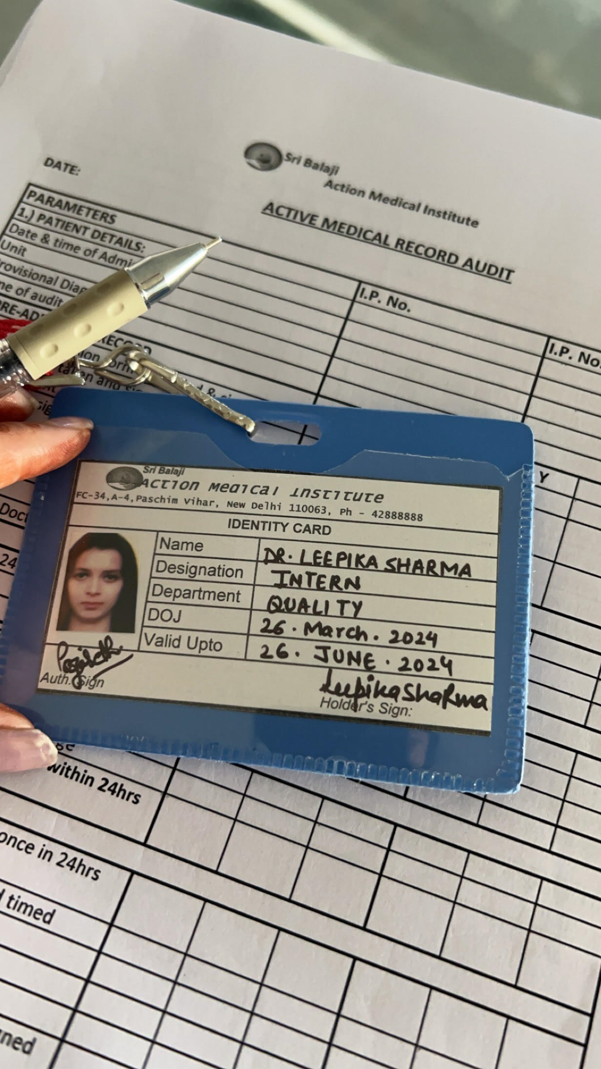
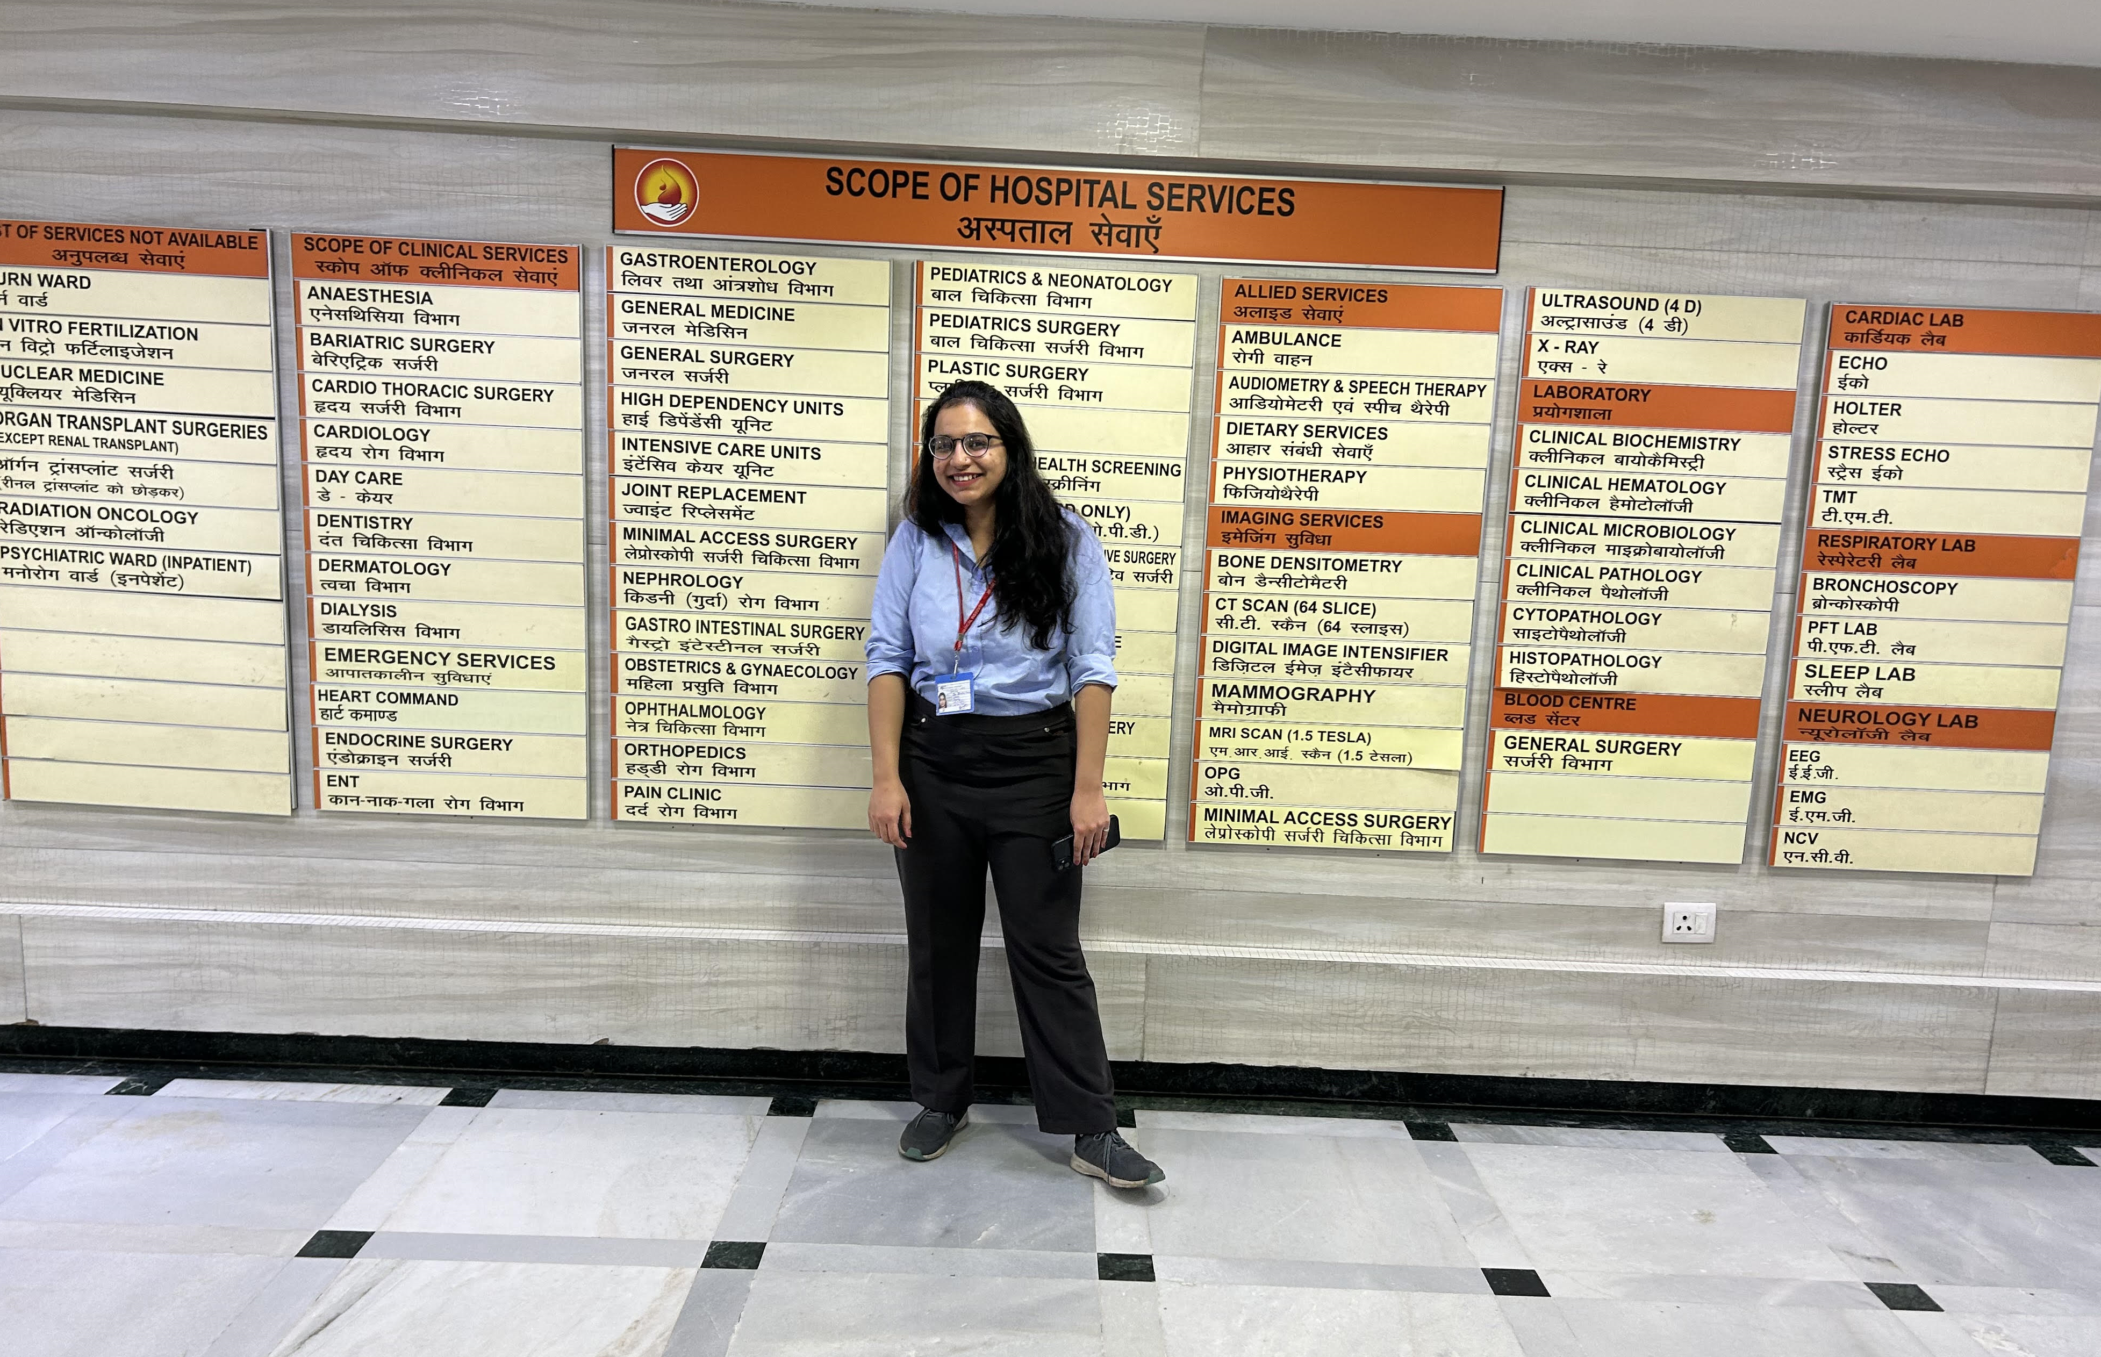
Pictorial Journey

Slide 22
THANK YOU!

